Slide 1
Okay, here's a PowerPoint presentation outline in bullet/section format based on
PPT Title: Performance Evaluation of Retrained CNN Models for Grape Leaf Disease Identification
Slide 1: Title Slide

Slide 2
Title: Performance Evaluation of Retrained CNN Models for Grape Leaf Disease Ide
Authors:

Slide 3
H. P. Khandagale
Sangram Patil

Slide 4
Affiliations: Computer Science and Engineering Department, D Y Patil Agricultura
Contact: hpk_tech@unishivaji.ac.in, sangrampatil@dyp-atu.org
Copyright: XXX-X-XXXX-XXXX-X/XX/$XX.00 ©20XX IEEE

Slide 5
Slide 2: Abstract
Content not available.

Slide 6
Title: Abstract
Bullet Points:

Slide 7
Smart agriculture relies on accurate leaf image disease identification.
CNN models show improved accuracy in disease detection.
Study focuses on retraining standard CNN models for grape leaf disease detection.
Evaluates CNN architectures: VGG, ResNet, Xception, Inception, DenseNet, MobileNet.
Uses two established datasets and a new "Dataset 3" for diverse training scenarios.
Data quality is critical to model performance.
Models perform well on Dataset 3, showing potential for early disease detection.
Advances agricultural technology and promotes sustainability.

Slide 8
Keywords: CNN Models, Grape Leaf Disease, Deep Learning, Dataset Quality, Agricu
Content not available.

Slide 9
Slide 3: Introduction
Content not available.

Slide 10
Title: Introduction
Bullet Points:

Slide 11
Grapevine cultivation is globally significant.
Grapevine health is vulnerable to diseases impacting yield and quality.
Early and accurate disease detection is crucial for sustainable viticulture.
Traditional disease detection is manual, time-consuming, and subjective.
Computer vision and deep learning, especially CNNs, offer a solution.
CNNs learn from labeled datasets, identifying visual cues on leaves.
Automated CNN systems provide efficient, early, and precise disease detection.
Evolving technology transforms disease management for resilient crops.

Slide 12
Slide 4: Problem Statement & Motivation
Content not available.

Slide 13
Title: Problem Statement & Motivation
Bullet Points:

Slide 14
Need for swift and unbiased disease diagnosis.
Importance of early detection for intervention.
Aim for efficient resource utilization in vineyards.
Data-driven insights can improve disease databases.
GIS-integrated models can optimize precision agriculture.
Objective to reduce environmental impact of disease management.
Automated CNN-powered disease detection promises transformative advancements in viticulture.

Slide 15
Slide 5: Grape Leaf Diseases
Content not available.

Slide 16
Title: Grape Leaf Diseases
Bullet Points:

Slide 17
Black Rot: Dark lesions on leaves and fruit, harming quality and spreading.
Grapevine Esca Disease: "Tiger stripe" leaf discoloration, hurting vine and grape production.
Leaf Blight: Brown lesions affecting leaves and fruit.
Management: Pruning, resistant varieties, fungicides, and airflow maintenance.

Slide 18
Include Figure 1: Grape Diseased and Healthy Leaf Images (A) Healthy, (B) ESCA,
Recommendation: Use a 2x2 grid to display the images.

Slide 19
Slide 6: Contributions
Content not available.

Slide 20
Title: Contributions
Bullet Points:

Slide 21
Automated CNN-based models advance viticulture.
Early disease detection capabilities.
Improved accuracy in disease identification.
Scalability of disease detection methods.
Data-driven insights for disease management.
Broader agricultural and environmental benefits.
Synergy between agriculture and AI for a resilient grape industry.

Slide 22
Slide 7: Related Work - Overview
Content not available.

Slide 23
Title: Related Work
Bullet Points:

Slide 24
Deep learning, especially CNNs, is increasingly used for plant disease detection
Abade et al. [4]: Investigated CNN algorithms, emphasizing PlantVillage and TensorFlow.
Dhaka et al. [5]: Examined CNN-based techniques, highlighting the importance of framework choice, model architecture, and pre-processing.
Nagaraju et al. [6]: Reviewed Deep Learning (DL) disease studies, emphasizing pre-processing.
Kamilaris et al. [7]: Showcased DL's superiority over traditional methods.
Fernandez-Quintanilla et al. [8]: Explored crop weed monitoring.

Slide 25
Slide 8: Related Work - Model Specific
Content not available.

Slide 26
Title: Related Work (Continued)
Bullet Points:

Slide 27
Lu et al. [9]: Evaluated CNN performance in plant disease classification.
Golhani et al. [10]: Highlighted hyperspectral data's potential.
Mosleh et al. [11]: Developed a CNN model for potato disease detection.
Huang et al. [12]: Introduced DenseNet.
Li et al. [13]: Extended DenseNet with fire-FRD-CNN and mobile-FRD-CNN.
Lee et al. [14]: Simplified disease classification with GoogleNet-BN.
Mao et al. [15]: Optimized models with depth-wise separable convolution and filter pruning.
Singh et al. [16]: Proposed joint pruning and fine-tuning.
Li et al. [17]: Emphasized compact models through CNNPruner.

Slide 28
Slide 9: Related Work - Lightweight Models & Architectures
Content not available.

Slide 29
Title: Related Work (Continued)
Bullet Points:

Slide 30
Hosny et al. [18]: Proposed a lightweight CNN model fusing deep and LBP features
Arun et al. [19]: Presented the CCDL architecture for multi-crop disease detection.
Sharma et al. [20]: Introduced the DLMC-Net, a lightweight CNN for real-time plant leaf disease detection.
Shoaib et al. [21]: Explored ML and DL techniques for plant disease identification from 2015 to 2022.
These studies emphasize accurate, efficient, and scalable disease detection systems.

Slide 31
Slide 10: Limitations of Existing Research
Content not available.

Slide 32
Title: Limitations of Existing Research
Bullet Points:

Slide 33
Focus on specific neural network architectures and datasets
Proposed techniques may require further optimization
Enhancement of model efficiency, but does not explore alternative approaches or real-world deployment challenges

Slide 34
Slide 11: Proposed Work - CNN Architectures Overview
Content not available.

Slide 35
Title: Proposed Work - CNN Architectures
Bullet Points:

Slide 36
Focus on the following CNN architectures:
Content not available.

Slide 37
VGGNet-16 and VGGNet-19
ResNet-50 and ResNet-101
Xception
Inception
MobileNet-V1 and MobileNet-V2
DenseNet-121 and DenseNet-201

Slide 38
General Note: The following slides will delve into the details of these architec
Content not available.

Slide 39
Slide 12: VGGNet-16 and VGGNet-19
Content not available.

Slide 40
Title: VGGNet-16 and VGGNet-19
Bullet Points:

Slide 41
Developed by Oxford University in 2014.
Praised for simplicity and depth.
VGG-16 and VGG-19 differ in the number of layers.
Use 3x3 filters and max-pooling.
Excel in capturing image features, ideal for image classification.
Depth increases computational complexity and training time.

Slide 42
Slide 13: ResNet-50 and ResNet-101
Content not available.

Slide 43
Title: ResNet-50 and ResNet-101
Bullet Points:

Slide 44
Introduced residual blocks with skip connections to mitigate the vanishing gradi
Residual blocks aid in learning residual functions, enhancing deep network optimization.
ResNet-50 and ResNet-101 have 50 and 101 layers respectively.
Leveraged skip connections for improved training and deeper network designs.

Slide 45
Slide 14: Xception
Content not available.

Slide 46
Title: Xception
Bullet Points:

Slide 47
Short for Extreme Inception.
Emphasizes depthwise separable convolutions.
Splits standard convolution into depthwise and pointwise convolutions.
Reduces computational complexity while maintaining performance.
Suitable for mobile and embedded devices.

Slide 48
Slide 15: Inception
Content not available.

Slide 49
Title: Inception
Bullet Points:

Slide 50
Introduced by Google in 2014.
Aims to address the trade-off between computational efficiency and model accuracy.
Employs a combination of parallel convolutional layers with different kernel sizes.
Allows the network to efficiently process fine-grained and coarse-grained features.

Slide 51
Slide 16: MobileNet-V1 and MobileNet-V2
Content not available.

Slide 52
Title: MobileNet-V1 and MobileNet-V2
Bullet Points:

Slide 53
Designed for resource-constrained environments (mobile devices, IoT).
MobileNet-V1 introduced depthwise separable convolutions.
Reduces model size and computational cost while maintaining accuracy.
MobileNet-V2 builds upon V1 with inverted residual blocks and linear bottlenecks.
Further enhances efficiency and effectiveness.

Slide 54
Slide 17: DenseNet-121 and DenseNet-201
Content not available.

Slide 55
Title: DenseNet-121 and DenseNet-201
Bullet Points:

Slide 56
Maximizes feature reuse by connecting each layer to all previous layers.
Boosting information flow.
Achieves impressive efficiency and effectiveness in computer vision tasks.
Retraining choice hinges on factors like data size and resources, impacting the system's efficacy and real-world feasibility.

Slide 57
Slide 18: Model Selection Considerations
Content not available.

Slide 58
Title: Model Selection Considerations
Bullet Points:

Slide 59
VGGNet suits moderate datasets due to its uniform structure.
ResNet, with skip connections, excels in complex feature learning.
Xception's efficiency is ideal for resource-constrained setups.
Inception's diverse-scale convolutions capture varied features.
MobileNet's lightweight design suits mobile deployment.
DenseNet's dense connectivity promotes feature reuse, which can be beneficial for capturing intricate patterns in grape leaves. Retraining DenseNet-121 or DenseNet-201 can yield accurate disease classification, especially if the dataset contains fine-grained details that need to be captured.

Slide 60
Slide 19: Comparison of Model Details
Content not available.

Slide 61
Title: Comparison of Model Details
Include Table 1: Comparison of Model Details (as provided).
Recommendation: Use a clear table format. Add a brief interpretation of the table highlighting differences in layer count and parameters.

Slide 62
Slide 20: Proposed Processing Flow
Content not available.

Slide 63
Title: Proposed Processing Flow for Experimental Evaluation
Include Figure 2: Proposed Processing Flow.
Bullet Points:

Slide 64
Data Preparation
Model Selection and Initialization
Transfer Learning
Hyperparameter Tuning
Performance Evaluation

Slide 65
Recommendation: Visually represent the flow as a diagram with arrows connecting
Content not available.

Slide 66
Slide 21: Data Preparation
Content not available.

Slide 67
Title: Data Preparation
Bullet Points:

Slide 68
Collect labeled grape leaf images (healthy and diseased).
Pre-process images: resizing, normalizing, augmentation.
Augmentation increases the diversity of training samples.

Slide 69
Slide 22: Model Selection and Initialization
Content not available.

Slide 70
Title: Model Selection and Initialization
Bullet Points:

Slide 71
Choose the CNN architecture based on dataset and resources.
Initialize the selected pre-trained model with weights learned from ImageNet to leverage learned features.

Slide 72
Slide 23: Transfer Learning
Content not available.

Slide 73
Title: Transfer Learning
Bullet Points:

Slide 74
Retrain the selected model on the grape leaf dataset.
Freeze initial layers (pre-trained weights).
Fine-tune the remaining layers using the dataset.
Leverages pre-trained features and adapts to the disease identification task.

Slide 75
Slide 24: Hyperparameter Tuning
Content not available.

Slide 76
Title: Hyperparameter Tuning
Bullet Points:

Slide 77
Adjust hyperparameters (learning rate, batch size, number of hidden neurons in t
Ensure efficient training convergence and avoid overfitting.

Slide 78
Slide 25: Evaluation and Fine-Tuning
Content not available.

Slide 79
Title: Evaluation and Fine-Tuning
Bullet Points:

Slide 80
Split the dataset into training, validation, and test sets.
Monitor the model's performance on the validation set.
Fine-tune hyperparameters if needed.
Evaluate the final model on the test set using accuracy, precision, recall, and F1-score.

Slide 81
Slide 26: Results and Analysis - Dataset Preparation
Content not available.

Slide 82
Title: Results and Analysis: Dataset Preparation
Bullet Points:

Slide 83
Grape leaf datasets collected from standard public repositories.
Two different datasets used to analyze model performance.
A third combined dataset is prepared for the classification task.
Images from common diseases in different datasets combined in a single directory.

Slide 84
Include Table 2: Dataset Information.
Content not available.

Slide 85
Slide 27: Performance Parameters
Content not available.

Slide 86
Title: Performance Parameters
Bullet Points:

Slide 87
The task is to classify grape leaf images into four distinct disease classes.
The goal is early disease detection and effective disease management.
Performance evaluation parameters: accuracy, specificity, sensitivity, F1 Score.

Slide 88
Include Table 3: Performance Parameters (Formulae).
Content not available.

Slide 89
Slide 28: Performance Analysis - Dataset 1
Content not available.

Slide 90
Title: Performance Analysis: Dataset 1
Include Figure 3: Performance Analysis on Dataset 1.
Bullet Points:

Slide 91
Summary of model performance on Dataset 1.
Highlight top-performing models (e.g., Inception-V2, MobileNet-V2).
Accuracy levels achieved.
Mention high accuracy, sensitivity, and F1-score.

Slide 92
Recommendation: Use a bar chart to compare performance metrics across models.
Content not available.

Slide 93
Slide 29: Performance Analysis - Dataset 2
Content not available.

Slide 94
Title: Performance Analysis: Dataset 2
Include Figure 4: Performance Analysis on Dataset 2.
Bullet Points:

Slide 95
Summary of model performance on Dataset 2.
Emphasize the impact of limited training data on CNNs.
Discuss the role of data augmentation and transfer learning.

Slide 96
Recommendation: Use a bar chart for comparison.
Content not available.

Slide 97
Slide 30: Performance Analysis - Dataset 3
Content not available.

Slide 98
Title: Performance Analysis: Dataset 3
Include Figure 5: Performance Analysis on Combined Dataset 3.
Bullet Points:

Slide 99
Summary of model performance on Dataset 3.
Highlight improved performance due to the comprehensive dataset.
Emphasize the importance of data quality.
Discuss models' potential in precise disease detection.

Slide 100
Recommendation: Use a bar chart for comparison.
Content not available.

Slide 101
Slide 31: Hyper Parameter Analysis
Content not available.

Slide 102
Title: Hyper Parameter Analysis
Include Table 4: Hyper Parameter Analysis
Bullet Points:

Slide 103
Consideration of fundamental hardware configuration of the experimentation machi
Avoid the overfitting and under fitting problems of the CNN model.
Specific values for batch size and hidden neurons in the last Dense Layer are set.
Average epochs needed for model convergence

Slide 104
Slide 32: Confusion Matrix
Content not available.

Slide 105
Title: Confusion Matrix
Include Figure 6: Confusion Matrix for All the models Considered in Comparative Analysis
Bullet Points:

Slide 106
The performance is evaluated using 20% split part as test set.
The confusion matrix thus compares the predicted and actual labels based on which model’s performance can be validated.

Slide 107
Slide 33: Discussion of Results
Content not available.

Slide 108
Title: Discussion of Results
Bullet Points:

Slide 109
ResNet-101, Xception, and MobileNet-V2 show high accuracy, sensitivity, and spec
The models reliably categorize distinct disease classes.
Insights from sensitivity and specificity analysis.
Balanced identification of positive and negative instances minimizes false positives and negatives.
Different performances across diseases emphasize tailored strategies.
Knowledge from this study can lead to reliable and efficient solutions for grape leaf disease recognition.

Slide 110
Slide 34: Implications
Content not available.

Slide 111
Title: Implications
Bullet Points:

Slide 112
The findings promise to revolutionize disease identification in viticulture.
Enhanced precision in disease assessment.
Potential to augment crop management practices.
Mitigation of the detrimental impact of yield losses.
Paves the way for innovative applications of deep learning in agriculture.
Far-reaching ramifications for sustainable and effective viticulture practices.

Slide 113
Slide 35: Conclusion
Content not available.

Slide 114
Title: Conclusion
Bullet Points:

Slide 115
Paper presents a thorough investigation of deep learning models for grape leaf d
Offers valuable insights and promising implications for viticulture.
ResNet-101, Xception, and MobileNet-V2 stand out.
Demonstrate a remarkable combination of accuracy, sensitivity, and specificity.
Highlight potential for practical integration into automated disease detection systems.
AI contributes to accurate diagnostics, optimizing crop management, yield, and resource utilization, ensuring agricultural sustainability.
Bridging computer science and farming for future global food security.

Slide 116
Slide 36: References
Content not available.

Slide 117
Title: References
List all references as provided (numbered 1-27).
Use a small but readable font size.

Slide 118
Important Notes for the Presenter:
Content not available.

Slide 119
Figures and Tables: Ensure that Figures 1-6 and Tables 1-4 are displayed clearly
Model Performance: When discussing the results, be prepared to explain why certain models performed better on particular datasets. Consider factors like model complexity, the type of features they are designed to capture, and the characteristics of each dataset (e.g., image resolution, variations in lighting/angle, amount of noise).
Hyperparameter Tuning: Be ready to discuss the process of hyperparameter tuning, why those parameters were chosen, and how they impacted the model's performance.
Visuals: Use visuals (images of grape leaves, diagrams of CNN architectures) to enhance engagement and understanding. Don't rely solely on bullet points.
Clarity: Avoid jargon. Explain concepts clearly and concisely.

Slide 120
This detailed outline should provide a strong foundation for creating an effecti
Content not available.

Slide 121
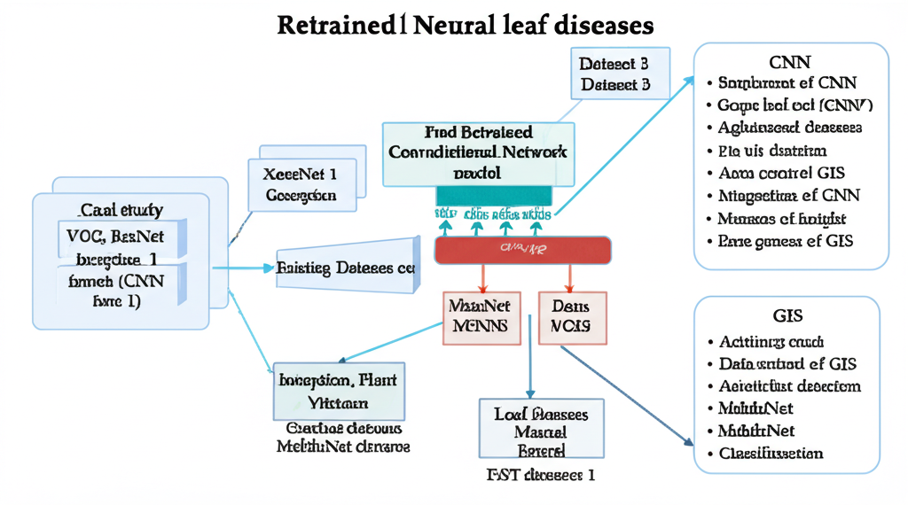
📊 Data Visualization

Slide 122
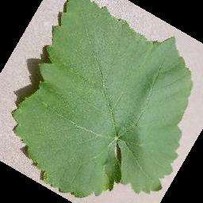
📸 Extracted Image

Slide 123
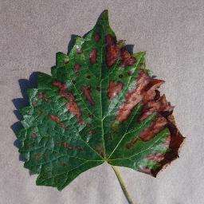
📸 Extracted Image

Slide 124
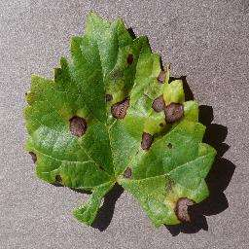
📸 Extracted Image

Slide 125
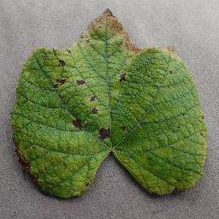
📸 Extracted Image

Slide 126
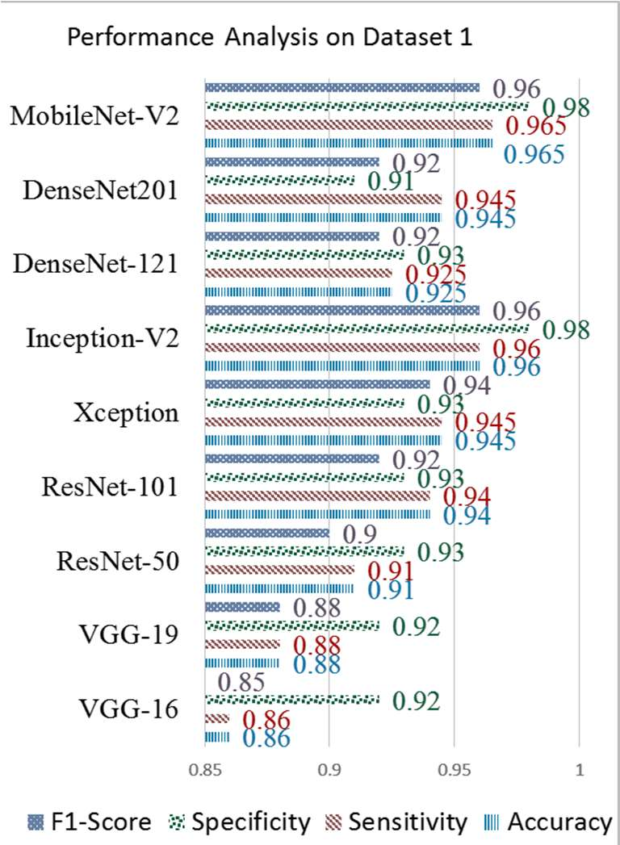
📸 Extracted Image

Slide 127
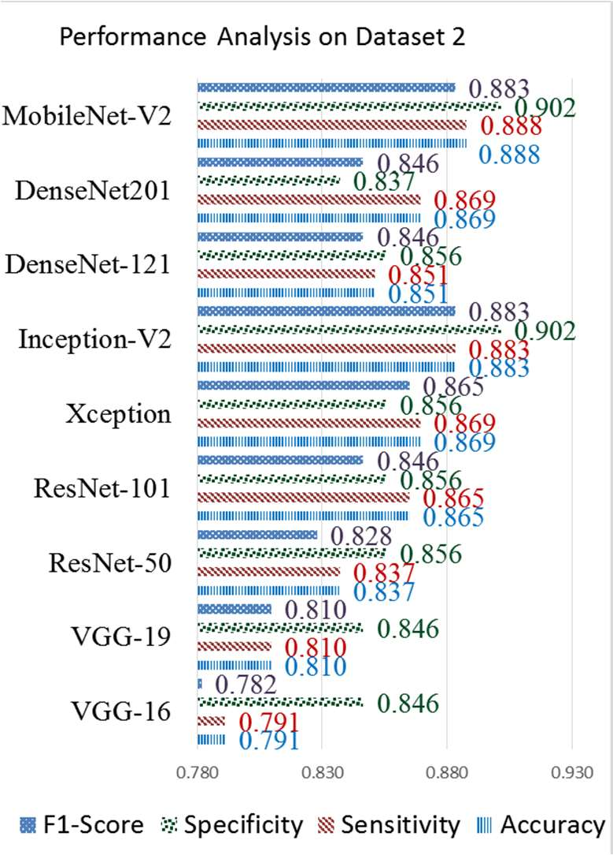
📸 Extracted Image

Slide 128
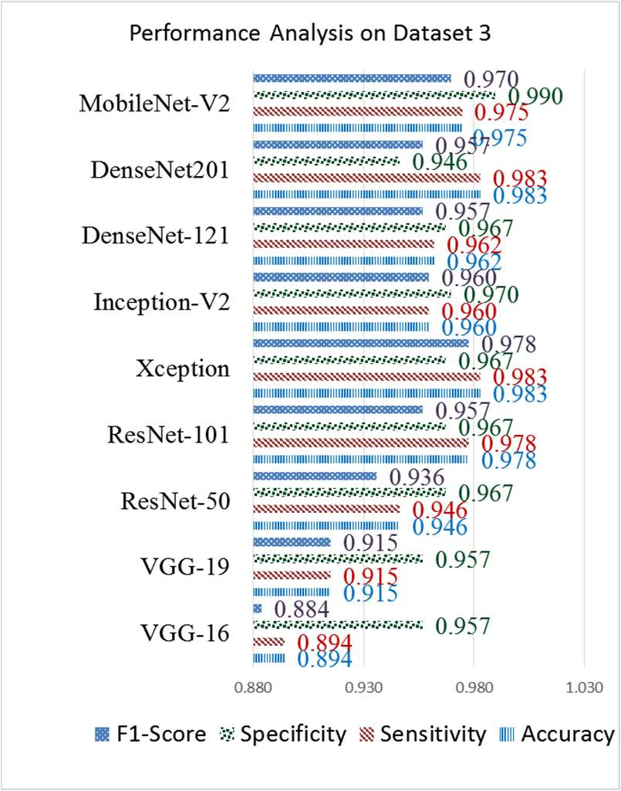
📸 Extracted Image

Slide 129
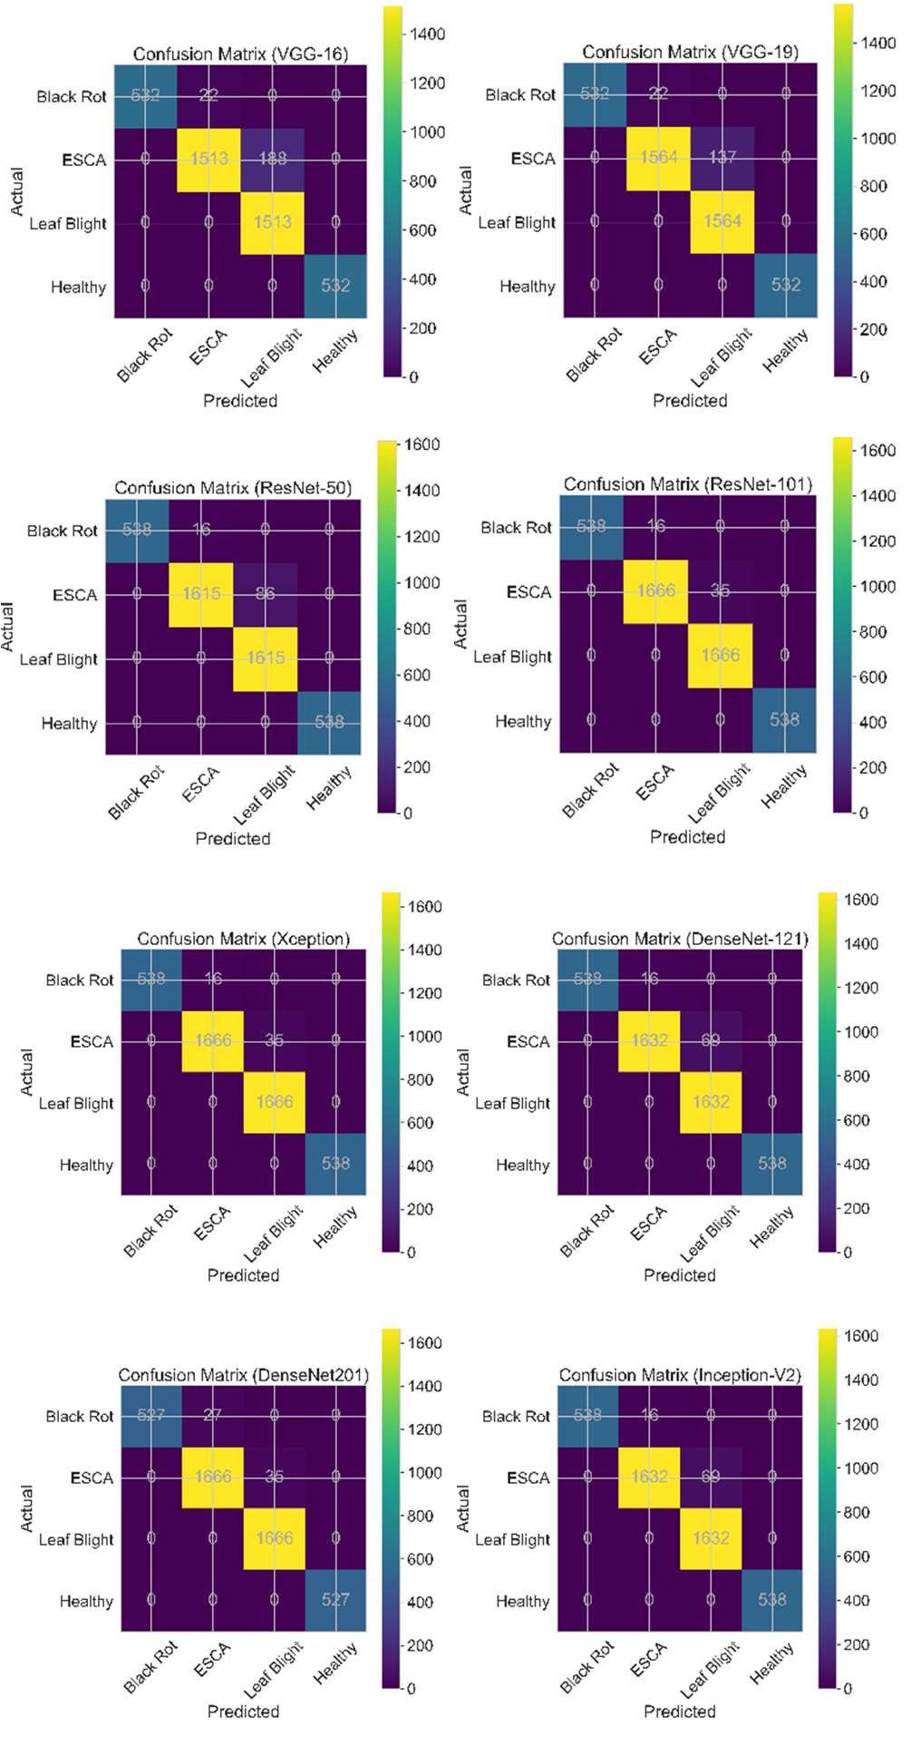
📸 Extracted Image

Slide 130
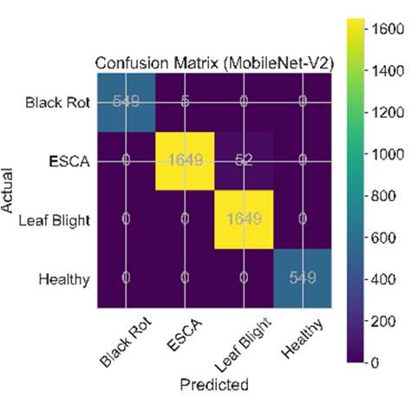
📸 Extracted Image

