Slide 1
Basic to Advanced Calculator
Python + Tkinter Project
Python + Tkinter Project
Developed by Deepak Patel, Intern at Nethike IT Solution

Slide 2
Project Overview
Feature-rich calculator developed in Python using Tkinter and CustomTkinter
Supports Standard, Scientific, Programmer, and Unit Conversion modes
Advanced functions: Trigonometry, Logarithms, Exponentials, Base Conversion, Factorials

Slide 3
Project Objectives
Learn GUI development in Python
Implement mathematical operations programmatically
Integrate multiple calculator modes in one app
Include features like History, ANS button, and Unit
Converter
Create a user-friendly interface

Slide 4
Tools & Technologies Used
Python 3.x
Tkinter & CustomTkinter
math & random libraries
simpledialog & messagebox

Slide 5
Standard Calculator Features
Basic operations: +, -, *, /
Percentage, square, square root, reciprocal, +/- toggle
Clear Entry (CE) & Clear (C)
Backspace support (X button)

Slide 6
Scientific Calculator Features
Trigonometry: sin, cos, tan, sec, csc, cot (with inverse functions)
Exponentials: xʸ, 10ˣ, 2ˣ, eˣ
Logarithms: log, ln, logᵧ(x)
Factorial, Random, Floor, Ceiling, Absolute Value
Toggle 2nd functions with “2nd” button

Slide 7
Programmer Calculator Features
Base conversions: DEC, BIN, OCT, HEX
Bitwise operations: AND, OR, XOR, NOT, <<, >>
Multi-base calculations supported

Slide 8
Unit Converter Features
Supports: Length, Weight, Temperature, Volume, Speed, Time
Auto-conversion using simple formulas
Integrated with main calculator interface

Slide 9
History & ANS Feature
ANS button retrieves last calculated result
History window shows previous calculations
Option to clear history

Slide 10
GUI Design
Horizontal layout for easy navigation
Hamburger side menu for switching modes
Clean color scheme: White + Blue accents
Consistent design across all modes

Slide 11
Challenges & Learning
Challenges:
Managing multiple calculator modes in one window
Implementing 2nd functions & trigonometric conversions
Handling errors and invalid inputs
Learning Outcomes:
GUI programming with Tkinter & CustomTkinter
Event handling & callbacks
Modular & reusable functions
Handling advanced mathematical calculations

Slide 12
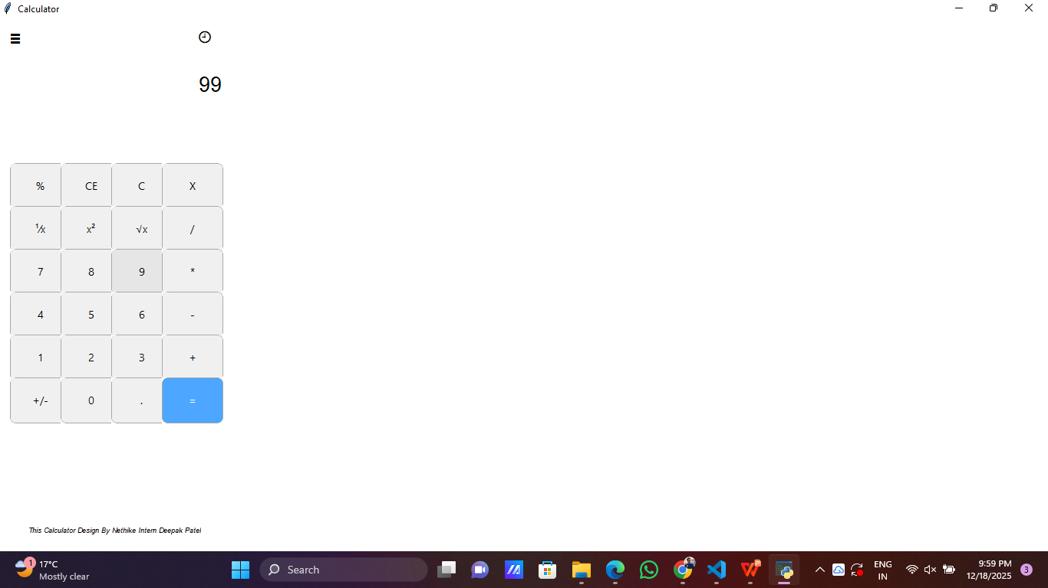
Demo / Screenshots
Standard Calculator

Slide 13
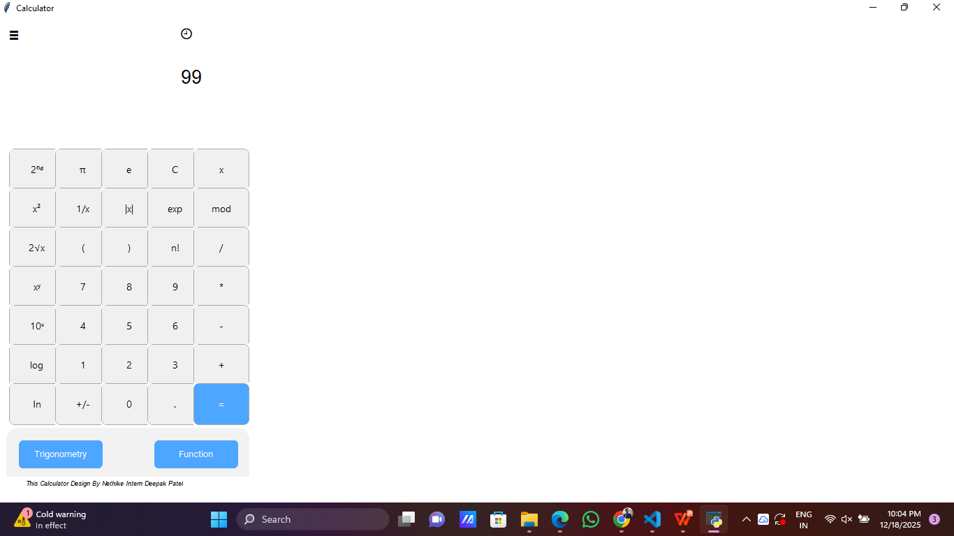
Demo / Screenshots
Scientific Calculator

Slide 14
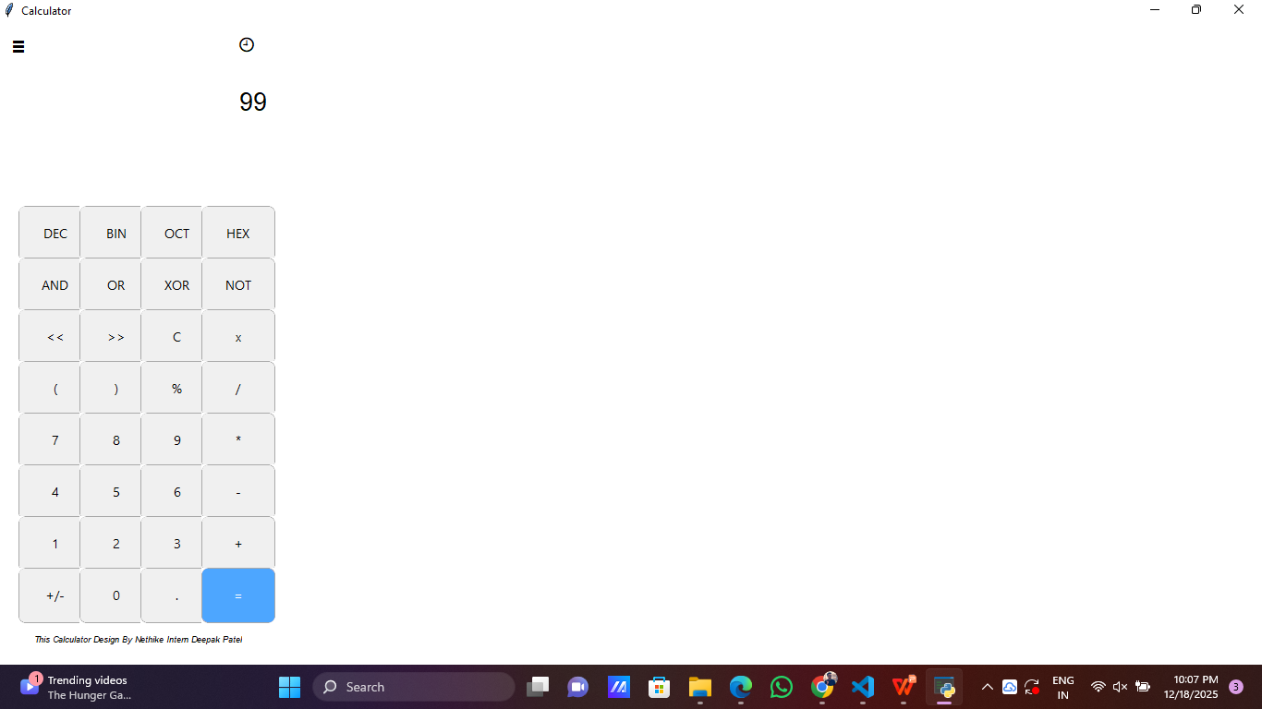
Demo / Screenshots
Programmer Calculator

Slide 15
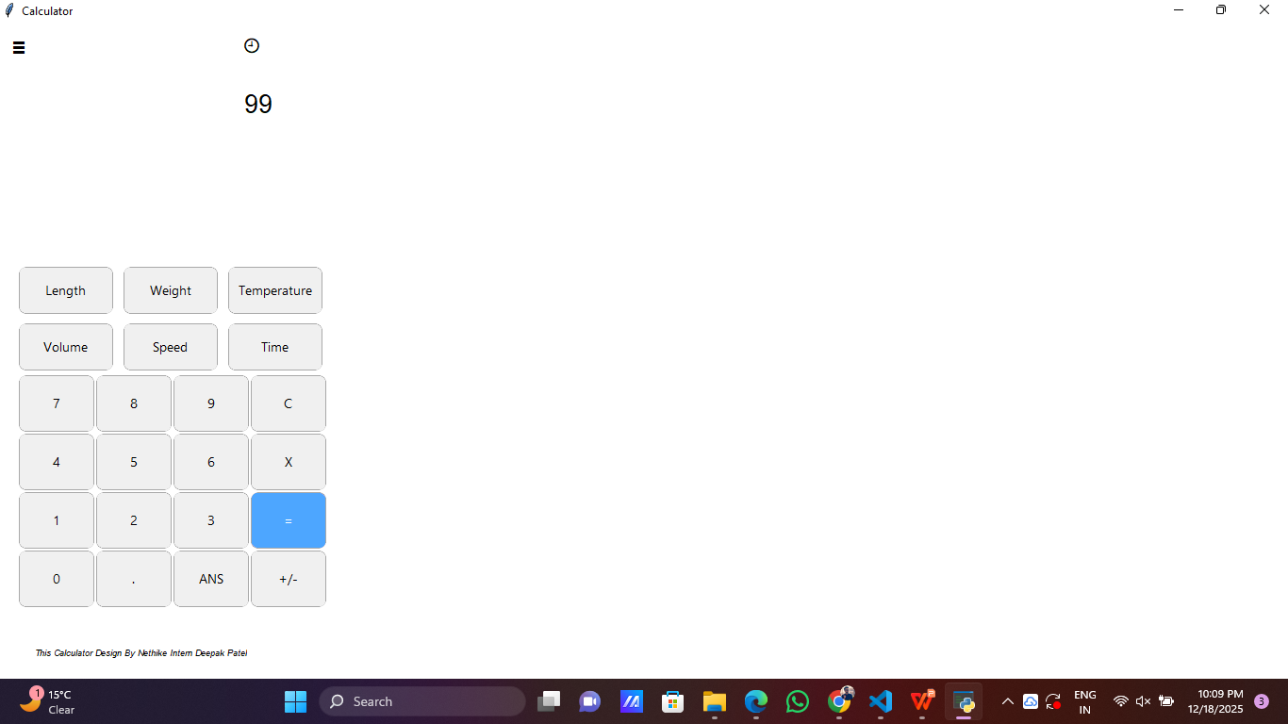
Demo / Screenshots
Unit Converter

Slide 16
Footer / Contact
This Calculator Design By Nethike Intern Deepak Patel
Email :- dp7380530@gmail.com

