Slide 1
Bike Sharing Analysis Dashboard
Internship Project Presentation
Nethike IT Solutions
By Deepak Patel

Slide 2
Project Objective
• To analyze bike-sharing demand patterns using Excel.
• Identify trends based on hour, season, weather, and user type.
• Build an interactive dashboard for business insights.
• Generate actionable insights for better operational decisions.

Slide 3
Dataset Overview
• Source: Provided dataset from Nethike IT Solutions.
• Total Records: ~1000
• Key Columns:
- Date, Season, Weather Code, Temperature, Humidity, Wind Speed
- Registered User, Non-Registered User, Total Users
• Tools Used: Microsoft Excel (Pivot Table, Charts, Dashboard)

Slide 4
KPI Summary (Key Metrics)
• Total Users: 58,304
• Registered Users: 53,383
• Non-Registered Users: 4,921
• Highest Hourly Users: 6,169
• Lowest Hourly Users: 69
• Avg Temperature: 20°C | Avg Humidity: 58%
• Total Rentals on Weekdays > Holidays

Slide 5
Pivot Table Insights
Hourly Demand Analysis – Identifies busiest hours.
Season-wise Analysis – Shows usage by season.
Weather-wise Analysis – Impacts of weather on demand.
User Type Split – Registered vs Non-Registered users.
Key Insight: Demand peaks during evening hours (17–18 hrs) and is highest in winter season with clear weather.

Slide 6
Excel Dashboard Overview
The final Excel dashboard includes:
• KPI Cards (Total Users, Avg Temp, Rentals, etc.)
• Interactive Pivot Charts for hour, season, and weather.
• Slicers for easy filtering by season and weather.
• Visual Insights helping decision-making.

Slide 7
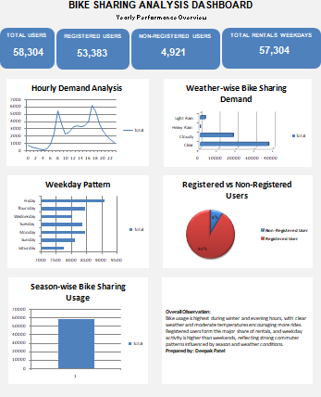
DASHBOARD

Slide 8
Conclusion & Learnings
✅ Clear relationship between temperature and total users.
✅ High user engagement during winter and evening hours.
✅ Registered users form majority (≈ 91.5%).
✅ Improved analytical and Excel dashboarding skills.
✨ Project done as part of internship at Nethike IT Solutions.

