Slide 1
Big Mart Sales Prediction
Group 10
Dev Patel-AU2040056
Meet Patel-AU2040010
Kush Patel-AU2040137
Vatsal Shah -AU2040019

Slide 2
Introduction
The Big Mart Sales Prediction project is an excellent example machine learning used in Business issues.
Predict the outlet sales using various Machine learning algorithms.
Methods like linear regression, XGBOOST, and Random Forest regression are used.
Comparing the model's predictions to the actual sales data includes testing the model on a holdout set of data.
BIG MART SALES PREDICTION USING MACHINE LEARNING. IJCRT
https://ijcrt.org/papers/IJCRT2105404.pdf

Slide 3
Problem Statement
The major aim is to create a predictive model that can accurately estimate product sales in the shop.
Allowing store managers to make deft choices regarding inventory control, sales forecasting, and marketing tactics.
Data gathering, data cleansing, feature engineering, model selection, and evaluation are just a few of the processes that the project goes through.

Slide 4
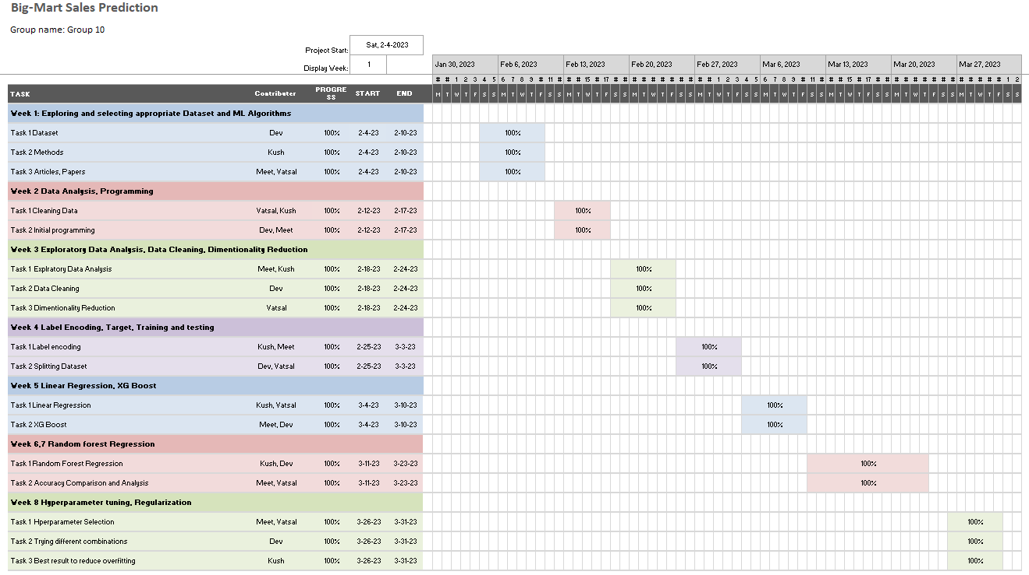
GANTT chart showing the project progress

Slide 5
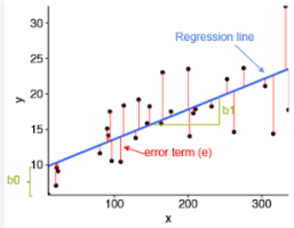
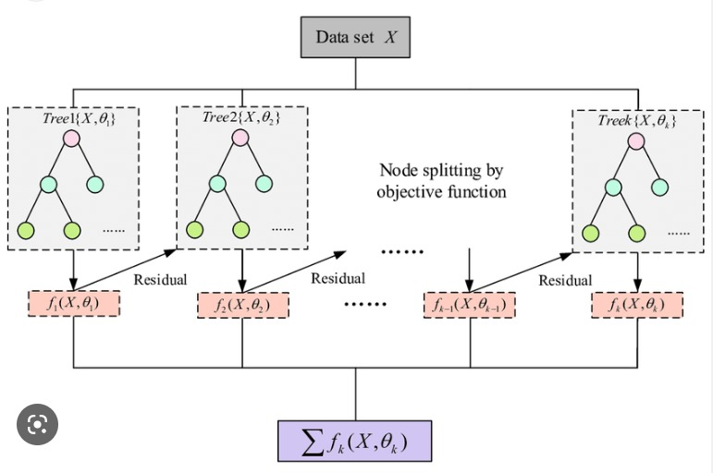
Linear Regression
Linear regression models the relationship between a dependent variable and independent variables.
The algorithm fits a line to the data, minimizing the squared distances.
The model can be used to predict new values of the dependent variable based on new values of the independent variables
XGBOOST
XGBOOST is a tree-based algorithm that utilizes multiple decision trees to make predictions.
Generates feature importance scores to identify which factors are most predictive of sales.
Robust to missing data and outliers, which are common in sales datasets.
Hamad, S., Alice, K., & Srivastava, A. Sales Forecasting using XGBoost. TechRxiv.
https://www.techrxiv.org/articles/preprint/Sales_Forecasting_using_XGBoost/21444129

Slide 6
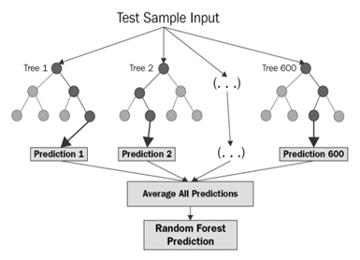
Random Forest
It is an ensemble learning method that combines multiple decision trees to make predictions.
Each decision tree is trained on a random subset of the training data and a random subset of the features.
The algorithm outputs the mode (for classification) or mean (for regression) of the predictions made by the individual trees.
It can also handle missing values and maintain accuracy even when some features are irrelevant or redundant.
The algorithm can be prone to overfitting if the number of trees is too large.
Kadam, H., Shevade, R., Ketkar, D., & Rajguru, S.
A Forecast for Big Mart Sales Based on Random Forests and Multiple Linear Regression..
https://www.ijedr.org/papers/IJEDR1804010.pdf

Slide 7
Approach
1
Big Mart Sales data Collection
B
E
2
Data Pre-processing
Data
Pre-processing
Final implementation
D
3
Train Data Sets
Data Visualization Using Pandas and KLIB
C
4
Split the dataset into train and test sets
Data Visualization
5
Fine tuning and initial implementation of the inbuilt model available in scikit library.
A
Data Collection
6
Improving the model
7
Final implementation and analysis of the outputs
D
R
E
A
M

Slide 8
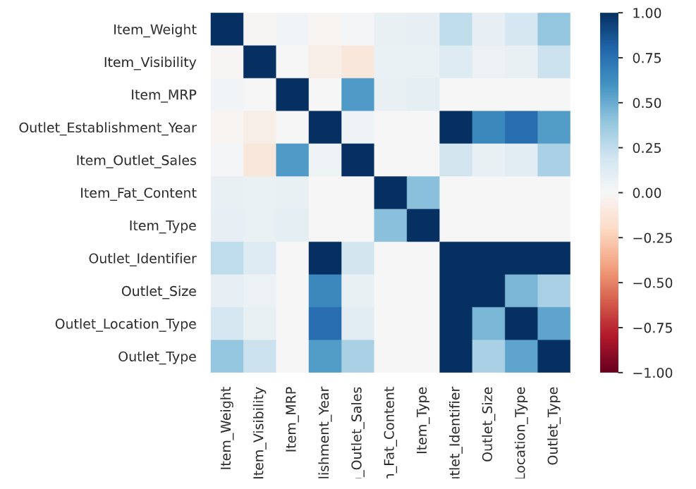
Data Analysis

Slide 9
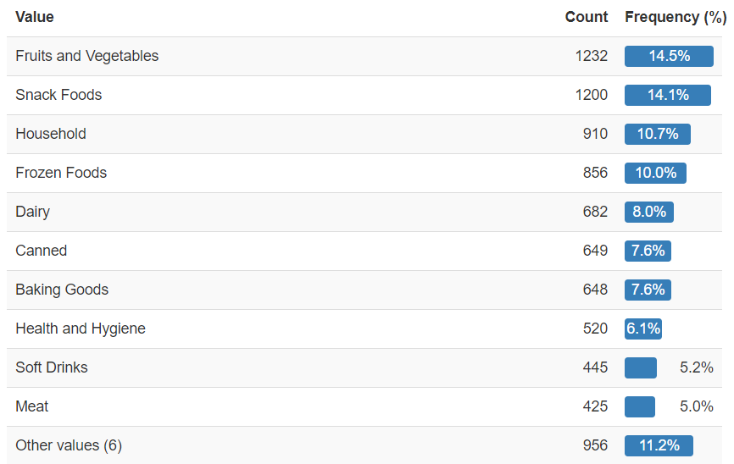
Data Analysis
Distribution of categories in the Item Type column:

Slide 10
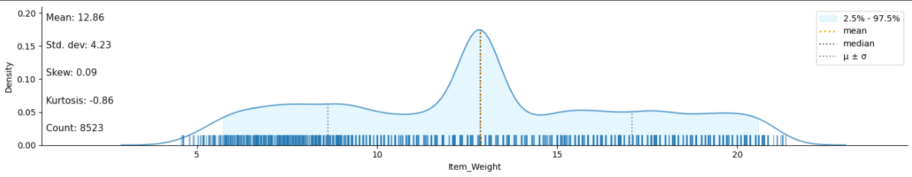
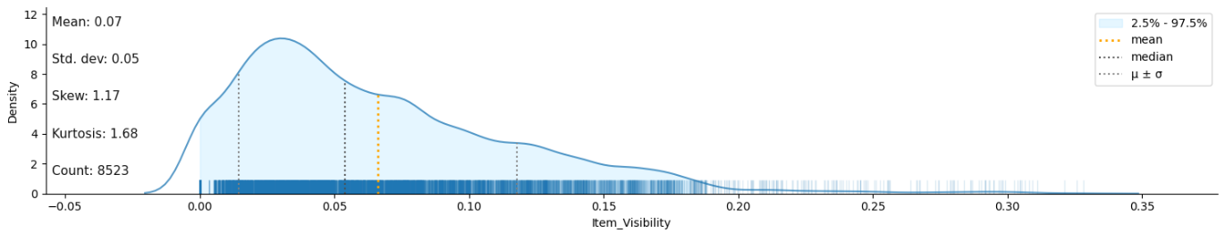
Data Analysis

Slide 11
Initial Results

Slide 12
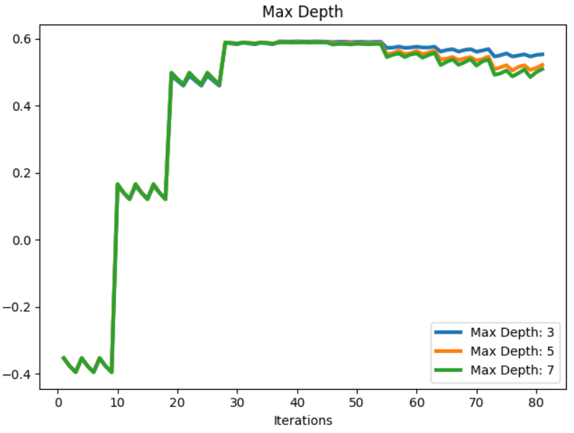
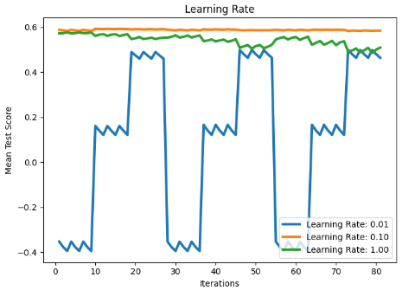
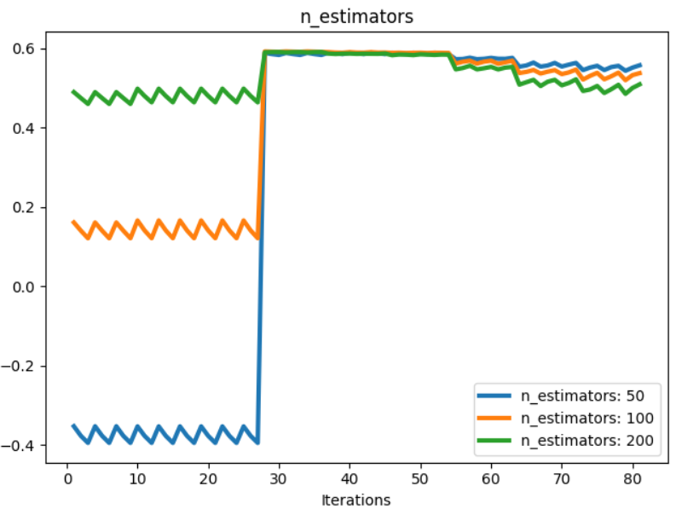
Hyperparameter Tuning
XGBOOST

Slide 13
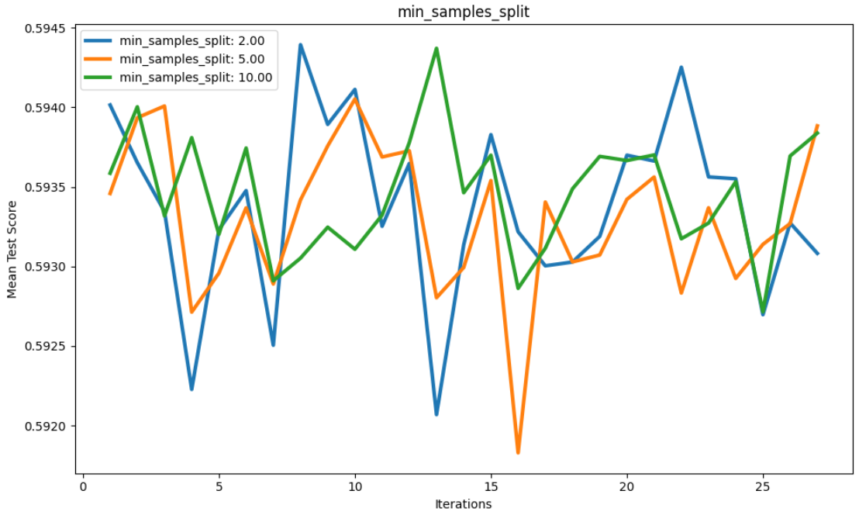
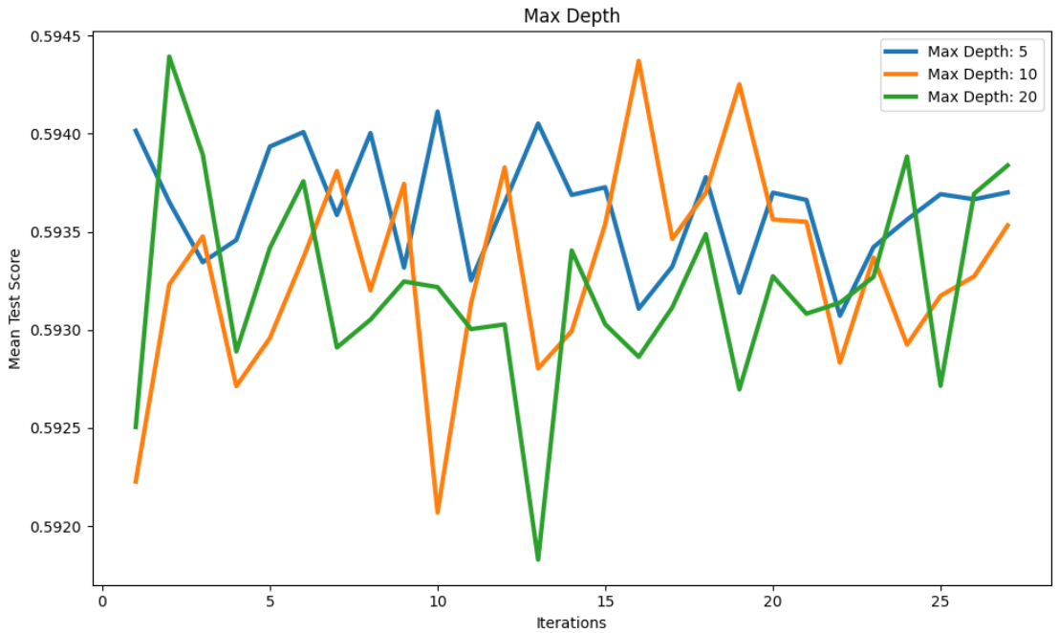
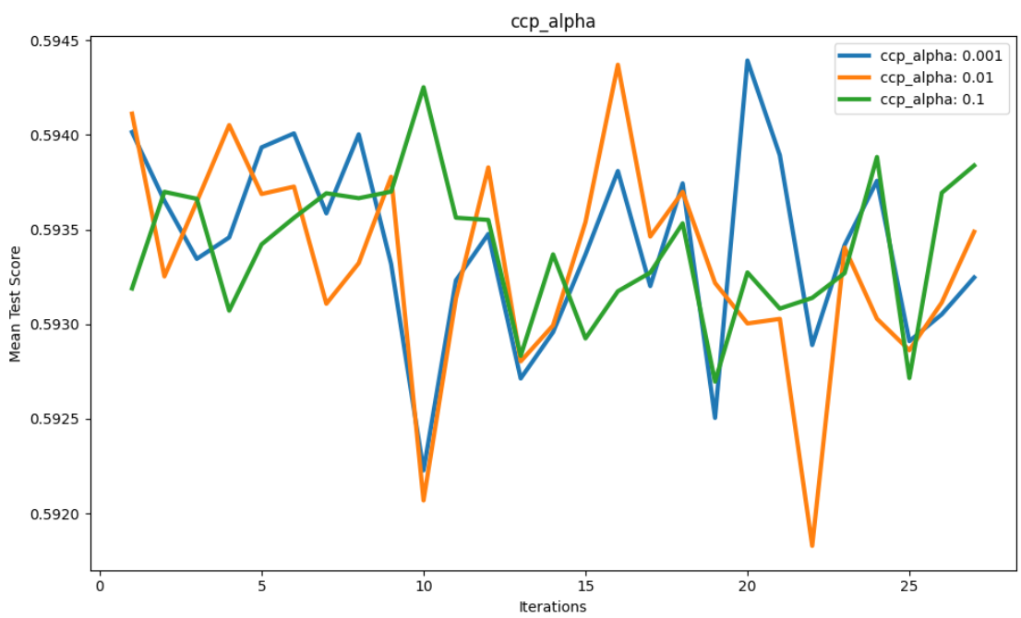
Hyperparameter Tuning
Random Forest

Slide 14
Final Results

Slide 15

Conclusion
XGBoost and Random Forest regression models give better performance than the linear regression model.
XGBoost and Random Forest models have a lower MAE and RMSE than linear regression.
The selection of an algorithm will depend on the specific needs and goals of the business.

Slide 16
16
Role of each group member & Future Work
DEv
Data pre-processing, XGBoost, hyperparameter tuning, report
Meet
EDA, Random Forest, hyperparameter tuning, report and PPT
Kush
Research, model output analysis, report and ppt
Vatsal
Research, Data analysis, report, PPT

Slide 17
References
BIG MART SALES PREDICTION USING MACHINE LEARNING. (n.d.). IJCRT from
https://ijcrt.org/papers/IJCRT2105404.pdf
Hamad, S., Alice, K., & Srivastava, A. (2022, November 7). Sales Forecasting using XGBoost. TechRxiv. https://www.techrxiv.org/articles/preprint/Sales_Forecasting_using_XGBoost/21444129
Kadam, H., Shevade, R., Ketkar, D., & Rajguru, S. (n.d.). A Forecast for Big Mart Sales Based on Random Forests and Multiple Linear Regression. Ijedr.org. https://www.ijedr.org/papers/IJEDR1804010.pdf
[3] Big Mart Sales Prediction Using Machine Learning Techniques. (n.d.). SVRECfromhttp://www.svrec.ac.in/docs/cse/publications/BIGMART.pdf

