Slide 1
Big Mart Sales Prediction
fantastic four
Dev Patel-AU2040056
Meet Patel-AU2040010
Kush Patel-AU2040137
Vatsal Shah -AU2040019

Slide 2
Elaborating Problem Statement
Introduction In this Project we are going to predict the outlet sales using various Machine learning algorithms. For this endeavour, methods like linear regression, XGBOOST, Random Forest regression, SARIMAX and neural network are used. The model must be tested after training to ascertain its correctness and dependability. Comparing the model's predictions to the actual sales data includes testing the model on a holdout set of data. The Big Mart Sales Prediction project is an excellect example Machine learning is used in Business issues.
I
Problem Statement The major goal of this project is to create a predictive model that can estimate product sales in the shop with accuracy, allowing store managers to make deft choices regarding inventory control, sales forecasting, and marketing tactics. Data gathering, data cleansing, feature engineering, model selection, and evaluation are just a few of the processes that the project goes through.
P

Slide 3
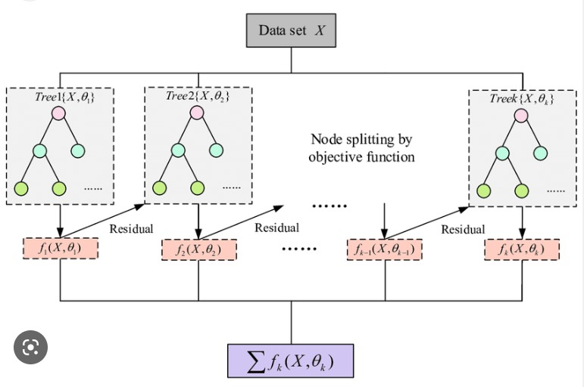
XGBOOST
XGBoost can handle large datasets with many features, making it useful for predicting big mart sales.
XGBoost is robust to missing data and outliers, which are common in sales datasets.
XGBoost can generate feature importance scores to identify which factors are most predictive of sales.
XGBoost can be tuned with hyperparameter optimization techniques to improve its accuracy on big mart sales prediction.
XGBOOST are tree-based algorithms that utilize multiple decision trees to make predictions. Decision trees can create a hierarchy of significant features, while XGBOOST can dynamically select and exclude features to address multicollinearity

Slide 4
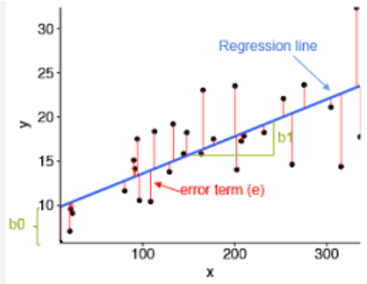
Linear Regression
Linear regression models the relationship between a dependent variable and one or more independent variables.
The algorithm fits a line/plane to the data that minimizes the squared distances between predicted and actual values.
The model can be used to predict new values of the dependent variable based on new values of the independent variables
Linear regression can be simple or multiple, and can handle non-linear relationships using techniques like polynomial regression.

Slide 5
Approach and Implementation
1
Big Mart Sales data Collection
B
2
E
Data Pre-processing
Data
Pre-processing
Final implementation
D
3
Train Data Sets
Data Visualization Using Pandas and KLIB
C
4
Split the dataset into train and test sets
Data Visualization
5
Fine tuning and initial implementation of the inbuilt model available in scikit library.
A
6
Data Collection
Improving the model
7
Final implementation and analysis of the outputs
D
R
E
A
M

Slide 6
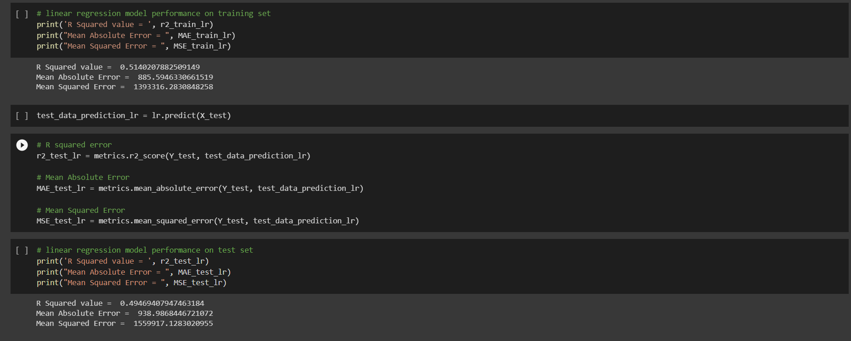
Initial Results

Slide 7
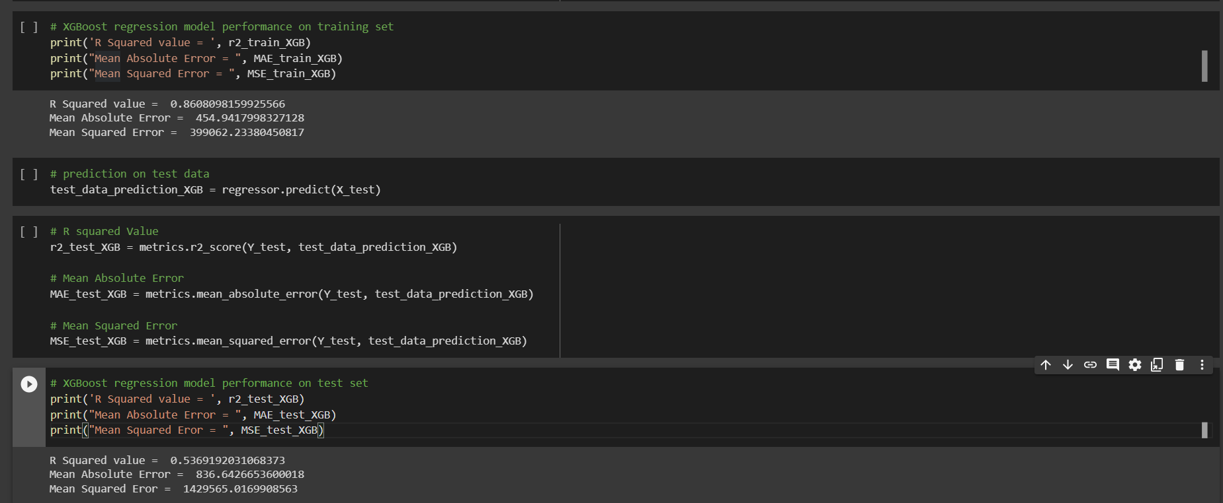
Initial Results

Slide 8
8
Role of each group member & Future Work
DEv
Data pre-processing, model implementation, report and ppt
Future Work
1. hyper parameter tuning
2 random forest
3 sarimax
4 final implementation
5 model comparison
Meet
EDA, model implementation, report and PPT
Kush
Research, model output analysis, report and ppt
Vatsal
Research, Data analysis, PPT

Slide 9

References
https://ijcrt.org/papers/IJCRT2105404.pdf
http://www.ijsred.com/volume3/issue4/IJSRED-V3I4P81.pdf
http://www.svrec.ac.in/docs/cse/publications/BIGMART.pdf
https://www.irjmets.com/uploadedfiles/paper/volume_3/issue_9_september_2021
/16025/final/fin_irjmets1630829142.pdf
https://www.jetir.org/papers/JETIREJ06034.pdf

Slide 10
Thanks for Seeing our Presentation
Hope you liked it.......

