Slide 1
Video Game Sales Analysis (1971 - 2024)
Insights into Sales Trends, Console Preferences, and Regional Differences.
*Power BI file shared, please refer to it, static images of dashboard used in this ppt*

Slide 2
Objective
Analyze Console Specialization in Genres
Identify best-performing genres for each console and peak performance years.
Understand Sales Trends Over Time
Track historical sales trends, including peaks and declines across years.
Compare Regional Popularity
Assess which consoles perform best across different global regions.
Deliver Actionable Insights
Summarize findings to inform future decisions in gaming strategy and console development.
Dataset Overview:
Total Titles: 60,000+ games
Time Period: 1971-2024
Data Fields: Game title, release year, genre, console, critic score, and regional sales

Slide 3
Top-Selling Genres and Games
Action & Shooting:
Key Games: Grand Theft Auto V, Call of Duty series
Insight: Action games, especially shooting titles, dominate the top sales list, indicating a strong player preference for high-intensity gameplay.
Sports:
Key Games: FIFA series, Pro Evolution Soccer
Insight: Sports games, particularly football/soccer titles, are among the best-sellers, showing consistent popularity across regions.
Racing:
Key Games: Need for Speed series
Insight: Racing games like Need for Speed attract a substantial audience, though they don’t quite reach the popularity of action/shooting genres.
Role-Playing (RPG):
Key Games: Fallout series
Insight: RPGs are well-represented in top sales, especially franchises with strong narratives and immersive worlds.
Simulation:
Key Games: The Sims series
Insight: Simulation games like The Sims have a niche but loyal following, though they’re less common among the very top sellers.

Slide 4
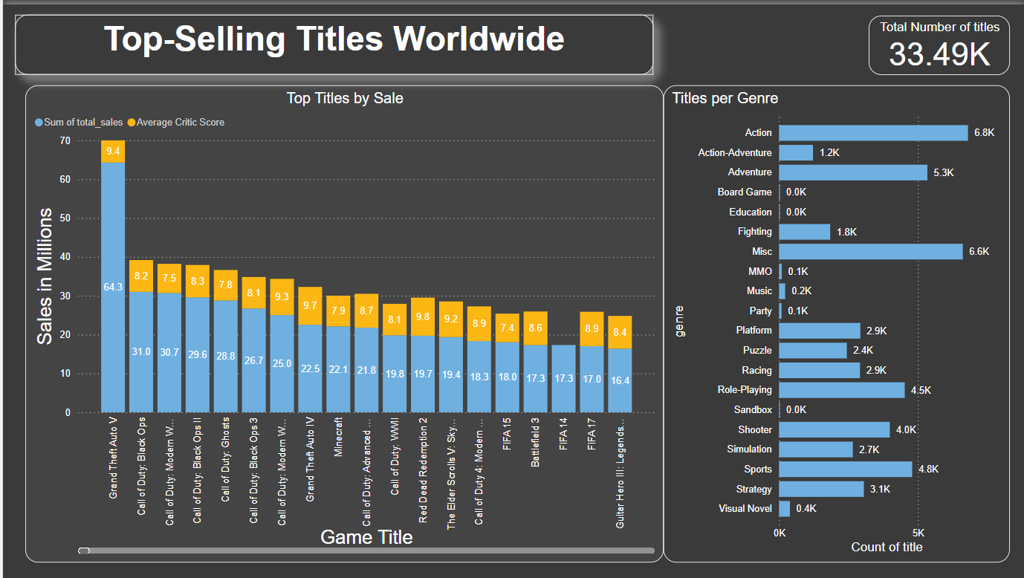
The Total number of titles card shows the actual number of titles. Games have different versions which are either purchased by the user or sold as a catalogue. The report combines all the released versions of the game as single Title. For more details click on the genre on the dashboard.

Slide 5
Top 10 Selling Titles and Critic Scores
Rank | Game Title | Global Sales (Millions) | Critic Score
1 | Grand Theft Auto V | 64.3 | 9.4
2 | Call of Duty: Black Ops | 31.0 | 8.2
3 | Call of Duty: Modern Warefare 3 | 30.7 | 7.5
4 | Call of Duty: Black Ops II | 29.6 | 8.3
5 | Call of Duty: Ghosts | 28.8 | 7.8
6 | Call of Duty: Black Ops III | 26.7 | 8.1
7 | Call of Duty: Modern Warefare 2 | 25.0 | 9.3
8 | Grand Theft Auto IV | 22.5 | 9.7
9 | Minecraft | 22.1 | 7.9
10 | Call of Duty: Advanced Warefare | 21.8 | 8.7
Here in the table, it is clearly visible that top selling category is dominated by shooter genre games. Also the shooter genre is dominated by “Call of Duty” franchise.

Slide 6
Objective: Present a historical overview of video game sales to see if the industry has grown, plateaued, or declined over time.
Visualization:
Area Chart:
Content: This chart shows annual sales and the number of titles released each year, illustrating trends in sales and game releases from 1971 to 2024.
X-axis: Years (1971 - 2024)
Y-axis: Total Sales Volume (Millions of Units or Revenue)
Secondary Y-axis: Total Release Volume
Pie Chart(Sales per Quarter):
Content: This chart displays the total sales volume per quarter for each genre when a specific genre is selected in the slicer.
Segments: Each segment shows the sales percentage as well as total sales in million. Ignore ‘Blank’ segment.
Pie Chart(Title release per Quarter):
Content: This chart shows the volume of title releases per quarter for each genre when a specific genre is selected in the slicer.
Segments: Each segment shows the title release percentage as well as total volume of title. Ignore ‘Blank’ segment.

Slide 7
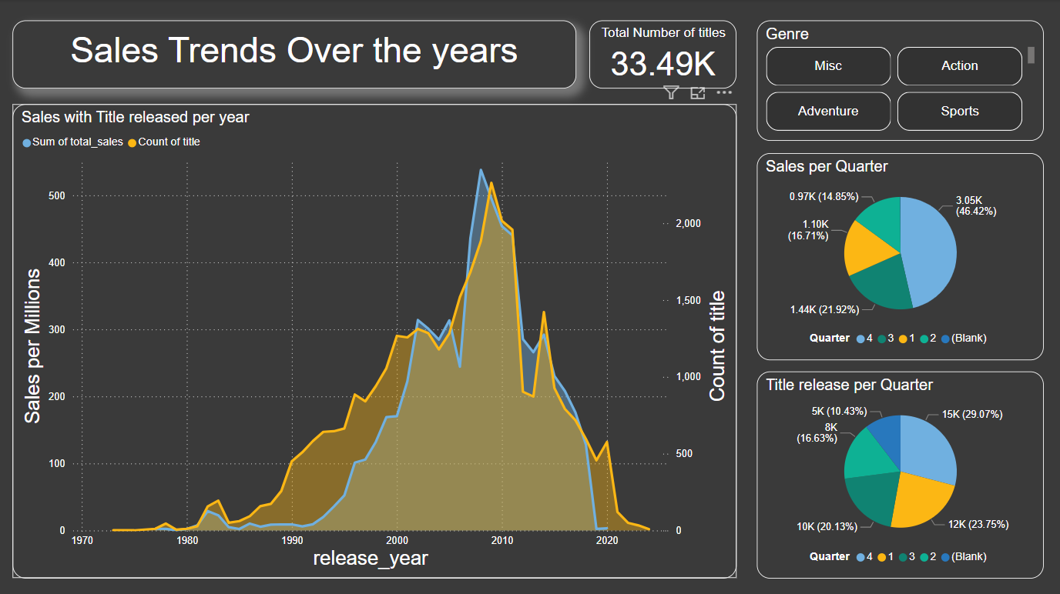

Slide 8
Sales Trends Over the Years and Quarterly Analysis
Sales and Title Releases Over Time:
Insights:
Early Trends (1981-1984): Notable initial increase in both game title releases and sales.
Gradual Rise (1987-2000): Game releases increased steadily, with sales showing slower growth until a significant spike from 1995 onwards.
Peak Period (2005-2009): The industry saw a peak in game releases in 2009 (2,263 titles) and record-breaking sales in 2008, reaching 537.96 million units.
Decline Post-2009: Both game releases and sales declined consistently each year, possibly due to market shifts or changing consumer interests.
Quarterly Sales Distribution (Pie Chart):
Insights:
4th Quarter Dominance: The 4th quarter accounts for 46.42% of annual sales, likely due to holiday season sales.
3rd Quarter Impact: The 3rd quarter follows with 21.92%, suggesting a strong back-to-school or pre-holiday season push.
Quarterly Title Releases (Pie Chart):
Insights:
Consistent 4th Quarter Releases: The 4th quarter has the highest percentage of releases (29.07%), aligning with sales trends.
Balanced Releases in Other Quarters: The 1st and 3rd quarters also see significant releases, suggesting balanced launch strategies throughout the year.

Slide 9
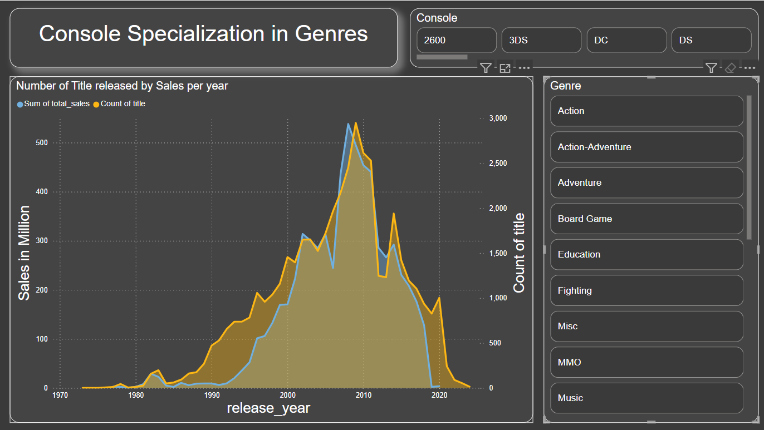

Slide 10
Console Specialization Insights:
2600: One of the earliest consoles in the dataset, the 2600 excelled in action, platform, puzzle, racing, and shooter genres, with shooter and action being its top-performing genres. The console reached its peak in 1982 with a notable sales figure of 28.99 million units, particularly thriving between 1980 and 1984.
3DS: The 3DS saw moderate popularity with peak sales in 2011 at 22.59 million units. However, sales declined steadily after a brief resurgence from 2014 to 2017, eventually losing its momentum entirely by 2020.
DC: Specializing in platform and sports genres, the DC console reached its peak in 1999 with 6.06 million units sold, but its success quickly waned after 2000.
DS: A strong contender from 2004 to 2012, the DS achieved a remarkable peak of 113.4 million units in 2008, with the highest title count of around 685 in 2008 and 2009. Sales sharply declined from 2008 to 2012.
GB: This console experienced two sales spikes in 1997 and 2001, with sales reaching 3.89 million and 4.48 million units, respectively. However, sales tapered off significantly after these peaks.
GBA: Operating from 2001 to 2007, the GBA performed well in action, adventure, racing, and puzzle genres, though it showed less engagement in the shooter genre.

Slide 11
GC: With a relatively brief lifespan, the GC performed decently from 2002 to 2006, without any standout peak years.
N64: The N64 was a well-rounded console active from 1996 to 2001 and achieved steady performance across multiple genres.
NES: A legacy console from 1983 to 1994, the NES reached its peak in 1986 with 9.96 million units, marking its status as an iconic console of its era.
PC: Known for its versatility, the PC shows broad genre representation. While data on PC is limited in the dataset, it consistently shows relevance, with a notable sales spike in 2011 at 29.72 million units.
PS (PlayStation): Covering all genres except party and visual novel, PlayStation enjoyed a strong run from 1994 to 2004, reaching an all-time peak in 1999 with 129.67 million units. After its peak, it saw a gradual decline.
PS2: Spanning 2000 to 2010, the PS2 performed best in action, sports, racing, and shooter genres, peaking in 2002 with 176.94 million units before gradually declining.
PS3: Active from 2006 to 2016, the PS3 mirrored PS2's success with a peak in 2011 at 155.48 million units, showing a characteristic mountain-shaped sales trend.

Slide 12
PS4: From 2013 to 2019, the PS4 performed well, particularly from 2014 to 2017 with annual sales between 96.78 million and 112.96 million units. Sales declined after 2018.
PS5: Launched in 2020, the PS5 has limited data available in the dataset for comprehensive analysis.
PSN: From 2008 to 2015, PSN showed moderate performance with a peak sales figure of 2.9 million units.
PSP: Between 2004 and 2014, the PSP had consistent performance across genres, peaking in 2006 with 46.81 million units.
PSV: Operating from 2011 to 2018, PSV saw its peak in 2012 with 20.98 million units, followed by a gradual decline.
SAT: From 1994 to 1999, SAT reached its peak in 1996 with 12.94 million units, showing a brief spike followed by a steep decline.
SNES: The SNES performed well from 1990 to 1999 with a rapid increase and subsequent decline, peaking in 1994 with 22 million units.
Wii: With a shorter lifecycle, Wii excelled from 2006 to 2014, especially between 2007 and 2010. It reached a peak in 2009 with 107.39 million units.

Slide 13
WiiU: Performing decently between 2012 and 2017, WiiU achieved its highest sales in 2013 with 9.9 million units.
X360: One of the most popular consoles, the X360 excelled from 2005 to 2018 with robust sales from 2007 to 2013 and a peak in 2011 with 142.51 million units.
XB: The XB performed well between 2002 and 2005, with a peak in 2003 at 55.39 million units.
XOne: From 2013 to 2018, the XOne saw significant sales with a peak in 2014 at 61.39 million units, followed by a gradual decline.

Slide 14
Regional Popularity Insights:
North America: The North American region consistently leads in total sales across all consoles, with especially high sales in action, shooter, and adventure genres. Modern handheld consoles like PS, PS2, PS3, PS4, X360, and XOne performed exceptionally well here. However, North America has seen a decline in recent years across several genres.
Europe & Africa: Following North America, the European and African regions also show strong sales, with slightly less of a drop in recent years. Some genres maintain steady sales, indicating a more consistent market for these regions.
Japan: The Japanese market presents a high degree of fluctuation, making it challenging to identify consistent sales patterns. Although it trails behind North America and Europe & Africa in overall sales, Japan still demonstrates decent performance for certain genres and titles.
Rest of the World: Similar to Japan, the Rest of the World region has relatively lower overall sales and fluctuating patterns across genres, with decent performance in specific areas.

Slide 15
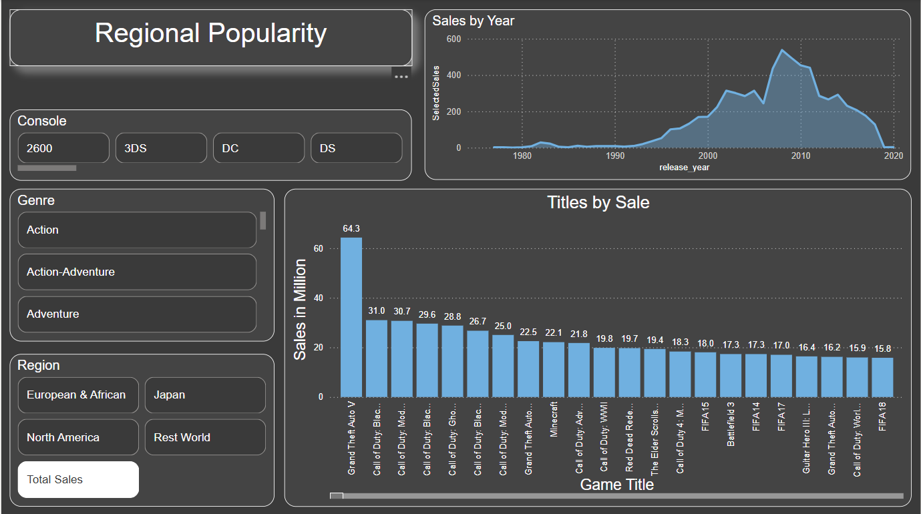

Slide 16
Summary of Video Game Console Sales Analysis (1971-2024): This presentation analyzed global video game console sales data across multiple dimensions, including genre specialization, console performance, and regional popularity. Below is a summary of the key insights.
1. Console Specialization by Genre
Classic Consoles: Early consoles like 2600, NES, SNES, and GB set the stage for genre diversity, excelling in action, platform, and shooter games. 2600 peaked between 1980-1984 with shooter and action genres leading.
PlayStation Series (PS, PS2, PS3, PS4): Dominated the action, sports, and racing genres across generations. PS2 hit a peak in 2002 with 176.94 million units, while PS3 saw its highest in 2011. PS4 maintained strong sales from 2014 to 2017, with gradual declines afterward.
Xbox Series (X360, XOne): The X360 was a top performer from 2007 to 2013, excelling across various genres, particularly action and shooter, with a peak in 2011 at 142.51 million units.
Nintendo Consoles (Wii, DS, 3DS): Wii performed exceptionally well from 2007-2010, peaking at 107.39 million units in 2009. DS had its peak in 2008 with high sales in action and adventure genres, followed by gradual declines.
PC Gaming: Everlasting popularity with diverse genres represented. Despite limited data, PC sales show consistent demand over time.

Slide 17
2. Sales Trends Over Time
Console popularity tends to follow a lifecycle pattern, with initial growth, a peak, and a gradual decline. Major spikes in sales are often linked to the release of hit titles or improved hardware.
Early Consoles (1970s-1990s): Many of these consoles followed a shorter lifecycle, with rapid peaks and declines.
Modern Consoles (2000s-2020s): Modern consoles like PS3, PS4, X360, and Wii sustained high sales over several years before gradual declines as newer generations were introduced.
Recent Consoles (PS5, XOne): Show potential but are still establishing a pattern. Limited data for PS5 makes long-term trends unclear.
3. Regional Popularity Insights
North America: Dominates in overall sales, particularly in action, shooter, and adventure games. However, recent years show a decline in sales.
Europe & Africa: Second highest in sales with more stability than North America, with some genres remaining consistent.
Japan: Shows fluctuating sales, making it harder to identify stable patterns. Certain genres perform well but with less predictability.
Rest of the World: Lower sales overall with similar fluctuations to Japan. Popularity varies greatly by genre and console.

Slide 18
Key Takeaways:
Console Lifecycles: Successful consoles often follow a predictable lifecycle, with a rapid rise, peak sales in a few years, and a gradual decline as new models emerge.
Genre Specialization: Consoles like 2600, PS2, and X360 showcased dominance in specific genres, with action, sports, and shooter games being consistent top-performers.
Regional Demand Differences: North America and Europe lead in sales, especially for action and shooter genres, while Japan and other regions exhibit more varied patterns.
Evergreen Titles: Iconic titles like Grand Theft Auto V continue to drive sales globally, exemplifying how blockbuster games contribute significantly to console popularity.

