Slide 1
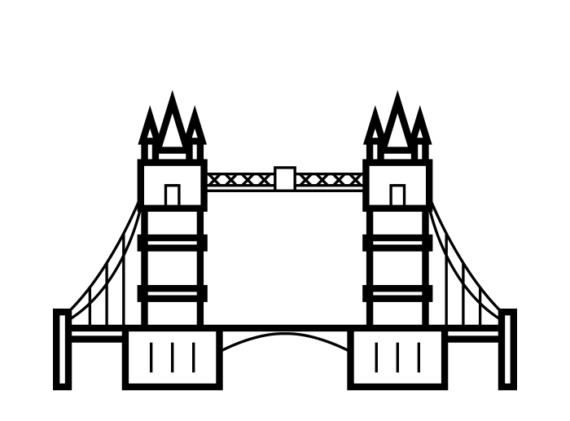
The Battle of Neighborhoods
IBM Professional Data Scientist Specialization – Capstone Project
- Finding the best area to build a student hall in London -

Slide 2




1. Problem
110,000+
international students
every year
High demand for student halls
London is a popular destination for higher education where diverse students from all around the world gather to study.
According to the data published by the Higher Education Statistical Agency (HESA), in the academic year 2016-2017 London welcomed 112,200 international students to its higher education institutions, which make up 29 percent of students at higher education institutions.
One of the big concerns for international students when moving to a new city would be finding an accommodation. Student halls are the most reliable means of housing for students, but it is not easy to secure a place in one as they are in high demand. Therefore this project aims to explore different neighborhoods of London and find the best area to build a new student hall for international students to solve this persistent problem and to find a new business opportunity. This research is expected to benefit real-estate investors looking for a profitable location or international students looking for a place to live in London.
From the student perspective, a lot of factors come into play when finding the best accommodation, including location and rent. In this project, however, the study focuses only on the safety and the general atmosphere of the neighborhood. Distance to universities are also an important factor in choosing a student hall, but as student halls accept students from different universities, it will be disregarded in this project.

Slide 3
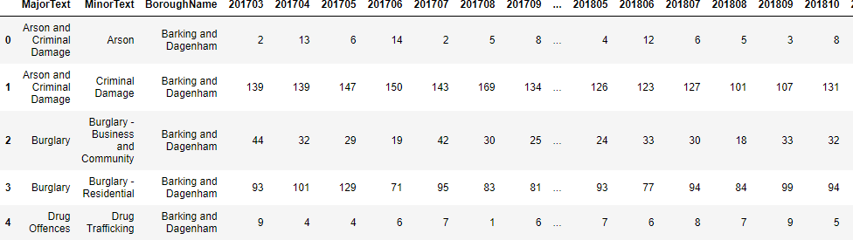
2. Data
In this project, three different datasets will be used to solve the problem - London Recorded Crime, List of London Boroughs, and
Foursquare API.
(1) London Recorded Crime
Description: London crime records classified by boroughs and crime type in the last 24 months
Size: 1594 * 27
Source: London Datastore, “London Recorded Crime : Geographic Breakdown”
URL: https://data.london.gov.uk/dataset/recorded_crime_summary

Slide 4
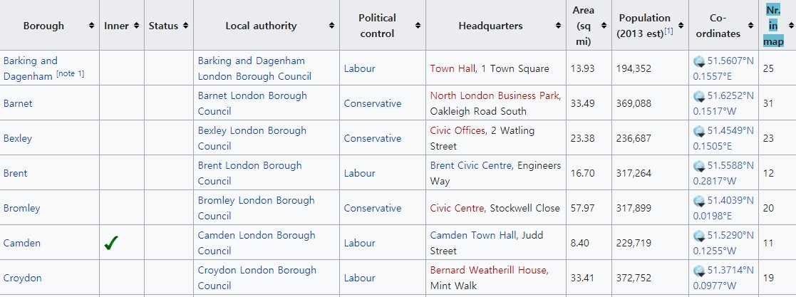
2. Data
(2) List of London Boroughs
Description: Information on 32 boroughs of London. ‘Population’ and ‘Coordinates’ will be used for the project.
Size: 33 * 10
Source: Wikipedia, “List of London Boroughs”
URL: https://en.wikipedia.org/wiki/List_of_London_boroughs

Slide 5
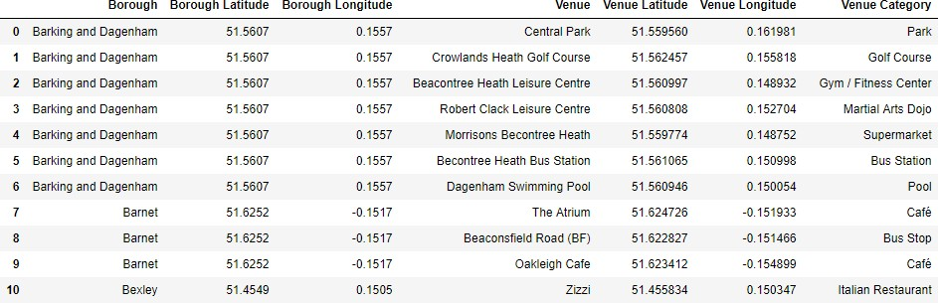
2. Data
(3) Foursquare API
Description: List of top 50 popular places in each borough. However, some suburban areas may have less than 50 places registered on Foursquare.
Size: 1112 * 7
Source: Foursquare API
URL: https://api.foursquare.com

Slide 6
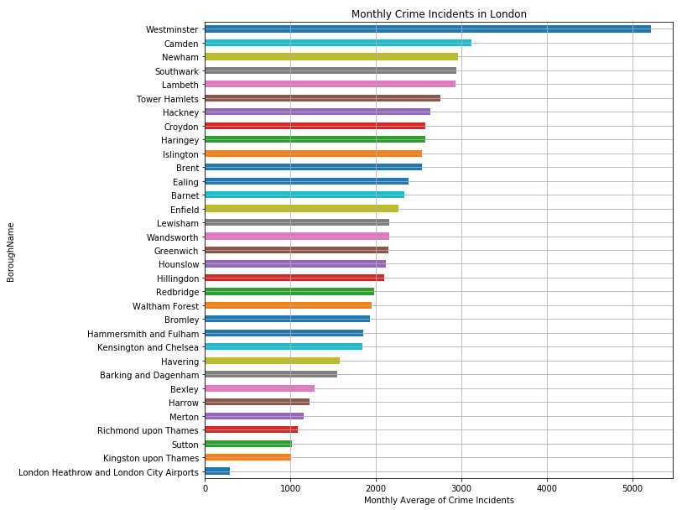
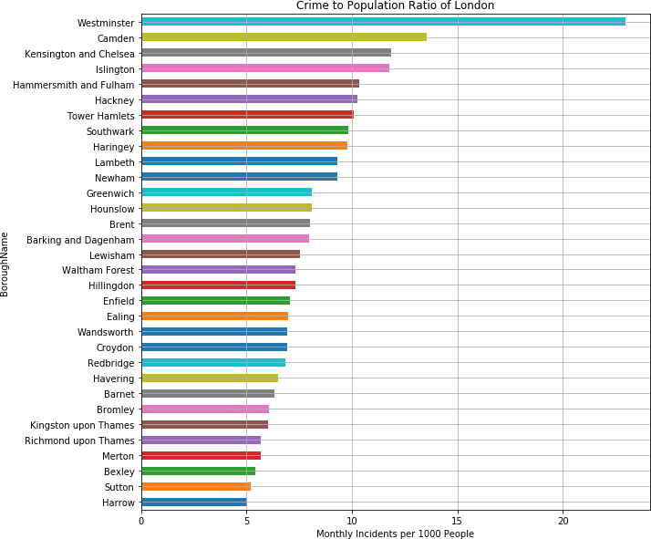
3. Methodology
(1) Exploratory Analysis: Which borough is more dangerous?
To observe the datasets better, each datasets were wrangled and cleansed into useful forms.
Combining the London Recorded Crime data and the List of London Boroughs data, the number of average monthly crime records per 1000 people was calculated.
When we visualize the boroughs by total number of crimes and by the ratio of crime to population, it is noticeable that the top
two dangerous boroughs, Westminster and Camden, still remain the top two dangerous places.

Slide 7
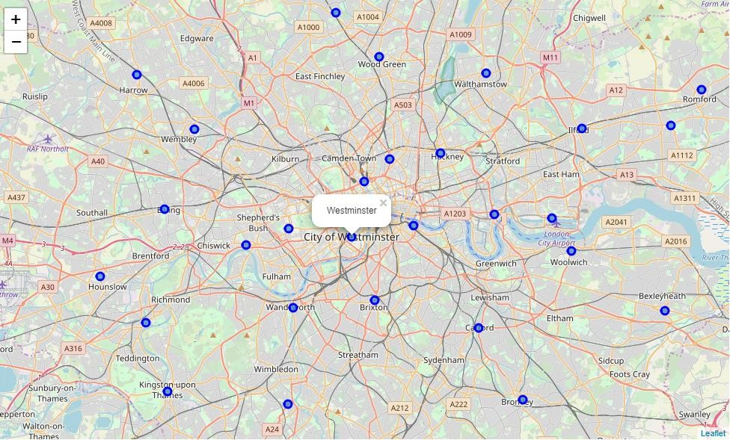
3. Methodology
(2) Exploratory Analysis: Map of London
Then with coordinates of each borough from List of London Boroughs data, we could visualize each borough on the map to get familiar with the Greater London area.

Slide 8
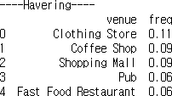
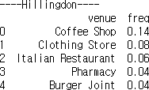
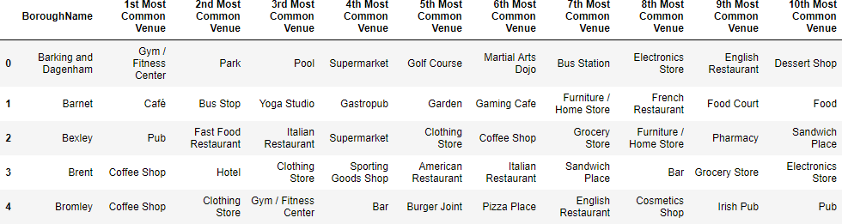
3. Methodology
(3) Cluster Analysis: Popular venues
From the top 50 venue data we have acquired from Foursquare, we used one hot encoding method to find out what venue categories are most popular. Venues from the same boroughs were grouped by borough names and popular categories were discovered by frequency.
…

Slide 9
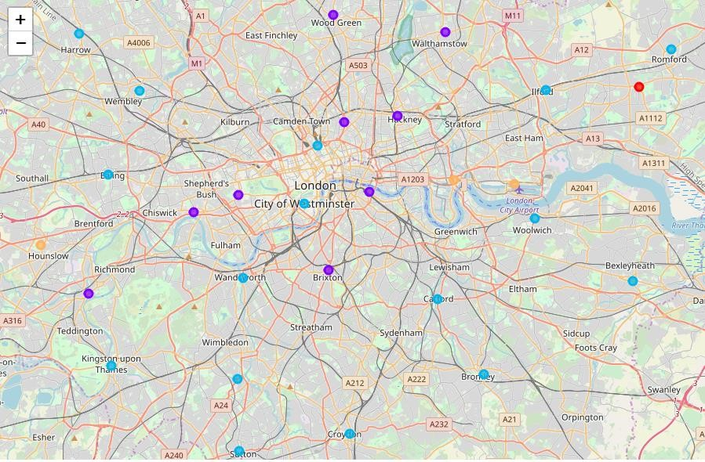
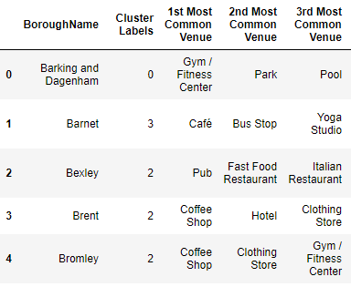
3. Methodology
(4) Cluster Analysis: K-Means Clustering
Based on the common venue categories, boroughs were grouped into five clusters as displayed on the map by colors.

Slide 10

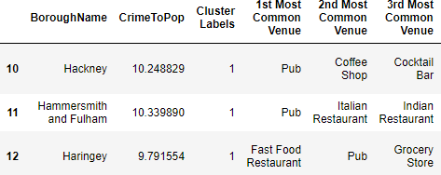
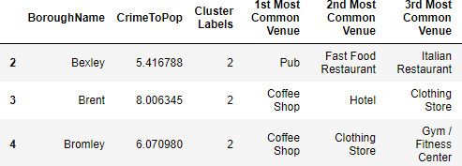
3. Methodology
(4) Cluster Analysis: K-Means Clustering
Each clusters were then given a name based on the characteristics they display.
Cluster 0 : Healthy area (gym, park, pool, …)
Cluster 1 : Lively area (Pub, restaurant, bar, …)
Cluster 2 : Busy area (Coffee shop, clothing store…)

Slide 11
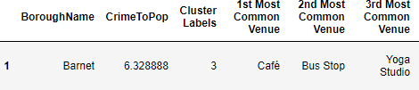
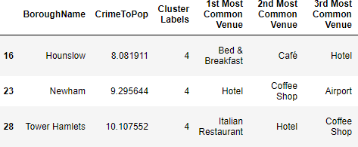
3. Methodology
(4) Cluster Analysis: K-Means Clustering
Each clusters were then given a name based on the characteristics they display.
Cluster 3 : Quiet area (Bus stop, yoga studio, garden …)
Cluster 4 : Traveler area (B&B, hotel, airport…)

Slide 12
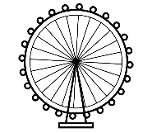
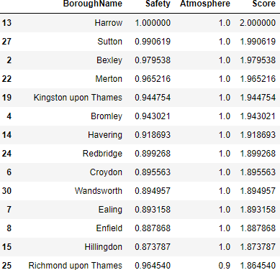
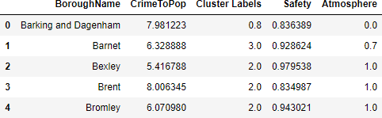
4. Results
Upon different analysis, we were able to discover the best neighborhoods based on our criteria of safety and atmosphere.
For safety, we normalized crime to population ratio and reversed the score so that 1 represents the neighborhood with least crimer per person.
For atmosphere, we gave an arbitrary score to each cluster based on personal preference, as preference is not easy to quantify without subjectivity. Highest score was given to Busy area (Cluster 2) which I prefer, and lowest score was given to Traveler area (Cluster 4).
Then by adding the two scores, we were able to find the best neighborhood scoreing full 2.0 points, Harrow.

Slide 13
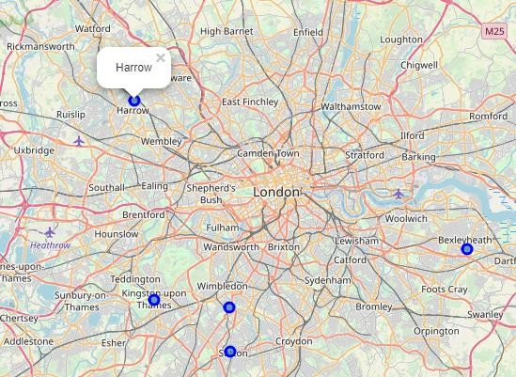
5. Conclusion
However, when we map the top five neighborhoods to live in, it is easily noticeable that they are all located in far out suburbs.
This is due to many limitations this research holds.
Among numerous factors that determine a good neighborhood, we only took into consideration what type of venues are popular and how many crime incidents are recorded for the sake of simplification. This means that serious crimes like homicide was treated the same as a comparatively petty crime like shoplifting. Moreover, the number of stores in the neighborhood may be as important as what type of stores there are.
To overcome the limitations of this study, we will need further data such as distance to city center, housing prices or ratio of the number of stores to population. Also, taking crime categories into factor and weighting them differently may be helpful.
Despite some limitations, this research was still enjoyable in that we were able to explore the neighborhoods in depth.

Slide 14
References
Images:
Tower Bridge by arloenl evinniev from the Noun Project
Big Ben by arloenl evinniev from the Noun Project
The London Eye by arloenl evinniev from the Noun Project
student by Mello from the Noun Project
House by Dilla Chee from the Noun Project
Data:
“London Recorded Crime : Geographic Breakdown”, London Datastore
“List of London Boroughs”, Wikipedia
Foursquare API
Document:
“The Economic Impact of London’s International Studnets”, London & Partners (2018)
Lecture notes from IBM Professional Data Science Specialization, Coursera

