Slide 1
APS
Badge Manager
Adobe Commerce App Builder · ACCS Capstone Challenge
Apex Parts Supply (APS)
Presenter: Dharmendra Patri · ACCS Cohort · June 2026
Commerce Admin
App Builder
EDS Storefront
Notes:
Welcome everyone. Badge Manager is our App Builder capstone for Apex Parts Supply — an industrial distributor. It spans Commerce Admin, App Builder, and the EDS storefront PDP.

Slide 2
TODAY'S AGENDA
What We'll Cover
1
2
3
4
Company & Solution
Live Walkthrough
Challenges & Learnings
Q&A
APS business context and the Badge Manager solution
Commerce Admin → App Builder → EDS storefront, end to end
What we hit, what we fixed, what we learned
Questions and feedback from the cohort
Notes:
20 minutes total. Business story first, then live demo, then learnings, then Q&A.

Slide 3
COMPANY OVERVIEW
Apex Parts Supply (APS)
Mid-sized industrial distributor serving manufacturing plants, maintenance teams, and contractors across North America.
Over 10,000 industrial products: machinery, hydraulic components, precision tools, and fasteners.
Target buyers: procurement managers and maintenance engineers who know exactly what they need, search for it, open the PDP, and decide quickly.
10,000+
Industrial Products
B2B
Procurement & Maintenance Teams
N. America
Distribution Reach
Notes:
APS is our fictional merchant. They sell industrial parts B2B. Buyers are professionals who know exactly what part they need — they search, open the PDP, and make a yes/no decision quickly.

Slide 4
BUSINESS PROBLEM
The Missed Opportunity
Shopper Scenario
Clearance inventory sits unsold
✕
A maintenance manager searches for a hydraulic pump.
Unknown to them: the product is 35% off and only 12 units remain in stock.
There is no visible signal on the product page. The buyer assumes it is a regular product, decides to purchase later — and eventually buys from another supplier after the stock is gone.
Both the customer and APS lose that opportunity.
✕
Promotional opportunities missed
✕
Customer buys from a competitor
Notes:
This is the core problem. APS runs promotions — clearance, limited stock, new arrivals. But the PDP gives buyers no signal. Professionals do not browse; they land on the PDP and decide in seconds.

Slide 5
THE SOLUTION
Badge Manager
Highlights critical product information directly on the PDP — at the exact moment buyers make their purchase decision.
R
Rule-Based Badges
M
Manual Assignments
Merchants define conditions once. Every product save triggers automatic evaluation in priority order.
Examples: Discount ≥ 30% → Clearance · Updated in last 24h → New Arrival
Assign any badge directly to a specific SKU for special business cases — curated picks, campaigns, featured items.
Always lower priority than rule-based badges.
BADGE EXAMPLES
Clearance
New Arrival
Limited Stock
Staff Pick
Exclusive
Notes:
The solution is Badge Manager. Two modes: rule-based (automated, runs on every product save event) and manual assignment (override for special cases). Rules always take priority over manual assignments.

Slide 6
GOALS & KPIs
What Success Looks Like
Clearance Velocity
Conversion Lift
C
Sell time-sensitive and discounted inventory faster by making the offer visible at decision time on the PDP.
L
Increase add-to-cart rate on promoted products by surfacing urgency and value signals when buyers are deciding.
PDP Engagement
Support Reduction
E
Reduce bounce rate on promotional PDPs. Buyers who see a badge engage longer and are more likely to return.
S
Fewer "Is this still on sale?" customer queries as product status is visible at a glance on the product page.
Notes:
Four KPIs: clearance velocity, conversion lift on promos, PDP engagement, and reduced support queries. The badge signal directly closes the information gap that causes buyers to delay or leave.

Slide 7
TECHNICAL ARCHITECTURE
How It All Connects
Commerce Admin (Admin UI SDK) · App Builder — 12 actions + evaluator.js · aio-lib-db (5 collections) · EDS Storefront PDP
Notes:
Three surfaces, one data flow. Admin UI SDK for configuration. App Builder for all backend logic and persistence. EDS storefront calls product-badge at page load. The event consumer runs independently, triggered by I/O Events when a product is saved in Commerce.

Slide 8
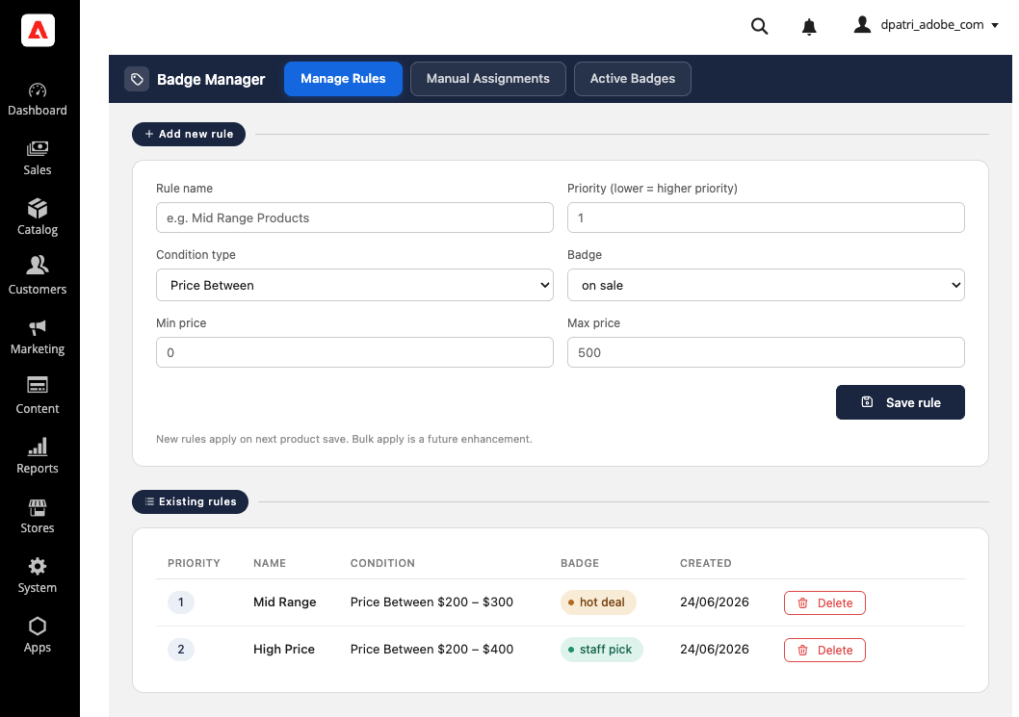
WALKTHROUGH — SURFACE 1
Commerce Admin: Badge Manager
Manage Rules Tab
1
[ SCREENSHOT ]
Define badge conditions: Discount %, recently updated, custom. Set priority order. Rules evaluated in ascending priority when a product is saved.
Apps > Badge Manager > Badge Admin
Show: Manage Rules tab with a saved rule
Manual Assignments tab
Active Badges read-only view
Manual Assignments Tab
2
Assign any badge directly to a SKU. Useful for curated picks and campaign overrides. Always lower priority than rule-based badges.
Active Badges Tab
3
Read-only view of all badge_state records. Verify what badge each product currently carries and when it was last evaluated.
Notes:
Demo step 1. Navigate to Apps > Badge Manager in Commerce Admin. This is embedded via Admin UI SDK as a left-nav extension. Create a rule: Discount >= 30%, badge = Clearance, priority 1. Hit Save Rule and verify it appears in the grid below.

Slide 9
WALKTHROUGH — SURFACE 2
App Builder: 12 Actions
ADMIN CRUD
STOREFRONT READ
EVENT PROCESSING
save-badge-rule
product-badge
product-event-consumer
get-badge-rules
(CORS restricted)
(non-web, I/O Events, Idempotency check)
delete-badge-rule
web-custom-options: true
evaluator.js
save-static-assignment
(rule priority engine)
get-static-assignments
delete-static-assignment
get-products
get-badge-catalog
get-badge-states
One-time setup: setup-collections initialises all 5 aio-lib-db collections and seeds badge_catalog with 10 badge definitions.
Notes:
Demo step 2 — the App Builder layer. 12 actions total. Save a product in Commerce Admin to trigger the event consumer. To see logs: Developer Console > App Builder Logs (filter by action name). For event delivery: Developer Console > DP Capstone Event > Debug Tracing. A 200 confirms the consumer ran.

Slide 10
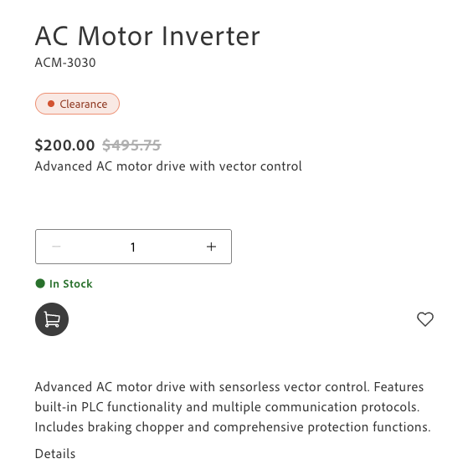
WALKTHROUGH — SURFACE 3
EDS Storefront: PDP Badge
Page Load
1
PDP block calls product-badge: GET ?sku=APS-4848
[ SCREENSHOT ]
/products/automated-positioning-system/aps-4848
Badge Resolution
Show: badge chip below the product title
(e.g. "Clearance" or "New Arrival" chip)
2
Action reads badge_state, resolves label from badge_catalog, returns badge_id + badge_label
Chip Renders
3
If badge_id is non-null, a styled chip appears below the product title with the badge label
Notes:
Demo step 3 — the storefront. APS-4848 is our demo product. Navigate to its PDP. The badge chip appears below the product title. This is a pure JS fetch at page load — no page rebuild or deployment needed to update badge state.

Slide 11
TECHNICAL DECISIONS
Architecture Choices
M
Micro API: Independent Deployability
S
Security Approach
Each action is a single-responsibility unit. Any one action deploys independently without touching the rest.
Faster iteration, isolated failures, and clear ownership per operation.
CORS via web-custom-options
Prevents the App Builder runtime from injecting Access-Control-Allow-Origin: * and merging it with the action's own header. Restricted to storefront domains and localhost.
IMS S2S for aio-lib-db
aio app deploy -a product-badge --no-web-assets
IMS OAuth Server-to-Server credentials generate access tokens per invocation. Token never stored. Credentials live in .env, never committed.
Replaces product-badge with any action name to deploy individually.
Secrets management
.env excluded from git via .gitignore. All IMS and Commerce credentials configured as environment variables only.
Notes:
Two design choices. Micro API: one action per operation, independently deployable. We can update product-badge without redeploying all 12 actions. CORS: web-custom-options was critical — without it, the runtime merges its own wildcard header with ours causing a browser error.

Slide 12
CHALLENGES & LEARNINGS
What We Hit. What We Learned.
CHALLENGES
LEARNINGS
CORS Double-Header
Scaffold with the Commerce Command
App Builder runtime injects Access-Control-Allow-Origin: * regardless of the action's own header, causing a MultipleAllowOriginValues browser error.
Fix: web-custom-options: true annotation stops the runtime injection entirely — the action controls CORS on its own.
aio app init is generic App Builder — it does not generate commerce/extensibility/1, install.yaml, or app.commerce.config.
Without these, Commerce Admin rejects the app. Correct command:
npx @adobe/aio-commerce-lib-app init
IMS Token for Admin Mutations (WIP)
Logs Live in Developer Console
Passing IMS tokens from App.js to enable require-adobe-auth: true on save and delete actions did not work as expected. Admin mutation actions are currently open. Documented as a known limitation.
The aio app logs CLI command is unreliable for real-time debugging.
For action output: Developer Console > App Builder Logs, filter by action name.
For event delivery: Developer Console > DP Capstone Event > Debug Tracing.
Notes:
Two challenges, two learnings. CORS took the most back-and-forth — web-custom-options was the fix. IMS token is WIP. Scaffolding: aio app init creates an app Commerce will reject. And the CLI log command is unreliable — Developer Console is the right tool.

Slide 13
Questions?
Thank you to the ACCS cohort and instructors.
App Builder → github.com/dpadobe/capstone-appbuilder
Storefront → github.com/dpadobe/dpcom-storefront
Badge Manager · Apex Parts Supply · ACCS Capstone 2026
Notes:
Open for questions. The repos are on GitHub. The README has full setup instructions, the architecture diagram, and the micro API deploy commands.

