Slide 1

Total Rewards: An Overview
Notes:
When we think about the value we receive from an employer, benefits and compensation are usually the first things that come to mind. But as a John Deere employee, you receive much more than that.
In exchange for your hard work and dedication, you are provided with monetary and non-monetary rewards to support your physical, emotional and financial well-being. This overall package is what we refer to as total rewards.

Slide 2
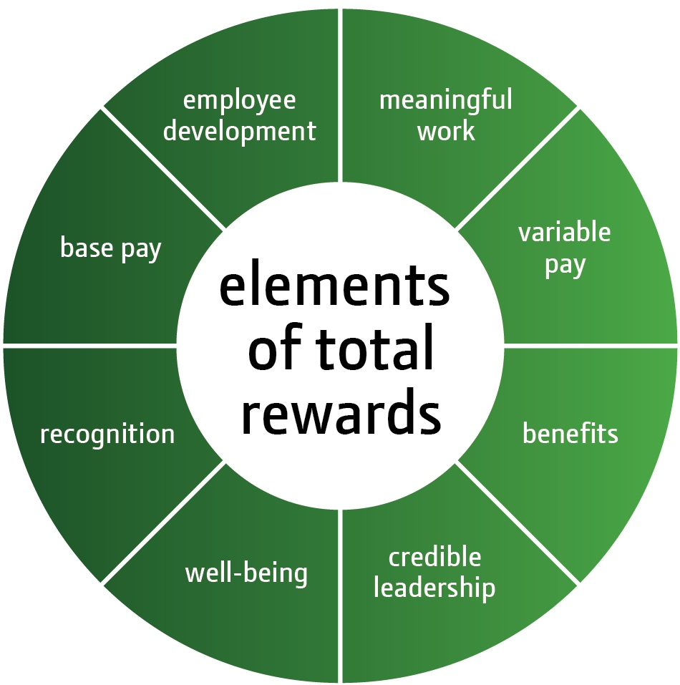
Total rewards
You share in rewards that are created by exceptional company performance
Notes:
Total rewards aligns with our company strategy, fostering a high-performance environment by rewarding employees for helping to achieve our company objectives. Our total rewards allow us to attract, develop and retain the best global talent from all backgrounds to support our global growth ambitions while maintaining strong company performance.
Note to speaker:
The rest of this verbiage is temporary, for transition communications, and may be removed after that.
Some of the elements of total rewards have changed from what you may have seen in the past. Some elements have been renamed and one element, credible leadership, has been added. Let’s take a look at how each of these elements is defined.
Additional note to speaker: These are the changes that were made to total rewards:
- Challenging work changed to meaningful work
- Work-life management changed to well-being - John Deere affiliation was removed (included in Who We Are piece of EVP) - Credible leadership was added

Slide 3

Base pay
One element of your total compensation
Fixed salary you receive in exchange for your contributions
Impacted by your performance
Accounts for internal and external equity
Competitive in each market
Notes:
Base pay is one element of your total compensation. It is the fixed salary you receive in exchange for your contributions and is impacted by your individual performance. Base pay supports our total compensation philosophy of paying for performance. It accounts for both internal and external equity.
We regularly measure the market by comparing pay with select companies that are in industries similar to John Deere. This includes both direct competitors and companies we compete with for talent. We align our base pay to the middle of what the market pays. By regularly monitoring the market and adjusting our compensation, we ensure we have an attractive and competitive base pay package.
Base pay along with variable pay allow us to offer an exceptional total compensation package when company performance is exceptional.

Slide 4

Employee development
We are committed to helping you reach your fullest potential
Development opportunities, training, coaches and other resources are available
Managers and employees share responsibility for development
Notes:
At John Deere, we are committed to helping you reach your fullest potential. We provide development opportunities, training, coaches and other resources to help you manage your career and advance as fast and as far as your experiences, competencies and ambitions allow.
Employee development is a shared responsibility between employees and their managers.
Employees are encouraged to develop themselves through their daily work, training, developmental assignments, and education. Internal development opportunities, such as participating in an employee network group, can foster your personal growth and broaden future opportunities. External development opportunities, such as volunteerism, can also supplement your professional development.
Managers are also responsible for providing coaching, feedback and recognition , as well as actively supporting employees’ personal and career development efforts. They are held accountable for this through our people component in Global Performance Management.
Developing and promoting talent within the organization ensures that employees are surrounded by exceptional team members.
As John Deere continues to grow globally, so will opportunities for personal growth and professional development.

Slide 5

Meaningful work
As a John Deere employee, you:
are part of a diverse, global team that’s committed to supporting a higher quality of life around the world
are involved in decisions that affect your work
create annual goals that provide a clear link to the company’s objectives
are challenged by your work and know what it takes to succeed
Notes:
John Deere employees are committed to helping customers do their life’s work more profitably and more productively. They understand our business and find passion – and purpose – in doing meaningful work that supports a higher quality of life around the world.
As a John Deere employee, you are involved in decisions that affect your work and are trusted to make the choices and decisions necessary to do your job effectively. You work with your manager to establish annual goals, using the Global Performance Management system to record your progress. This includes both business goals and people goals that drive accountability for achieving business results while fostering a team-oriented, positive work environment. Our Global Performance Management process provides a clear link between your work, your manager’s expectations and the company’s objectives.
Our inclusive work environment welcomes diverse backgrounds, talents and perspectives and encourages effective teamwork. This puts the company in the best position to understand customer needs and create innovative products, services and processes.
As John Deere continues to grow and generate new global business opportunities, there will be even more opportunities for meaningful work. You are part of a global team that’s committed to making a difference in the lives of those linked to the land.

Slide 6

Variable pay
One element of your total compensation
Includes compensation elements such as annual cash bonuses, stock options and other longer-term cash awards that vary from year-to-year
Provides the potential for exceptional pay when company performance is exceptional
Notes:
Variable pay is one element of your total compensation. It includes compensation elements such as annual cash bonuses, stock options and other longer-term cash awards that vary from year-to-year based on company performance.
Variable pay supports our total compensation philosophy of paying for performance. When company performance is exceptional, you have the potential for exceptional pay through our variable awards.
By working as an aligned high-performance team, we can achieve and sustain high company performance and increase our potential for variable pay. We must be responsive to the local needs of our customers while holding steadfast to our core values.
Eligibility for certain variable pay elements is dependent on position within the company, market practices, and legal and tax issues within countries.

Slide 7

Benefits
Market competitive
Support your physical, emotional and financial well-being
Includes:
Insert country-specific benefits here
Notes:
Our philosophy on benefits is to be market competitive. Our benefits vary by country and market, depending upon what is market practice for employers to offer.
We offer a combination of benefits to help support your physical, emotional and financial well-being.
Note to speaker:
Each country will need to supply their own benefits in the speaker notes and on the slide.

Slide 8

Credible leadership
Have the knowledge and skills to advance our great company
Create a compelling vision for our future success
Communicate transparently, creating a climate of trust and respect
Support diversity and inclusion
Act with character and integrity, demonstrating our core values with their behavior
Notes:
Our leaders have the knowledge, skills and abilities to live up to the tremendous responsibility of advancing this great company.
They create a compelling vision that builds commitment and alignment within our organization and ensures the future success of our company.
They inspire and engage employees by communicating transparently and creating a climate of trust and respect.
They strive to incorporate diversity and inclusion into the workplace, community, and our dealers and suppliers, so they are reflected in everything the company does.
Our leaders act with character and integrity, demonstrating our core values with their behavior.
By requiring this type of leadership, we help create an environment that inspires trust, teamwork, and a reputation for integrity both inside and outside the company.

Slide 9

Well-being
Committed to your health and safety, on and off the job
Work environment recognizes your personal and family commitments at different stages in life
Health, safety and work-life resources are provided in an effort to have the healthiest and safest employees in the world
Notes:
At John Deere, we are committed to the safety and overall well-being of our employees.
We encourage you and your family to be healthy and safe, both on and off the job. We also strive to create a work environment that recognizes your personal and family commitments at different stages in life.
To support this, we offer you and your family health, safety and work-life resources in an effort to have the healthiest and safest employees in the world.
Our focus on well-being is part of the way we operate – and essential to our success.

Slide 10

Recognition
Actions that lead to exceptional performance are valued and recognized
Recognition is foundational to a strong manager-employee relationship
Recognition leads to strong individual performance and aligned high-performance teamwork
Notes:
We are committed to building an environment where actions that lead to exceptional performance are valued and recognized.
Recognition is foundational to a strong manager-employee relationship. Managers must recognize employees for their accomplishments and celebrate actions that represent reasonable risks – even when they’re not always successful. When combined with pay for performance, formal and informal recognition lead to strong individual performance and aligned high-performance teamwork which are critical to accomplishing our business objectives.

Slide 11
Total rewards
The value of total rewards is unique to the individual
Total rewards includes common enterprise elements and regionally or locally customized elements
Notes:
The previous slides provided a brief description of each of these elements. While there are several elements of total rewards, the value that each of us perceives is as unique as the individual. The framework of total rewards provides a global platform but may vary to reflect regional or local differences.
Note to speaker:
The rest of this verbiage is a temporary message for 2011 and may be removed after that.
More detailed information about each of the elements will be available in separate slide decks in the coming months.

Slide 12
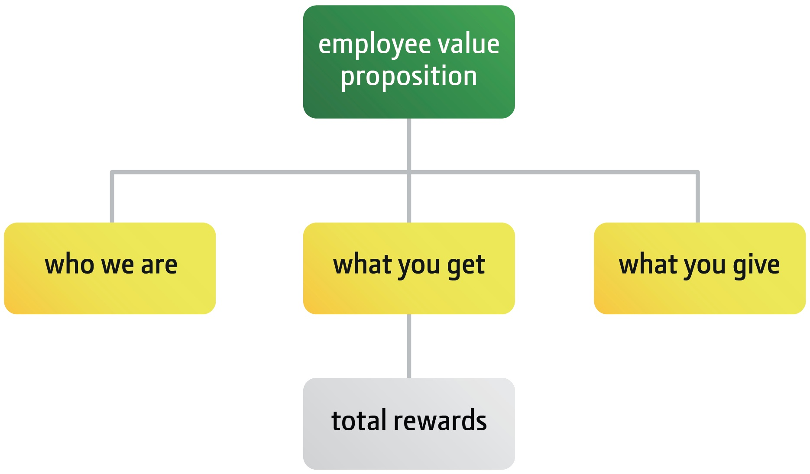
Employee Value Proposition (EVP)
Notes:
Total rewards is a key component of our Employee Value Proposition (EVP). An EVP is what is offered by an employer in exchange for the productivity and performance of an employee.
The elements that make up John Deere’s EVP can be organized into three main categories: Who We Are, What You Get and What You Give. Total rewards is the What You Get component of EVP.
In exchange for what you give, you get a comprehensive set of rewards to support your well-being.

Slide 13
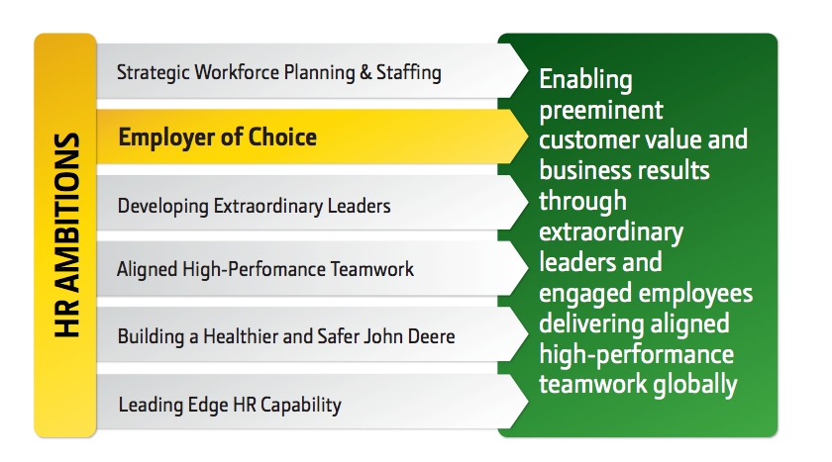
Our ambitions regarding employees
Notes:
Our Employee Value Proposition will help us become and remain an Employer of Choice which is part of our long-term HR strategy. This in turn supports one of John Deere’s critical success factors: Growing Extraordinary Global Talent. This means supplying our businesses with the right talent at the right time to meet our ambitious global growth goals.

Slide 14
Summary
Notes:
In summary, we are proud to offer a very comprehensive rewards package to our employees, who are a key part of achieving the company’s success.
Total rewards aligns with our company strategy, supporting a high-performance environment by rewarding employees for helping achieve our company objectives. They allow us to attract, develop and retain the best global talent from all backgrounds to support our global growth ambitions and achieve high company performance.
If you have questions about your total rewards, you can contact your manager or unit HR.
By working together and sharing in the rewards that are created by exceptional company performance, we can help meet the world’s growing need for food and infrastructure.
Note to speaker: You may choose to share additional resources you currently have that are available to employees, for example, an online Total Rewards statement.

Slide 15
Notes:
15

