Slide 1

Variable Pay: An Overview
Notes:
The intent of this presentation is to provide education to employees about variable pay, which is one element of Total Rewards.
Note to speaker: Due to the subject matter, it is recommended that unit HR conducts this presentation. If not, it would be helpful to have a unit HR person present to help answer employee questions during the meeting.
Some of the slides include “Additional Info”. It is up to the speaker as to if they wish to share this detailed information, depending on their audience or the questions they receive.
There is also a reference section with examples and specific information. It is recommended that the speaker familiarize themselves with the information provided in the reference section so that they can use the additional slides, if appropriate, for their audience.

Slide 2

Objectives
Understand:
John Deere’s compensation philosophy
Variable pay depends on company performance
Components of variable pay
Your role and responsibilities
Notes:
The objectives of the variable pay module are for you to be able to understand John Deere’s overall compensation philosophy, how variable pay depends on company performance, the components of variable pay and to define your role as an employee or a manager.

Slide 3
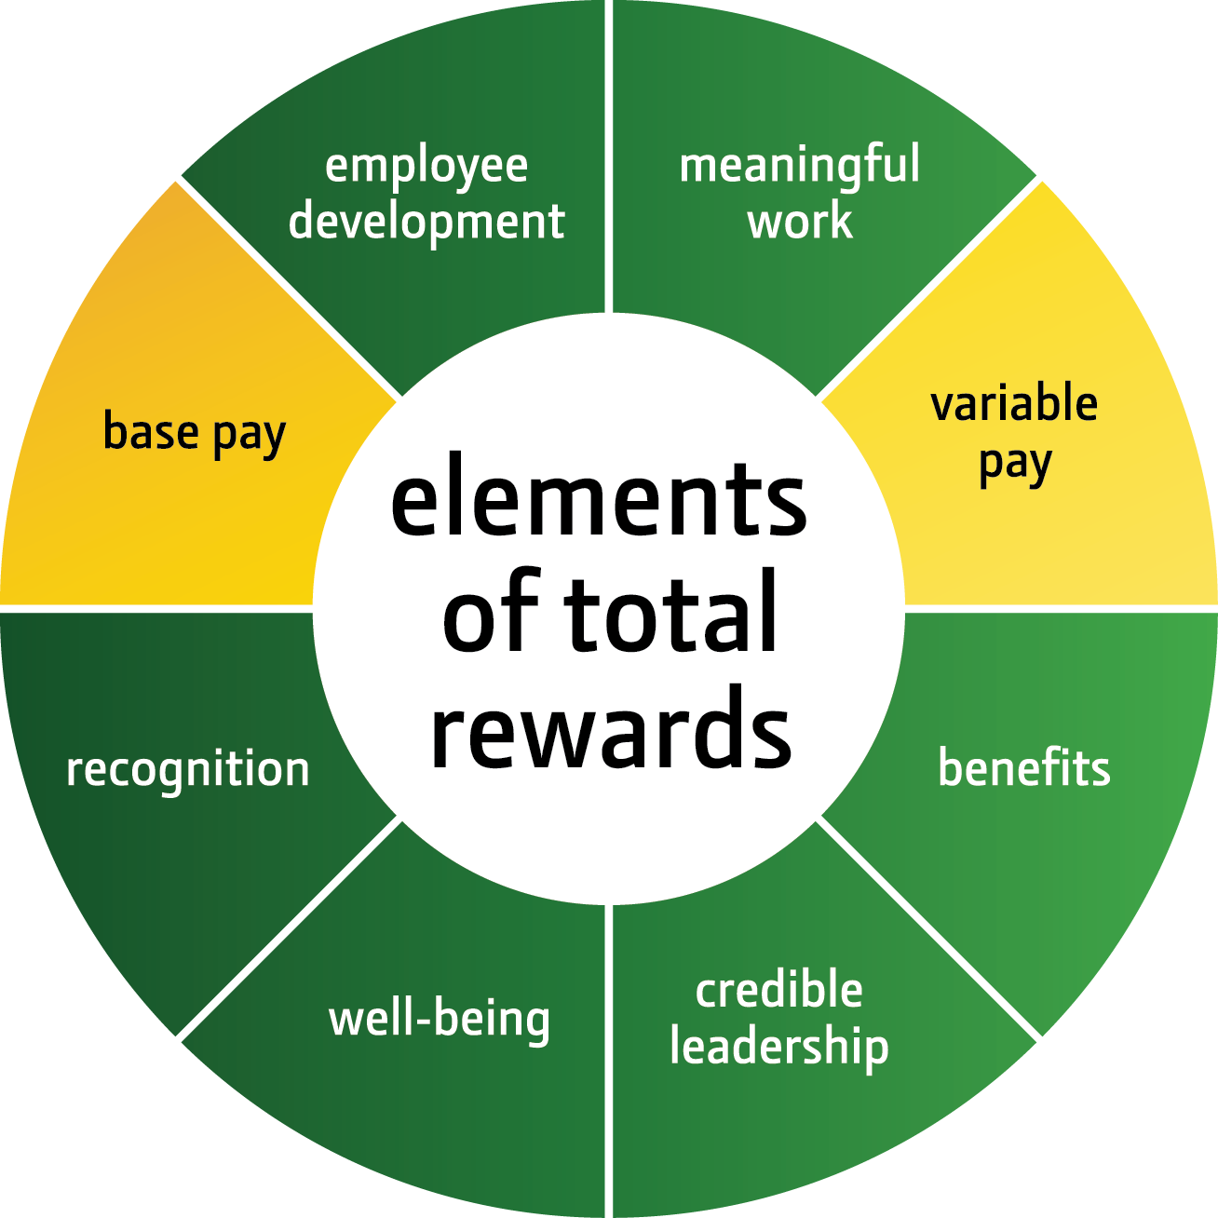
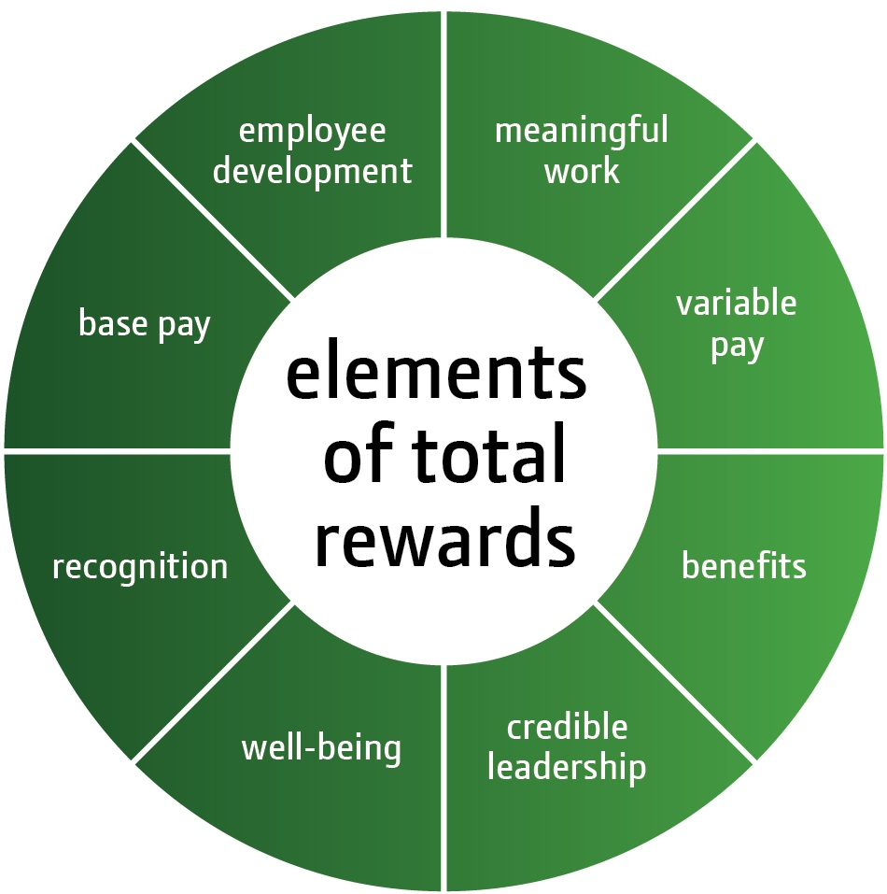
Total Rewards
You share in the rewards that are created by exceptional company performance
The value of Total Rewards is unique to the individual
Total Rewards includes common enterprise elements and regionally or locally customized elements
Notes:
(Note to Speaker: this is a build slide)
Our total compensation is part of our Total Rewards.
(CLICK) Our Total Rewards includes monetary and non-monetary rewards to support your physical, emotional and financial well-being.
(CLICK) As a John Deere employee, you share in the rewards that are created by exceptional company performance. Our Total Rewards helps create a higher performance culture and rewards you for helping achieve our company objectives.
(CLICK) While there are several pieces to Total Rewards, the value each of us perceives is as unique as the individual. The framework of Total Rewards provides a global platform with some common enterprise elements and some regionally or locally customized elements.
As you can see, some of the elements of Total Rewards have changed from what you have seen in the past. Some of the element names have changed, some elements have combined and one element, credible leadership, has been added. More detailed information about Total Rewards will be available in the next few months.
Our Total Rewards allows us to attract, develop and retain the best talent from all backgrounds to support our global growth ambitions and achieve higher company performance.
(CLICK) For today’s presentation, we’ll talk about our total compensation.
(Additional Info: Here is a brief description of each of the Total Rewards elements.
Employee Development - We provide development opportunities to help employees advance as fast and as far as their ambitions, skills and competencies allow.
Meaningful Work - We encourage an environment where employees are challenged by their work and know what it takes to succeed. Variable Pay – Our “pay for performance” philosophy rewards employees for their contribution toward overall company performance. Benefits – Our benefits are market competitive and support our commitment to the security and well-being of our employees. Credible Leadership - Our leaders strive to ensure their actions are consistent with their words and respond to employee feedback. Well-Being - We offer programs and resources to encourage your well-being inside and outside of work. Recognition - We value recognition as foundational to strong individual performance and aligned high-performance teamwork. Base Pay - We offer competitive base pay.)

Slide 4
Total Compensation
Our total compensation consists of two components:
Base pay
Variable pay
Short-Term Incentive (STI)
Mid-Term Incentive (MTI)
Long-Term Incentive (LTI)
Notes:
Our total compensation consists of two components:
Base pay and
Variable pay, which consists of:
Short-Term Incentive,
Mid-Term Incentive, and
Long-Term Incentive.

Slide 5

John Deere Compensation Philosophy
Pay for Performance
Individual performance impacts base pay
Company performance impacts variable pay
Notes:
Our total compensation philosophy is to pay for performance. This philosophy is used throughout the company to reward employees in alignment with company and individual performance. Your individual performance impacts your base pay, while variable pay depends on company performance.
How this compensation philosophy is implemented depends on the market, employment law, and sometimes cultural practices. Our goal is to be competitive in each respective market, so we align our base pay to the middle of what the market pays. We have designed our variable pay plans to deliver additional compensation when company performance is strong. When maximum variable pay goals are achieved, total compensation is paid at the top of the market.
For both base and variable pay, we regularly monitor the market and adjust our compensation practices based on market conditions.
In this module, we will concentrate on the variable pay portion of your total compensation.

Slide 6
John Deere Compensation Philosophy
Company Performance
Total Compensation
Base Salary
Variable Pay
Notes:
This chart illustrates how our total compensation increases as we achieve and exceed our business goals. The green bar represents our base pay, which aligns to the market and is not impacted by company performance.
The yellow bars depict our variable pay. As you can see, more money is awarded through variable pay when the company achieves its business goals.
This is pay for performance.

Slide 7

Variable Pay

Slide 8
Variable Pay
Variable pay is based on company results, which are influenced by our collective employee efforts.
Positive Employee Performance
Positive Company Performance
Better Variable Pay Awards
There is a potential for exceptional pay when company performance is exceptional.
Notes:
Variable pay is based on company results, which are influenced by our collective employee efforts. By working as an aligned, high-performance team, we can achieve higher company performance and increase our potential for variable pay.
When our company performance is exceptional, we have the potential for exceptional pay through our variable pay awards.
Since our variable pay program was introduced, employees have often received maximum or near-maximum bonuses due to achieving our business goals.

Slide 9
Variable Pay
Variable pay plans and employee eligibility are based on market data
Non-Management
Management
Base Pay
Variable Pay
Senior Management
Notes:
Market data collected from other companies in similar industries and geographic locations is used to determine John Deere’s variable pay rates as well as the level of employees eligible for the variable pay plans.
As you can see in the illustration, in keeping with market practice, a larger portion of management’s compensation is tied to variable pay. This means they have more compensation at risk if the company does not achieve its objectives.

Slide 10
Three Variable Pay Plans
Plan | Salary Grade Eligibility | Objective
Short-Term Incentive (STI) Cash Incentive | 1+ | Rewards higher operational performance for a fiscal year
Mid-Term Incentive (MTI) Cash Incentive | 8+ | Rewards profitable growth that is sustained over multiple fiscal years
Long-Term Incentive (LTI) Stock Options or Stock Appreciation Rights | 12+ | Focus on making John Deere an attractive investment for shareholders
Notes:
There are three variable pay plans that are designed to reward an appropriate balance of compensation based on short and long-term business results. Our variable pay plans are part of our competitive pay package. These plans provide an opportunity for you to receive exceptional pay when compared to the market. Our variable pay is just one of our offerings to attract and retain diverse top talent.
STI is an annual cash incentive for most salaried employees that rewards higher performance through operating efficiencies during a fiscal year. Minimum company performance levels must be met for an STI award to be paid.
MTI is a cash incentive for salary grades 8 and higher that rewards profitable growth that is sustained over multi-year periods.
LTI is primarily stock options or stock appreciation rights and provided for salary grades 12 and higher with a focus on making John Deere an attractive investment for shareholders.
(Additional information: The salary grade eligibility shown on this slide for STI and MTI is generally true, however, there are some exceptions at some units due to country or market practices, as well as contractual considerations.)

Slide 11
STI
STI
Notes:
Note to Presenter: For audiences that prefer more detail and examples, slides 15-17 may be replaced by slides 39-41 in the reference materials.

Slide 12
Short-Term Incentive (STI) Objectives
Reward employee contributions in operating efficiency and effective use of assets
Align an element of variable pay with annual company performance
Notes:
STI is meant to:
reward employee contributions in operating efficiency and effective use of assets, and
align an element of variable pay with annual company performance.

Slide 13
STI Award Calculation
Use this formula to calculate your STI bonus:
Company Performance
(as % of Target)
x
STI Target Rate
(for your grade)
x
Eligible Earnings
(for the fiscal year)
Notes:
This slide shows you the formula used to calculate your STI bonus amount.
Company Performance as % of Target is a percentage calculated at the end of the year. It can range from 0-200%.
A target award is equal to 100%
A maximum award is equal to 200%
We will talk more about more about company performance on the next slides.
The STI target rate for your grade is available from your unit HR representative.
(Additional Info: For most employees, their STI target rate will be provided along with their 2011 merit statement.)
For most employees, eligible earnings represents the base salary an employee earned in the fiscal year.
These three numbers are multiplied together to arrive at your STI bonus amount.
(Additional Info: If you change grades during the fiscal year, the calculation uses your eligible earnings and target rate for each grade during the fiscal year. In other words, the STI award is prorated for your grade and earnings throughout the fiscal year. Employees who retire will receive an STI award amount based on their eligible earnings during the year they retired.)

Slide 14

STI Metrics
Operating Return on Operating Assets (OROA):
Measures how profitably and effectively the equipment divisions use their assets
Return on Equity (ROE):
Used by financial services industry and measures the level of profitability relative to investment
Notes:
(Note to Speaker: This is a build slide)
Company performance is the first variable of the formula we use to calculate your STI bonus amount. It is determined by achieving goals against two metrics: Operating Return on Operating Assets and Return on Equity.
(click) Operating Return on Operating Assets (OROA) is a metric that measures how profitably and effectively the equipment divisions use their assets
(Additional info: The OROA formula is: operating profit ÷ average assets with inventory at standard cost (expressed as a percentage)) See example in Reference section
(click) Return on Equity (ROE) is a metric used by the financial services industry to measure the level of profitability relative to investment
(Additional info: The ROE formula is: Credit net income ÷ average equity (expressed as a percentage)) See example in Reference section
(Additional Info: In the event of an acquisition where goodwill exceeds $50 million, goodwill is excluded from OROA or ROE for two years to allow time for integration of the new business)

Slide 15
OROA Goals for Equipment Operations
The OROA goals for the fiscal year depend on the level of sales volume for that year.
Goals at Peak
28%
Goals at Mid-Cycle
OROA
20%
20%
Goals at Trough
12%
12%
12%
8%
8%
4%
% of Mid-Cycle = Actual Sales
Mid-Cycle Sales
Notes:
(Note to Speaker: This is a build slide)
The OROA goals for the fiscal year depend on the level of sales volume for that year. This allows the potential for STI bonuses to be paid out even when sales are low. This chart illustrates how OROA goals are adjusted for various sales levels.
Let’s start with the horizontal axis.
(click) The percent of mid-cycle is calculated by dividing actual sales by mid-cycle sales. Mid-cycle sales are the expected average, annual net sales generated over a typical business cycle. Each year, our company reviews our mid-cycle sales, taking into consideration historical sales volumes, industry growth rates, market share data and other business strategies.
(click) The vertical axis represents Operating Return on Operating Assets. This is the STI metric used to measure the equipment division performance.
(click) When actual sales are equal to mid-cycle sales, OROA goals at mid-cycle are 20% to receive a maximum STI payout, 12% to receive a target payout and 8% to receive a minimum payout
(click) Because equipment business volumes are cyclical, the OROA goals will vary based on actual sales. When actual sales are low, it is more difficult to cover fixed costs and achieve high asset turnover, so OROA goals are lower. When actual sales are high, it is easier to cover fixed costs and achieve a high asset turnover, so OROA goals are higher.
(click) The potential for a maximum STI award is possible at every level of sales volume, whether actual sales are at trough (the bottom line on the chart), at mid-cycle or at peak (the top line on the chart). The same OROA goals are used for A&T, C&F and the Equipment Operations.
Now that we’ve talked about OROA goals, let’s cover ROE goals.
(Additional Info: This same slide with an example is included in Reference section)

Slide 16
ROE Goals for Credit Operations
ROE goals differ based on business segments
Business Segment | Receivables resulting from… | Minimum | Target | Maximum
Transfer Priced | equipment division sales with finance incentive programs | 10% | 10% | 10%
Non-Transfer Priced | equipment sales that do not have a finance incentive program as well as receivables from other finance products such as wholesale, crop insurance and the Farm Plan revolving credit program | 10% | 13% | 16%
Notes:
Return on Equity is a metric used by the financial services industry to measure the level of profitability relative to investments. There are unique ROE goals for the different business segments in the financial services division because the level of return is different.
Transfer Priced Business refers to the receivables resulting from equipment division sales with finance incentive programs. This is about 70% of Credit’s business. The ROE goal is the same for minimum, target and maximum because these are receivables purchased from the equipment divisions.
Non-Transfer Priced Business refers to receivables resulting from equipment sales that do not have a finance incentive program as well as receivables from other finance products such as wholesale, crop insurance and the Farm Plan revolving credit program. This is about 30% of Credit’s business. The ROE goals are different for minimum, target and maximum because this business offers an opportunity for higher level of return.
ROE goals for minimum, target and maximum payout are determined based on the actual mix of the segments for the fiscal year.
(Additional Info: For a more detailed explanation with an example, see Reference section)

Slide 17
STI - Award Calculation Example (in U.S. dollars)
Company Performance (as % of Target) X | 200% Maximum | 125% Above Target | 100% Target | 75% Below Target | 0% Minimum
STI Target Rate (for your grade) X | 5% | 5% | 5% | 5% | 5%
Eligible Earnings (for the fiscal year) = | $40,000 | $40,000 | $40,000 | $40,000 | $40,000
STI Award | $4,000 | $2,500 | $2,000 | $1,500 | $0
Notes:
This slide shows you how various levels of company performance can affect your STI award. In this example, the employee’s STI target rate is 5% and has $40,000 in eligible earnings for the fiscal year. If company performance was at maximum, or 200%, the STI award would be $4,000. If company performance was at 100%, a target STI award would be $2,000. If the company did not achieve any of the OROA or ROE objectives for the year, no STI award would be paid.

Slide 18
STI – Enterprise Metric
Enterprise Metric Components | Award Weighting
Equipment Operations OROA* | 50%
A&T OROA | 25%
C&F OROA | 15%
Credit ROE | 10%
Company Performance (as % of target)
Ranges between 0% and 200%
A target award = 100%
A maximum award = 200%
*Equipment Operations OROA consists of the combined results of Ag & Turf and C&F
Notes:
(Note to Speaker: This is a build slide)
The OROA results for the equipment divisions and the ROE results for Credit are combined using the weighting in the enterprise metric.
(click) The weighted combination is added together and results in a percentage that represents Company Performance (as % of target). It can range between 0% and 200%. If the company performance as % of target is 100%, then a target award is provided. A maximum award is equal to 200%.
As a reminder, the enterprise metric will be used to calculate company performance for all employees. Therefore, transferring to a different division will not affect your STI bonus.
(Additional Info: Where the enterprise metric does not apply:
The STI for JD Landscapes employees contains 70% weighting of Landscapes operating profit and 30% enterprise metric
Employees in Greeneville covered under a local plan
Sales employees at Water units (except India))

Slide 19
MTI
MTI

Slide 20
Mid-Term Incentive (MTI) Objectives
Reward sustainable, profitable growth
Acknowledge leadership and management contributions in the growth and success of the company
Notes:
MTI is a cash award that supports the company’s compensation philosophy of providing exceptional pay potential when we achieve profitable growth over multiple fiscal years. When combined with other elements of compensation, a target MTI award is designed to deliver total compensation that is significantly above average (75th percentile of market).
In addition to rewarding sustainable, profitable growth, MTI acknowledges leadership and management contributions in the growth and success of the company.

Slide 21
MTI Eligibility
Must be in qualifying grade as of 30 September, at least 13 months prior to the end of the performance period.
Example:
Salary Grade 8 or above
By 30 September 2010
2011 MTI Eligibility
Notes:
Globally, most employees salary grade 8 and above are eligible for MTI.
An employee must be in grade 8 or above as of the eligibility date of 30 September, 13 months prior to the end of the performance period, and must be an active salaried employee on the last day of the performance period.
So to be eligible for an MTI payout in 2011, an employee must have been in grade 8 or above on 30 September 2010 and must still be active on 31 October 2011.
(Additional Info: Employees who retire, become permanently disabled or die during the last 13 months of the performance period will receive an MTI award if otherwise qualified.
For the performance period ending in 2013, there is a change for employees that retire, die or become disabled in the last 13 months of the performance period. More information is available in the Reference Section.)

Slide 22
MTI Performance Periods in Progress
Performance Period Ending in FY | Fiscal Years in MTI Performance Periods |  |  |  |  |  | # of Years in Performance Period | Potential Payout year
2011 | 2008 | 2009 | 2010 | 2011 |  |  | 4 | 2011
2012 |  | 2009 | 2010 | 2011 | 2012 |  | 4 | 2012
2013 |  |  |  | 2011 | 2012 | 2013 | 3 | 2013
4 Year Performance Periods in Progress
3 Year Performance Period in Progress
Notes:
This chart shows the performance periods currently in process. Beginning with the performance period that ends in 2013, we are transitioning from four-year to three-year MTI performance periods. The yellow shows the four-year performance periods currently in progress. The green shows the three- year performance period that just began in 2011 and has the potential to pay out in 2013.
(Additional Info: See reference section for SVA goals and accumulated SVA to date.)

Slide 23
MTI Award Calculation
Use this formula to calculate your MTI bonus*:
Company Performance
(as % of Target)
x
MTI Target Rate
(for your grade)
x
Salary Grade Midpoint as of 30 September (13 months prior to the end of the performance period)
*For performance periods ending in 2011 and 2012: If the total MTI payout to employees exceeds the maximum SVA pool to be shared, the total payout will be limited to the amount available in the SVA pool.
Notes:
This slide shows you the formula to calculate your MTI bonus amount.
Company performance as % of Target is calculated at the end of the performance period. It represents how the company performed against the Shareholder Value Added, or SVA, goals for the performance period. Company performance as % of target can range from 0 to 200%.
A target award is equal to 100%
A maximum award is equal to 200%
The MTI target rate for your grade is available from your unit HR representative.
(Additional Info: For most employees, their MTI target rate will be provided along with their 2011 merit statement.)
Unlike STI which is based on eligible earnings, MTI uses the midpoint of your salary grade to calculate the MTI award amount. The midpoint is for your grade as of 30 September, 13 months before the end of the performance period. This means that all employees who are in the same grade and salary structure on 30 September will receive the same MTI award amount.
These three numbers are multiplied together to arrive at your MTI bonus amount.
For the performance periods ending in 2011 and 2012, the pool-sharing concept is still in place. If the total MTI payout to employees exceeds the maximum SVA pool to be shared, the total payout will be limited to the amount available in the SVA pool. If total MTI payouts to employees are less than the maximum SVA pool, payouts will not be impacted by the pool size or the population.
(Additional Info: For 2011 and 2012, MTI bonus amounts will be calculated in U.S. dollars and are subject to fluctuations in exchange rates.)

Slide 24
MTI Metrics
Based on accumulated Shareholder Value Added (SVA) generated over multiple, consecutive fiscal years
Shareholder Value Added (SVA)
Measures company performance in terms of profit that exceeds cost of assets or equity
$1 Million SVA or greater = MTI Payout
Less than $1 Million in SVA = No MTI Payout
Notes:
Company performance is the first variable of the formula we use to calculate your MTI bonus amount. MTI is based on the company’s accumulated Shareholder Value Added, or SVA, that is generated over multiple fiscal years.
SVA is a metric used by John Deere to evaluate business results. SVA measures the company’s performance in terms of profit that exceeds cost of assets or equity. SVA encourages a disciplined focus on both income and assets.
If at least $1 million of positive SVA is generated over the multi-year performance period, an MTI payout is awarded. If not, an MTI payout is not awarded.
(Additional Info: See Reference section for SVA calculations for 2011, 2012 and 2013 and MTI goal information.)

Slide 25
MTI – Company Performance Example
(in US dollars)
SVA Goal for Target Payout | SVA Goal for Maximum Payout | Accumulated SVA | Company Performance (as % of Target)
$2 billion | $4 billion | $3 billion | 150%
$2 billion | $4 billion | $4 billion | 200%
Notes:
(Note to Speaker. This is a build slide)
SVA goals are determined at the beginning of the performance period and are aligned to the business strategy. As an example, if the SVA goal at target is $4 billion, then the SVA goal for a maximum payout is $4 billion. In this example, accumulated SVA for the performance period is $3 billion so company performance as a percent of target equals 150%.
(click) In the second example, accumulated SVA for the performance period is $4 billion. Company performance as a percent of target is 200%.
Company Performance as % of Target represents how the company performed against the goal. It is one of the variables used to calculate MTI award amounts.

Slide 26
MTI - Award Calculation Example (in U.S. dollars)
Company Performance (as % of Target) X | 200% Maximum | 150% Above Target | 100% Target | 0% Minimum
MTI Target Rate (for your grade) X | 4% | 4% | 4% | 4%
Salary Grade Midpoint as of 30 September (13 months prior to the end of the performance period) = | $60,000 | $60,000 | $60,000 | $60,000
MTI Award | $4,800 | $3,600 | $2,400 | $0
Notes:
This slide shows you how various levels of company performance can affect an MTI award. In this example, the employee’s MTI target rate for their grade is 4% and the salary grade midpoint is $60,000.
If company performance was at maximum, or 200%, the MTI award would be $4,800.
If company performance was at 100%, a target MTI award would be $3,600.
If the company did not accumulate at least $1 million in SVA during the performance period, an MTI award would not be paid out.

Slide 27
LTI
LTI

Slide 28
Long-Term Incentive (LTI) Objectives
Align higher level employees with interests of shareholders
Promote ownership interest in the company
Notes:
Long-Term Incentive (LTI) is primarily stock options.
The objectives of LTI are to:
Align our higher level employees with the interests of shareholders, and
Promote ownership interest in the company.
Additional Info: Due to regulatory issues, employees in China and Russia will receive Stock Appreciation Rights (SARs). SARSs function the same as stock options except SARs are settled in cash. References to stock options can be replaced with SARs throughout the presentation.

Slide 29
Long-Term Incentive (LTI)
Forward-looking award, typically delivered in stock options
Stock option: Right to buy company stock at the grant price
Base award value is aligned to the market and established by salary grade and structure
Managers can adjust award value to recognize individual performance
Grade 12 and above are eligible for LTI
Notes:
LTI is a forward-looking award which is normally granted in the form of stock options for most eligible employees. A stock option is the right to buy company stock at the grant price. Options vest over three years. After options vest, they may be exercised to in the form of shares or cash.
The base award value of LTI is aligned to the market and established by salary grade and structure. Managers can adjust the award value positively or negatively to recognize individual performance.
An employee must be a grade 12 as of 30 September and also be an active employee at the grant date to qualify.
(Additional Info: The grant date is one week after the first Board of Directors meeting in the fiscal year and typically falls in December. The Board of Directors Committee on Compensation must also approve the annual grant of stock options before awarding to employees. If the employee retires during the fiscal year following the grant, they will forfeit a pro-rated portion of their most recent award.

Slide 30
What is the Compensation Opportunity?
 | Example 1 | Example 2
# of Options Awarded | 1,100 | 1,100
Grant Price | $ 60 | $ 60
Current Stock Value | $ 80 | $ 55
Net Gain Per Share | $ 20 | $ 0
Net Gain for Employee (pre-tax) | $ 22,000 | $ 0
Notes:
Stock options are not an outright award of common stock, but an opportunity to purchase stock at a predetermined price during a certain timeframe. The compensation opportunity related to stock options depends on the current stock price compared to the grant price. If the stock price rises during a specified period of time, employees can exercise their options, which results in a pre-tax, net gain for the employee.
In example #1, the employee received 1,100 options at a grant price of $60. If the stock price rises to $80, the employee could choose to purchase 1,100 shares at $60 per share, then sell them for $80 per share. The net gain for the employee would be $20 per share or $22,000.
In example #2, if the stock price does not go above $60 during the specified period of time, there is no value for the employee.

Slide 31
Roles and Responsibilities
Roles and
Responsibilities
Notes:
Let’s talk about your role. You are part of a high performance team. As such, you have an effect on company performance and, in turn, your own compensation.

Slide 32

Your Role as an Employee
As a John Deere employee, it is your responsibility to:
Understand and contribute to company strategy
Understand your job grade, pay range, and compa-ratio
Increase efficiencies and reduce assets
Notes:
As a John Deere employee, you have certain responsibilities to:
Set aligned business and people goals so you will be better able to understand and contribute to company strategy,
Become more knowledgeable about your Total Rewards so you understand your job grade, pay range and variable pay opportunities, and
Increase efficiencies in your work and reduce assets. OROA, ROE and SVA are about being efficient in our operations so the improvements that you can make in your every day work will result in increased opportunities for variable pay awards.

Slide 33

The Manager’s Role
A John Deere manager’s responsibility is to:
Communicate business objectives
Share compensation information with employees
Assess employee performance fairly and objectively
Support employee development
Notes:
Managers at John Deere have a responsibility to:
Talk to their employees about business objectives so they can set aligned business and people goals in Global Performance Management,
Gain a better understanding of Total Rewards so they can initiate conversations with their employees about compensation,
Be fair and objective in the performance assessment of their employees, and
Encourage and support the development of their employees.

Slide 34
Summary
Summary

Slide 35
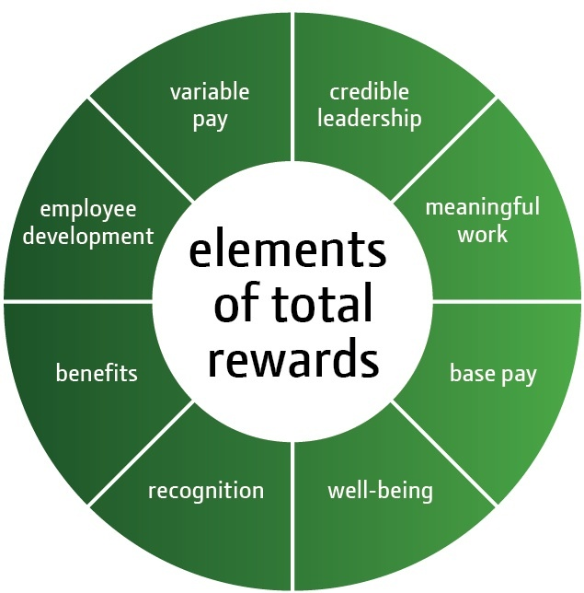
Summary
Variable pay is one element of our Total Rewards
Variable pay is dependent on company performance
Contact your manager or unit HR if you have questions about your variable pay
Notes:
Variable pay is one element of our global Total Rewards. The better the employee performance, the greater the company performance, the higher the variable pay awards. When the company achieves its maximum business goals, you receive more money through variable pay. When you combine this exceptional variable pay with base pay, your total compensation is exceptional when compared to the market.
By working together and sharing in the rewards that are created by exceptional company performance, we can help meet the world’s growing need for food and infrastructure.
If you have questions about your variable pay, please contact your manager or unit HR. (Note to speaker: You may choose to share additional resources you currently have that are available to employees, for example, an online Total Rewards statement)

Slide 36
Reference
Reference

Slide 37
STI - OROA and ROE Calculation
OROA Calculation for Equipment Operations
Operating Profit (Loss)
÷ Average Assets ⁽¹⁾ ⁽²⁾
As reported OROA
ROE Calculation for
Credit
Net Income (Loss) ⁽³⁾
÷ Average Equity ⁽²⁾
As reported ROE
⁽¹⁾ Includes inventory at standard cost
⁽²⁾ In the event of an acquisition where goodwill exceeds $50 million, goodwill is excluded for two years to allow time for integration of the new business
⁽³⁾ Attributable to Deere & Company

Slide 38
STI - Enterprise Metric
A&T Operating Profit + C&F Operating Profit
÷ A&T Average Assets + C&F Average Assets
Equipment Ops OROA
50%
A&T Operating Profit
÷ A&T Average Assets
A&T OROA
25%
C&F Operating Profit
÷ C&F Average Assets
C&F OROA
15%
Credit Net Income
÷ Credit Average Equity
Credit ROE
10%
Enterprise Metric for STI
Average assets include inventory at standard cost
In the event of an acquisition where goodwill exceeds $50 million, goodwill is excluded from average assets or average equity for two years to allow time for integration of the new business
Credit Net Income as attributable to Deere & Company

Slide 39
STI - OROA Goals for Equipment Operations (with examples)
The OROA goals for the fiscal year depend on the level of sales volume for that year.
Equipment Operations
Percent of Mid-Cycle: 95%
OROA: 16%
Result: Between Target and Maximum (171% of Target)
Goals at Peak
A&T
Percent of Mid-Cycle: 90%
OROA: 13%
Result: Between Target and Maximum (150% of Target)
28.00%
Goals at Mid-Cycle
OROA
20.00%
20.00%
Goals at Trough
12.00%
12.00%
12.00%
8.00%
8.00%
C&F
Percent of Mid-Cycle: 110%
OROA: 24%
Result: Maximum (200% of Target)
4.00%
% of Mid-Cycle = Actual Sales
Mid-Cycle Sales
Notes:
(Note to Speaker: This is a build slide)
The OROA goals for the fiscal year depend on the level of sales volume for that year. This allows the potential for STI bonuses to be paid out even when sales are low. This chart illustrates how OROA goals are adjusted for various sales levels.
Let’s start with the horizontal axis.
(click) The percent of mid-cycle is calculated by dividing actual sales by mid-cycle sales. Mid-cycle sales are the expected average, annual net sales generated over a typical business cycle. Each year, our company reviews our mid-cycle sales, taking into consideration historical sales volumes, industry growth rates, market share data and other business strategies.
(click) The vertical axis represents Operating Return on Operating Assets. This is the STI metric used to measure the equipment division performance.
(click) When actual sales are equal to mid-cycle sales, OROA goals at mid-cycle are 20% to receive a maximum STI payout, 12% to receive a target payout and 8% to receive a minimum payout
(click) Because equipment business volumes are cyclical, the OROA goals will vary based on actual sales. When actual sales are low, it is more difficult to cover fixed costs and achieve high asset turnover, so OROA goals are lower. When actual sales are high, it is easier to cover fixed costs and achieve a high asset turnover, so OROA goals are higher.
(click) The potential for a maximum STI award is possible at every level of sales volume, whether actual sales are at trough (the bottom line on the chart), at mid-cycle or at peak (the top line on the chart). The same OROA goals are used for A&T, C&F and the Equipment Operations.
(click) Now let’s look at an example. In the Ag & Turf division, the Percent of Mid-Cycle is 90% and the OROA is 13%. This results in performance between Target and Maximum or 150% of Target for this component of the Enterprise Metric.
(click) In C&F division, the Percent of Mid-Cycle is 110% and OROA is 24%. This results in performance at maximum or 200% of Target for this component of the Enterprise Metric.
(click) The combined results, reported as Equipment Operations, is at 95% of Mid-Cycle and OROA is 16%. This results in performance between Target and Maximum or 171% of Target for this component of the Enterprise Metric.
Now that we’ve talked about OROA components of the Enterprise Metric, let’s cover ROE goals.

Slide 40
STI - ROE Goals for Credit
ROE Goals
Minimum | Target | Maximum
10% | 10% | 10%
10% | 13% | 16%
% of Business
70%
30%
Transfer Priced Business
Non-Transfer Priced Business
Weighted Goals based on % of business | 10.00% | 10.90% | 11.80%
Example:
Actual ROE | Award Result | Results as % of Target
11.35% | Between Target and Maximum | 150%
Notes:
(Note to Speaker: This is a build slide)
Credit ROE or Return on Equity is a metric used by our financial services division to measure the level of profitability relative to investments.
(click) Transfer Priced Business refers to the receivables resulting from equipment division sales with finance incentive programs. This is about 70% of Credit’s business.
(click) Non-Transfer Priced Business – refers to receivables resulting from John Deere equipment sales that do not have a finance incentive program as well as receivables from other finance products such as wholesale, crop insurance and the Farm Plan revolving credit program. This is about 30% of Credit’s business.
(click) ROE goals differ for the transfer and non-transfer priced businesses because the level of return is different.
(click) Goals for minimum, target and maximum payout are determined based on the actual mix of transfer priced and non-transfer priced business at the end of the fiscal year. The ROE goal for Transfer-Prices business is the same for minimum, target and maximum because these are receivables purchased from the equipment divisions. The ROE goals for Non-Transfer priced business are different for minimum, target and maximum because this business offers an opportunity for higher level of return.
(click) In this example, the actual ROE is compared to the ROE goals to determine the result which is an award between target and maximum or 150% of target.

Slide 41
STI – Company Performance Example
Enterprise Metric Components | Award Result | Results as % of Target | Award Weighting | Weighted Award
Equipment Operations | Between Target and Maximum | 171% | 50% | 85.5%
Ag & Turf | Between Target and Maximum | 150% | 25% | 37.5%
C&F | Maximum | 200% | 15% | 30%
Credit | Between Target and Maximum | 150% | 10% | 15%
Company Performance (as % of Target) |  |  |  | 168%
Notes:
The OROA results for the equipment divisions and the ROE results for Credit are combined using the weighting in the enterprise metric. This percentage is the company performance and is one of the variables used to calculate the STI award. It can range between 0% and 200%. If the company performance as % of target is 100%, then a target award is provided. A maximum award is equal to 200%.
As a reminder, the enterprise metric will be used to calculate company performance for all employees. Therefore, transferring to a different division will not affect your STI bonus.
This slides provides an example that brings together all of the award results for the components of the Enterprise Metric. The results (as a percent of target) are multiplied times the weighting for each component to arrive at a weighted award. The sum of the weighted awards results in Company Performance of 168% as a % of target.
So as you can see in this example, the result is between target and maximum which aligns to the OROA and ROE performance. This is pay for performance.
Company Performance (168%) is one of the variables used to calculate the STI award.
(Additional Info: Where the Enterprise Metric does not apply:
The STI for JD Landscapes employees contains 70% weighting of Landscapes operating profit and 30% Enterprise Metric
Employees in Greeneville covered under a local plan
Sales employees at Water units (except Israel)

Slide 42
MTI – Additional Eligibility Criteria for Performance Period Ending in 2013
Retirements* between dates: No MTI
Retirements* after
30 April 2013:
Receive MTI
1 Nov
2010
30 Sept
2012
30 April 2013
31 Oct
2013
Beginning of performance period
Must be grade 8 or above
End of performance period
* Also applies to death and disability
Notes:
(Note to Speaker: This is a build slide)
Starting for the performance period that ends in 2013, employees must remain active through 30 April to quality for an MTI award. Let’s walk through an example for the performance period ending in 2013.
(click) To eligible for payout at the end of 2013, an employee must be grade 8 or above on 30 September 2012.
(click) An employee must still be active on 31 October 2013 at the end of the performance period.
(click) An employee that retires prior to 30 April 2013 will not receive an MTI payout at the end of the year.
(click) An employee that retires after 30 April 2013 will receive an MTI payout if one is earned.
This requirement also applies to death and disability.

Slide 43
MTI – SVA Goals
In millions of US dollars:
Plan Ending | SVA |  |  |  |  |  | Total accumulated SVA thru 2010 | SVA goal for maximum MTI payout | Average SVA goal per year | Maximum % SVA to be shared | Maximum SVA pool to be shared
 | 2008 | 2009 | 2010 | 2011 | 2012 | 2013
2011 | 1,850 | -98 | 1,770 | ?? |  |  | $3,522 | $4,150 | $1,038 | 4.0% | $166
2012 |  | -98 | 1,770 | ?? | ?? |  | $1,672 | $5,700 | $1,425 | 4.0% | $228
2013 |  |  |  | ?? | ?? | ?? | ?? | $4,930 | $1,643 | N/A* | N/A*
* The pool sharing concept is replaced by target rates by salary grade.
4 Year Performance Periods in Progress
3 Year Performance Period in Progress
Notes:
This chart shows the performance periods currently in process. Beginning with the performance period that ends in 2013, we are transitioning from four-year to a three-year MTI performance periods. For the fiscal years completed, the amount of SVA earned is shown along with the amounts accumulated through 2010.
The column “SVA goal for maximum MTI payout” are the SVA goals which have been approved for a maximum payout. The goals for a target payout are half of maximum. They are aligned with business strategies and represent the level of company performance required to deliver upper quartile compensation.
The column “Average SVA per year” equals the SVA goal divided by the number of years in the performance period. This allows for comparison of goals between performance periods of varying length. The level of stretch to meet our MTI goal, as reflected in this column, has increased to reflect our business growth strategies.
The last column is the maximum % of SVA to be shared x the SVA goal for the performance period.
(Explanation of the “N/A”)For the performance periods ending in 2011 and 2012, the pool-sharing concept is still in place. If the total MTI payout to employees exceeds the maximum SVA pool to be shared, the total payout will be limited to the amount available in the SVA pool. If total MTI payouts to employees are less than the maximum SVA pool, payouts will not be impacted by the pool size or the population.
For the performance period ending in 2013, the pool sharing concept is replaced by target rates by salary grade. The target rates will be measured on a regular basis to ensure MTI delivery remains aligned with our compensation philosophy.

Slide 44
MTI – SVA Calculation
Performance Periods Ending in 2011 and 2012:
Equipment Operations:
Operating Profit (Loss)
+ MTI Expense _________________________
Adjusted Operating Profit
- (Average Assets⁽¹⁾⁽²⁾x 12% Cost of Capital)__
SVA for MTI Bonus Purposes
⁽¹⁾ Includes inventory at standard cost
⁽²⁾ In the event of an acquisition where goodwill exceeds $0.5% of average assets (at mid-cycle in the year of acquisition), goodwill is phased in over 5 years to allow time for integration of the new business
⁽³⁾ Attributable to Deere & Company
Financial Services:
Net Income (Loss) ⁽³⁾
+/- Allowance for credit losses
+ MTI Expense_________________________
Adjusted Net Income
- (Average Equity⁽²⁾x ~18% Cost of Equity)__
SVA for MTI Bonus Purposes
Notes:
SVA for MTI calculation for performance periods ending in 2011 and 2012:
excludes the cost of MTI
cost of equity for Financial Services is 18%
in the event of an acquisition, goodwill is phased in goodwill over 5 years if exceeds 0.5% of average assets

Slide 45
MTI – SVA Calculation
Performance Period Ending in 2013:
Equipment Operations:
Operating Profit (Loss)
- (Average Assets⁽¹⁾⁽²⁾ x 12% Cost of Capital)____
SVA for MTI Bonus Purposes
Financial Services:
Net Income (Loss)⁽³⁾
- (Average Equity⁽²⁾ x ~15% Cost of Equity)____
SVA for MTI Bonus Purposes
⁽¹⁾ Includes inventory at standard cost
⁽²⁾ In the event of an acquisition where goodwill exceeds $50 million, goodwill is excluded from average assets or average equity for two years to allow time for integration of the new business
⁽³⁾ Attributable to Deere & Company
Notes:
SVA for MTI calculation for performance periods ending in 2013:
includes the cost of MTI
cost of equity is 15% for Financial Services
in the event of an acquisition, goodwill is excluded for 2 years if over $50 million

Slide 46
LTI – Number of Stock Options Calculation
Base Award Value | 18,000
Adjustment factor | X 110%
Adjusted Base Award Value | $19,800
Binomial Value for 8 December 2010 Award | ÷ 30%
Grant Price on 8 December 2010 | ÷ $60
Number of Options Awarded | 1,100
Base Award Value | 18,000
Adjustment factor | X 110%
Adjusted Base Award Value | $19,800
Binomial Value as of Grant Date | ÷ 30%
Grant Price as of Grant Date | ÷ $60
Number of Options Awarded | 1,100
Notes:
(Note to Speaker: There is animation on this slide)
The number of options awarded is determined by several factors.
(click) The base award value is determined using market data and the employee’s grade as of 30 September.
(click) The adjustment factor is used by managers to recognize performance, potential, or significant projects. In this example, a 10 percent adjustment was made resulting in the adjusted base award value.
(click) The binomial value is used to determine how much an option is worth on the date of the grant. It is calculated by an outside firm taking into consideration interest and dividend rates, stock volatility and terms of the award.
(click) The grant price is based on the average of the high and low stock price on the date of the grant.

Slide 47
Variable Pay – Metrics and Goals
Information about STI Metrics and Goals is available at:
http://jdonline.deere.com/humanresources/benefits/2011_sti_goal.html
Notes:
Note to Speaker– If your audience is appropriate, the link below includes MTI Metrics and Goals.
http://jdonline.deere.com/humanresources/benefits/2011_sti_mti_goal.html

