Slide 1
Overview Global Information Classification Policy
Rich Johnson – Director, Global Business Conduct Strategy

Slide 2
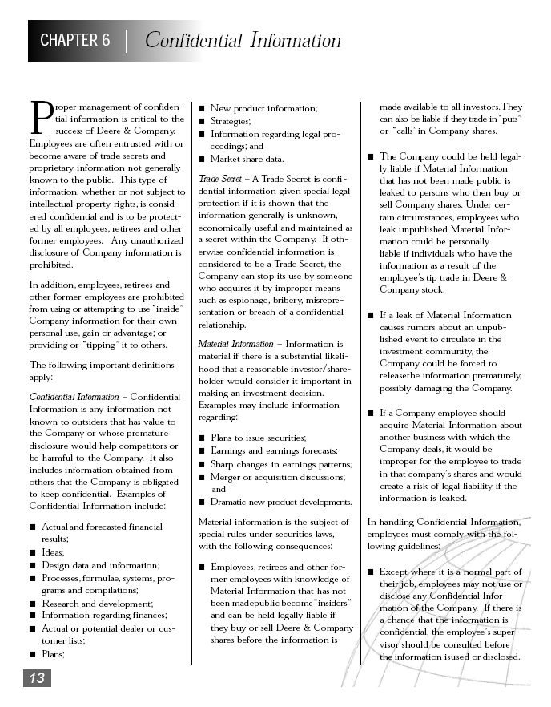
The Global Information Classification Policy
Proper management of confidential information is critical to the company’s success. Our company’s confidentiality policy is found in the Business Conduct Guidelines, Chapter 6 - Confidential Information.
The Global Information Classification Policy is intended to ensure compliance with Chapter 6 of the Business Conduct Guidelines.
Employees are often entrusted with proprietary, personal or other confidential information that is not known to the public.
At a minimum, unauthorized disclosure of this type of information can result in embarrassment to the Company and the individual involved and could be very costly to resolve.

Slide 3
The Global Information Classification Policy
The Details…
The Global Information Classification Policy has two components:
1) The actual Policy which includes:
an introduction
a brief policy statement
a description of the scope
an enforcement perspective
how to report violations
additional information/contacts
2) The Policy Matrix which is an easy reference chart that provides policy details for each classification including:
Definitions
Examples
Document Marking
Transmittal / Transport
Encryption
E-Mail
Secure Data Repository Requirements

Slide 4
Your responsibility: Under the Policy, protection of classified information is the responsibility of all employees, contingent workers, dealers, merchants and suppliers.. Examples of Information Covered by the Policy: Physical information such as letters, documents, memoranda, reports, records, forms, reproductions, drawings, photographs, slides, films, graphs, charts, microfilms and video recordings. Electronic information such as documents, e-mails, engineering or product related data, facsimiles, visual displays and electronic data storage devices such as flash drives, disks, CDs, DVDs and audio recordings. Oral information such as conversations and telephone calls.
The Global Information Classification Policy

Slide 5
The Global Information Classification Policy
Classification of Information Under the Policy:
Under the Policy, information will be classified according to the degree of confidentiality required to protect it. The four classifications are:
1. Restricted (the highest classification - critical information) Unless you are preparing board meeting information or handling a major merger or acquisition it is unlikely that you will come in contact with restricted information.
2. Personal & Confidential - (pertains to individuals – personal information)
3. Confidential – (pertains to business entities)
4. Unclassified - (routine information)
The classification level determines the appropriate marking, access, control, transmittal, encryption, storage and disposal procedures to be applied to the information.

Slide 6
The Global Information Classification Policy
Applying the Policy:
Marking, access, control, transmittal, encryption:
As you will learn, the Policy requires that classified information be protected from unauthorized disclosure through a series of steps such as marking, access control, transmission restrictions, encryption rules, etc.

Slide 7
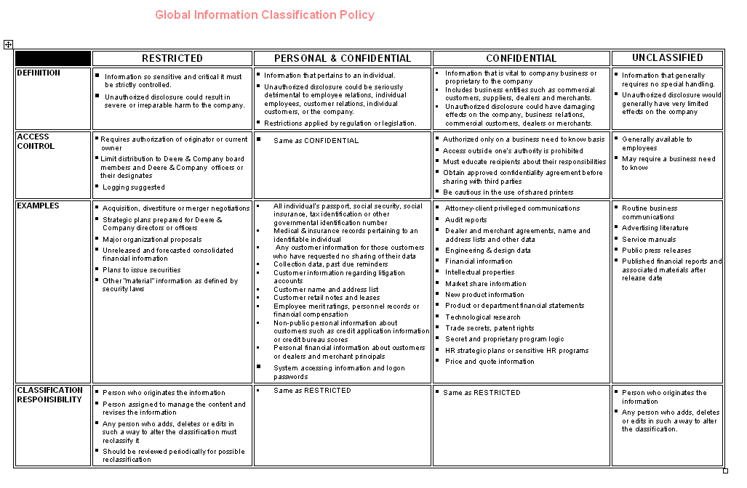
The Global Information Classification Policy
Let’s Look at the Policy Matrix:
What is the Policy Matrix?
The Policy Matrix is a quick reference chart included with the Policy where you will find definitions for each of the four information classifications. It also provides information on how you should treat information under each classification.
How should I use it?
The Policy Matrix is a practical guide that can be of assistance in applying the policy. It includes examples for each category of information and specific guidance in 11 key areas.

Slide 8
The Global Information Classification Policy
The Policy Matrix includes definitions for the 4 information classifications:
“Restricted” critical information that must be strictly controlled because unauthorized disclosure could result in severe harm to the company.
“Personal & Confidential” information relates to an individual. Unauthorized disclosure could be seriously harmful to an employee, a customer or the company.
“Confidential” information is vital to company business. It relates to business entities such as commercial customers, suppliers, dealers and merchants. Unauthorized disclosure could damage the company, business relations, commercial customers, dealers or merchants.
“Unclassified” information generally requires no special handling. Disclosure would not have a negative effect on the company.

Slide 9
The Global Information Classification Policy
The following are examples of the types of information that might be included in each category:
“Restricted”
acquisition negotiations
strategic long-range plans
financial forecasts or results
major organization proposals
“Confidential”
technological research
marketing information
Engineering/design data
trade secrets
intellectual property
certain legal information
financial information
audit reports
Proprietary program code
“Personal & Confidential”
merit ratings
personnel records
compensation records
Social Security Numbers
medical and insurance records
system access/logon information
personal customer information
“Unclassified”
Advertising literature
Press releases
Service manuals

Slide 10
The Global Information Classification Policy
Marking Requirements are Described in the Policy Matrix:
Electronic or paper documents sent or taken outside the Secure Data Repository (SDR) must be marked (or placed in a properly marked file folder) with the correct classification.
Each page of “Restricted” documents should be marked. Mark the front & back covers of all other classified documents.
Mark the outside of electronic media such as CDs & DVDs leaving the SDR.
Digital versions of stamps are available on the Center for Global Business Conduct website and can be “pasted” into Word and other documents. These digital versions are similar to the ones used here.
Physical stamps to mark paper documents will be provided as needed by your supervisor or may be ordered from the Center for Global Business Conduct website.

Slide 11

The Global Information Classification Policy
The Policy Matrix includes instructions on a number of other Policy related topics. Let’s look at some of the more important ones: Classification Responsibility: The responsibility to classify information and ensure that it is properly handled lies with those who create (or alter) it.
The person originating the information has the responsibility to classify it.
Any person altering the information has the responsibility to re-classify it.
Access Control: Access to information needs to be managed to ensure confidentiality according to the Policy.
Access restrictions vary based on the classification.
Access to “Restricted” information requires the authorization of the originator or current owner.
Access to classified information requires a business need to know.
Access to classified information outside one’s authority is prohibited.

Slide 12
The Global Information Classification Policy
More Policy Matrix topics:
Transmittal: The transmittal of all classifications of confidential information outside the SDR must be transmitted via secure methods.
Confidential information may not be transmitted or shared with others outside the SDR if doing so would violate corporate policy.
Electronic communication of classified information outside the firewall (i.e. to a non-John Deere domain name) is only acceptable when proper access control, confidentiality and information security measures are used, including encryption.
Enclose regular mailings in a sealed container or envelope. Mark with the appropriate classification and the phrase “To Be Opened by Addressee Only”.
Additional rules apply for “Restricted” materials (see the Policy Matrix for details).

Slide 13

The Global Information Classification Policy
More Policy Matrix topics:
Encryption: Encryption helps ensure confidentiality when communicating information electronically.
Encryption is required when transmitting classified e-mail outside of the company network (i.e. when transmitting materials outside the “firewall” such as to non-John Deere e-mail address).
In all cases company approved encryption technology must be used. PGP Universal software is one example of a company approved e-mail encryption solution that is currently in use.
Because laptop computer use often involves the transportation of classified data on laptop hard-drives, a laptop encryption tool should be used.

Slide 14
The Global Information Classification Policy
Additional E-Mail Information:
In addition to encryption, the Policy also requires that e-mail messages and attachments sent outside the “firewall” be marked as instructed by the Policy (e.g. “Confidential” in the subject field) and all e-mail message and attachments must contain an appropriate confidentiality disclaimer approved by the Law department. Approved disclaimers can be found at the following web link:
http://glsg.deere.com/compliance/disclaimers.html
Approved disclaimers vary depending on your job type and the nature of the information in the e-mail. Below is just one example of a particular type of email disclaimer. Remember that you should check the above web link to determine what disclaimer is appropriate for your individual job and situation.
CONFIDENTIALITY. This electronic mail and any files transmitted with it may contain information proprietary to Deere & Company, or one of its subsidiaries or affiliates, and are intended solely for the use of the individual or entity to whom they are addressed, shall be maintained in confidence and not disclosed to third parties without the written consent of the sender. If you are not the intended recipient or the person responsible for delivering the electronic mail to the intended recipient, be advised that you have received this electronic mail in error and that any use, dissemination, forwarding, printing, or copying of this electronic mail is strictly prohibited. If you have received this electronic mail in error, please immediately notify the sender by return mail.

Slide 15
The Global Information Classification Policy
Storage: All “Restricted”, “Confidential” or “Personal & Confidential” information must be physically or electronically protected from unauthorized access.
Laptops must be secured in locked storage at the end of the day. Properly secure all classified documents and materials after normal business hours.
Paper documents, flash drives, CDs, DVDs, disks and laptop computers must be kept in a physically restricted, locked storage container when not in use. Classified documents, data on electronic devices or the devices themselves may not be left exposed when unattended.

Slide 16
The Global Information Classification Policy
More Policy Matrix topics:
Oral Communication:
Outside the SDR, these communications must be conducted in such a manner that avoids overhearing or interception by unauthorized individuals.
Disposal:
The length of retention and proper disposal of company information (including the shredding of sensitive information) should be done in accordance with the corporate records management and disposition policies.
Please press space bar to continue.

Slide 17
The Global Information Classification Policy
Compliance With The Policy
Omissions or failures to properly classify and mark a document should be corrected Immediately.
Violations of the Policy leading to misuse or unauthorized disclosure of classified information may result in disciplinary action in accordance with applicable human resources policies as well as potential legal consequences (subject to applicable data privacy, confidentiality and employment labor law).
Violations should be promptly reported to your supervisor, unit management, or the Center for Global Business Conduct.

Slide 18
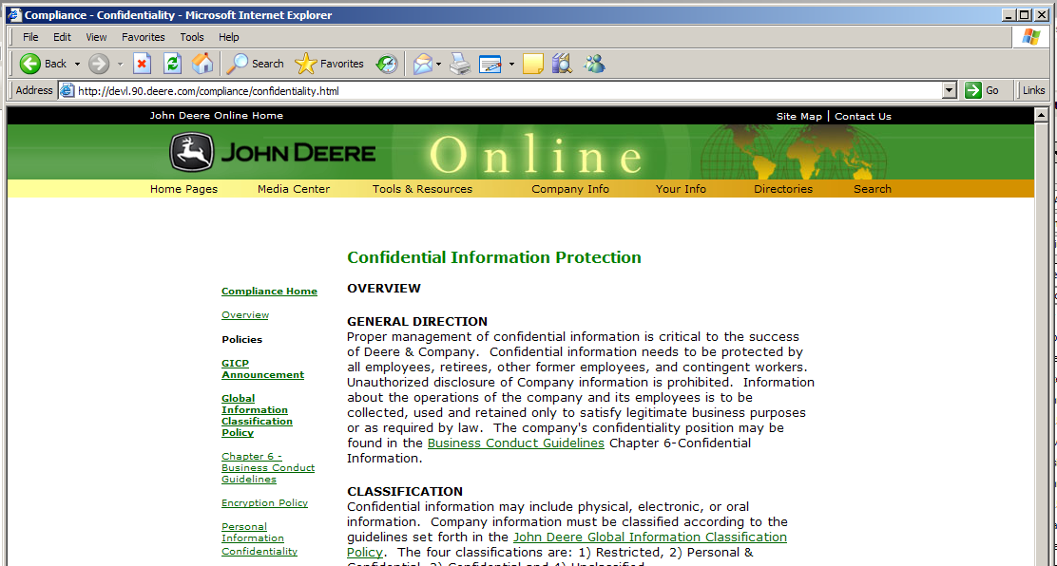
The Global Information Classification Policy
The Complete Policy:
A complete copy of the Policy and relevant general information, such as related policies, legal disclaimers for e-mail messages, etc. may be found on the Deere & Company Confidential Information website located at: http://glsg.deere.com/compliance/confidentiality.html

Slide 19


