Slide 1
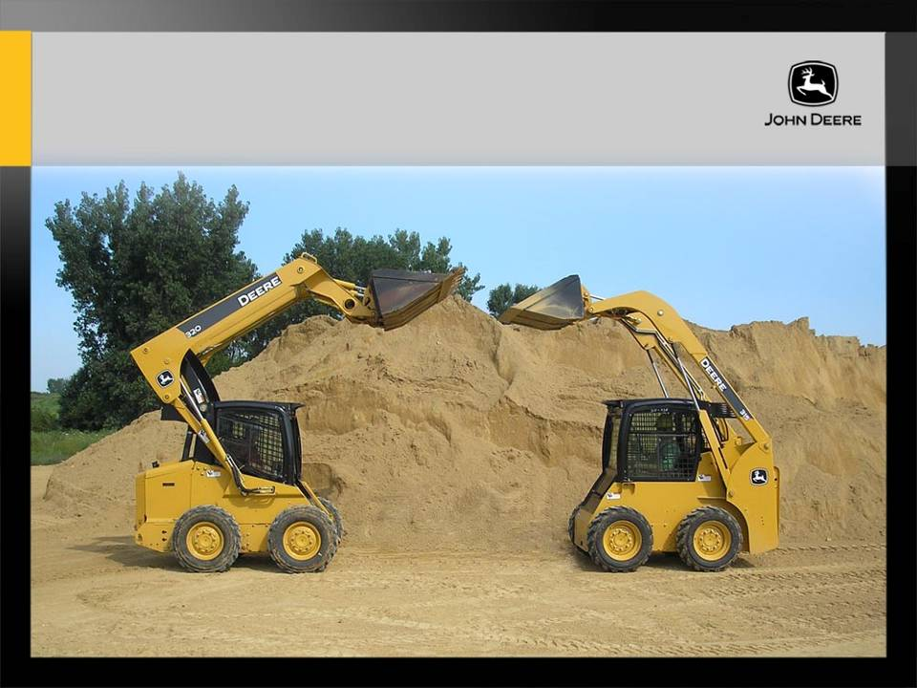
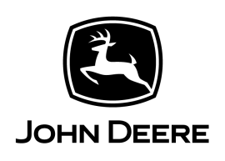
Vertical Lift vs. Radial Lift
Rated capacity,
max. reach
Minimum Reach
Bucket is the highest point in confined areas
Boom is the highest point in confined areas
Strong lift,
min reach
Rated capacity,
max. reach
Vertical
Lift and carry to truck bed height.
Dump in center of dump truck.
Radial
Confined quarters, dump in low
side trailer I.e.: manure spreader
Notes:
The linkage of the skid steer is the major difference between the radial and vertical lift machines.
Radial lift arms are connected to the machine with a single pin on each side. The radial linkage design keeps the load close to the machine when the load is near the ground, good for digging or prying and compactness when moving around a jobsite.
A radial lift also requires a longer bucket cylinder stroke to help overcome the radial arc lifting pattern. Because of this, a self-level option is much more common on radial lift machines.
On a vertical lift machine, the boom arms would be the first contact point when lifted into a ceiling. On a radial lift machine, the attachment would contact the ceiling first.

