Slide 1
ADAPTIVE SERIOUS GAMES:THE JOURNEY AND SOA APPROACH
Utilizing Service-Oriented Architecture for Enhanced Learning
DATE:17/07/24
PRESENTER:DEEPAK P

Slide 2
INTRODUCTION
The objective is used to showcase the use of Service Oriented Architecture (SOA) in the development of "The Journey," a serious game for teaching probability.
Here we will see
Benefits of adaptive features in serious games (SGs).
How SOA simplifies integration and enhances flexibility.
Future Direction for Serious game.
Conclusion.

Slide 3
COMPETENCE MODEL
Competence targeted
Probability Space
Probability of Mutually Exclusive Events
Probability of Non-Mutually Exclusive Events
Probability of Independent Events
Probability of Dependent Events

Slide 4
IMPLEMENTATION ARCHITECTURE
Overview:
SOA Approach: Local game with network-based adaptation service.
Game Platform: Flash Desktop Application on Adobe Air.
Database: Local SQLite database.
Service Interaction:
REST-based CbKST service for adaptation.
Asynchronous communication with performance metrics.

Slide 5
SYSTEM INTERACTION FLOW
Steps:
Player starts game and opens adaptation session.
Game requests tasks from service.
Service updates competence model based on player responses.
Game presents new tasks and continues until all competences are acquired.

Slide 6
ARCHITECTURE AND SERVICE INTERFACE
Components:
Game Controller
Service Connector
Database Connector
Internal Task Sequencer
Service Interfaces:
Manage game adaptation sessions
Assess competences

Slide 7
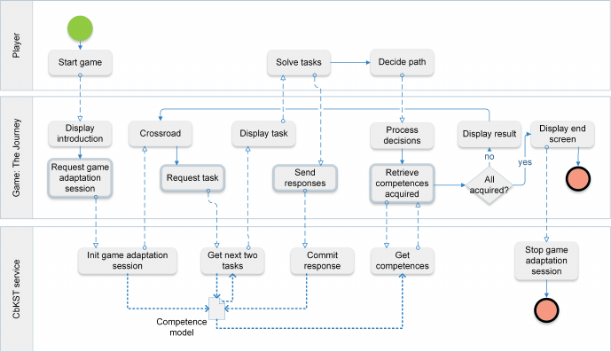

Slide 8
EVALUATION AND ATAM ANALYSIS
Quality Attributes:
Performance: Low network latency, minimal game disruption.
Availability: Backup task sequencer for offline play.
Modifiability: Flexibility in incorporating new task types.
Risks and Trade-offs:
Static service binding
Future developments and shared user profiles

Slide 9
BENEFITS OF SOA IN SG DEVELOPMENT
Increased Flexibility: Easier integration of adaptive features.
Reusability: Utilization of pre-existing services.
Reduced Development Time: Focus on specific game features and pedagogical content.
There are many benefits in this SG development using SOA but these are the major benefits.

Slide 10
FUTURE DIRECTIONS
Potential Developments:
Stealth Assessment: Detecting behaviors for competence evaluation.
Teacher Interfaces: Providing feedback and assessment tools.
Shared Competence Models: Integrating across multiple games and learning tools.

Slide 11
CONCLUSION
Conclusion
SOA enhances adaptability and efficiency in serious game development.
The Journey demonstrates successful application of SOA in educational games.
Future potential for expanding the ecosystem of services and capabilities.

