Slide 1
Complete the Outfit with Boosted Trees
SIGIR 2022
FARFETCH Data Challenge
David Albrecht

Slide 2
Summary
Results
Methodology // how did we get these results?
Practicality of Solution // can we deploy it?
Future Work // how can we do better?
Challenge Design

Slide 3
Results
20 LightGBM classifiers each trained on one of 20 disjoint data partitions, totaling the full training set
Final FITB: 0.764
Partition 1
Partition 2
Partition 3
Partition 20
. . . .
Model
1
Model
2
Model
3
Model
20
Test Set

Slide 4
Methodology
Assemble
Concatenate Fashion Outfits, Stage 1 test set, and Stage 2 test set. Note leakage, to be addressed in Challenge Design
Positive
Generate N-items positive labels per outfit by removing each item
Negative
Generate 20 random negative products per positive label
Process
Process Product Metadata and feature engineering
Model
Train models to predict the positive label given an incomplete outfit

Slide 5
Methodology (data)
All features were used in some way. Below are the most interesting:
Product Image Path: Split on the forward slash, one hot encode (although not relevant for real-world)
Product Highlights: Remove rare characters, keep tokens that appear >= 50 times, one hot encode
Product Short Description: Keep tokens that appear >= 50 times and are >= 2 characters in length, extract bigrams at a PMI threshold of >= 1, one hot encode
Product ID: One hot encode IDs that occur >= 149 times (99.5th percentile of occurrences in all outfits)
Image: 8x8 perceptual hash (no other image processing)

Slide 6
Methodology (modeling)
Encodings per product, for each incomplete outfit, were summed and treated as the “query” to remove product order
Encoding of the missing products were treated as the “answer”
20 models on 20 disjoint training partitions were trained to predict whether the answer and query combination complete the outfit or not as a binary classification problem
Parameters were LightGBM’s default parameters with exception of num_leaves (1,000) and n_estimators (1,000)
Predictions were made on the test sets by summing scores equally from all models
Notes:
Infographic showing query/answer procedure

Slide 7
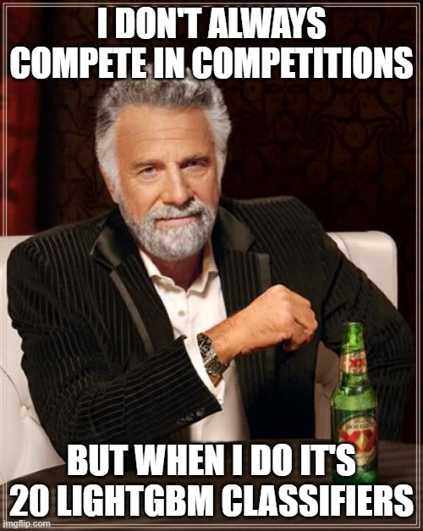
Practicality of Solution
Hardware: 50GB RAM, single P100 GPU on Google Colab
Latency: 20 models with 1,000 trees
each is likely not fast enough to serve users
Conclusion: This solution is
likely not easily production ready
Notes:
Ricky Bobby meme

Slide 8
Future Work
How might we increase performance?
Feature engineering:
Different bag-of-words scoring (TF-IDF)
Word and image embeddings such as from ResNet, BERT, CLIP, or Fashion CLIP
Product ID embeddings using Word2Vec, Matrix Factorization, candidate generator embedding process, etc.
More random, negative sampling (compute resources limited this)
Alternative sampling methods such as similar category sampling
How might we increase practicality?
Increase compute and train a single LightGBM model
Transfer learning with text and image embeddings, and a neural net based ranker such as a mixture of experts or multi-task

Slide 9
Challenge Design
Eval.ai has an interesting approach to competitions
No private leaderboard so didn’t need to actually create a model that generalizes. Just overfit to the final, public leaderboard
Distributions of product categories between train and test sets seemed very different
I had a hard time getting my local models to perform similarly online (>98% FITB offline on a held-out test set). Probably due to the random negative sampling strategy - clearly the process that generated the data was not random

Slide 10
Challenge Design
This challenge could have more closely aligned with the objective of generating outfits if candidates weren’t provided for contestants
Allowed for Stage 1 and 2 leakage (although didn’t increase FITB very much)
Candidate generation is a critical part of outfit generation from a large catalog
This challenge could be framed as a recommendation system for complementary products: Given N products, what are other products that would go with them?
Remove provided candidates
Use a ranked precision metric, like MAP@K, instead of FITB

Slide 11
Thank You
Questions?

