Slide 1

STM32L4xx Nucleo Consumption Measurements
V1.2 1st July 2015

Slide 2
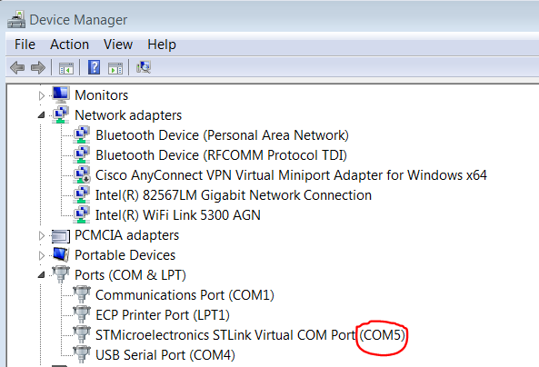
SW and Measurement description
The SW is based on HAL version from STM32CubeL4 FW V1.0.0
USART2 is connected to PC through ST Link
The below setup (it is normally the default on Nucleo board) must be done on Solder Bridges on back side of Nucleo board in order to connect USART to ST Link: (according p25 UM1724 Nucleo User Manual)
SB62, SB63 → OFF
SB13, SB14 → ON
- Also must make sure SB16 and SB50 are OFF (otherwise may see additional parasitic current on IDD )
GUI is run through TeraTerm Pro (UTF8 TeraTermPro v2.3)
We use default port setup (Baud Rate 9600, 8 bit, no parity, 1 bit stop, no flow control)
Command is set through the “Broadcast command window”
Need to configure the correct
COM port on hyperterminal setup
looking at PC Device Manager
Ex: COM5 on this example
Each time USB link is physically
de-connected, user needs to re-open
hyperterminal and select COM port !!
Notes:
313 et 383???

Slide 3
SW and Measurement description
Below tests can be selected:
0 (SHUTDOWN)
1 (STANDBY)
2 (STANDBY + RTC)
3 (STANDBY + RTC + SRAM2)
4 (STOP2)
5 (STOP2 + RTC)
6 (STOP1 + MR OFF)
7 (STOP1 + MR OFF + RTC)
8 (LPSLEEP 2MHz - FLASH off)
9 (LPRUN 2MHz - with FLASH ART ON)
10 (SLEEP Range 2, 24MHz - with FLASH ART ON)
11 (SLEEP Range 1, 80MHz - with FLASH ART ON)
12 (RUN Range 2, 24MHz - with FLASH ART ON)
13 (RUN Range 1, 80MHz - with FLASH ART ON)
Notes:
313 et 383???

