Slide 1
Parallel Tracking And Multiplo Mapping
Student: Daniel Palomino

Slide 2

PTAMM

Slide 3
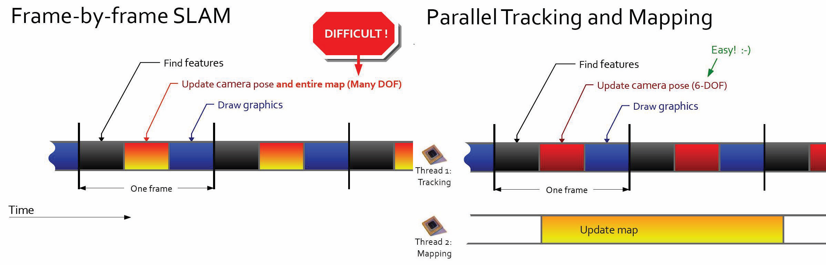

Slide 4
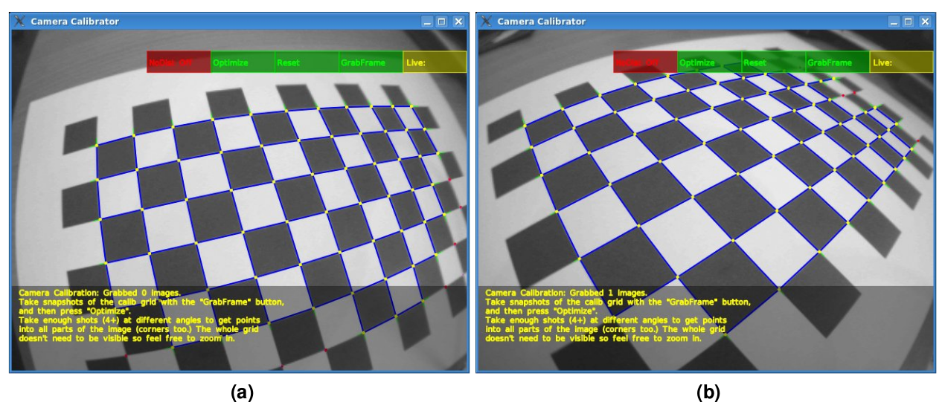
Calibración

Slide 5
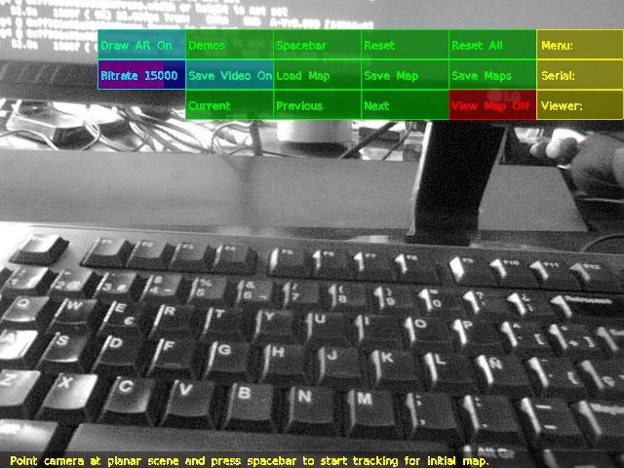
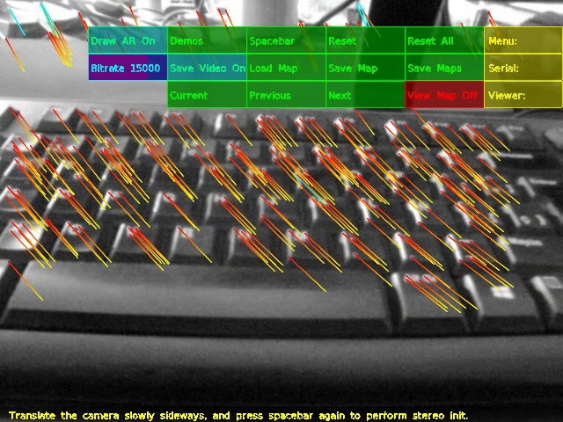
Point the Camera at planar scene and press spacebar to start for initial map

Slide 6
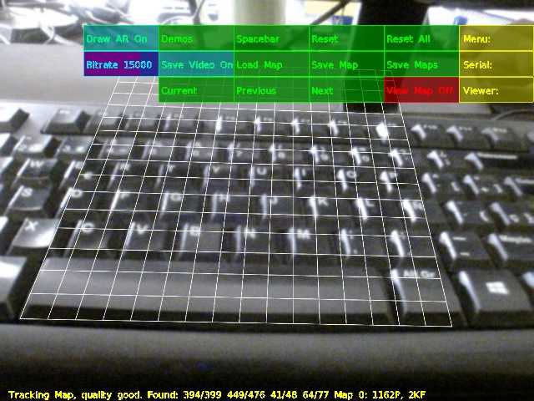
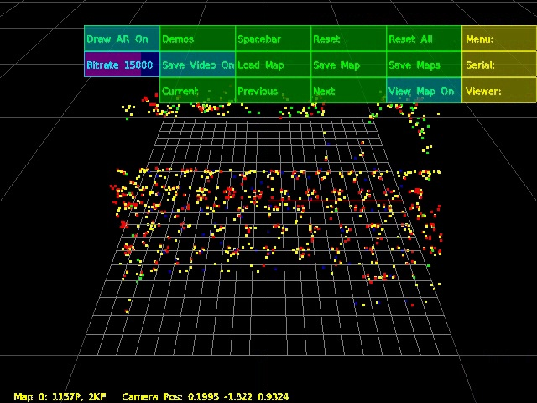
Visualize the map created

Slide 7
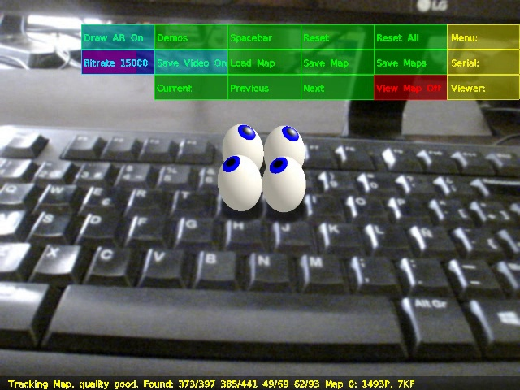
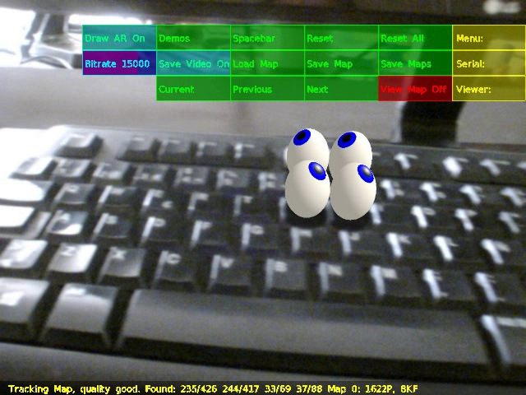
Choose the AR model

Slide 8
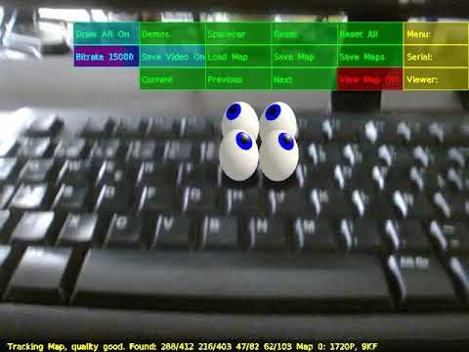
Demo

Slide 9
Thanks

