Slide 1
Project Health
Meal Planner
by Yaoheng Mo and Domenic Palucci

Slide 2
Healthy Lifestyle
Nutrition and Exercise
Different types of people require different types of meals (i.e. endurance athletes vs a typical 50 year old man.
Daily Calorie Consumption examples:
Women (19-30) 2000 calories
Women (31-50) 1800 calories
Men (19-30) 2400 calories
Men (31-50) 2200 calories

Slide 3
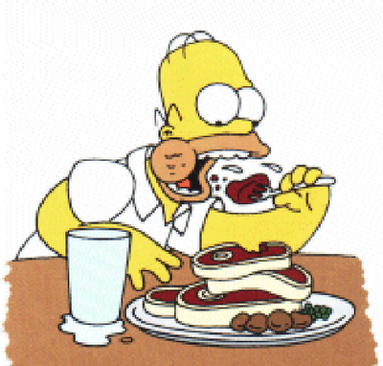
MEAL PLANNER – The Idea If you fail to plan, then plan to fail…
Planning meals helps to monitor calorie consumption.
Provides a nutritional count for every meal of the day.
Provides different plan for individual’s goals, ie. Weight loss, or very active.

Slide 4
Meal Planner – The Application
Allows for personal individual data thru registration.
Allows for flexibility to add recipes, or select from the database.
Displays and calculates Nutritional information like Calorie, Fat, Protein, and Carbohydrate count.
Application goal is to notify user if their combined daily calorie count exceeds their limit.
Displays a Daily or weekly calendar of their selected meals.

Slide 5
Challenges
Design & Implementation
Technological -
Validation
Github
Combobox / Database
Datagrids

Slide 6
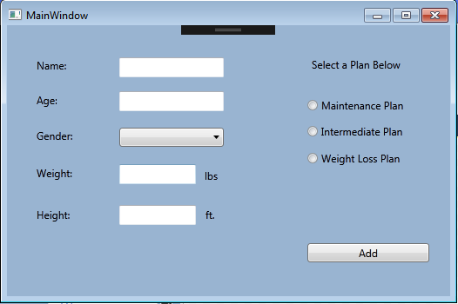
User Registration

Slide 7
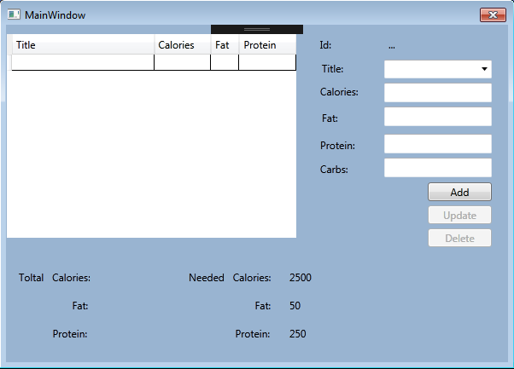
MealPicker Window

Slide 8

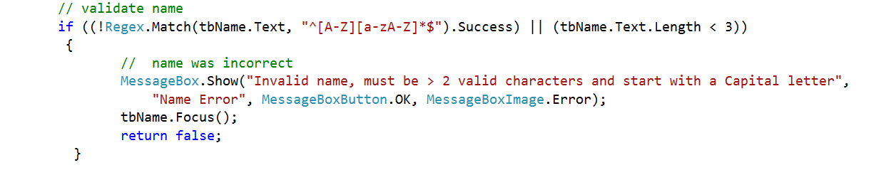
Validation

Slide 9

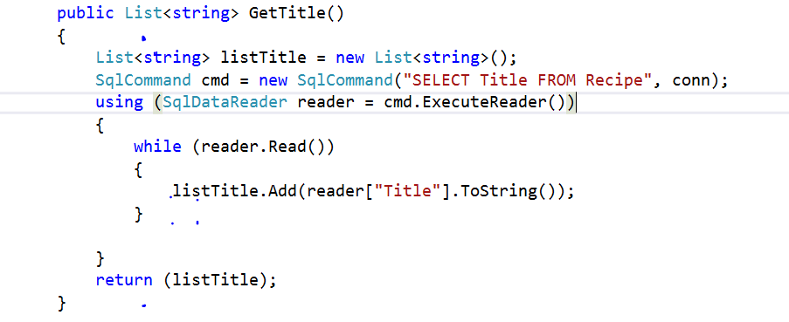
T.E.A. (Technical Educational Advancements) (Also known as “What we learned”)
Listing items in ComboBox from Database.

Slide 10
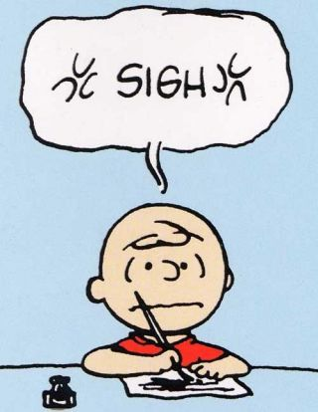
24 Hours I will never get back!!!
Do not call your User table “USER”, unless you include the brackets!!!!

Slide 11
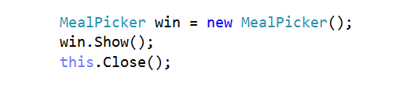
Connecting to another window.

Slide 12

Future Upgrades
Calendar View Window
Individual meal Selection, ie. Breakfast, Lunch, Supper, and Dessert.

Slide 13
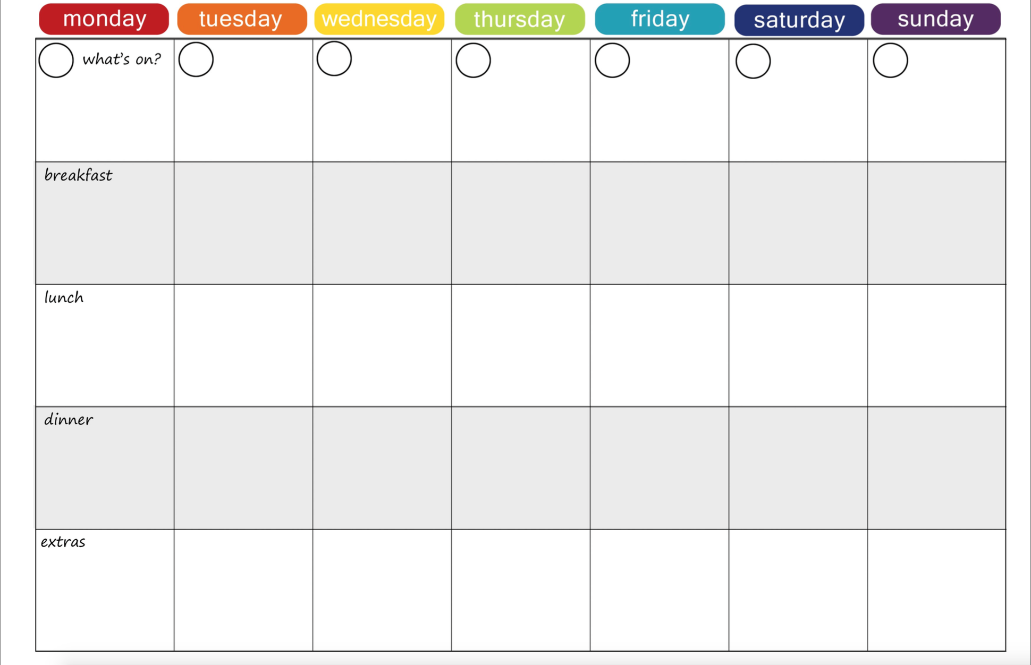

Slide 14
*** No computers were harmed in the making of this Presentation or Project … well, maybe a little.

