Slide 1
TypeScript
February 2017

Slide 2
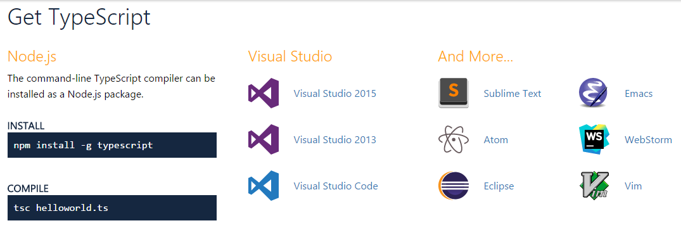
Get TypeScript

Slide 3
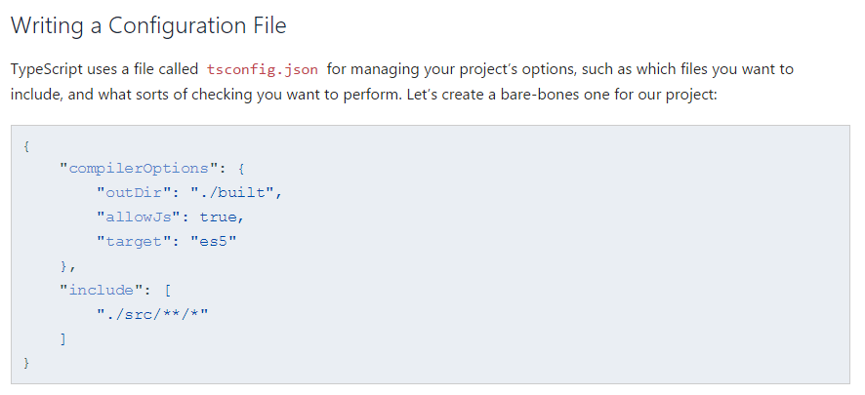
Configuration
Notes:
Here we’re specifying a few things to TypeScript:
Read in any files it understands in the src directory (with include).
Accept JavaScript files as inputs (with allowJs).
Emit all of the output files in built (with outDir).
Translate newer JavaScript constructs down to an older version like ECMAScript 5 (using target).
At this point, if you try running tsc at the root of your project, you should see output files in the built directory. The layout of files in built should look identical to the layout of src. You should now have TypeScript working with your project.

Slide 4

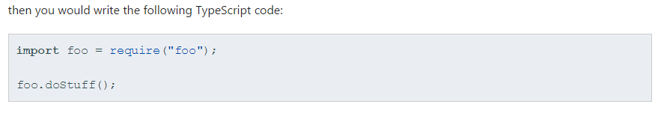
Moving js to ts
At this point, you’re probably ready to start using TypeScript files. The first step is to rename one of your .js files to .ts. If your file uses JSX, you’ll need to rename it to .tsx.

Slide 5
Moving js to ts
You may need to fix a few things

Slide 6
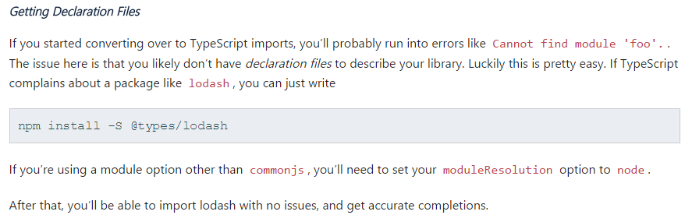
Moving js to ts
You may need to fix a few things

Slide 7
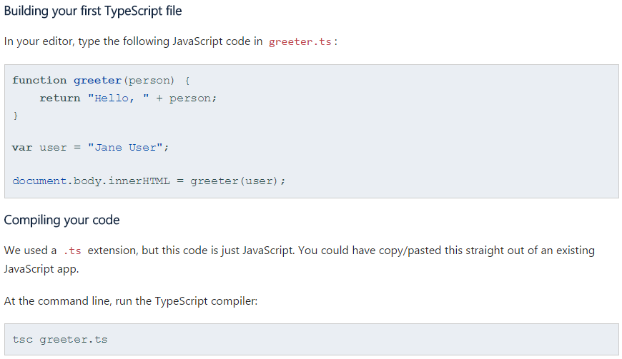
Make sure it works

Slide 8
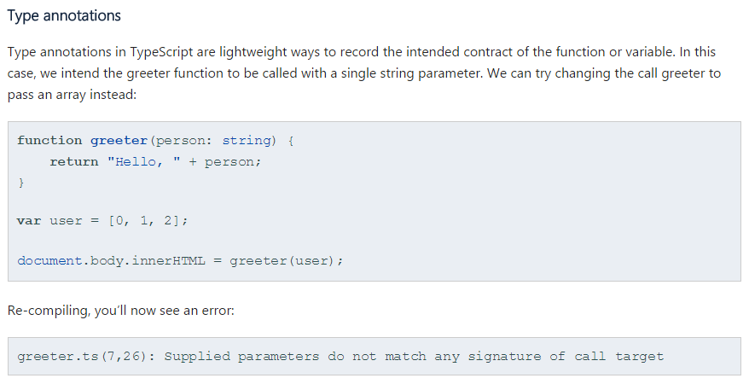
Type Checking

Slide 9
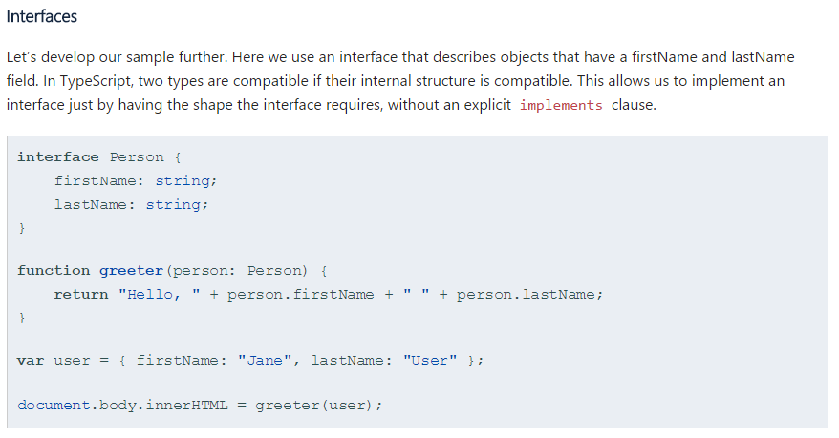
Interfaces

Slide 10
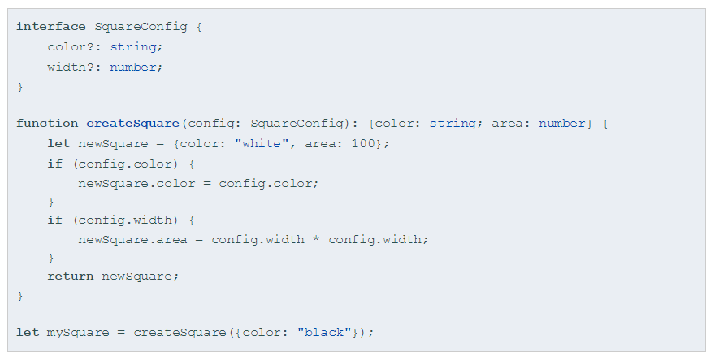
Optional Parameters
Notes:
interface SquareConfig { color?: string; width?: number; } function createSquare(config: SquareConfig): {color: string; area: number} { let newSquare = {color: "white", area: 100}; if (config.color) { newSquare.color = config.color; } if (config.width) { newSquare.area = config.width * config.width; } return newSquare; } let mySquare = createSquare({color: "black"});

Slide 11
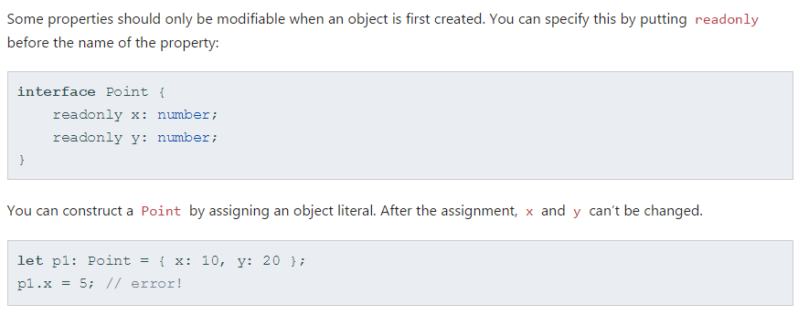
Readonly
Notes:
readonly vs const
The easiest way to remember whether to use readonly or const is to ask whether you’re using it on a variable or a property. Variables use const whereas properties use readonly.

Slide 12
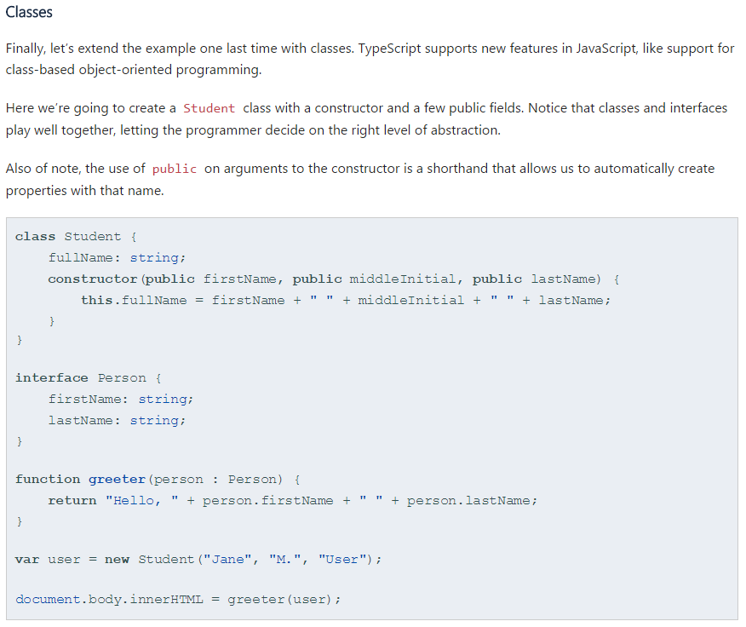
Classes

Slide 13
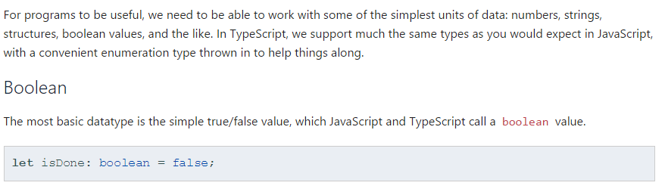
Boolean

Slide 14
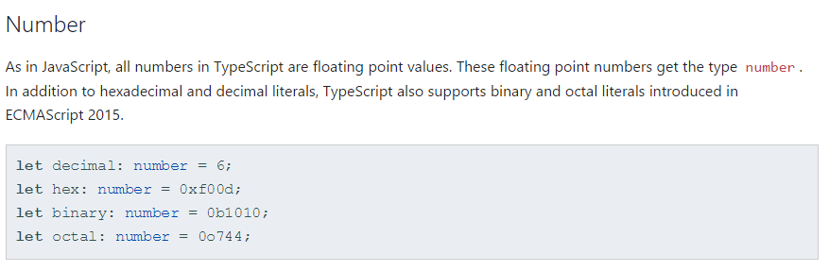
Numbers

Slide 15
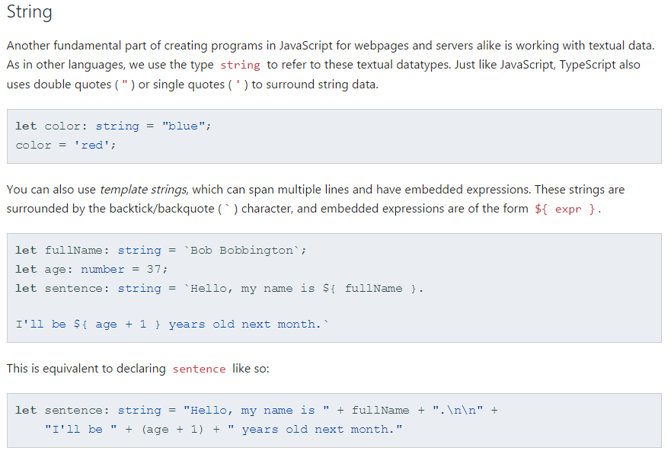
String

Slide 16
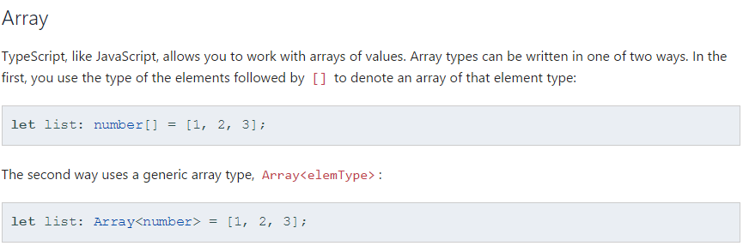
Array

Slide 17
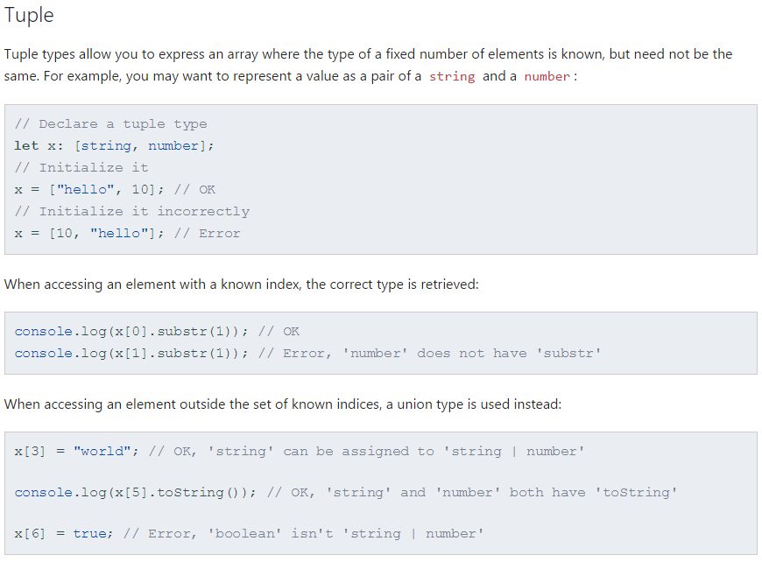
Tuple

Slide 18
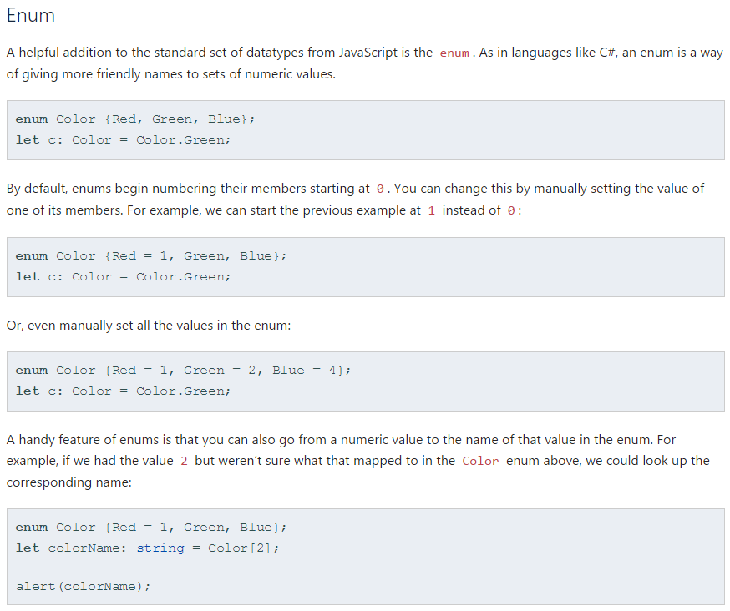
Enum

Slide 19
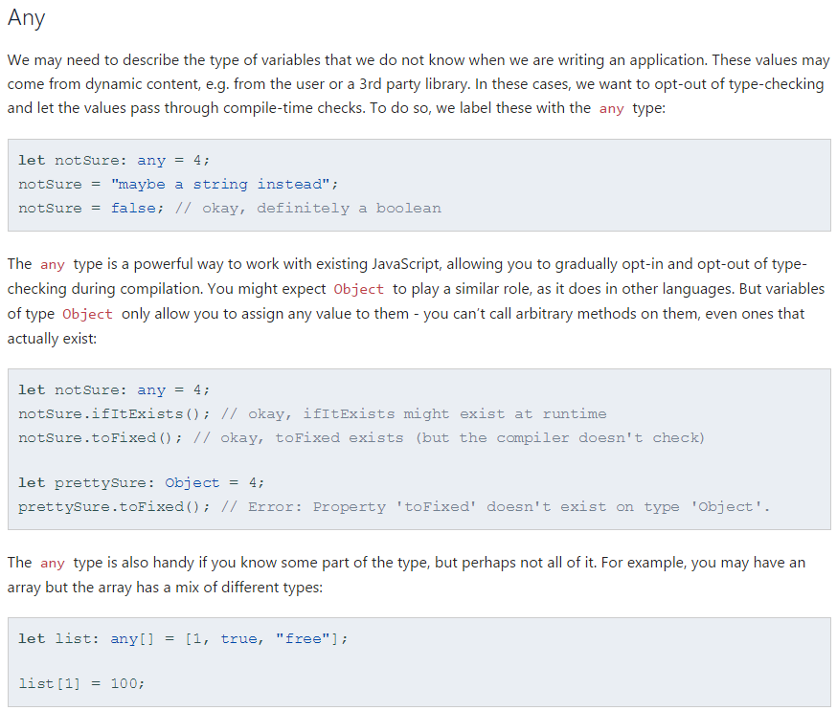
Any

Slide 20
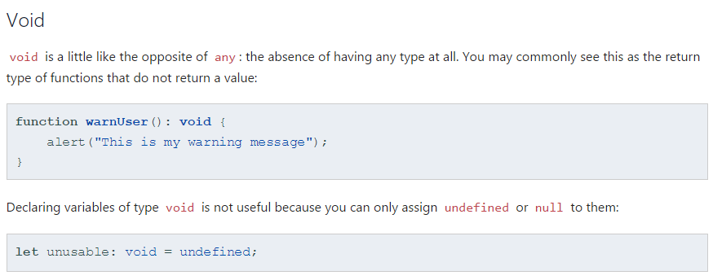
void

Slide 21
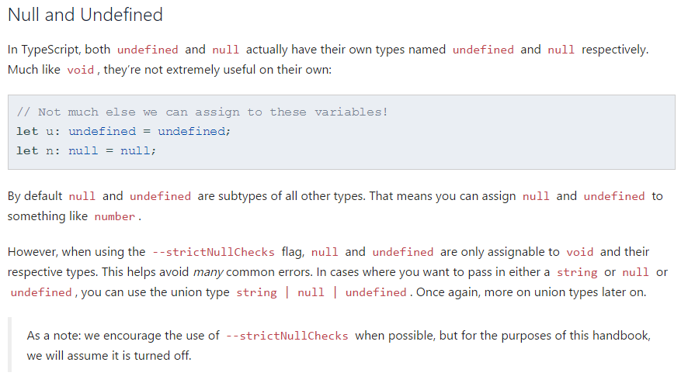
Null

Slide 22
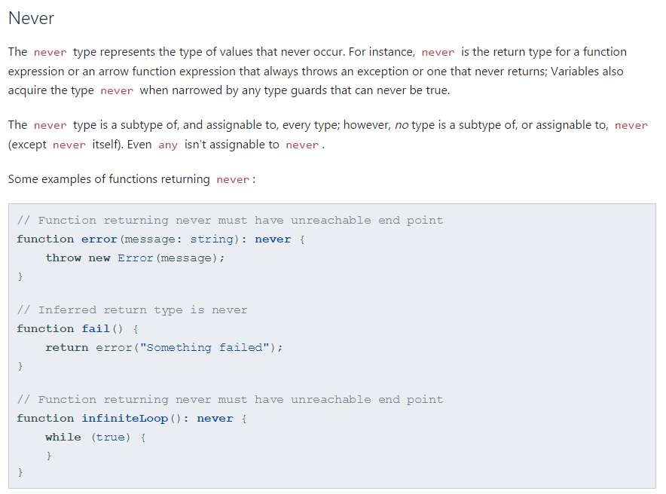
Never

Slide 23
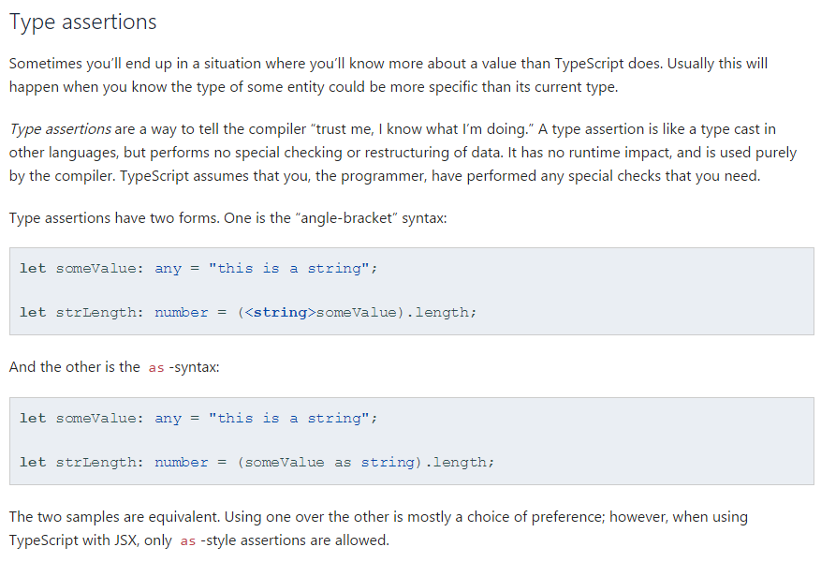
Type

Slide 24
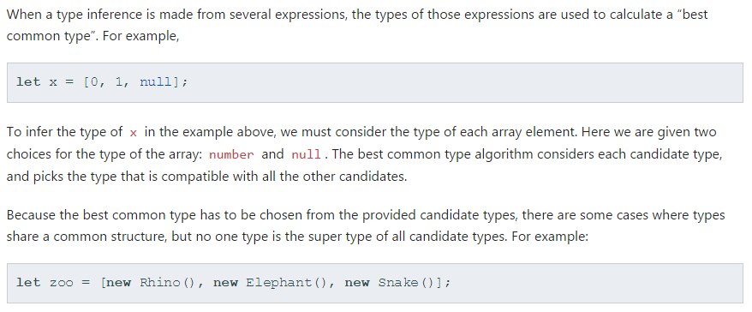
Type Inference

Slide 25
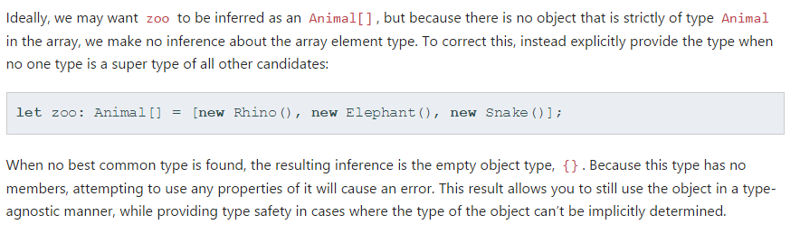
Type Inference

Slide 26
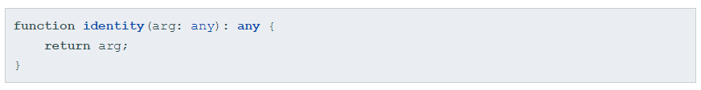
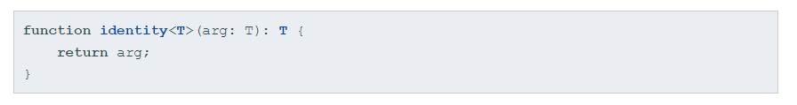
Generics
Notes:
We’ve now added a type variable T to the identity function. This T allows us to capture the type the user provides (e.g.number), so that we can use that information later. Here, we use T again as the return type. On inspection, we can now see the same type is used for the argument and the return type. This allows us to traffic that type information in one side of the function and out the other.

Slide 27
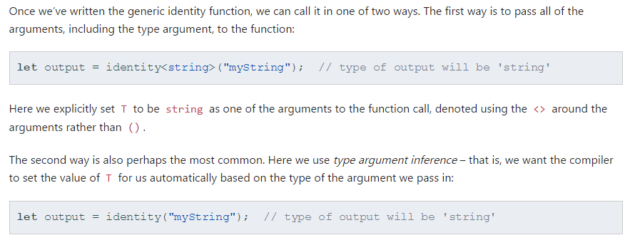
Generics

Slide 28
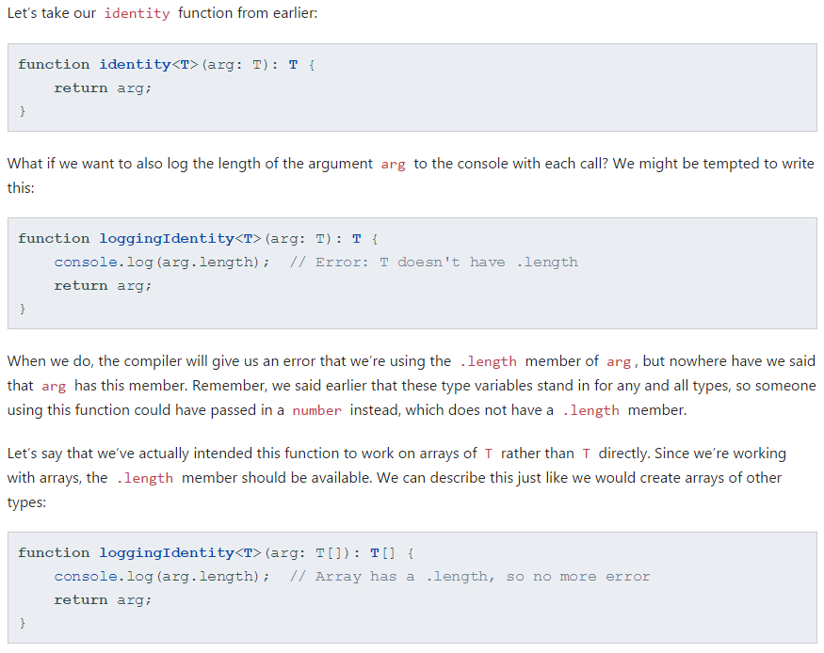

Slide 29
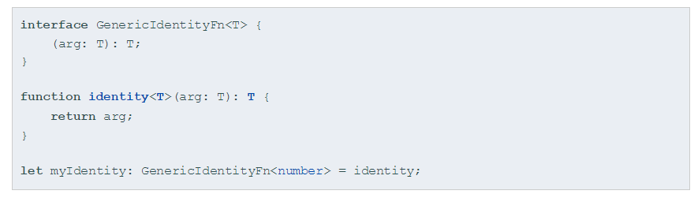
Generic Interface

Slide 30
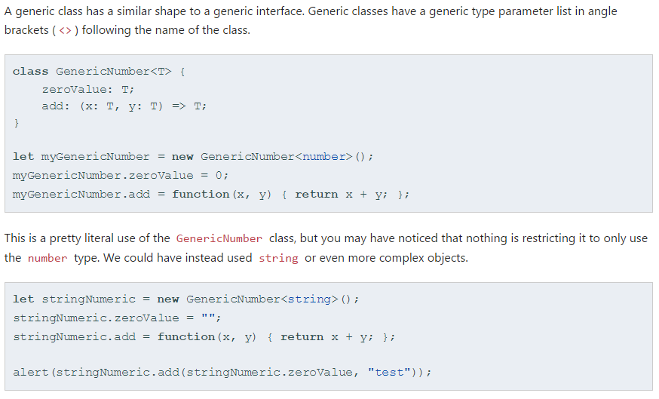
Generic Class

Slide 31
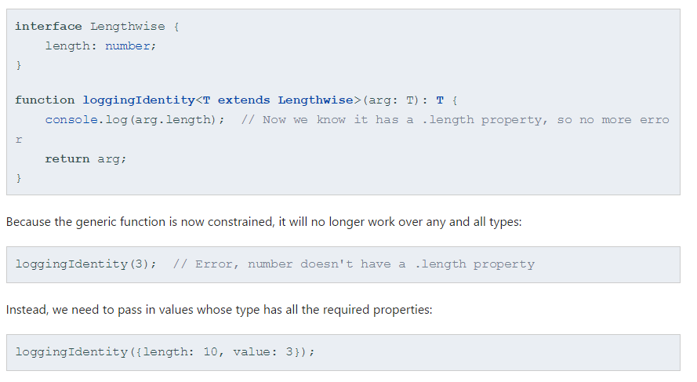
Generic Constraints

Slide 32
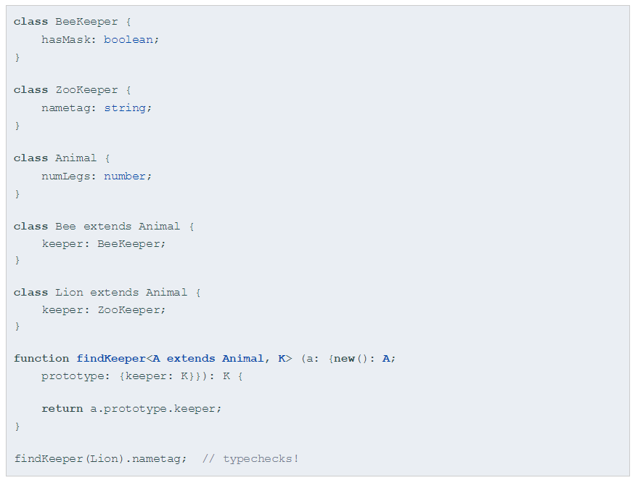
Generic Class Types
Notes:
When creating factories in TypeScript using generics, it is necessary to refer to class types by their constructor functions. For example,

Slide 33
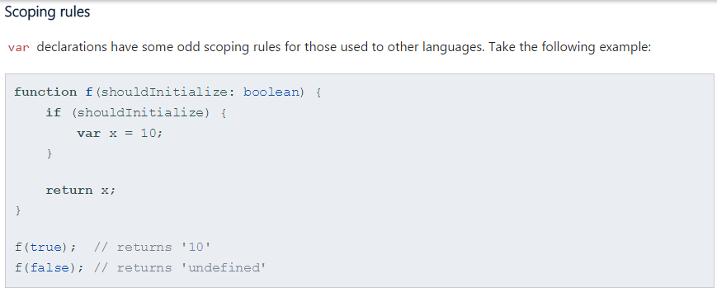
Scoping Rules
Notes:
Some readers might do a double-take at this example. The variable x was declared within the if block, and yet we were able to access it from outside that block. That’s because var declarations are accessible anywhere within their containing function, module, namespace, or global scope - all which we’ll go over later on - regardless of the containing block. Some people call this var-scoping or function-scoping. Parameters are also function scoped.

Slide 34
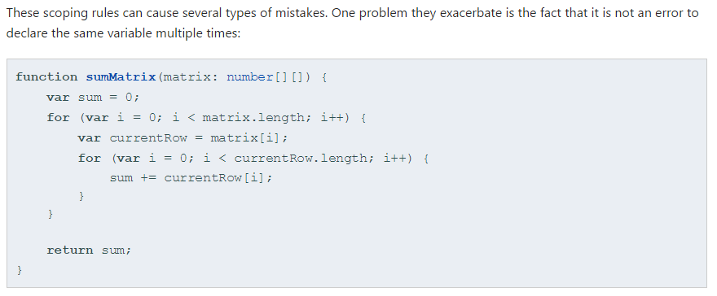
Common Errors
Notes:
Maybe it was easy to spot out for some, but the inner for-loop will accidentally overwrite the variable i because irefers to the same function-scoped variable. As experienced developers know by now, similar sorts of bugs slip through code reviews and can be an endless source of frustration.

Slide 35
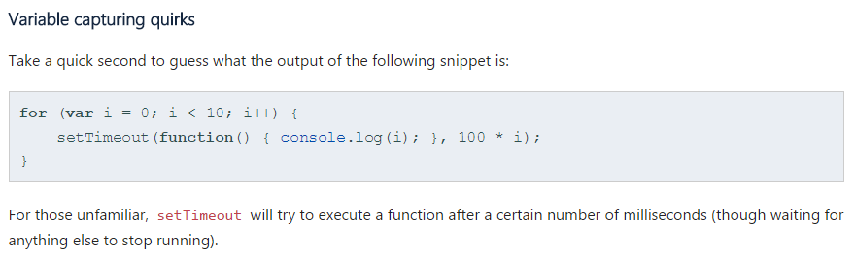
Variable capture quirks

Slide 36
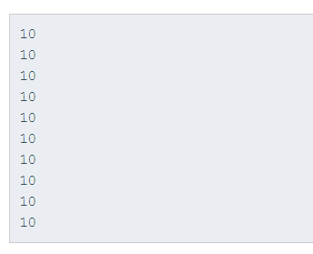
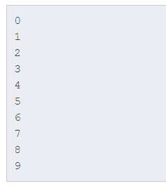
What happens
Notes:
Remember what we mentioned earlier about variable capturing? Every function expression we pass to setTimeoutactually refers to the same i from the same scope.
Let’s take a minute to consider what that means. setTimeout will run a function after some number of milliseconds, but only after the for loop has stopped executing; By the time the for loop has stopped executing, the value of i is 10. So each time the given function gets called, it will print out 10!

Slide 37
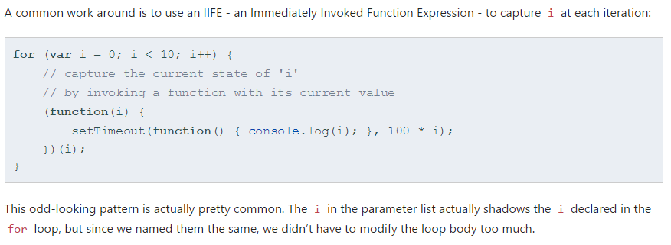
Work around - IIFE

Slide 38
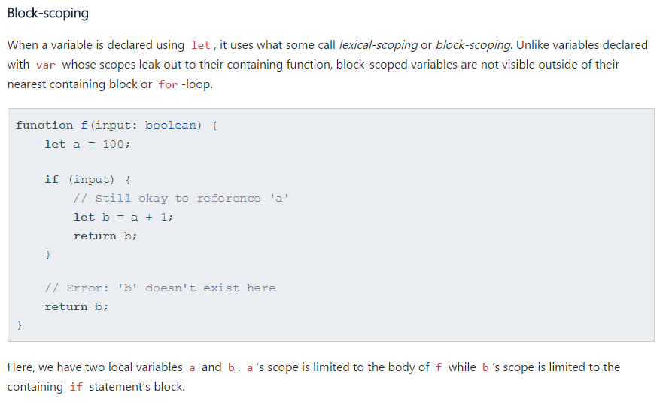
Let declarations

Slide 39
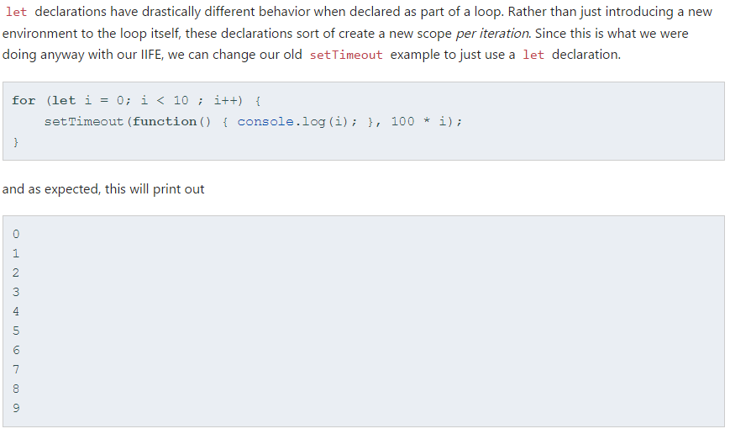
Let fix

Slide 40
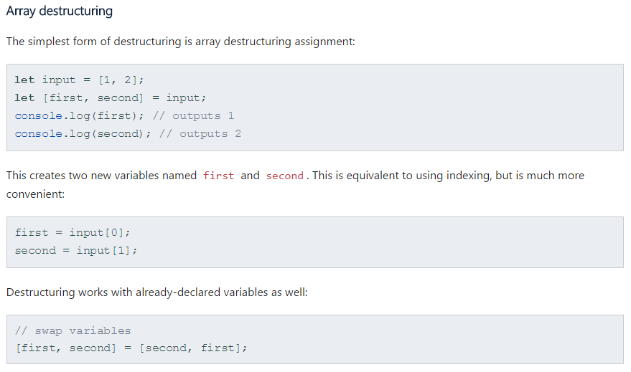
Array destructuring

Slide 41
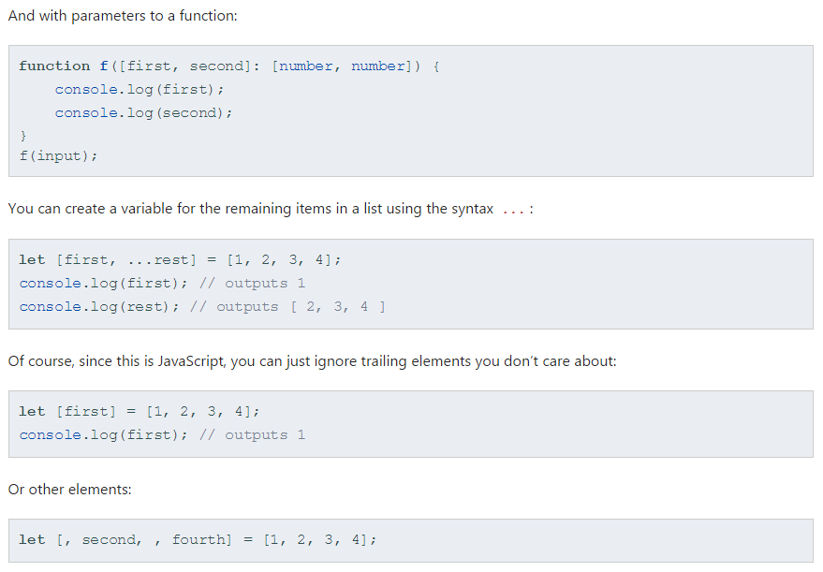
Destructuring Parameters

Slide 42
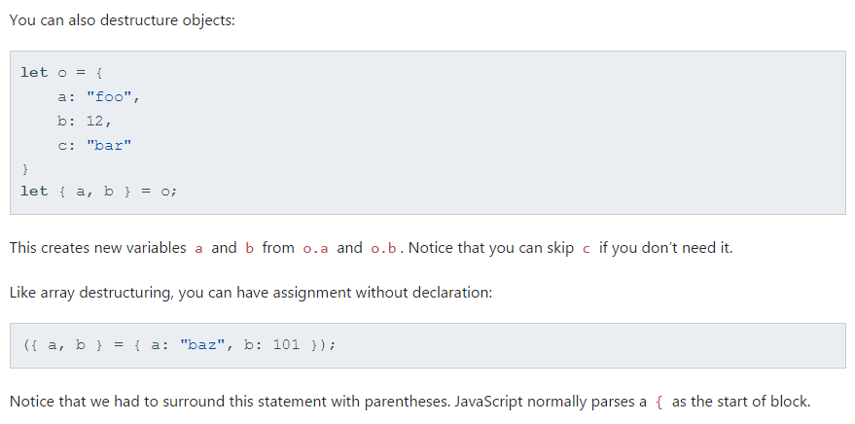
Destructuring Objects

Slide 43
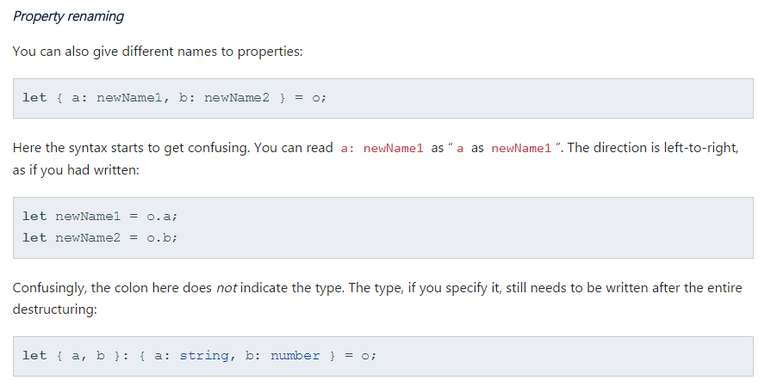
Property Renaming

Slide 44
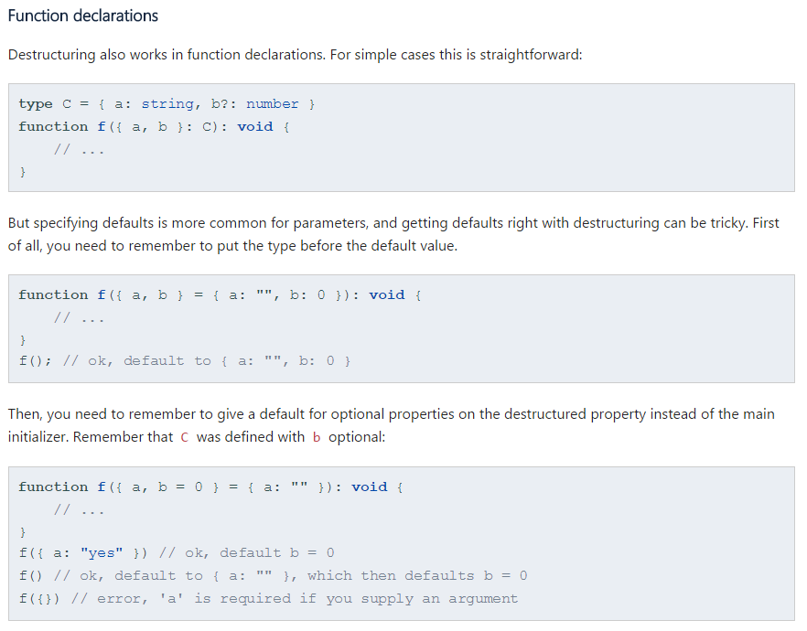
Function Declarations
Notes:
Use destructuring with care. As the previous example demonstrates, anything but the simplest destructuring expression is confusing. This is especially true with deeply nested destructuring, which gets really hard to understand even without piling on renaming, default values, and type annotations. Try to keep destructuring expressions small and simple. You can always write the assignments that destructuring would generate yourself.

Slide 45
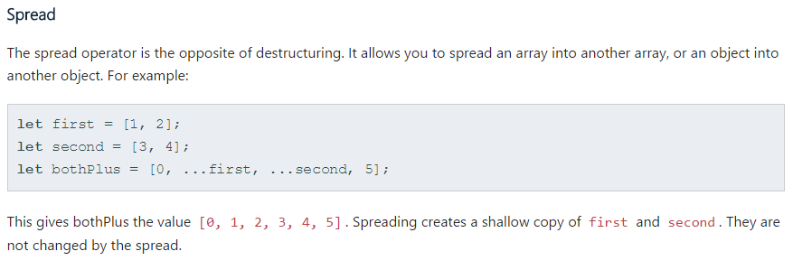
Spread

Slide 46
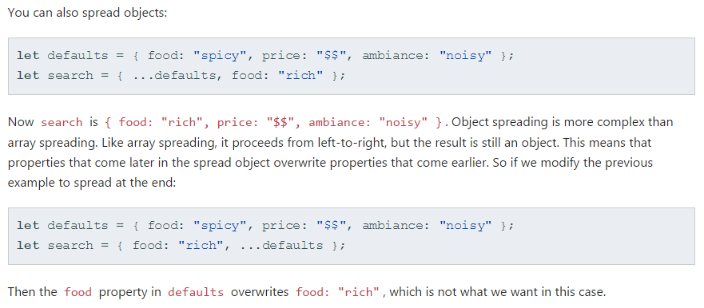
Spread objects

Slide 47
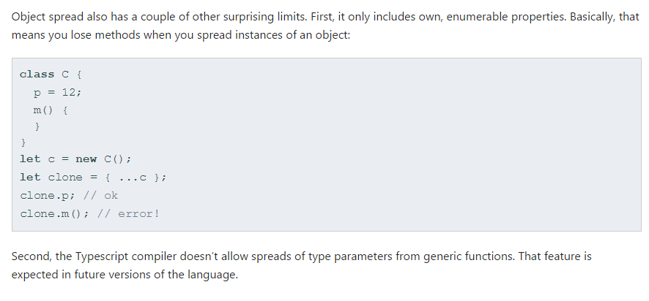
Spread considerations

Slide 48
this
In JavaScript, this is a variable that’s set when a function is called. This makes it a very powerful and flexible feature, but it comes at the cost of always having to know about the context that a function is executing in. This is notoriously confusing, especially when returning a function or passing a function as an argument.
Notes:
Learning how to use this in JavaScript is something of a rite of passage. Since TypeScript is a superset of JavaScript, TypeScript developers also need to learn how to use this and how to spot when it’s not being used correctly. Fortunately, TypeScript lets you catch incorrect uses of this with a couple of techniques. If you need to learn how thisworks in JavaScript, though, first read Yehuda Katz’s Understanding JavaScript Function Invocation and “this”. Yehuda’s article explains the inner workings of this very well, so we’ll just cover the basics here.

Slide 49
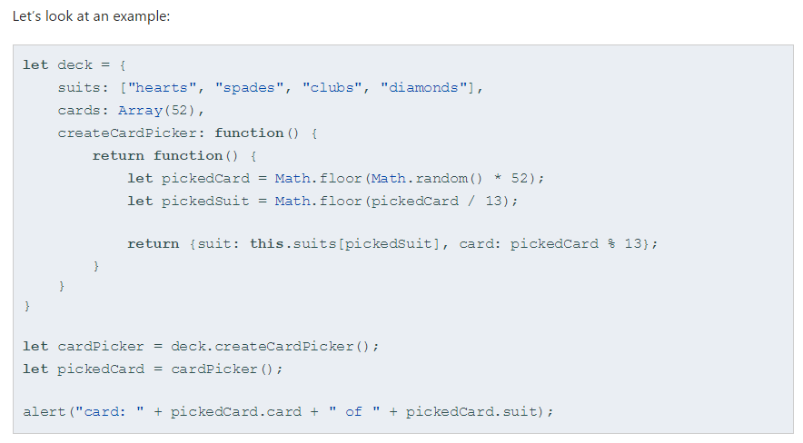
this
Notes:
Notice that createCardPicker is a function that itself returns a function. If we tried to run the example, we would get an error instead of the expected alert box. This is because the this being used in the function created by createCardPicker will be set to window instead of our deck object. That’s because we call cardPicker() on its own. A top-level non-method syntax call like this will use window for this. (Note: under strict mode, this will be undefined rather than window).
Even better, TypeScript will warn you when you make this mistake if you pass the --noImplicitThis flag to the compiler. It will point out that this in this.suits[pickedSuit] is of type any.

Slide 50
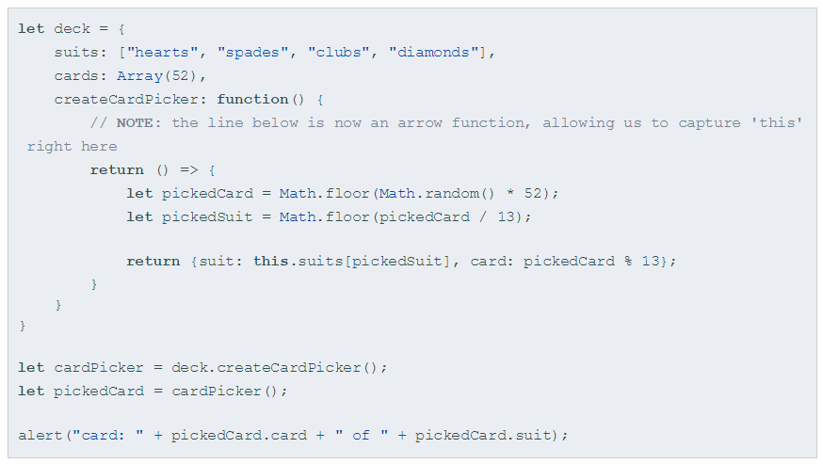
Arrow =>
Notes:
We can fix this by making sure the function is bound to the correct this before we return the function to be used later. This way, regardless of how it’s later used, it will still be able to see the original deck object. To do this, we change the function expression to use the ECMAScript 6 arrow syntax. Arrow functions capture the this where the function is created rather than where it is invoked:

Slide 51
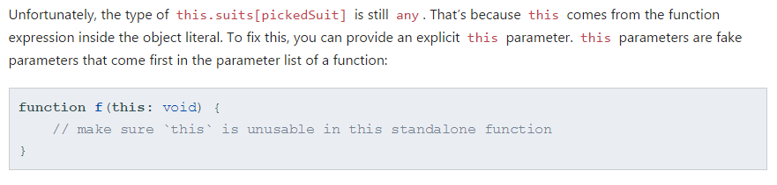
this

Slide 52

Notes:
Now TypeScript knows that createCardPicker expects to be called on a Deck object. That means that this is of typeDeck now, not any, so --noImplicitThis will not cause any errors.

Slide 53

Iterators

Slide 54

Iterators

Slide 55

Iterators Object

Slide 56

Iterators and ES5/3

Slide 57

Modules

Slide 58

Modules

Slide 59

Modules

Slide 60

Default Export

Slide 61

Default

Slide 62
Typescript 2.2
New Object Types

Slide 63
Terminology
A mixin constructor type refers to a type that has a single construct signature with a single rest argument of type any[]and an object-like return type. For example, given an object-like type X, new (...args: any[]) => X is a mixin constructor type with an instance type X.
A mixin class is a class declaration or expression that extends an expression of a type parameter type. The following rules apply to mixin class declarations:
The type parameter type of the extends expression must be constrained to a mixin constructor type.
The constructor of a mixin class (if any) must have a single rest parameter of type any[] and must use the spread operator to pass those parameters as arguments in a super(...args) call.

Slide 64

Mixin
Notes:
class Point { constructor(public x: number, public y: number) {} } class Person { constructor(public name: string) {} } type Constructor<T> = new(...args: any[]) => T; function Tagged<T extends Constructor<{}>>(Base: T) { return class extends Base { _tag: string; constructor(...args: any[]) { super(...args); this._tag = ""; } } } const TaggedPoint = Tagged(Point); let point = new TaggedPoint(10, 20); point._tag = "hello"; class Customer extends Tagged(Person) { accountBalance: number; } let customer = new Customer("Joe"); customer._tag = "test"; customer.accountBalance = 0;

Slide 65

Subclass Factory
Notes:
interface Point { x: number; y: number; } const WithLocation = <T extends Constructor<Point>>(Base: T) => class extends Base { getLocation(): [number, number] { return [this.x, this.y]; } }

Slide 66

object type

Slide 67

null/undefined

Slide 68

Dotted Properties

Slide 69

Questions?

