Slide 1
Bellhaven CRM Pipeline
Daily scrape -> match -> review -> write-back pipeline for the Bellhaven Senior Living CRM sandbox
github.com/dparikh066-stack/bellhaven-crm-pipeline

Slide 2
The Problem
• ~60% of the LTC facilities in this CRM are owned by a parent company, and ownership changes constantly -- acquired, rebranded, split, consolidated.
• Every ownership event can quietly break the parent_id link between a facility and its parent account.
• Corporate-owned vs. independent facilities are sold to differently -- an inaccurate ownership picture is a real, ongoing operational problem.
• Goal: keep the CRM's picture of which facilities Bellhaven owns accurate, automatically, every day -- without ever writing to the CRM unreviewed.
2

Slide 3
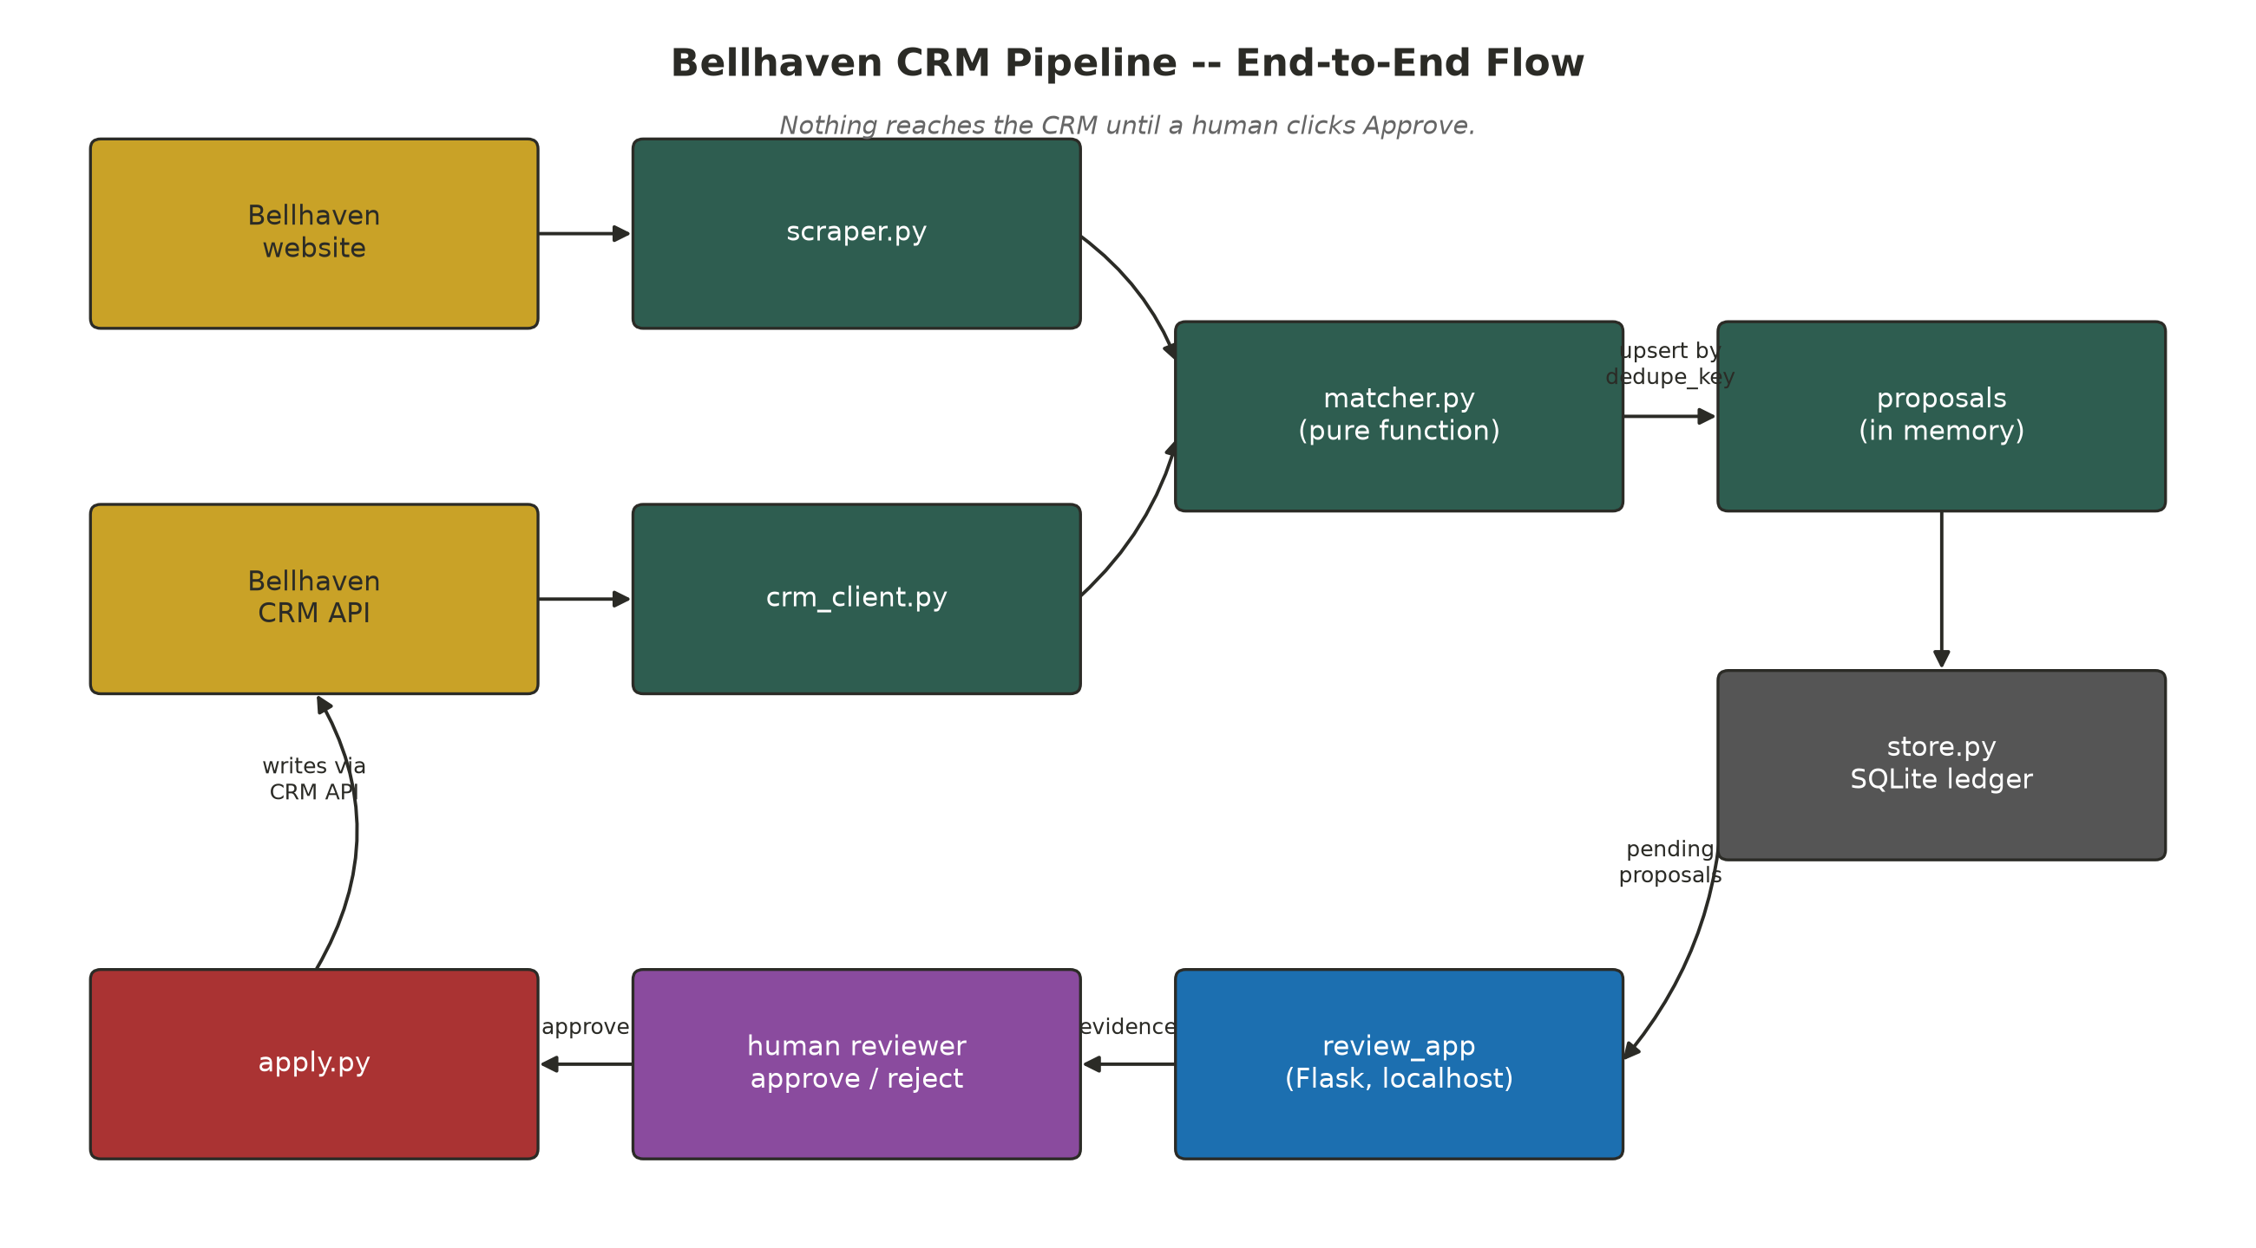
Architecture Overview
• scraper.py and crm_client.py independently pull the two sources of truth: the public website and the CRM API.
• matcher.py is a pure function -- (locations, accounts) -> proposals -- with no I/O, so it's trivial to reason about and re-run.
• store.py is a SQLite ledger that turns repeated runs into an idempotent upsert instead of duplicate proposals.
• review_app is the only thing allowed to write to the CRM, and only after a human clicks Approve.
3

Slide 4
Component: The Scraper
• Walks /communities?page=N and parses every listing card: name, street, city, state, zip, and one or more care-offering badges.
• Also scans the homepage for /communities/{slug} links -- a just-announced acquisition (Bellhaven Meadows of Findlay) was linked from a promo banner before it ever made it into the paginated directory grid.
• Result: 35 locations captured, not the 34 the paginated grid alone would have found.
• Output is a plain list of dicts (data/locations.json) -- no CRM knowledge lives in this module.
4

Slide 5
Component: Matching Signals
• Every scraped location is scored against every CRM account on street similarity, name similarity, and exact zip/city/state matches.
• Two independent confirmation tests sit on top of the raw score, because the data breaks in two different ways:
• Address-confirmed: zip matches and the street reads the same ("875 Elm Street" vs "875 Elm St").
• Identity-confirmed: zip+city+name are strong even when the street is stale -- a PO box on file (Ashtabula), or the zip itself is wrong, a transposed digit (Portsmouth: 45626 vs 45662).
5

Slide 6
Code: Scoring & Confirmation
def score_pair(loc, acct):
a_street = norm_street(acct.get("billing_street"))
a_name = norm_name(acct.get("name"))
street_sim = difflib.SequenceMatcher(None, norm_street(loc["street"]), a_street).ratio()
name_sim = difflib.SequenceMatcher(None, norm_name(loc["name"]), a_name).ratio()
zip_match = loc["zip"] == acct.get("billing_zip")
a_city = (acct.get("billing_city") or "").strip().lower()
city_match = loc["city"].strip().lower() == a_city
state_match = loc["state"] == acct.get("billing_state")
combined = (0.4 * street_sim + 0.25 * name_sim + 0.2 * zip_match
+ 0.1 * city_match + 0.05 * state_match)
return {"street_sim": street_sim, "name_sim": name_sim,
"zip_match": zip_match, "combined": combined}
def is_address_confirmed(s):
"""Same physical address: zip matches and the street reads the same."""
return s["zip_match"] and s["street_sim"] >= 0.75
def is_identity_confirmed(s):
"""Same facility even if one field is stale (a PO-box billing street,
or a transposed zip digit) -- name/city/state carry enough signal alone."""
if s["zip_match"] and s["city_match"] and s["name_sim"] >= 0.85:
return True
if (s["name_sim"] >= 0.95 and s["street_sim"] >= 0.85
and s["city_match"] and s["state_match"]):
return True
return False
• score_pair() is pure and side-effect free -- same inputs always produce the same score, which is what lets matcher.build_proposals() be a pure function end to end.
• Two confirmation paths, not one threshold: is_address_confirmed catches reformatted streets; is_identity_confirmed catches a stale/wrong street when name+city+zip still agree.
• Portsmouth needed a third path in practice: name+street+city+state strong even when zip itself was the wrong field (a transposed digit) -- handled in the full identity check in matcher.py.
6

Slide 7
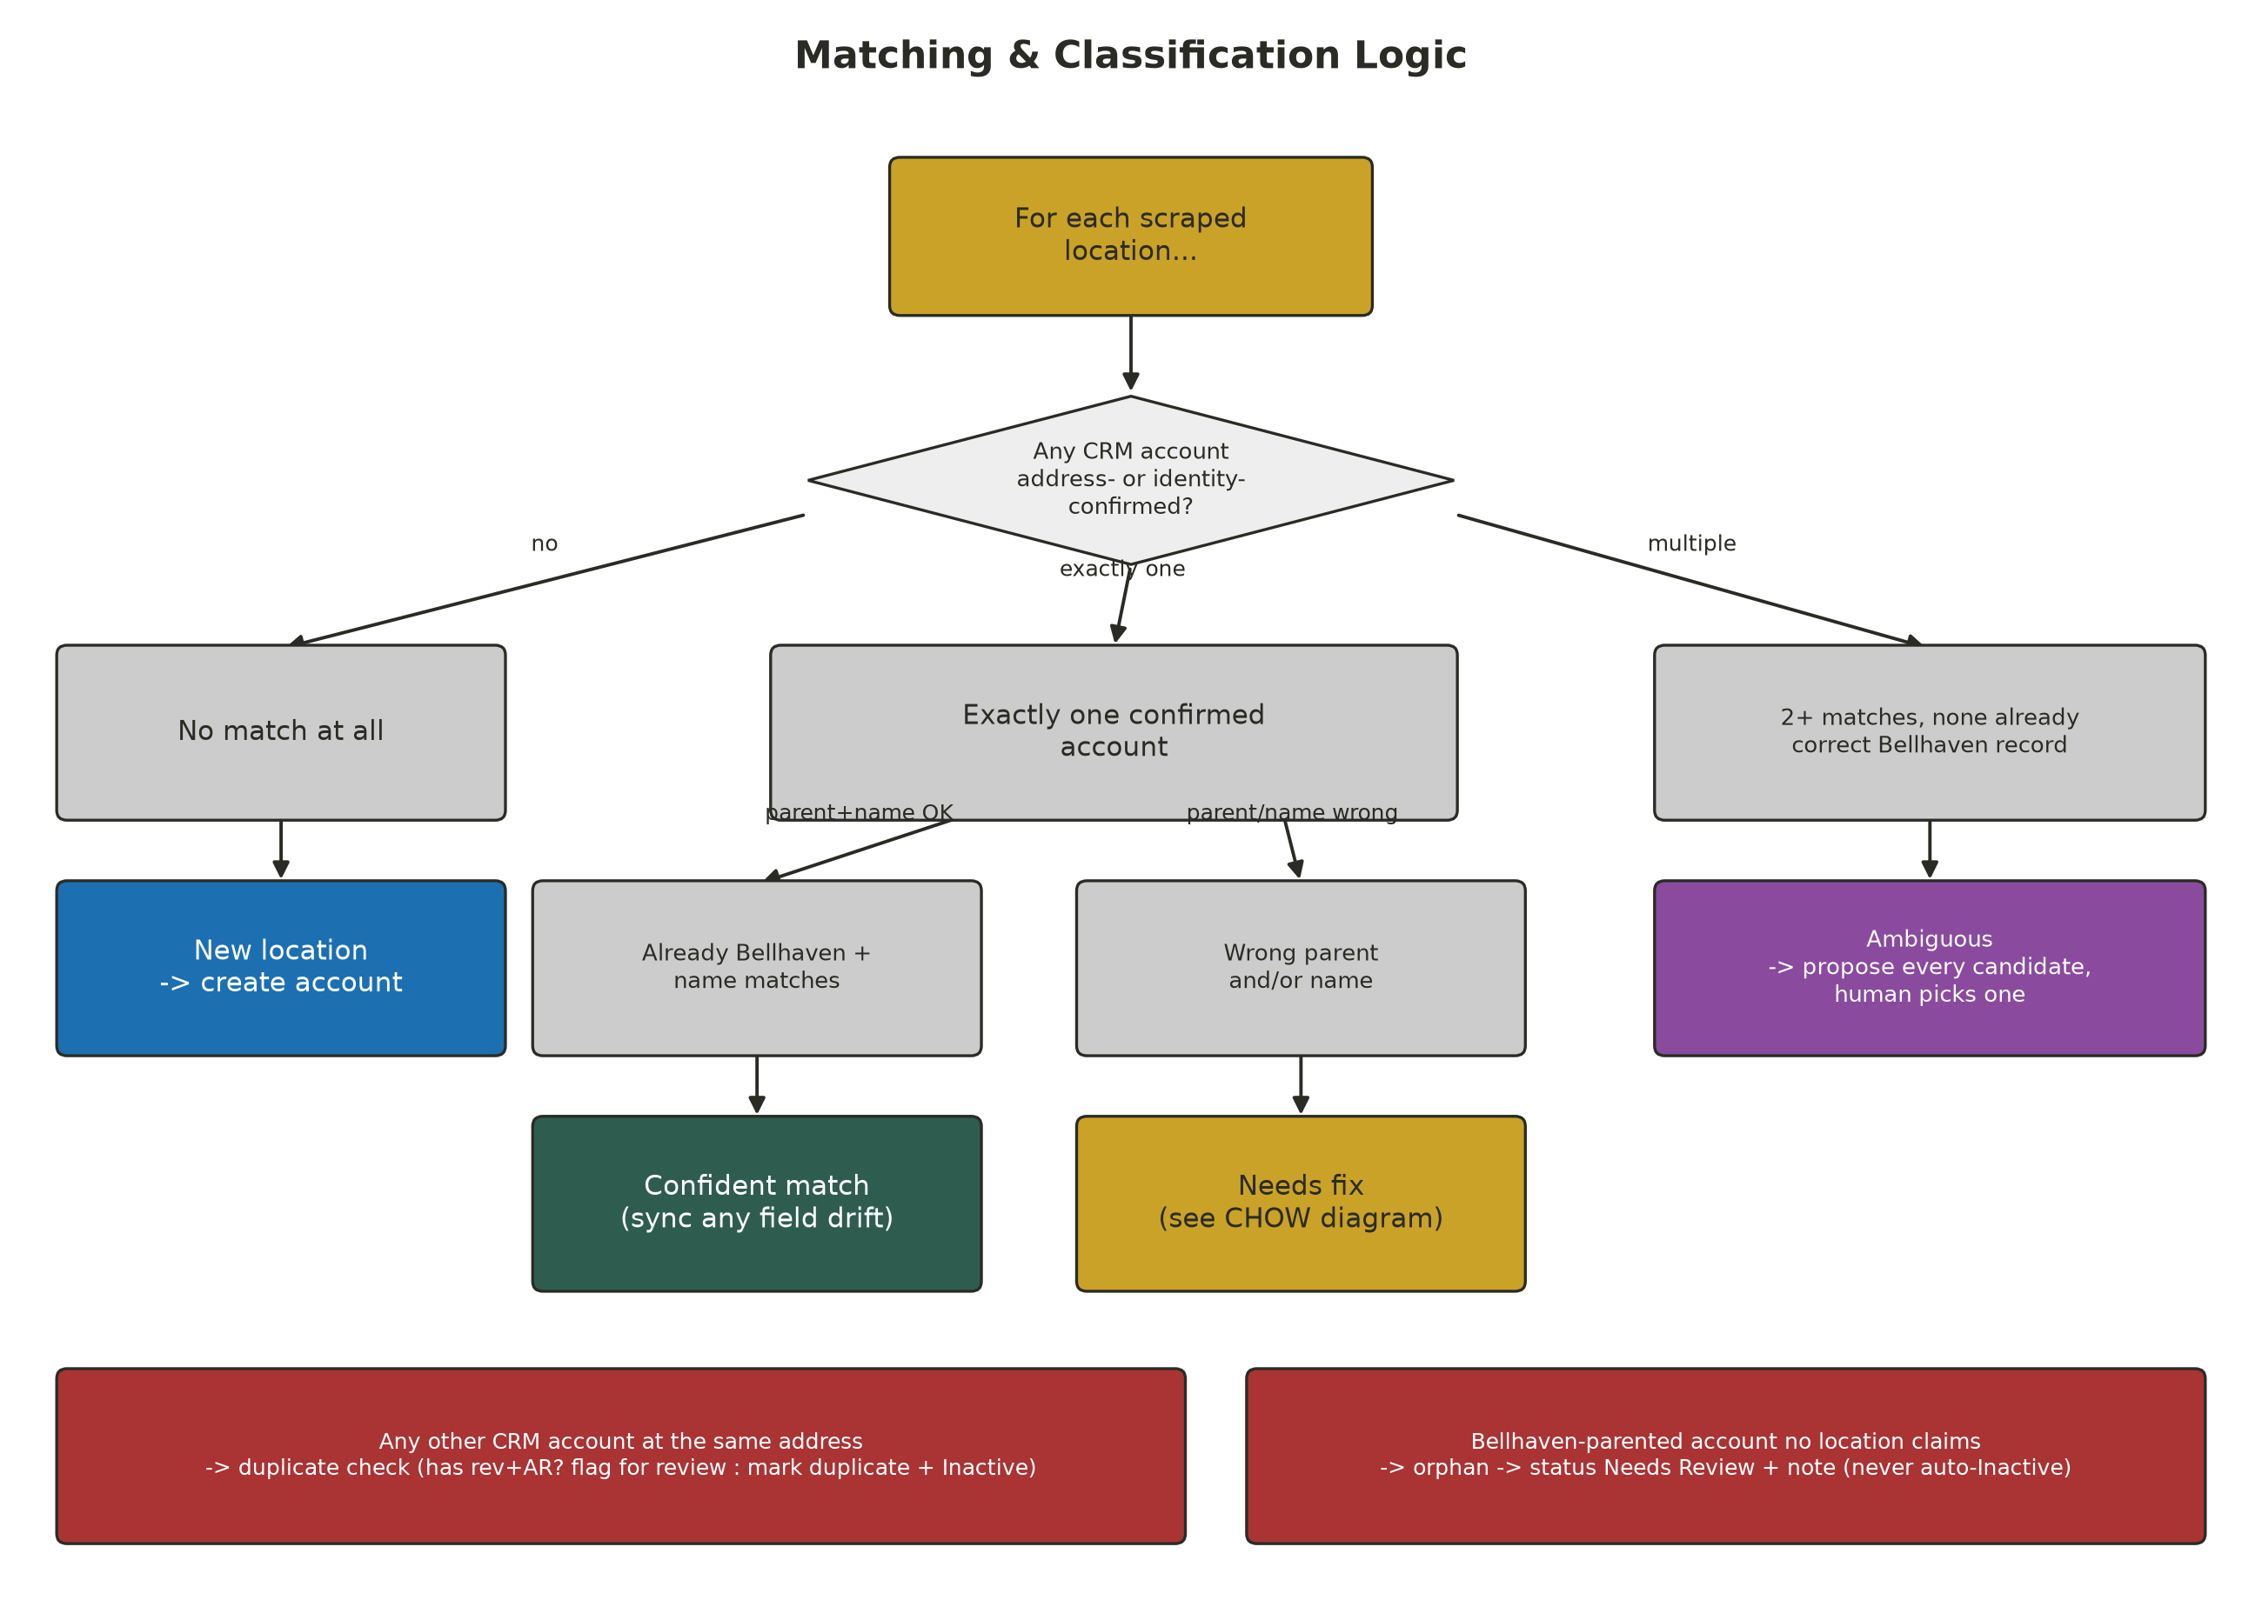
Classification Logic
• Confident match -- right account, already correctly parented and named. Still checked field-by-field for drift (stale phone numbers turned out to be extremely common).
• Needs fix -- right account exists, but the parent and/or name is wrong.
• New location -- nothing matches; propose creating the account.
• Ambiguous -- 2+ CRM accounts at the same address, none already the correct Bellhaven record. No auto-pick: every candidate is proposed as a mutually exclusive alternative for a human to choose.
• Orphan -- a Bellhaven-parented account no scraped location claims. Always Needs Review, never auto-Inactive.
7

Slide 8
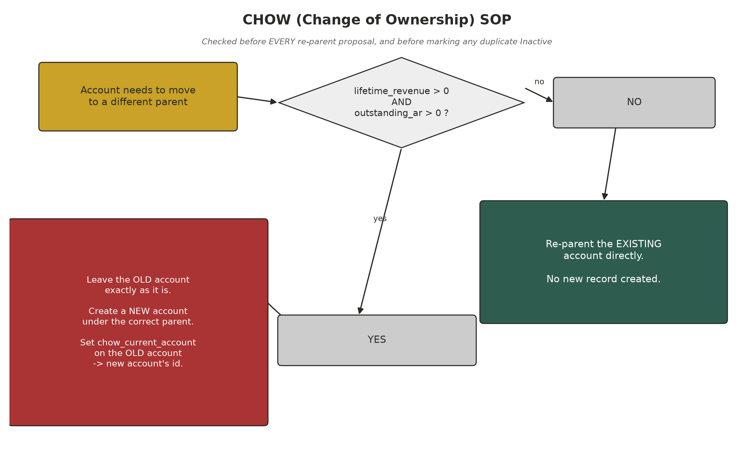
The CHOW (Change of Ownership) SOP
• Implemented literally: before re-parenting an existing account, check lifetime_revenue and outstanding_ar.
• Both > 0 -> leave the old account completely untouched (only chow_current_account gets set), create a new account under the correct parent, point the old one at the new one.
• Otherwise -> re-parent the existing account directly, no new record.
• Fired for real on two accounts: Marietta and Tiffin, both under Cedar Trail Communities with real billing history.
• Second-order effect: after a split, old and new accounts share an address, so duplicate-detection finds the old one again -- correctly routes it to human review instead of auto-deactivating it, since it still carries revenue + AR.
8

Slide 9
Code: The CHOW Check
def needs_chow_split(account):
"""CHOW SOP: preserve the old account (don't reparent it) only when it
has BOTH revenue history AND currently-outstanding AR."""
return (account.get("lifetime_revenue") or 0) > 0 \
and (account.get("outstanding_ar") or 0) > 0
# ... in build_proposals(), whenever a match's parent is wrong:
if needs_chow_split(anchor_acct):
# leave anchor_acct's parent/status untouched; propose a NEW account
# under Bellhaven, and patch anchor_acct.chow_current_account -> new id
...
else:
# no revenue/AR entanglement -- safe to re-parent anchor_acct directly
...
• One boolean gate, checked in exactly one place, applied consistently everywhere a parent could change -- including the ambiguous-Kettering candidates, had one been approved with revenue on the books.
• "Preserve" means literally not included in that proposal's proposed_changes at all -- the old account's PATCH call only ever sets chow_current_account, nothing else.
9

Slide 10
Data Quality Issues Found & Handled
Issue | Example | Resolution
Stale phone numbers | ~13 accounts | synced from website
Reformatted/abbreviated street | Toledo, Marion, Ashtabula... | synced from website
Stale billing address (PO box) | Ashtabula | synced physical address
Transposed zip digit | Portsmouth (45626->45662) | corrected
Outdated name after rebrand | Chesterton, Chagrin Falls, Willow Creek | renamed to match website
Wrong parent, no billing history | Findlay, Lima | re-parented directly
Wrong parent, real revenue+AR | Marietta, Tiffin | CHOW split
Exact duplicate, same address | Owosso (x2), Port Clinton, Erie, Monroe | duplicate_of_account + Inactive
Multiple same-address, no survivor | Kettering (3 pre-acquisition records) | left pending for a human
Active in CRM, gone from website | Alliance, Coldwater, Sandusky | flagged Needs Review, never auto-closed
New community, no CRM account | Batavia, Union Square, Carlisle, Amberly Manor | created
Name collision, unrelated facility | "Amberly Manor" also exists in Colorado Springs | correctly not matched -- different state
10

Slide 11
Making the Note Field Do Its Job
• The assignment names status AND the free-text note field as the two tools for expressing findings that aren't simple field updates.
• Duplicate and orphan proposals write an explanation into the CRM's actual note field, not just the review app's evidence panel -- status alone doesn't say WHY an account was deactivated or flagged.
• Caught this gap during a self-review after the first full run, fixed the matcher, and backfilled the 8 accounts already approved before the fix so the live CRM matches what the corrected pipeline produces.
11

Slide 12
Code: Idempotent Re-Runs
def dedupe_key_for(p):
ct = p["change_type"]
if ct == "chow_split":
return f"chow:{slug}:{ids}"
if ct == "mark_duplicate":
return f"duplicate:{ids}:{p['proposed_changes']['duplicate_of_account']}"
if ct == "flag_review" and p["classification"] == "orphan":
return f"orphan:{ids}"
...
# upsert_proposals(): a proposal whose dedupe_key already exists with
# status in {approved, rejected} is NEVER modified again -- only a
# 'pending' row gets its content refreshed, or gets auto_resolved if the
# matcher stops producing it on a later run.
• Every proposal type has its own deterministic key format -- based on the location slug and/or account id(s), never on anything that changes run to run.
• This is the entire idempotency mechanism: no separate "already processed" flag, no timestamps compared -- just an upsert keyed on content identity.
12

Slide 13
Idempotency, Verified Live
• matcher.build_proposals is a pure function of current CRM + website state -- every run regenerates the entire proposal set from scratch.
• A proposal that already has a decision (approved/rejected) is never touched again -- only its last_seen_run_id is bumped.
• A pending proposal the matcher no longer produces gets auto-closed as auto_resolved (someone fixed it by hand, or an approval already resolved it).
• Verified live: re-running after approving 33 proposals produced 0 duplicate re-proposals of anything already decided -- only 2 genuinely new items surfaced (the expected post-CHOW same-address flags, described above).
13

Slide 14
The Review App
• Local Flask app (python -m review_app.app, http://127.0.0.1:5000) -- the only place a CRM write can originate from.
• Every proposal card shows: classification, the plain-language rationale, a current-vs-proposed field diff table, and (for creates/CHOW) the full new-account payload.
• Approve calls the real CRM API immediately; Reject just records the decision. Nothing else writes to the CRM.
• Ambiguous groups (like Kettering) are rendered together; approving one automatically rejects its siblings.
• A later addition: Reopen for review on rejected proposals -- undoes a reject decision without needing a full re-run (deliberately blocked for approved proposals, since those already made a real, un-undoable CRM write).
14

Slide 15
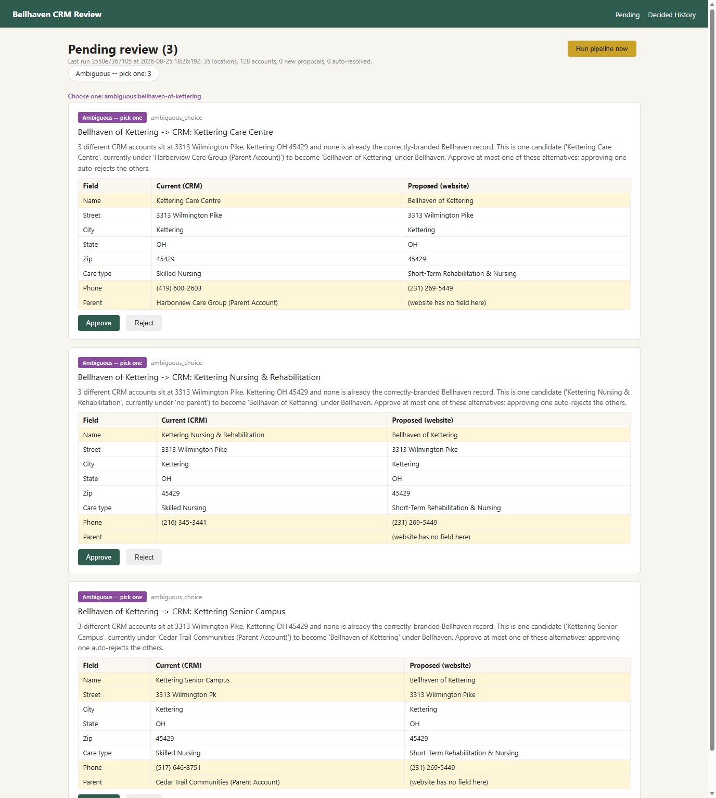
Screenshot: Pending Review Queue
• The 3 Kettering alternatives, live in the app -- rendered as a "Choose one" group.
• Each card shows the full current-vs-proposed field diff, plus which parent/account it would come from.
• Approving any one of the three automatically rejects the other two -- enforced by the app, not left to the reviewer to remember.
15

Slide 16
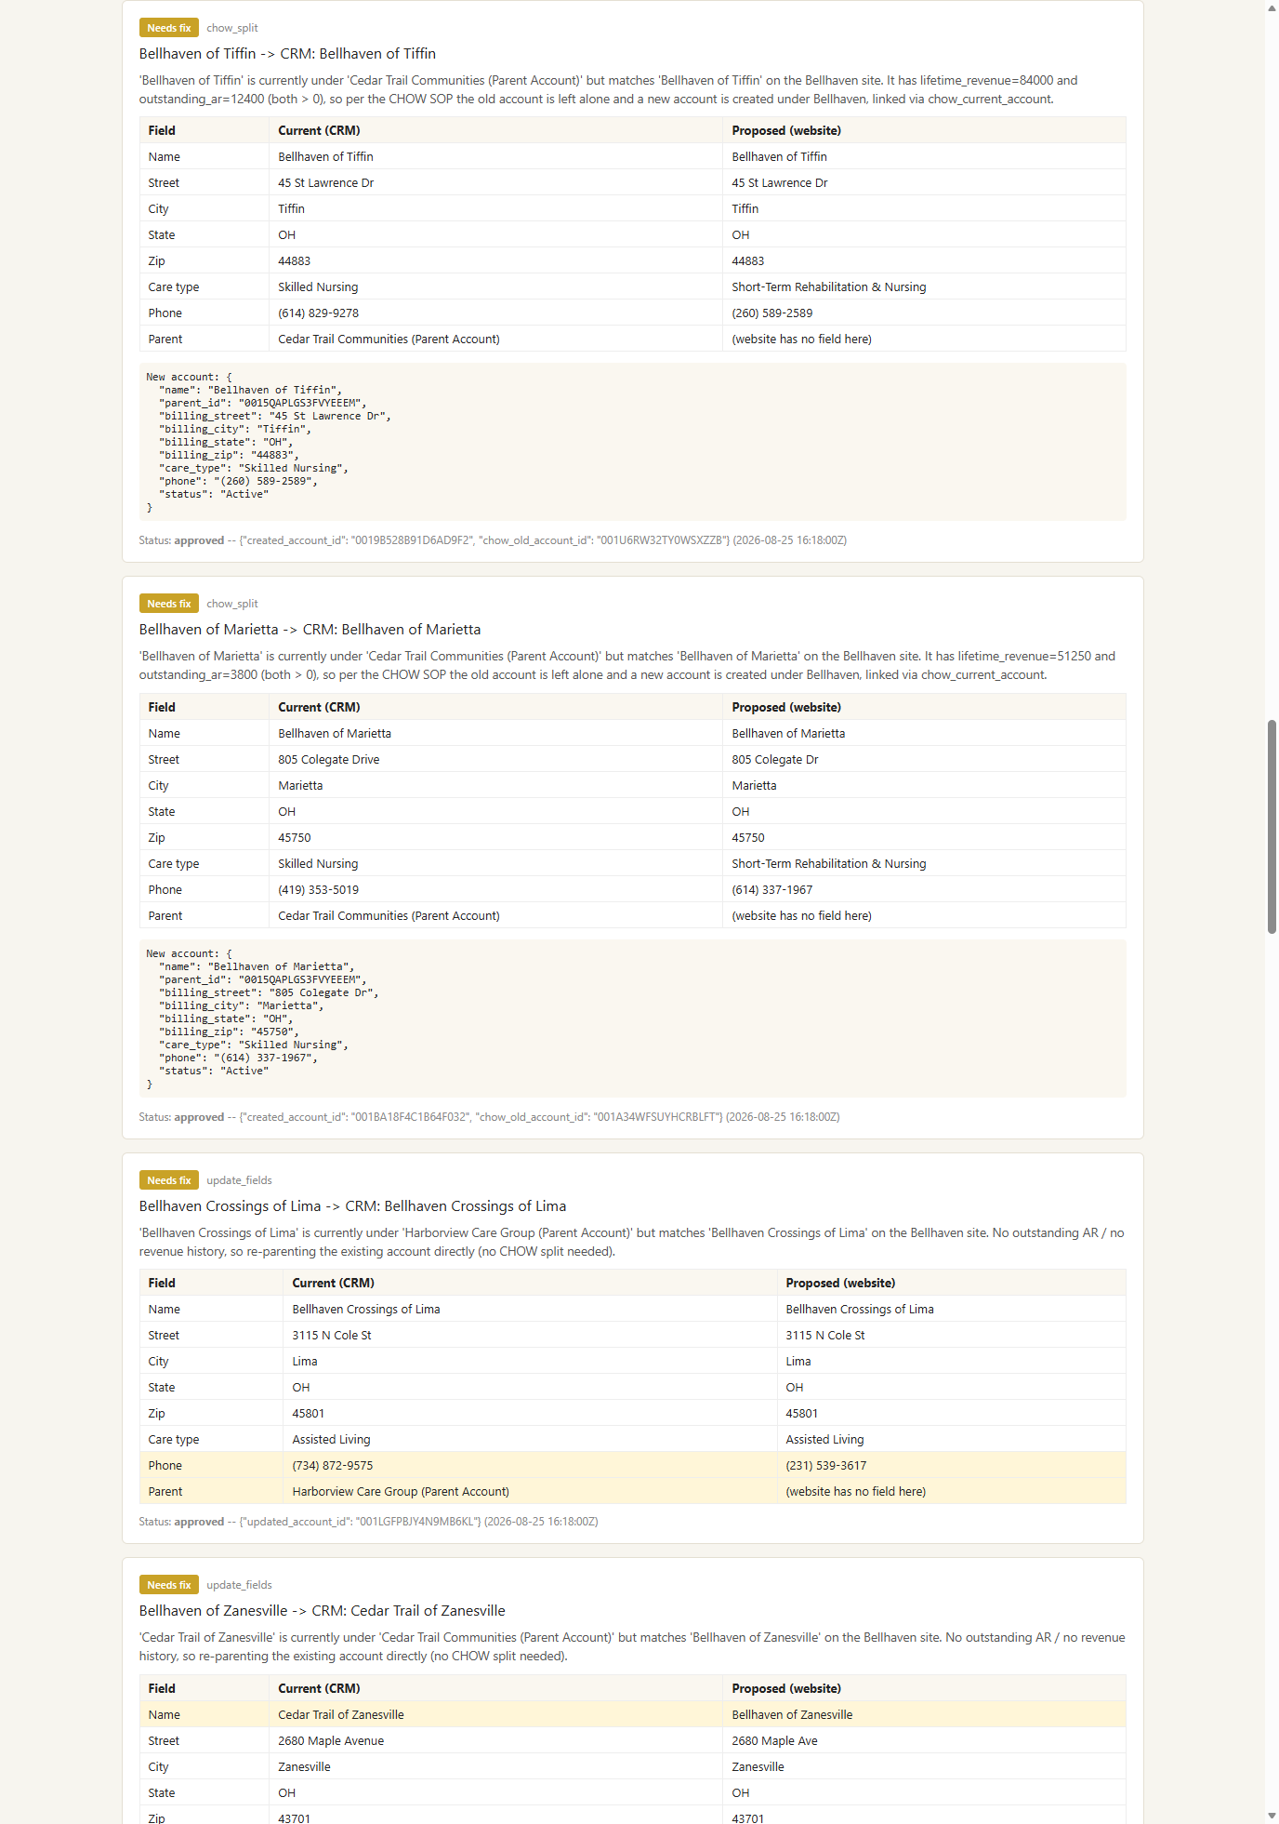
Screenshot: A Real CHOW Split, Approved
• Decided History for Bellhaven of Tiffin: rationale, full diff table, the exact new-account JSON payload that was POSTed, and the applied result -- created_account_id + chow_old_account_id -- all in one card.
• Directly below it, Lima's direct re-parent (no CHOW needed) shows the contrast: same 'Needs fix' classification, different resolution, because outstanding_ar was 0.
16

Slide 17
Built to Run Daily
• schedule/crontab.example -- a plain cron entry running pipeline.py once a day.
• .github/workflows/daily-pipeline.yml -- equivalent GitHub Actions schedule (cron trigger + manual workflow_dispatch).
• Neither is live, per the assignment -- both are ready to enable.
• The GitHub Actions version commits data/pipeline.db back to the repo after each run, so the idempotency ledger survives between ephemeral runner instances.
17

Slide 18
Results: What Actually Landed in the CRM
• 35 locations scraped, 121 CRM accounts at the start -- 36 proposals generated on the first run.
• 33 approved and applied through the real review app: 13 field syncs, 6 renames/re-parents, 2 CHOW splits, 5 duplicates marked Inactive, 3 orphans flagged Needs Review, 4 new accounts created.
• 2 more surfaced on the very next run and were rejected: the expected post-CHOW same-address flags on the Tiffin/Marietta OLD accounts -- correctly left untouched per the SOP.
• 3 left pending on purpose: the Kettering ambiguous-alternatives group -- see below.
• Every CHOW split, duplicate, and orphan outcome was individually verified against the live CRM API after approval, not assumed from the proposal text.
18

Slide 19
Full Change Log (1/2)
# | Location / Account | Classification | What Happened
1 | Bellhaven of Goshen | Confident match | Updated: phone
2 | Bellhaven of Defiance | Confident match | Updated: phone
3 | Bellhaven Woods of Toledo | Confident match | Updated: billing_street
4 | Bellhaven of Marion | Confident match | Updated: phone
5 | Bellhaven Rehab & Nursing of Grove City | Confident match | Updated: name
6 | Bellhaven at Sycamore Ridge | Confident match | Updated: phone
7 | The Arbors at Bellhaven - Dayton | Confident match | Updated: phone
8 | Bellhaven Healthcare Centre of Ashland | Confident match | Updated: name, phone
9 | Bellhaven of Port Clinton | Confident match | Updated: phone
10 | Harborview Nursing & Rehab of Port Clinton | Duplicate | duplicate_of_account -> Port Clinton, Inactive
11 | Bellhaven Shores of Erie | Confident match | Updated: phone
12 | Harborview Shores of Erie | Duplicate | duplicate_of_account -> Bellhaven Shores of Erie, Inactive
16 | Bellhaven Gardens of Monroe | Confident match | Updated: phone
17 | Monroe Gardens Care Center | Duplicate | duplicate_of_account -> Gardens of Monroe, Inactive
18 | Cedar Trail of Monroe | Duplicate | duplicate_of_account -> Gardens of Monroe, Inactive
19 | Bellhaven of Tiffin | Needs fix | CHOW split -- old preserved, new account created
20 | Bellhaven of Marietta | Needs fix | CHOW split -- old preserved, new account created
21 | Bellhaven Crossings of Lima | Needs fix | Updated: parent_id, phone (direct re-parent)
19

Slide 20
Full Change Log (2/2)
# | Location / Account | Classification | What Happened
22 | Bellhaven of Zanesville | Needs fix | Updated: parent_id, name, phone
23 | Bellhaven of Chagrin Falls | Needs fix | Updated: name, phone (rename only)
24 | Bellhaven Willow Creek | Needs fix | Updated: name, phone (rename only)
25 | Bellhaven of Ashtabula | Confident match | Updated: billing_street (PO box -> physical)
26 | Bellhaven of Owosso (dup) | Duplicate | duplicate_of_account -> Owosso, Inactive
27 | Bellhaven of Portsmouth | Confident match | Updated: billing_zip (typo fix)
28 | Bellhaven of Batavia | New location | Created under Bellhaven
29 | Bellhaven at Union Square | New location | Created under Bellhaven
30 | Bellhaven of Carlisle | New location | Created under Bellhaven
31 | Amberly Manor (Hudson, OH) | New location | Created under Bellhaven
32 | Bellhaven of Chesterton | Needs fix | Updated: name, billing_street
33 | Bellhaven Meadows of Findlay | Needs fix | Updated: parent_id, phone (direct re-parent)
34 | Bellhaven Care Center of Alliance | Orphan | status -> Needs Review + note
35 | Bellhaven of Coldwater | Orphan | status -> Needs Review + note
36 | Bellhaven of Sandusky | Orphan | status -> Needs Review + note (has $130k rev / $5.2k AR)
37 | Bellhaven of Tiffin (OLD, post-CHOW) | Rejected | flag_review REJECTED -- old account left untouched, per SOP
38 | Bellhaven of Marietta (OLD, post-CHOW) | Rejected | flag_review REJECTED -- old account left untouched, per SOP
20

Slide 21
Kettering: Left Unresolved, Deliberately
• Three different CRM accounts sit at 3313 Wilmington Pike -- "Kettering Care Centre" (Harborview), "Kettering Nursing & Rehabilitation" (unparented), "Kettering Senior Campus" (Cedar Trail).
• None is already correctly named or parented for Bellhaven. All three have zero revenue and zero AR -- no billing signal to break the tie.
• Nothing in the scraped data indicates which pre-acquisition entity is meant to continue as "Bellhaven of Kettering."
• Auto-picking one risked silently misattributing history to the wrong legal entity, so the pipeline proposes all three as mutually exclusive alternatives and leaves the decision pending for a person with more context (e.g. corporate development).
21

Slide 22
What I'd Do Differently With More Time
• The fuzzy-matching thresholds in matcher.py are hand-tuned against this dataset -- a production version would want a labeled match/no-match set to validate against.
• care_type is single-select in the CRM but the website lists multiple care offerings for a few communities (e.g. Erie) -- currently maps to the first offering only.
• The SQLite ledger works at this scale (~120 accounts); at real scale, a hosted DB would replace the git-commit-as-database approach used in the GitHub Actions workflow.
22

Slide 23
Repository
• github.com/dparikh066-stack/bellhaven-crm-pipeline
• scraper.py, crm_client.py, matcher.py, store.py, pipeline.py, apply.py, review_app/
• schedule/crontab.example, .github/workflows/daily-pipeline.yml
• README.md (setup + quick start), WRITEUP.md (full design rationale)
23

