Slide 1
DEPO / INDUSTRIAL DATA PLATFORM
Enterprise
software architecture
Ontology alignment, governed agents and reusable data products
C4 • UML • TOGAF-aligned architecture views
16 October 2026 | Repository baseline 0d728b9
Notes:
Architecture baseline: repository commit 0d728b9, reviewed 16 October 2026.
Sources:
D:\paritosh\PMem-codex-apach_agent\infra\deployment\services.json
D:\paritosh\PMem-codex-apach_agent\docs\DATA_PRODUCT_INGESTION.md
D:\paritosh\PMem-codex-apach_agent\INSTALLATION.md
Implementation statements describe the repository. Live customer deployment acceptance remains separate.

Slide 2
ARCHITECTURE DECISIONS
Architecture scope and TOGAF-aligned layers
Four architecture domains organize the views; this is an implementation architecture, not a certification claim.
Layer | Architecture responsibility | DEPO implementation
Business | Engineering meaning, stewardship and reusable evidence | Ontology review, instance linking, governed products
Application | Service responsibilities and permitted interactions | 10 APIs, 3 workers, React / Siemens IX frontend
Data | Identity, lineage, persistence and publication outcomes | PostgreSQL, Neo4j and immutable artifact references
Technology | Runtime, network, security and operational readiness | Windows deployment, optional gateway, Spark and Ollama
Scope: repository capabilities and customer deployment controls; untested external connectors remain deployment work.
DEPO / Industrial data architecture / 16 October 2026
02
Notes:
Architecture baseline: repository commit 0d728b9, reviewed 16 October 2026.
Sources:
D:\paritosh\PMem-codex-apach_agent\docs\DATA_PRODUCT_INGESTION.md
D:\paritosh\PMem-codex-apach_agent\infra\deployment\services.json
Implementation statements describe the repository. Live customer deployment acceptance remains separate.

Slide 3
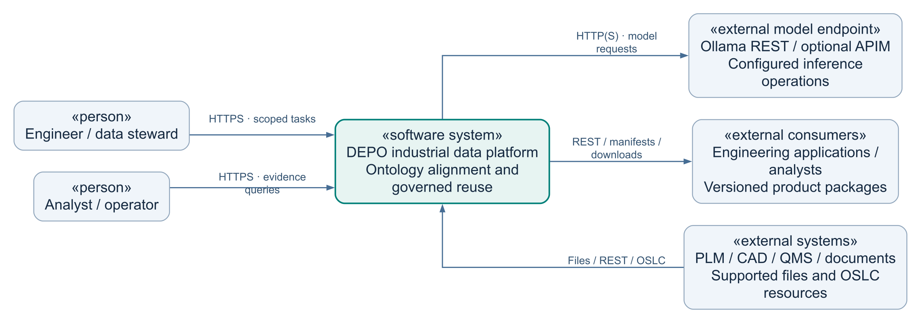
ARCHITECTURE VIEWS
C4 context — users, platform and external systems
Level 1 · DEPO is the system of interest; external systems remain outside its authority.
WHAT
Industrial semantic integration and reuse.
WHY
Preserve meaning and evidence across systems.
WHO
Engineers, stewards, analysts and operators.
WHEN
Import, align, query and publish tasks.
WHERE
Customer application and private data services.
HOW
Scoped APIs, supported files and model REST.
DEPO / Industrial data architecture / 16 October 2026
03
Notes:
Architecture baseline: repository commit 0d728b9, reviewed 16 October 2026.
Sources:
D:\paritosh\PMem-codex-apach_agent\docs\DATA_PRODUCT_INGESTION.md
D:\paritosh\PMem-codex-apach_agent\infra\deployment\services.json
C4 System Context. External source coverage depends on supported parsers and configured adapters.
Implementation statements describe the repository. Live customer deployment acceptance remains separate.

Slide 4
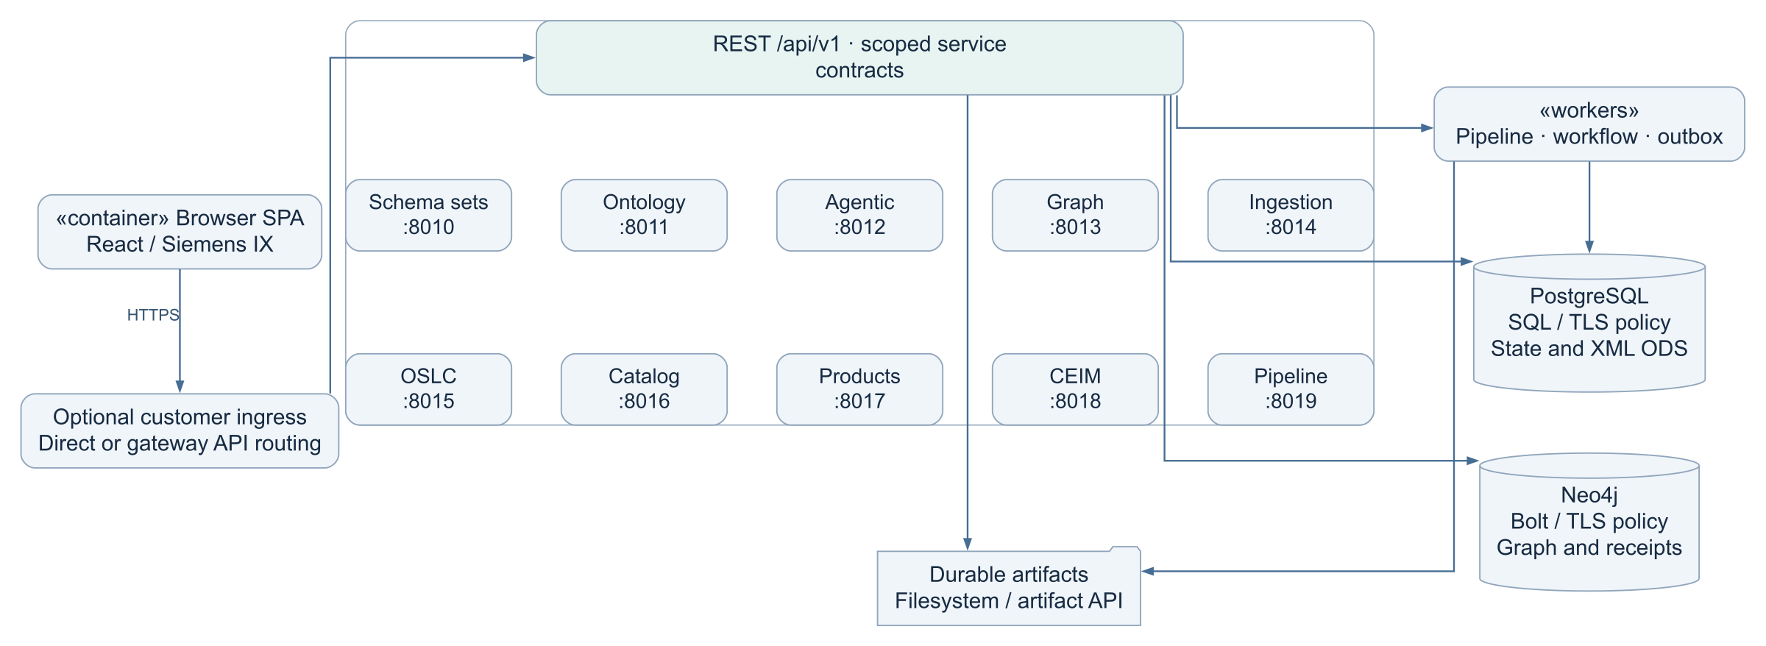
ARCHITECTURE VIEWS
C4 containers — ten APIs and three workers
Level 2 · Container names and ports follow the deployment manifest.
WHAT
Deployable APIs, workers and persistent stores.
WHY
Separate request handling from durable execution.
WHO
Frontend, domain services and worker processes.
WHEN
Interactive requests and queued background work.
WHERE
Internal ports 8010–8019; public routing is configurable.
HOW
REST, PostgreSQL leases, artifacts and Bolt.
DEPO / Industrial data architecture / 16 October 2026
04
Notes:
Architecture baseline: repository commit 0d728b9, reviewed 16 October 2026.
Sources:
D:\paritosh\PMem-codex-apach_agent\infra\deployment\services.json
D:\paritosh\PMem-codex-apach_agent\frontend\src\config.js
D:\paritosh\PMem-codex-apach_agent\infra\windows\runtime-config.ps1
C4 Container. Gateway is optional. Storage arrows summarize ownership rather than enumerate every read connection.
Implementation statements describe the repository. Live customer deployment acceptance remains separate.

Slide 5
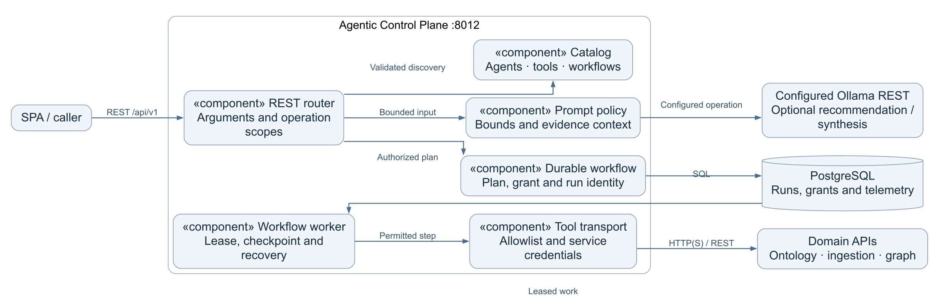
ARCHITECTURE VIEWS
C4 components — agentic execution boundary
Level 3 · Recommendations and durable workflows share the validated tool catalog.
WHAT
Agent discovery, planning and permitted tool execution.
WHY
Keep model suggestions behind service authorization.
WHO
Agentic router, workflow worker and domain APIs.
WHEN
Recommendation and approved multi-step workflows.
WHERE
Agentic :8012 with PostgreSQL run state.
HOW
Validated catalog, grants, leases and bounded tools.
DEPO / Industrial data architecture / 16 October 2026
05
Notes:
Architecture baseline: repository commit 0d728b9, reviewed 16 October 2026.
Sources:
D:\paritosh\PMem-codex-apach_agent\backend\agentic_service\catalog.json
D:\paritosh\PMem-codex-apach_agent\backend\agentic_service\durable_workflows.py
D:\paritosh\PMem-codex-apach_agent\backend\agentic_service\worker.py
D:\paritosh\PMem-codex-apach_agent\backend\agentic_service\transport_auth.py
C4 Component. LLM assistance is optional; agents do not self-authorize protected operations.
Implementation statements describe the repository. Live customer deployment acceptance remains separate.

Slide 6
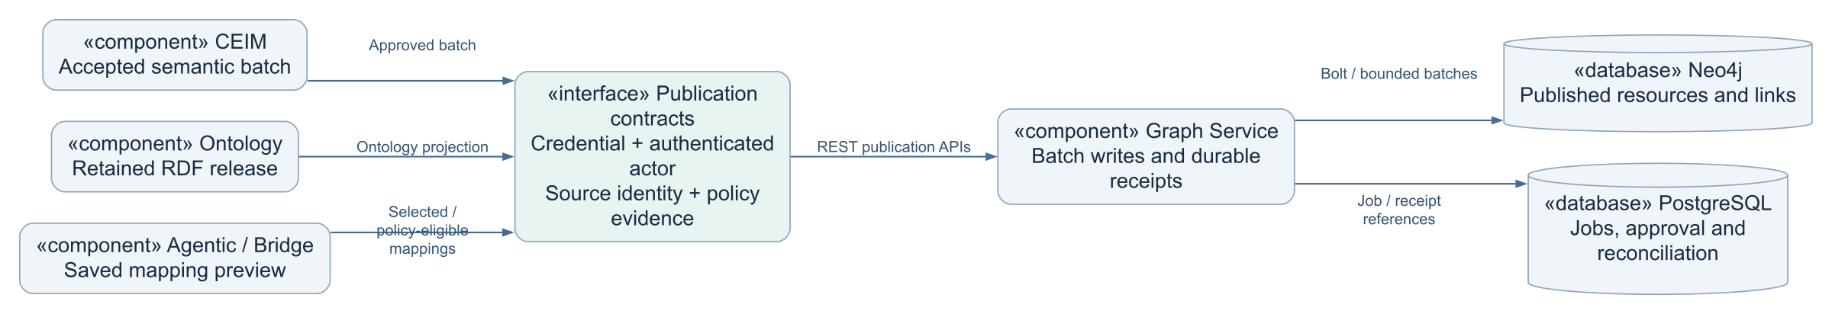
ARCHITECTURE VIEWS
UML components — governed graph publication
Ontology projection, CEIM batches and Bridge links have separate contracts.
WHAT
Distinct publication contracts converge on graph writes.
WHY
Prevent hidden writes and ambiguous completion.
WHO
Ontology, CEIM, Agentic and Graph services.
WHEN
After source and policy evidence satisfy a contract.
WHERE
Private Graph API and named Neo4j database.
HOW
Scoped credentials, batched writes and receipts.
DEPO / Industrial data architecture / 16 October 2026
06
Notes:
Architecture baseline: repository commit 0d728b9, reviewed 16 October 2026.
Sources:
D:\paritosh\PMem-codex-apach_agent\backend\ontology_service\publication_jobs.py
D:\paritosh\PMem-codex-apach_agent\backend\agentic_service\bridge_jobs.py
D:\paritosh\PMem-codex-apach_agent\backend\graph_service\router.py
UML Component view. Product packaging and ODS commits are independent persistence outcomes.
Implementation statements describe the repository. Live customer deployment acceptance remains separate.

Slide 7
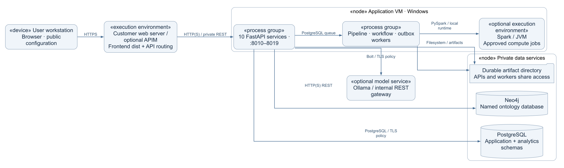
ARCHITECTURE VIEWS
UML deployment — customer runtime and network zones
The deployment can use direct service URLs or a configured gateway.
WHAT
Browser, ingress, APIs, workers and data services.
WHY
Expose the UI while containing privileged data access.
WHO
Customer operations and service identities.
WHEN
Installation, normal operation and recovery.
WHERE
Application VM and private database network.
HOW
Reviewed routing, TLS policy and durable storage.
DEPO / Industrial data architecture / 16 October 2026
07
Notes:
Architecture baseline: repository commit 0d728b9, reviewed 16 October 2026.
Sources:
D:\paritosh\PMem-codex-apach_agent\infra\deployment\services.json
D:\paritosh\PMem-codex-apach_agent\frontend\src\config.js
D:\paritosh\PMem-codex-apach_agent\infra\windows\runtime-config.ps1
D:\paritosh\PMem-codex-apach_agent\INSTALLATION.md
D:\paritosh\PMem-codex-apach_agent\infra\windows\install-depo-windows.ps1
D:\paritosh\PMem-codex-apach_agent\infra\windows\update-depo-windows.ps1
D:\paritosh\PMem-codex-apach_agent\backend\postgres_migrations.py
UML Deployment. Diagram is a deployment pattern; VM placement, firewall rules and TLS require customer acceptance.
Implementation statements describe the repository. Live customer deployment acceptance remains separate.

Slide 8
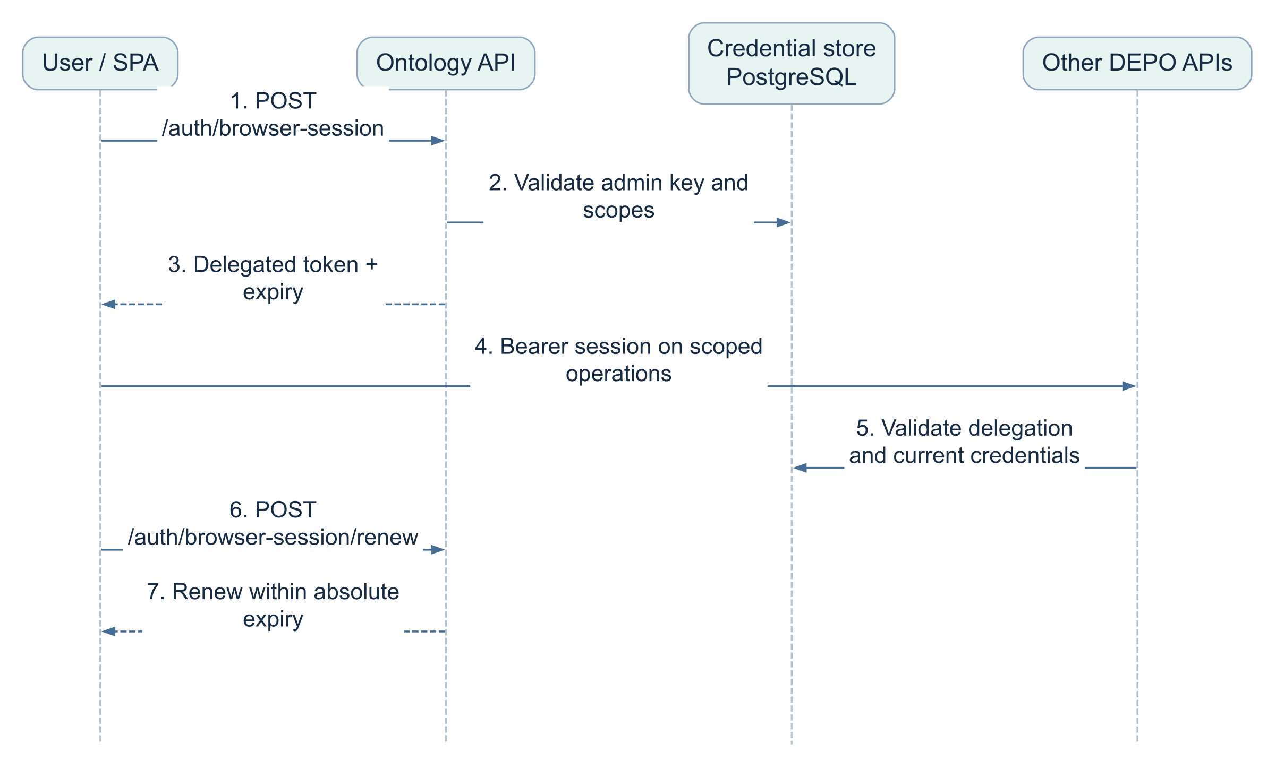
ARCHITECTURE VIEWS
UML sequence — delegated browser access
Reconnection restores access; expiry does not undo completed writes.
WHAT
A bounded browser session with selected scopes.
WHY
Avoid repeated raw-key entry during active use.
WHO
User, ontology session API and protected APIs.
WHEN
Connect, authorized requests and active renewal.
WHERE
Browser token; PostgreSQL credential validation.
HOW
Admin verification, delegation and absolute expiry.
DEPO / Industrial data architecture / 16 October 2026
08
Notes:
Architecture baseline: repository commit 0d728b9, reviewed 16 October 2026.
Sources:
D:\paritosh\PMem-codex-apach_agent\frontend\src\services\serviceAuth.js
D:\paritosh\PMem-codex-apach_agent\backend\depo_platform\browser_credentials.py
D:\paritosh\PMem-codex-apach_agent\frontend\src\app\RunRecoveryNotice.js
UML Sequence. Renewal remains bounded by absolute expiry. Revoked or fully expired access requires reconnection.
Implementation statements describe the repository. Live customer deployment acceptance remains separate.

Slide 9
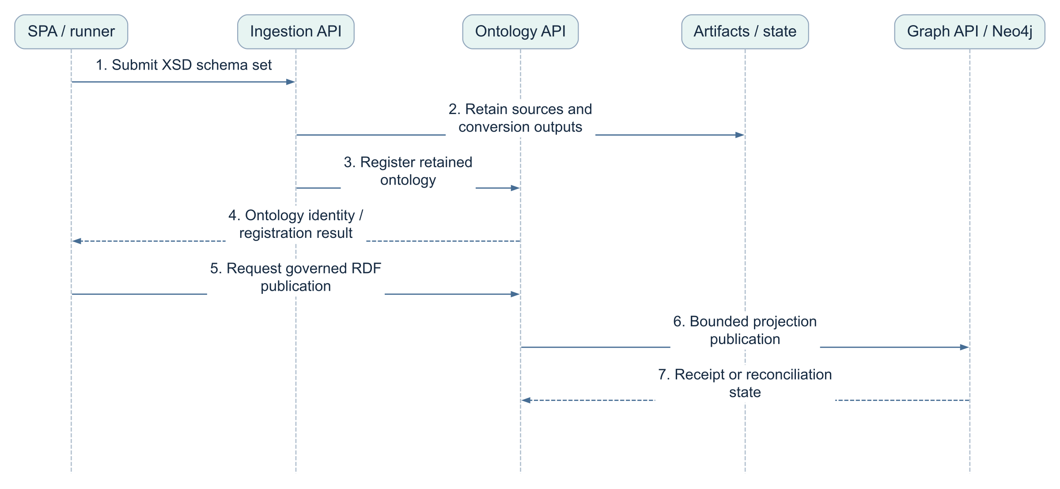
ARCHITECTURE VIEWS
UML sequence — source registration and RDF publication
A registered ontology and a published RDF projection are separate states.
WHAT
Create an ontology from retained engineering inputs.
WHY
Separate registration evidence from graph availability.
WHO
User, ingestion, ontology and graph services.
WHEN
Schema conversion, then authorized publication.
WHERE
Artifacts and PostgreSQL; RDF projection in Neo4j.
HOW
Retained identity, publication job and receipt.
DEPO / Industrial data architecture / 16 October 2026
09
Notes:
Architecture baseline: repository commit 0d728b9, reviewed 16 October 2026.
Sources:
D:\paritosh\PMem-codex-apach_agent\backend\ontology_service\publication_jobs.py
D:\paritosh\PMem-codex-apach_agent\backend\agentic_service\bridge_jobs.py
D:\paritosh\PMem-codex-apach_agent\backend\graph_service\router.py
D:\paritosh\PMem-codex-apach_agent\backend\ingestion_service\router.py
UML Sequence. Logical handoffs omit internal validation calls; clients must inspect retained outcomes after response loss.
Implementation statements describe the repository. Live customer deployment acceptance remains separate.

Slide 10
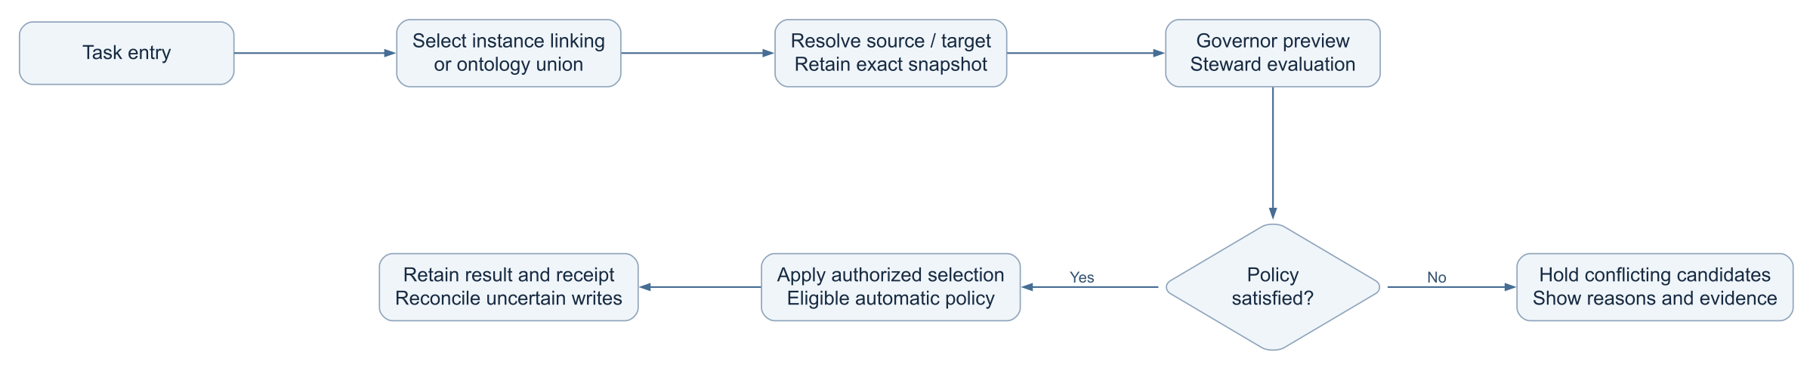
ARCHITECTURE VIEWS
UML activity — Semantic Bridge decision flow
Automatic policy routes hold unsupported, stale or conflicting candidates.
WHAT
Instance linking or ontology-to-ontology union.
WHY
Keep task types and conflict decisions explicit.
WHO
Governor, steward, authorized user and services.
WHEN
After exact source and target selection.
WHERE
Ontology Junction / Semantic Bridge and workers.
HOW
Preview, policy evaluation and retained outcomes.
DEPO / Industrial data architecture / 16 October 2026
10
Notes:
Architecture baseline: repository commit 0d728b9, reviewed 16 October 2026.
Sources:
D:\paritosh\PMem-codex-apach_agent\backend\agentic_service\catalog.json
D:\paritosh\PMem-codex-apach_agent\backend\agentic_service\durable_workflows.py
D:\paritosh\PMem-codex-apach_agent\backend\agentic_service\worker.py
D:\paritosh\PMem-codex-apach_agent\backend\agentic_service\transport_auth.py
D:\paritosh\PMem-codex-apach_agent\backend\ontology_service\publication_jobs.py
D:\paritosh\PMem-codex-apach_agent\backend\agentic_service\bridge_jobs.py
D:\paritosh\PMem-codex-apach_agent\backend\graph_service\router.py
UML Activity. Automatic publication remains subject to server policy and supplied authorization.
Implementation statements describe the repository. Live customer deployment acceptance remains separate.

Slide 11
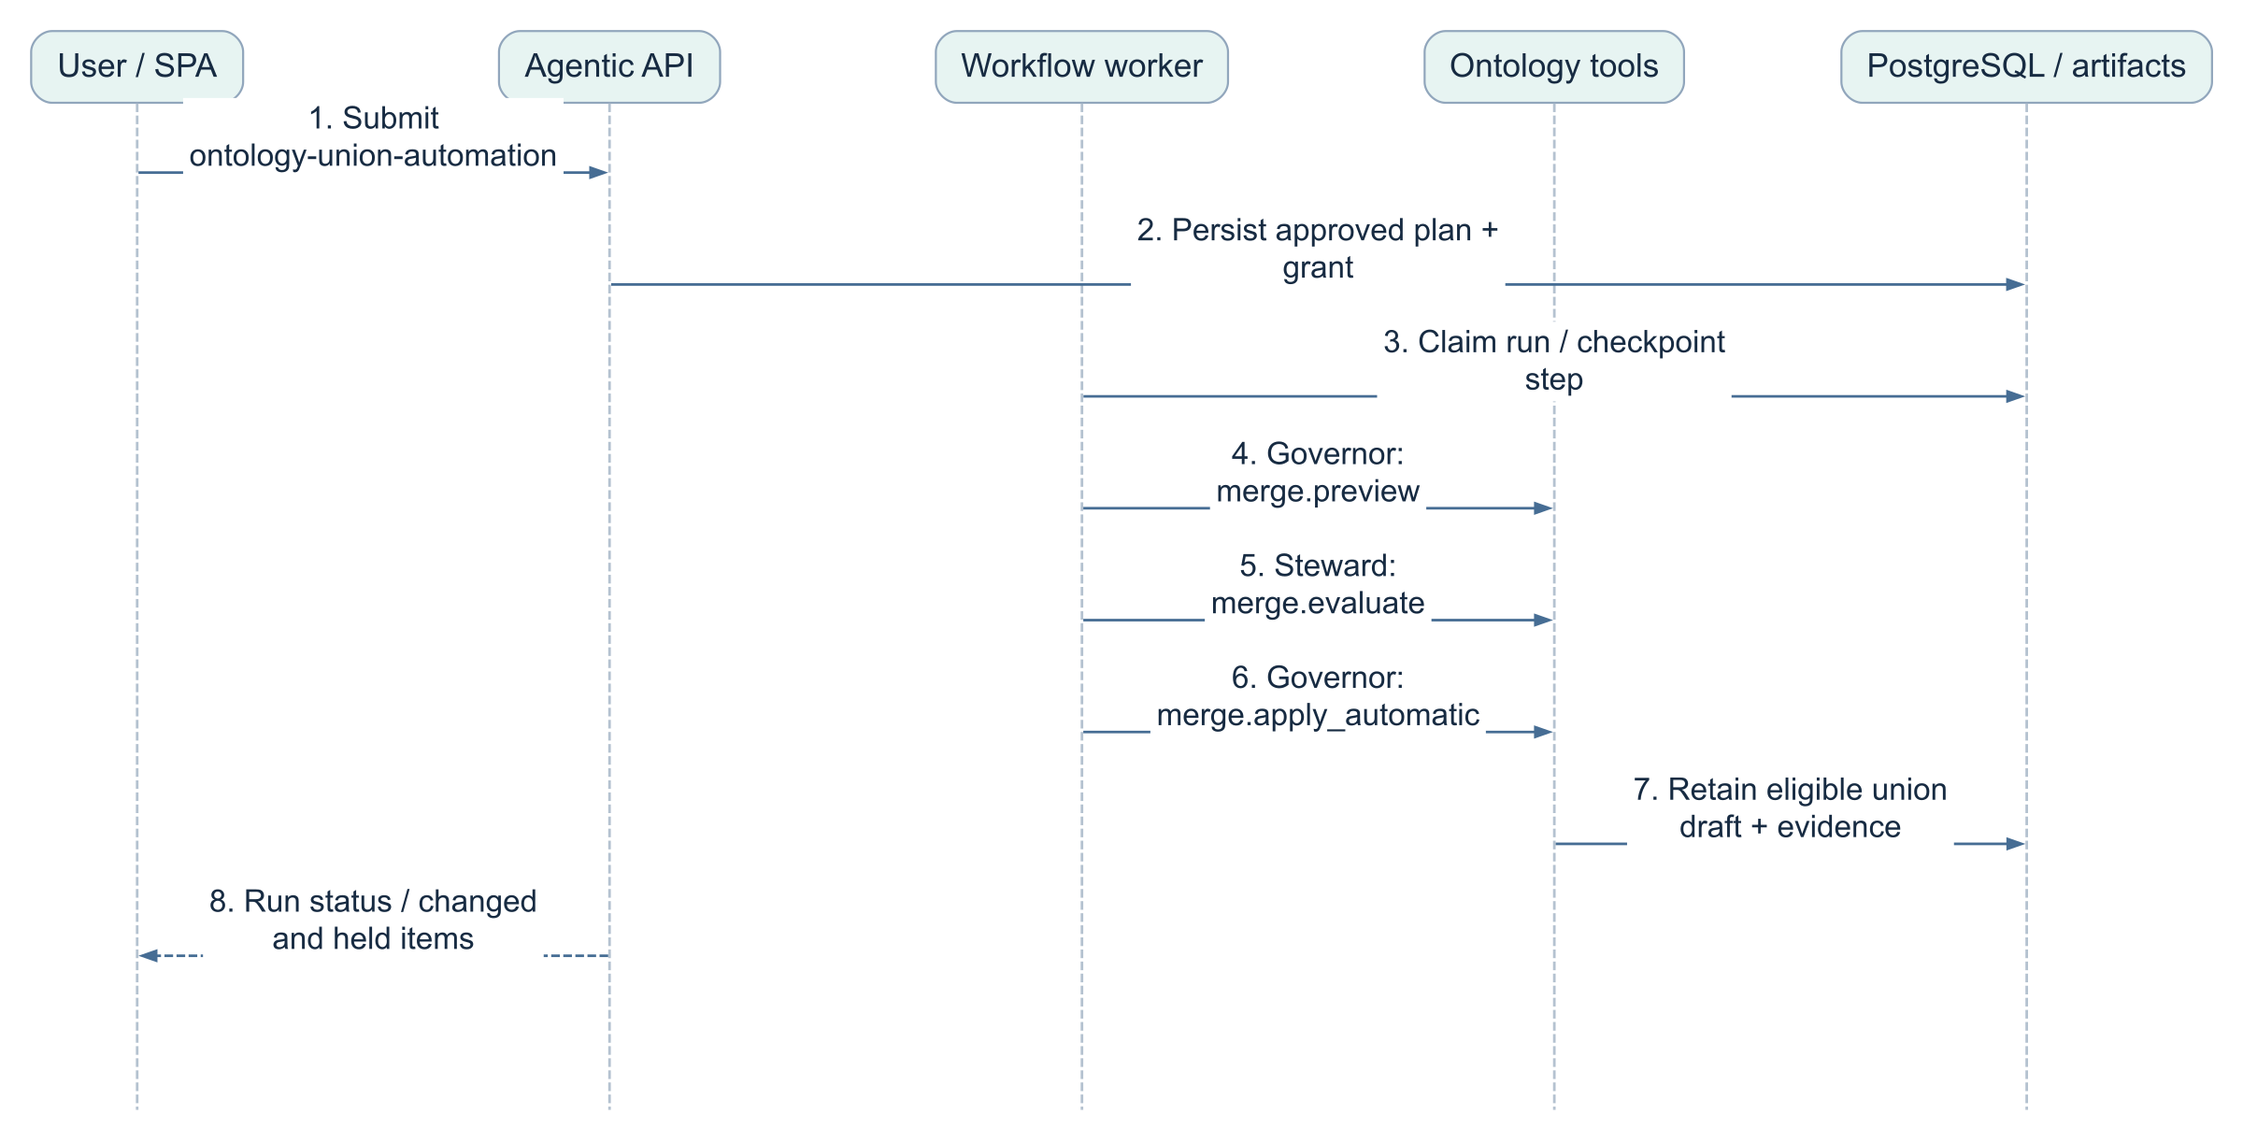
ARCHITECTURE VIEWS
UML sequence — automated ontology union draft
The workflow creates an eligible union draft; graph publication is a separate outcome.
WHAT
A retained union draft with evaluation evidence.
WHY
Reduce repetitive review without bypassing policy.
WHO
Governor previews; steward evaluates; governor applies.
WHEN
Authorized ontology-union-automation run.
WHERE
Agentic worker, ontology tools and retained stores.
HOW
Checkpointed preview, evaluate and eligible apply.
DEPO / Industrial data architecture / 16 October 2026
11
Notes:
Architecture baseline: repository commit 0d728b9, reviewed 16 October 2026.
Sources:
D:\paritosh\PMem-codex-apach_agent\backend\agentic_service\catalog.json
D:\paritosh\PMem-codex-apach_agent\backend\agentic_service\durable_workflows.py
D:\paritosh\PMem-codex-apach_agent\backend\agentic_service\worker.py
D:\paritosh\PMem-codex-apach_agent\backend\agentic_service\transport_auth.py
UML Sequence. Tool names and workflow steps follow backend/agentic_service/catalog.json.
Implementation statements describe the repository. Live customer deployment acceptance remains separate.

Slide 12
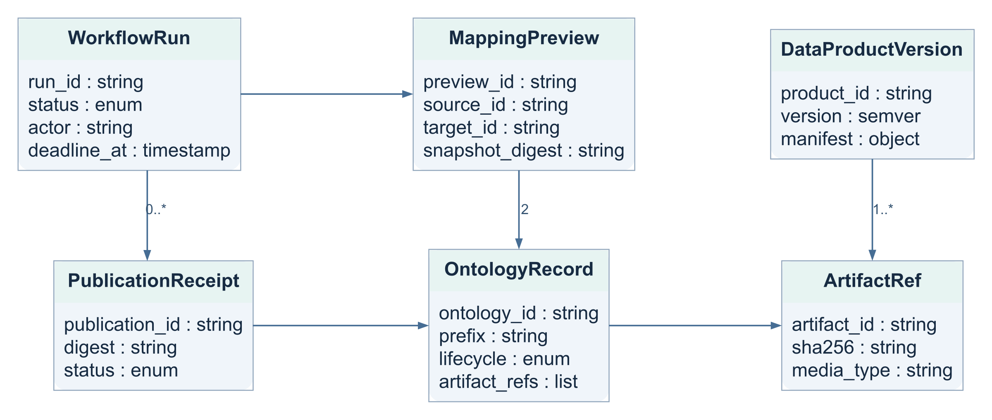
ARCHITECTURE VIEWS
UML class view — retained domain identities
Logical domain model · records may be JSON documents rather than ORM classes.
WHAT
Logical records and their evidence relationships.
WHY
Keep source, run, publication and product identities distinct.
WHO
Domain services own records; clients use references.
WHEN
Across review, execution and publication.
WHERE
PostgreSQL records plus referenced artifacts.
HOW
Stable keys, digests and explicit cardinalities.
DEPO / Industrial data architecture / 16 October 2026
12
Notes:
Architecture baseline: repository commit 0d728b9, reviewed 16 October 2026.
Sources:
D:\paritosh\PMem-codex-apach_agent\docs\DATA_PRODUCT_INGESTION.md
D:\paritosh\PMem-codex-apach_agent\backend\data_pipeline_service\router.py
D:\paritosh\PMem-codex-apach_agent\backend\depo_platform\database_setup.py
D:\paritosh\PMem-codex-apach_agent\backend\agentic_service\catalog.json
D:\paritosh\PMem-codex-apach_agent\backend\agentic_service\durable_workflows.py
D:\paritosh\PMem-codex-apach_agent\backend\agentic_service\worker.py
D:\paritosh\PMem-codex-apach_agent\backend\agentic_service\transport_auth.py
UML Class diagram is conceptual. Field names summarize domain contracts and do not claim one SQL table or Python class per box.
Implementation statements describe the repository. Live customer deployment acceptance remains separate.

Slide 13
ARCHITECTURE DECISIONS
Data ownership — application state, ODS, RDF and artifacts
Storage responsibilities follow independent commit and publication boundaries.
Store | Owned data | Important boundary
PostgreSQL application schema | 10 tables and 1 analytics view; registry namespaces, credentials and runs | Migrations 001–011; namespaces share relations
PostgreSQL analytics schemas | One versioned schema per retained XSD closure / prefix; XML entities and links | Fact / dimension views require explicit grain and keys
Neo4j | Published RDF resources, semantic relationships and publication evidence | Registration alone does not establish publication
Durable artifact storage | Original bytes, RDF, reports, load receipts and product packages | Retention and access policies apply to each artifact
A product package references selected evidence; it does not automatically export every ODS row or the entire graph.
DEPO / Industrial data architecture / 16 October 2026
13
Notes:
Architecture baseline: repository commit 0d728b9, reviewed 16 October 2026.
Sources:
D:\paritosh\PMem-codex-apach_agent\docs\DATA_PRODUCT_INGESTION.md
D:\paritosh\PMem-codex-apach_agent\backend\data_pipeline_service\router.py
D:\paritosh\PMem-codex-apach_agent\backend\depo_platform\database_setup.py
Implementation statements describe the repository. Live customer deployment acceptance remains separate.

Slide 14
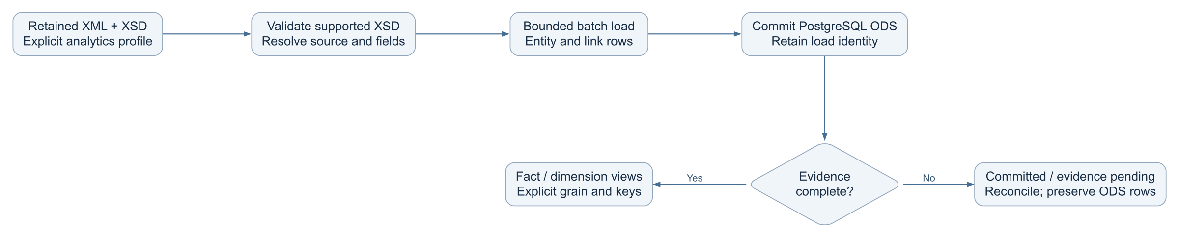
ARCHITECTURE VIEWS
UML activity — XML ODS and data-mart preparation
Business grain and history policy remain explicit; arbitrary files do not define a data mart.
WHAT
Validated XML becomes structural PostgreSQL data.
WHY
Keep a committed load recoverable after evidence failure.
WHO
Pipeline worker and explicit analytics profile.
WHEN
Supported XSD projection and XML instance load.
WHERE
Versioned analytics schema in PostgreSQL.
HOW
Bounded batches, commit receipt and reconciliation.
DEPO / Industrial data architecture / 16 October 2026
14
Notes:
Architecture baseline: repository commit 0d728b9, reviewed 16 October 2026.
Sources:
D:\paritosh\PMem-codex-apach_agent\docs\DATA_PRODUCT_INGESTION.md
D:\paritosh\PMem-codex-apach_agent\backend\data_pipeline_service\router.py
D:\paritosh\PMem-codex-apach_agent\backend\depo_platform\database_setup.py
UML Activity. Current ODS path is XSD/XML. CSV/XLSX-to-ODS and SCD/conformed dimensions need separate contracts.
Implementation statements describe the repository. Live customer deployment acceptance remains separate.

Slide 15
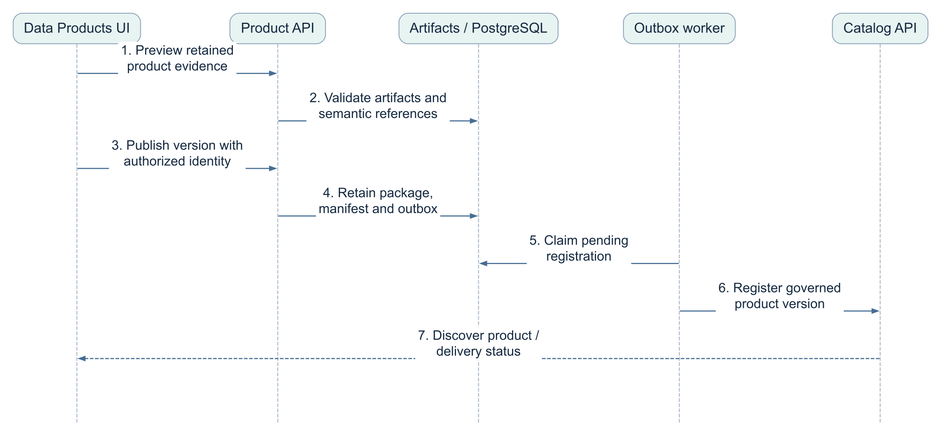
ARCHITECTURE VIEWS
Sequence — product packaging and catalog delivery
Catalog retries reconcile registration; they do not rerun ingestion.
WHAT
A versioned package and discoverable catalog record.
WHY
Separate durable packaging from delivery retries.
WHO
Product API, outbox worker and catalog service.
WHEN
After evidence and authorization validate.
WHERE
Artifact packages and PostgreSQL product state.
HOW
Preview, immutable package and outbox reconciliation.
DEPO / Industrial data architecture / 16 October 2026
15
Notes:
Architecture baseline: repository commit 0d728b9, reviewed 16 October 2026.
Sources:
D:\paritosh\PMem-codex-apach_agent\docs\DATA_PRODUCT_INGESTION.md
D:\paritosh\PMem-codex-apach_agent\backend\data_pipeline_service\router.py
D:\paritosh\PMem-codex-apach_agent\backend\depo_platform\database_setup.py
D:\paritosh\PMem-codex-apach_agent\backend\data_product_service\router.py
UML Sequence. Package publication, graph publication and catalog registration have distinct completion evidence.
Implementation statements describe the repository. Live customer deployment acceptance remains separate.

Slide 16
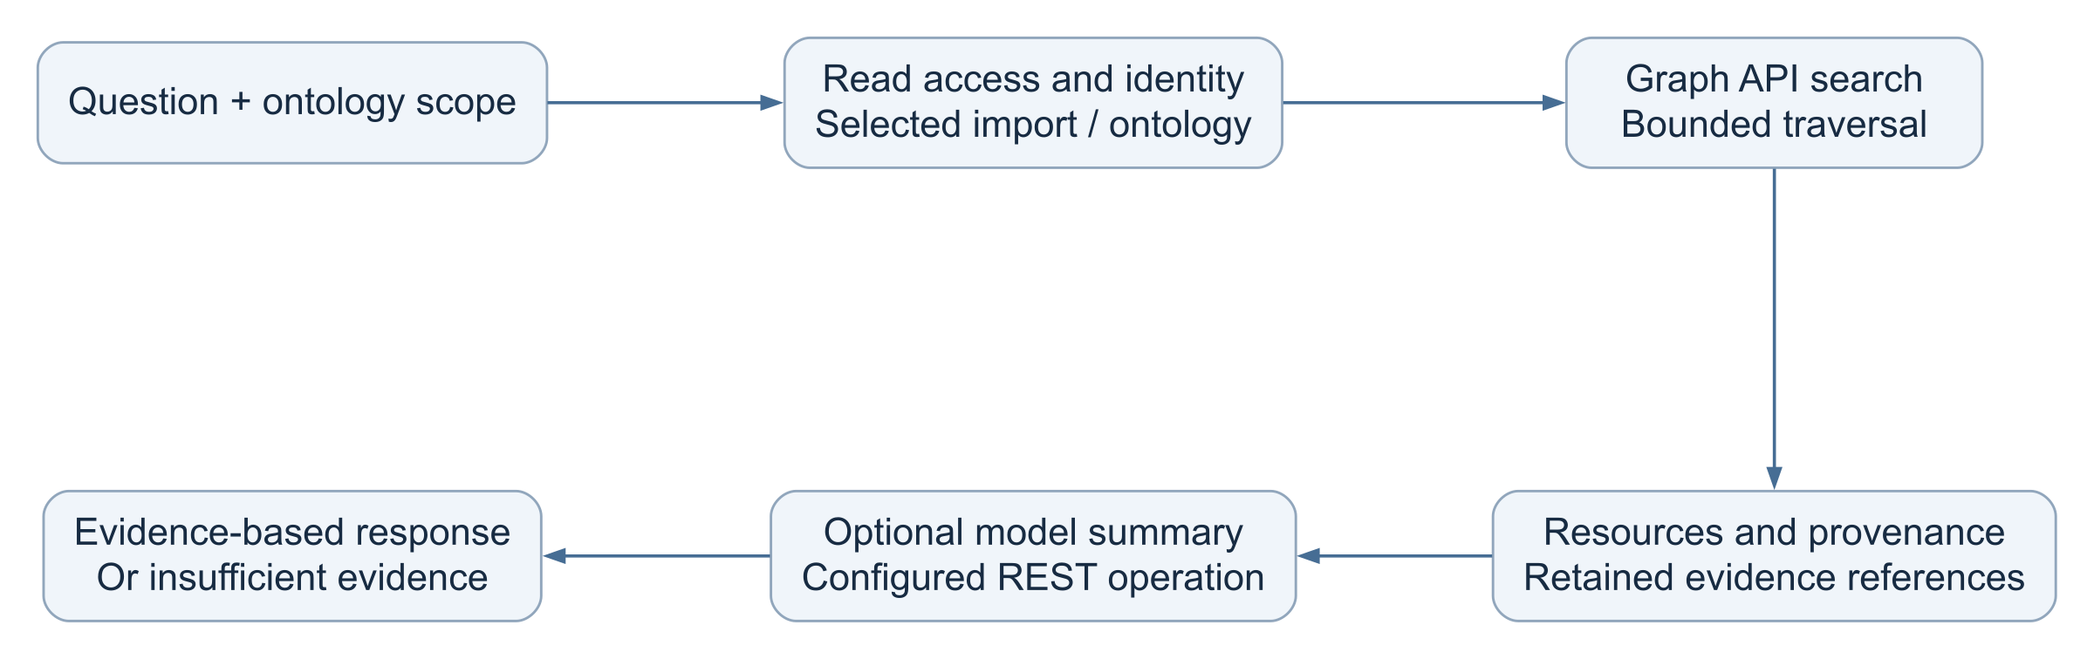
ARCHITECTURE VIEWS
Scoped graph retrieval and Knowledge Companion
Model availability and graph evidence availability are independent checks.
WHAT
Bounded graph evidence and optional model summary.
WHY
Explain answers using the selected ontology context.
WHO
Knowledge Companion, Graph API and optional model.
WHEN
A user submits an authorized scoped question.
WHERE
Graph resources, provenance and response evidence.
HOW
Search, bounded expansion and evidence references.
DEPO / Industrial data architecture / 16 October 2026
16
Notes:
Architecture baseline: repository commit 0d728b9, reviewed 16 October 2026.
Sources:
D:\paritosh\PMem-codex-apach_agent\backend\agentic_service\companion.py
D:\paritosh\PMem-codex-apach_agent\backend\agentic_service\oslc_graph_rag.py
D:\paritosh\PMem-codex-apach_agent\frontend\src\Components\Chatbot.js
Component/data-flow view. Vector ranking and retrieval quality require configured models, data and evaluation; no universal accuracy claim.
Implementation statements describe the repository. Live customer deployment acceptance remains separate.

Slide 17
ARCHITECTURE DECISIONS
Ollama REST integration — verify capabilities separately
REST operation paths follow the deployed gateway contract.
Capability | Contract and control | Verification meaning
Generation / chat | Use the configured API root or explicit operation URL | A completed response verifies that operation only
Model discovery | GET /api/tags only when the gateway exposes it | A missing optional discovery route does not prove chat failure
Streaming | Validate native response frames and terminal completion | HTTP 200 alone does not establish a complete stream
Tool calling | Model / route capability check; tools retain their own authorization | Chat completion alone does not prove tool support
Credentials | Server-side API key header and explicit gateway scope | Never compile LLM or gateway keys into browser settings
Examples in configuration are guidance; test the actual customer route, model and response contract.
DEPO / Industrial data architecture / 16 October 2026
17
Notes:
Architecture baseline: repository commit 0d728b9, reviewed 16 October 2026.
Sources:
D:\paritosh\PMem-codex-apach_agent\backend\core\ollama_auth.py
D:\paritosh\PMem-codex-apach_agent\backend\agentic_service\local_llm.py
D:\paritosh\PMem-codex-apach_agent\infra\windows\test-depo-ollama.ps1
Implementation statements describe the repository. Live customer deployment acceptance remains separate.

Slide 18
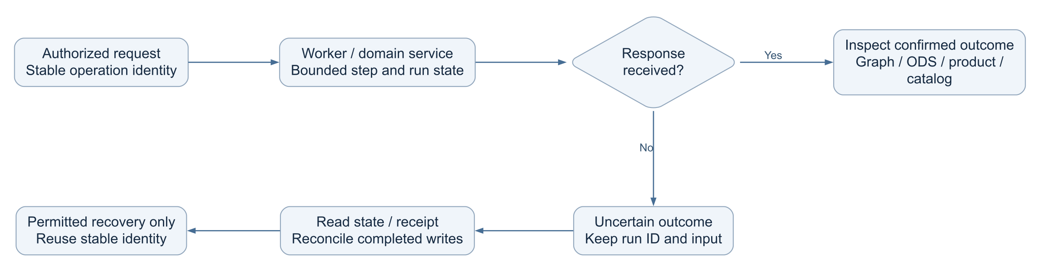
ARCHITECTURE VIEWS
Failure lifecycle — uncertain response, retained outcome
Browser session expiry does not cancel an authorized background workflow.
WHAT
Recovery across side effects and response loss.
WHY
Prevent duplicate writes after a client timeout.
WHO
UI, workers, domain APIs and operators.
WHEN
Timeout, interruption or downstream failure.
WHERE
Persisted run state and service-owned receipts.
HOW
Inspect, reconcile and reuse stable identities.
DEPO / Industrial data architecture / 16 October 2026
18
Notes:
Architecture baseline: repository commit 0d728b9, reviewed 16 October 2026.
Sources:
D:\paritosh\PMem-codex-apach_agent\backend\ontology_service\publication_jobs.py
D:\paritosh\PMem-codex-apach_agent\backend\agentic_service\bridge_jobs.py
D:\paritosh\PMem-codex-apach_agent\backend\graph_service\router.py
D:\paritosh\PMem-codex-apach_agent\frontend\src\services\serviceAuth.js
D:\paritosh\PMem-codex-apach_agent\backend\depo_platform\browser_credentials.py
D:\paritosh\PMem-codex-apach_agent\frontend\src\app\RunRecoveryNotice.js
D:\paritosh\PMem-codex-apach_agent\docs\DATA_PRODUCT_INGESTION.md
D:\paritosh\PMem-codex-apach_agent\backend\data_pipeline_service\router.py
D:\paritosh\PMem-codex-apach_agent\backend\depo_platform\database_setup.py
UML Activity. Pause and cancel remain cooperative at tool boundaries; completed writes remain retained.
Implementation statements describe the repository. Live customer deployment acceptance remains separate.

Slide 19
ARCHITECTURE DECISIONS
Security and governance boundaries
Session lifecycle, operation authority and workflow execution are separate controls.
Boundary | Implemented control | Operating rule
Browser access | Delegated session, selected scopes, active renewal and expiry | Reconnect after full expiry / revocation; raw admin key stays out of builds
Protected service operations | Credential profiles and authenticated actor resolution | Model recommendations never grant approval authority
Durable workflow execution | Persisted grant, credential fingerprints, lease and checkpoints | No caller secrets in retained workflow inputs
Network and data services | Configured gateway roots, exact origins and database identities | Customer validates TLS, firewall access and least privilege
Operational maintenance | Separate admin authorization, scoped cleanup and audit evidence | Cleanup actions retain their own permissions and confirmations
DEPO / Industrial data architecture / 16 October 2026
19
Notes:
Architecture baseline: repository commit 0d728b9, reviewed 16 October 2026.
Sources:
D:\paritosh\PMem-codex-apach_agent\frontend\src\services\serviceAuth.js
D:\paritosh\PMem-codex-apach_agent\backend\depo_platform\browser_credentials.py
D:\paritosh\PMem-codex-apach_agent\frontend\src\app\RunRecoveryNotice.js
D:\paritosh\PMem-codex-apach_agent\backend\depo_platform\authorization.py
D:\paritosh\PMem-codex-apach_agent\backend\routes\admin_routes.py
Implementation statements describe the repository. Live customer deployment acceptance remains separate.

Slide 20
ARCHITECTURE DECISIONS
Installation entry points and database upgrade responsibilities
Python 3.12.x · Node.js 24+ · npm 10.2+ · Spark/JDK only for enabled compute paths.
Command / script | Owned responsibility | Existing customer installation
Root install-depo.ps1 | Delegates to complete Windows installer | Use one entry point; do not run both installers separately
infra/windows/install-depo-windows.ps1 | Dependencies, migrations, graph schema, startup and validation | Preserve environment files and durable data
infra/windows/install-depo.ps1 | Runtime prerequisites and dependency installation helper | Complete installer calls this helper automatically
infra/postgres/ update-postgres-schema.ps1 | Pending PostgreSQL migrations and schema verification | Schema-only operation; no application restart
infra/windows/update-depo-windows.ps1 | Validated update sequence using the selected environment | Use -InstallDependencies when release locks change
DEPO / Industrial data architecture / 16 October 2026
20
Notes:
Architecture baseline: repository commit 0d728b9, reviewed 16 October 2026.
Sources:
D:\paritosh\PMem-codex-apach_agent\INSTALLATION.md
D:\paritosh\PMem-codex-apach_agent\infra\windows\install-depo-windows.ps1
D:\paritosh\PMem-codex-apach_agent\infra\windows\update-depo-windows.ps1
D:\paritosh\PMem-codex-apach_agent\backend\postgres_migrations.py
Implementation statements describe the repository. Live customer deployment acceptance remains separate.

Slide 21
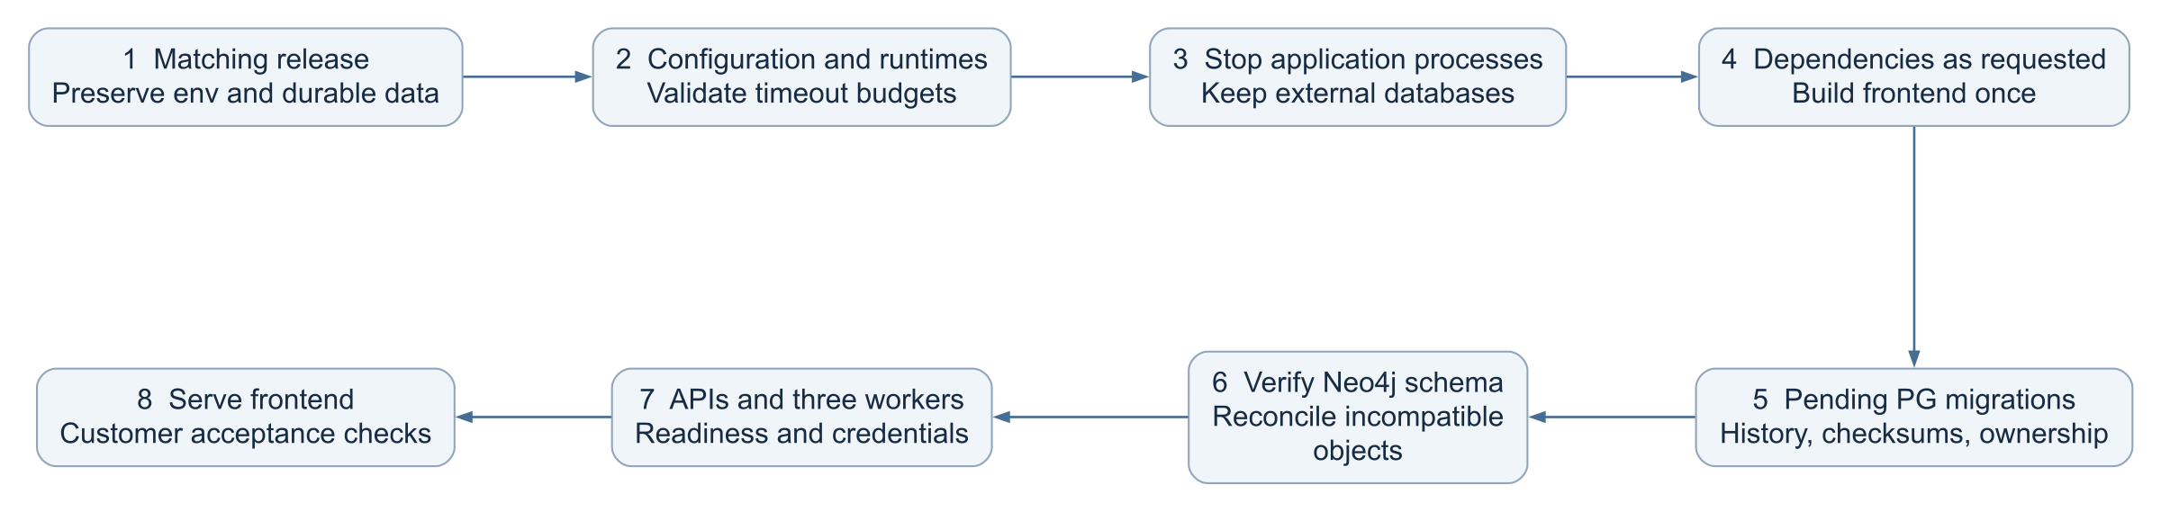
ARCHITECTURE VIEWS
UML activity — customer update and restart sequence
Service timeout limit: 300 seconds. Longer workflow and publication budgets have separate controls.
WHAT
An in-place update using the selected environment.
WHY
Fail early and preserve existing data and credentials.
WHO
Deployment operator and service-owned scripts.
WHEN
After placing the complete matching release.
WHERE
Customer application VM; existing databases.
HOW
Preflight, pending migrations, readiness and acceptance.
DEPO / Industrial data architecture / 16 October 2026
21
Notes:
Architecture baseline: repository commit 0d728b9, reviewed 16 October 2026.
Sources:
D:\paritosh\PMem-codex-apach_agent\INSTALLATION.md
D:\paritosh\PMem-codex-apach_agent\infra\windows\install-depo-windows.ps1
D:\paritosh\PMem-codex-apach_agent\infra\windows\update-depo-windows.ps1
D:\paritosh\PMem-codex-apach_agent\backend\postgres_migrations.py
UML Activity. Migration failure rolls back its transaction. Failure after a successful migration requires an operator recovery plan; no automatic downgrade is implied.
Implementation statements describe the repository. Live customer deployment acceptance remains separate.

Slide 22
ARCHITECTURE DECISIONS
Service contracts and primary frontend consumers
OpenAPI 3.0.3 and service discovery describe operation ownership and authorization.
Service / internal port | API responsibility | Primary UI / caller
Schema sets :8010 | Engineering schema inspection and conversion | Import / QIF
Ontology :8011 | Registration, lifecycle, modeling and publication jobs | Ontology Junction / Admin
Agentic :8012 | Agent catalog, tools, workflows and Companion | Semantic Bridge / Companion
Graph :8013 | Publication receipts, scoped queries and traversal | Graph Explorer / domain APIs
Ingestion :8014 | Sources, supported parsers and retained evidence | Import / engineering workflow
OSLC :8015 · CEIM :8018 | Linked resources / canonical mapping and validation | Configured integrations / semantic jobs
Products :8017 · Catalog :8016 | Immutable packages / governed product discovery | Data Products / Data Catalog
Pipeline :8019 | Job definitions, worker runs and analytics recovery | Data Flow / XML analytics loader
DEPO / Industrial data architecture / 16 October 2026
22
Notes:
Architecture baseline: repository commit 0d728b9, reviewed 16 October 2026.
Sources:
D:\paritosh\PMem-codex-apach_agent\infra\deployment\services.json
D:\paritosh\PMem-codex-apach_agent\frontend\src\config.js
D:\paritosh\PMem-codex-apach_agent\infra\windows\runtime-config.ps1
Implementation statements describe the repository. Live customer deployment acceptance remains separate.

Slide 23
OPERATING MODEL
Operational readiness and customer acceptance
Repository verification supports release preparation. Customer acceptance establishes deployment readiness.
Implemented controls
Customer evidence
Explicit product choices
Durable run identities and receipts
Scoped access and request IDs
Bounded writes and recovery paths
Configuration and migration checks
Database ownership and history
Gateway, TLS and browser access
Large-ontology load and recovery
Worker restart and backup restore
Fact grain and dimension policy
Named external source adapters
Mapping / retrieval evaluation
Model capability and deployment sizing
DEPO / Industrial data architecture / 16 October 2026
23
Notes:
Architecture baseline: repository commit 0d728b9, reviewed 16 October 2026.
Sources:
D:\paritosh\PMem-codex-apach_agent\INSTALLATION.md
D:\paritosh\PMem-codex-apach_agent\infra\windows\install-depo-windows.ps1
D:\paritosh\PMem-codex-apach_agent\infra\windows\update-depo-windows.ps1
D:\paritosh\PMem-codex-apach_agent\backend\postgres_migrations.py
D:\paritosh\PMem-codex-apach_agent\docs\DATA_PRODUCT_INGESTION.md
D:\paritosh\PMem-codex-apach_agent\backend\data_pipeline_service\router.py
D:\paritosh\PMem-codex-apach_agent\backend\depo_platform\database_setup.py
Implementation statements describe the repository. Live customer deployment acceptance remains separate.

Slide 24
OPERATING MODEL
Architecture decisions and extension points
A framework replacement alone does not establish correctness, interoperability or customer readiness.
Stable service boundaries
Evidence before scale
Independent outcomes
Keep domain APIs as the source of operation contracts.
Expose governed tools through the existing catalog and MCP adapter.
Measure import, mapping and retrieval outcomes on agreed engineering data.
Preserve lineage and recovery identities when adding connectors.
Track ontology registration, RDF publication, ODS commit, product packaging and catalog delivery separately.
Use explicit business contracts for new analytics.
DEPO / Industrial data architecture / 16 October 2026
24
Notes:
Architecture baseline: repository commit 0d728b9, reviewed 16 October 2026.
Sources:
D:\paritosh\PMem-codex-apach_agent\docs\DATA_PRODUCT_INGESTION.md
D:\paritosh\PMem-codex-apach_agent\infra\deployment\services.json
D:\paritosh\PMem-codex-apach_agent\backend\agentic_service\catalog.json
D:\paritosh\PMem-codex-apach_agent\backend\agentic_service\durable_workflows.py
D:\paritosh\PMem-codex-apach_agent\backend\agentic_service\worker.py
D:\paritosh\PMem-codex-apach_agent\backend\agentic_service\transport_auth.py
Implementation statements describe the repository. Live customer deployment acceptance remains separate.

