Slide 1
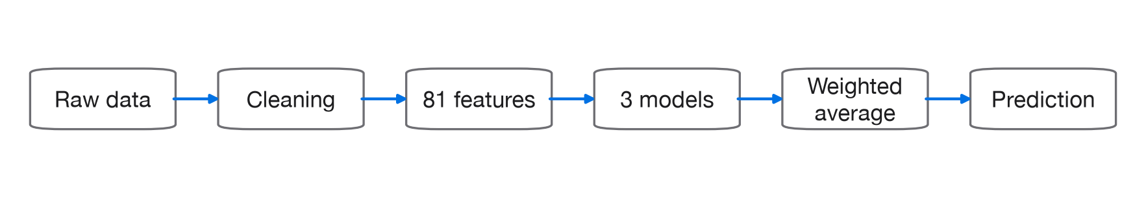
STREAM 1 · CREDIT CARD DEFAULT
Overview
Predict each customer's probability of default next month.
HIDDEN-TEST LOG LOSS
- Binary log loss, probability quality and calibration matter, not just ranking.
- 24,000 labelled customers, 6,000 test customers, 23 raw columns, 22.12% default rate.
- Final model: 0.45 LightGBM + 0.30 GRU + 0.25 TabPFN.
- Final submission: submission_tabpfn6.csv.
0.40982
The result came from combining three complementary views of each customer.
1
Notes:
We're predicting each customer's probability of default next month, scored by binary log loss, so calibration matters as much as ranking. Twenty-four thousand labelled customers, six thousand held out, twenty-three raw columns, a 22.12 percent default rate. Our final hidden-test log loss is 0.40982, from a blend of 0.45 LightGBM, 0.30 GRU, and 0.25 TabPFN.

Slide 2
PREPARATION
Data Cleaning
01
02
Repayment Status
Education
- PAY_0, PAY_2 through PAY_6 show months behind on payment.
- -2 = no balance, -1 = paid in full, 0 = paid minimum amount.
- Raw values stay untouched in the cleaned dataset, no grouping here.
- Aggregate lateness features (pay_max, n_late, trend_pay) clip -2/-1/0 to 0 only.
- ever_paid_full and never_used deliberately keep the original codes.
- 1 = graduate school, 2 = university, 3 = high school, 4 = other (official codes).
- Undocumented codes 0, 5, 6 folded into "other" (4), 290 rows.
- Confirmed cost: "other" over-predicted about 61%, AUC 0.645 vs about 0.79 elsewhere.
- The only subgroup where the model underperforms its own base rate.
03
04
Marriage
What We Didn't Clean
- 1 = married, 2 = single, 3 = other (official codes).
- Undocumented code 0 folded into "other" (3), 42 rows.
- No confirmed fairness or accuracy issue for this group.
- Zero missing values, no malformed rows, confirmed directly across all 24,000 rows.
- No outlier removal: large balances and payments can be genuine risk signal.
- No resampling or class weighting: preserves the true 22.12% base rate for calibration.
- client_id excluded from the feature matrix (not predictive), kept for the submission's ID column.
2
Notes:
The data had no missing values and no malformed rows. Cleaning stayed deliberately narrow. EDUCATION codes 0, 5, and 6 got grouped into "other", 290 rows; MARRIAGE code 0 grouped into "other", 42 rows. We kept PAY status values of minus 1 and minus 2 as features, since they mean paid-in-full and inactive account, not missing data. No outlier removal, since large balances can be genuine signal. No resampling, since changing the 22 percent base rate would hurt calibration. Twenty-three raw columns became 81 engineered features.

Slide 3
SIX FAMILIES, ONE STANDOUT
Feature Engineering
23 raw columns became 81 features across six families.
01
02
03
Repayment Status History
Credit Utilisation
Payment Coverage
- Worst and average lateness across the 6 months (pay_max, pay_mean).
- Number of late months, and months 2+ behind (n_late, n_late2plus).
- Trend: improving or worsening, plus longest late streak (trend_pay, max_late_streak).
- How recently they were late, weighted to the last 2 months (recent_late, months_since_late).
- Ever paid in full, or never used the card (ever_paid_full, never_used).
- Share of the credit limit used up, each of the 6 months (util1-util6).
- Average and peak usage, rising or falling (util_mean, util_max, util_trend).
- Actual dollars of credit still available (avail_credit).
- Fraction of each month's bill actually paid off (payratio1-payratio5).
- Average and worst month's payment coverage (payratio_mean, payratio_min).
- Months paid in full, and months paid nothing (paid_full_months, n_zero_pay).
- Hypothesis: paying a higher share each month predicts lower risk.
04
05
06
Levels & Momentum
Spending Decomposition
Minimum-Payment Behaviour
- Calculated: total/average dollars billed and paid (bill_sum/mean, amt_sum/mean); overall coverage (coverage_total); raw balance change (bill_growth); spend vs. limit and a log-scaled limit (amt_over_limit, log_limit).
- Used: fed to all three models identically, same 81-feature matrix. Restores scale the ratio families strip out; trees don't need it, the GRU does.
- spend_t = BILL_t - BILL_(t+1) + PAY_AMT_t
- Estimated dollars spent each month, plus average, peak and trend (spend1-spend5, spend_mean/max/trend).
- Months where new spending outpaced repayment (spend_minus_paid, months_spend_gt_paid).
- Separates "spent more" from "stopped paying" as the reason a balance rises.
- +0.00046 OOF / +0.00173 hidden test, the largest gain of the whole project.
- How close payments are to the assumed 10% minimum due, on average and at worst (min_pay_ratio_mean/min).
- Months paying only around the minimum, a sign of financial strain (months_paid_about_min).
- Months paying even less than the minimum due (months_paid_under_min).
3
Six additional feature families were tried and rejected (behavioural signatures, spend-as-sequence, interaction terms, peer-relative limit, velocity/acceleration, target encoding); none cleared the 0.0005 noise threshold.
Notes:
The data gives statement balances and payments, but never states what a customer actually spent. So we worked it out ourselves. New activity equals current bill minus previous bill plus payment. That matters because a rising balance from new spending is a different risk story than a rising balance from missed payments. This one feature family improved out-of-fold log loss by 0.00046 and hidden-test log loss by 0.00173, the largest gain of the project. Six other feature families we tried never cleared our 0.0005 noise threshold.

Slide 4
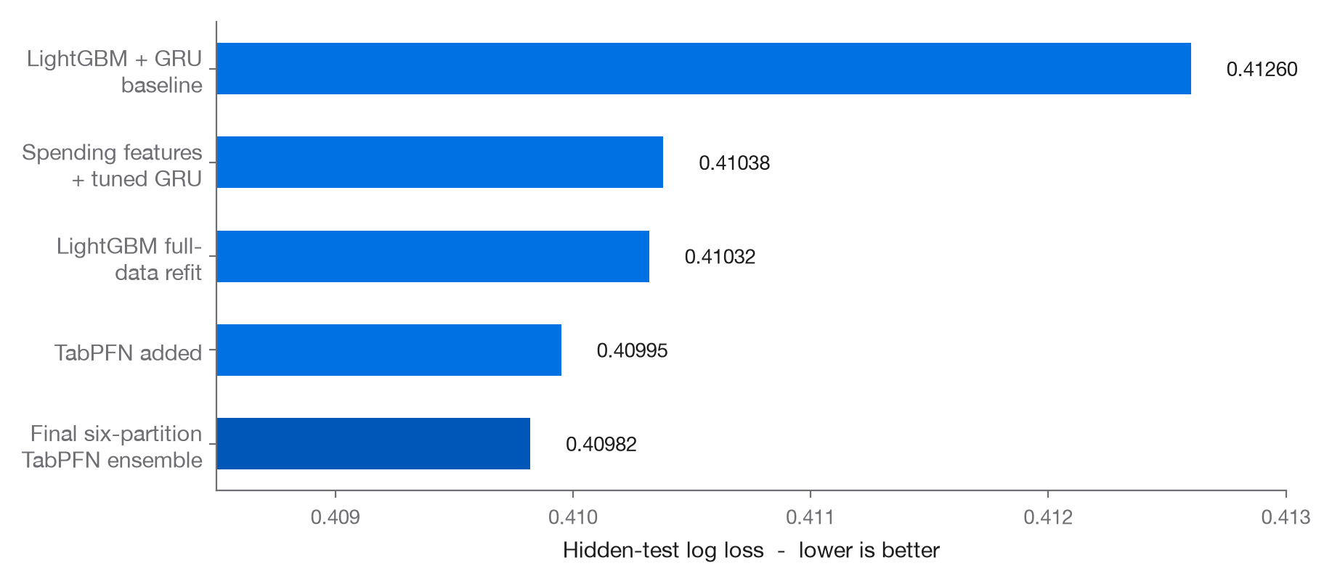
41 EXPERIMENTS
Experimentation
- 10 model families · 7 candidate feature families · 135 LightGBM configurations.
- Switched selection from AUC to log loss.
- Added the GRU to preserve month-to-month order.
- Introduced spending decomposition, the largest gain.
- Added TabPFN as the final complementary model.
Notable failures
- 135 LightGBM configs: no reliable gain.
- 1D-CNN duplicated the GRU signal (0.9924 correlated).
- Survival model improved OOF but worsened hidden test, removed.
- Isotonic calibration looked best on OOF, worst under nested CV.
Disagreement between models only helps when it contains useful signal.
4
Notes:
We ran 41 experiments across 10 model families, 7 feature families, and 135 LightGBM configurations. Only a handful of decisions actually moved the needle. We switched from AUC to log loss, added a GRU to preserve month-to-month order, added the spending decomposition, the biggest single jump, then added TabPFN. Score fell from 0.41260 to 0.40982. Plenty of experiments went nowhere. 135 LightGBM configs found nothing reliable, a 1D-CNN just duplicated the GRU's signal, a survival model improved out-of-fold but got worse on hidden test so we dropped it, and isotonic calibration looked great until nested cross-validation revealed it was leakage. Disagreement between models only helps when it carries real signal.

Slide 5
MODEL SELECTION AND VALIDATION
The Models
LightGBM
GRU
TabPFN
WEIGHT
OOF LOG LOSS
WEIGHT
OOF LOG LOSS
WEIGHT
OOF LOG LOSS
45%
0.42211
30%
0.42392
25%
0.42345
HYPERPARAMETERS
HYPERPARAMETERS
HYPERPARAMETERS
learning_rate
0.03
architecture
2-layer bi-GRU
pretrained
0 params fit
num_leaves
12
hidden size
32
n_estimators
4
max_depth
4
dropout
0.4
balance_probabilities
False
min_child_samples
100
optimiser
Adam, lr 2e-3
device
cpu
reg_lambda
30.0
batch size
512
context size
19,200 / fold
fits
90 + 3-seed refit
fits
150 + 5-seed refit
fits
30 + 3-seed refit
HOW IT PREDICTS
HOW IT PREDICTS
HOW IT PREDICTS
Gradient-boosted decision trees. Hundreds of shallow trees, each correcting errors left by the ones before it, reading the 81 engineered features as one aggregate customer profile.
Bidirectional recurrent network. Reads the six months in order, updating an internal memory at each step, so it can tell a recovering customer apart from a deteriorating one.
Pretrained transformer. Applies a prior learned from millions of synthetic datasets; the training rows act as live context at prediction time, with no parameters fit to this data.
5
Notes:
Three models, three different views of the same customer. LightGBM carries the most weight and reads 81 engineered features as one aggregate profile. The GRU reads six months as an ordered sequence, telling recovery apart from deterioration. TabPFN applies a pretrained prior, with zero parameters fit to our data.

Slide 6
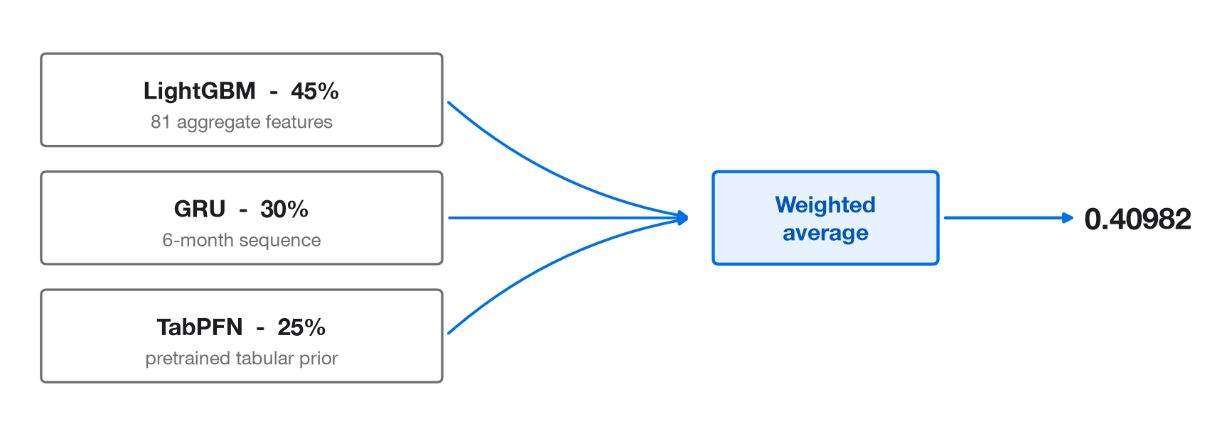
MODEL SELECTION AND VALIDATION
Validation & Results
Validation strategy
Stratified 5-fold CV across 6 partitions, identical folds for every model. Differences below 0.0005 OOF log loss are noise; nested CV for anything fitted.
OUT-OF-FOLD
Post-processing
0.42136
Plain weighted average of the three probabilities, 0.45 / 0.30 / 0.25. No calibration. Clipped to [1e-4, 1-1e-4].
HIDDEN TEST
0.40982
6
Notes:
All three share identical cross-validation folds, so a 0.0005 gap is just noise. The blend reaches 0.42136 out-of-fold and 0.40982 on hidden test, a plain weighted average, no calibration, just a clip to the probability bounds.

Slide 7
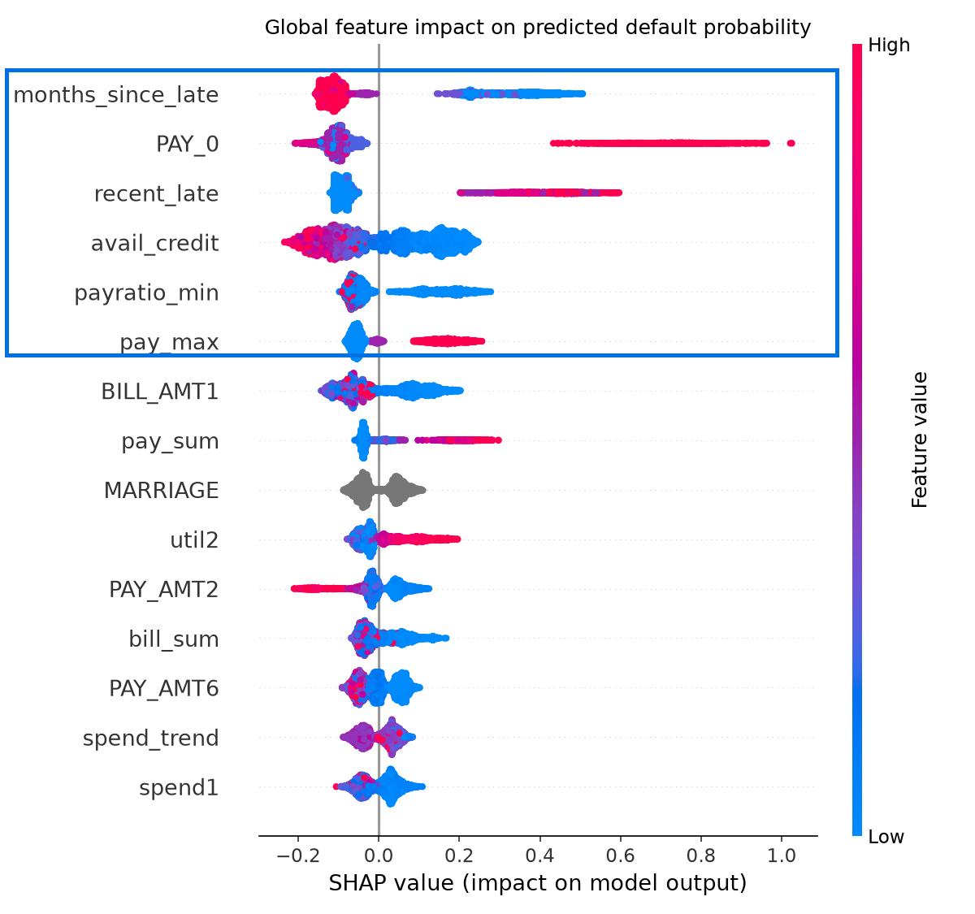
WHAT THE MODEL LEARNED, AND WHERE IT FAILS
Model Insights & Limitations
Strongest indicators
- Recent, severe delinquency.
- Low available credit, low payment-to-bill coverage.
- High utilisation.
20 largest errors → all unexpected defaults, scored 2-4% risk, with clean payment histories. The driver isn't in this data.
EDUCATION = "other"
387 customers, 28 defaults, risk over-predicted ~61%. AUC 0.645 vs. ~0.79 elsewhere. Should not support automated adverse decisions.
LightGBM component interpretation, 45% of ensemble
7
Notes:
The strongest predictors are all about recent, severe delinquency, low available credit, and weak payment coverage. This SHAP view explains the LightGBM component specifically, not the full ensemble. But the model has real blind spots. Our twenty worst-predicted customers all defaulted despite scoring just 2 to 4 percent risk, every one with a clean payment history, meaning the real driver isn't in this data at all. And the EDUCATION "other" subgroup, 387 customers, 28 defaults, gets over-predicted by about 61 percent, with an AUC of just 0.645 against roughly 0.79 elsewhere. That subgroup shouldn't drive automated decisions.

Slide 8
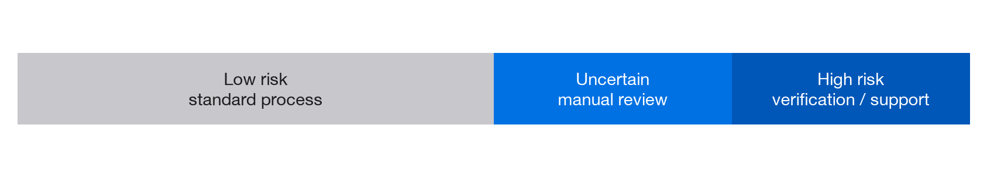
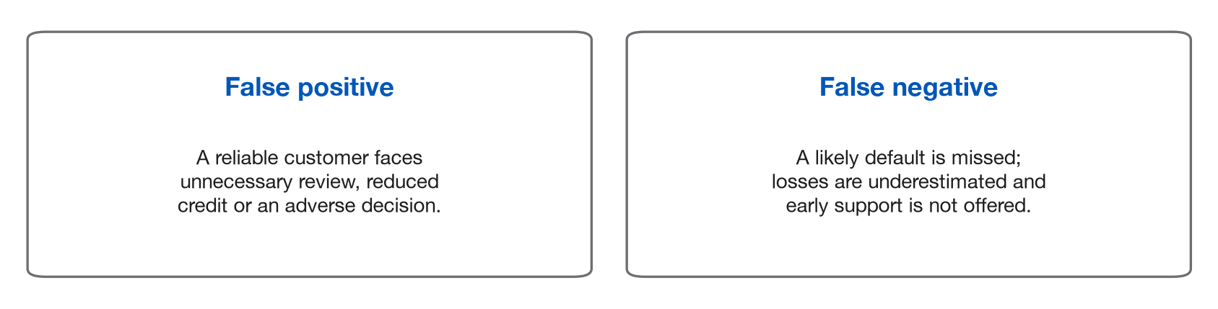
DECISION SUPPORT, NOT AUTOMATION
Real-World Application
- Calibrated probabilities support manual review, early customer assistance, limit monitoring and portfolio prioritisation, not an automatic approve/decline rule.
- Thresholds should reflect business cost, regulation and review capacity, not the competition score alone.
Limitations: missing drivers of unexpected defaults · weak education subgroup · ensemble compute cost · TabPFN licence dependency.
Understanding the account mechanics and validating decisions carefully mattered more than adding model complexity.
8
Notes:
These probabilities should support manual review, early customer assistance, limit monitoring, and portfolio prioritization, not function as an automatic approve or decline rule. A false positive means a reliable customer faces unnecessary friction; a false negative means a missed default and a missed chance to help early. Thresholds should come from business cost and review capacity, not the competition score. Some defaults aren't predictable from this data, one subgroup is unreliable, and TabPFN adds licensing and compute cost for a small gain. Understanding the account mechanics and validating carefully mattered more than adding model complexity.

Slide 9
APPENDIX · A1
Full hyperparameters & fit counts
- LightGBM (strongest single model; reads all 81 features as a flat snapshot): learning_rate 0.03, num_leaves 12, max_depth 4, min_child_samples 100, reg_lambda 30.0, feature_fraction 0.5, seeds (0,1,2), 90 fits + 3-seed refit.
- GRU (reads six months in order; the only model tuned from scratch this project): 2-layer bi-GRU, hidden size 32, dropout 0.4, Adam lr 2e-3, batch 512, max epochs 120/patience 12, seeds range(5), 150 fits + 5-seed refit.
- TabPFN (pretrained prior; zero parameters fit to this data): n_estimators 4, balance_probabilities False, device cpu, context 19,200/fold, 30 fits + 3-seed refit.
- Correlation is not the selection criterion: logistic regression was the most decorrelated model tested (0.948 vs. LightGBM) yet received weight 0.00. GRU earned 0.30 at a higher correlation of 0.983, what matters is whether disagreement carries signal.
- Totals: 270 cross-validated fits plus 11 full-data refits stand behind each submitted probability. TabPFN also requires a Prior Labs licence and API token.

Slide 10
APPENDIX · A2
41 experiments, grouped
- Successful (4): log-loss alignment + GRU added (0.41260); full-data refit for the GRU (-0.00023); repeated CV, 3 -> 6 partitions (-0.00026); spending decomposition + tuned GRU (-0.00173).
- Other models & tuning, rejected: 135 LightGBM configs (best +0.00004); 1D-CNN, corr. 0.9924 w/ GRU (0.42601); autoencoder (0.42685); MLP (0.42882); CatBoost/ExtraTrees/LogReg/multi-task GRU (weight 0.00); pseudo-labelling the test set (-0.00024).
- Techniques from the AMEX Kaggle winners (5, none adopted): DART boosting (-0.00072); high min_data_in_leaf, 2048 (-0.00104); feature_fraction_bynode (-0.00011); recency windows / within-customer ranks (-0.00035); denoising / rank blending (not applicable).
- Harmful, caught and reverted: survival/hazard model improved OOF by +0.00027 but hidden test got worse (0.41044 vs. 0.41038 without it), dropped despite the OOF gain. Isotonic calibration looked like the best result on OOF; was leakage (fit and scored on the same rows); under nested CV became the single worst result (-0.00330).
- Next investigation: whether the EDUCATION "other" codes are a genuinely homogeneous group, or should be split.

Slide 11
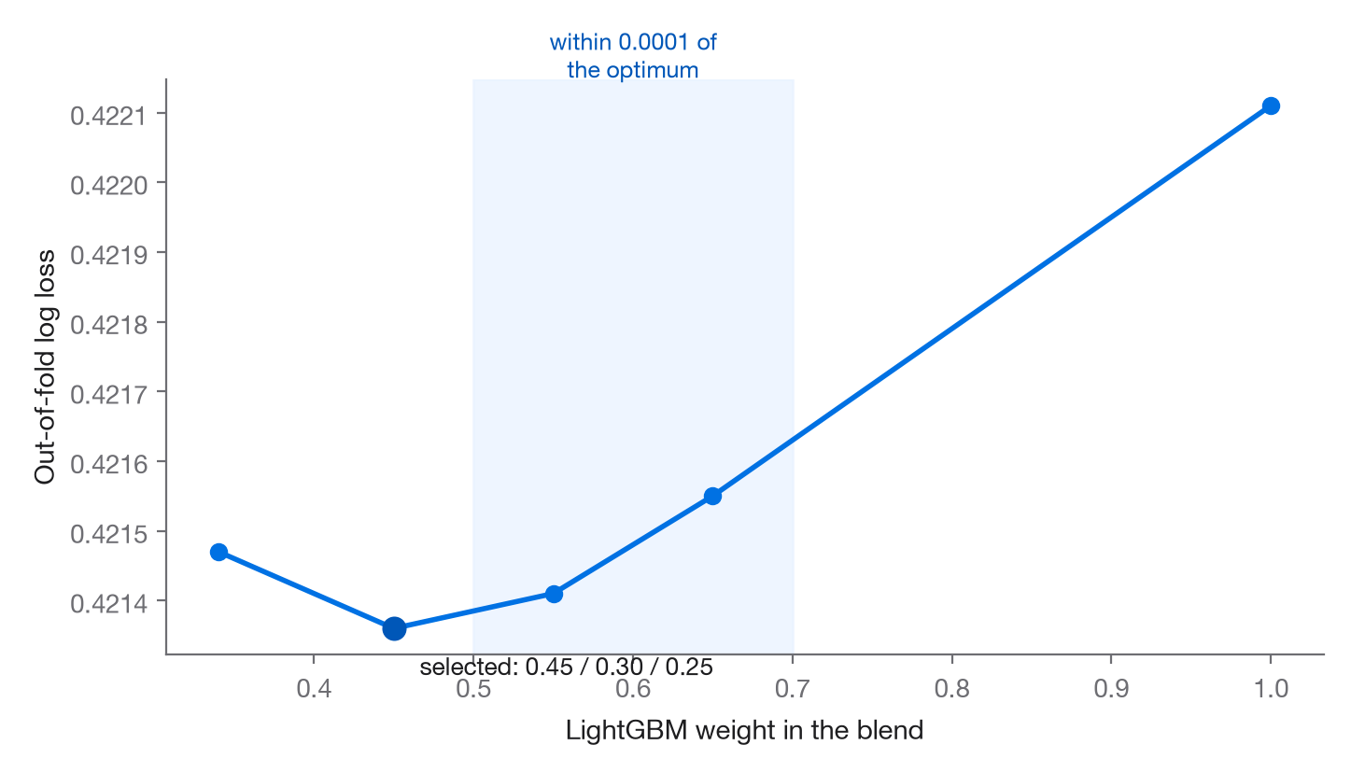
APPENDIX · A3
Ensemble weight search and calibration
- Grid search over ~230 valid weight triples (0.05 steps) on OOF log loss; nothing is fitted.
- (1.00, 0.00, 0.00) 0.42211 → (0.65, 0.35, 0.00) 0.42155 → (0.55, 0.30, 0.15) 0.42141 → (0.45, 0.30, 0.25) selected 0.42136 → (0.34, 0.33, 0.33) equal 0.42147.
- Broad plateau: every LightGBM weight 0.50-0.70 lands within 0.0001 of the optimum. Shrinking weights toward uniform made hidden test worse (0.41045 vs. 0.41032), the standard overfitting check the fitted weights passed.
- 4 calibration schemes tested under nested CV, all worse than no calibration: Platt (−0.00005), per-segment (−0.00030), isotonic (−0.00330), base-rate pull (α=1.0, i.e. no adjustment selected).
- Post-processing: one clip to [1e-4, 1-1e-4] and nothing else. No value hand-edited.

Slide 12
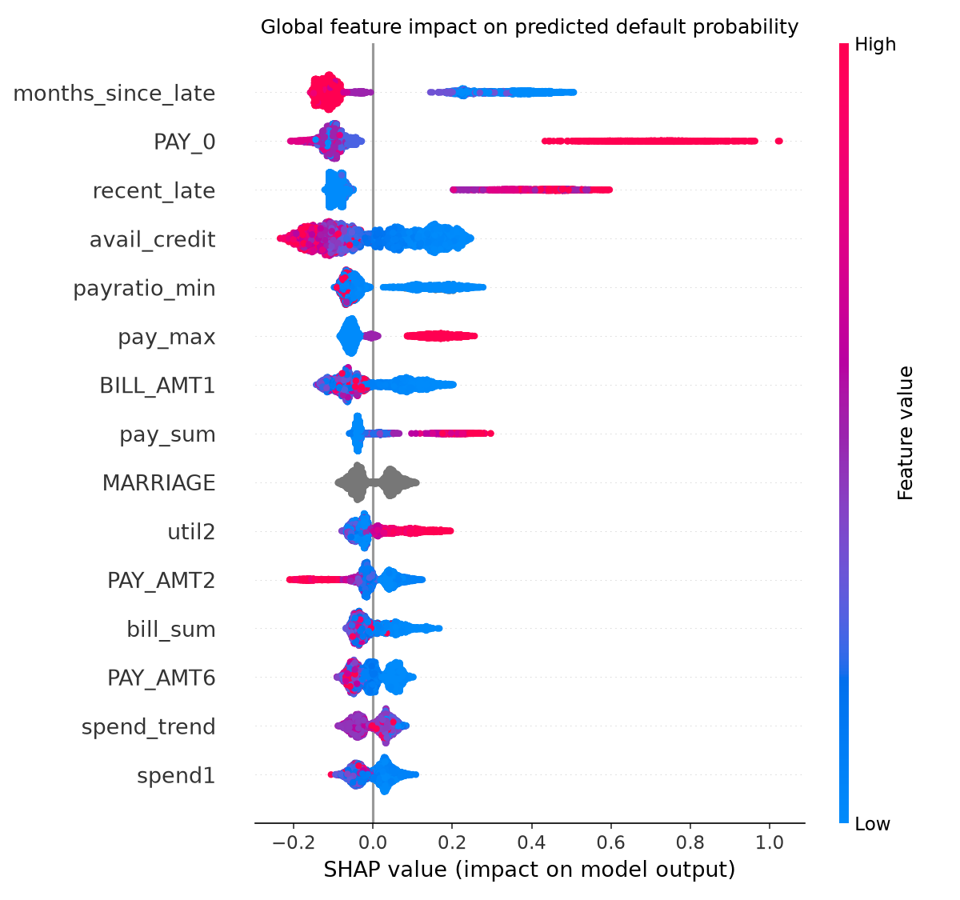
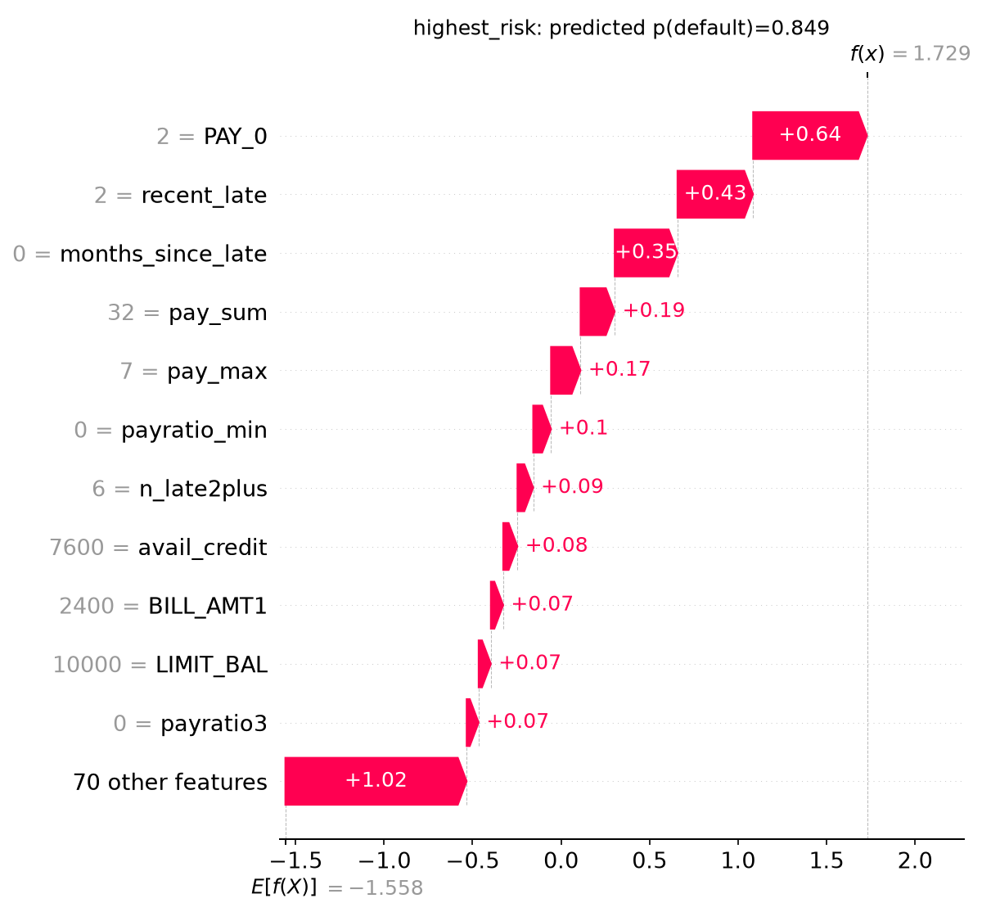
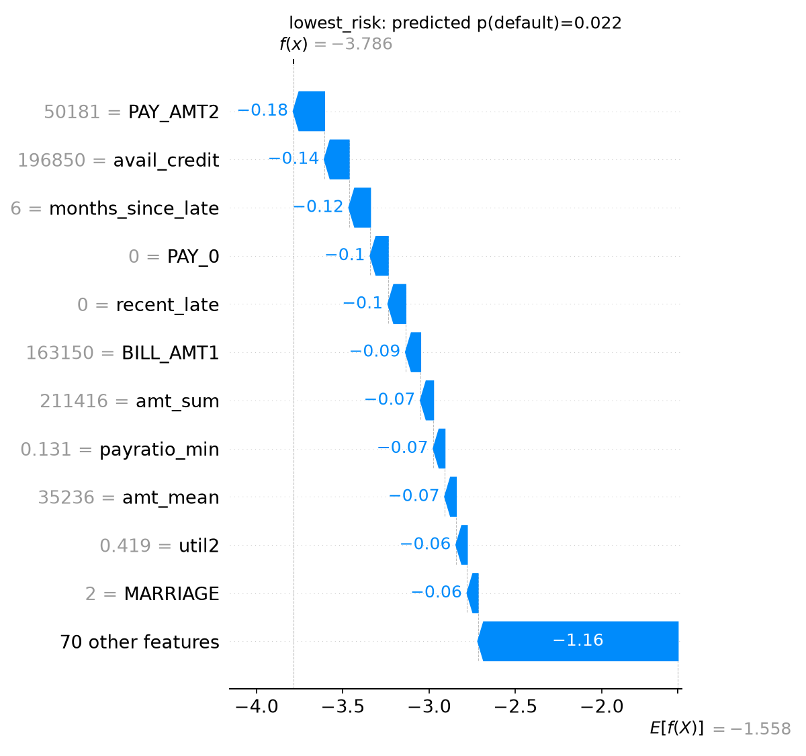
APPENDIX · A4
SHAP detail
- Full SHAP summary (14 features) and per-customer waterfalls for the highest- and lowest-risk predictions available on request.
- SHAP explains the LightGBM component only (45% of the ensemble weight), not the GRU or TabPFN.

Slide 13
APPENDIX · A5
Subgroup fairness audit
- EDUCATION = "other": n=387, 28 defaults (7.2% observed rate).
- Risk over-predicted by approximately 61% relative to the observed rate.
- AUC 0.645 in this subgroup versus approximately 0.79 elsewhere, the only segment where the model underperforms its own base-rate guess.
- This is a heterogeneous, undocumented category and should route to manual review rather than support an automated adverse decision.

Slide 14
APPENDIX · A6
Reproducibility and disclosure
- Saved OOF and test prediction vectors are committed under artifacts/; applying the 0.45/0.30/0.25 weighted average and the clip reconstructs the submission to 9.7e-17, in seconds, without rerunning the ~3-hour TabPFN pass.
- Pretrained model: TabPFN (Prior Labs, tabpfn package v8.5.0), requires a licence and API token; performs in-context learning, fits zero parameters to this dataset.
- No external datasets used. AMEX winning-solution write-ups were consulted; 5 techniques tested, none adopted.
- Claude Code (Anthropic) used throughout for code, experiments and drafting these documents; all modelling decisions were taken on measured cross-validation results.
- No manual modification of predictions beyond the [1e-4, 1-1e-4] clip. No calibration applied.

Slide 15
APPENDIX · A7
Operational thresholds and OOF vs. hidden-test gaps
- OOF and hidden-test improvements can diverge because OOF rows are only ever scored by models that didn't see them, while hidden-test rows are scored by the average of all folds, e.g. the sixth CV partition helped OOF by 0.00024 and did nothing on hidden test.
- Decision thresholds should be set from business cost, regulatory requirement and review capacity, not the competition log loss score alone.
- False positive: unnecessary review, reduced credit or an adverse decision for a reliable customer. False negative: missed default, underestimated loss, missed early support.

