Slide 1
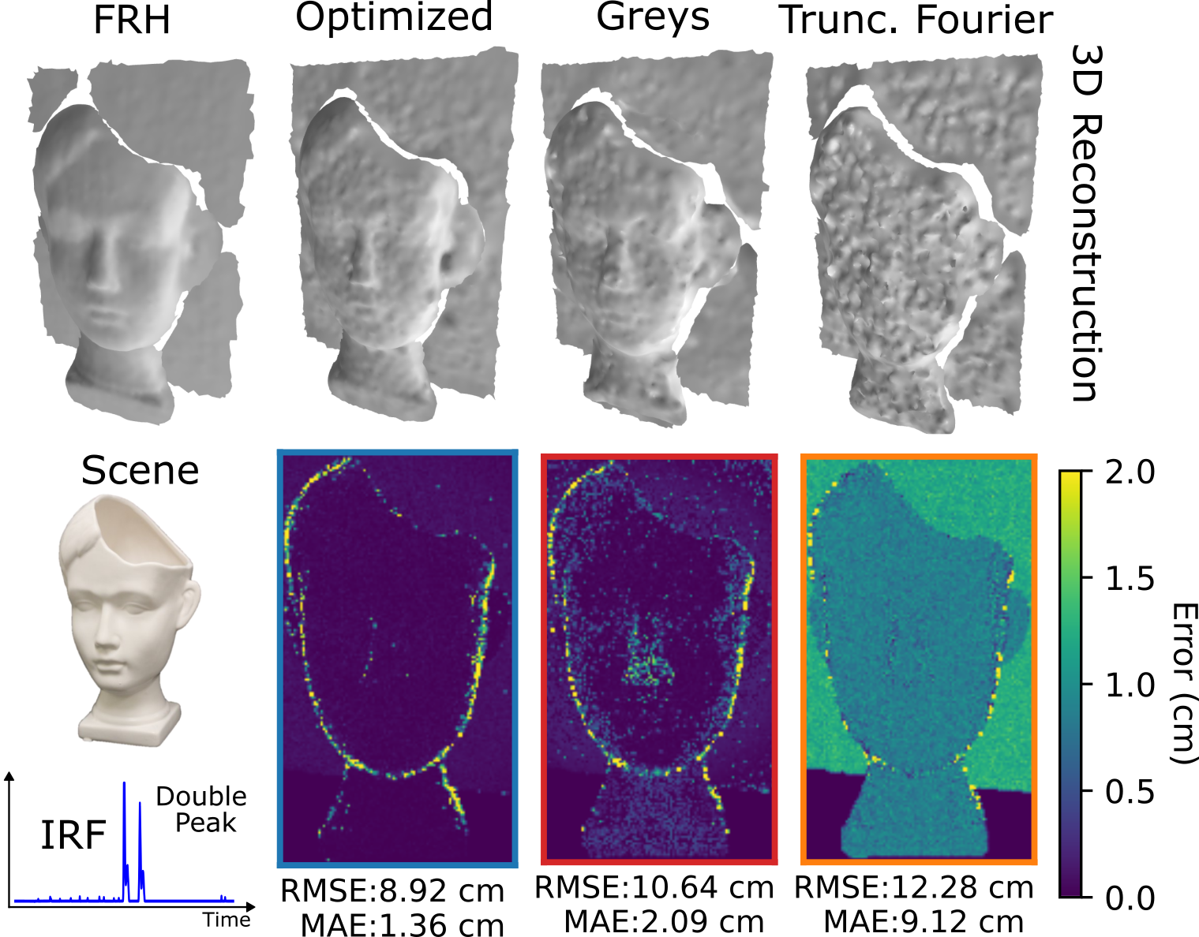
GT
Ours
Previous
Scene
Notes:
The full-resolution histograms has the highest performance because it is able to differentiate between the double peaks in the IRF
However compressive histograms struggles with the double peak, and as a result have suboptimal performance
Conversely, our coding functions is robust to the non-ideal impulse response function and achieves the closest reconstruction to the FRH.

Slide 2
Proposed Illumination
Key Contribution: Design of the illumination for single-photon 3D cameras that adhere to illumination constraints
Notes:
The full-resolution histograms has the highest performance because it is able to differentiate between the double peaks in the IRF
However compressive histograms struggles with the double peak, and as a result have suboptimal performance
Conversely, our coding functions is robust to the non-ideal impulse response function and achieves the closest reconstruction to the FRH.

