Slide 1
What If Your Robot Can't Trust Its Own Eyes?
Reinforcement Learning Under Data Dropouts
Doron Peleg | Afeka College of Engineering, Tel Aviv
Inspired by Fan et al. (2025) — IEEE Transactions on Cybernetics

Slide 2
Imagine this...
A surgical robot is operating remotely. The Wi-Fi drops for half a second. The robot's last known position of the scalpel is 2mm from where it actually is. Does it cut? Does it freeze? Does it guess?
This is the data dropout problem in networked control systems.

Slide 3
Every RL algorithm assumes the agent can see.
What happens when it can't?
Pretend nothing happened
Use the stale observation as if it were current
Try to predict what you missed
Extrapolate from last known state + action
Admit you don't know
Skip learning when the data is unreliable

Slide 4
Our Simplified World
A 1D number line from -4 to +4
Target moves in a sine wave
2.0 * sin(2πt / 100)
3 actions: LEFT (-0.2), STAY (0), RIGHT (+0.2)
41 discrete states (bins of relative distance)
Bin 20 = right on target
Reward = -|distance|
On target = 0 (best), 4 units away = -4 (worst)
Each episode = 300 steps (3 sine cycles)
The Number Line
-4
target
+4
▲
▲
Agent
Target (moving)
Reward examples:
On target: reward = 0.0 1 unit away: reward = -1.0 4 units away: reward = -4.0

Slide 5
The Dropout Channel: 30% Packet Loss
Like a GPS that freezes 30% of the time— showing where you were instead of where you are.
Step 1
True: Bin 18
Seen: Bin 18
OK
Step 2
True: Bin 19
Seen: Bin 19
OK
Step 3
True: Bin 20
Seen: Bin 19
DROP
Step 4
True: Bin 21
Seen: Bin 21
OK
Step 5
True: Bin 22
Seen: Bin 22
OK
Step 6
True: Bin 21
Seen: Bin 22
DROP
Step 7
True: Bin 20
Seen: Bin 20
OK
Step 8
True: Bin 19
Seen: Bin 19
OK
Step 9
True: Bin 20
Seen: Bin 20
OK
Step 10
True: Bin 21
Seen: Bin 20
DROP
Red steps: agent thinks it's in one bin but is actually in another. It makes decisions based on wrong information.

Slide 6
Three Agents, One Environment
Same Q-learning algorithm (41 states x 3 actions). Only difference: how they handle dropout.
BASELINE
No dropout at all
Sees true state every step
Always updates Q-table
The upper bound—
what's possible with perfect information
NAIVE
30% dropout
Receives stale states
Always updates Q-table
Writes updates to wrong
Q-table entries—
corrupting its knowledge
DROPOUT-AWARE
30% dropout
Receives stale states
Skips Q-update if stale
Protects Q-table from
corruption—learns less
often, but learns correctly
Q-table: 41 rows (states) x 3 columns (actions). Each cell = expected future reward for taking that action in that state.

Slide 7
What We Expected vs. What We Found
We tested every combination of dropout-handling strategies:
Strategy | Reward
Baseline (no dropout) | -31.80
Naive (always update) | -45.94
Confidence alpha only | -45.66
State estimator only | -68.10
Estimator + confidence | -68.02
Skip when stale | -43.24
The fancy solution made it WORSE
State estimator: -68.10
vs. doing nothing: -45.94

Slide 8
"When you don't know, don't learn."
~28% of steps are skipped (83 out of 300 per episode) But the remaining 72% write accurate values to the correct Q-table entries. A smaller set of clean updates beats a larger set of noisy ones.

Slide 9
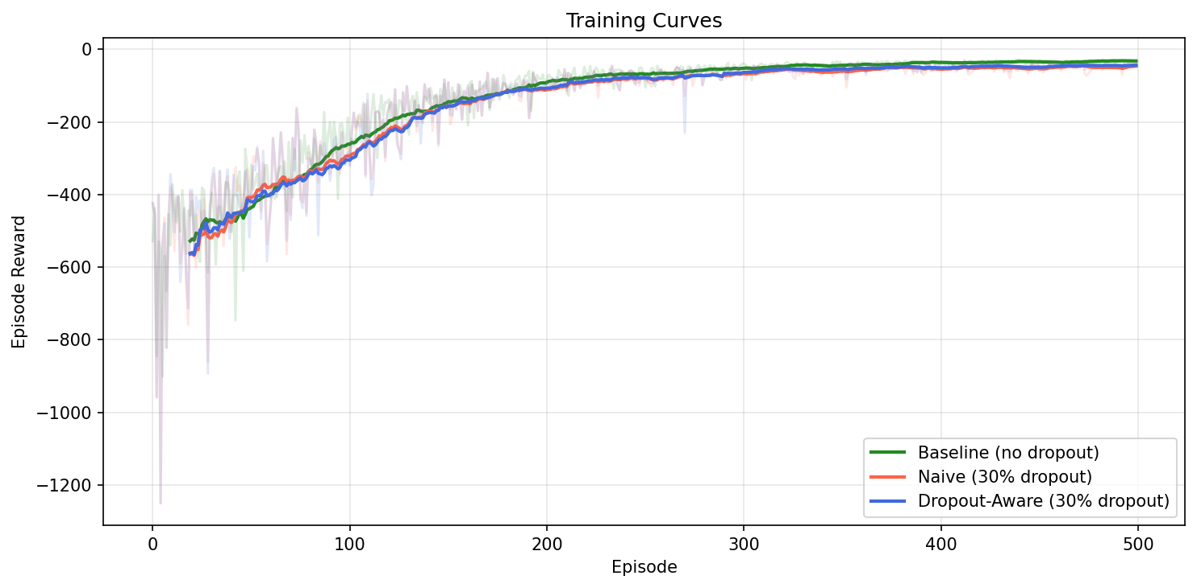
Training: 500 Episodes
Last-20 Episode Average
Baseline
-31.80
Dropout-Aware
-43.24
Naive
-45.94
~6% improvement from skipping stale updates

Slide 10
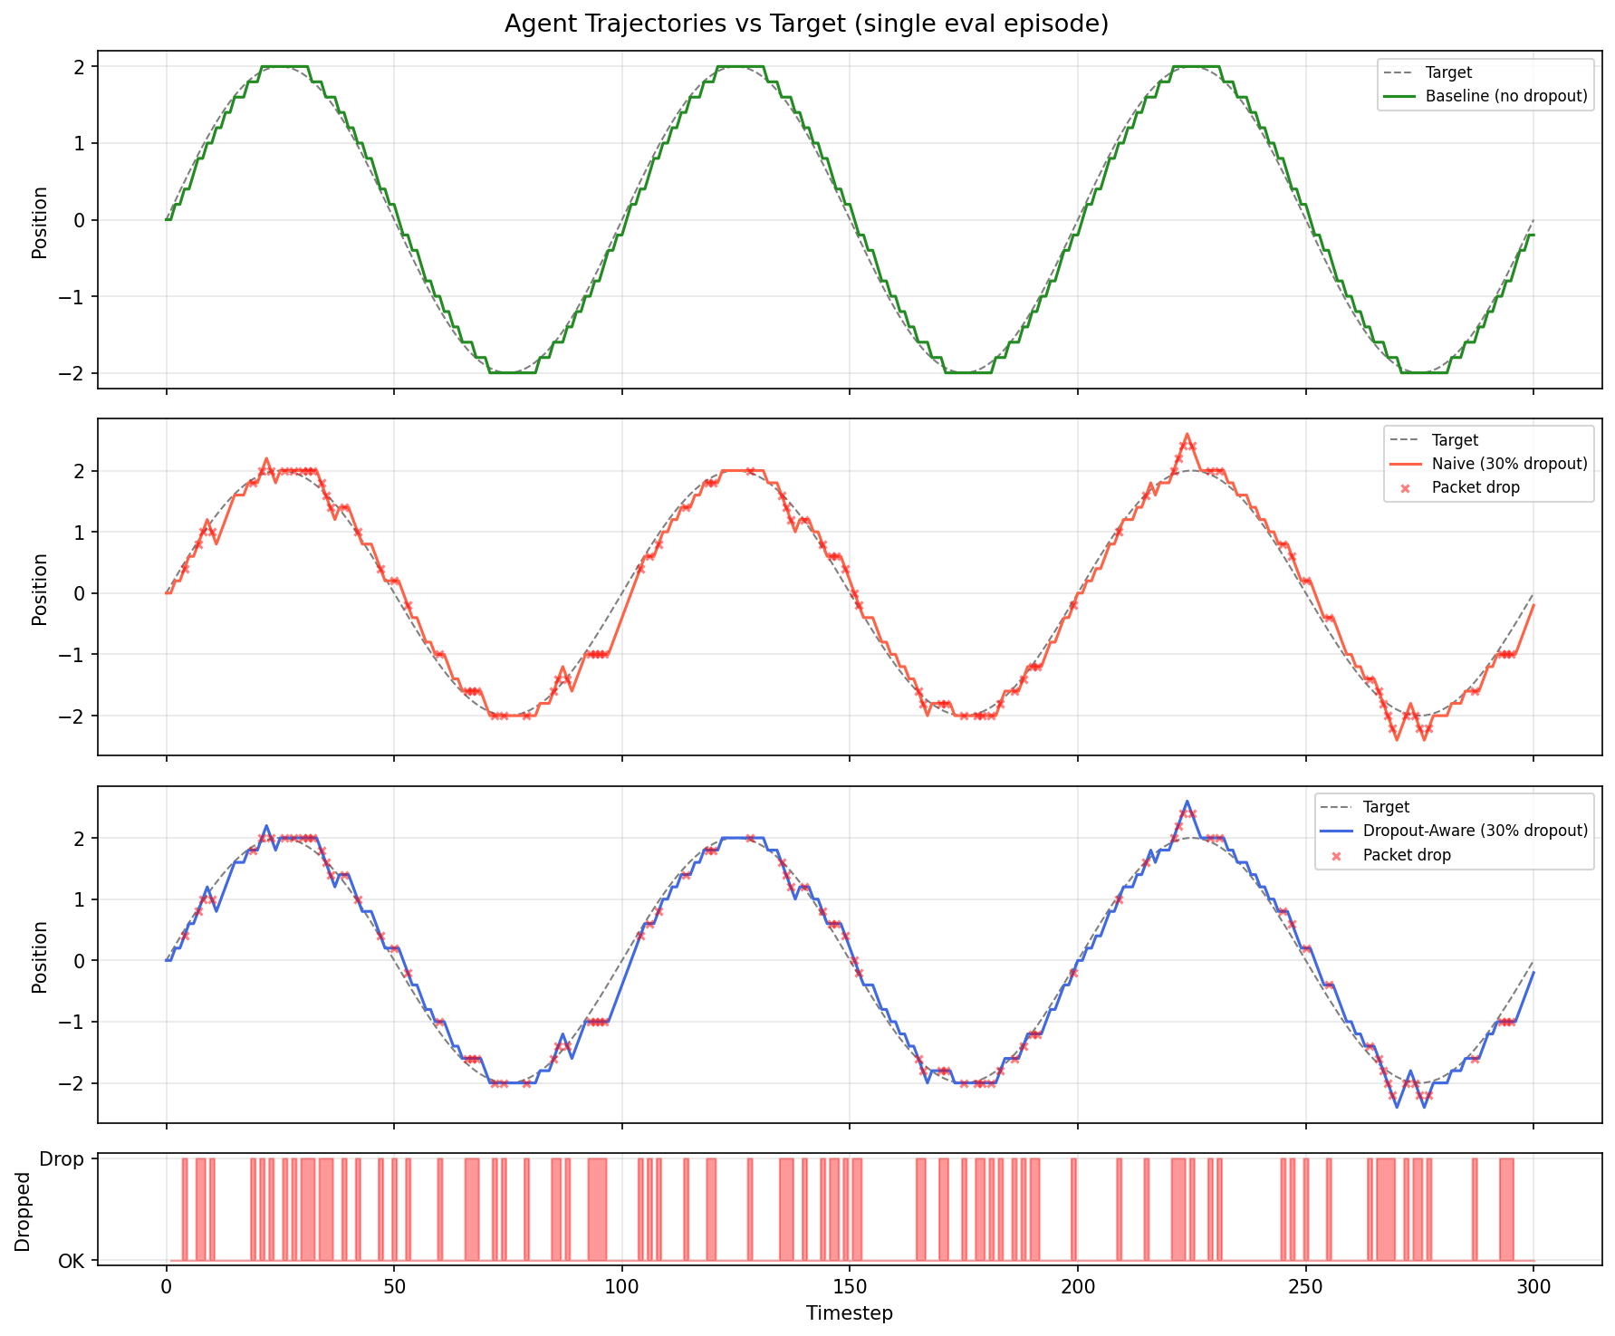
What Does It Look Like?
Top: Baseline hugs the target Middle: Dropout agents show overshoots at peaks Bottom: Red = packet was lost

Slide 11
The Second Surprise
At evaluation time (greedy policy, no learning):
Agent | Mean Tracking Error | Total Reward
Baseline | 0.0858 | -25.75
Naive | 0.1236 | -37.09
Dropout-Aware | 0.1236 | -37.09
Naive and Dropout-Aware: IDENTICAL evaluation scores
With 41 states and 3 actions, both Q-tables converge to the same argmax.
The dropout-aware advantage is learning efficiency, not the final policy.

Slide 12
But wait...
We hand-coded the reward: -|distance|
How did we know that was right?
What if we could discover the reward automatically—
just by watching an expert do the task?

Slide 13
Inverse Reinforcement Learning
Regular RL
Given: reward function
Find: optimal policy
Inverse RL
Given: expert demonstrations
Find: reward function
The Analogy
You watch a top student ace every exam.
You don't copy their answers.
You figure out what textbook they're studying from.

Slide 14
5 Hypotheses About What the Expert Cares About
f0: Bullseye
1.0 if within 0.1 units of target
Does the expert care about precision?
f1: Linear
-|distance|
Is the penalty proportional to distance?
f2: Quadratic
-distance²
Is the penalty proportional to distance²?
f3: Danger
-1.0 if beyond 75% of range
Does the expert avoid edges specifically?
f4: Bias
constant 1.0
Is there a constant cost per step?
We give IRL these building blocks. It discovers which ones matter.

Slide 15
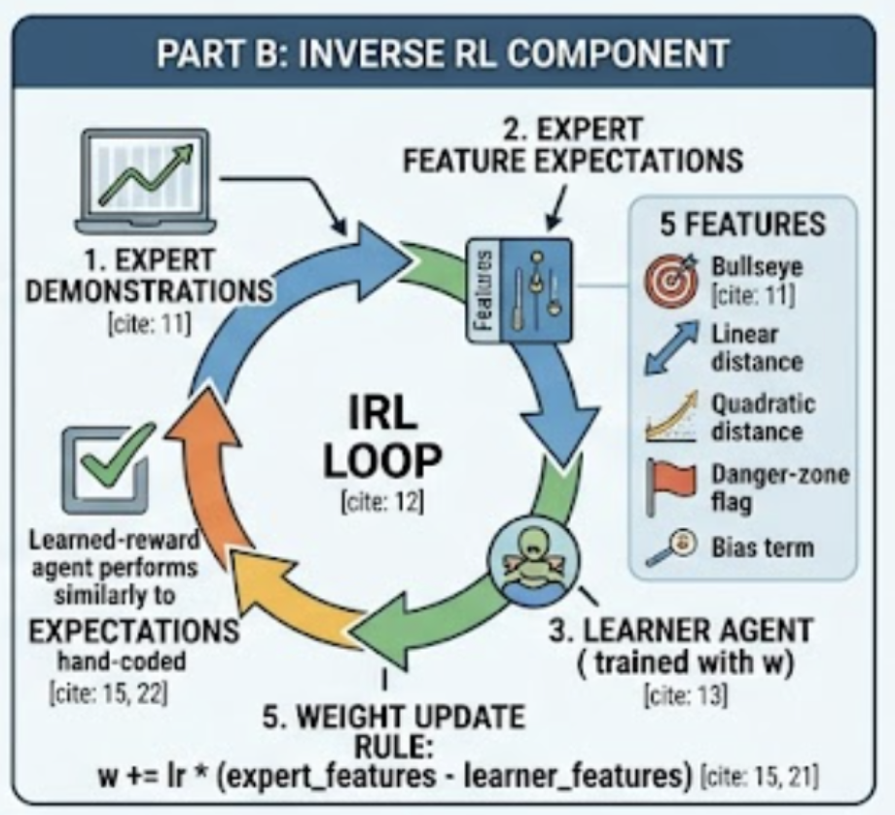
The IRL Loop: 200 Iterations
1
Train Q-learner (100 episodes) reward = weights · features
2
Run policy (10 episodes) Measure average feature vector
3
gradient = expert - learner "Where is the learner falling short?"
4
weights += 0.01 × gradient "Push reward toward expert behavior"
Repeat until the learner's behavior matches the expert's → reward function found

Slide 16
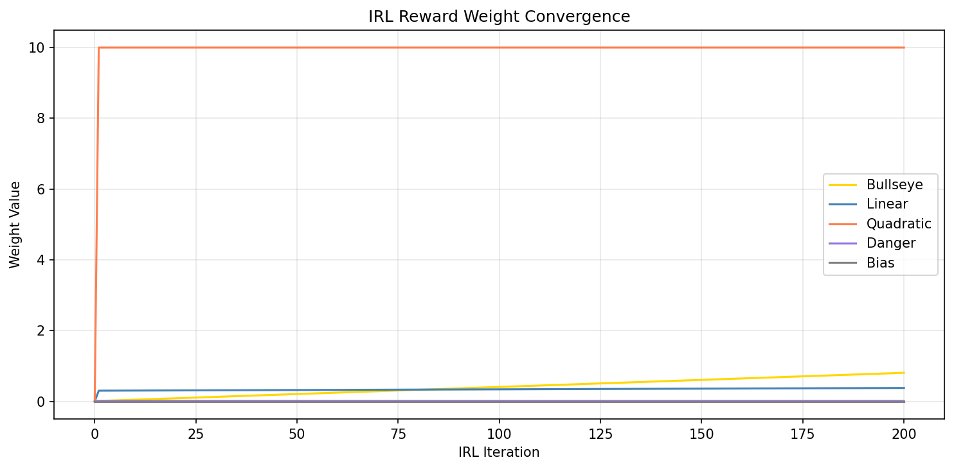
What IRL Discovered
Final Learned Weights
Quadratic
10.000
Bullseye
0.806
Linear
0.378
Danger
0.010
Bias
0.000
Quadratic dominates—
being far is very costly

Slide 17
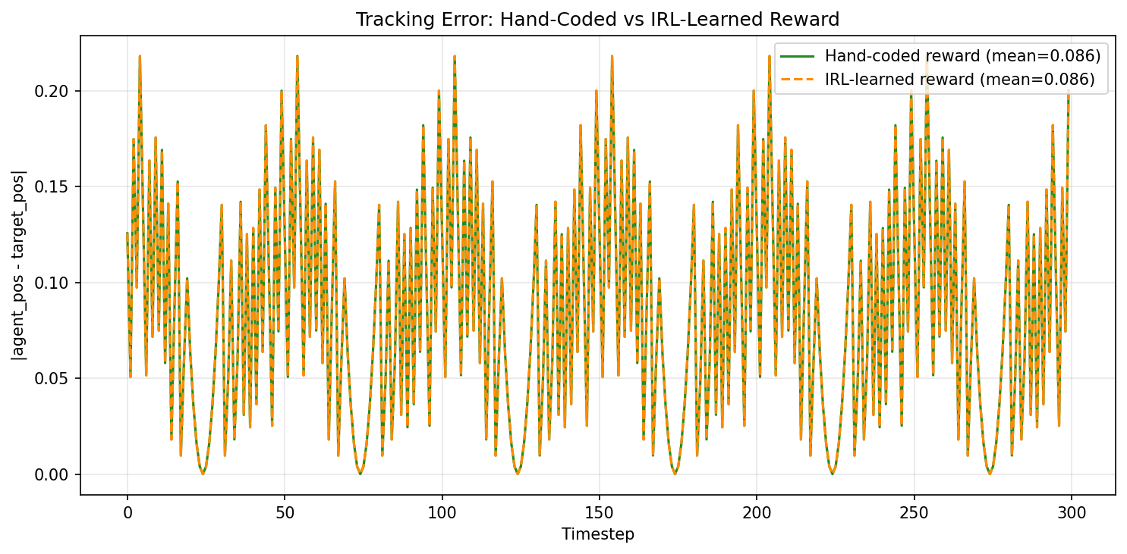
The Proof: Hand-Coded vs. IRL-Learned
Agent | Hand-coded Error | IRL-learned Error
Baseline | 0.0858 | 0.0858
Naive | 0.1236 | 0.1236
Dropout-Aware | 0.1236 | 0.1236
Every cell matches. IRL recovered the reward perfectly.
Green (hand-coded) and orange (IRL) overlap exactly

Slide 18
But was our problem too easy?
In 1D, Naive and Dropout-Aware converged to the same policy.
41 states, 3 actions — too simple to corrupt.
What happens when we scale up?

Slide 19
Scaling Up: 2D Figure-Eight Tracking
 | 1D (before) | 2D (now)
States | 41 | 441 (21x21)
Actions | 3 | 9 (8 dirs + stay)
Q-table | 123 entries | 3,969 entries
Target | Sine wave | Figure-eight
Training | 500 episodes | 800 episodes
Why 2D changes everything
32x larger Q-table
Many states visited rarely — corrupted updates can flip the best action
3x more actions
Choosing between 8 directions is ambiguous — noise promotes wrong ones
2D stale states
Wrong in both X and Y simultaneously — bigger mistakes, harder to recover

Slide 20
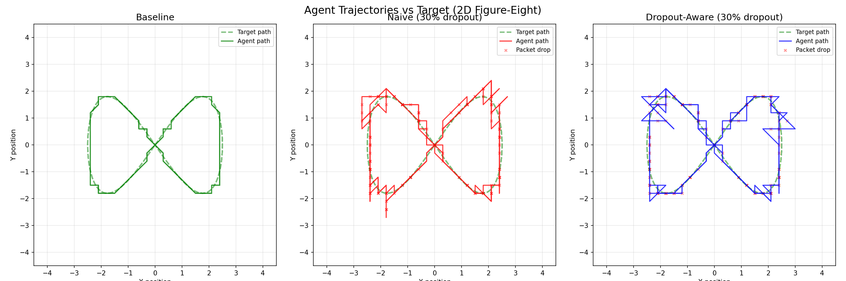
2D Trajectories: The Difference Is Visible
Dropout-Aware (blue) traces the figure-eight more smoothly. Naive (red) shows sharper deviations from corrupted Q-table entries.

Slide 21
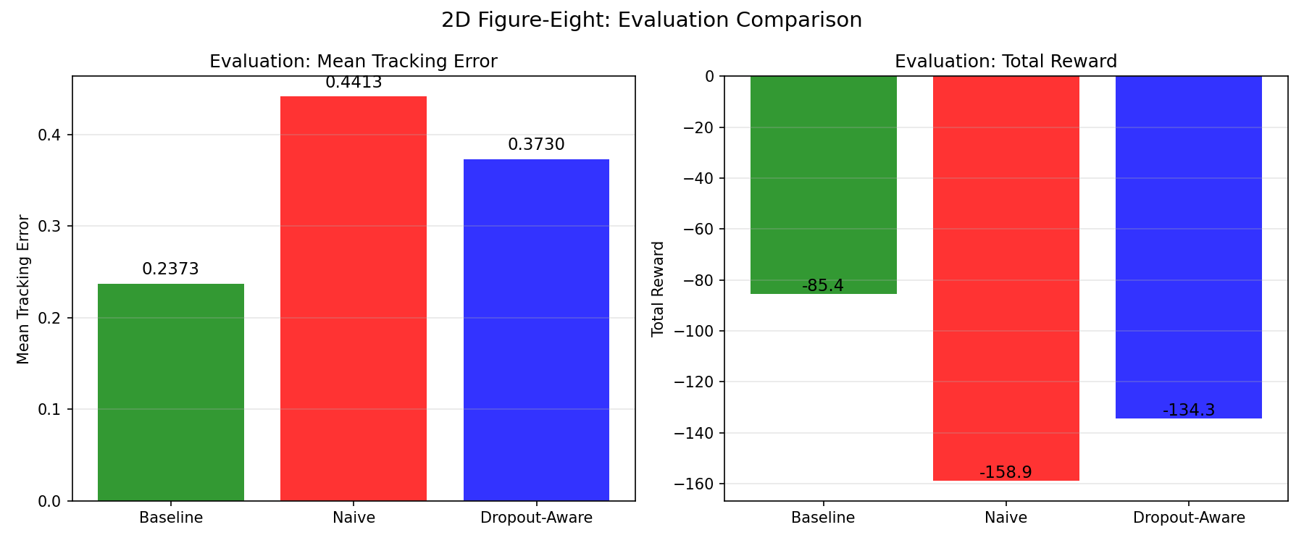
2D Results: The Gap Is Real
Agent | Mean Track Error | Total Reward
Baseline (no drop) | 0.2373 | -85.44
Naive (30% drop) | 0.4413 | -158.87
Dropout-Aware (30%) | 0.3730 | -134.29
Dropout-Aware beats Naive by 15.5%
Unlike 1D, the policies are now DIFFERENT.
Corrupted Q-table entries produce wrong actions in rarely-visited states.

Slide 22
1D vs 2D: Complexity Reveals the Truth
1D Sine Wave (Simple)
2D Figure-Eight (Complex)
123 Q-table entries
3,969 Q-table entries (32x larger)
Agent | Eval Error
Baseline | 0.0858
Naive | 0.1236
Dropout-Aware | 0.1236
Agent | Eval Error
Baseline (no drop) | 0.2373
Naive (30% drop) | 0.4413
Dropout-Aware | 0.3730
Naive = Dropout-Aware Same policy, no visible difference
Dropout-Aware BEATS Naive by 15.5% Complexity reveals the real advantage

Slide 23
Three Takeaways
1
When in doubt, don't act.
Acting on bad information is worse than waiting. The dropout-aware agent improved by simply skipping uncertain updates.
2
Simple beats clever.
A sophisticated state estimator made things worse. The best strategy was the most obvious one.
3
You don't need to define the goal.
Inverse RL discovered the reward from expert demonstrations alone. The objective reveals itself through behavior.

Slide 24
The next time a robot loses signal mid-operation...
the smartest thing it can do might be the simplest:
Put down the scalpel. Wait for a clear picture. Then cut.

Slide 25
Thank You
Questions?
Doron Peleg | doron.peleg@gmail.com
Code: github.com/dpartuk/RL
Based on: Fan et al. (2025) "Inverse RL for Discrete-Time Systems With Data Dropouts" — IEEE Trans. Cybernetics, Vol. 55, No. 4

