Slide 1
Smart Walkability Perception
Measuring How Walkable Tel Aviv's Streets Feel
Using Municipal Open Data
Doron Peleg | 2026

Slide 2
1
Project Goal

Slide 3
What Makes a Street Feel Walkable?
Some streets invite you to walk. Others make you want to drive.
This "feeling" is called Visual Walkability Perception (VWP) —
it combines safety, comfort, liveliness, and accessibility into
a single impression of how pleasant a street is for pedestrians.
Traditional measurement requires expensive surveys or
street-level imagery analysis. We asked a different question:
Can a city's own operational data — business records, complaints,
demographics — tell us how walkable its streets are?

Slide 4
2
The Base Paper

Slide 5
Li et al. (2022) — Measuring Visual Walkability
The Problem
How walkable a street looks matters for urban planning, health,
and property values — but measuring it at city scale is hard.
Surveys are expensive. Audits are subjective.
Their Method
Collected 2,642 panoramic street images from 7 world cities
30 people rated them in VR headsets across 6 walkability dimensions
Used AI (deep learning) to identify what makes streets look walkable
Found that vegetation, sidewalks, and traffic signs matter most
Key Result: 19 visual features explain 41–59% of walkability perception

Slide 6
Six Dimensions of Walkability
Walkability
Overall impression — does this street support walking?
Feasibility
Is there a reason to walk here? Shops, services, mixed land use
Accessibility
Can you walk here? No barriers, dead ends, or missing sidewalks
Safety
Does it feel safe from crime and traffic?
Comfort
Is it pleasant? Wide sidewalks, shade, low noise
Pleasurability
Is it enjoyable? Greenery, lively atmosphere, interesting views
Based on Alfonzo's Hierarchy of Walking Needs (2005)

Slide 7
3
Our Project

Slide 8
A Different Lens on Walkability
The paper used:
We use instead:
Street-level photos
AI to count pixels of trees, cars, signs
Human raters in VR headsets
Tel Aviv municipal open data
Business registries, complaint logs, demographics
Traffic speed as walkability proxy
Key Insight
A camera sees trees, sidewalks, and cars.
Municipal data sees what the camera can't:
• Are businesses thriving or closing?
• Are residents complaining about noise and broken sidewalks?
• Do women feel safe enough to move into the neighborhood?
• Are there cultural events that bring people to the street?

Slide 9
4
Approach & Datasets

Slide 10
Tel Aviv Open Data
Traffic Speed Segments
24 months of hourly speeds on 2,070 road segments
ArcGIS REST API
Business Registry
35,172 businesses with category, licensing, neighborhood
Azure Blob CSV
106 Hotline Complaints
286,657 municipal complaints (noise, infrastructure...)
Azure Blob CSV
Closed Streets
2,006 street closures: events, construction, light rail
Azure Blob CSV
Population & Migration
Age, gender, neighborhood breakdown (2010–2022)
CBS/Municipal CSV
Dwelling Units
Residential vs. commercial unit counts by neighborhood
Municipal CSV
Socio-Economic Index
18 indicators per neighborhood (income, cars, education)
Municipal Excel
Construction Starts
Building starts/completions by district (2020–2022)
CBS CSV
Total: 35 raw files | 255 MB | 1.3M+ records | All freely available

Slide 11
Methodology
Download
& Clean
8 data sources
35 files
UTF-8 normalization
Spatial
Database
GeoPackage
16 layers
71 neighborhoods
Feature
Engineering
27 features
per segment
5 join strategies
Modeling
& PCA
Linear, RF, NN
Permutation imp.
Composite score
Validation
& Maps
Paper comparison
Interactive map
Recommendations
→
→
→
→
Unit of analysis: directed traffic segment (~100m of street)
Outcome variable: average traffic speed (proxy for walkability)

Slide 12
5
Features of Interest

Slide 13
27 Features Across 8 Categories
Traffic (5)
avg speed, peak-hour drop, speed variance, directional differential, evening recovery
Business (5)
restaurant count, total businesses, diversity index, licensed ratio, evening business count
Street Events (5)
event frequency, event diversity, light rail closures, parade routes, infrastructure closures
Complaints (2)
noise complaints, infrastructure complaints
Construction (2)
building starts, completion rate
Demographics (3)
female population growth, young adult share (20-34), elderly share (65+)
Housing (2)
residential density, commercial-to-residential ratio
Socio-Economic (3)
SES cluster, cars per 100 residents, avg monthly income
Coverage: 82–100% across all features | Joined via spatial + code-based strategies

Slide 14
6
Project Plan

Slide 15
Four Phases, Eight Weeks
Phase 1
Phase 2
Phase 3
Phase 4
Data Collection
& Pipeline
Feature
Engineering
Analysis &
Modeling
Validation &
Interpretation
Weeks 1–2
→
Weeks 3–4
→
Weeks 5–6
→
Weeks 7–8
Download, clean, and store
all datasets in a spatial database
Compute 27 features per
street segment from raw data
Regression, PCA, walkability
scoring and mapping
Compare with paper, generate
recommendations and deliverables
Tech stack: Python, GeoPandas, statsmodels, scikit-learn, Folium | Storage: GeoPackage (243 MB)

Slide 16
7
Phase Details

Slide 17
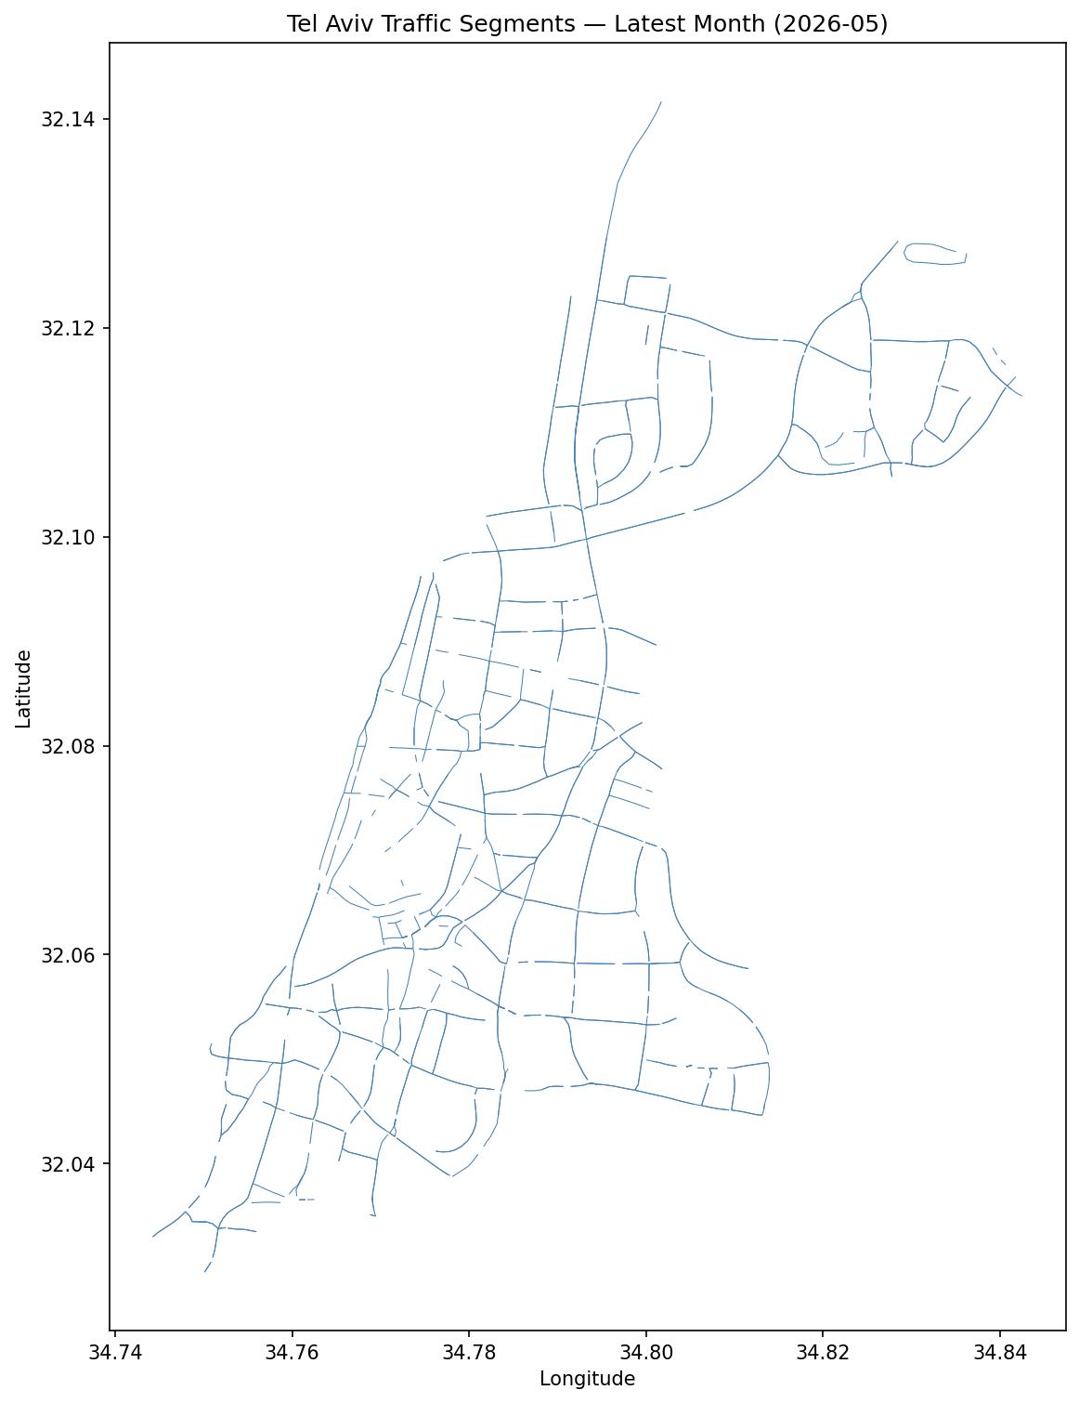
Phase 1: Data Collection & Pipeline
Downloaded 24 monthly traffic layers from ArcGIS REST API
with pagination (2,000 records/request)
Downloaded 10 CSV datasets, handling 3 different encodings
(UTF-16LE, Windows-1255, UTF-8) and 4 different delimiters
Normalized all column names: Hebrew → English snake_case
Built GeoPackage spatial database with 16 layers
Downloaded 71 neighborhood boundary polygons
for spatial joins in later phases
Output:
35 raw files (255 MB)
50,947 traffic segments (24 months)
1.3M+ records across all datasets
smarttraffic.gpkg (243 MB, 16 layers)

Slide 18
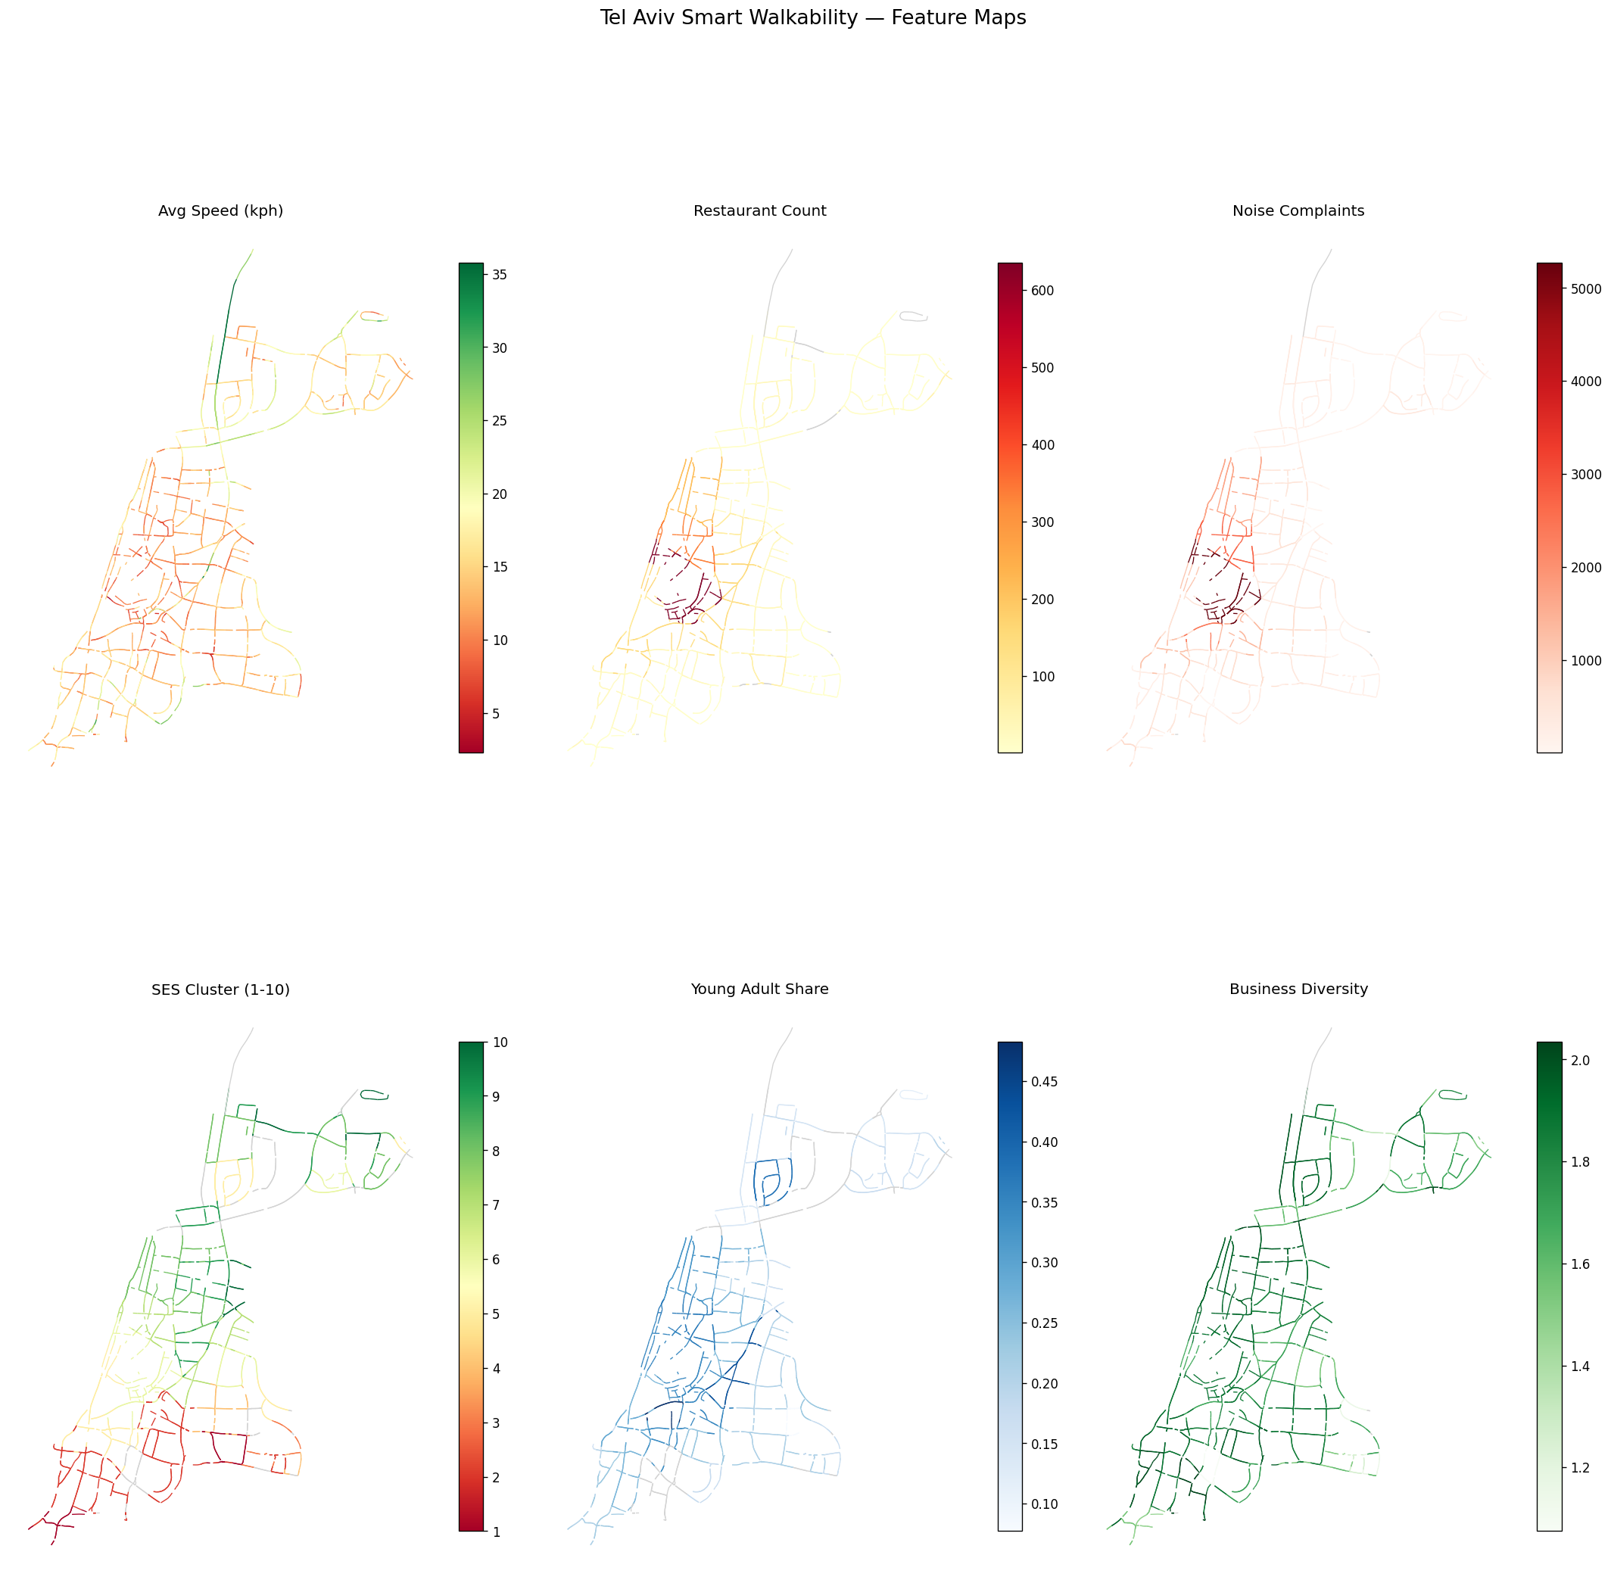
Phase 2: Feature Engineering
Spatial join: segment centroids → neighborhood polygons
(99.6% matched, using projected CRS for accuracy)
5 traffic features computed directly from hourly speed columns
5 business features via neighborhood_code join
(Shannon entropy for diversity, license ratio, evening count)
5 street event features via street_code join
(event frequency, light rail, parade routes)
Complaint, construction, demographic, housing, SES features
aggregated at neighborhood level with name normalization
Output:
2,070 segments × 27 features
Coverage: 82–100% per feature
'features' layer in GeoPackage

Slide 19
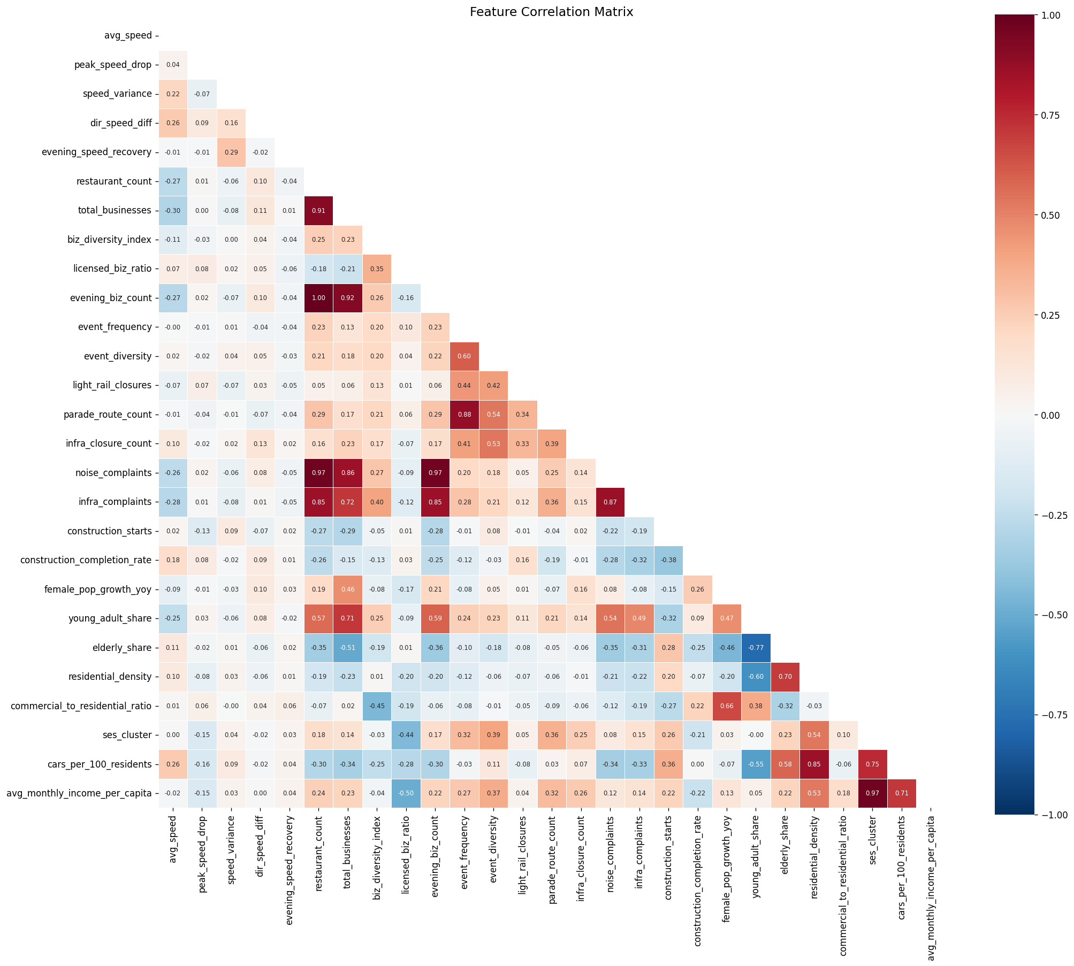
Phase 3: Analysis & Modeling
Explored distributions, correlations, and VIF across 27 features
Found strong multicollinearity: restaurant ≈ evening businesses,
SES cluster ≈ income, noise ≈ infrastructure complaints
Three modeling approaches (5-fold CV):
Linear Reg.
Stepwise, 17 features
R² = 0.330
Neural Net
2 layers (64-32), early stop
R² = 0.437
Random Forest
300 trees, leaf=5
R² = 0.489
PCA walkability composite score (0–100):
PC1 captures 26% of variance across 24 features

Slide 20
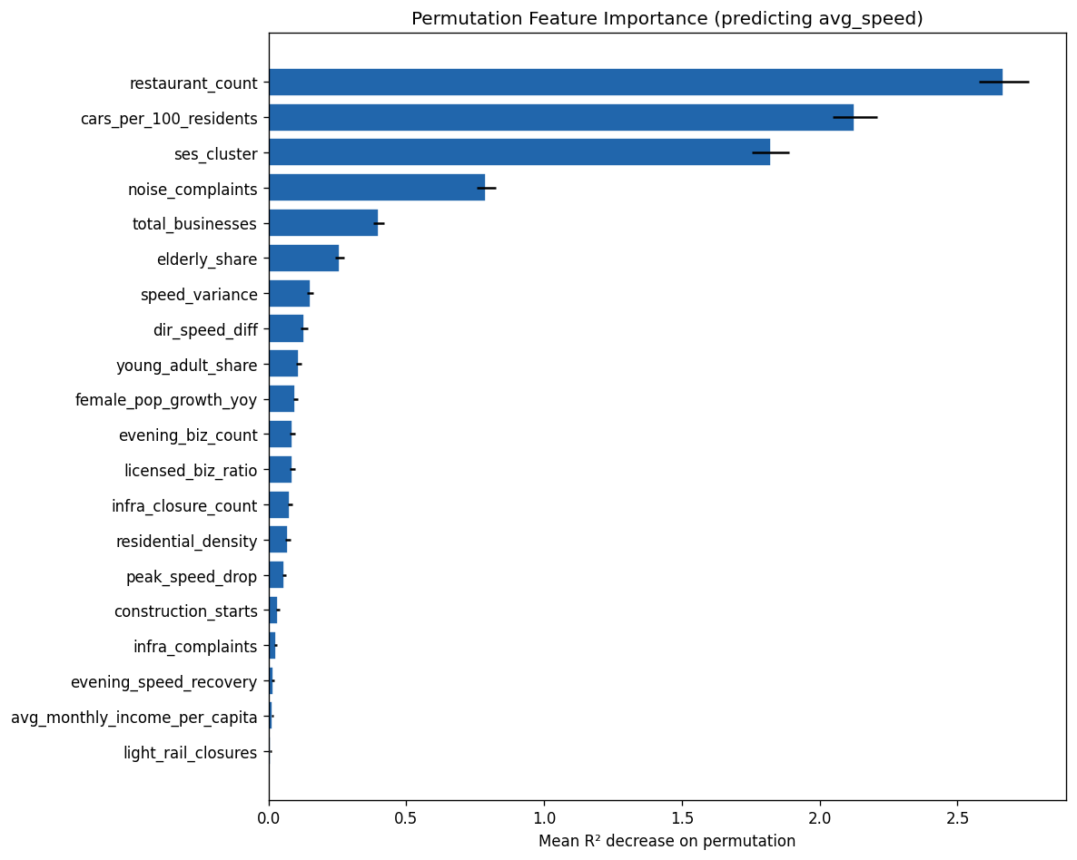
Phase 4: Validation & Interpretation
Permutation feature importance: restaurant_count,
cars_per_100_residents, and ses_cluster dominate
Mapped all features to the paper's 6 VWP categories
to compare our findings against visual-feature results
PCA walkability composite score (0–100 scale):
PC1 explains 26% of variance across 24 features
Built interactive Folium map with click-to-inspect
walkability scores for each street segment
Generated policy recommendations for low-scoring areas

Slide 21
8
Results

Slide 22
The Dataset: 1,278 Segments × 26 Features
2,070 segments reduced to 1,278 after dropping rows with missing values
What one row looks like — three example segments:
Feature
Feature
Rothschild Blvd
(high walkability)
Rothschild Blvd
(high walkability)
Ben Tzvi
(mid)
Ben Tzvi
(mid)
Yerushalayim St
(low walkability)
Yerushalayim St
(low walkability)
Neighborhood
Lev Tel-Aviv
Machon Yaffo TLV
Yaffo G + Neve Golan
avg_speed
11.6 km/h
13.0 km/h
17.3 km/h
restaurant_count
635
19
1
total_businesses
4,806
251
54
ses_cluster
6
2
1
cars_per_100_residents
39
37
34
noise_complaints
5,270
485
760
speed_variance
1.3
4.1
0.1
Walkable streets: slow traffic, many restaurants, high SES. Non-walkable: faster traffic, few businesses, low SES.

Slide 23
Municipal Data Captures Walkability
Municipal features alone explain more traffic speed variance
than the traffic's own temporal patterns.
Combined model (traffic + municipal): Adj-R² = 0.354
Top 5 most important features:
1. Restaurant count
— street-level vitality signal
2. Cars per 100 residents
— car dependency = less walkable
3. SES cluster
— wealthier areas have better infrastructure
4. Noise complaints
— direct pedestrian discomfort
5. Total businesses
— mixed-use streets attract walking

Slide 24
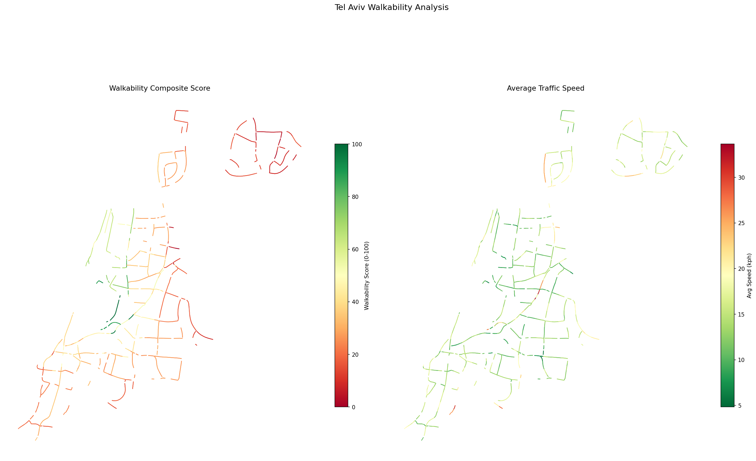
Tel Aviv Walkability Map
Most walkable
Rothschild Blvd (100/100)
Old North — south part (73)
Old North — north part (62)
Montefiori (48)
Least walkable
Neve Dan (3/100)
Rabiviim (5)
Ramat HaChayal (9)
Neot Afeka (10)
Pattern: central mixed-use → high;
peripheral residential → low

Slide 25
How Our Findings Compare to the Paper
Comfort
Paper: car/truck pixels (–)
Ours: cars per 100 residents, noise complaints
Strong match
Pleasurability
Paper: person/bicycle pixels (+)
Ours: restaurants, events, young adults
Strong match
Safety
Paper: vegetation (+), truck (–)
Ours: female pop growth, evening businesses
Novel signal
Accessibility
Paper: sidewalk (+), fence (–)
Ours: infrastructure complaints, construction
Good proxy
Novel: female population growth as safety proxy has no visual equivalent

Slide 26
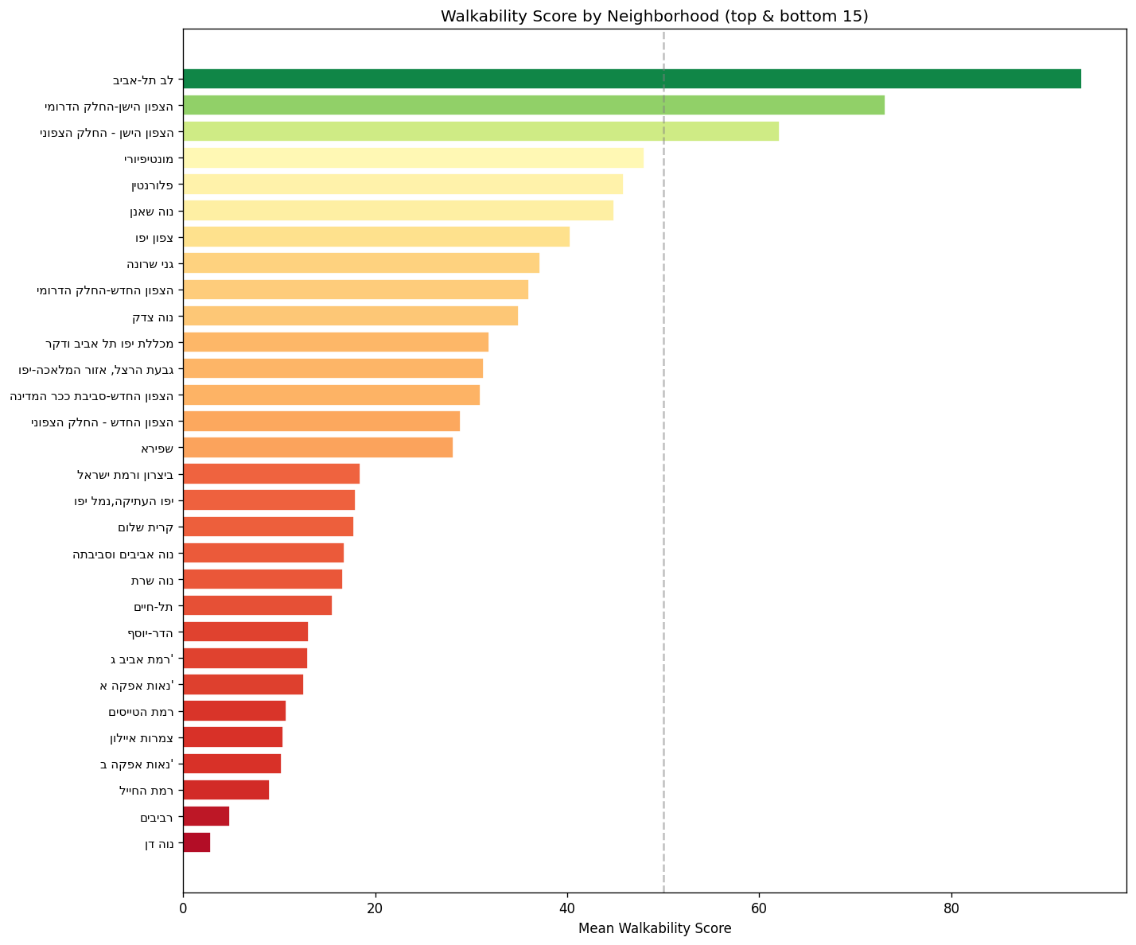
Neighborhood Walkability Ranking
Key observations:
Clear north-south SES gradient
matches walkability scores
Central mixed-use neighborhoods
(Lev TLV, Old North) score highest
Car-dependent northern suburbs
(Rabiviim, Neve Dan) score lowest
Low-scoring areas share a pattern:
few restaurants, low events,
high car ownership
Jaffa neighborhoods are mid-range—
high vitality but also high complaints

Slide 27
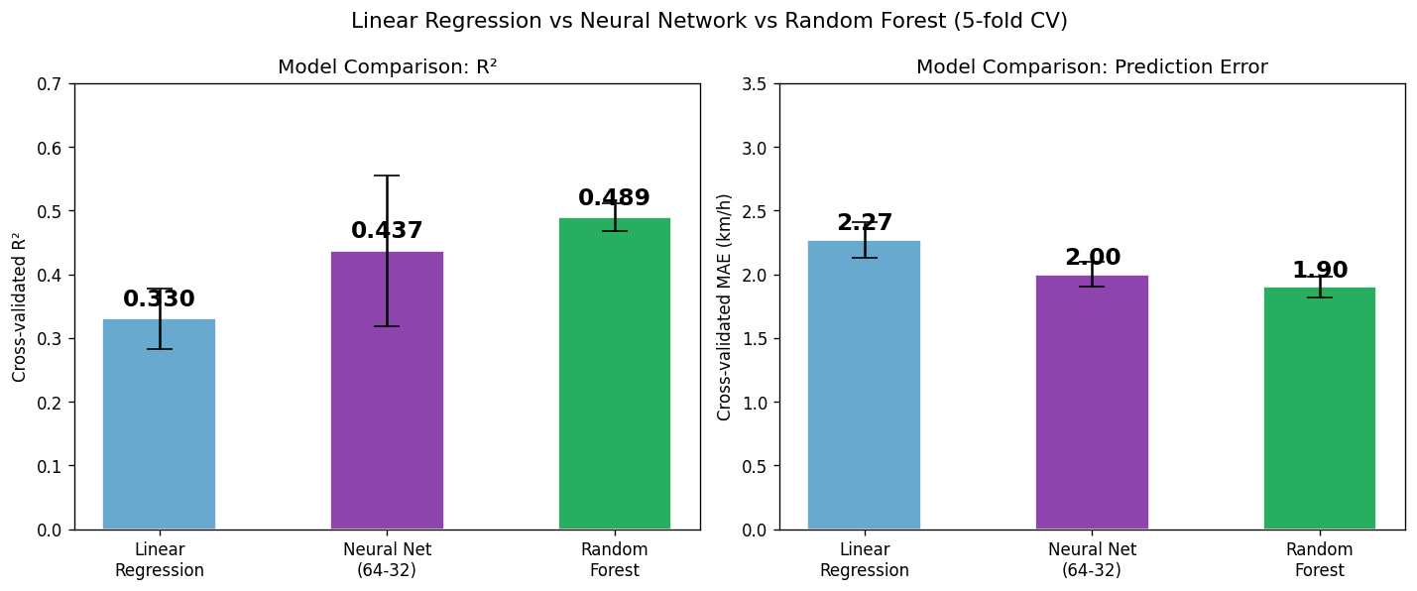
Three Models Compared
Random Forest (R²=0.489) > Neural Network (0.437) > Linear Regression (0.330)
Neural net improves over linear (+32%) but is unstable with only 1,278 samples
Random Forest wins: best accuracy, most stable, no tuning needed

Slide 28
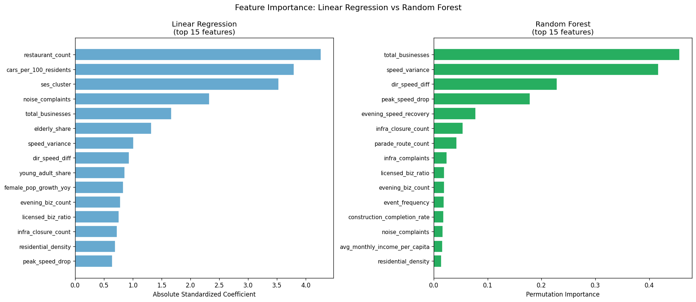
Feature Importance Shifts Between Models
Linear Regression: municipal features dominate (restaurant count, cars, SES)
Random Forest: traffic features rise to top (speed variance, directional diff)
Both agree: business count and speed patterns are key predictors

Slide 29
TLV Walkability Index — Weighted Formula
Walkability = Σ ( wᵢ × signᵢ × z_scoreᵢ ), normalized to 0–100
Feature
Sign
Weight
Interpretation
restaurant_count
+
0.31
More restaurants = more street vitality
cars_per_100_residents
−
0.25
Car dependency = less walkable
ses_cluster
+
0.21
Higher SES = better infrastructure
noise_complaints
−
0.09
Noise = pedestrian discomfort
total_businesses
+
0.05
Mixed-use streets attract walking
elderly_share
−
0.03
Higher elderly share = less active streets
speed_variance
−
0.02
Unstable traffic = less safe
dir_speed_diff
−
0.02
Asymmetric flow = bottleneck
young_adult_share
+
0.01
Young adults prefer walkable areas
female_pop_growth
+
0.01
Women move to safe neighborhoods
Weights derived from permutation importance of linear regression | Correlation with PCA score: r = 0.950

Slide 30
9
Appendix: Feature Details

Slide 31
Traffic Features (5) + Business Features (5)
Feature
Source / Join
What It Captures
avg_speed
Hourly speed cols
Mean of 15 hourly speeds (6am-8pm)
peak_speed_drop
Hourly speed cols
Ratio: 8am speed / 6am speed (rush impact)
speed_variance
Hourly speed cols
Variance across 15 hours (stability)
dir_speed_diff
Both directions
|speed dir A - speed dir B| (asymmetry)
evening_speed_recovery
Hourly speed cols
Ratio: 7pm speed / 5pm speed
restaurant_count
Businesses / nh_code
Food & hospitality businesses per neighborhood
total_businesses
Businesses / nh_code
All registered businesses per neighborhood
biz_diversity_index
Businesses / nh_code
Shannon entropy of business categories
licensed_biz_ratio
Businesses / nh_code
Fraction requiring a license (formality)
evening_biz_count
Businesses / nh_code
Restaurants + entertainment (nightlife)

Slide 32
Street Events (5) + Complaints (2) + Construction (2)
Feature
Source / Join
What It Captures
event_frequency
Closed streets / street_code
Number of event-type closures on this street
event_diversity
Closed streets / street_code
Distinct event types on this street
light_rail_closures
Closed streets / street_code
Light rail construction closures
parade_route_count
Closed streets / street_code
Marathon / parade route closures
infra_closure_count
Closed streets / street_code
Infrastructure work closures
noise_complaints
Hotline 106 / nh_code
Noise-related complaints per neighborhood
infra_complaints
Hotline 106 / nh_code
Sidewalk/road/lighting complaints
construction_starts
CBS / sub_district→nh
Building starts (latest year)
construction_completion_rate
CBS / sub_district→nh
Completions / starts ratio

Slide 33
Demographics (3) + Housing (2) + Socio-Economic (3)
Feature
Source / Join
What It Captures
female_pop_growth_yoy
Population / name match
Year-over-year female population growth
young_adult_share
Population / name match
% of population aged 20-34
elderly_share
Population / name match
% of population aged 65+
residential_density
Dwelling / nh_code
Dwelling units per billed area
commercial_to_residential_ratio
Dwelling / nh_code
Commercial units / residential units
ses_cluster
SES / name + manual map
Socio-economic cluster (1-10)
cars_per_100_residents
SES / name + manual map
Car ownership rate
avg_monthly_income_per_capita
SES / name + manual map
Average monthly income

Slide 34
Key Takeaway
A city's own data — business registries, complaint logs,
demographics — reveals how walkable its streets feel,
capturing dimensions that even street-level photos miss.
No cameras needed. No surveys. Just open data.
Thank you | Questions?

