Slide 1
Project Design for Math by VR
By Group 5: Dhruv Patel, Priyam Patel, Muhammad Hassan, and Mariam Zikaria

Slide 2
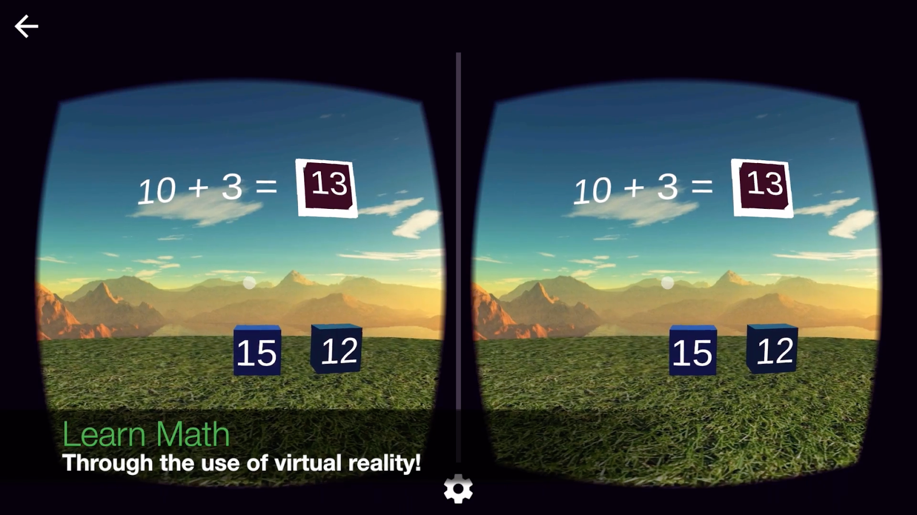
About our project
Learning Math using VR.
Notes:
https://lh3.googleusercontent.com/cKK-9ZBnFQLxScR8-YDINhjEp49HAUJEz8UB5gVBqop2XP6P5tlVRYnARVd6Xdw0Yw44=h900

Slide 3
Overview of today's Presentation
We are going to cover
Software Architecture
Software Design
Class Diagrams
Object Design
Testing
Risk and Cost

Slide 4
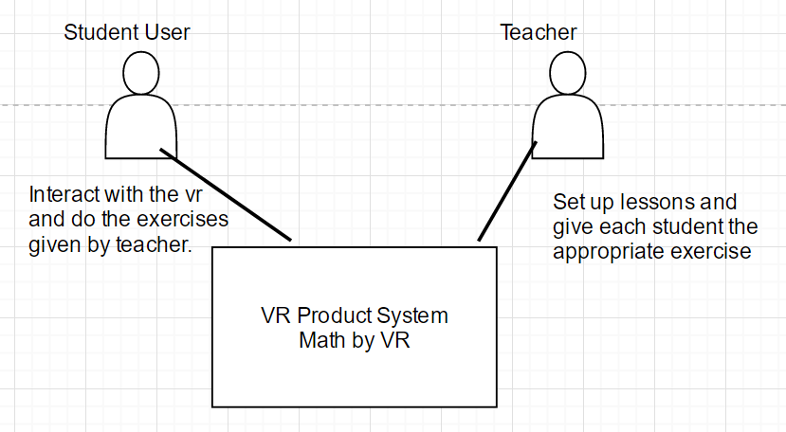
Software Architecture - Context Diagram

Slide 5
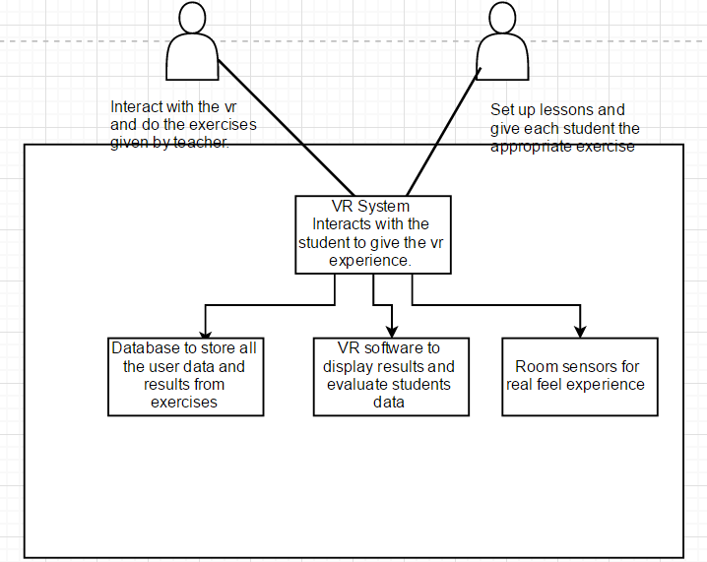
Software Architecture - Container Diagram

Slide 6
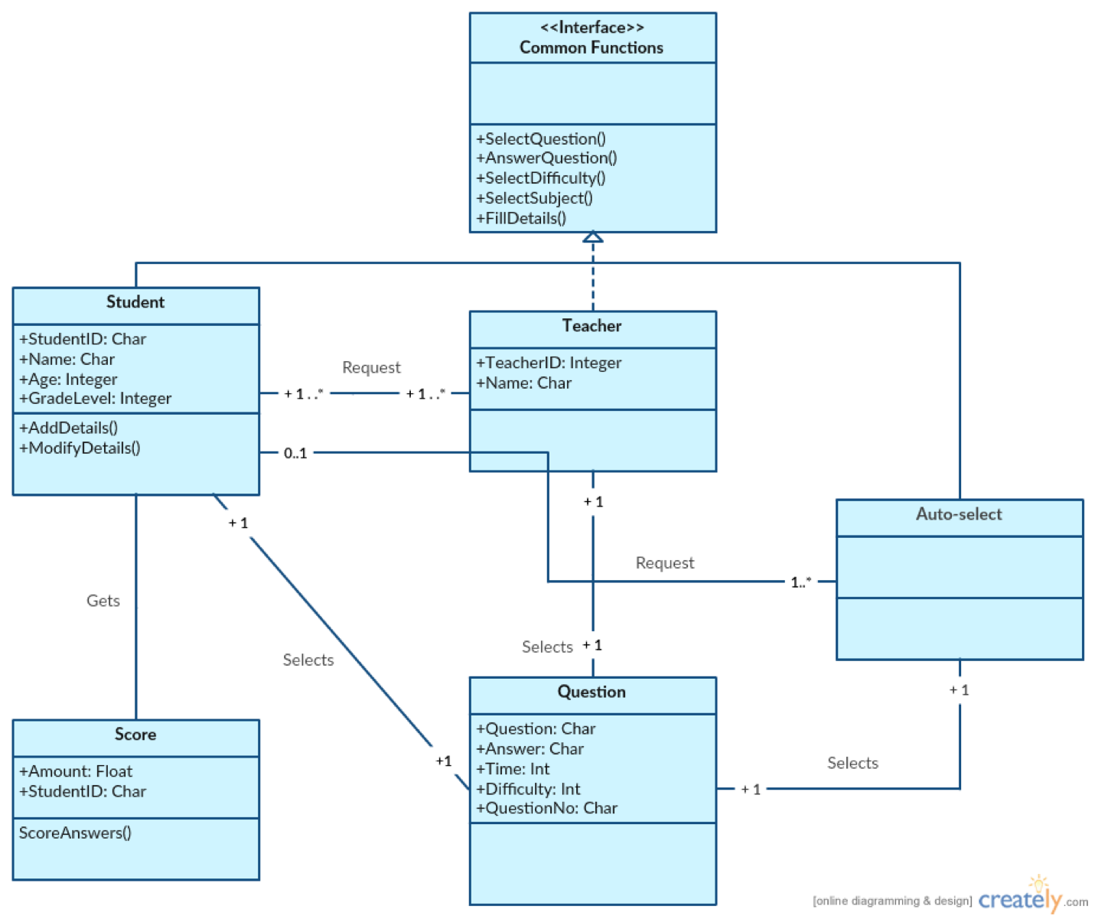
Class Diagram

Slide 7
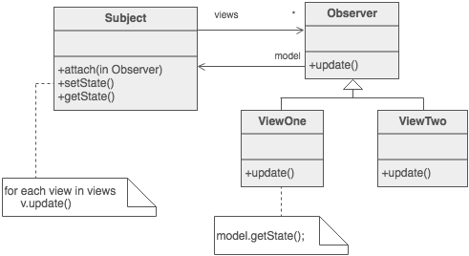
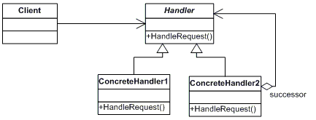
Object Design
Design Patterns
Chain of Responsibility
Memento - capture and restore
Observer - student activity display
Iterator

Slide 8
System Design
•Project goal and objectives: Interactive math VR application
•Major system interfaces: User, Teacher, Questions,
•System refined: by the received input from the VR (example: graphics, difficulty level)
•subsystem making up each component: Operations, Score
•Controls for the system interfaces: Common Functions

Slide 9
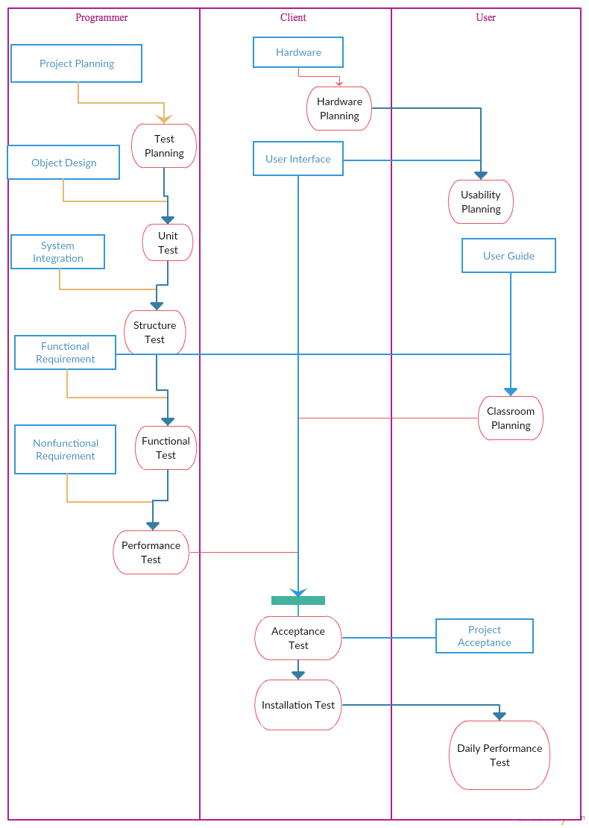
Testing

Slide 10
Risk and Cost
Inaccurate metrics
Low quality
Low usability
Inaccurate cost estimation
Cost:
HTC Vive - Headset => $799
Project Documentation => $700-$3400
Application Development => $50,000-$200,000
Graphic Designs => $50,000-$100,000
Post production maintenance and system updates => $50/mo fee

Slide 11
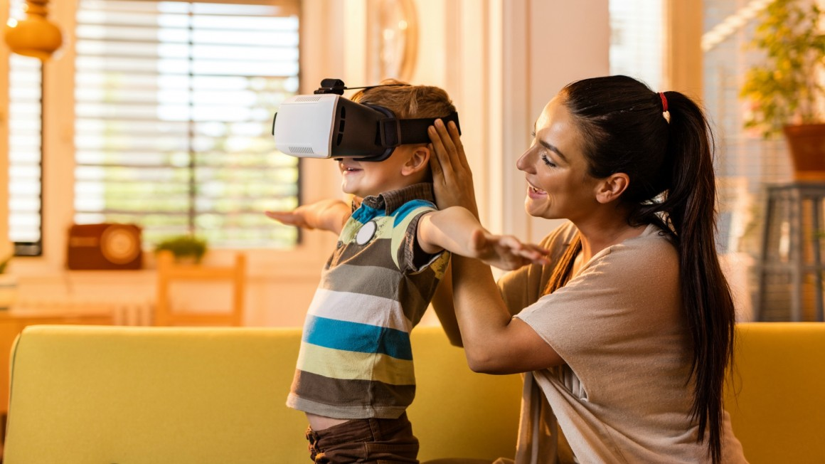
Thank You for listening!!

