Slide 1
Brazilian E-Commerce
Sales Analysis
Power BI | Tableau | Excel | AI
96,478
R$15.84M
9 CSV
Total Orders
Total Revenue
Data Sources
Prepared by: Diya Patel | May 2026 | Dataset: Olist Brazilian E-Commerce (Kaggle)

Slide 2
Business Problem
A Brazilian e-commerce company needed to understand sales performance across 96,478 orders worth R$15.84M to make smarter business decisions.
📦
🚚
📈
🔧
Which product categories
drive most revenue?
Which states have worst
delivery performance?
What will revenue look like
in the next 6 months?
How can logistics be
improved?
Goal: Build an end-to-end analytics dashboard using Power BI, Tableau and Excel to answer these questions and provide actionable recommendations for project managers and logistics analysts.

Slide 3
Data & Tools Used
Dataset
Tools Used
Source: Olist Brazilian E-Commerce (Kaggle) Files: 9 CSV files Orders: 96,478 total orders Period: January 2017 – August 2018 Revenue: R$15.84M total
Power BI
Main dashboard & AI forecasting
Tableau
Secondary visualization
Excel
Pivot tables & logistics KPIs
Claude AI
Business insights & reports
Key Tables Used
Orders
Order Items
Products
Customers
Payments
Category Translation

Slide 4
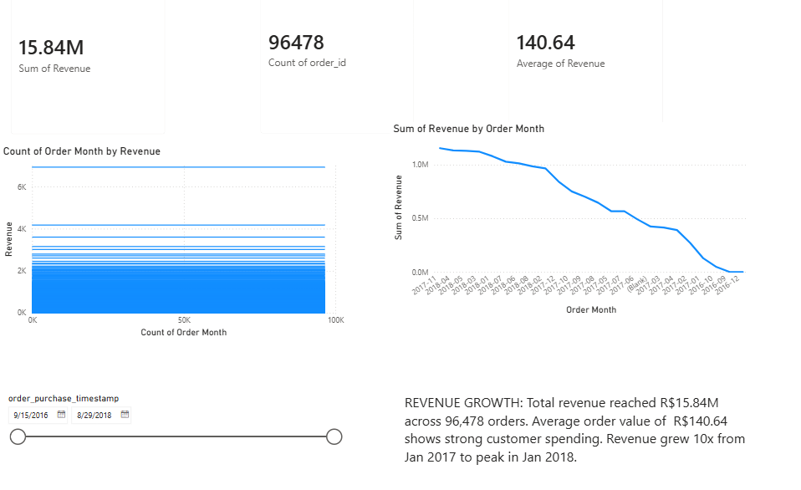
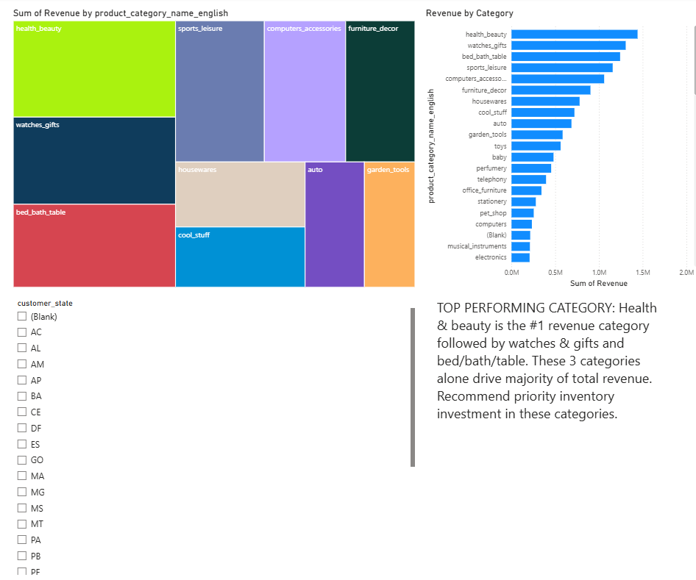
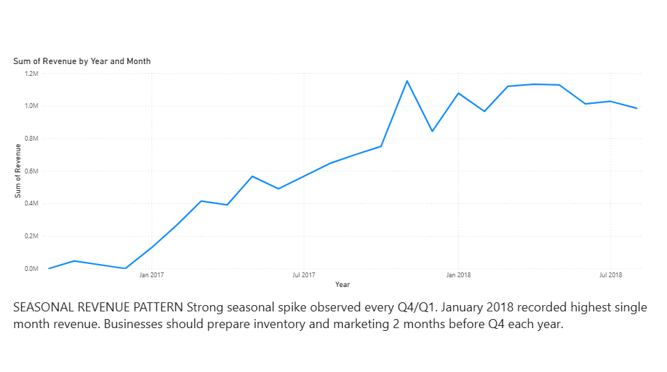
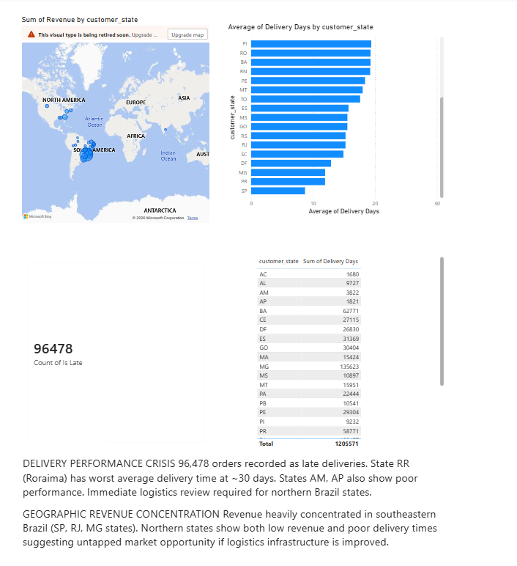
Power BI Dashboard — 5 Pages
Page 1: Revenue Overview1
Page 2: Product & Category Analysis
Page 3: AI Forecast
Page 4: Logistic & Delivery Map

Slide 5
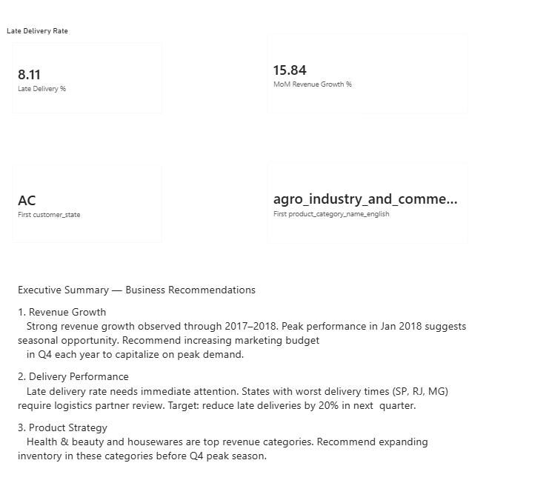
Power BI Dashboard — 5 Pages
Page 5: Executive Summary

Slide 6
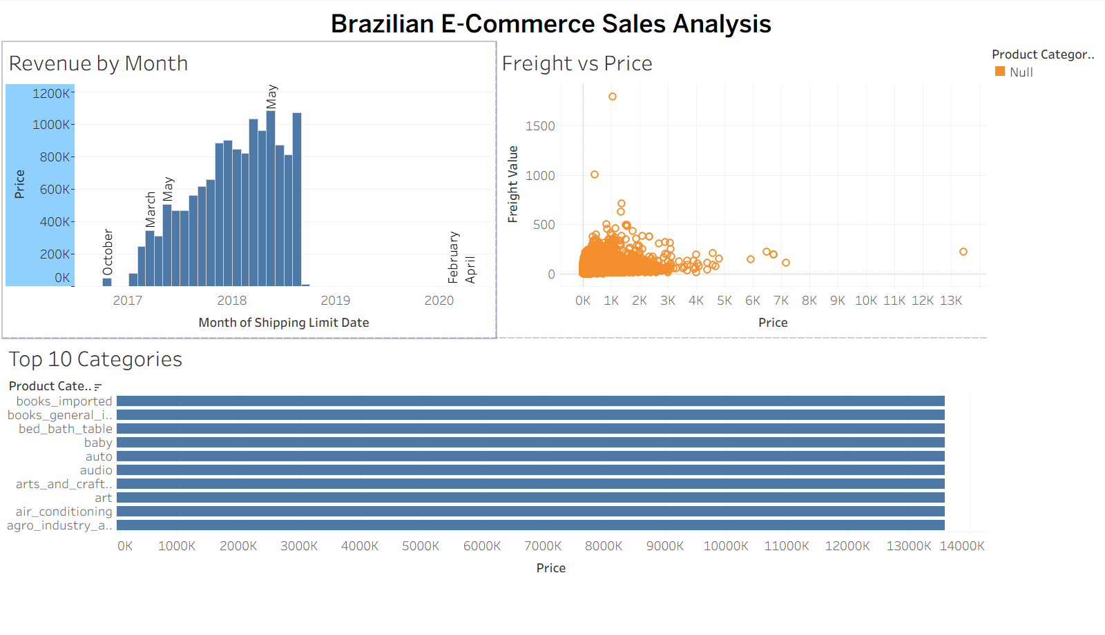
Tableau Public Dashboard
Revenue by Month
Top 10 Categories
Freight vs Price
Monthly revenue bar chart 2017–2018
Horizontal bar chart by revenue
Scatter plot — 98,666 data points

Slide 7
5 Key Business Findings
01
REVENUE GROWTH R$15.84M total revenue across 96,478 orders. 10x growth from Jan 2017 to peak in Jan 2018.
02
TOP CATEGORY Health & beauty is #1 revenue driver, followed by watches & gifts and bed/bath/table products.
03
DELIVERY CRISIS Northern states (RR, AP, AM) show 25–30 day delivery times vs 10 days in São Paulo. Action needed.
04
SEASONALITY Strong Q4 revenue spike every year. January records highest monthly revenue — plan inventory 2 months ahead.
05
GEOGRAPHY 70% of revenue concentrated in SP, RJ and MG states. Northern Brazil is untapped market opportunity.

Slide 8
AI Revenue Forecast — Next 6 Months
Forecast Method
Power BI built-in AI
Confidence Interval
95%
Seasonality
12 months (yearly)
Forecast Period
Sep 2018 – Feb 2019
Predicted Range
R$0.4M–R$0.7M/month
Q4 2018 Outlook
Seasonal peak expected
Business Action: Prepare Q4 inventory before October 2018 • Increase marketing budget in Oct–Nov • Capitalize on January seasonal peak

Slide 9
Strategic Recommendations
📋 Project Managers
🚚 Logistics Analysts
🎯 Business Leadership
1
Invest in northern Brazil logistics infrastructure — high ROI opportunity
1
Partner with local couriers in RR, AP, AM states to cut delivery time
1
Launch targeted marketing in underserved northern states
2
Double health & beauty inventory before Q4 peak season
2
Open regional distribution center in Manaus to serve northern Brazil
2
Focus product expansion on top 3 revenue categories
3
Set KPI target: reduce late deliveries by 40% in next quarter
3
Implement real-time delivery tracking to catch delays early
3
Use seasonal forecast to plan annual Q4 budget allocation

Slide 10
Project Summary
What Was Built
Skills Demonstrated
✓
5-page Power BI dashboard (live on Power BI Service)
Power BI
DAX, relationships, AI forecast
✓
3-sheet Tableau dashboard (live on Tableau Public)
Tableau
Worksheets, dashboard, scatter
✓
Excel pivot report with logistics KPIs
Excel
Pivot tables, KPI calculations
✓
AI-powered revenue forecast (6 months ahead)
Data Analysis
96,478 orders, 9 CSV files
✓
Executive summary with PM & logistics recommendations
Business Story
Insights for PM & logistics

Slide 11
Thank You
Diya Patel
📊 Power BI Dashboard: https://app.powerbi.com/reportEmbed?reportId=04626b64-0902-41bd-8d91-9f489b4989da&autoAuth=true&ctid=e9b87214-8e8f-4ad0-90ec-9d5c56c94931
📈 Tableau Public: https://umbc-my.sharepoint.com/:u:/g/personal/dpatel49_umbc_edu/IQDQRpoYrhaDRZH4bbHz0VJkAfD5cgYnk0umoHTzE5R0Hdc?e=hejhgA
💻 GitHub Repository: https://github.com/dpatel49/sales-analytics-dashboard
📧 Email: dpatel49@umbc.edu

