Slide 1
Cocktails Recommendation System
Using Machine Learning to Suggest Cocktails
Presented By: Dharti Seagraves
Date: May 22, 2024
Github

Slide 2
Problem Statement
A new restaurant owner just hired an inexperienced bartender to keep costs down.
As an inexperienced bartender he is not great at recommending cocktails with the same enthusiasm and charm as an experienced bartender.
The owner has hired (me) the Data Scientist to create an algorithm to aide the bartender in finding the customer’s next favorite drink!

Slide 3
Dataset
Dataset web-scrapped from: https://dachang.github.io/CocktailViz/
Cocktails, their ingredients, and their flavor profile

Slide 4
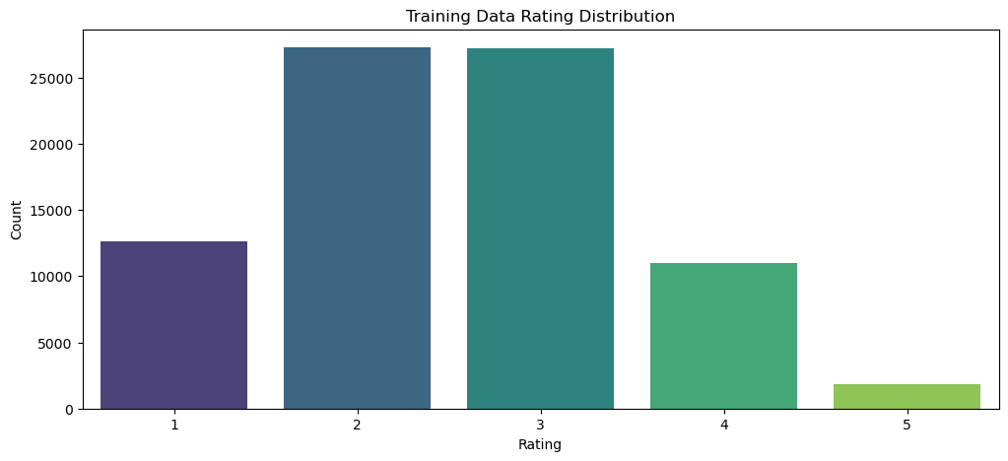
Dataset, Assumptions and Hypotheses
User cocktail ratings
Survey bias
Synthetic Dataset: Neutral Responding – shows a normally distributed curve
CTGAN Dataset: Extreme Response Bias – strongly agree
It is predicted that features such as alcohol content, type of liquor (Base Wine) would be of high importance.

Slide 5
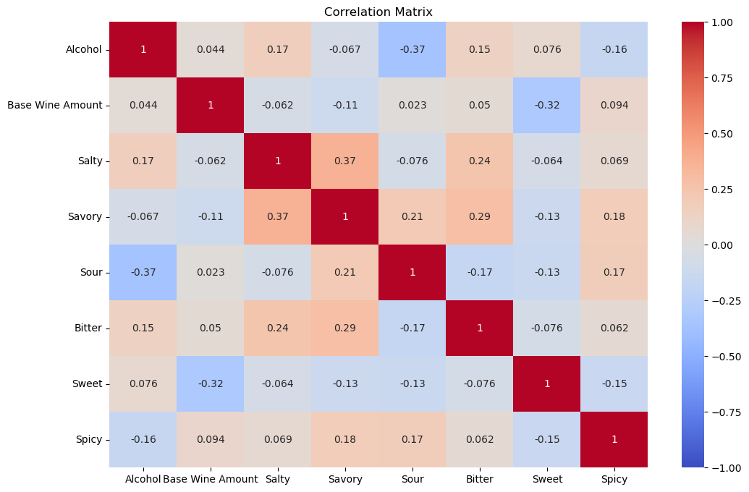
Exploratory Data Analysis
There are 48 cocktails with 22 features (117 after feature engineering)
Unique ‘Base Wine’: 'Tequila', 'Vodka', 'Brandy', 'Rum', 'Whiskey', 'Gin’
Numerical correlation matrix (right)
No multi-collinearity

Slide 6
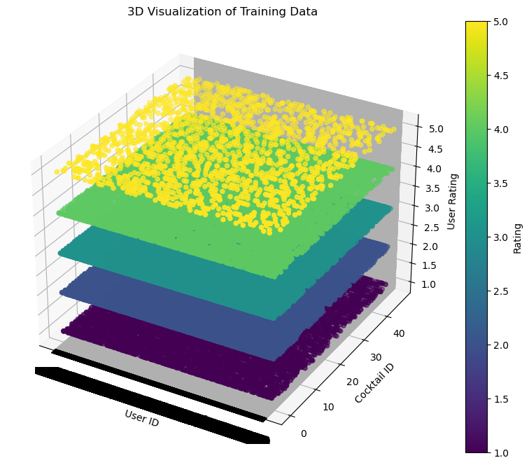
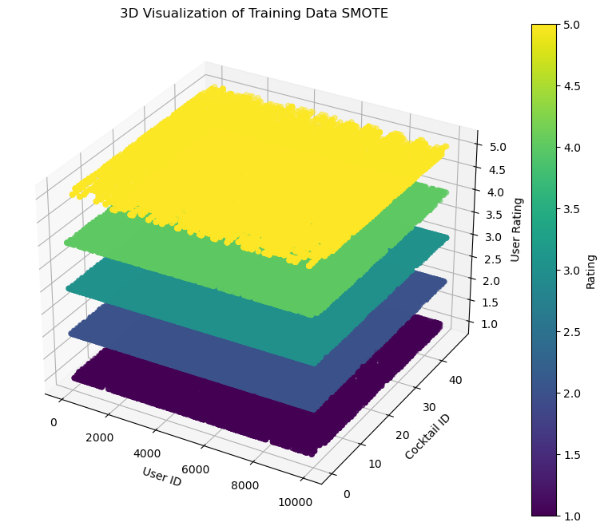
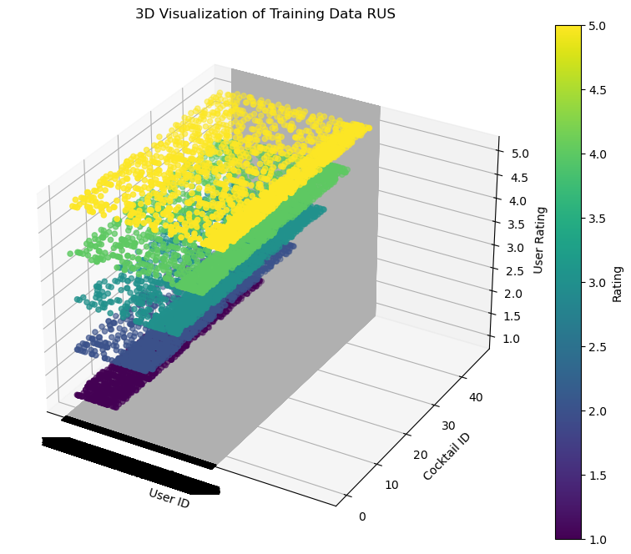
Exploratory Data Analysis
Unbalanced synthetically generated user ratings:
Train/validation/test: 80000, 10000, 10000
Unique Users = 10k
SMOTE
Train/validation/test: 136420, 10000, 10000
RUS
Train/validation/test: 9185, 10000, 10000

Slide 7
Feature Engineering & Transformations
Feature Scaling (cocktails data)
Standard Scaling numerical values
['Alcohol', 'Base Wine Amount', 'Salty', 'Savory', 'Sour', 'Bitter', 'Sweet', 'Spicy']
One-hot encoding categorical values
['Category', 'Making', 'Base Wine', 'Liquor', 'Liquor Amount', 'Juice', 'Juice Amount', 'Spice', 'Spice Amount', 'Soda', 'Soda Amount', 'Others', 'Taste', 'Type of Glass']

Slide 8
Proposed Approaches (Model)
Content-based filtering
Finding cocktails based on cosine similarity
Recommended cocktails similar to a Margarita :
['Sidecar', 'New York', 'Cosmopolitan', 'Stinger', 'Havana Beach']
Collaborative filtering
User-based
Item-based
SVD (Singular Value Decomposition) – matrix factorization technique
NCF (Neural Collaborative Filtering) – voted against because high computational power required
Cross-validation techniques used
tested 3, 5, 10 folds
Cocktail Name 1 | Cocktail Name 2 | Similarity Score
French Connection | Godfather | 0.85179458
Martini | Tequila Martini | 0.66374954
Black Russian | Dirty Mother | 0.62852109
Black Russian | Brave Bull | 0.60777374
Margarita | Sidecar | 0.582504

Slide 9
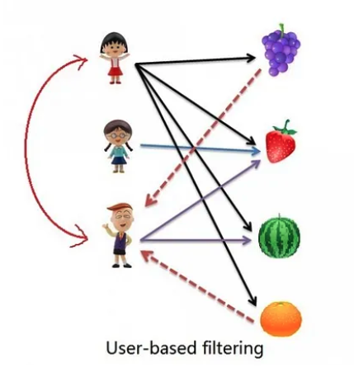
Collaborative Filtering (User-Based)
X

Slide 10
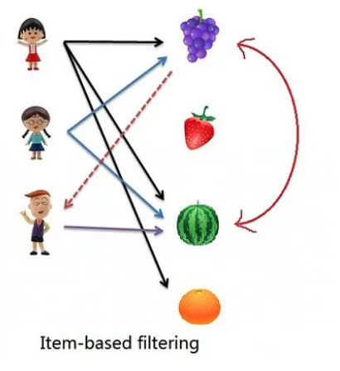
Collaborative Filtering (Item-Based)
X

Slide 11
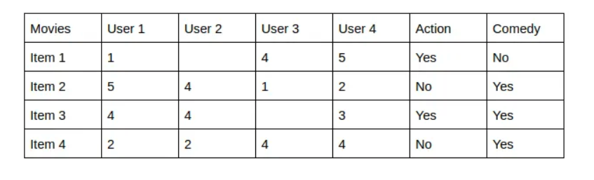
Content-Based Filtering
Content-Based recommender system tries to guess the features or behavior of a user given the item’s features, he/she reacts positively to.

Slide 12
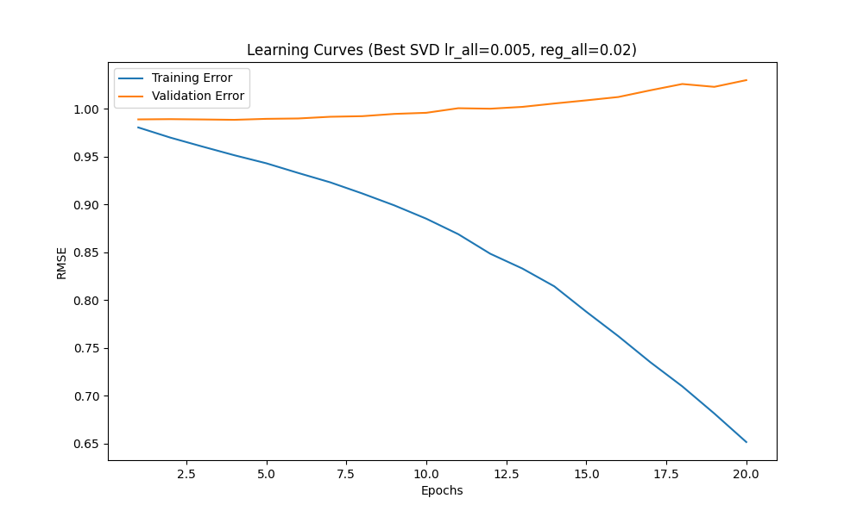
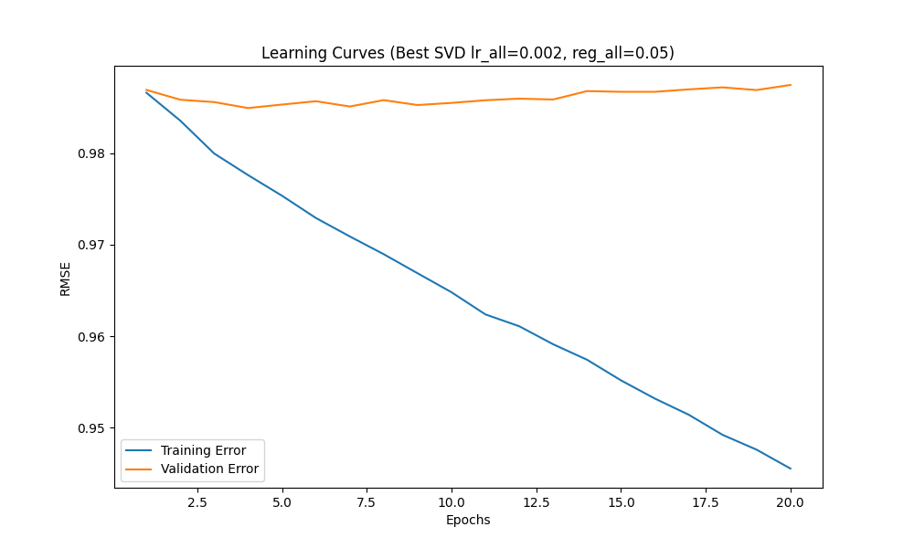
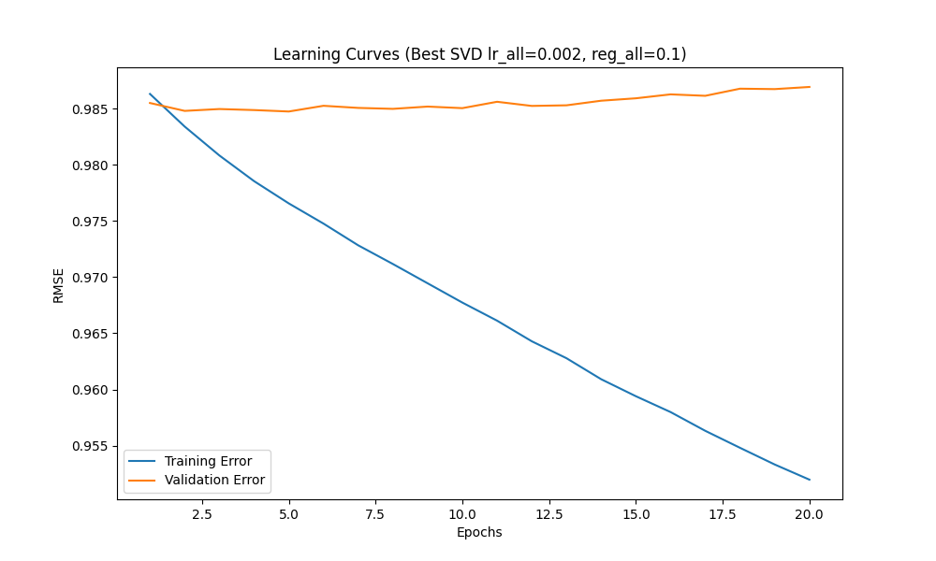
Proposed Approaches (Model)
Checks for overfitting and underfitting (SVD w/ Random Search) on synthetic dataset (100k records)
Training RMSE steadily decreases as we reach 20 epochs, indicating that the model continues to improve. However, since the validation RMSE is relatively constant/slightly increasing this shows the model is overfitting, it is learning the training set.
Best parameters: {'n_factors': 20, 'n_epochs': 10, 'lr_all': 0.002, 'reg_all': 0.02}
Validation RMSE: 0.9853372223313915

Slide 13
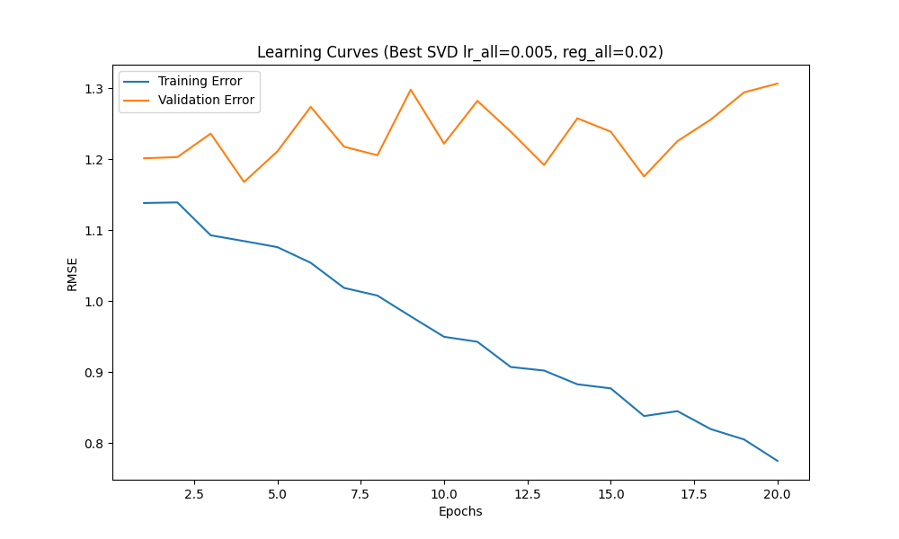
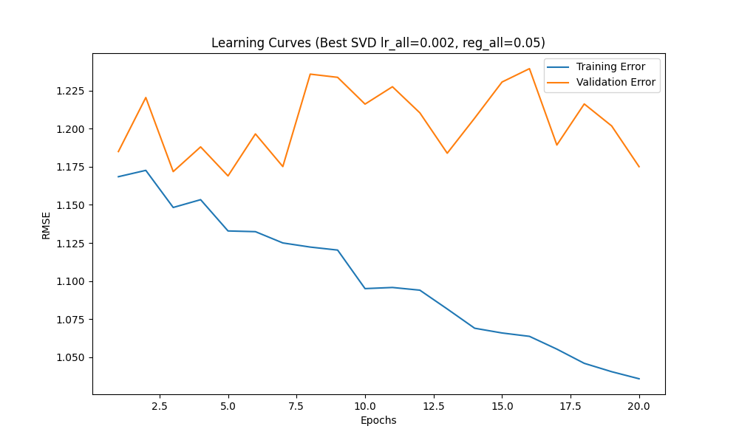
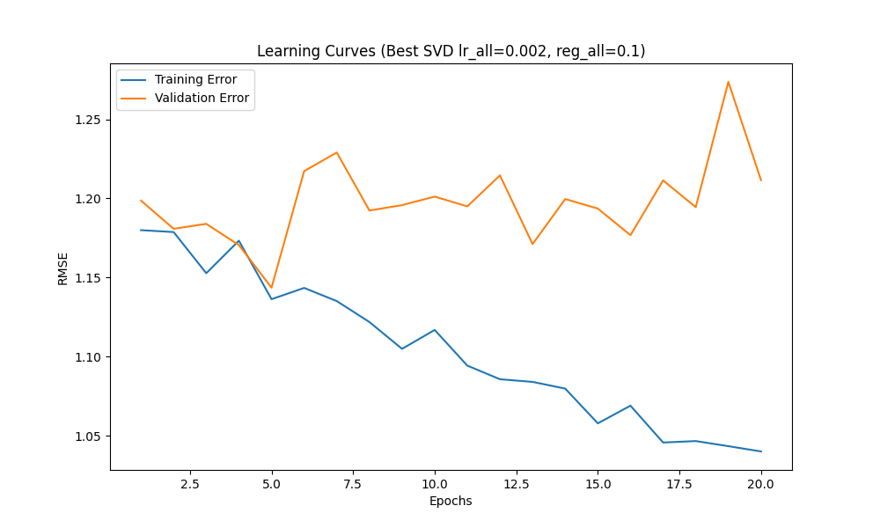
Proposed Approaches (Model)
Checks for overfitting and underfitting (SVD w/ Random Search) on original survey data (100 records)
Training RMSE steadily decreases as we reach 20 epochs, indicating that the model continues to improve. However, since the validation RMSE is relatively constant/slightly increasing this shows the model is overfitting, it is learning the training set.
Best parameters: {'n_factors': 100, 'n_epochs': 20, 'lr_all': 0.005, 'reg_all': 0.1}
Validation RMSE: 1.276437999626136

Slide 14
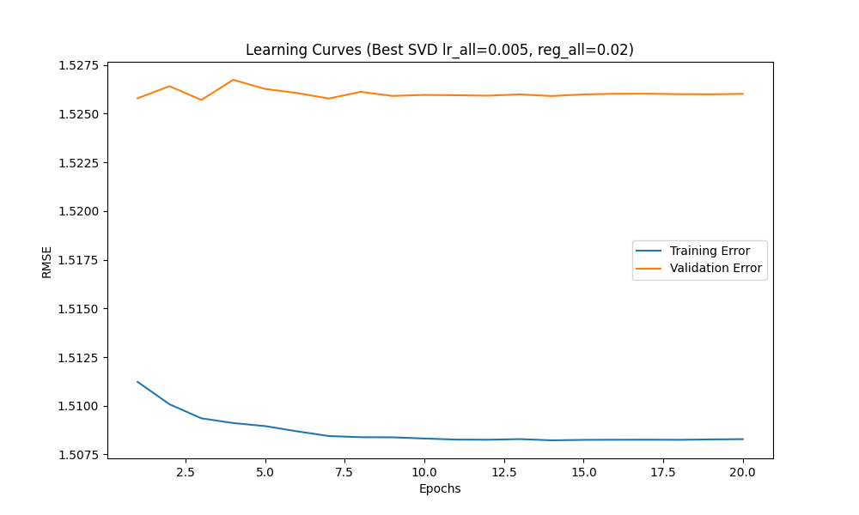
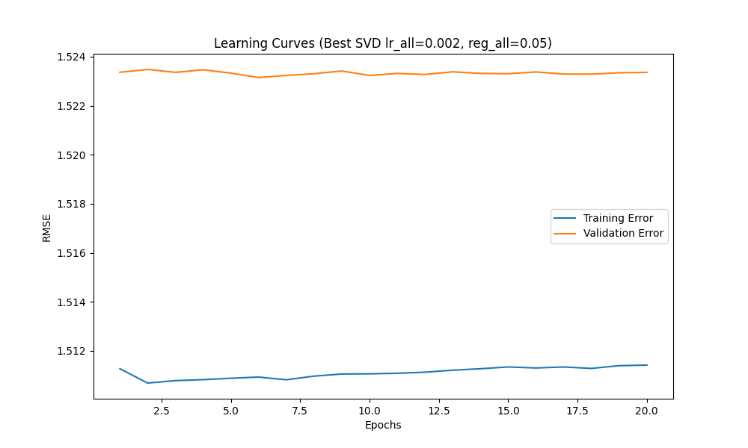
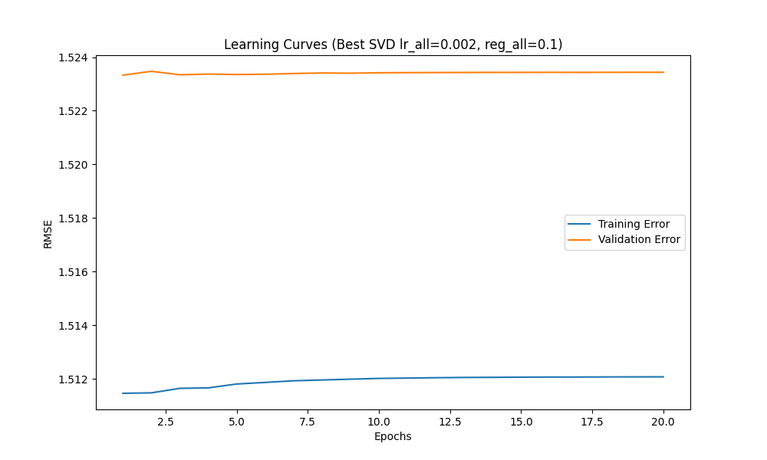
Proposed Approaches (Model)
Checks for overfitting and underfitting (SVD w/ Random Search) on original synthetic dataset applied to CTGAN (100k records)
Training RMSE steadily decreases as we reach 20 epochs, indicating that the model continues to improve. However, since the validation RMSE is relatively constant/slightly increasing this shows the model is overfitting, it is learning the training set.
Best parameters: {'n_factors': 150, 'n_epochs': 10, 'lr_all': 0.002, 'reg_all': 0.1}
Validation RMSE: 1.5233890473123166

Slide 15

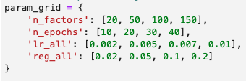
Model Selection
Model Chosen: SVD
Captures latent factors
Reduces dimensionality, effective for smaller datasets
Handles sparsity when user ratings are missing or items have not yet been rated
Requires lower computational requirements, easier to train and deploy
Hyperparameter techniques applied: Random Search
Computationally efficient
Increases likelihood of finding optimal settings
A = User Ratings Σ = diagonal matrix of singular value
U = User “features” matrix V^{T}= Cocktail “features” matrix

Slide 16
Results and Learnings
Root Mean Squared Error (RMSE) on the validation set:
SVD - Validation RMSE: 1.04
SVD w/ Random Search – Validation RMSE: 0.99
Best parameters: {'n_factors': 150, 'n_epochs': 10, 'lr_all': 0.002, 'reg_all': 0.2}
With Random Search the model improved by 0.05 points
With the training RMSE decreasing from 0.99 to ~0.68 by the 20th epoch and the validation error increasing, it shows the model is learning the training set (overfitting)
However, even with data balancing and hyperparameter tuning the above is common
To optimize the number of latent factors by minimizing the training RMSE, eventually the validation RMSE will start increasing
Provide visualizations of the model's predictions compared to the actual ratings.
Highlight key learnings from the project, such as the impact of different features on the recommendations or challenges faced during the project.

Slide 17
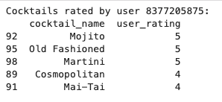
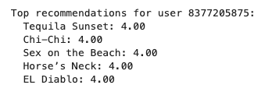
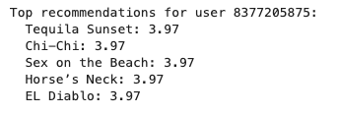
Results and Learnings
This is with the ~100 user_ratings
SVD
Best_svd

Slide 18
Future Work
Potential improvements
Further hyperparameter tuning
Adjusting the hyperparameters even more may give better results
Model ensemble
Combining multiple models can potentially improve performance
Additional real user ratings data (cold start)
Evaluating this with real user data will be the most beneficial in finding a good recommender model
Cold item problem
When new cocktails are added use similar cocktails by ingredients and categories to know which users would like this cocktail
Other models or techniques to explore
There is more work on CTGAN and Gaussian Coupula that can be used to generate user ratings
Shuffling survey

