Slide 1
Cocktail Recommender System Using Real & Synthetic Data for Recommendations Evaluation
Using Machine Learning to Suggest Cocktails
Dharti Seagraves
Date: May 22, 2024
Github

Slide 2
Problem Statement
Objective: Create a cocktail recommender system using cocktail features and user ratings data.
Importance:
Personalized recommendations can enhance user experience and satisfaction in cocktail selection.
Helps users discover new cocktails tailored to their tastes.
Motivation: Improve customer engagement and satisfaction in the beverage industry.
Notes:
A new restaurant owner just hired an inexperienced bartender to keep costs down.
As an inexperienced bartender he is not great at recommending cocktails with the same enthusiasm and charm as an experienced bartender.
The owner has hired (me) the Data Scientist to create an algorithm to aide the bartender in finding the customer’s next favorite drink!

Slide 3
Dataset
Cocktail Data Source: Web scraped from CocktailViz
48 cocktails, 22 features
Details on ingredients, alcohol content, and flavor profiles
User Ratings Data Source: Collected via a Google Form survey
Included user preferences and ratings on various cocktails
Dataset Size:
Real Data: 115 records (actual user ratings)
Synthetic Data: 10,000 records (generated to compare with a larger dataset)

Slide 4
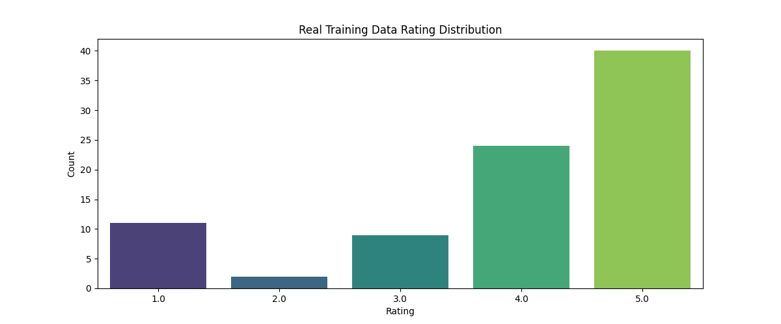
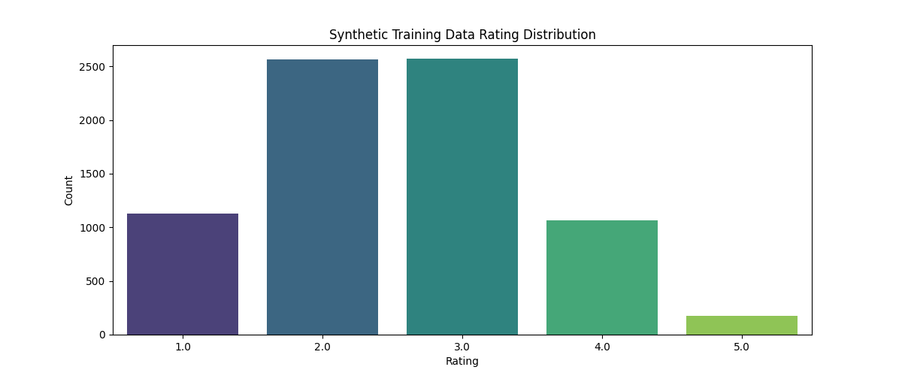
Assumptions and Hypotheses
Assumptions
User preferences are consistent over time
Survey bias does not exist
Synthetic data is a reliable approximation of real user behavior
Hypotheses
Feature importance aligns with user preferences
Synthetic data will not replicate real user data because it lacks real-world patterns (used primarily for the quantity of records)

Slide 5
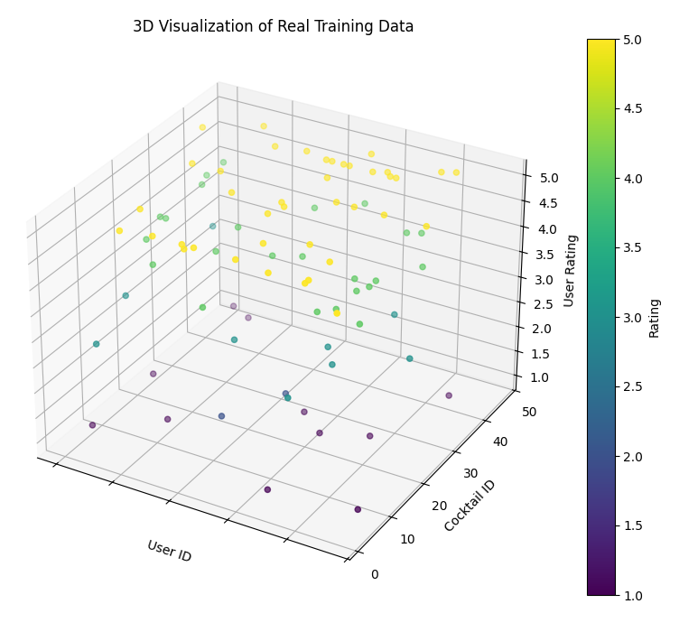
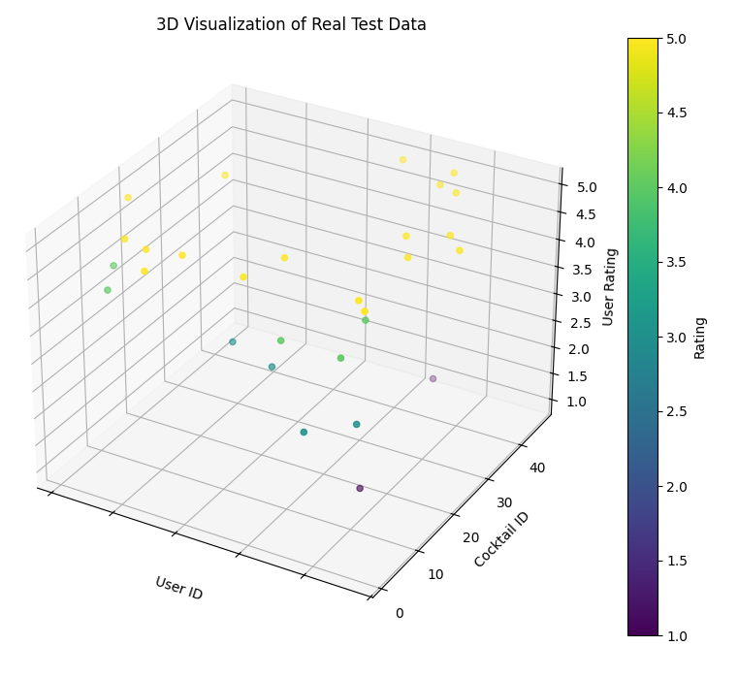
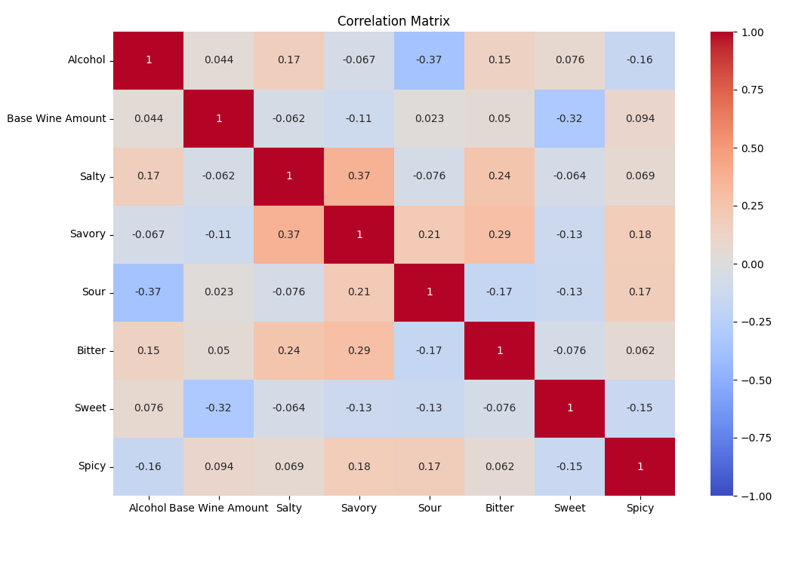
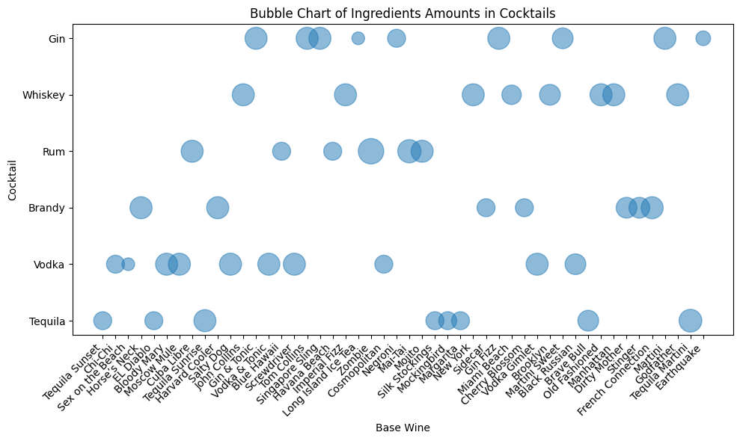
Exploratory Data Analysis
Correlation Matrix (left top)
No multi-collinearity
117 features after Feature Scaling
Even distribution of liquors and alcohol content (left bottom)
3D distribution of users, cocktails, and ratings (top right)
Unbalanced synthetically generated user ratings:
Train/test: 7500, 2500
Unique Users = 2k

Slide 6
Feature Engineering & Transformations
Feature Engineering: None conducted
Transformations: Normalization, encoding, and scaling techniques applied to improve model performance
Standard Scaling numerical values
['Alcohol', 'Base Wine Amount', 'Salty', 'Savory', 'Sour', 'Bitter', 'Sweet', 'Spicy']
One-hot encoding categorical values
['Category', 'Making', 'Base Wine', 'Liquor', 'Liquor Amount', 'Juice', 'Juice Amount', 'Spice', 'Spice Amount', 'Soda', 'Soda Amount', 'Others', 'Taste', 'Type of Glass’]
Feature Importance:
Sweet: 0.000569
Juice_Pineapple: 0.000374
Alcohol: 0.000354
Liquor_Green Mint: 0.000147
Base Wine_Rum: 0.000140

Slide 7
Model Development
Approaches:
Item-based Collaborative Filtering: Recommends items similar to those the user liked
User-based Collaborative Filtering: Recommends items liked by similar users
Content-based Filtering: Recommends items similar to those the user has liked based on features
SVD-based Collaborative Filtering: Uses matrix factorization to predict user preferences
Overfitting and Underfitting Checks:
Learning Curves: Analyzed to determine if models are learning effectively.

Slide 8
User Profiles (Item-Based)
user_id | Cocktail | user_rating
2 | Tom Collins | 5
2 | Gin & Tonic | 4
2 | Mojito | 4
2 | Black Russian | 4
2 | Manhattan | 3
2 | Screwdriver | 3
2 | Cosmopolitan | 1
2 | Bloody Mary | 1
2 | Tequila Martini | 1
User A (2) | Recommendation 1 | Recommendation 2 | Recommendation 3
Item Based CF | Blue Hawaii | Vodka & Tonic | Martini
User Based CF | Martini | Moscow Mule | Long Island Ice Tea
Content Based | Horse’s Neck | Moscow Mule | Vodka & Tonic
SVD | Margarita | Old Fashioned | Moscow Mule
Blue Hawaii: This cocktail is very similar to the Tom Collins rated highly by user 2
Vodka & Tonic: This drink is similar to Gin & Tonic in the simplicity, base spirit, and carbonation.
User-similarities: Item-based also considers how other users rated their drinks; user 38 rated both Tom Collins and Blue Hawaii highly
Alcohol | Name | Category | Making | Taste | Sour | Sweet | Spicy
16 | Tom Collins | Long | Shake | Mild | 17 | 17 | 0
14 | Blue Hawaii | Long | Shake | Mild | 17 | 17 | 0
user_id | Cocktail | user_rating
38 | Blue Hawaii | 4
38 | Tom Collins | 4

Slide 9
User Profiles (User-Based)
user_id | Cocktail | user_rating
2 | Tom Collins | 5
2 | Gin & Tonic | 4
2 | Mojito | 4
2 | Black Russian | 4
2 | Manhattan | 3
2 | Screwdriver | 3
2 | Cosmopolitan | 1
2 | Bloody Mary | 1
2 | Tequila Martini | 1
User A (2) | Recommendation 1 | Recommendation 2 | Recommendation 3
Item Based CF | Blue Hawaii | Vodka & Tonic | Martini
User Based CF | Martini | Moscow Mule | Long Island Ice Tea
Content Based | Horse’s Neck | Moscow Mule | Vodka & Tonic
SVD | Margarita | Old Fashioned | Moscow Mule
User 2 is most similar to User 38 based on the similarity matrix.
User 2 and User 38 both have highly rated Tom Collins and Gin & Tonic.
Moscow Mule and Long Island Ice Tea are recommended because User 38 enjoys these drinks and they share similar preferences with User 2.
user_id | Cocktail | user_rating
38 | Gin & Tonic | 5
38 | Moscow Mule | 5
38 | Bloody Mary | 5
38 | Margarita | 5
38 | Blue Hawaii | 4
38 | Tom Collins | 4
38 | Long Island Ice Tea | 4
38 | Manhattan | 4
38 | Tequila Sunset | 3
38 | Vodka & Tonic | 3
38 | Screwdriver | 1

Slide 10
User Profiles (Content-Based)
Here we can see the similarities between User 2’s highly rated drinks and the recommended drinks (Category, Making, Taste)
User A (2) | Recommendation 1 | Recommendation 2 | Recommendation 3
Item Based CF | Blue Hawaii | Vodka & Tonic | Martini
User Based CF | Martini | Moscow Mule | Long Island Ice Tea
Content Based | Horse’s Neck | Moscow Mule | Vodka & Tonic
SVD | Margarita | Old Fashioned | Moscow Mule
User Rating | Alcohol | Name | Category | Making | Base Wine | Base Wine Amount | Soda Amount | Others | Taste | Type of Glass | Salty | Sour | Sweet
5 | 16 | Tom Collins | Long | Shake | Gin | 45 | 200 | Lemon Piece | Mild | Highball | 17 | 17 | 17
4 | 14 | Gin & Tonic | Long | Build | Gin | 45 | 240 | Lemon Piece | Mild | Highball | 17 | 83 | 33
4 | 25 | Mojito | Long | Build | Rum | 45 | - | Lime/Mint | Mild | Highball | 17 | 33 | 17
4 | 32 | Black Russian | Long | Build | Vodka | 40 | - | - | Mild | Rock | 0 | 0 | 50
- | 10 | Horse‚Äôs Neck | Long | Build | Brandy | 45 | 200 | Lemon Piece | Mild | Old Fashioned | 17 | 83 | 17
- | 12 | Moscow Mule | Long | Build | Vodka | 45 | 220 | Lime Piece | Mild | Highball | 0 | 83 | 17
- | 14 | Vodka & Tonic | Long | Build | Vodka | 45 | 200 | - | Mild | Old Fashioned | 0 | 83 | 33

Slide 11

User Profiles (SVD)
A = User Ratings Σ = diagonal matrix of singular value
U = User “features” matrix V^{T}= Cocktail “features” matrix
user_id | Cocktail | user_rating
2 | Tom Collins | 5
2 | Gin & Tonic | 4
2 | Mojito | 4
2 | Black Russian | 4
2 | Manhattan | 3
2 | Screwdriver | 3
2 | Cosmopolitan | 1
2 | Bloody Mary | 1
2 | Tequila Martini | 1
User A (2) | Recommendation 1 | Recommendation 2 | Recommendation 3
Item Based CF | Blue Hawaii | Vodka & Tonic | Martini
User Based CF | Martini | Moscow Mule | Long Island Ice Tea
Content Based | Horse’s Neck | Moscow Mule | Vodka & Tonic
SVD | Margarita | Old Fashioned | Moscow Mule
SVD-based collaborative filtering leverages matrix factorization to reveal the latent relationships between users and items other than ratings.
Margaritas usually have a sweet, sour, and salty flavor profile, similar to User 2’s preferences which is why it was highly recommended.

Slide 12
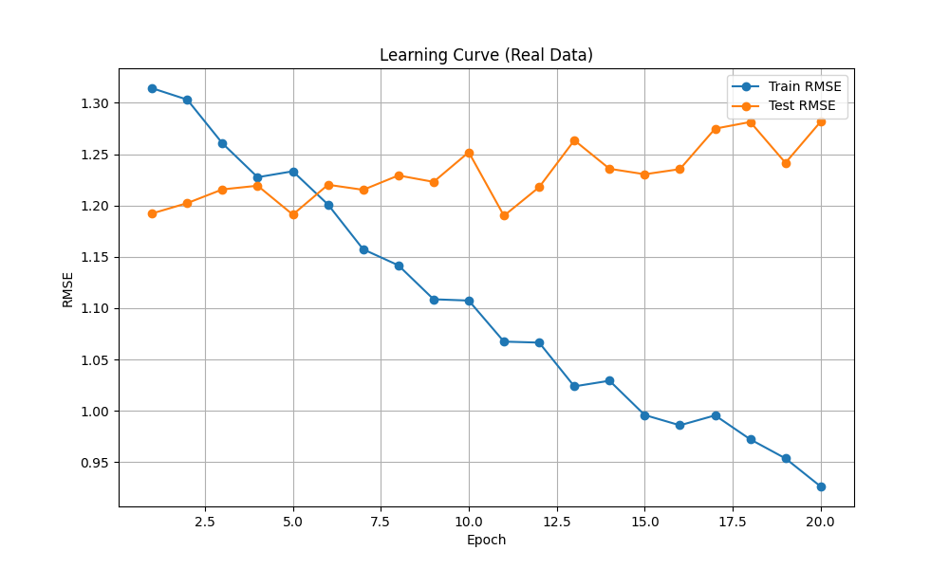
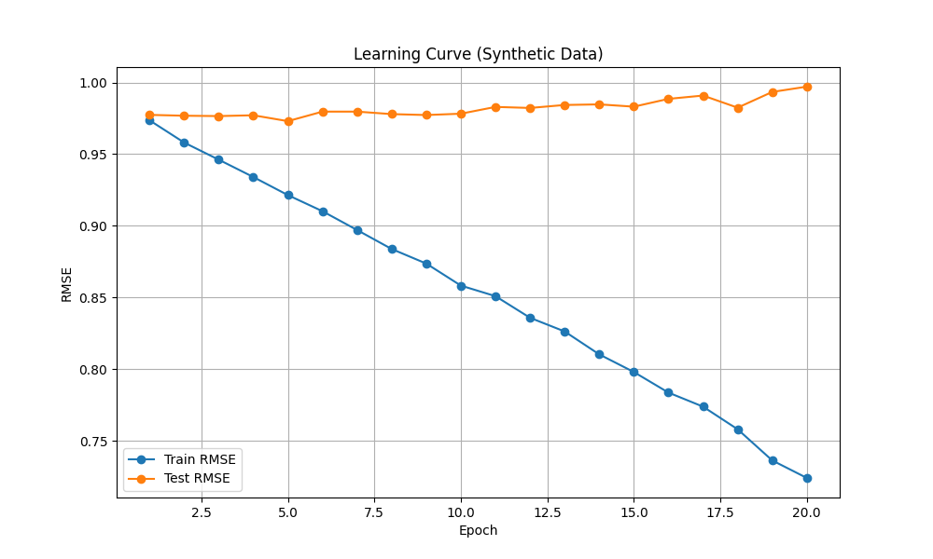
Model Evaluation
Visualization: Below are the learning curves for the SVD model on both the real and synthetic datasets for 20 epochs
Metrics: RMSE for training and testing sets
Real data - Train RMSE: 1.31 Test RMSE: 1.17
Synthetic data - Train RMSE: 0.97 Test RMSE: 0.97
Observations:
Real: The training RMSE is steadily decreasing over epochs indicating the model is learning the data set. The testing RMSE remains fairly stable with a slight increase towards the end indicating the data is starting to overfit.
Synthetic: Compared to the real data the synthetic data train and test RMSE start at about the same point, due to the nature of less noise/variability in the synthetic data. The test RMSE has a steeper curve indicating the model is learning quicker than with the real data. The test data shows very good generalization with a steady curve.

Slide 13
Results & Learnings
Model Performance: Summary of accuracy and key performance metrics.
Visualization: 3D visualizations of real and synthetic data.
Include images: 3D Visualization of Real Test Data.png, 3D Visualization of Real Training Data.png, 3D Visualization of Synthetic Test Data.png, 3D Visualization of Synthetic Training Data.png
Key Learnings: Insights gained from the methodology and analysis.

Slide 14
Future Work
Improvements:
Incorporating more diverse features.
Using advanced algorithms for better accuracy.
Collecting more user data for enhanced recommendations.
Further Research: Explore deep learning techniques and hybrid recommendation systems.

Slide 15
Conclusion
Summary: Recap the project's objectives, methods, and findings.
Impact: How the recommender system can benefit users.
Acknowledgments: Thanking contributors and sources.

Slide 16
Proposed Approaches (Model)
Content-based filtering
Finding cocktails based on cosine similarity
Recommended cocktails similar to a Margarita :
['Sidecar', 'New York', 'Cosmopolitan', 'Stinger', 'Havana Beach']
Collaborative filtering
User-based
Item-based
SVD (Singular Value Decomposition) – matrix factorization technique
NCF (Neural Collaborative Filtering) – voted against because high computational power required
Cross-validation techniques used
tested 3, 5, 10 folds
Cocktail Name 1 | Cocktail Name 2 | Similarity Score
French Connection | Godfather | 0.85179458
Martini | Tequila Martini | 0.66374954
Black Russian | Dirty Mother | 0.62852109
Black Russian | Brave Bull | 0.60777374
Margarita | Sidecar | 0.582504

Slide 17
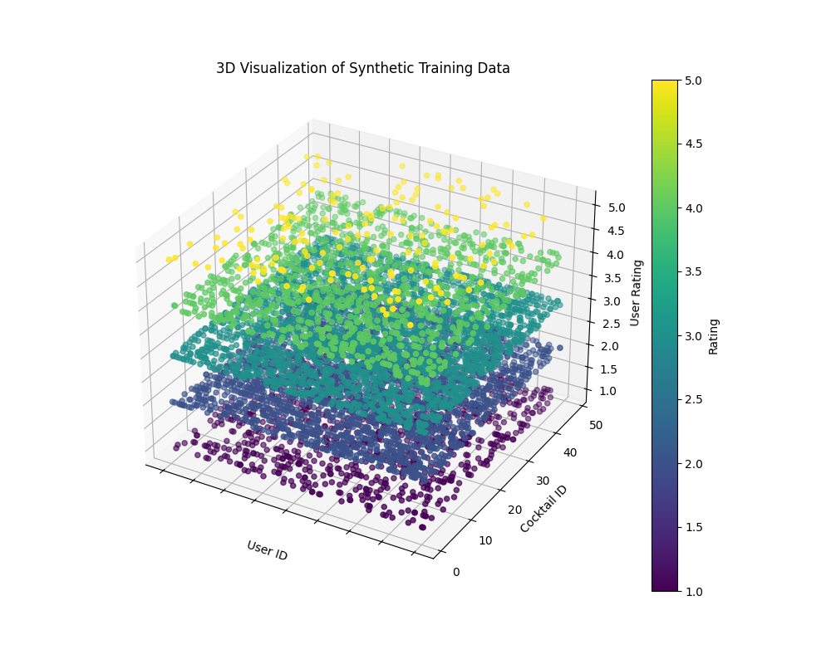
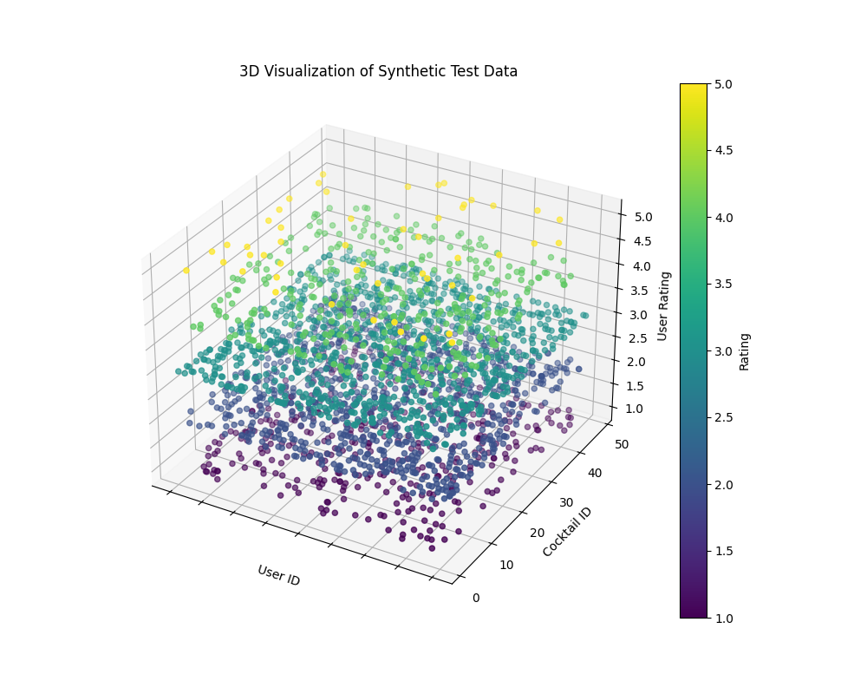
Exploratory Data Analysis
Unbalanced synthetically generated user ratings:
Train/test: 7500, 2500
Unique Users = 2k

Slide 18
User Profiles
user_id | Cocktail | user_rating
38 | Gin & Tonic | 5
38 | Moscow Mule | 5
38 | Bloody Mary | 5
38 | Margarita | 5
38 | Blue Hawaii | 4
38 | Tom Collins | 4
38 | Long Island Ice Tea | 4
38 | Manhattan | 4
38 | Tequila Sunset | 3
38 | Vodka & Tonic | 3
38 | Screwdriver | 1
User B (38) | Recommendation 1 | Recommendation 2 | Recommendation 3
Item Based CF | Gin Fizz | Black Russian | Tequila Martini
User Based CF | Mojito | Old Fashioned | Black Russian
Content Based | Tequila Sunrise | Horse’s Neck | Harvard Cooler
SVD | Black Russian | Old Fashioned | Godfather

Slide 19
User Profiles
user_id | Cocktail | user_rating
47 | Mojito | 5
47 | Long Island Ice Tea | 3
47 | Bloody Mary | 1
User C (47) | Recommendation 1 | Recommendation 2 | Recommendation 3
Item Based CF | Havana Beach | Cuba Libre | Mai-Tai
User Based CF | Old Fashioned | Gin & Tonic | Martini
Content Based | Horse’s Neck | Earthquake | Moscow Mule
SVD | Moscow Mule | Old Fashioned | Margarita

Slide 20
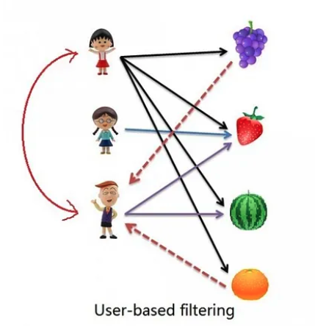
Collaborative Filtering (User-Based)
X

Slide 21
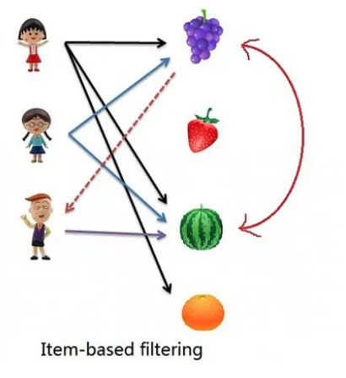
Collaborative Filtering (Item-Based)
X

Slide 22
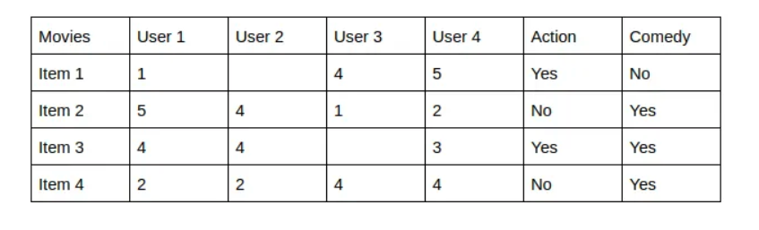
Content-Based Filtering
Content-Based recommender system tries to guess the features or behavior of a user given the item’s features, he/she reacts positively to.

Slide 23
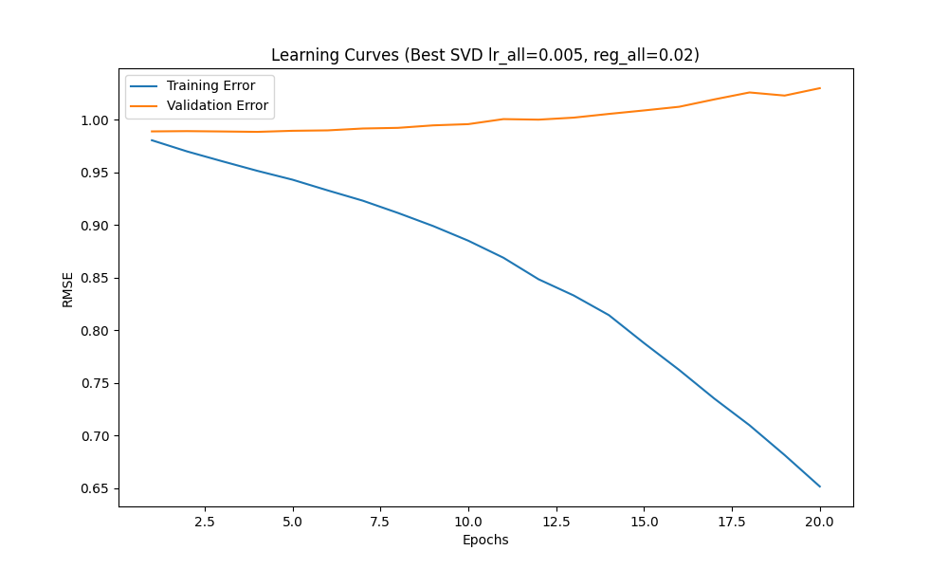
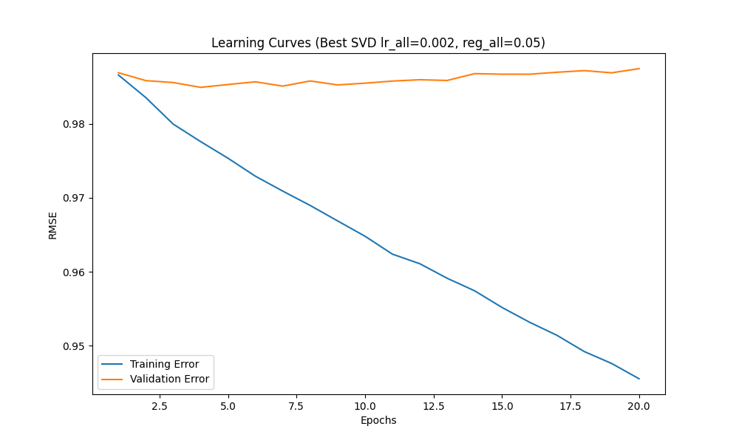
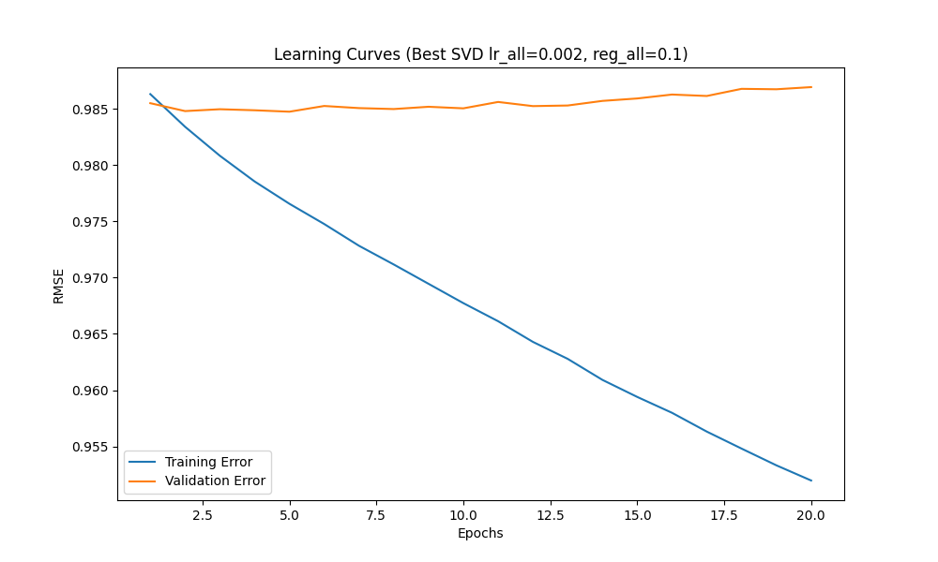
Proposed Approaches (Model)
Checks for overfitting and underfitting (SVD w/ Random Search) on synthetic dataset (100k records)
Training RMSE steadily decreases as we reach 20 epochs, indicating that the model continues to improve. However, since the validation RMSE is relatively constant/slightly increasing this shows the model is overfitting, it is learning the training set.
Best parameters: {'n_factors': 20, 'n_epochs': 10, 'lr_all': 0.002, 'reg_all': 0.02}
Validation RMSE: 0.9853372223313915

Slide 24
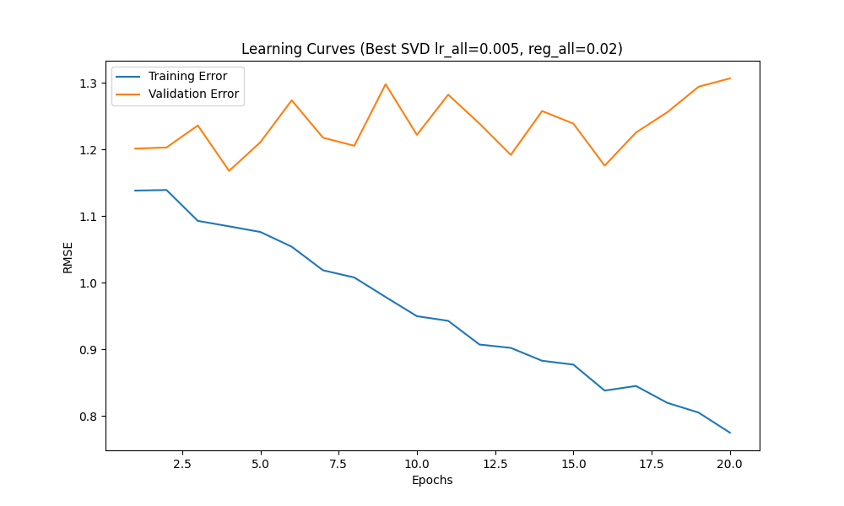
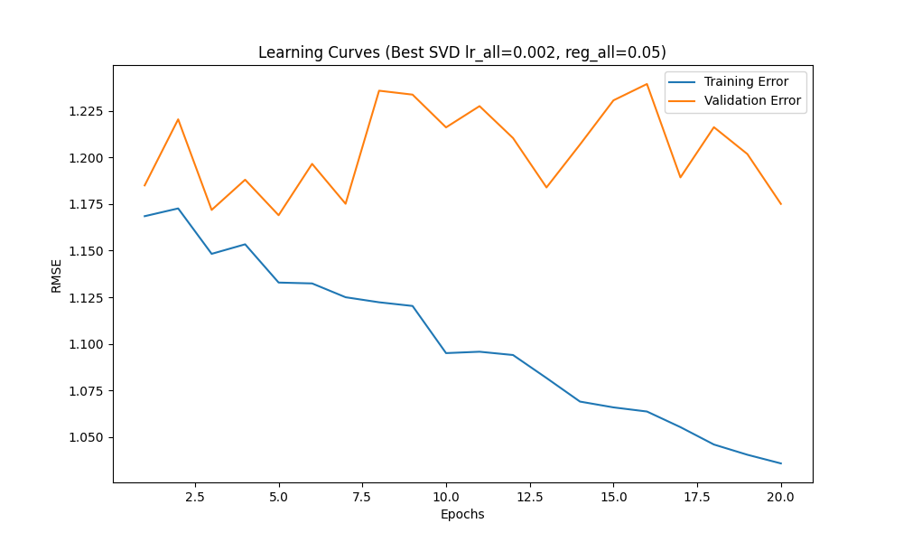
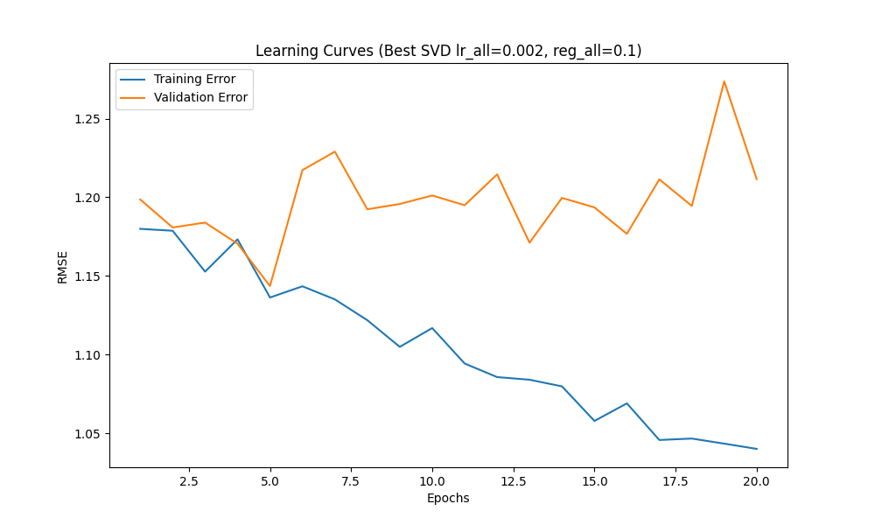
Proposed Approaches (Model)
Checks for overfitting and underfitting (SVD w/ Random Search) on original survey data (100 records)
Training RMSE steadily decreases as we reach 20 epochs, indicating that the model continues to improve. However, since the validation RMSE is relatively constant/slightly increasing this shows the model is overfitting, it is learning the training set.
Best parameters: {'n_factors': 100, 'n_epochs': 20, 'lr_all': 0.005, 'reg_all': 0.1}
Validation RMSE: 1.276437999626136

Slide 25
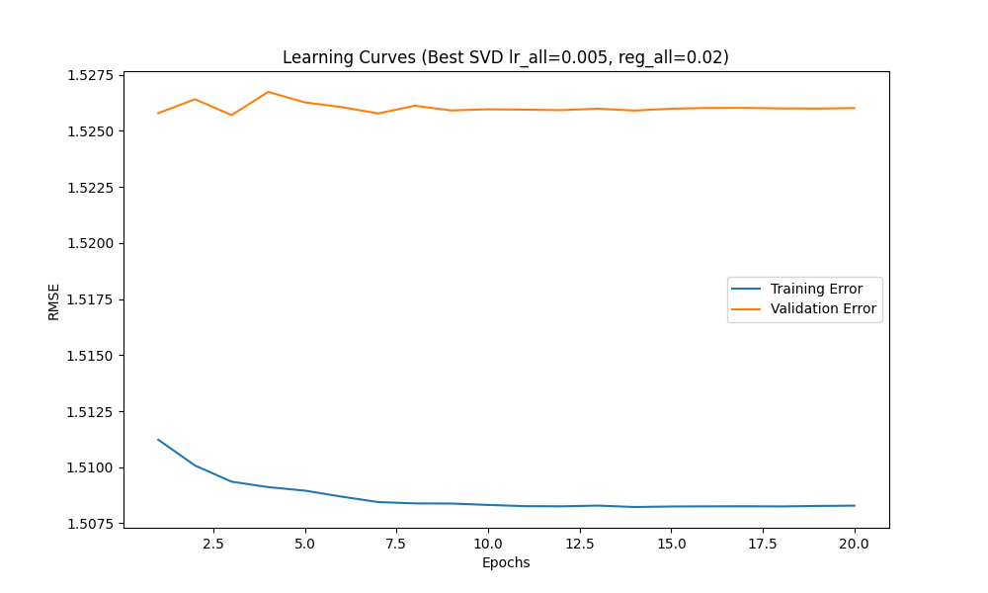
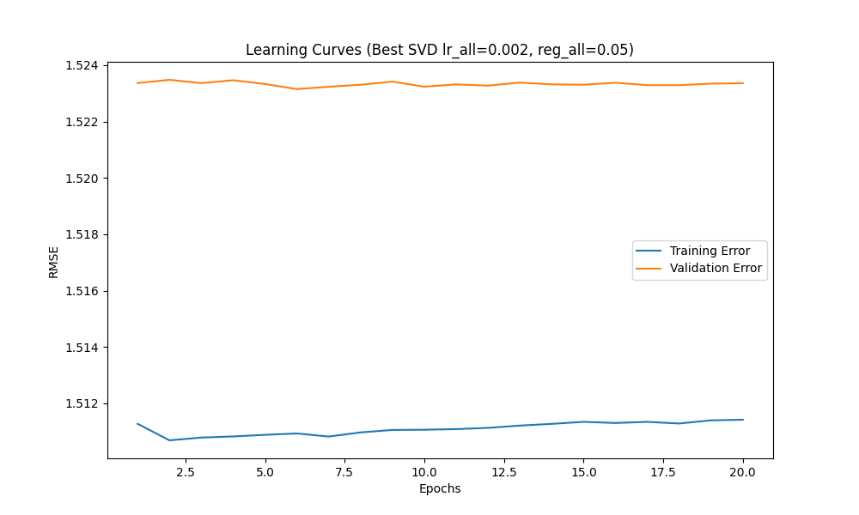
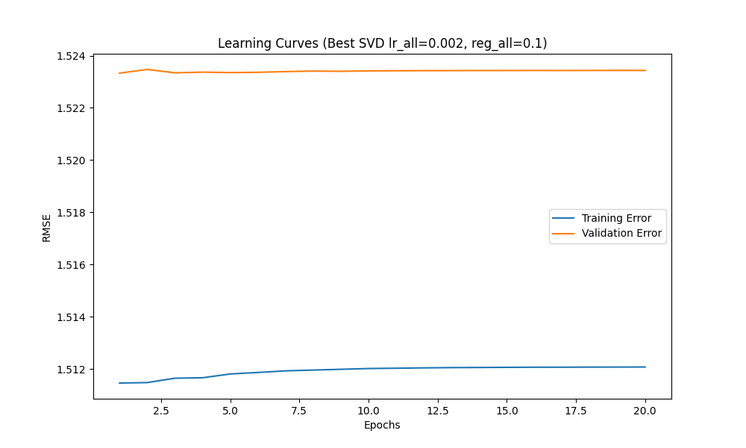
Proposed Approaches (Model)
Checks for overfitting and underfitting (SVD w/ Random Search) on original synthetic dataset applied to CTGAN (100k records)
Training RMSE steadily decreases as we reach 20 epochs, indicating that the model continues to improve. However, since the validation RMSE is relatively constant/slightly increasing this shows the model is overfitting, it is learning the training set.
Best parameters: {'n_factors': 150, 'n_epochs': 10, 'lr_all': 0.002, 'reg_all': 0.1}
Validation RMSE: 1.5233890473123166

Slide 26
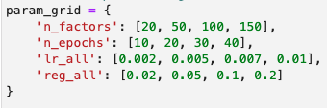
Model Selection
Model Chosen: SVD
Captures latent factors
Reduces dimensionality, effective for smaller datasets
Handles sparsity when user ratings are missing or items have not yet been rated
Requires lower computational requirements, easier to train and deploy
Hyperparameter techniques applied: Random Search
Computationally efficient
Increases likelihood of finding optimal settings
A = User Ratings Σ = diagonal matrix of singular value
U = User “features” matrix V^{T}= Cocktail “features” matrix

Slide 27
Results and Learnings
Root Mean Squared Error (RMSE) on the validation set:
SVD - Validation RMSE: 1.04
SVD w/ Random Search – Validation RMSE: 0.99
Best parameters: {'n_factors': 150, 'n_epochs': 10, 'lr_all': 0.002, 'reg_all': 0.2}
With Random Search the model improved by 0.05 points
With the training RMSE decreasing from 0.99 to ~0.68 by the 20th epoch and the validation error increasing, it shows the model is learning the training set (overfitting)
However, even with data balancing and hyperparameter tuning the above is common
To optimize the number of latent factors by minimizing the training RMSE, eventually the validation RMSE will start increasing
Provide visualizations of the model's predictions compared to the actual ratings.
Highlight key learnings from the project, such as the impact of different features on the recommendations or challenges faced during the project.

Slide 28
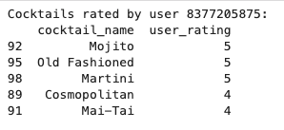
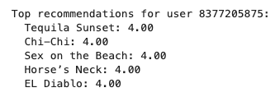
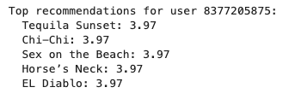
Results and Learnings
This is with the ~100 user_ratings
SVD
Best_svd

Slide 29
Future Work
Potential improvements
Further hyperparameter tuning
Adjusting the hyperparameters even more may give better results
Model ensemble
Combining multiple models can potentially improve performance
Additional real user ratings data (cold start)
Evaluating this with real user data will be the most beneficial in finding a good recommender model
Cold item problem
When new cocktails are added use similar cocktails by ingredients and categories to know which users would like this cocktail
Other models or techniques to explore
There is more work on CTGAN and Gaussian Coupula that can be used to generate user ratings
Shuffling survey

