Slide 1
Module 3: Simple Loops and Nested Loops

Slide 2
Part 1: Simple Loops

Slide 3
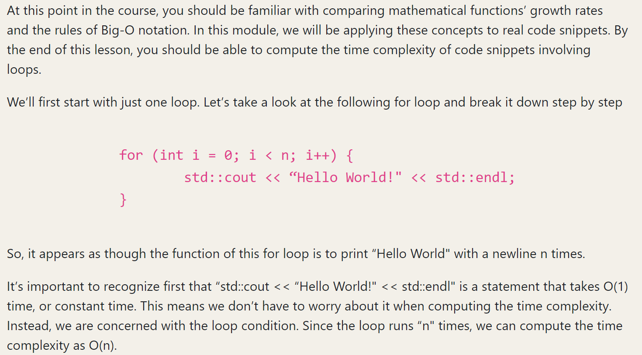
Simple Loops

Slide 4
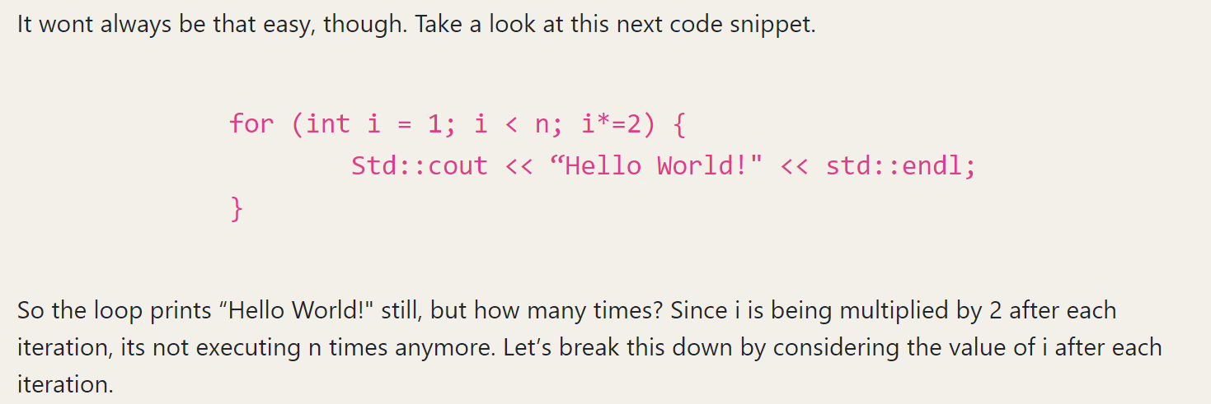
Simple Loops

Slide 5
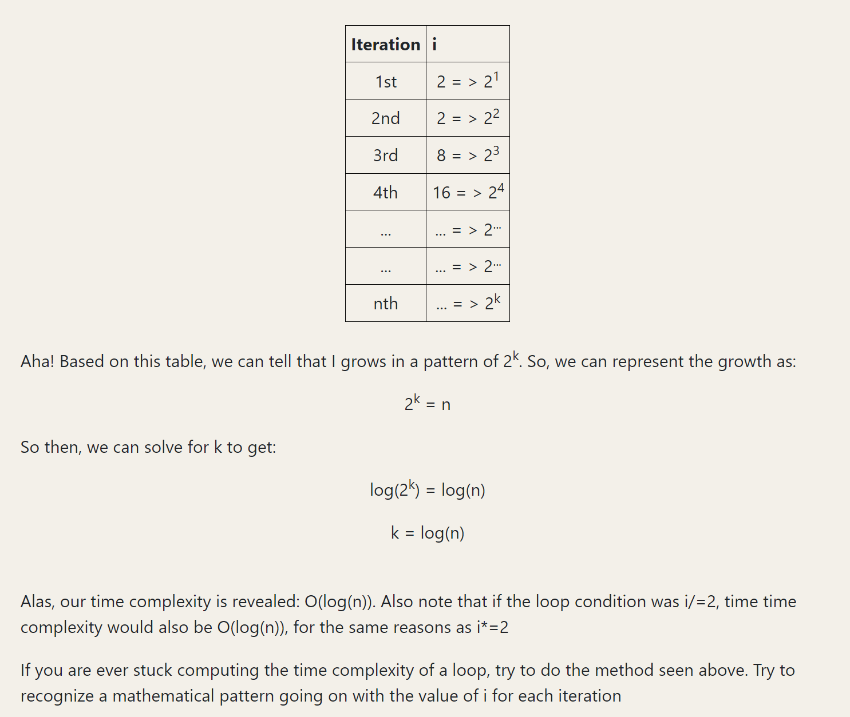
Simple Loops

Slide 6
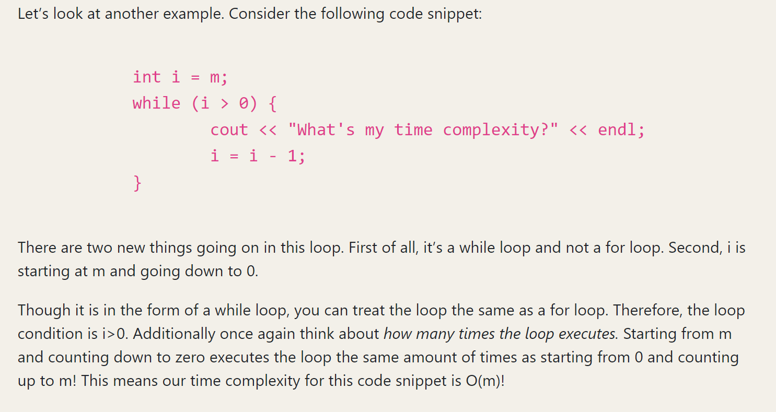
Simple Loops

Slide 7
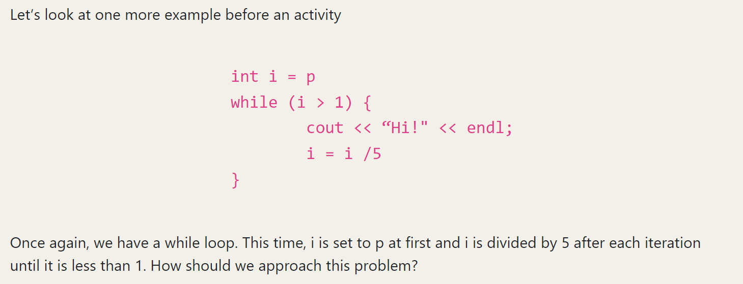
Simple Loops
Any Suggestions?

Slide 8
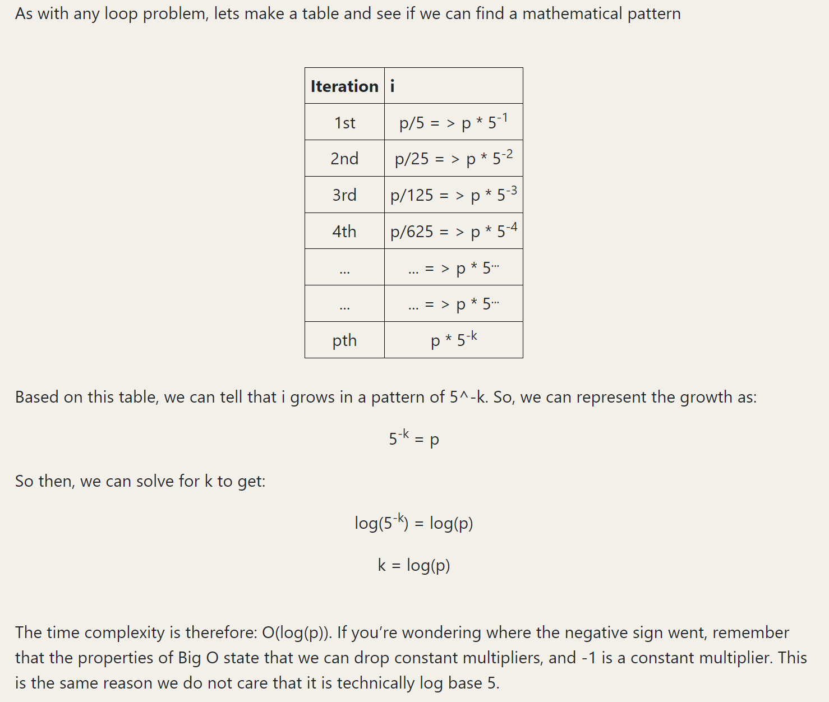
Simple Loops

Slide 9
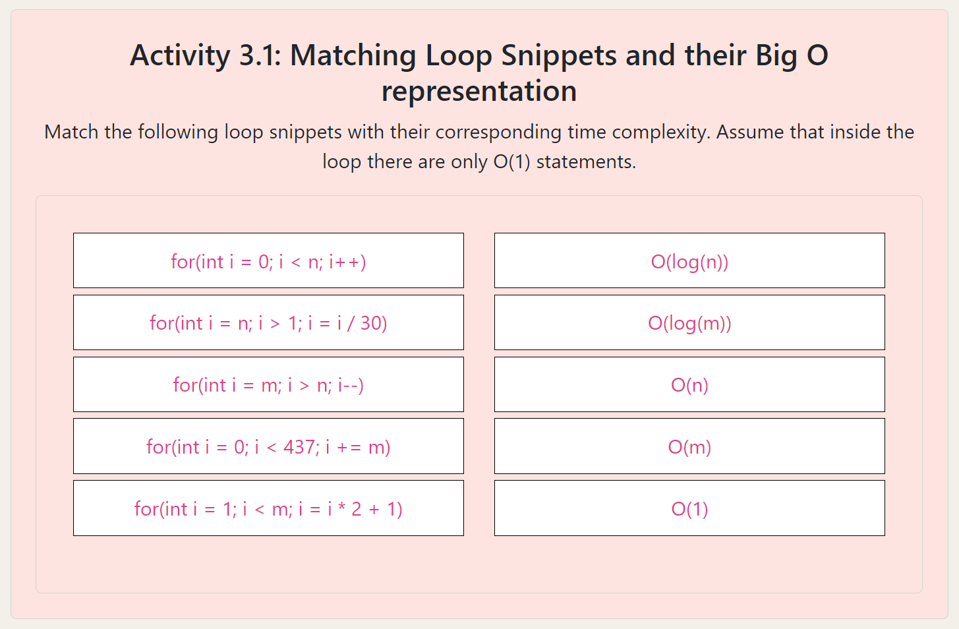
Simple Loops – Matching Activity
Go to website for full experience

Slide 10
Simple Loops – Matching Activity
Go to website for full experience

Slide 11
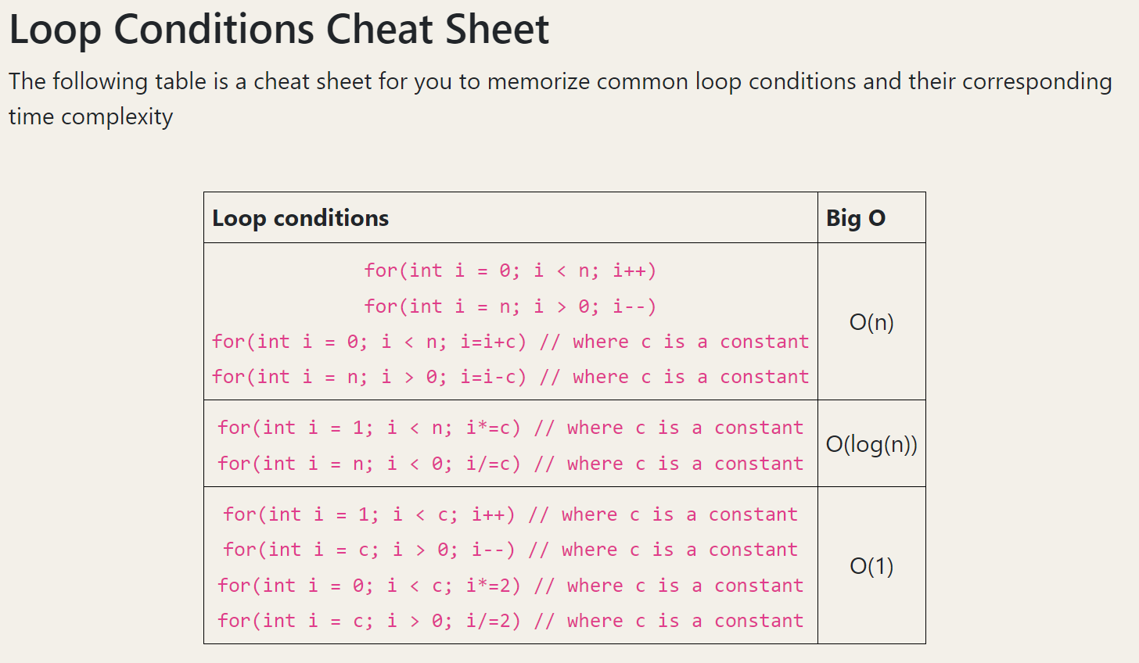
Simple Loops

Slide 12
Simple Loops
Remember this!

Slide 13
Part 2: Non-Nested Multiple Loops

Slide 14
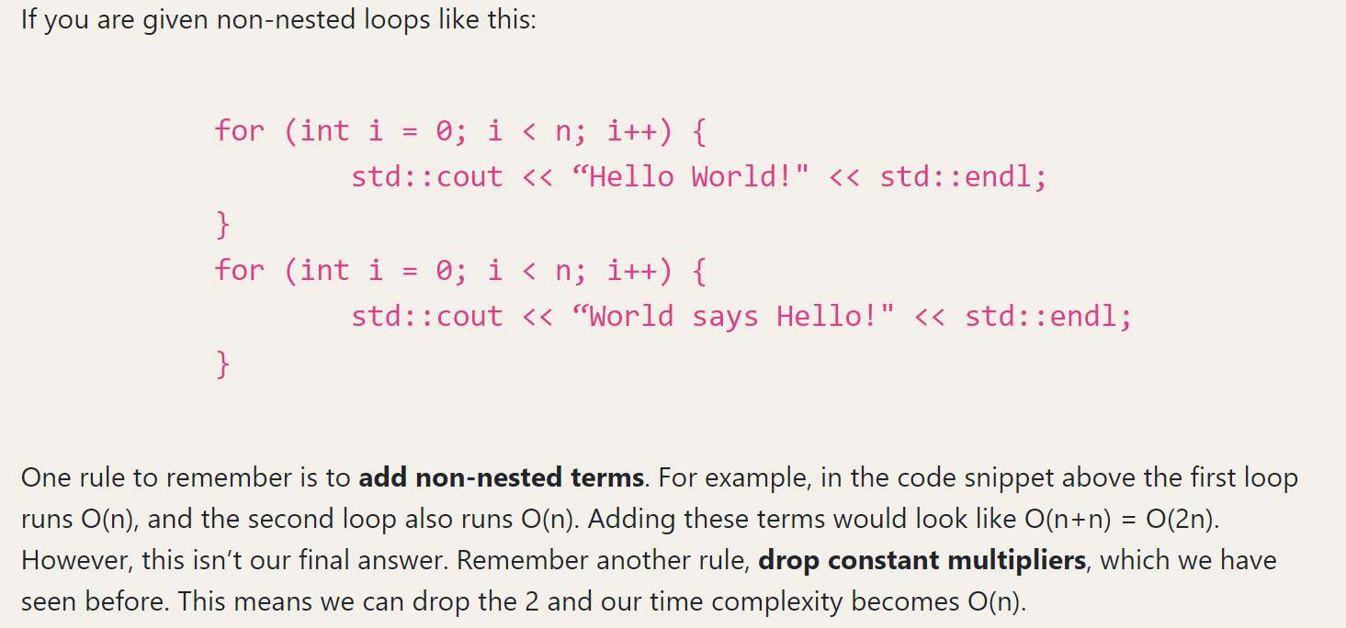
Non-nested multiple loops

Slide 15
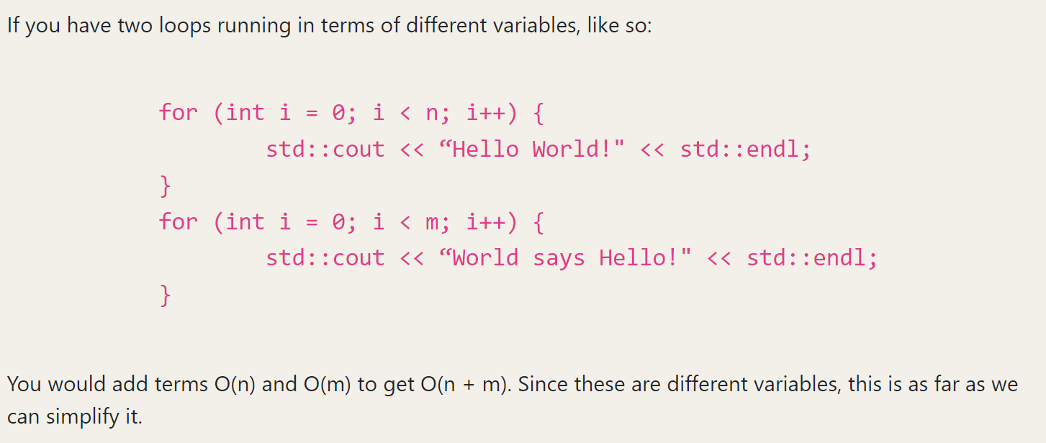
Non-nested multiple loops

Slide 16
Non-nested multiple loops

Slide 17
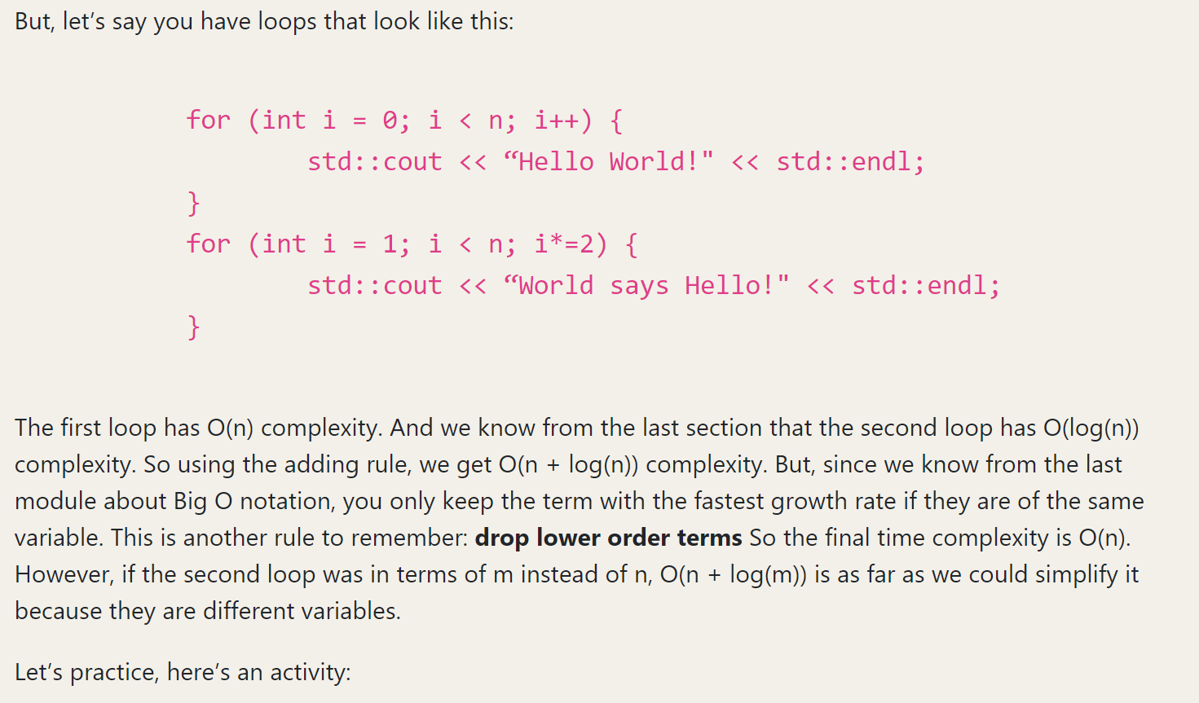
Non-nested multiple loops

Slide 18
Non-nested multiple loops
Activity Time!

Slide 19
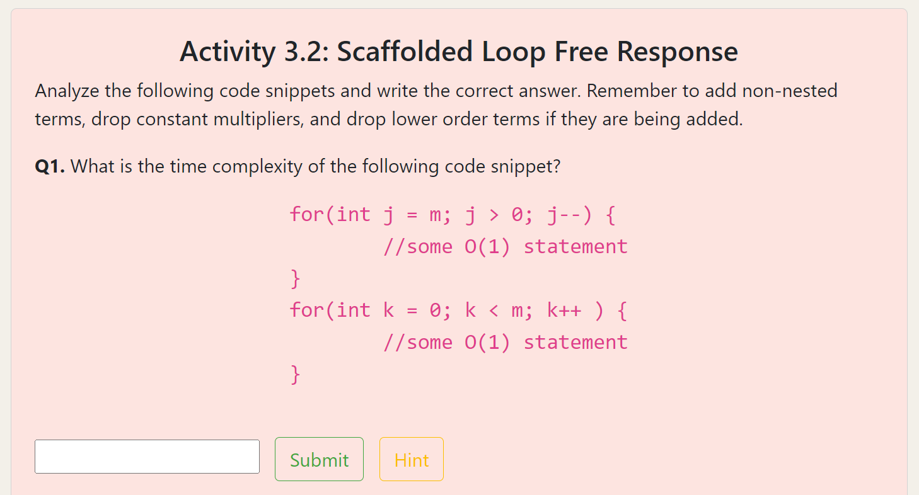
Non-nested multiple loops
Please view website for full experience

Slide 20
Non-nested multiple loops
Answer: O(m)
Please view website for full experience

Slide 21
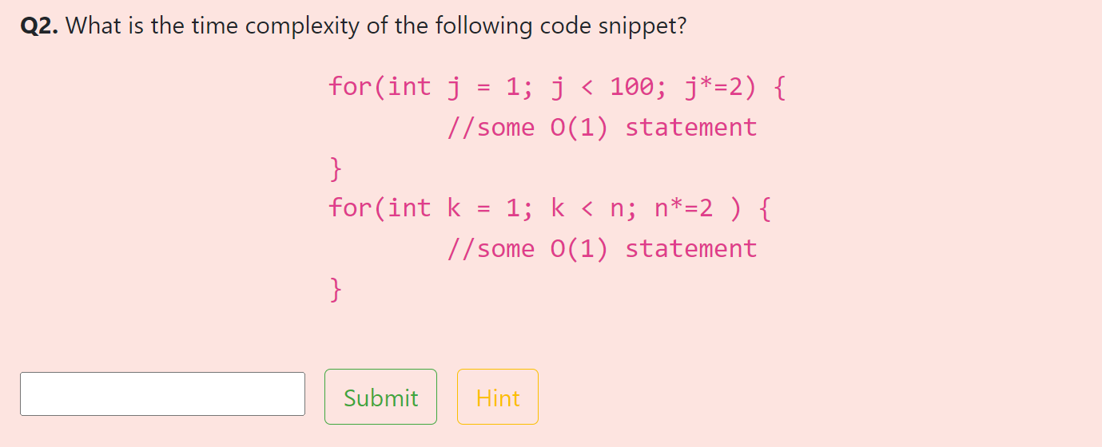
Non-nested multiple loops
Answer: O(m)
Please view website for full experience

Slide 22
Non-nested multiple loops
Answer: O(log(n))
Please view website for full experience

Slide 23
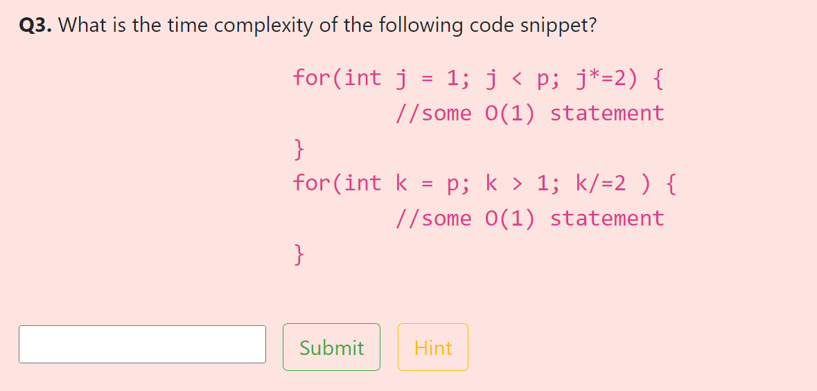
Non-nested multiple loops
Answer: O(log(p))
Please view website for full experience

Slide 24
Non-nested multiple loops
Answer: O(log(p))
Please view website for full experience

Slide 25
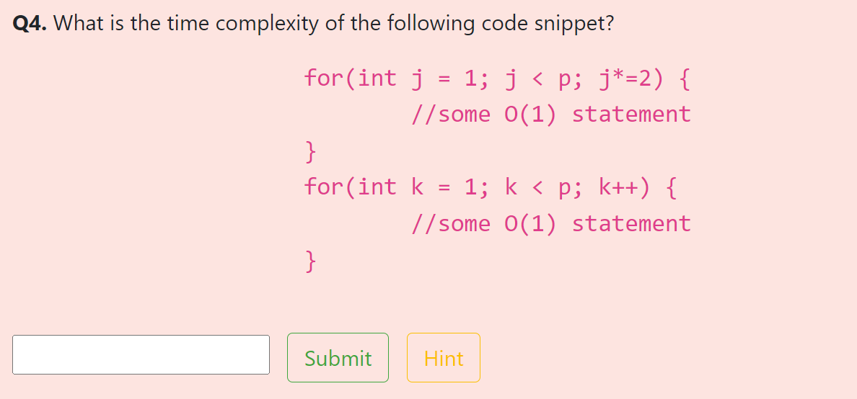
Non-nested multiple loops
Answer: O(p)
Please view website for full experience

Slide 26
Non-nested multiple loops
Answer: O(p)
Please view website for full experience

Slide 27
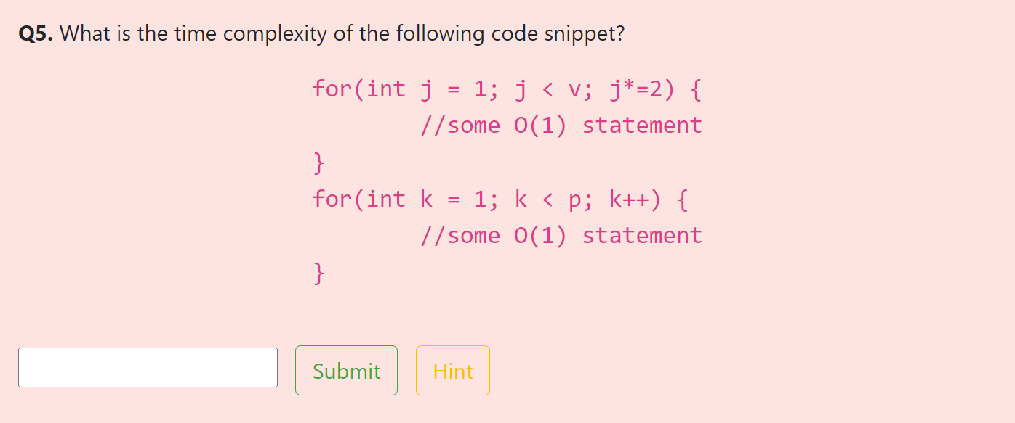
Non-nested multiple loops
Answer: O(p + log(v)) or O(log(v) + p)
Please view website for full experience

Slide 28
Non-nested multiple loops
Answer: O(p + log(v)) or O(log(v) + p)
Please view website for full experience

Slide 29
Part 3: Nested Loops

Slide 30
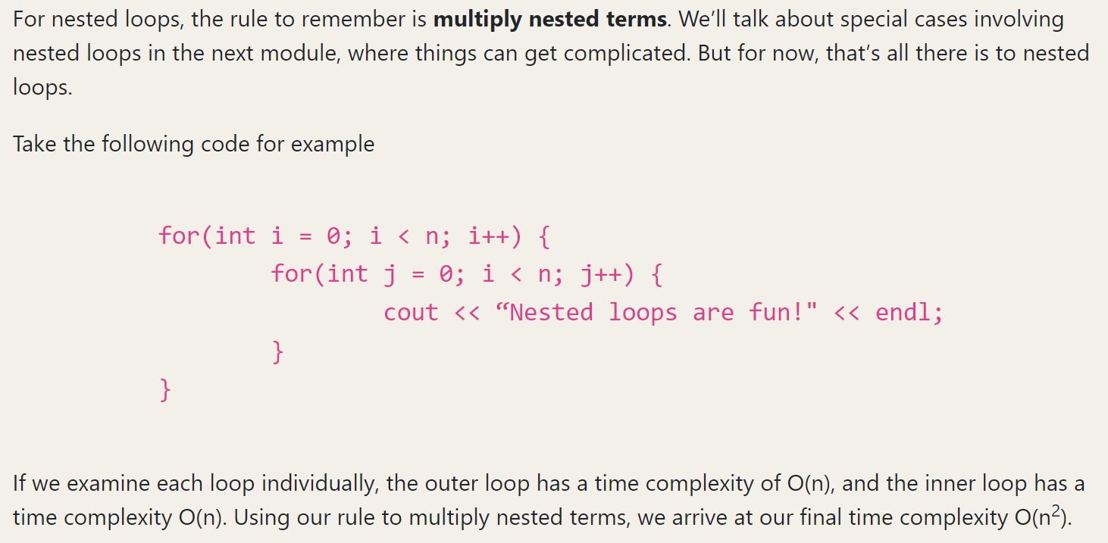
Nested Loops

Slide 31
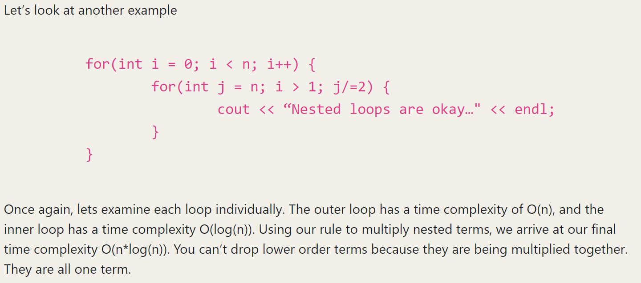
Nested Loops

Slide 32
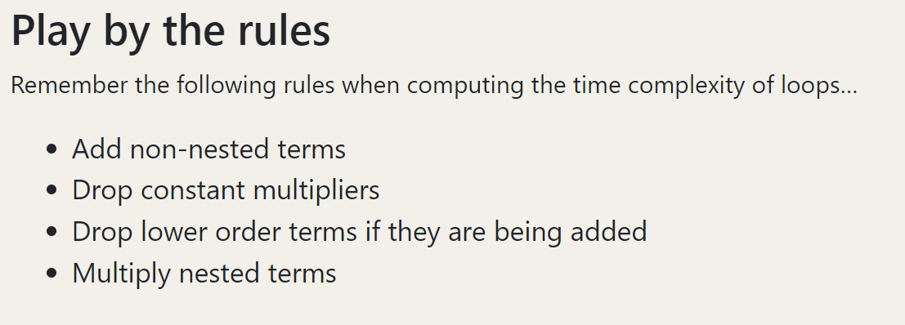

Slide 33
Take the assessment!
https://www.cise.ufl.edu/~dpayne1/TimeComplexity/modules/module3/assessment.php

