Slide 1


Introduction to Time Series Forecasting
Danielle Paes Barretto
April 25, 2023
Photo by Jon Tyson on Unsplash

Slide 2
The goal of forecasting is not to predict the future but to tell you what you need to know to take meaningful action in the present.
Paul Saffo

Slide 3
Overview
Introduction to Time Series
Time Series Decomposition
Stationarity Tests
Making a TS stationary
ARIMA models
Estimate parameters
Fit model
Evaluate model
Forecast
Save model
FB Prophet
Prepare data
Train model
Forecast
Prophet Diagnostic Tools (Cross Validation, parameters fine tunning)
Use additional data (holidays)
Save model
ARIMA vs Prophet

Slide 4
Time Schema
13:00 – 15:00 – Introduction to Time Series Forecasting (Part 1 of 2)
15:00 – 15:30 – Break
15:30 – 17:00 – Introduction to Time Series Forecasting (Part 2 of 2)

Slide 5
Datasets
Some datasets are made available in GitHub. Mostly from Google trends. These will be used to explore time series properties.
The main dataset can be found and download at https://www.kaggle.com/competitions/demand-forecasting-kernels-only/data . You can find the description of the dataset there. This will be the main dataset used to explore the forecasting models presented here.
Some suggestions of datasets for further exploration are given in the notebooks.

Slide 6
Kagle Store Item Demand Forecasting Challenge
5 years of store-item sales (01-01-2013 until 31-12-2017)
Kaggle objective forecast 3 months (01-01-2018 until 31-03-2018) of sales for 50 different items at 10 different stores.
Our objective forecast 3 months (01-01-2018 until 31-03-2018) of sales for item 28 at store. Download this data from data/processed/sales_store_2_item_28.csv.
For both models presented here (ARIMA and Prophet) you need to forecast the sales of each product in each store individually. This can be done by using the model for each product-store combination and then combining the results.
Is there a forecasting model that can be applied to the whole dataset at once? Yes, there are other forecasting models such as exponential smoothing and neural networks that can be applied to a dataset as a whole.

Slide 7
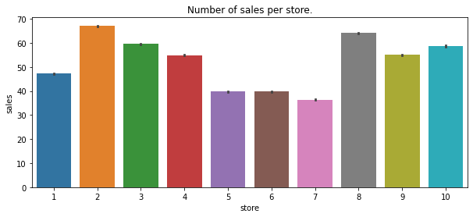
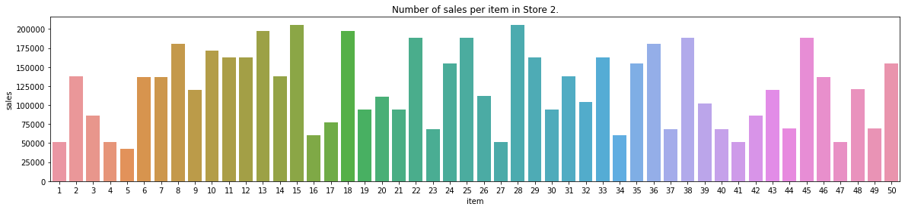
EDA

Slide 8
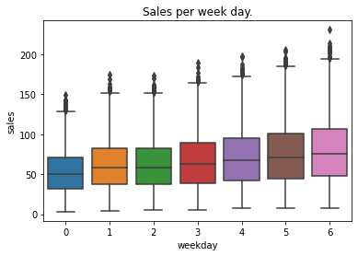
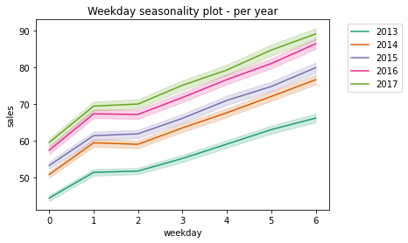
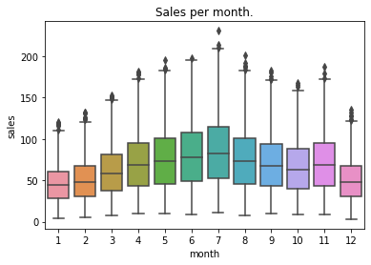
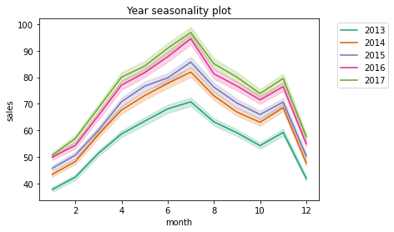
EDA

Slide 9
What is Time Serie?
Time series is a sequence of data points with the following characteristics :
Sequence of data points taken over a continuous time interval.
Each data point is a measurement taken at successive points in time.
There is equal spacing between every two consecutive measurements.
Each time unit within the interval has no more than one data point.

Slide 10
What is Forecasting?
It is a tool used to predict future outcomes based on past data and current trends.
It can help businesses make better decisions.
It can inform government policy decisions.
Ultimately, it benefits the population by ensuring resources are allocated in the most effective way.

Slide 11
Examples of Forecasting Applications
Financial: Stock market predictions, currency exchange rate forecasting, investment portfolio optimization.
Retail: Demand forecasting, inventory management, pricing optimization.
Healthcare: Disease outbreak forecasting, medical treatment effectiveness, medication side effects.
Weather: Climate change predictions, hurricane tracking, air quality predictions.
Manufacturing: Production planning, supply chain management, machinery maintenance.
Energy: Renewable energy forecasting, energy usage optimization, power grid maintenance.
Transportation: Traffic flow predictions, airline scheduling, ride-sharing optimization.
Sports: Team performance predictions, player performance analysis, win probability estimations.
Advertising: Ad placement optimization, campaign effectiveness, customer segmentation.
Security: Intrusion detection, anomaly detection, malware analysis.

Slide 12
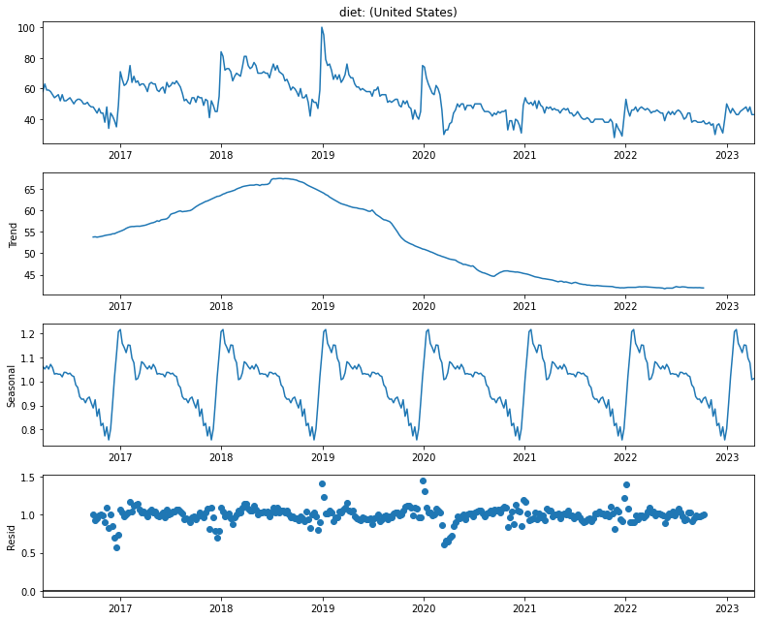
Time Series Components

Slide 14
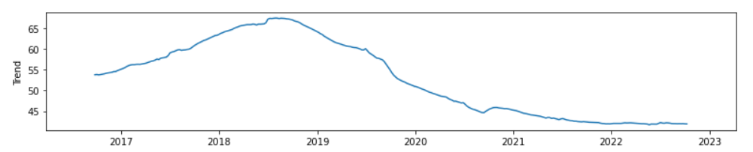
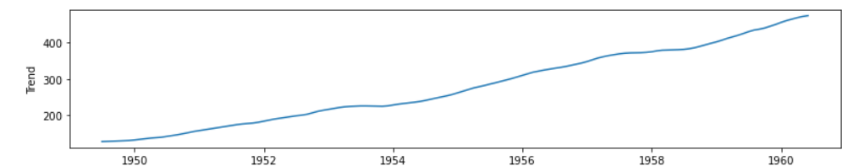
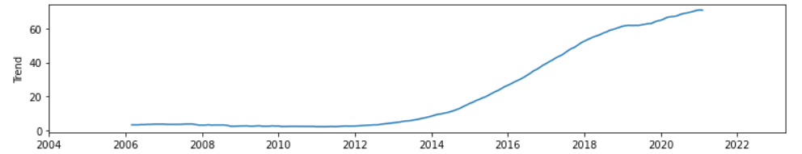
Trend
Shows whether the series is consistently decreasing (downward trend), constant (no trend) or increasing (upward trend) over time.

Slide 15
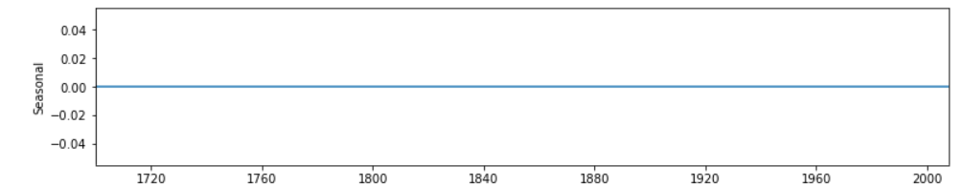
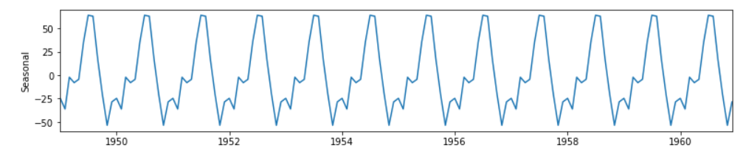
Seasonality
Describes the periodic signal in your time series. Seasonality should always present a fixed and known period.
These changes usually happen on a regular basis, like on a daily, weekly, or yearly basis. Seasonality is usually caused by natural cyclical patterns or by the conventions of the people regarding certain dates and times.

Slide 16
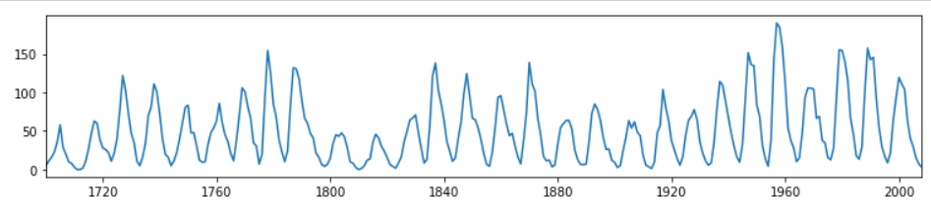
Cyclical Patterns
Cycles are patterns of peaks and dips in a time series that are caused by how the value in the series at one time is determined by the values at earlier times, i.e. , a cyclic pattern exists when data exhibit rises and falls that are not of fixed period. This type of behaviour can be seen in economies, epidemics, animal populations, volcano eruptions, and other natural processes.
Yearly sunspots data 1700-2008

Slide 17
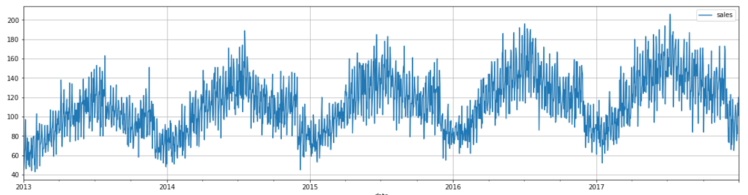
Seasonality vs Cyclicality
The difference between cyclic behaviour and seasonality is that cycles don't necessarily depend on the particular date of occurrence - it's more about what has happened in the recent past. This independence from time makes cycles much less regular than seasonal patterns.

Slide 18


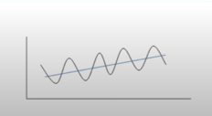
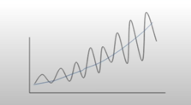
Additive x Multiplicative Model
Y(t) = trend + seasonality + residual
Y(t) = trend x seasonality x residual
Trend and Seasonal variation increases or decreases in magnitude over time.
Trend and Seasonal variation relatively constant over time.
Notes:
Additive
* Linear trend: trend is a straight line
* Linear seasonality: Seasonality with same frequency (width of cycles) and amplitude (height of cycles).
Multiplicative
* Non-linear trend: trend is a curved line
Non-linear seasonality: Seasonality varies in frequency (width of cycles) and/or amplitude (height of cycles).
One of the main objectives for a decomposition is to estimate **seasonal effects** that can be used to create and present seasonally adjusted values (https://online.stat.psu.edu/stat510/lesson/5/5.1). So to choose between additive and multiplicative decompositions we consider that:
* The additive model is useful when the seasonal variation is relatively constant over time.
* The multiplicative model is useful when the seasonal variation increases over time.

Slide 19
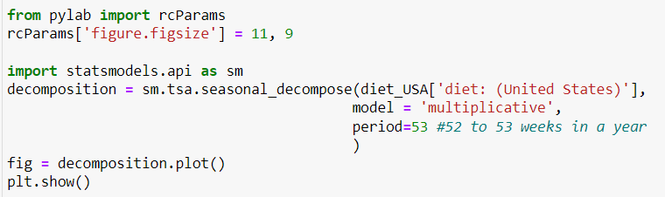
Time Series Decomposition
We will have the help of the Python’s statsmodels library seasonal_decompose to access the components of time series.

Slide 20

on time….
Let’s decompose some time series and analyze:
Trend,
Seasonality vs Cyclicality,
Additive vs Multiplicative behavior
Use library seasonal decompose to decompose time series on datasets:

Slide 21
Stationarity
A stationary time series fulfills the following criteria:
Trend zero
The variance in the seasonality component is constant: The amplitude of the signal does not change much over time.
Autocorrelation is constant: The relationship of each value of the time series and its neighbors stays the same.
Why is it important?
If a time series exhibits a certain behavior over a period of time, then it is likely that it will have the same behavior over a different time period, so long as the time series is stationary. This helps in making forecasts with a higher degree of accuracy. Algorithms such as ARIMA and its variants rely on this property.

Slide 22
Stationarity tests
Augmented Dicky-Fuller test (ADF)
Null Hypothesis: The series has a unit root, meaning it is non-stationary. It has some time dependent structure.
Alternate Hypothesis: The series has no unit root, meaning it is stationary. It does not have time-dependent structure.
A p-value below a threshold (such as 5% or 1%) suggests we reject the null hypothesis (stationary), otherwise a p-value above the threshold suggests we fail to reject the null hypothesis (non-stationary).
Kwiatkowski-Phillips-Schmidt-Shin (KPSS)
Null Hypothesis: The process is trend stationary.
Alternate Hypothesis: The series has a unit root (series is not stationary).
A p-value below a threshold (such as 5% or 1%) suggests we reject the null hypothesis (non-stationary), otherwise a p-value above the threshold suggests we fail to reject the null hypothesis (stationary).
Important: Apply both since it can happen that a time series passes the ADF test, without being stationary.

Slide 23
on time….
Let’s test for stationarity using ADF and KPSS tests.
 | ADF | KPSS | Conclusion
Case 1 | p > threshold (non-stationary) | p < threshold (non-stationary) | TS is not stationary
Case 2 | p < threshold (stationary) | p > threshold (stationary) | The series is stationary
Case 3 | p > threshold (non-stationary) | p > threshold (stationary) | The series is trend stationary
Case 4 | p < threshold (stationary) | p < threshold (non-stationary) | The series is difference stationary

Slide 24
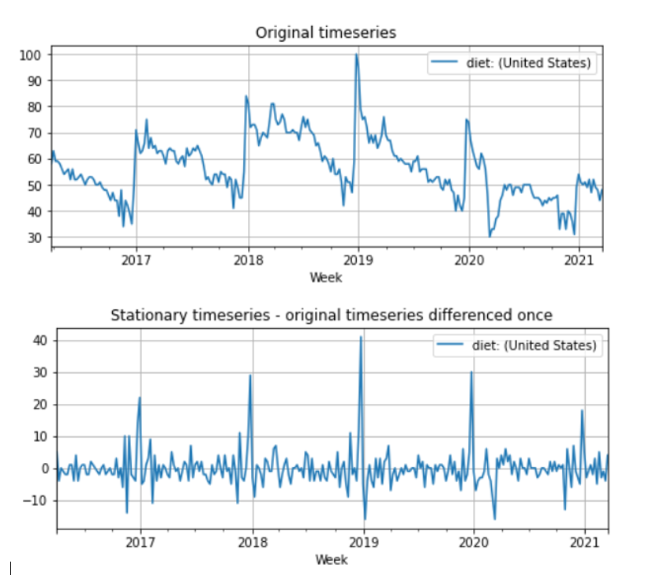
Making Time Series Stationary

Slide 25
ARIMA models

Slide 26
Auto Regressive Integrated Moving Average models
There are two types:
Non-seasonal ARIMA, or simply ARIMA
Seasonal ARIMA, or SARIMA
(S)ARIMAX is a extension of the ARIMA model using exogenous variable, i.e., variables that might have influence on the target. For instance, temperature might help in predicting the number of ice cream sold, the number of nurses in a shift might have influence on the waiting time of patients.

Slide 27

Non-seasonal ARIMA
ARIMA (p, d, q)
AR (p) : AutoRegressive component
I (d) : differencing component
MA (q) : Moving Average component
Number of periods of the TS used in the calculation
(incorporate the effect of past values into our model)
Number of transformations used to transform a TS into a stationary one (incorporate the amount of differencing)
Number of lags of the error component
(allows us to set the error of our model as a linear combination of the error values observed at previous time points in the past)
Notes:
Purely AR models look like linear regression models where the predictive variables are the p previous periods.
A stationary series is a series without trend or seasonality
Error component: The part of the series not explained by trend or seasonality
MA models look like linear regression models where the predictive variables are the q previous periods of errors

Slide 28
Stationarity and ways of making TS stationary.
Stationary time series has mean and variance constant over time.
Differencing is a method of transforming a non-stationary time series to a stationary one.
The number of times of differencing needed to render the series stationary will be the differenced I(d) term in our ARIMA model.
ADF and KPSS tests can help to know how many times or if differencing is the way to go.
However, other common transformations for enforcing stationarity include (sometimes in combination with one another):
Square root or N-th root transformations
De-trending your time series
Differencing your time series one or more times
Log transformations
Note, however, that a transformation on data as a pre-processing stage will result in forecasts in the transformed space. When in doubt, let the auto_arima function do the heavy lifting for you. Read more on difference stationarity in this Duke article.
Notes:
Station

Slide 29
Seasonal Arima
When dealing with a seasonal time series, we make use of the seasonal ARIMA, denoted by ARIMA(p,d,q)(P,D,Q)m.
(p, d, q) are the non-seasonal parameters described previously, while (P, D, Q) follow the same definition but are applied to the seasonal component of the time series.
m is the periodicity of the time series (4 for quarterly periods, 12 for yearly periods, etc.).
D can be estimated via Canova-Hansen test (This test can be found in de pmdarima package).
Auto_arima will estimate it if seasonal=True.

Slide 30
Seasonal ARIMA Models
Non - Seasonal
Seasonal
ARIMA(p, d, q)
ARIMA(p, d, q)(P,D,Q)m
p: Autoregressive component
d: Differencing component
q: Moving Average component
p, d, q : like in the non-seasonal ARIMA
m: Number of periods in each season (e.g. monthly data m=12)
P: Autoregressive component for the seasonal part
D: Differencing component for the seasonal part
Q: Moving average component for the seasonal part

Slide 31
Estimating coefficients numerically
ACF and PACF plots can help us find appropriate values for parameters `p` and `q` . However, the interpretation of these plots is not always clear.
The numerical method consists in fitting the ARIMA model and observing the values of AIC (Akaike Information Criterion) and BIC (Bayesian Information Criterion).
For both criterium the smaller the better.
Usually there is a agreement between AIC and BIC. If there is no agreement choose smaller AIC for a predictive model and smaller BIC for a explanatory model (less complex)
Notes:
The Akaike Information Criterion (AIC) and the Bayesian Information Criterion (BIC) are two widely used criteria for selecting the optimal parameters of an ARIMA model. The general rule of thumb is that the model with the lowest AIC or BIC values should be chosen. However, it is important to keep in mind that the AIC and BIC do not always select the same model as the best one. In some cases, the AIC may select a model with higher complexity than the BIC, or vice versa. In such cases, it may be necessary to evaluate the models using other criteria, such as the out-of-sample predictive accuracy of the models. Ultimately, the choice of the best ARIMA model should be based on the balance between model complexity and predictive accuracy.

Slide 32
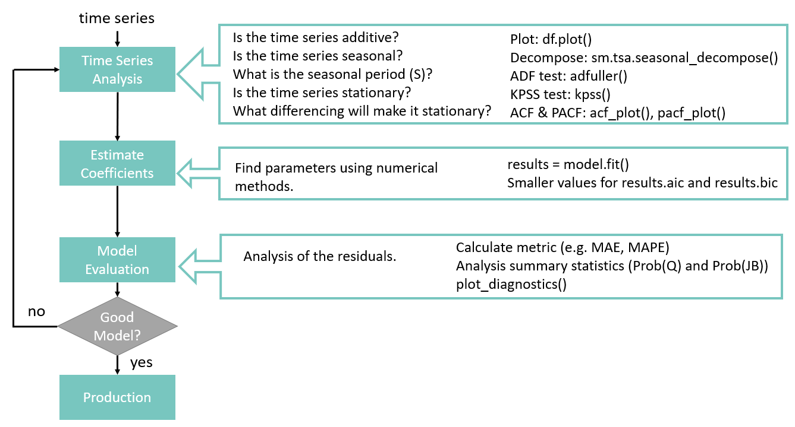
Box-Jenkins Method

Slide 33
on time….
Load sales_store_2_item_28.csv
Apply Box-Jenkins Method
STEP 1 : Identify
Visualize components
Stationary?
STEP 2: Estimate coefficients numerically
Run model for different parameters (p,d)
Evaluate AIC and BIC
Choose parameters
STEP 3: Evaluate model
Summary statistics
plot_diagnostics
Apply autoarima

Slide 34
Forecasting with Facebook Prophet
How to apply Facebook Prophet for forecasting
How to search for the best model using hyperparameter fine tunning
How to evaluate the obtained model
How to save the chosen model for future use

Slide 35

Facebook Prophet
Open-source forecasting tool available in R and Python.
Open sourced in 2017 Facebook’s core Data Science team. It is full optimized for the business forecasts tasks they encountered at Facebook. It is still used internally.
Prophet is a procedure for forecasting time series data based on an additive model, and the implementation supports trends, seasonality, and holidays.
It works best with time series that have strong seasonal effects and several seasons of historical data.
Prophet is robust to missing data and shifts in the trend, and typically handles outliers well.
Accurate and Fast: Still used internally by Facebook for producing reliable forecasts for planning and goal setting. Fit models in Stan so that you get forecasts in just a few seconds.
Fully automatic: Has the capacity of find automatically a good set of hyperparameters for the model so non-experts users can quickly make high quality forecasts.
Tunable Forecasts: Prophet allows also hand tunning parameters so experts can improve theirs results.
Notes:
Stan is a state-of-the-art platform for statistical modeling and high-performance statistical computation.

Slide 36
Links
https://kourentzes.com/forecasting/2014/11/09/additive-and-multiplicative-seasonality/
ARIMA with exogenous regressors:
https://gist.github.com/ChadFulton/82744b500a5dcb0283624c80fd10c92b
https://facebook.github.io/prophet/
https://github.com/facebook/prophet
Example Prophet using holidays and weather effects: https://nbviewer.org/github/nicolasfauchereau/Auckland_Cycling/blob/master/notebooks/Auckland_cycling_and_weather.ipynb
ACF and PACF
https://medium.com/towards-data-science/interpreting-acf-and-pacf-plots-for-time-series-forecasting-af0d6db4061c
In case you cannot access the medium article
https://www.kaggle.com/code/iamleonie/time-series-interpreting-acf-and-pacf/notebook

Slide 37
Questions? Comments?

Slide 38

Thanks!
Photo by Aron Visuals on Unsplash

