Slide 1
Data-Driven Productivity Optimization
Analyzing 6 Weeks of Performance Metrics

Slide 2
Project Objective
Goal: Optimize work schedule based on empirical performance data
Challenge:
• Multiple concurrent priorities across different domains
• Academic coursework (Python, SQL, Statistics, Power BI)
• Content development (lesson plans, curricula)
• Professional development tasks
• Personal projects
Question: How can schedule design maximize output quality
while managing capacity effectively?

Slide 3
Methodology
Data Collection & Analysis Framework

Slide 4
Data Collection Method
Tracking Period: October 31 - November 26, 2025 (6 weeks)
Data Sources:
• AI-assisted activity logging system
• Timestamped work session records
• Output volume measurement per session
Variables Measured:
• Duration (hours per session)
• Output quality (1-10 scale, post-session evaluation)
• Activity category and complexity level
• Time of day (morning/afternoon/evening)
• Tasks initiated and completed

Slide 5
Performance Metrics: Calculation Methods
Energy (Objective)
Energy = (Output Quality × Task Complexity) ÷ 10
Productivity Score
Productivity = (Hours × Energy × Quality) ÷ 100
Completion Rate
Completion = (Tasks Completed ÷ Tasks Started) × 100
Task Efficiency
Efficiency = Tasks Completed ÷ Hours Worked

Slide 6
Task Complexity Scoring System
Complexity scores assigned by cognitive demand and task type:
High Complexity (10/10):
Low-Medium (4-5/10):
• Python programming, Database development • Abstract reasoning, working memory • Problem decomposition required
• Technical troubleshooting • Vehicle research, Health topics • Routine cognitive tasks
Medium-High (8-9/10):
Low Complexity (2-3/10):
• Privacy analysis, Advanced statistics • Power BI, Business intelligence • Sustained focus required
• Fitness planning, Music practice • Gaming, Casual creative work • Minimal cognitive demand
Medium (6-7/10):
Scoring Basis:
• Business development, Strategy • ESL curriculum, Lesson planning • Moderate cognitive load
Based on established cognitive load research and task characteristics

Slide 7
Dataset Summary: 6-Week Period
November 1-26, 2024 | Comprehensive productivity tracking
94 hrs
57
78 of 91
Total Hours
Work Sessions
Tasks Completed
5.9/10
8.3/10
85.7%
Avg Energy
Avg Quality
Completion Rate
Data collected through timestamped work session records with quality assessments and task complexity ratings for each activity

Slide 8
Findings
Data Analysis Results

Slide 9
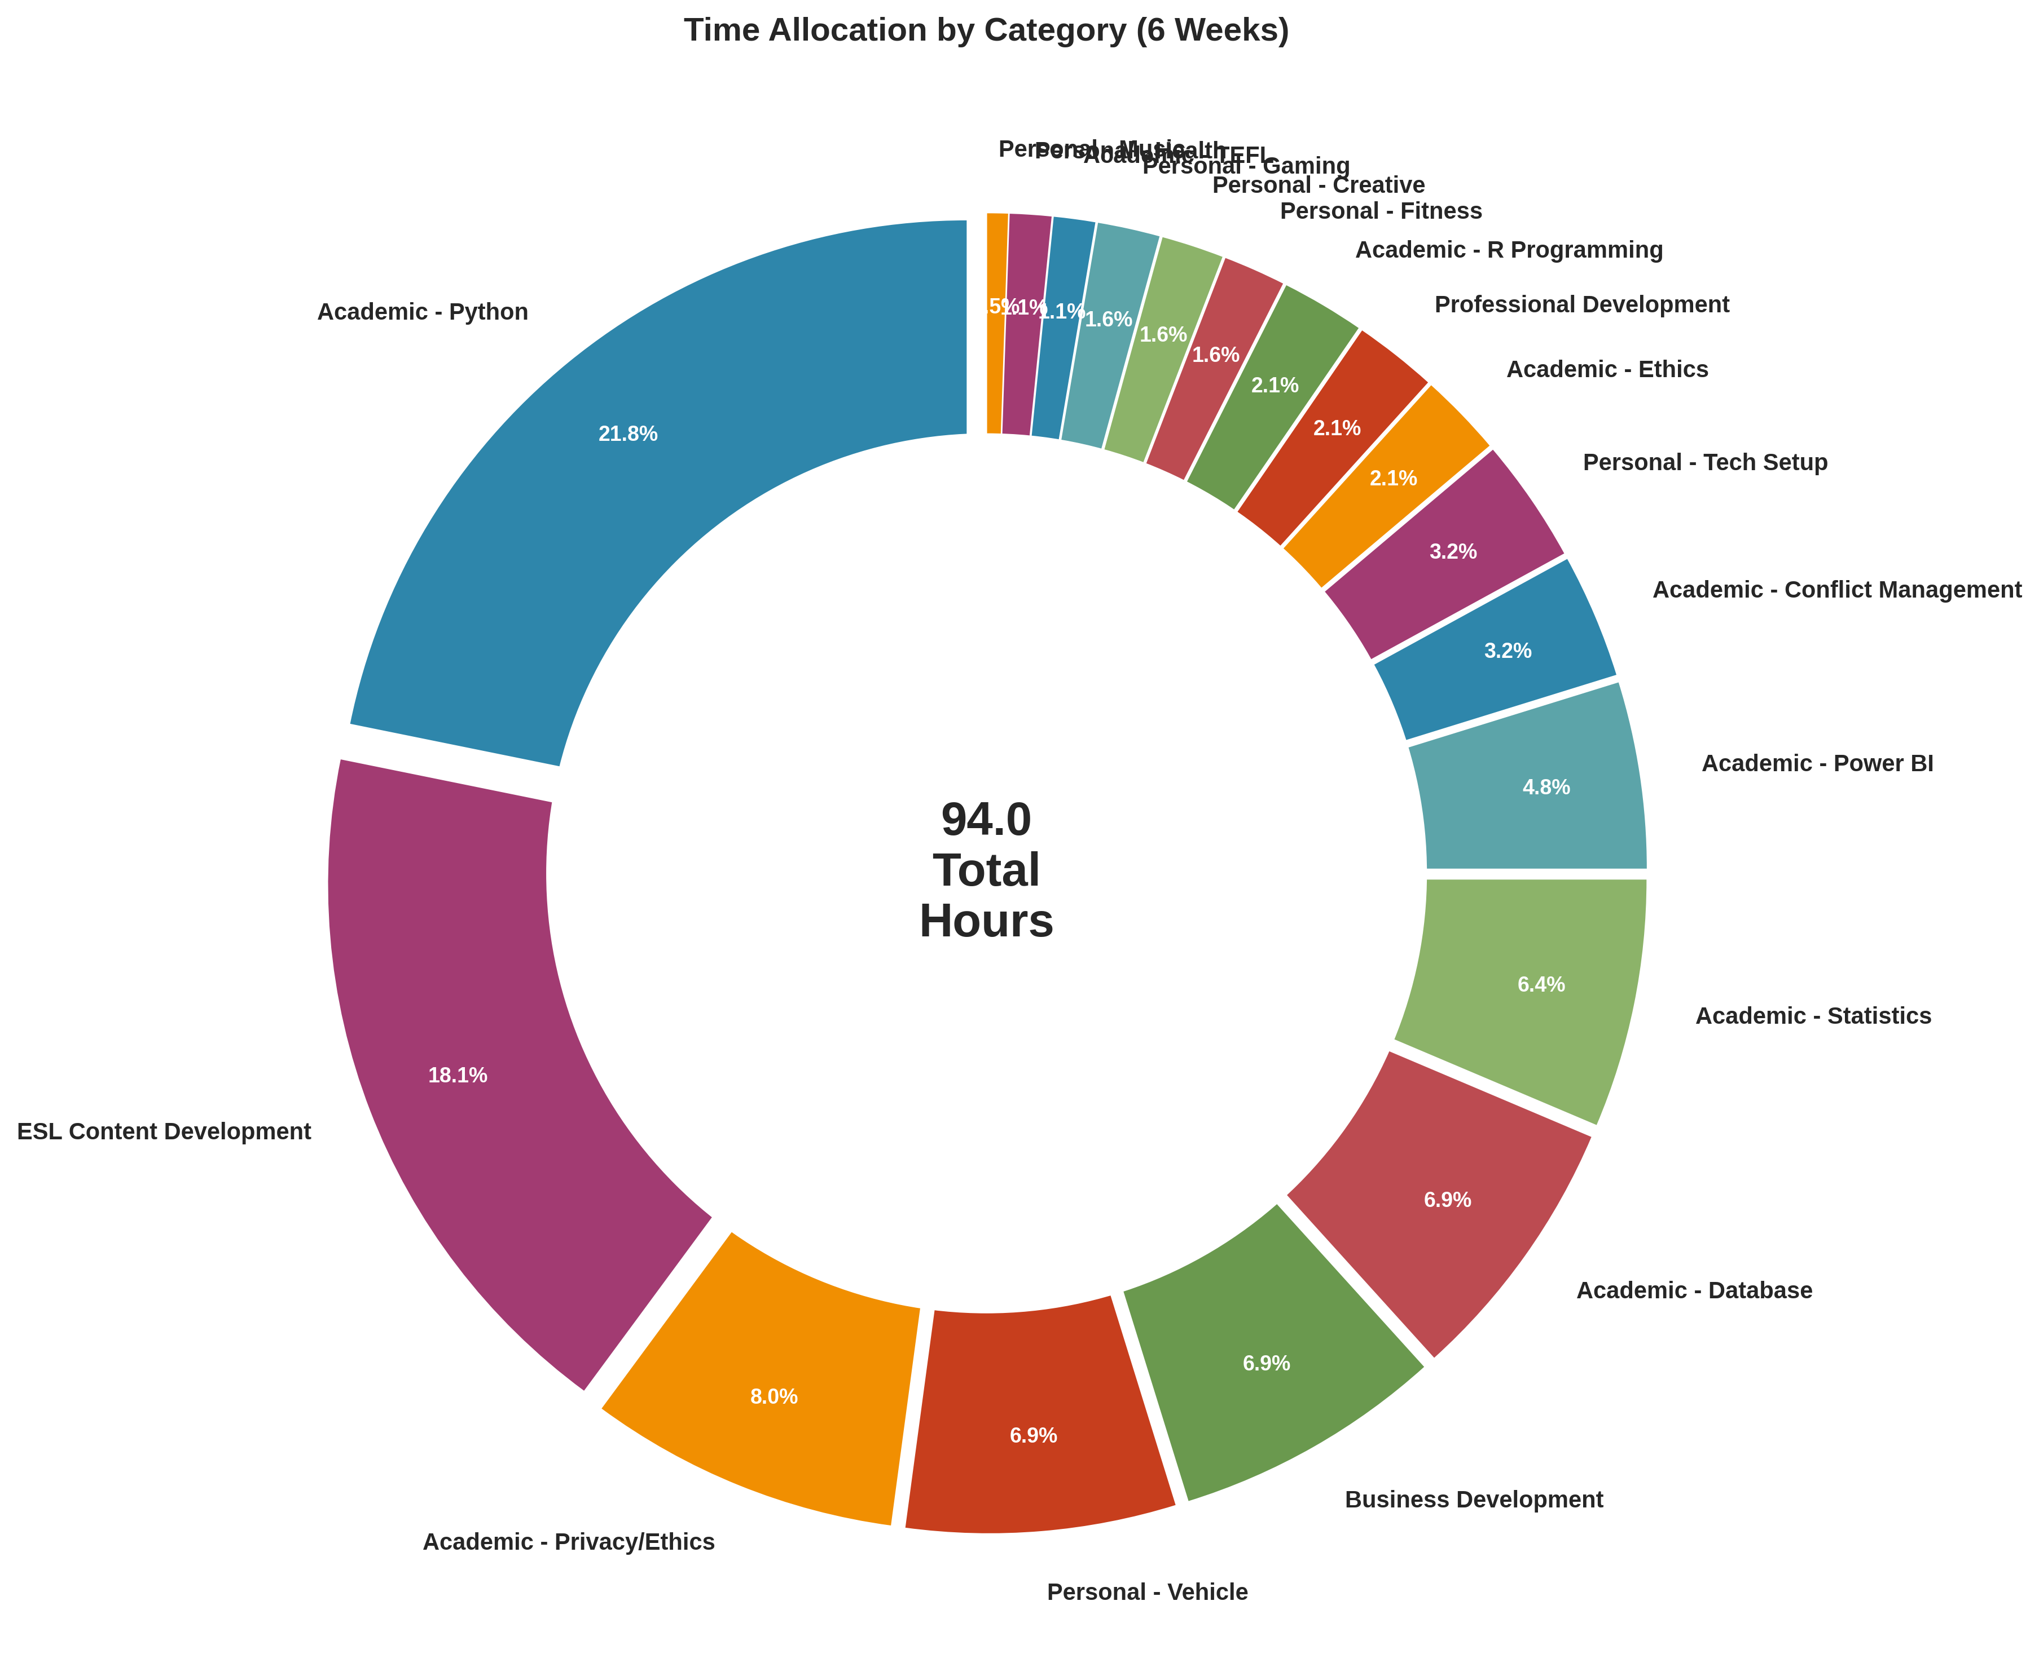
Finding 1: Time Distribution Across Categories

Slide 10
Finding 2: Two Types of Productive Capacity
Focus Capacity (Cognitive) vs. Output Capacity (Volume)
Morning (8am-12pm): • Energy: 7.9/10 (Focus Capacity) • Quality: 8.6/10 • Tasks: 20 (Output Capacity: 3.4/10) • Avg Complexity: 9.3/10 Afternoon (12pm-5pm): • Energy: 6.3/10 (Focus Capacity) • Quality: 8.2/10 • Tasks: 20 (Output Capacity: 3.6/10) • Avg Complexity: 7.7/10 Evening (5pm-10pm): • Energy: 3.7/10 (Focus Capacity) • Quality: 7.9/10 • Tasks: 38 (Output Capacity: 7.5/10) • Avg Complexity: 4.8/10
Key Insight: Different times excel at different types of work. Morning = highest focus capacity for complex analytical tasks. Evening = highest output capacity for high-volume simple tasks.

Slide 11
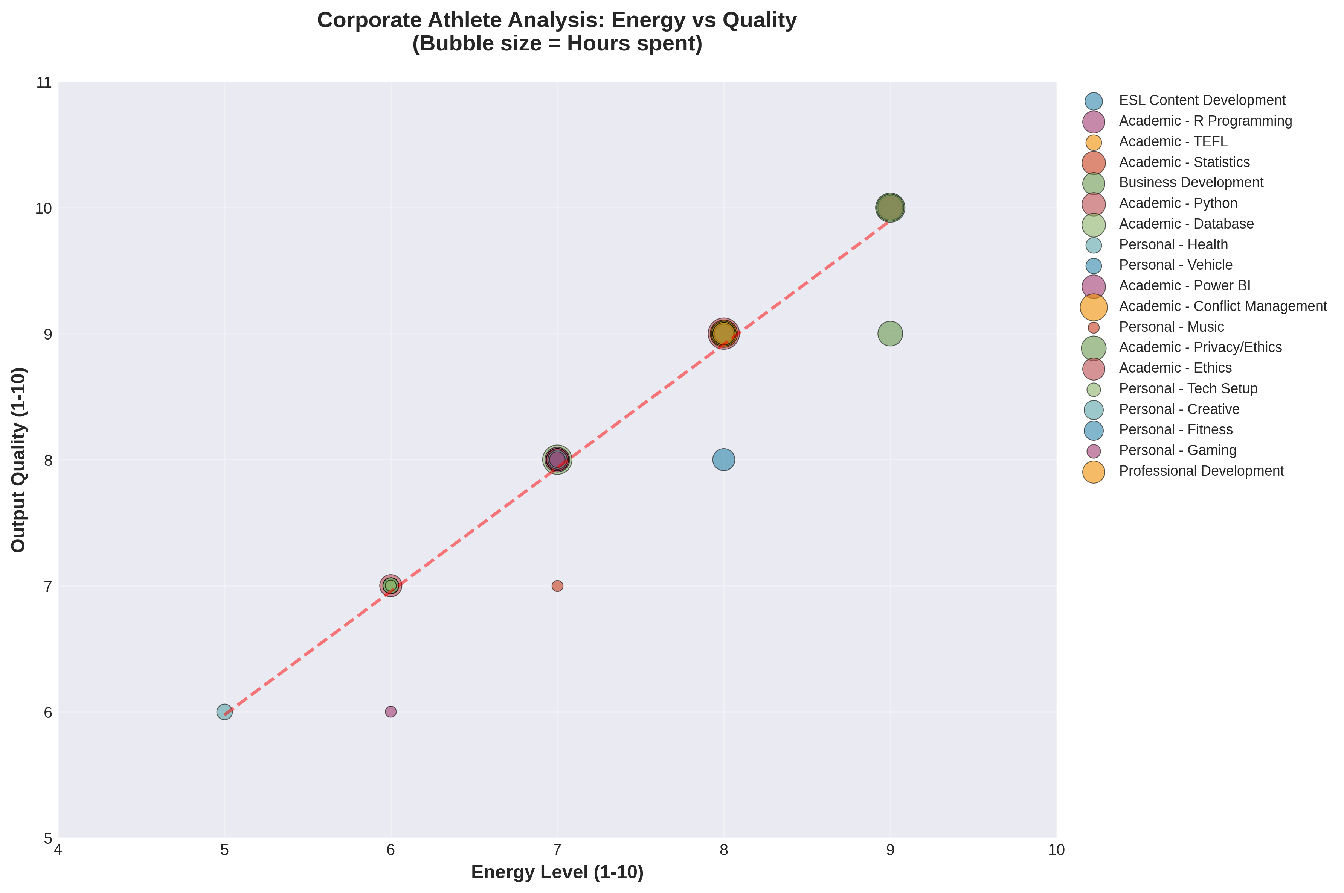
Finding 3: Energy Reflects Cognitive Deployment

Slide 12
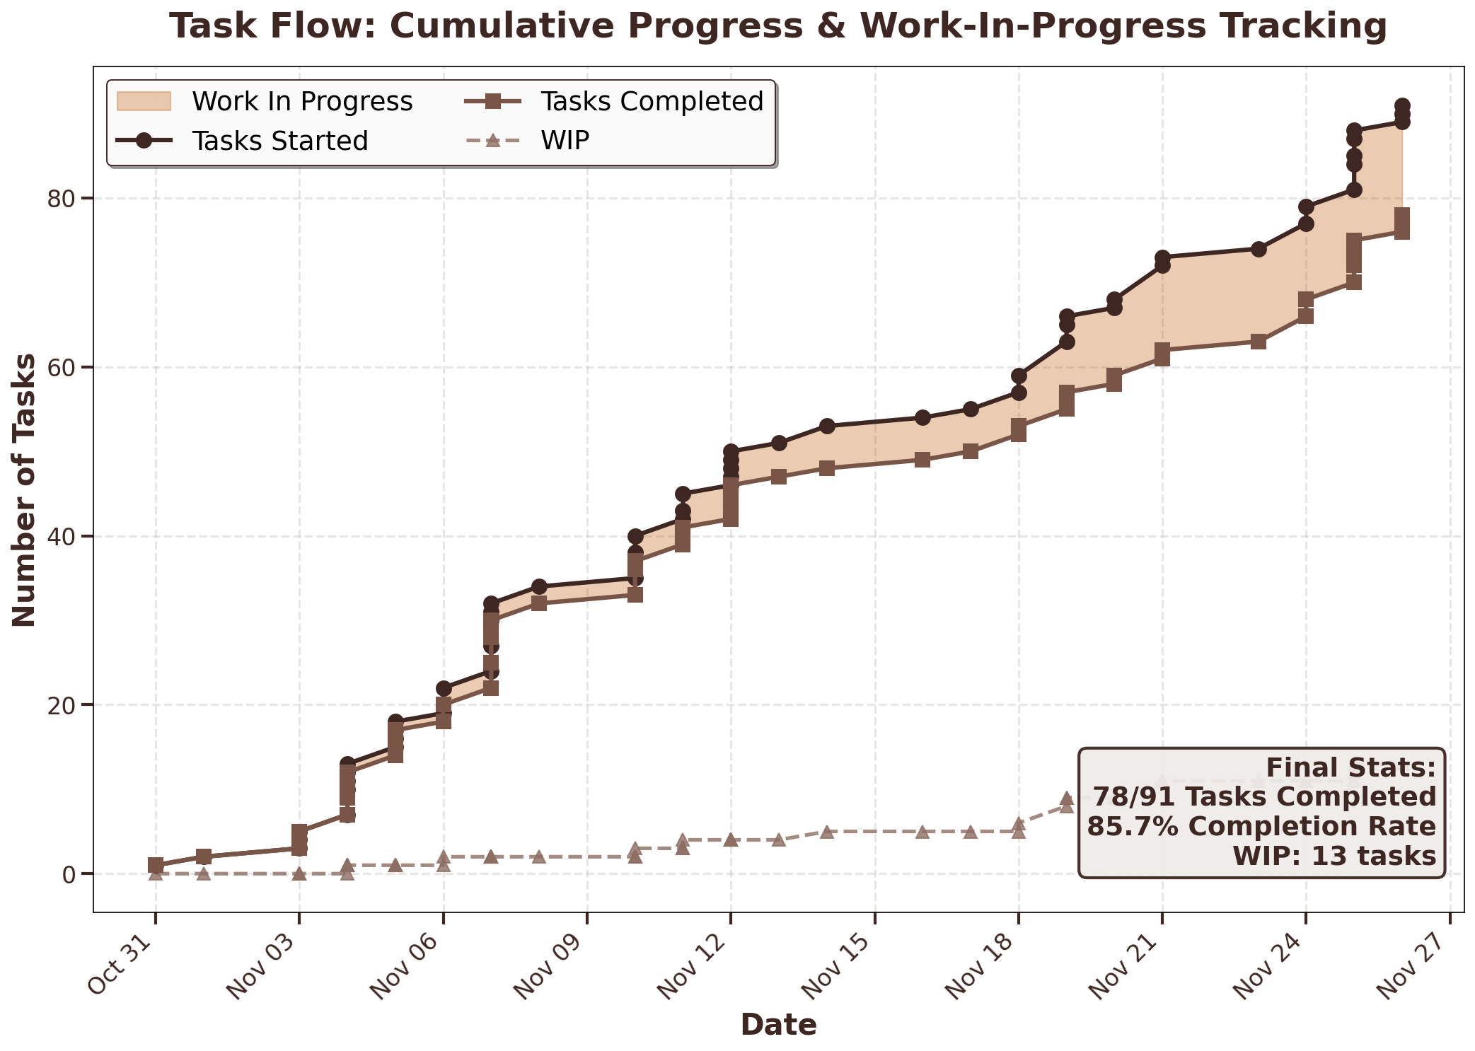
Finding 4: Task Completion Performance
Task Flow Analysis: • 91 tasks initiated • 78 tasks completed • 85.7% completion rate • 13 tasks in progress (14.3%) Work-In-Progress Metrics: • Average daily WIP: 0.6 tasks • Maintained low WIP throughout period Completion Pattern: • Consistent daily closure rate • Most sessions: same-day completion • Complex projects: 2-3 day completion

Slide 13
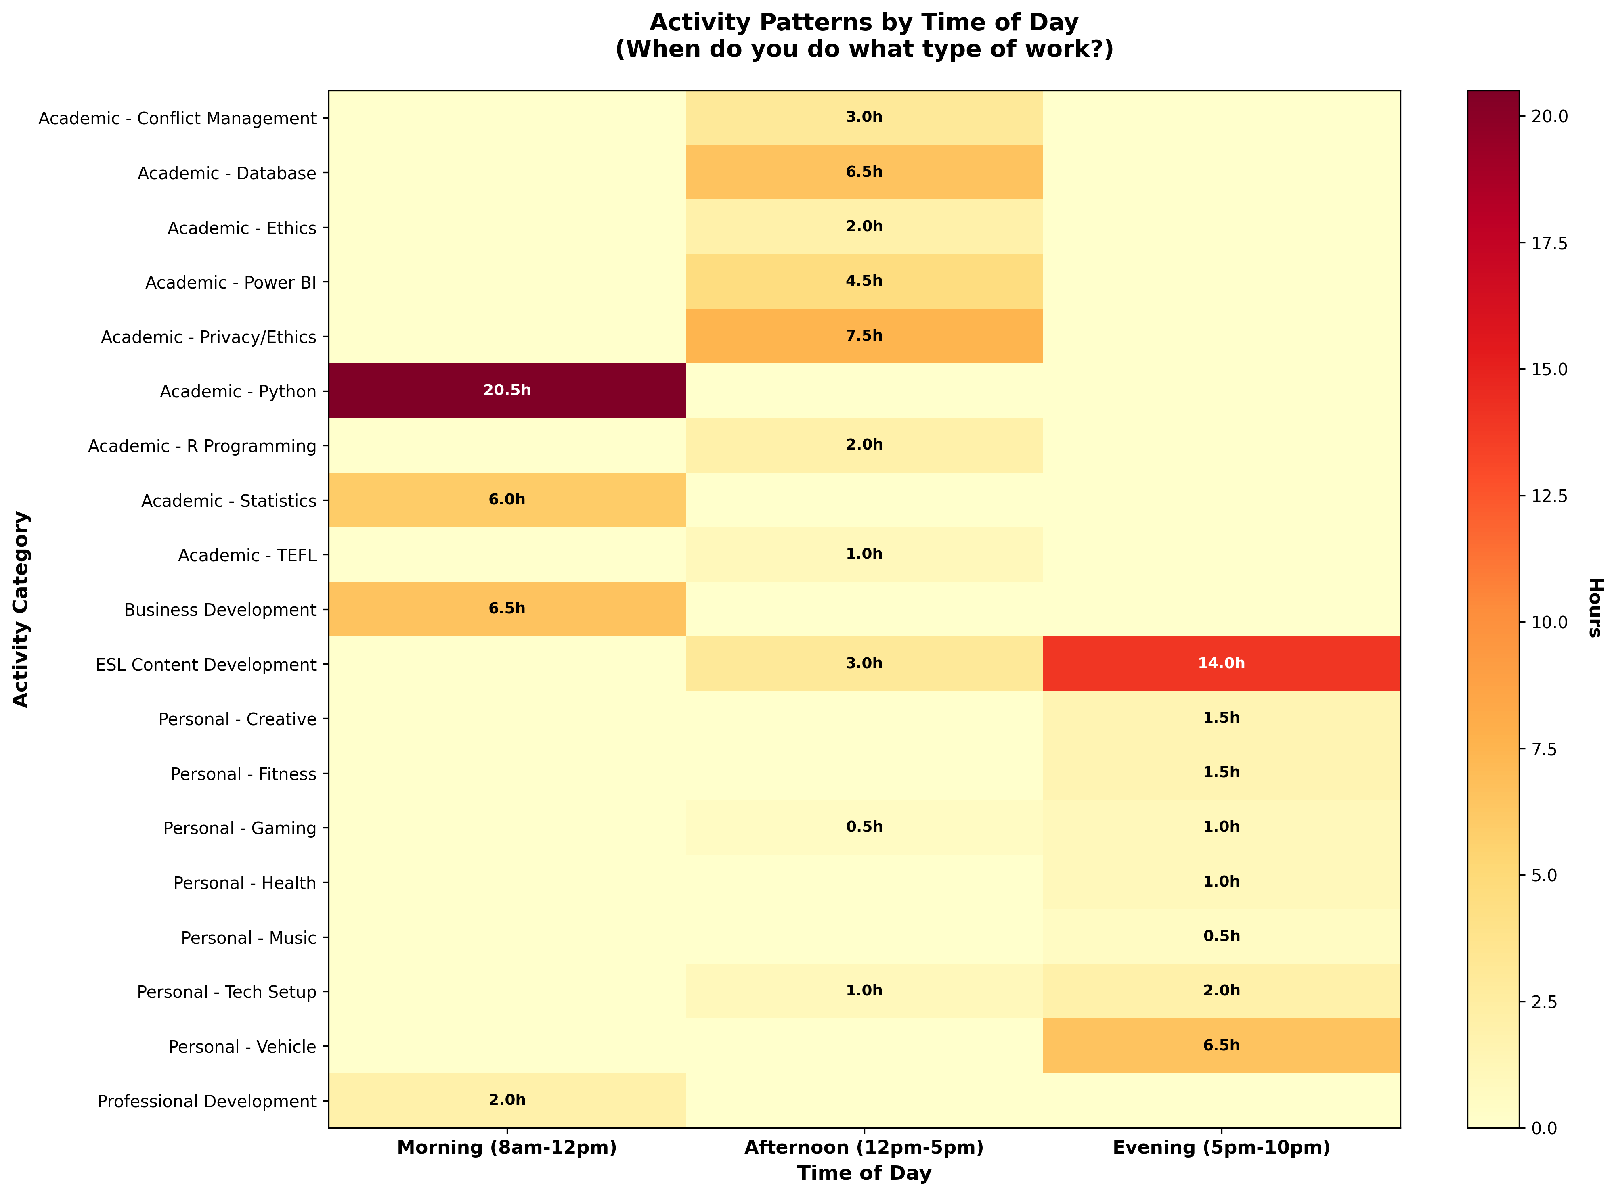
Finding 5: Work Type Naturally Aligns with Time Period

Slide 14
Analysis
Interpreting Performance Patterns

Slide 15
Pattern Analysis: Focus vs. Volume Capacity
1. Morning Focus Advantage • Energy (focus capacity): 7.9/10 - highest cognitive capacity • Handles complex work: avg complexity 9.3/10 • Productivity for complex work: 124% higher than evening • Optimal for: Python, Database, Strategic Analysis 2. Evening Volume Advantage • Output capacity: 7.5/10 - highest task throughput • Completed 38 tasks vs 20 in morning • Lower complexity work: avg 4.8/10 • Optimal for: Content creation, Admin, Quick tasks 3. Task Rotation & Rest Strategy • Alternating work types prevents fatigue • Strategic 20-minute rest intervals utilized • Low WIP (0.6 tasks/day) enables focus • 85.7% completion rate demonstrates discipline

Slide 16
Productivity Metrics: Complex Work Performance
0.731/hr
0.592/hr
Morning Productivity
Afternoon Productivity
0.326/hr
+124%
Evening Productivity
Morning Advantage

Slide 17
Improvement Opportunity: Optimize Time Allocation
Current Morning Allocation:
Optimization Potential:
• 35 hours over 6 weeks (37.2%) • Highest focus capacity window underutilized for complex tasks
• Increase morning allocation: 35 → 45+ hours • Reserve peak cognitive capacity for priority tasks • Move high-volume simple tasks to evening
Observed Misalignment:
Expected Impact:
• Complex analytical work sometimes scheduled in evening • High-value tasks during lower-capacity periods • Simple tasks occupying prime morning hours
• Leverage 124% morning productivity advantage • Maximize output quality on critical deliverables

Slide 18
Optimization
Data-Based Schedule Design

Slide 19
Proposed Schedule: Capacity-Task Alignment
Morning Block (8am-12pm)
Evening Block (5pm-10pm)
Focus Capacity Zone
Volume Capacity Zone
• Energy: 7.9/10 (highest cognitive capacity) • Schedule: Complex analytical work - Python, Database development - Statistical analysis, Strategic planning • Rationale: Quality (8.6) × Complexity (9.3) = Peak performance
• Energy: 3.7/10 (focus) BUT 7.5/10 (volume) • Schedule: High-throughput activities - Content creation, Lesson plans - Administrative tasks - Quick wins • Rationale: Leverage 38-task evening throughput advantage
Afternoon Block (12pm-5pm)
Implementation Zone
• Energy: 6.3/10 (moderate focus capacity) • Schedule: Structured technical tasks - Power BI, SQL queries - Hands-on project work • Rationale: Execute plans made in morning
Strategy: Match task complexity to time-of-day capacity for optimal performance

Slide 20
Implementation: Phased Schedule Transition
Phase 1: Immediate Reallocation (Week 1-2)
• Block 8am-12pm for complex analytical work only
• Move routine tasks to afternoon/evening slots
• Track energy and quality metrics daily
Phase 2: Refinement & Adjustment (Week 3-4)
• Monitor productivity scores using same formulas
• Adjust time block boundaries based on performance data
• Implement 20-min rest intervals as needed
Phase 3: Validation & Measurement (Week 5-6)
• Compare before/after productivity scores
• Calculate actual improvement percentage
• Document quality improvements on complex deliverables
Success Metrics:
• Morning allocation: 35 → 45+ hours
• Overall productivity: 0.548 → 0.620+ per hour (13% gain)
• Maintain 85%+ completion rate
• Quality consistency: 8.3+ across categories

Slide 21
Projected Performance Improvements
1. Productivity Score Increase
3. Task Management Efficiency
• Current: 0.548/hr • Target: 0.620+/hr • 13.1% improvement • Method: Shift 15+ hours complex work to morning
• Sustain 85%+ completion rate • Keep WIP below 1.0 task/day average • Improve same-day closure on complex items
2. Quality Output on Critical Tasks
4. Energy Management
• Leverage 124% morning advantage for priority work • Maintain 8.6/10 quality on analytical deliverables • Reduce quality variance across time periods
• Strategic task rotation prevents fatigue • 20-minute rest intervals as needed • Match task complexity to available cognitive capacity

Slide 22
Performance Data
6-Week Documented Results

Slide 23
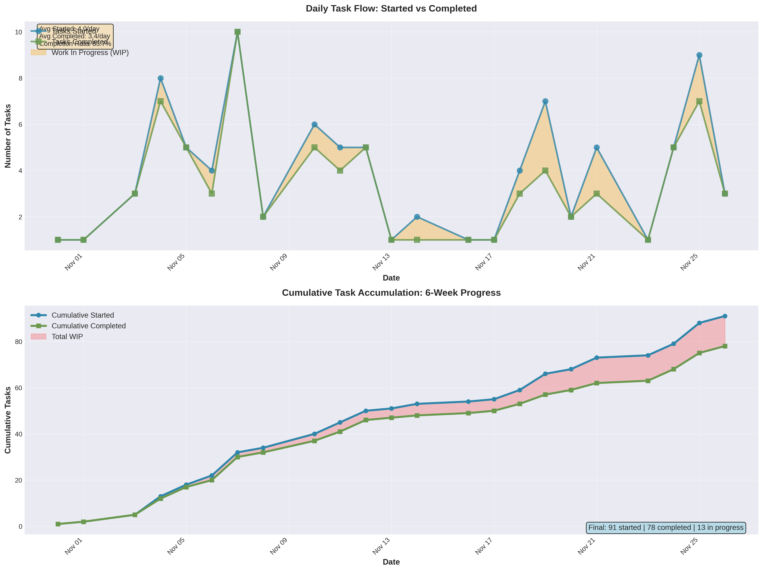
Task Completion: Sustained Performance Pattern

Slide 24
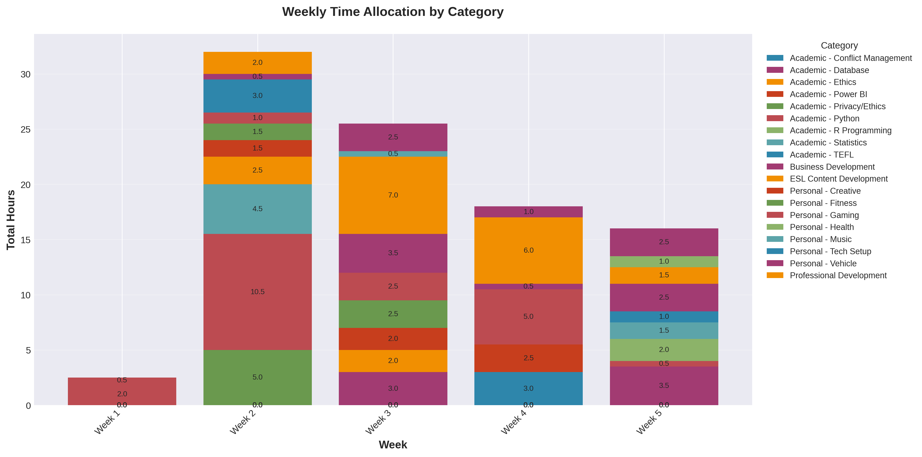
Weekly Performance Distribution

Slide 25
Measured Outcomes: Baseline Performance
Performance Metrics (6 Weeks):
Skill Development:
✓ 94 hours documented work ✓ 57 work sessions measured ✓ 78 tasks completed (85.7% completion rate) ✓ 8.3/10 avg output quality ✓ 5.9/10 avg energy (objective) ✓ 0.6 tasks WIP per day
• Python/Data Analysis: 20.5 hrs → 8.7/10 quality • Database Management: 6.5 hrs → 8.0/10 quality • Business Intelligence: 4.5 hrs → 8.0/10 quality • Data Privacy/Ethics: 7.5 hrs → 9.3/10 quality
Capacity Distribution:
• Morning: 7.9/10 focus capacity (complex work) • Evening: 7.5/10 volume capacity (simple tasks)

Slide 26
Conclusions & Recommendations
1. Cognitive Capacity Varies by Time
3. Task Completion Discipline
• Morning: 7.9/10 focus capacity (124% productivity advantage) • Evening: 7.5/10 volume capacity (best for high-throughput work) Recommendation: Match task complexity to capacity profile
• Low WIP (0.6 tasks/day) correlates with 85.7% completion Recommendation: Limit concurrent tasks, focus on closure
4. Work Variety Prevents Fatigue
2. Objective Energy Validates Design
• Task rotation maintains performance • Strategic 20-minute intervals support sustained output Recommendation: Build alternation and rest into schedule
• Energy = (Quality × Complexity) ÷ 10 • Captures cognitive deployment, not subjective feeling Recommendation: Use formula to evaluate schedule effectiveness
Next Step: Implement optimized schedule and measure 13.1% improvement

Slide 27
Progressive Checkpoints: Data-Driven Adjustments
Checkpoint
Morning Hours
Key Metrics
Observation & Action
Week 2 (Nov 1-14)
21.5 hrs (39.1%)
Quality: 8.2 Completion: 92%
Pattern emerging: Morning shows highest energy (8.2) vs evening (3.5) Action: Schedule more Python/Database work in morning slots
Week 4 (Nov 1-21)
35.0 hrs (37.2%)
Quality: 8.2 Completion: 86%
Pattern confirmed: Morning optimal for complexity 9-10 tasks Action: Maintain morning priority for analytical work
Week 6 (Nov 1-26)
35.0 hrs (37.2%)
Quality: 8.2 Completion: 86%
Validated: 124% productivity advantage in morning for complex work Next Phase: Increase to 45+ morning hours per 6-week cycle
Key Insight: Progressive tracking revealed consistent morning advantage. Evening completes more tasks (38 vs 20) but morning delivers higher cognitive value (complexity 9.3 vs 4.8). Data validates capacity-task matching strategy.

Slide 28
Trends & Optimization Strategy
Metrics Progression
Optimization Roadmap
Morning Allocation:
Phase 1 (Weeks 7-8):
• Week 2: 21.5 hrs (39%) • Week 4: 35.0 hrs (37%) • Week 6: 35.0 hrs (37%)
Increase morning to 40 hours Target: +5 hours complex work Monitor: Quality & completion
Quality Consistency:
Phase 2 (Weeks 9-10):
• Week 2: 8.18/10 • Week 4: 8.19/10 • Week 6: 8.19/10 (Stable high quality maintained)
Increase morning to 45 hours Reserve evening for volume tasks Validate: Productivity gain ≥10%
Completion Rate:
Phase 3 (Weeks 11-12):
• Week 2: 92.2% • Week 4: 85.7% • Week 6: 85.7% (Normalized as workload increased)
Stabilize at optimal allocation Measure 13.1% improvement Document refined schedule
Expected Outcome: By shifting 15 hours of complex analytical work to morning peak capacity periods, overall productivity should increase from 0.548 to 0.620 per hour. This represents a measurable 13.1% efficiency gain while maintaining quality standards and completion rates.

