Slide 1
Definitions
Observer(s)
Radiologist(s)
AI algorithm
Task
Detecting cancers/lesions in medical cases
Performance
A number quantifying how good the observer is at detecting lesions

Slide 2
Tasks
Non search
Known lesion location
or
Location known or implicit
Search
Unknown lesion(s) location(s), observer needs to find lesion(s)

Slide 3
Two types of observer performance studies
ROC (Receiver operating characteristic)
non-search tasks
FROC (Free-response ROC)
search tasks

Slide 4
ROC studies
Case and image are used interchangeably
Observer shown non-diseased and diseased cases one at a time
Decisions: classify each case as non-diseased (D = 1) or diseased (D = 2)
Actually non-diseased: Truth = 1
Actually diseased: Truth = 2

Slide 5
FOM
Decisions + Truth → FOM
FOM
Figure of merit
Performance measure
Number between 0 and 1

Slide 6
FOM examples
FOM = 1 if every case is classified correctly
Every diseased cases is classified as diseased and every non-diseased case is classified as non-diseased
i.e., every case is classified correctly
FOM = 0 if every case is classified incorrectly

Slide 7
Question
What does FOM = 0.5 mean?

Slide 8
Question?
What does FOM = 0.5 mean?
Every diseased cases is classified at random
FOM = classification accuracy

Slide 9
ROC studies
Truth = 0 or 1
0 for non-diseased
1 for diseased
Decisions + Truth → FOM
FOM
Figure of merit
Performance measure

Slide 10
Truth and Decision
Truth T, true disease state status of case
1 for non-diseased case
2 for diseased case
Decision D, interpretation of case
D = 1, case interpreted as non-diseased
D = 2, case interpreted as diseased

Slide 11
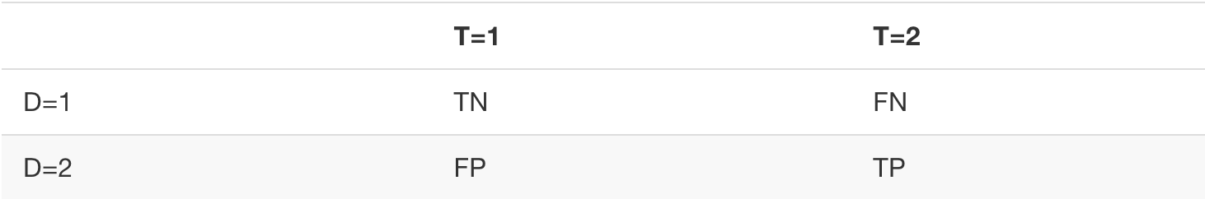
Events: TP, FP, etc.
TN = True Negative
FN = False Negative (“miss”)
FP = False Positive
TP = True Positive (“hit”)
2 x 2 Table:

Slide 12
Sensitivity and Specificity
P(x|y) = probability of event x given y
True positive fraction (TPF)
TPF = P(D = 2|T = 2) = Sensitivity
False positive fraction (FPF)
FPF = P(D = 2|T = 1) = 1 – Specificity
Specificity = P(D = 1|T = 1)

Slide 13
Estimating TPF, FPF
# D = 2 means number of diseased decisions
# T = 2 means number of diseased cases
TPF = (# D = 2) / (# T = 2)
FPF = (# D = 2) / (# T = 1)

Slide 14
ROC curve
Plot of TPF vs. FPF
Since 0 <= TPF <= 1 and 0 <= FPF <= 1, the ROC curve is contained within the unit square

Slide 15
Obtaining an ROC curve
Ratings method
Observer rates each case for confidence that it is diseased, e.g.:
1 = very confident non-diseased
2 = somewhat confident non-diseased
3 = ambiguous
4 = somewhat confident diseased
5 = very confident diseased
Cumulate the numbers and divide by appropriate denominator to get operating points on ROC

Slide 16
Example
 | Total | Bin counts
 |  | 1 | 2 | 3 | 4 | 5
Non-dis | 60 | 13 | 19 | 8 | 2 | 1
Dis | 50 | 5 | 6 | 5 | 12 | 22
ROC |  | Operating points
 |  | ≥5 | ≥4 | ≥3 | ≥2 | ≥1
FPF |  | 0.017 | 0.050 | 0.183 | 0.500 | 1.000
TPF |  | 0.440 | 0.680 | 0.780 | 0.900 | 1.000
1/60 = 0.017; 3/60 = 0.05; etc
22/50 = 0.44; 34/50 = 0.68; etc

Slide 17
An operating point
2+3+4+5
3+4+5
4+5
5

Slide 18
ROC curve
AUC = area under ROC curve
Classification accuracy between non-diseased and diseased cases
0 <= AUC <= 1
AUC = 0: “worst” performance
AUC = 0.5: random performance
AUC = 1: best performance

Slide 19
Empirical vs. analytical AUC
Empirical AUC
Connect adjacent points with straight lines
Compute trapezoidal area under curve
Analytical AUC
Fit the ratings data to a model of the ROC data
Compute AUC under predicted ROC curve

Slide 20
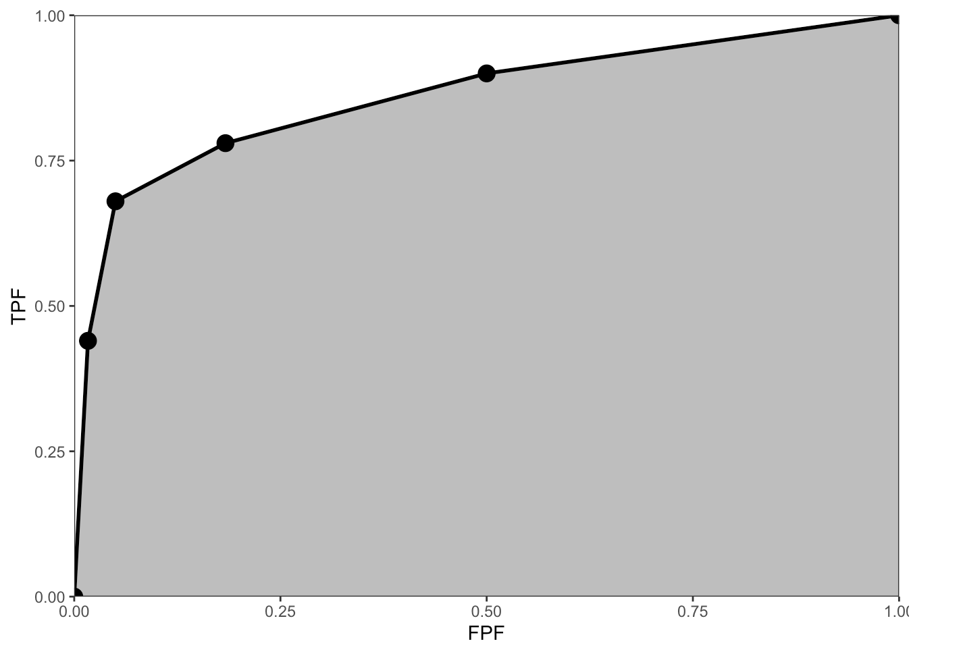
Empirical AUC

Slide 21
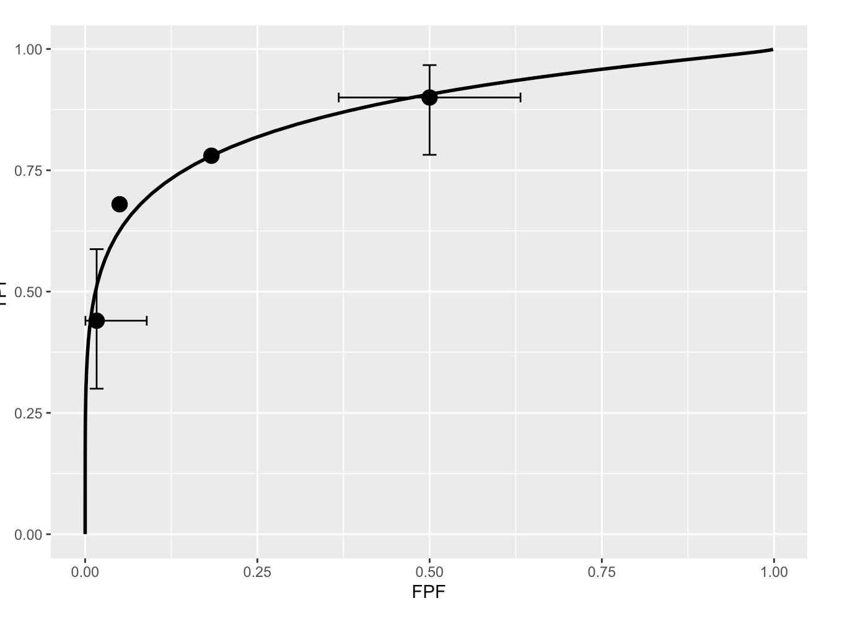
Analytical AUC

Slide 22
Comments
The modern trend is to use empirical AUC
Theorem: empirical AUC = Wilcoxon statistic W
W is probability that a diseased case is rated higher than a non-diseased case
Analytical AUC does not have such a simple interpretation , but yields other insights

Slide 23
Moving along the ROC
Action level ζ
cases with confidence levels above ζ are called +ve and rest are called -ve
Thus ζ defines an operating point
As ζ is lowered from +∞ operating point moves up curve starting from (0,0) and approaches (1,1) as ζ approaches -∞

Slide 24
High z
Low z
2+3+4+5
3+4+5
4+5
5

Slide 25
AUC ....
AUC is action-level independent!
AUC increases
Abn. imgs assigned high ratings (6)
Nor. imgs assigned low ratings (1)
AUC = classification accuracy
E.g.,
if all abn. imgs. rated ≥3 and all nor. imgs. rated <3, then AUC = 1

Slide 26
Comparing 2 modalities
Determine AUC for each modality & each observer
Statistical analysis
determines significance of the reader-averaged observed difference in AUC between modalities ΔAUC_{obs}
Significance ≡ p-value
I will not bore you with details
Software: DBM-MRMC, U of Chicago, U of Iowa

Slide 27
The p-value
Prob. ΔAUC_{obs}, or larger, could occur by chance given ΔAUC_{true} is 0
Probability is infinitesimal that random sample is exactly equal to ΔAUC_{obs}; hence "or larger“
If p ≤ α (usually α = 5%) conclude
AUCs are different at α-significance level
Sign (+-) of ΔAUC_{obs} determines which modality has higher AUC

Slide 28
Choice of α
Convention: α = 0.05
If cost of finding a non-existent modality difference is high, choose smaller α, e.g., α = 0.01
E.g., new modality is much more expensive
Scientific honesty: a is chosen before study is conducted

Slide 29
Outcome of a ROC study
Binary outcome
Significant (p ≤ α ) or not significant (p > α ) difference
If p > α
Cannot claim modalities have “identical or similar” performance, or
Study “approached” significance (e.g., p = 0.055)
If ΔAUC_{obs} and clinical considerations warrant it, perform a larger study (sample size)

Slide 30
ROC is a non-search paradigm
Binary task: case is called -ve or +ve
Applicable to tasks involving diffuse lesions, e.g., pulmonary fibrosis
Search tasks such as finding lung nodules involve not only detecting presence of nodules (binary task) but also pointing to correct locations of nodules
Not analyzing location information can lead to “faulty scoring”, e.g., giving credit when credit is not due and vice-versa

Slide 31
An example of faulty scoring
Observer may miss a lesion and instead find a highly suspicious false lesion
The overall high rating was likely influenced by the false lesion
The ROC figure of merit rewards this type of decision, i.e., AUC increases
Bunch et al 1978 quote several other examples

Slide 32
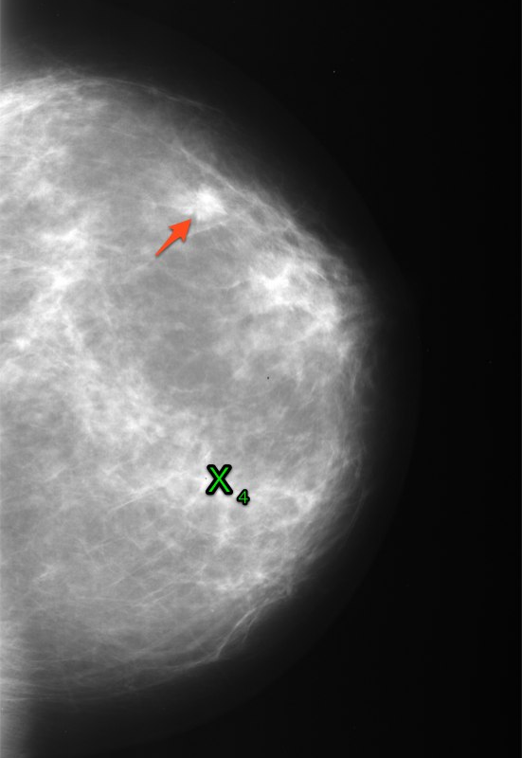
Right for wrong reason can have serious consequences
Missed lesion (arrow) and false positive rated 4 (cross)
Missed lesion grows
Biopsy performed at wrong location

Slide 33
Another example
True target missed
Civilian position “taken out”
Collateral damage

Slide 34
Consequence of not using location information
More difficult to detect a modality improvement (lower statistical power)
Missing a cancer is bad BUT ....
Missing a modality that is better at detecting cancers, which would have benefited thousands of women, is much worse
Algorithm designer may discard a “good idea”, etc.

Slide 35
Search performance
Ubiquitous task in daily life
Cancer in the breast
Face in crowd
Contraband in luggage, etc.
To improve search performance one needs a figure of merit for search
Common methods, e.g., detection rate, do not account for action level z effect

Slide 36
The FROC (free-response ROC) paradigm
Observer searches cases for lesions
Finds regions that are suspicious for presence of lesions
Sufficiently suspicious regions are marked and rated
Rating = degree of suspicion (e.g., 1, 2, ..., 5)
Data consists of n mark-rating pairs per case
n is a non-negative random integer, that depends on case, observer, task, imaging system, etc.

Slide 37
Example of an FROC interpretation
One mark rated 4
In screening mammography 90% of cases have 0 marks
Incidence of breast cancer is low (~ 0.005)

Slide 38
True and false target localizations
If mark is close to a real target → lesion localization, LL
Other marks → non-lesion localizations, NL
Missed lesions (“FN”) are known
True negatives (“TN”) are unknown
This is why FROC analysis has been so elusive

Slide 39
Unobservable “TN”
“FN”
4
4
NL rated 1
1
LL rated 5
True Lesion

Slide 40
Figure of merit for search performance
Visually summarizing search performance: FROC, AFROC and ROC curves

Slide 41
FROC curve, 1986
LLF = # LL / # lesions
NLF = # NL / # cases
FROC curve is plot of LLF vs. NLF
Following examples are for 50 normal cases and 50 abnormal cases containing 98 lesions
Data was simulated and binned to maintain at least 5 counts in each bin

Slide 42
Example
 | TOT. | Bin counts
IMGS | 100 | 1 | 2 | 3 | 4 | 5 | 6
NL | ?? | 9 | 16 | 20 | 5 | 13 | 8
LL | 98 | 5 | 5 | 6 | 5 | 5 | 24
ROC |  | Operating points
 |  | ≥6 | ≥5 | ≥4 | ≥3 | ≥2 | ≥1
NLF |  | 0.08 | 0.21 | 0.26 | 0.46 | 0.62 | 0.71
LLF |  | 0.245 | 0.296 | 0.347 | 0.408 | 0.459 | 0.510
8/100 = 0.08; 21/100 = 0.21; etc
24/98 = 0.245; 29/98 = 0.296; etc

Slide 43
An FROC curve
Cannot define an action-level independent FOM
AUFCγ = area under FROC curve to left of NLF = γ is used by some
But γ is arbitrary and there are other problems

Slide 44
AFROC curve, 1990
Alternative FROC
FPF = # FP / # normal cases
AFROC curve is plot of LLF vs. FPF
Hybrid curve
y-axis same as FROC
x-axis same as ROC

Slide 45
How does one get FPF?
ROC data can be inferred from FROC data
Cannot go the other way
Highest rating assumption
ROC rating = rating of highest rated mark on case
FP rating = that of most suspicious NL on normal case
TP rating = that of most suspicious NL or LL, whichever is higher, on abnormal case

Slide 46
Example
 | Total | Bin counts
 |  | “0” | 1 | 2 | 3
FP | 50 | 32 | 5 | 7 | 6
LL | 98 | 48 | 10 | 6 | 34
AFROC |  | Operating points
 |  | ≥3 | ≥2 | ≥1 | ≥”0”
NLF |  | 0.12 | 0.26 | 0.36 | 1.0
LLF |  | 0.347 | 0.408 | 0.510 | 1.0
6/50 = 0.12; 13/50 = 0.26; etc
34/98 = 0.347; 40/98 = 0.408; etc

Slide 47
An AFROC curve
Area θ under AFROC is an action-level independent FOM
Dotted line ... later

Slide 48
ROC curve
FPF = # FP / # normal cases
TPF = # TP / # abnormal cases

Slide 49
Example
 | Total | Ratings data
 |  | “0” | 1 | 2 | 3
FP | 50 | 32 | 5 | 7 | 6
TP | 50 | 61 | 7 | 5 | 25
ROC |  | Operating points
 |  | ≥3 | ≥2 | ≥1 | ≥”0”
FPF |  | 0.12 | 0.26 | 0.36 | 1.0
TPF |  | 0.50 | 0.60 | 0.74 | 1.0
6/50 = 0.12; 13/50 = 0.26; etc
25/50 = 0.50; 30/50 = 0.60; etc

Slide 50
An ROC curve

Slide 51
Why does ROC curve does not extend continuously to (1,1)?
Reporting an case
assigning an ROC rating > 1 (1 is definitely normal)
OR
marking the case (a mark corresponds to a suspicious region)
Finite number of cases (set A) with nothing to report (~90% in mammography)
Remaining cases (set B) have something to report
As action level ζ is lowered, more and more cases in set B get reported until one runs out of cases

Slide 52
Why does ROC curve not ...
cases in set A are never reported, unless
Observer adopts guessing mechanism when there is nothing to report
highly unlikely as mammographers do not guess
The investigator assigns the default ROC “0” rating to these cases
in a true ROC study they would have been rated “1”
When “0s” are cumulated the non-informative (1,1) point is discontinuously reached via a jump

Slide 53
Quantifying search performance: JAFROC

Slide 54
JAFROC: on my website
Jackknife AFROC
FOM = area under AFROC curve (θ)
θ = 0% : worst performance
θ = 100%: perfect performance
θ < AUC; as LL is subset of TP
Δθ > Δ(AUC); as θ has a larger range
FROC has greater modality discrimination ability
i.e., greater statistical power

Slide 55
JAFROC ...
Analogous to ROC software DBM-MRMC, except it applies to FROC (and ROC) data
ROC data is a special case of FROC data
Yields p-value, ...

Slide 56
Modeling search
2-stage model (Rock, Wolfe, Kundel and Nodine, etc.)
Global-response stage (~100 ms per case)
Observer identifies suspicious regions: noise sites, signal sites
Decision-making stage (~1 s per site)
Observer calculates decision variable (confidence level) z
Region is marked if z > action level ζ
Rating is the bin-index of z

Slide 57
Analogy to computer aided detection (CAD) algorithms
CAD algorithms use a 2-stage process to find lesions
Global response → "initial detections"
Decision-making → "candidate analysis“
Wasteful to give equal attention units to all parts of the case, and
Performance suffers from indiscriminate “exhaustive” search

Slide 58
Search model parameterization
μ
λ
ν
z
Noise site samples
Signal site samples
ζ
s = # of lesions
n = n₁ + n₂

Slide 59
Meaning of SM parameters
λ = mean number of noise sites per case
ν = probability (≤1) that a lesion is a signal site (“found”)
μ = ability of observer to discriminate between signal and noise sites
Performance increases for large μ, small λ and large ν

Slide 60
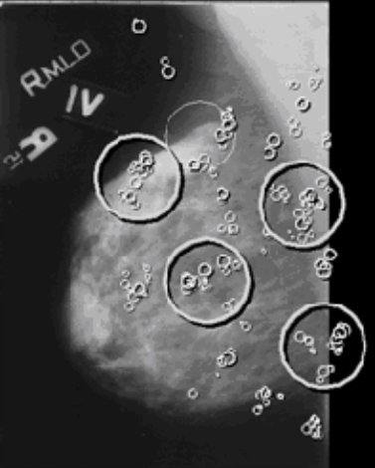
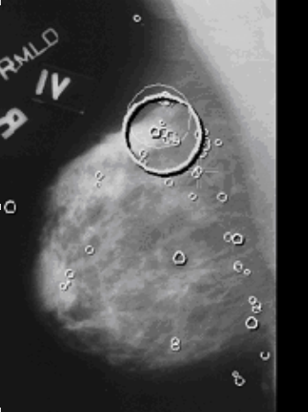
Expert
Noise site
Lesion
Lesion
Signal site
Naive

Slide 61
Applications: Identifying the weak link
If λ is large train with normal-rich cases
Help observer/CAD reject (from stage-2 analysis) normal variants that look like lesions
If ν is small train with abnormal-rich cases
Help observer find lesions
If μ is small train with abnormal-rich cases, with locations of true lesions and false lesions (for experts) shown
Help observer recognize features that distinguish true lesions from false lesions

Slide 62
Suggestion for CAD developers
Problem: λ is usually larger than for experts
Regard suspicious regions found by experts as “pseudo-lesions”
Train CAD to find pseudo-lesions while not finding other regions that experts rejected; this should decrease λ
Since the pseudo-lesions fooled experts, finding them may also improve ν
Since normal cases are easy to acquire, CAD can be trained on a large data set
Pseudo-lesion locations obtained by asking the experts for locations of other suspicious regions they considered in their interpretation of the case

Slide 63
Suggestion ...
Improve μ by optimizing classifier performance between true lesions and the pseudo-lesions
Currently CAD developers optimize classifier performance between true lesions and false lesions found by CAD (not those found by experts)
Pseudo-lesions are more like lesions than other regions, so this type of optimization is expected to be better

Slide 64
Estimation of SM parameters

Slide 65
2-step ML procedure
Likelihood function L (μ, λ, ν, FROC data)
For values of all other parameters determine μ to minimize goodness-of-fit statistic G
Effectively reduces the number of parameters to two: l and n
While (not converged) {
Determine μ to minimize G
Vary l and n and cutoffs z_{i}
} until L is maximized

Slide 66
DM = digital mammography BT = breast tomosynthesis

Slide 68
Evidence for search model
SM is not concerned with how one gets to noise and signal sites (domain of CAD)
SM makes parametric assumptions which makes math more tractable, but these could be relaxed
Direct evidence is from eye-tracking data on radiologists
Kundel and Nodine, Krupinski, ...

Slide 69
Evidence...
SM ROC curves are proper (never cross the chance diagonal)
Inaccessible dotted portion on ROC is consistent with clinical data
Difficult to get radiologists to move sufficiently “up” the curve
Consequence of small λ (~ 1 for experts, i.e., roughly 37% of cases have no noise sites)

Slide 70
Evidence...
Binormal model (Dorfman and Alf)
abnormal case pdf is wider than normal case pdf (b < 1)
In SM the noise and signal site pdfs are unit variance, but since TP rating could be from either distribution, the effective width of TP pdf increases
Also due to multiple noise site samples, width of FP pdf decreases
With appropriate choice of parameters SM behaves like other ROC models

Slide 71
DEMO

Slide 72
Recent work
Incorporating correlations into search model: intra-case, inter-modality, etc.
Fairly sophisticated FROC simulator

Slide 73
Needed extensions of search model
Satisfaction of search (SOS)
Observer finds a lesion but does not find other lesions
Premature termination of search on lesion-rich cases
Possible explanations:
A: ν is smaller on lesion-rich cases
B: ζ is higher on lesion-rich cases

Slide 74
Needed extensions ...
Fewer NLs on abnormal cases
Possible explanations:
A: λ is smaller on abnormal cases
B: ζ is higher on lesion-rich cases

Slide 75
Needed extensions ...
Vigilance: missing rare lesions (Wolfe, Science)
Possible explanations:
A: ν decreases with decreasing abnormal case prevalence, approaching 0 as prevalence approaches 0
B: ζ increases as prevalence approaches 0

Slide 76
Avenues for research
These hypotheses can be tested
Simultaneous eye-tracking and FROC data
Eye-tracking tells us where they looked
FROC tells us the decisions they made
Integrated analysis of eye-tracking and FROC data could yield insight

Slide 77
Conclusions
Understanding search is crucial to vision science and its practical applications
Widely researched field
SM comes at it from a different angle by relating it to FROC paradigm
Commonly held beliefs in non-visual science community, e.g., exhaustive search, not supported by evidence

Slide 78
Conclusions ...
Modern tools available for FROC analysis and parameter estimation
Higher statistical power
Greater relevance to search tasks

Slide 81
Comparing 2 modalities
Diagnostic task
Mammography, chest, etc.
ROC
Data acquisition paradigm
2 or more modalities, radiologists, cases
Ratings data
FROC
LROC
ROI
ROC: AUC, others
Figure of merit
One value per reader per modality
FROC: JAFROC, others
LROC: PCL, others
ROI: AUC
Significance testing
p-value, 95% CI
Parametric or non-parametric
DBM-MRMC, OR, BWC, others

Slide 82
FROC figure of merit
In medical context: target = lesion
LLF = lesion localization fraction
LLF is fraction of correctly localized lesions
AFROC curve is plot of LLF vs. FPF
Area under AFROC is desired figure of merit
It is the probability that a lesion is rated higher than highest rated mark on a normal case

Slide 83
Why observer performance?
Fourier measurements (MTF, SNR, etc.) are useful for optimizing parts of imaging chain, e.g., detector
Display, case processing, observer (human or computer) skill, the task, etc., are not accounted for
Cannot identify the “weak-link”

Slide 84
Estimation of parameters
Expressions for ROC, FROC, AFROC curves and likelihood are available
E.g. for ROC (s is number of lesions)
MLE

Slide 85
Likelihood function
r is a ratings bin index
P (z_{r} < z < z_{r+1} | NOR) = FPF(z_{r}) - FPF(z_{r+1})
P (z_{r} < z < z_{r+1} | ABN) = TPF(z_{r}) - TPF(z_{r+1})

Slide 86
2-step ML procedure
2-step method
Starting with trial values of all parameters except μ
While (not converged) {
Determine μ to minimize chi-square statistic
Vary remaining parameters to maximize likelihood
} until likelihood is maximized

