Slide 1
Manage Virtual Machines with WebVirtMgr on openSUSE
October, 2nd 2016
Dendy Putra Delly
delly.dendy@gmail.com
https://web.telegram.org/#/im?p=@dpdelly

Slide 2
Agenda
Intro
About WebVirtMgr
Installation
Features
Demo
Conclusion

Slide 3
Hi,
Dendy Putra Delly
Member @ GLiBogor
Jr. System Administrator @ Pusilkom UI
New Student @ Universitas Mercu Buana
Dendy Putra Delly
Member @ GLiBogor
Jr. System Administrator @ Pusilkom UI
New Student @ Universitas Mercu Buana

Slide 4
Virtualization
Virtualization is a technology that provides a way for a machine (Host) to run another operating system (guest virtual machines) on top of the host operating system

Slide 5
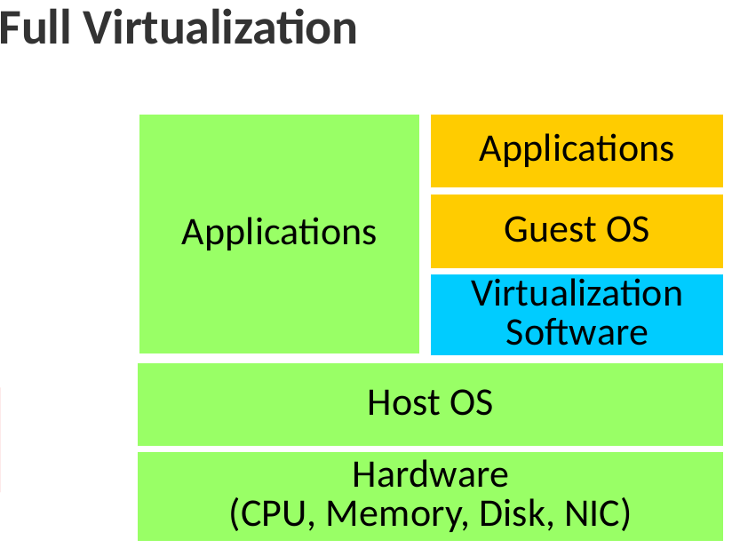

Slide 6
WebVirtMgr
WebVirtMgr is a libvirt-based Web interface for managing virtual machines. KVM is currently the only hypervisor supported.
WebVirtMgr created as a centralized tool for managing virtual machines through a web browser for personal use. This project is an alternative to virt-manager for the browser.

Slide 7
Project Owner
First Launch on 30 October 2011
Maxim Derzhak https://web.facebook.com/maxim.derzhak
Anatoliy Guskov
https://web.facebook.com/retspen
Current Version WebVirtMgr panel - v4.8.9

Slide 8
Installation
Setup Host:
https://github.com/retspen/webvirtmgr/wiki/Setup-Host-Server
Setup Web Panel Only:
https://github.com/retspen/webvirtmgr/wiki/Install-WebVirtMgr

Slide 9
KVM Hardware Requirements
egrep '(vmx|svm)' /proc/cpuinfo
vmx ” Intel VT-x, virtualization support enabled in BIOS.
Svm ” AMD SVM,virtualization enabled in BIOS.
If this command returns no output, your processor either does not support hardware virtualization, or this feature has been disabled in the BIOS or Firmware.

Slide 10
Authentication
Create Super User For Login in Web Interface
$ ./manage.py createsuperuser
Create Connection For Managing VM
$ saslpasswd2 -a libvirt username

Slide 11
Troubleshoots
Failed to intialize libnetcontrol. Management of interface devices is disabled
libvirtd.service start request repeated too quickly, refusing to start
KVM Virtualization is not possible when you run inside virtualbox.

Slide 12
Features
Host System
View CPU usage
View memory usage
Manage network pool
Manage storage pool
Manage VMs image
Cloning image VMs
Manage snapshots
View logs
Virtual machine
View CPU usage
View memory usage
Manage ISO images
Shutdown
Force shutdown
Installation
VNC access
Create snapshots

Slide 13
Let’s See How It’s Work:
1. Verification
2. Add Connection
3. Add Instance

Slide 14
Questions?

Slide 15
Conclusion
WebVirtMgr is a solution for you who want to manage your VM through browser and want to share your environment to one of your member in your team.
There’s a lot FOSS projects out there that need your help to make the projects better and could be used for everyone.
If you want to running this project in production environment, you should do some tests.

Slide 16
Support This Project
If you interesting with this project you can contribute directly:
support@webvirtmgr.net
http://github.com/retspen/webvirtmgr

Slide 17
References
https://www.webvirtmgr.net
https://doc.opensuse.org/documentation/leap/virtualization/book.virt_color_en.pdf

Slide 18
Join the conversation,
contribute & have a lot of fun!
www.opensuse.org
http://s.id/GLiB
https://www.facebook.com/groups/opensuse.indonesia/

Slide 19
License
This slide deck is licensed under the Creative Commons Attribution-ShareAlike 4.0 International license. It can be shared and adapted for any purpose (even commercially) as long as Attribution is given and any derivative work is distributed under the same license.
Details can be found at https://creativecommons.org/licenses/by-sa/4.0/
Credits
Template
Richard Brown
rbrown@opensuse.org
Design & Inspiration
openSUSE Design Team
http://opensuse.github.io/branding-guidelines/

