Slide 1


Institute for Advanced Computing and Software Development, Akurdi, Pune
Regression Analysis on Medicare Spends!
Presented By
Dhanashree Prakash Deore Roll No: -1511
Minal Arvindrao Yawale Roll No: - 1557
Mr. Prashant Karhale Mr. Akshay Tilekar
Center Coordinator (External Guide)

Slide 2
About Dataset
healthcare_census.csv (163,065 rows, 19 columns)
DRG_Definition : The Diagnosis related groups (DRGs) are a patient classification scheme which provides a means of relating the type of patients a hospital treats (i.e., its case mix) to the costs incurred by the hospital
Provider_Id : Id of Medicare insurance provider
Provider_Name : Name of Medicare insurance provider
Provider_Street_Address : Address of Medicare insurance provider
Provider_City : City of Medicare insurance provider
Provider_State : State of Medicare insurance provider
Provider_Zip_Code : Zip code of Medicare insurance provider
Hospital_Referral_Region_Description : Hospital Referral Region Description in which Medicare facility available
Total_Discharges : Total patients discharges from hospital
Average_Covered_Charges : Average Covered Charges from patients
Average Total Payments : Average Total Payments
Average Medicare Payments : medical costs billed by health insurance.
State : State of Insurance Provider
Insured_Males_18to25 : count of insured males between age 18-25.
Noninsured_Males_18to25 : count of non insured males between age 18-25
Females_18to25_with_Insurance : count of insured females between age 18-25
Females_18to25_without_insurance :count of non insured females between age 18-25

Slide 3
Introduction
Medical expenses are one of the major recurring expenses in our life. It’s a common knowledge that one life style and various physical parameters dictates diseases or ailments one can have and these ailments dictates medical expenses.
According to our dataset prospective payments system based on diagnosis related groups (DRGs) by many third party payers represents an important shift in hospital payment policy.
In this study, we aim to find a correlation between average medical expenses and different factors, and compare them.
Then we use the prominent attributes as predictors to predict medical expenses by creating regression models and comparing them.
Regression analysis refers to the method of studying the relationship between independent variable and dependent variable.

Slide 4
Aims & Objectives
The goal of this project is to use the trained models to predict Medicare charges. The training of the models will be done using a bunch of different Regressor ML models and after the training is done the Regressor ML models will be compared based on their R2 score and RMSE error and the best model will be selected which will then be used to make predictions.

Slide 5
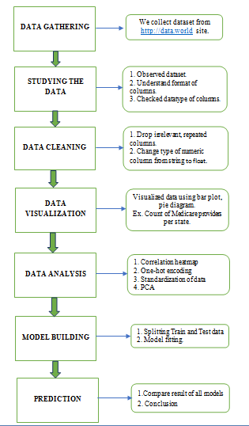
Workflow of Project

Slide 6
Regression Modeling
In our project we use total 5 Regression modelling algorithm listed as :
Linear Regression : It is used to estimate real values based on continuous variable(s).
Decision Tree Regressor : A decision tree falls under supervised Machine Learning Algorithms in Python and comes of use for both classification and regression- although mostly for classification. This model takes an instance, traverses the tree, and compares important features with a determined conditional statement.
Random Forest Regressor : A Random Forest is an ensemble technique capable of performing both regression and classification tasks with the use of multiple decision trees and a technique called Bootstrap and Aggregation, commonly known as bagging.
XGBOOST Regressor : XGBoost is an optimized distributed gradient boosting library designed to be highly efficient, flexible and portable. It implements machine learning algorithms under the Gradient Boosting framework.
KNeighbors Regressor : This is a Python Machine Learning algorithms for classification and regression- mostly for classification. This is a supervised learning algorithm that considers different centroids and uses a usually Euclidean function to compare distance.

Slide 7
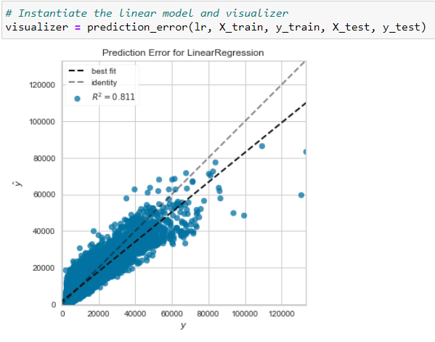
Linear Regression
Linear Regression model gives following result on training dataset
RMSE : 3183.04
MAE : 2121.06
R2 Score : 0.81
The above graph is giving prediction error for Linear Regression on training dataset. The identity line is far from best fit line and R2 score is 0.81 ,RMS Error is 3183.04.

Slide 8
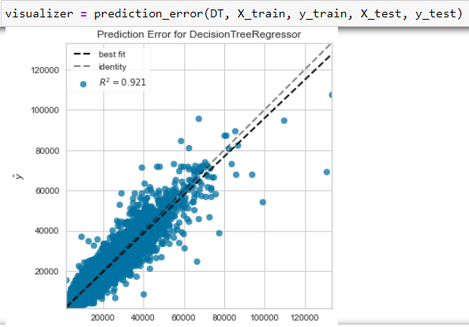
Decision Tree Regressor
Decision Tree Regressor gives following result on training dataset
RMSE : 2060.03
MAE : 1214.26
R2 Score : 0.92
The above graph is giving prediction error for Decision Tree Regressor on training dataset. The identity line is much closer to best fit line and R2 score is0.92, RMS Error is 2060.03. All these parameters makes this model good .

Slide 9
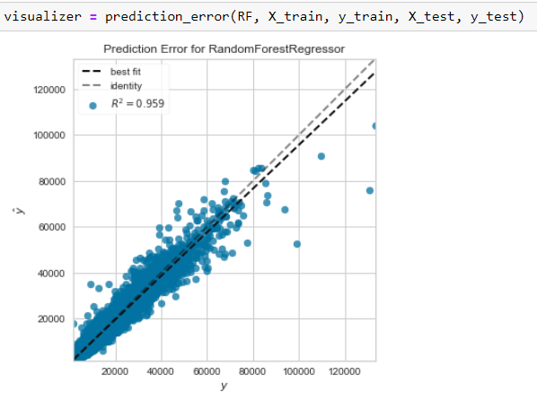
Random Forest Regressor
Random Forest Regressor gives following result on training dataset
RMSE : 1480.49
MAE :865.85
R2 Score :0.95
The above graph is giving prediction error for Random Forest Regressor on training dataset. The identity line is much closer to best fit line and R2 score is0.95, RMS Error is 1480.49. All these parameters makes this model good .

Slide 10
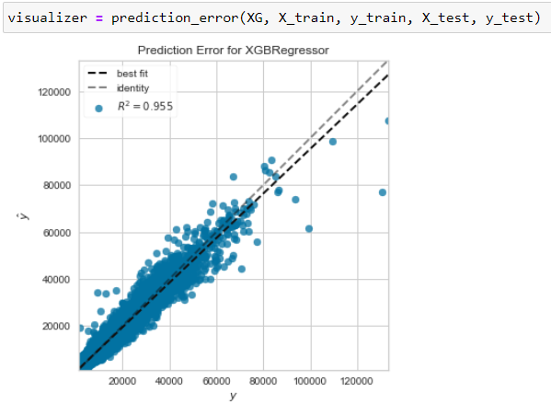
XGBOOST Regressor
XGBOOST Regressor gives following result on training dataset
RMSE : 1558.94
MAE :975.10
R2 Score :0.95
The above graph is giving prediction error for XGBOOST Regressor on training dataset. The identity line is much closer to best fit line and R2 score is0.95, RMS Error is 1558.94. All these parameters makes this model good .

Slide 11
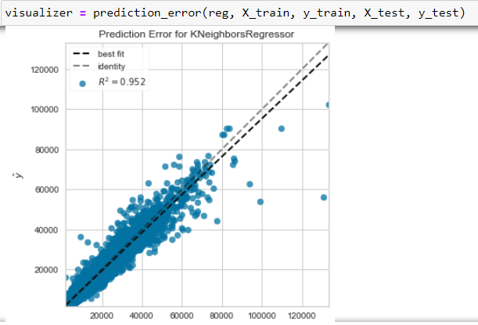
KNeighbors Regressor
KNeighbors Regressor gives following result on training dataset
RMSE : 1602.34
MAE :929.16
R2 Score :0.95
The above graph is giving prediction error for KNeighbors Regressor on training dataset. The identity line is much closer to best fit line and R2 score is0.95, RMS Error is 1602.34. All these parameters makes this model good .

Slide 12
R2 score and RMSE of all regression model
Regression Model | R2 | Adjusted R2 | RMSE
Linear Regression | 0.81 | 0.81 | 3183.04
Decision Tree Regressor | 1.0 | 0.92 | 2060.03
Random Forest Regressor | 0.95 | 0.99 | 1480.49
XGBoost Regressor | 0.95 | 0.96 | 1558.94
KNeighbors Regressor | 0.95 | 0.97 | 1602.34

Slide 13
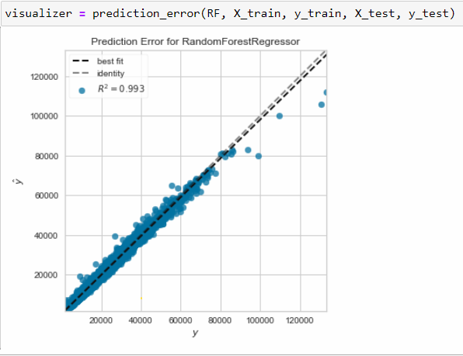
Model Testing:
RF model gives following result on testing dataset
R2 score : 0.993
RMS Error : 1545.85
MA Error : 932.15
The above graph is giving prediction error for Random Forest Regressor on test dataset. The identity line is closer to best fit line and R2 score is 0.99 ,RMS Error is 1545.85. All these parameters makes our model best fit.

Slide 14
Prediction
All applied regression model gives R2 score and Root Mean Square Error. From that we conclude, Random forest regression model is best fit model because,The R2 score is much more stable i.e. 0.95 and the RMSE is also less i.e. 1480.49 than others.

Slide 15
CONCLUSION
1. Linear Regression model:
R2 score: 0.81
RMSE:3183.04
2.Decision Tree Regression:
R2 score: 1
RMSE:2060.03
3.Random Forest Regression:
R2 score: 0.95
RMSE: 1480.49
4.XGboost Regression:
R2 score:0.95
RMSE: 1558.94
5.KNeighbors Regressor:
R2 score:0.95
RMSE: 1602.34
Above result shows RMSE and R2 score of all applied regression models. From that we can see most of models giving R2 score value above 0.95,which is stable. but its RMSE value is high. Hence, we conclude that, Random Forest regression is best fit to our dataset.

Slide 16
Future Scope
For this project we used historical data. In future we can use this model on real time dataset to predict Medicare spends.
Data set have no restrictions because new data gets added yearly into it.
In some countries Medicare Insurance is compulsory.
This model helps the people to plan their financial investments better way. Because it predicts appropriate cost of Medicare spend.

Slide 17
References
1. Linear regression model for predicting medical expenses based on insurance data, December 2019, [DOI: 10.13140/RG.2.2.32478.38722].
2. Regression Analysis of Health Insurance Cost Affecting Factors, 2013 International Conference on Advances in Social Science, Humanities, and Management (ASSHM 2013)
3. The research of regression model in machine learning field, MATEC Web of Conferences 176, 01033 (2018) https://doi.org/10.1051/matecconf/201817601033 IFID 2018
Health Management based on History of Personalized Physiological Data using Linear Regression Analysis, 2018, GLOBAL MEDICAL ENGINEERING PHYSICS EXCHANGES/PAN AMERICAN HEALTH CARE EXCHANGES (GMEPE / PAHCE)
Improving Healthcare Services of Community Clinics using Machine Learning Techniques, 2018 2nd Int. Conf. on Innovations in Science, Engineering and Technology (ICISET) 27-28 October 2018, Chittagong, Bangladesh

Slide 18
THANK YOU

