Slide 1
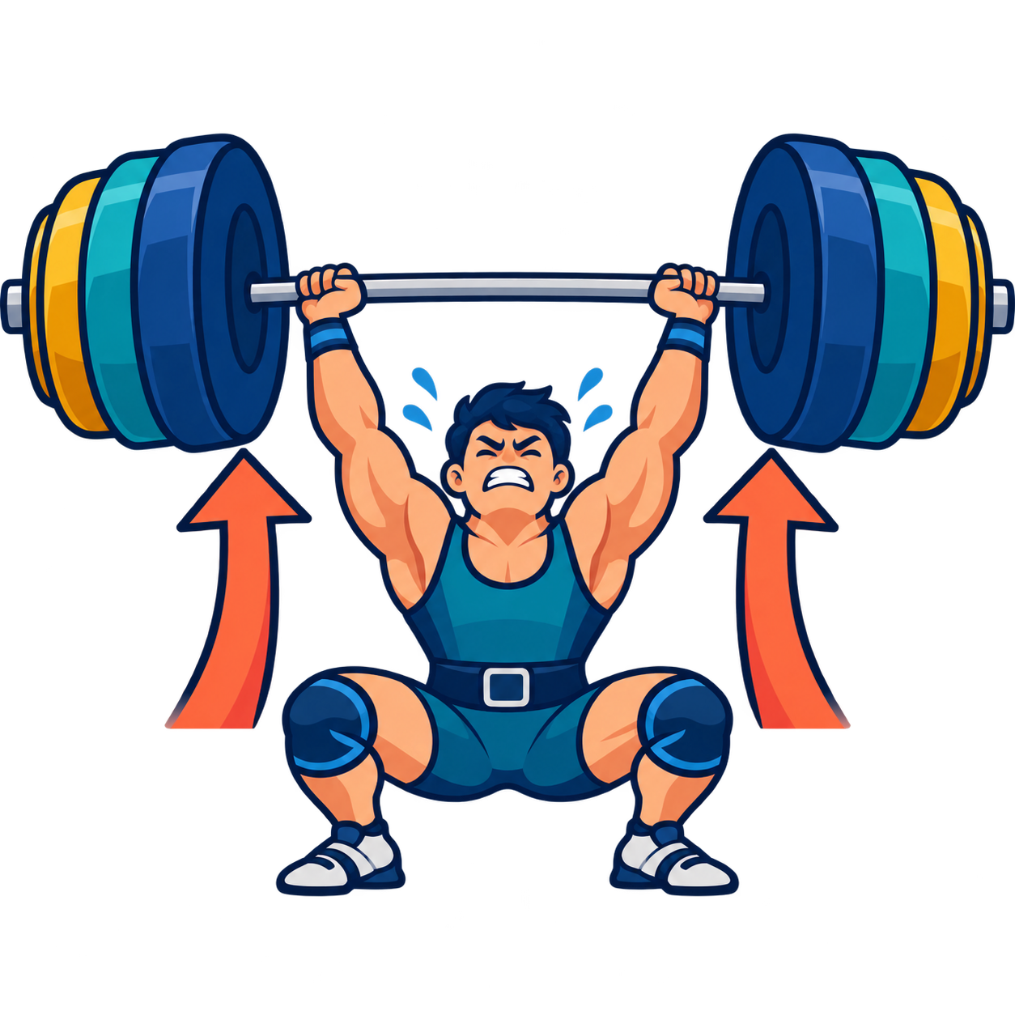


Dan Dewey · Brigham Young University
Pushed Output
Helping every learner talk
And pushing them
But not overwhelming them
Notes:
My first time in Mongolia
Glad to see you all and enjoy hearing your stories as teachers.
DIC organizers.
Hook: today is about one lever — getting language out of every learner, often, and pushed to be better each time. • Set up the two demos early: "you'll be my learners twice today."

Slide 2
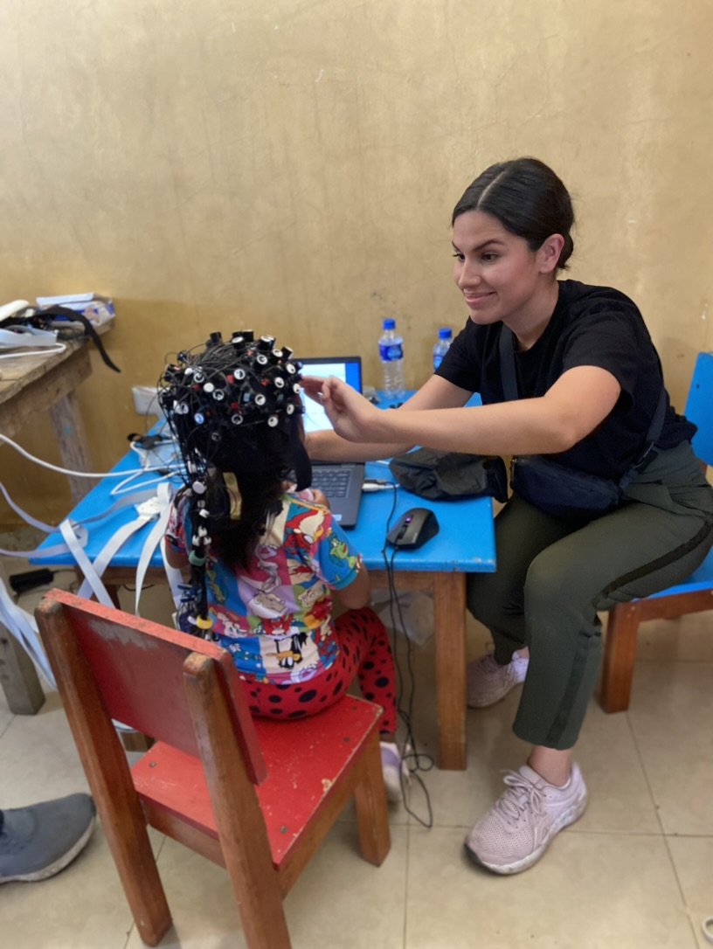
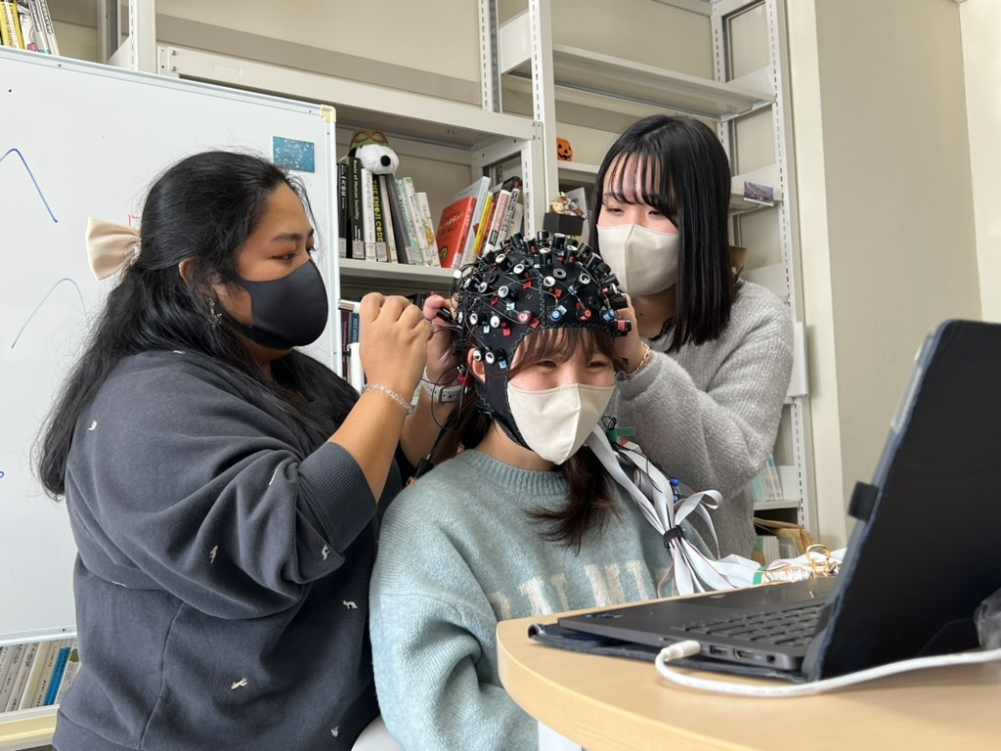
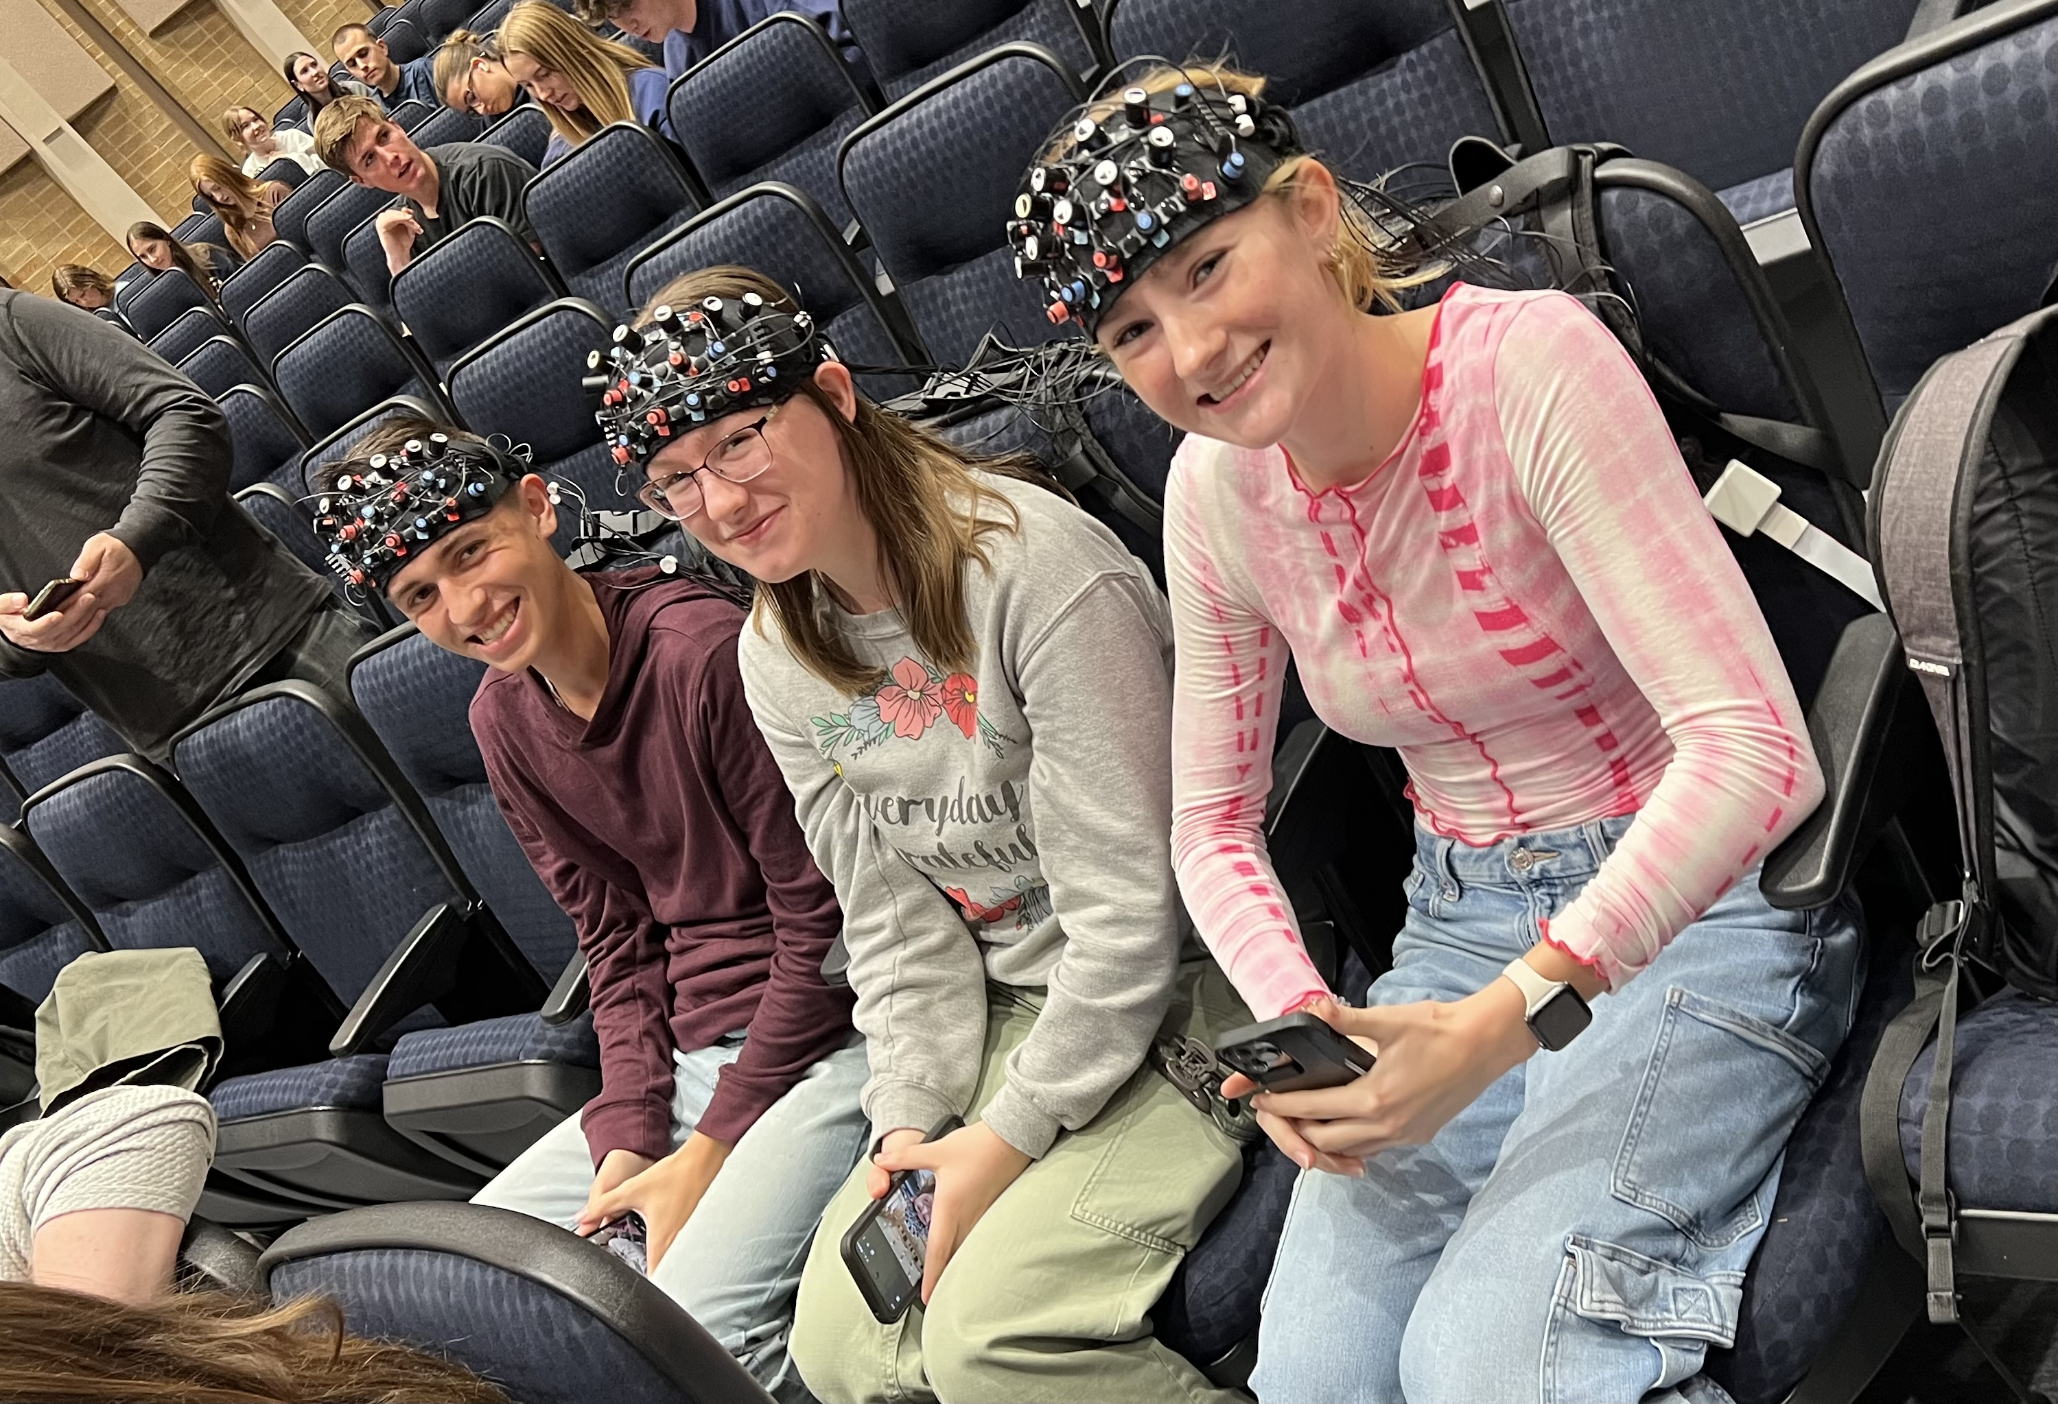

Slide 3
Question 1: How much do your students speak in class?
Question 2: What makes speaking difficult for them?
Question 3: Is it possible for students to speak for 45 minutes in a 60 minute class period?
Notes:
Evidence overview. Key sources: Swain (1985), The Output Hypothesis; Izumi (2003), Applied Linguistics, 24(2), 168-196, https://doi.org/10.1093/applin/24.2.168; DeKeyser & Sokalski (1996), Language Learning, 46(4), 613-642, https://doi.org/10.1111/j.1467-1770.1996.tb01354.x; Mackey (1999), Studies in Second Language Acquisition, 21(4), 557-587, https://doi.org/10.1017/S0272263199004027; Freed, Segalowitz, & Dewey (2004), Studies in Second Language Acquisition, 26(2), 275-301, https://doi.org/10.1017/S0272263104262064; Hanzawa (2024), Language Teaching Research, 28(3), 816-838, https://doi.org/10.1177/13621688211008693; Abdi Tabari, Zhuang, & Farahanynia (2025), System, 135, 103868, https://doi.org/10.1016/j.system.2025.103868.

Slide 4


Slide 5

Notes:
Evidence overview. Key sources: Swain (1985), The Output Hypothesis; Izumi (2003), Applied Linguistics, 24(2), 168-196, https://doi.org/10.1093/applin/24.2.168; DeKeyser & Sokalski (1996), Language Learning, 46(4), 613-642, https://doi.org/10.1111/j.1467-1770.1996.tb01354.x; Mackey (1999), Studies in Second Language Acquisition, 21(4), 557-587, https://doi.org/10.1017/S0272263199004027; Freed, Segalowitz, & Dewey (2004), Studies in Second Language Acquisition, 26(2), 275-301, https://doi.org/10.1017/S0272263104262064; Hanzawa (2024), Language Teaching Research, 28(3), 816-838, https://doi.org/10.1177/13621688211008693; Abdi Tabari, Zhuang, & Farahanynia (2025), System, 135, 103868, https://doi.org/10.1016/j.system.2025.103868.

Slide 6
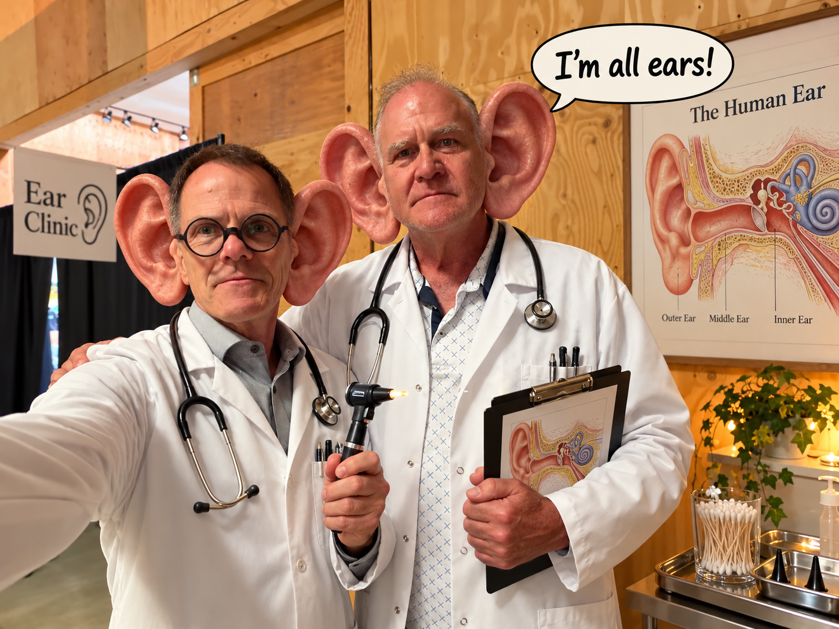

Slide 7
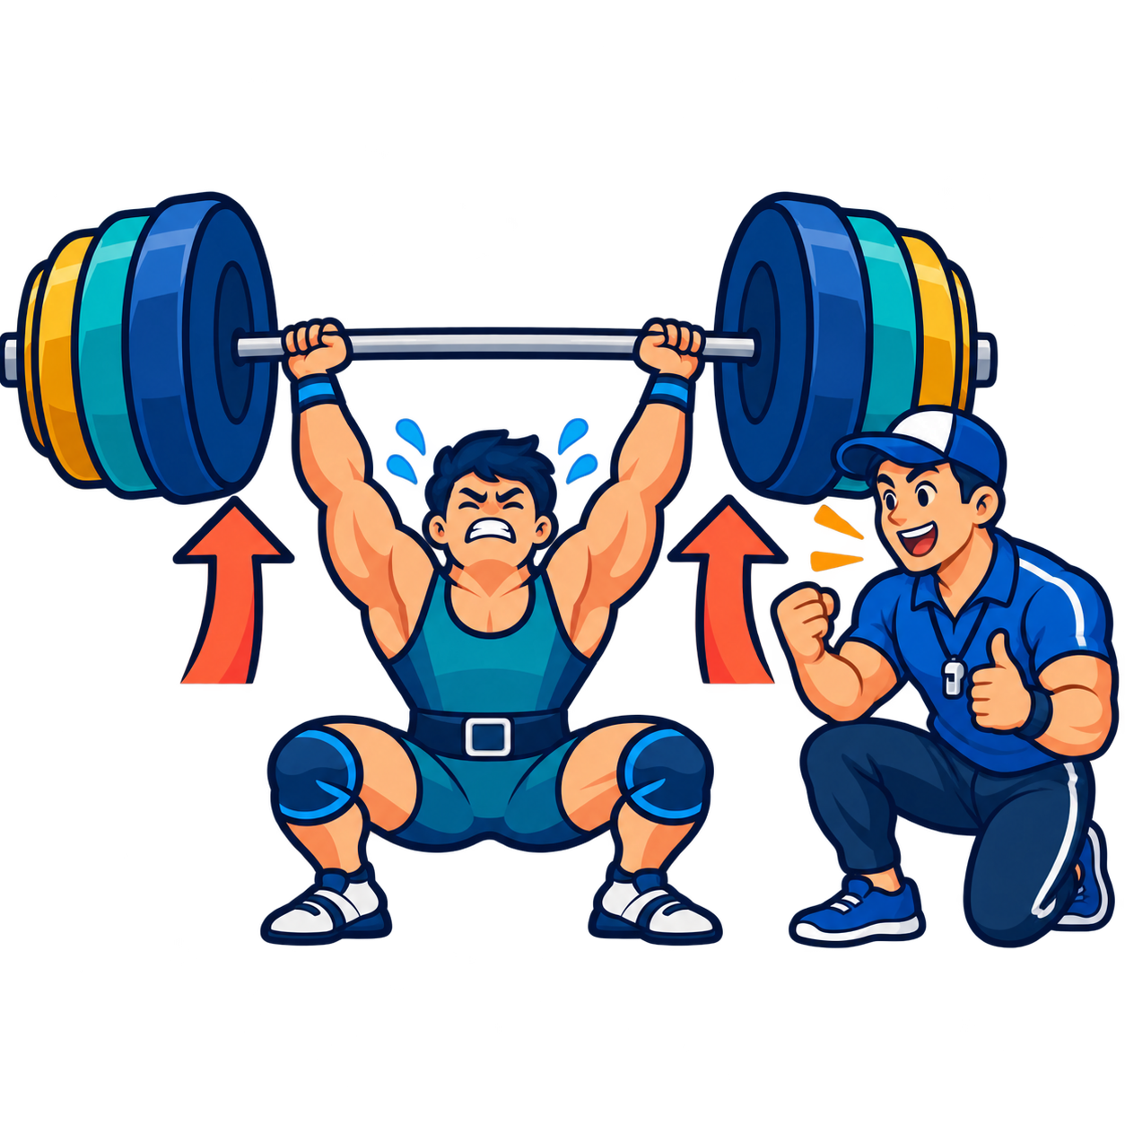
Repetitions (Reps)
Hard lifts-the push

Slide 8

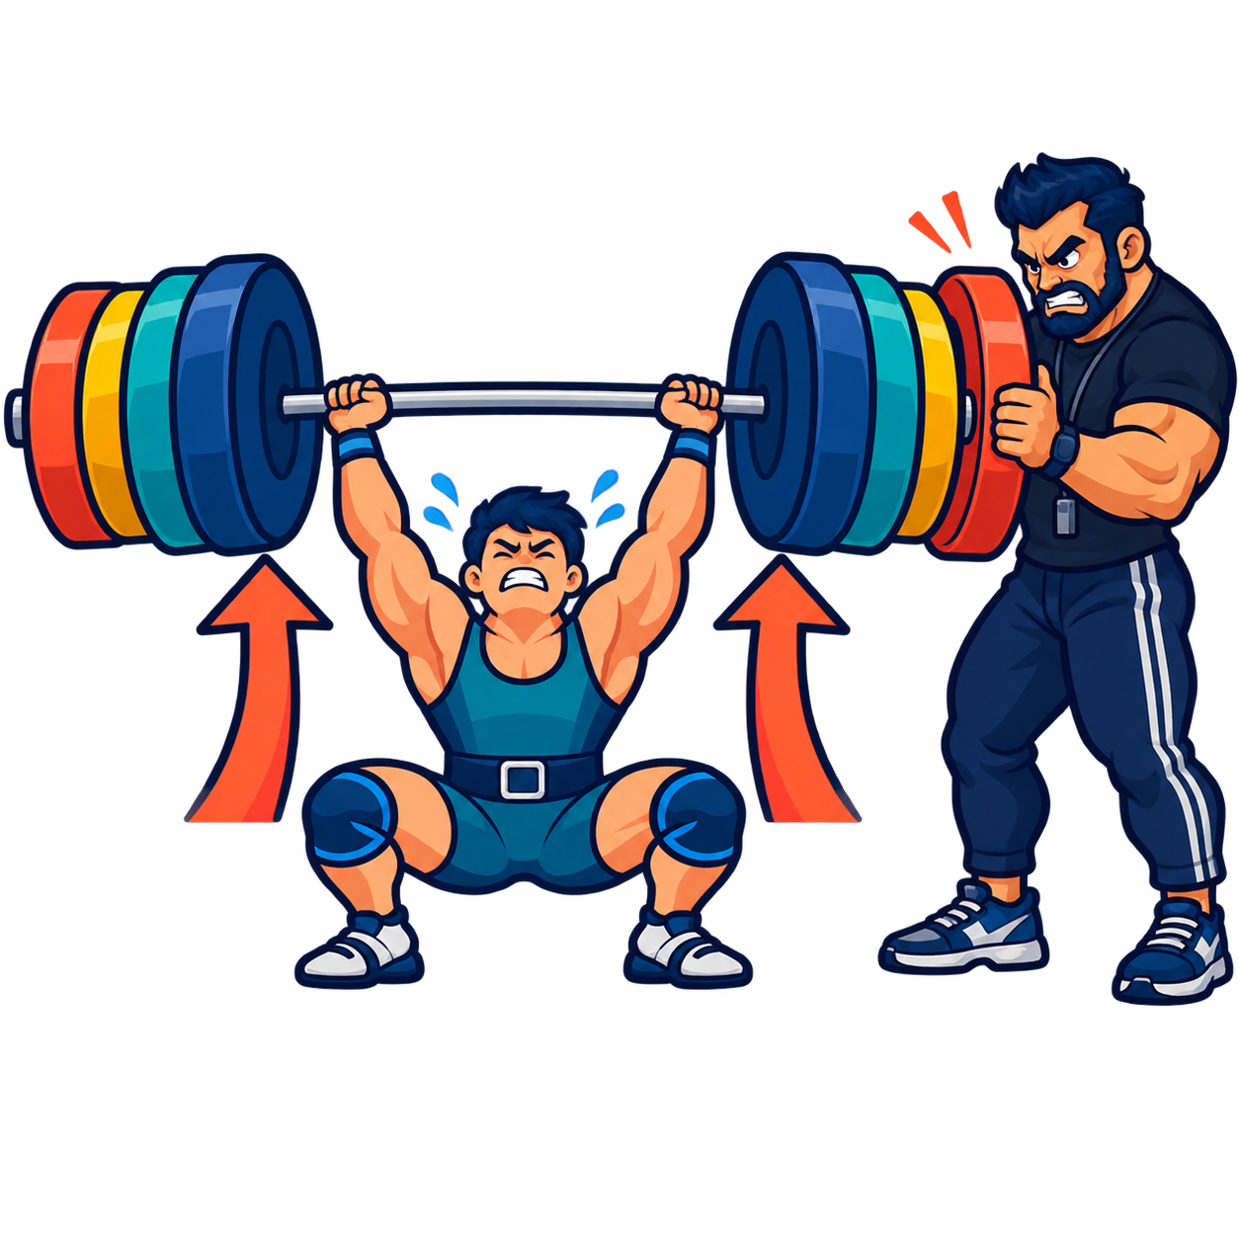

Slide 9
AN HONEST QUESTION
CLASSROOM TIME:
In your last class, how many seconds did your quietest student speak?
Өмнөх хичээлийн цагт танай ангийн хамгийн дуу цөөтэй сурагч хэдэн секунд ярьсан бэ?
Notes:
Let the question sit. Most teachers realise the honest answer is "almost none." • This is the problem the whole session solves: not whether students hear English, but whether they produce it.

Slide 10
AN HONEST QUESTION
Typically, the quietest student speaks little or not at all.
≈ 0
seconds of English
NOTHING
Notes:
Let the question sit. Most teachers realise the honest answer is "almost none." • This is the problem the whole session solves: not whether students hear English, but whether they produce it.

Slide 11

WHAT THE RESEARCH SAYS
Research shows that speaking leads to learning.
Listening alone is not enough.
01
02
REPEATED speaking practice leads to gains
Being pushed shows the gaps
Swain, 1985; Izumi, 2003; DeKeyser & Sokalski, 1996; Mackey, 1999; Freed, Segalowitz, & Dewey, 2004; Hanzawa, 2024; Abdi Tabari, Zhuang, & Farahanynia, 2025
Notes:
Evidence overview. Key sources: Swain (1985), The Output Hypothesis; Izumi (2003), Applied Linguistics, 24(2), 168-196, https://doi.org/10.1093/applin/24.2.168; DeKeyser & Sokalski (1996), Language Learning, 46(4), 613-642, https://doi.org/10.1111/j.1467-1770.1996.tb01354.x; Mackey (1999), Studies in Second Language Acquisition, 21(4), 557-587, https://doi.org/10.1017/S0272263199004027; Freed, Segalowitz, & Dewey (2004), Studies in Second Language Acquisition, 26(2), 275-301, https://doi.org/10.1017/S0272263104262064; Hanzawa (2024), Language Teaching Research, 28(3), 816-838, https://doi.org/10.1177/13621688211008693; Abdi Tabari, Zhuang, & Farahanynia (2025), System, 135, 103868, https://doi.org/10.1016/j.system.2025.103868.

Slide 12
WHAT THE RESEARCH SAYS
Student talk is considerably more effective than teacher talk.
Doing is better than hearing.
Swain, 1985; Izumi, 2003; DeKeyser & Sokalski, 1996; Mackey, 1999; Freed, Segalowitz, & Dewey, 2004; Hanzawa, 2024; Abdi Tabari, Zhuang, & Farahanynia, 2025
Notes:
Evidence overview. Key sources: Swain (1985), The Output Hypothesis; Izumi (2003), Applied Linguistics, 24(2), 168-196, https://doi.org/10.1093/applin/24.2.168; DeKeyser & Sokalski (1996), Language Learning, 46(4), 613-642, https://doi.org/10.1111/j.1467-1770.1996.tb01354.x; Mackey (1999), Studies in Second Language Acquisition, 21(4), 557-587, https://doi.org/10.1017/S0272263199004027; Freed, Segalowitz, & Dewey (2004), Studies in Second Language Acquisition, 26(2), 275-301, https://doi.org/10.1017/S0272263104262064; Hanzawa (2024), Language Teaching Research, 28(3), 816-838, https://doi.org/10.1177/13621688211008693; Abdi Tabari, Zhuang, & Farahanynia (2025), System, 135, 103868, https://doi.org/10.1016/j.system.2025.103868.

Slide 13
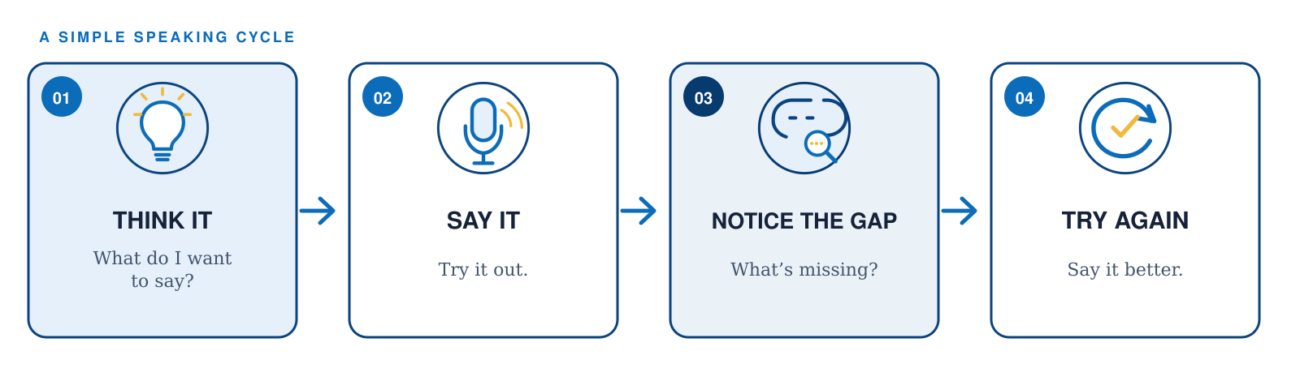
Give them time to:
  Prepare/think about it
  Say what they want to say
  Reflect on what they could do better
  Try again
Notes:
Theoretical mechanism. Swain's Output Hypothesis identifies noticing the gap, hypothesis testing, and metalinguistic reflection as functions of output. See Swain (1985), in Gass & Madden (Eds.), Input in Second Language Acquisition; Swain & Lapkin (1995), Applied Linguistics, 16(3), 371-391; Izumi (2003), Applied Linguistics, 24(2), 168-196, https://doi.org/10.1093/applin/24.2.168. The slide uses a conceptual sequence rather than claiming that every attempt produces learning automatically.
YOU DON’T KNOW WHAT YOU NEED TO SAY UNTIL YOU TRY TO SAY IT.
I did not play sports well when I was a child. I kicked the ball very bad. I hitted the ball in the wrong place. I cannot throw the ball good. But I ran very fast!

Slide 14
What kind of feedback do you give this student?
Prompt: Talk about a skill that was difficult for you to learn at first (like riding a bicycle, driving, or cooking). How did you learn it?”
Answer: I did not played sports well when I was a child. I kicked the ball very bad. I hitted the ball in the wrong place. I cannot throw the ball good. But I ran very fast!

Slide 15
Coaching:
Feedback or Suggestions for Change
Focus on 1-2 things—help them notice but don’t overwhelm them. If you give too much, they can’t usually process it well.
Нэг эсвэл хоёр зүйлд л анхаарлаа хандуулаарай; тэдэнд анзаарах боломж олгох хэрэгтэй ч хэт их мэдээллээр бүү ачааллаарай. Хэт ихийг өгвөл тэд ихэвчлэн түүнийг сайн боловсруулж чаддаггүй.

Slide 16
HOW IT WORKS
Notice with teacher and peer support
Notes:
Theoretical mechanism. Swain's Output Hypothesis identifies noticing the gap, hypothesis testing, and metalinguistic reflection as functions of output. See Swain (1985), in Gass & Madden (Eds.), Input in Second Language Acquisition; Swain & Lapkin (1995), Applied Linguistics, 16(3), 371-391; Izumi (2003), Applied Linguistics, 24(2), 168-196, https://doi.org/10.1093/applin/24.2.168. The slide uses a conceptual sequence rather than claiming that every attempt produces learning automatically.
I did not play sports well when I was a child. I kicked the ball very bad. I hitted the ball in the wrong place. I cannot throw the ball good. But I ran very fast!

Slide 17
A RESEARCH STUDY
Students get better at the skill they practice
DeKeyser and Sokalski compared two kinds of practice with learners of Spanish:
INPUT PRACTICE
OUTPUT PRACTICE
Better for
understanding
OR
Better for
speaking
Students practiced understanding grammar forms.
Students practiced finding and using grammar forms to speak.
Note: results also depended on how hard the grammar was and when students were tested.
DeKeyser & Sokalski, 1996 · Language Learning, 46(4), 613-642 · https://doi.org/10.1111/j.1467-1770.1996.tb01354.x
Notes:
DeKeyser & Sokalski (1996), The Differential Role of Comprehension and Production Practice, Language Learning, 46(4), 613-642, https://doi.org/10.1111/j.1467-1770.1996.tb01354.x. The study included 82 first-year Spanish learners. Its central finding was not that output always wins, but that production practice was better aligned with production outcomes and input practice with comprehension outcomes, with effects moderated by structure complexity and testing delay.

Slide 18

WHEN PUSHED OUTPUT WORKS BEST
Talking with a partner makes the push stronger; students have someone to go back and forth with
ACTIVE PARTICIPATION
CHECKING MEANING
FEEDBACK + REFORMULATION
→
Fixes the message
→
Student answers
Clearer form
The student tries again
A real answer
A better form appears
Notes:
Mackey (1999), Input, Interaction, and Second Language Development: An Empirical Study of Question Formation in ESL, Studies in Second Language Acquisition, 21(4), 557-587, https://doi.org/10.1017/S0272263199004027. Adult ESL learners (N=34) took part in task-based interaction. Results supported a link between interaction and grammatical development and highlighted the importance of active participation. The slide's final box describes a pedagogical pathway, not a claim that all feedback types are equally effective.

Slide 19
AUDIO EXAMPLE?
WHAT CHANGES WHEN STUDENTS SPEAK
Repeating a task builds fluency step by step
Fluency improves, but different parts of speaking improve at different times.
SAME TASK—WITH PRACTICE
1–2
3–4
5–6
→
→
Pauses at clause ends
get shorter first
Pauses mid-clause
get shorter next
Self-corrections
happen less often
Lambert et al. (2017): fluency improved right away at all levels. A 2025 review: repetition helped grammar (complexity and accuracy) most, and fluency and vocabulary a little.
Lambert, Kormos, & Minn, 2017 · Hanzawa, 2024 · Abdi Tabari, Zhuang, & Farahanynia, 2025
Notes:
Oral fluency evidence: Lambert, Kormos, & Minn (2017), Task Repetition and Second Language Speech Processing, Studies in Second Language Acquisition, 39(1), 167-196, https://doi.org/10.1017/S0272263116000085. In 32 Japanese learners of English, same-task repetition related to gains in oral fluency. Speech rate gains were largest across the first three performances but continued through the fifth; clause-final pauses decreased by the second performance, midclause pauses through the fourth, and self-repairs only after the fourth. Hanzawa (2024), Language Teaching Research, 28(3), 816-838, https://doi.org/10.1177/13621688211008693, followed 50 Japanese university students over one academic year and found decreases in pause measures. Abdi Tabari, Zhuang, & Farahanynia (2025), System, 135, 103868, https://doi.org/10.1016/j.system.2025.103868, meta-analyzed task repetition and found substantial effects for syntactic complexity and accuracy, with smaller positive effects for fluency and lexical complexity.

Slide 20
WHERE THIS COMES FROM
Lots of good input isn't enough
Listening alone doesn’t produce proficiency
Merrill Swain studied students who learned in English-only classes for years. They heard lots of English they could understand, but their speaking stopped getting more accurate. Her conclusion: hearing English is necessary, but it is not enough. Learners also need to speak it in order to become proficient and fluent speakers.
Output Hypothesis
Notes:
Be honest with this audience: this isn't a brand-new idea. It's foundational and well-validated — which is exactly why it's safe to build a practice around. • The plateau story is the memorable anchor: great input, stalled output.

Slide 21

DEMO · 1
Pair Work Value
Same question, several ways.
Demo 1 — Getting everyone talking
Notes:
Round 1 (serial): ask a question, call on people one at a time for 90 sec. Count total speakers (≈3–4) and rough seconds of talk. • Round 2 (simultaneous): "everyone, both partners, answer for 90 sec." Now everyone talked ~60–90 sec at once. • Do the math out loud: serial ≈ 1 minute of total learner talk; simultaneous ≈ 25+ minutes of talk in the same 90 seconds.
Have someone count total number of speakers and seconds they speak.

Slide 22
What did you do last weekend?
Question to whole group or class

Slide 23

THE REAL PROBLEM
One learner talks. Twenty-five students wait.
When the teacher asks the whole class a question, only one student speaks at a time. A few confident students answer, and most say nothing. The class feels busy, but almost no one is practicing.
1 student
speaking
25 waiting
Notes:
Name the trap directly — hands-up Q&A feels like participation but concentrates all output in 3–4 students. • Set up Demo 1: we're about to measure exactly how big this waste is.

Slide 24
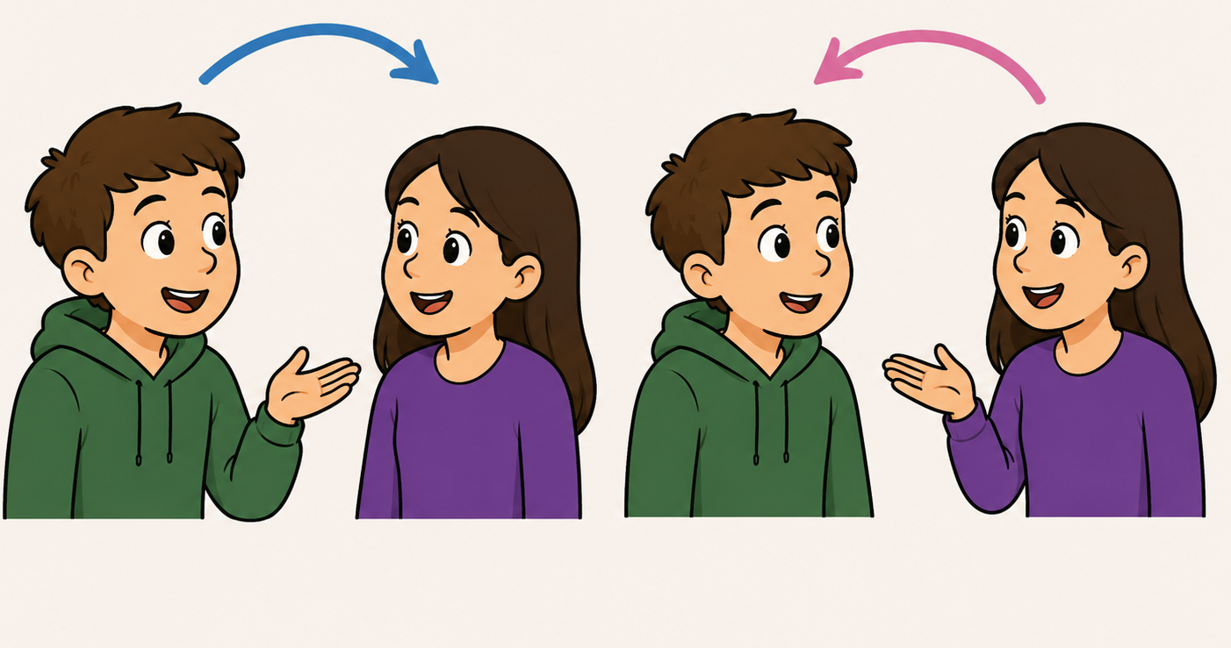
Shift to Pair Work
30 Seconds with Prompt

Slide 25
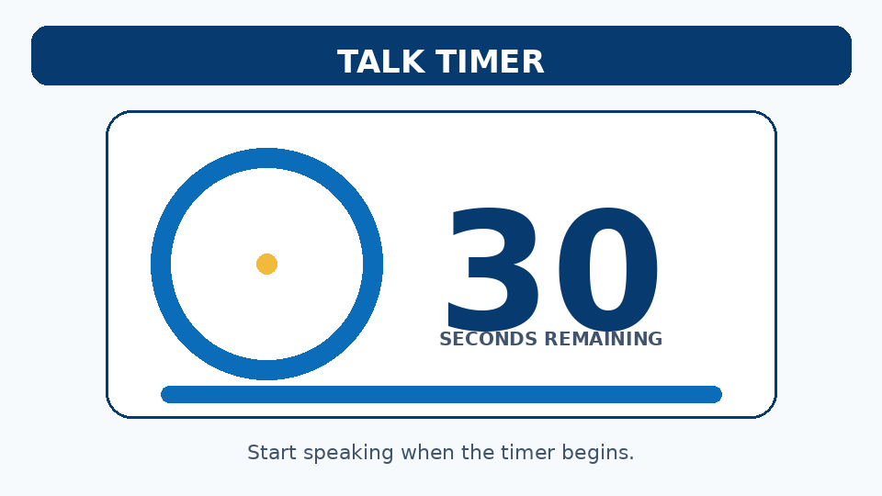
What did you do last weekend?
Question to individuals for pair work

Slide 26
LEVER 1 · TURN UP THE VOLUME
Everyone talks at once during pair work.
HANDS-UP Q&A
PAIRS, ALL AT ONCE
≈ 1 min
≈ 25+ min
of student talk in 90 seconds — only 3–4 students speak.
of student talk in the same 90 seconds — every student speaks.
Notes:
This single switch — pairs/groups instead of whole-class Q&A — is the largest volume multiplier available, and it's free. • The number is approximate but the order of magnitude is real and it lands hard.

Slide 27
Instruction must be designed to produce interaction and require students to speak.

Slide 28



WHY SPEAKING HELPS LEARNING
Speaking does three things listening can't.
01
02
03
You notice the gap
You test an idea—try it out
You reflect on your language
When you try to say something, you see what you can't say yet.
Speaking is an experiment: “Does this work?” Trial and error helps you learn.
Talking about how to say something helps you learn the grammar better. Thinking about language helps.
Think hypothesis testing and reflection on results.
Notes:
Swain's three functions. The key reframe for teachers: production isn't just performance of what's learned — it's part of how learning happens. • "Notice the gap" is the big one: silent students never discover what they're missing.

Slide 29
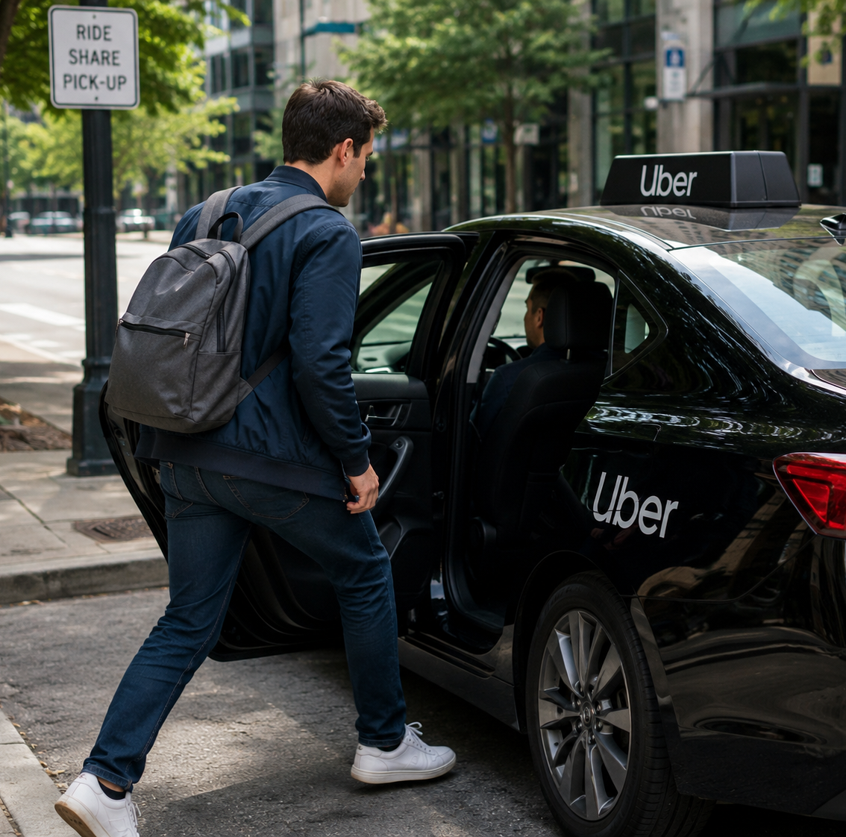
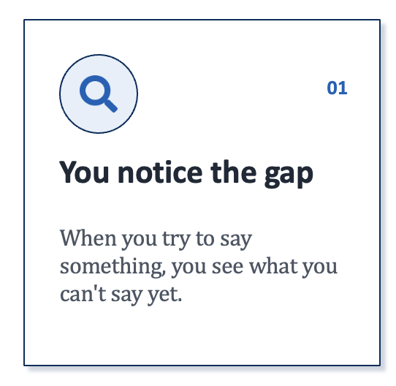
DAN’S GAP MINDING AND HYPOTHESIS TESTING IN SPANISH
Gaps I noticed when speaking
Full-time
Hybrid
I’m sorry for VERB ing
Throughout the world

Slide 30
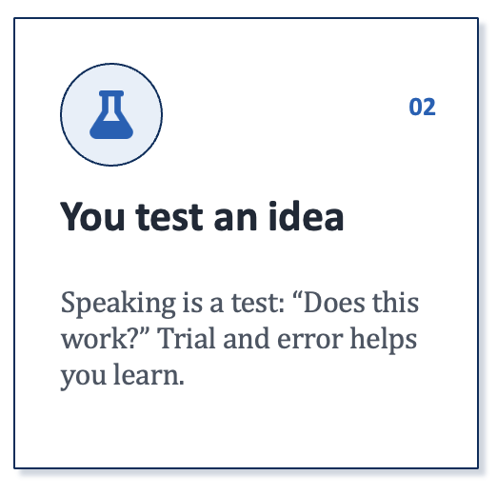
DAN’S GAP MINDING AND HYPOTHESIS TESTING IN SPANISH
Gaps I noticed when speaking
Full-time
  (all + time?)
Hybrid
  (English loan?)
I’m sorry for VERB ing
  I’m sorry + verb
Throughout the world
  (in + whole + world)

Slide 31
PRODUCTIVE SPEAKING CYCLE
Perfection is not needed—progress is valued most (praise growth and learning as a teacher)

Slide 32


PRODUCTIVE SPEAKING CYCLE
Students can notice gaps by themselves or teachers or peers can point them out at any stage—when they are thinking what to say at first, when they try to do the task (answer the prompt) or when they reflect on what they said at any stage.

Slide 33
CYCLE
Learn what’s missing
Fill a gap
Practice
Learn what’s missing
Fill a gap
Practice

Slide 34
DEMO · 2
Repetition with Push
Same question, several ways.
Demo 1 — Getting everyone talking
Notes:
Round 1 (serial): ask a question, call on people one at a time for 90 sec. Count total speakers (≈3–4) and rough seconds of talk. • Round 2 (simultaneous): "everyone, both partners, answer for 90 sec." Now everyone talked ~60–90 sec at once. • Do the math out loud: serial ≈ 1 minute of total learner talk; simultaneous ≈ 25+ minutes of talk in the same 90 seconds.
Have someone count total number of speakers and seconds they speak.

Slide 35
PRACTICE TASK
Today's Discussion Prompt
TOPIC: DECISION MAKING
"When you have a difficult decision to make, do you usually follow your gut feeling or ask other people for advice? Give an example."
Option A: Intuition & Gut Feelings
Option B: External Guidance & Consultation
Хэцүү шийдвэр гаргах шаардлагатай үед та ихэвчлэн дотоод мэдрэмждээ итгэдэг үү, эсвэл бусдаас зөвлөгөө авдаг уу? Жишээ дурдана уу.
зөн совин
Notes:
zön sovin = gut feeling
zön sovin tataad baina
minii zön sovin kheleed baina

Slide 36


STAGE 02 • 90 SECONDS
Say It: Try It Out—Just Speak
(don’t hesitate or second guess)
Continuous Flow
Ignore Mistakes
Full Duration
Maintain spoken momentum.
Prioritize communication over perfection.
Talk through the timer.

Slide 37
PRACTICE PROTOCOL
Take time to prepare to speak first (20 seconds in our demo but normally more like 1-2 minutes)
Get ready to respond to the prompt.
Then you will speak (30 seconds each in our demo, but typically more time in your classrooms)
Ready to Begin Your Round?
Round 1
Round 2
Speaker A Shares
Speaker B Shares

Slide 38
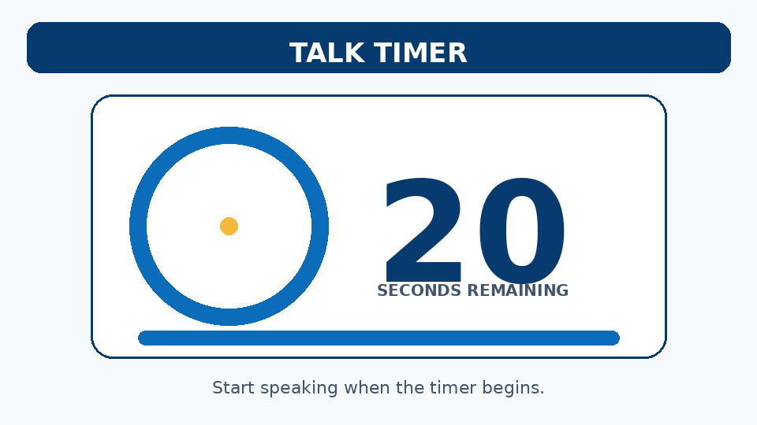
PRACTICE TASK
Prepare: Today's Discussion Prompt
TOPIC: DECISION MAKING
"When you have a difficult decision to make, do you usually follow your gut feeling or ask other people for advice? Give an example."
Option A: Intuition & Gut Feelings
Option B: External Guidance & Consultation

Slide 39
First Person Speaks Next

Slide 40

PRACTICE TASK
Today's Discussion Prompt
TOPIC: DECISION MAKING
"When you have a difficult decision to make, do you usually follow your gut feeling or ask other people for advice? Give an example."
Option A: Intuition & Gut Feelings
Option B: External Guidance & Consultation

Slide 41
ROTATE: Second Person Speaks Next

Slide 42
PRACTICE TASK
Today's Discussion Prompt
TOPIC: DECISION MAKING
"When you have a difficult decision to make, do you usually follow your gut feeling or ask other people for advice? Give an example."
Option A: Intuition & Gut Feelings
Option B: External Guidance & Consultation

Slide 43

Are there things you had difficulty saying? Can you look them up or ask someone else how to say them?
Could you improve your grammar or use something more complex? What could you do better?

Slide 44
Repeat Task
First Person Speaks

Slide 45
PRACTICE TASK
Today's Discussion Prompt
TOPIC: DECISION MAKING
"When you have a difficult decision to make, do you usually follow your gut feeling or ask other people for advice? Give an example."
Option A: Intuition & Gut Feelings
Option B: External Guidance & Consultation

Slide 46
ROTATE: Second Person Speaks Next

Slide 47
PRACTICE TASK
Today's B1 Discussion Prompt
TOPIC: DECISION MAKING
"When you have a difficult decision to make, do you usually follow your gut feeling or ask other people for advice? Give an example."
Option A: Intuition & Gut Feelings
Option B: External Guidance & Consultation

Slide 48

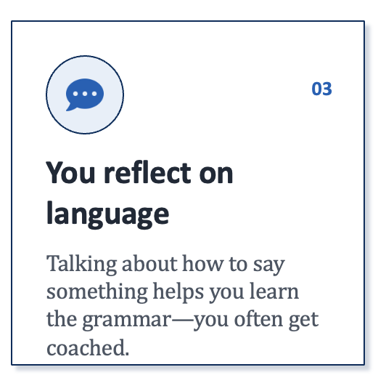

Slide 49
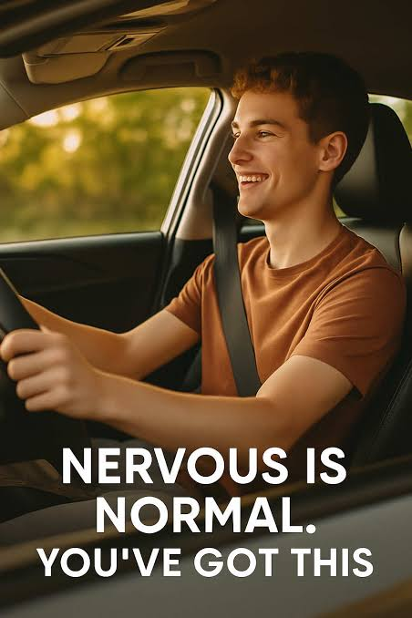
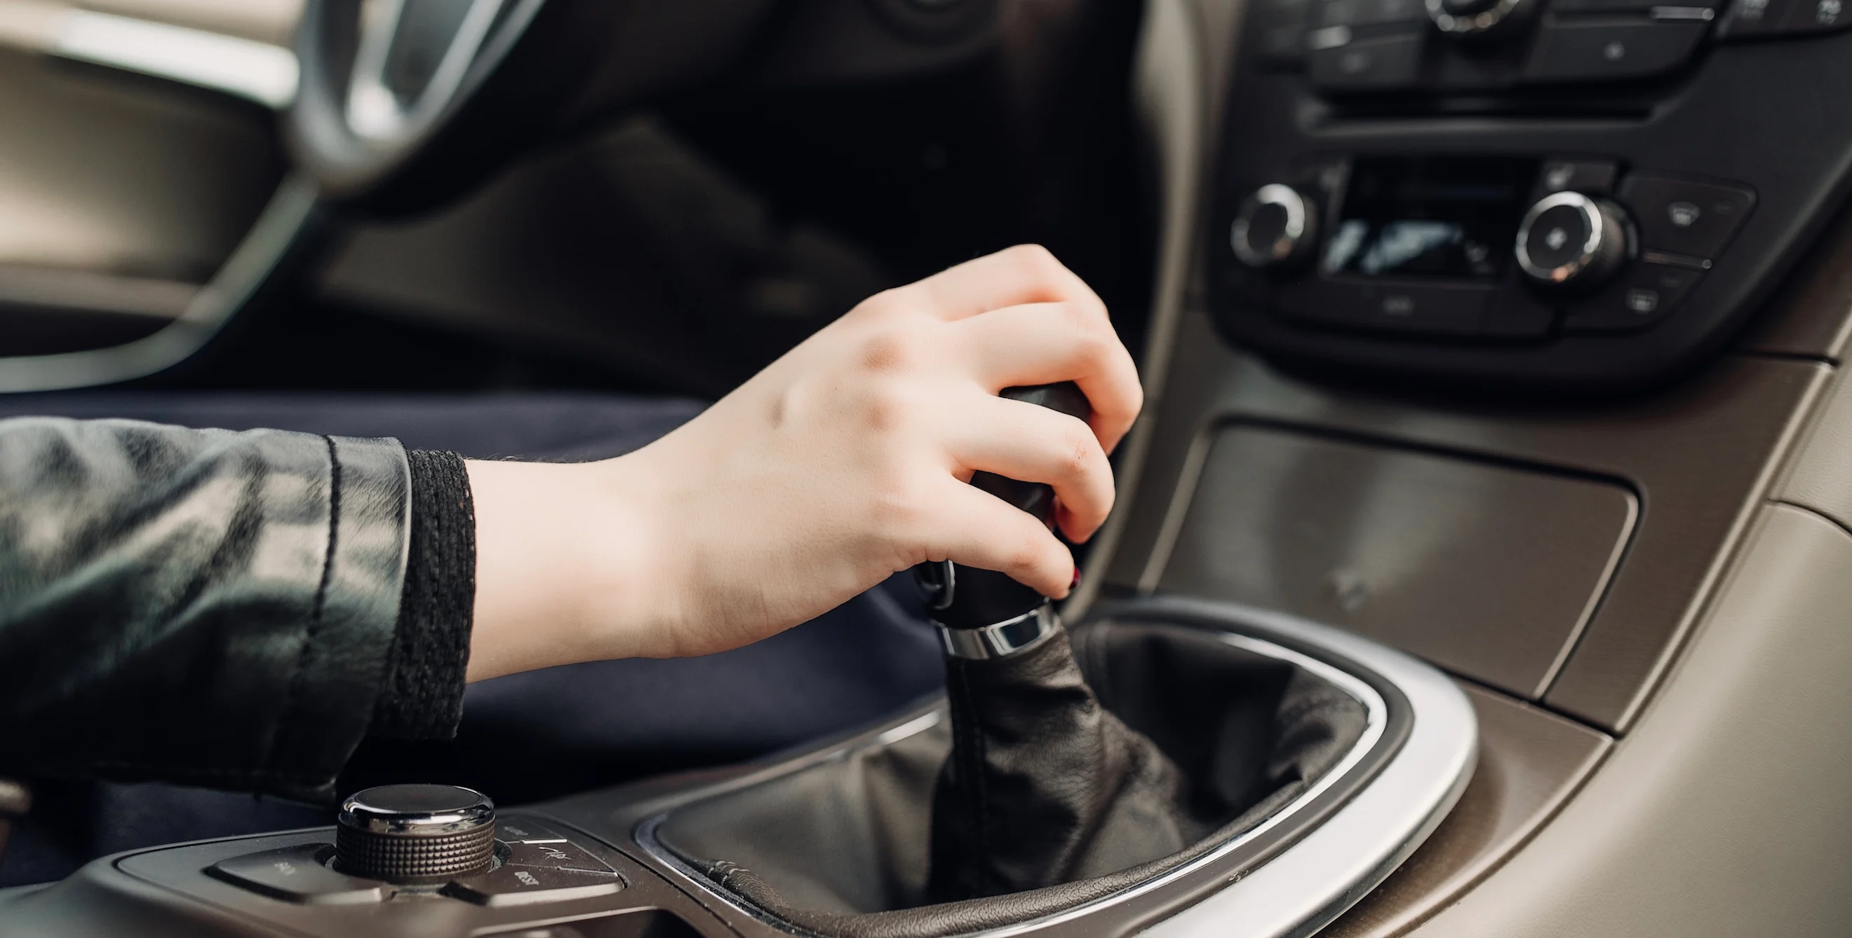
Repetition Yields Fluency

Slide 50
WHY A 1985 IDEA STILL MATTERS
You become fluent by using the language.
Skill Acquisition Theory: knowing a rule and using it are different skills. Fluency grows when you use the language again and again, until the words come automatically.
A range of research in multiple languages by Robert DeKeyser supports this idea. The main point is volume: the more you use the language, the better you know it.
Notes:
This bridges the old hypothesis to current cognitive accounts: declarative → procedural knowledge through practice. • Tie back to any retrieval-practice session you've run: producing language is retrieval. Same engine.

Slide 51

PUSH
But Remember This
Difficulty is good!
Stressed and anxious is not.

Slide 52


Slide 53


TODAY’S BIG IDEA
There are two dials in the classroom.
Turn both up but sometimes one more than the other
DIAL 01
DIAL 02
Volume
Push
How much each student says in class. More turns, more words, more often.
How hard they work. They must speak using things they don’t know well.
Notes:
This is the spine of the talk. Everything later is a technique for turning up one or both dials. • "Pushed output" = output cranked on the Push dial. Swain's term means being stretched, not just talking more.

Slide 54
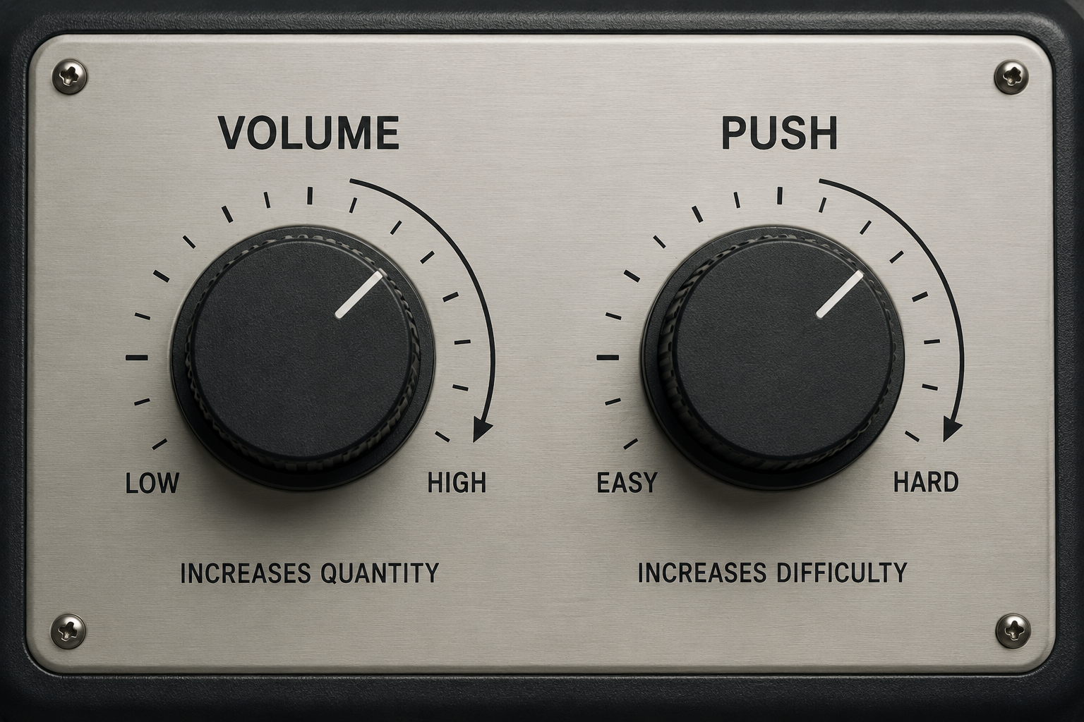

Slide 55
ONE IMPORTANT POINT
Simply talking more isn't the goal.
Talking a lot with no push does not help much.
What works is volume and push together, with feedback, in a relaxed classroom where students have the words and phrases they need.
Notes:
Pre-empt the misreading: this is not "abandon input and just have them chat." • Scaffolding matters — if you push without giving them frames/chunks, you raise anxiety and shut them down. (Nod to prior chunks session if relevant.)

Slide 56
Push: Use two new words
Holed up (Verb/Phrase): To hide away or take refuge.
"I completely holed up at home all Sunday and watched a whole season of that new show."
Rejuvenate (Verb): To make feel fresh, young, or energetic again.
"I felt completely rejuvenated after relaxing all weekend.."
Puttered (Verb): To spend time doing small, relaxed tasks with no big plan.
"I just puttered around the garden and fixed a few things around the house."
Hiatus (Noun): A pause or break. Often used for a short break from something (like social media or work).
"I went on a strict digital hiatus from Friday to Sunday night."

Slide 57

Moving On

Slide 58
DEMO · 2
Tell the same story three times.
But shrink time to build fluency.
Demo 2
Notes:
Topic: "the best meal you've had recently." New partner each round. Compressed timing: 90 / 60 / 45 sec. • Speaker talks the whole time; listener only listens. Rotate listeners between rounds. • Debrief: by round 3 it's faster and smoother on less time. That's automatization you just felt.

Slide 59

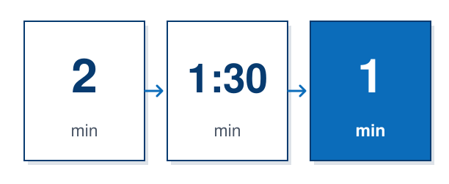
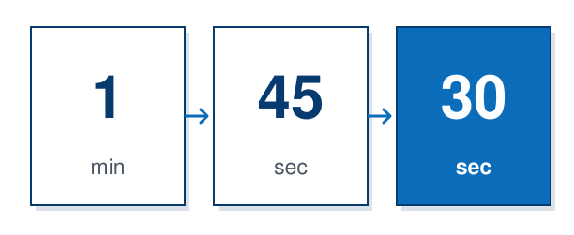
Say it again. Faster. New partner.
Students repeat the same talk with less time each round.
The words start to come automatically.
The classic version is 4/3/2: the same talk to three partners — four minutes, then three, then two.
We will do shorter times for demo purposes.
→
→
4
3
2
min
min
min
Notes:
Counter the old worry that repetition is boring — the changing partner and shrinking time keep it alive, and fluency visibly climbs. • Set up Demo 2: they'll feel their own fluency rise across three rounds.

Slide 61
Tell about the best meal you had recently—where you ate, what you ate, who you ate it with, etc.

Slide 62
PRACTICE TASK
зөн совин
PREPARE
TOPIC: DECISION MAKING
Tell about the best meal you had recently—where you ate, what you ate, who you ate it with, etc.
Option A: Intuition & Gut Feelings
Option B: External Guidance & Consultation

Slide 63
First Person Speaks Next

Slide 64
PRACTICE TASK
Today's Discussion Prompt
Tell about the best meal you had recently—where you ate, what you ate, who you ate it with, etc.

Slide 65
ROTATE: Second Person Speaks Next

Slide 66
PRACTICE TASK
Today's B1 Discussion Prompt
Tell about the best meal you had recently—where you ate, what you ate, who you ate it with, etc.

Slide 67
LEVER 3 · TURN UP THE PUSH DIAL
The second time, ask for more.
Volume gives them the practice. Push produces more complexity and accuracy. Between rounds, say: “Now say it again — but better.”
Ask for one more detail.
1
Give them a better way to say their idea.
2
Give quick feedback between rounds, not after class.
3
Notes:
This is what separates "pushed output" from "just talk a lot." The second and third attempts are where you load the demand. • Reformulation is the lightest-weight push: you don't correct, you offer the upgrade and they reuse it.

Slide 68
Did you use any of these phrases?
The main dish was ____.
It tasted ____.
We were celebrating ____.
My favorite part was ____.
I remember it because ____.
I would recommend it to others because ____.

Slide 69
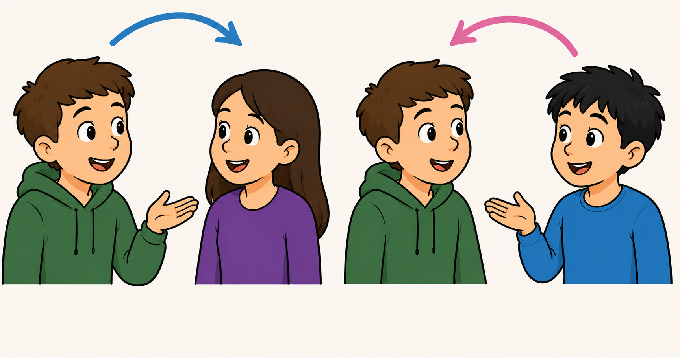
Different Person Please
Rotate Partner—Tell Someone Else

Slide 70

PRACTICE TASK
Today's B1 Discussion Prompt
Tell about the best meal you had recently—where you ate, what you ate, who you ate it with, etc.

Slide 71
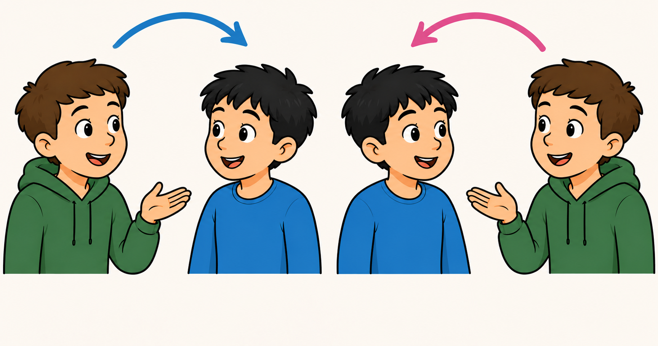
Next Person’s Turn to Speak

Slide 72
PRACTICE TASK
Today's B1 Discussion Prompt
Tell about the best meal you had recently—where you ate, what you ate, who you ate it with, etc.

Slide 73
LEVER 3 · TURN UP THE PUSH DIAL
The third time, ask for more.
SYNONYMS
FOOD NAMES
ADJECTIVES
Use two new words—look them up now.
1
2
3
Notes:
This is what separates "pushed output" from "just talk a lot." The second and third attempts are where you load the demand. • Reformulation is the lightest-weight push: you don't correct, you offer the upgrade and they reuse it.
SYNONYMS
FOOD NAMES
ADJECTIVES

Slide 74
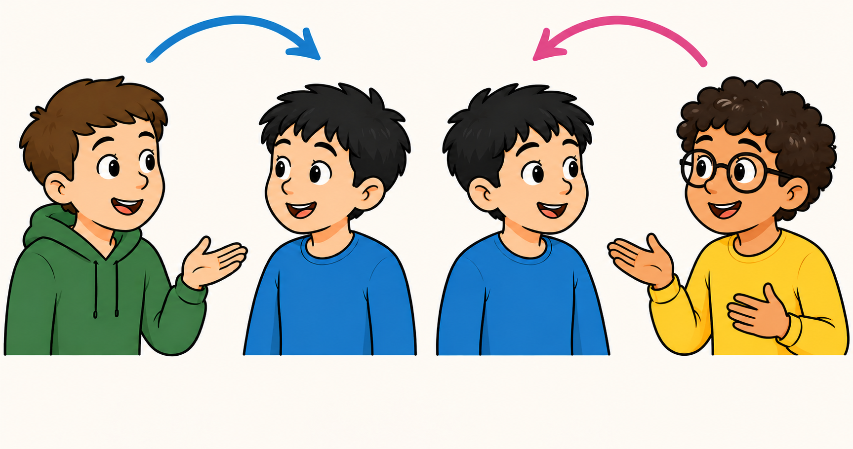
Rotate Partner—Tell Someone Else

Slide 75
PRACTICE TASK
Today's B1 Discussion Prompt
Tell about the best meal you had recently—where you ate, what you ate, who you ate it with, etc.

Slide 76
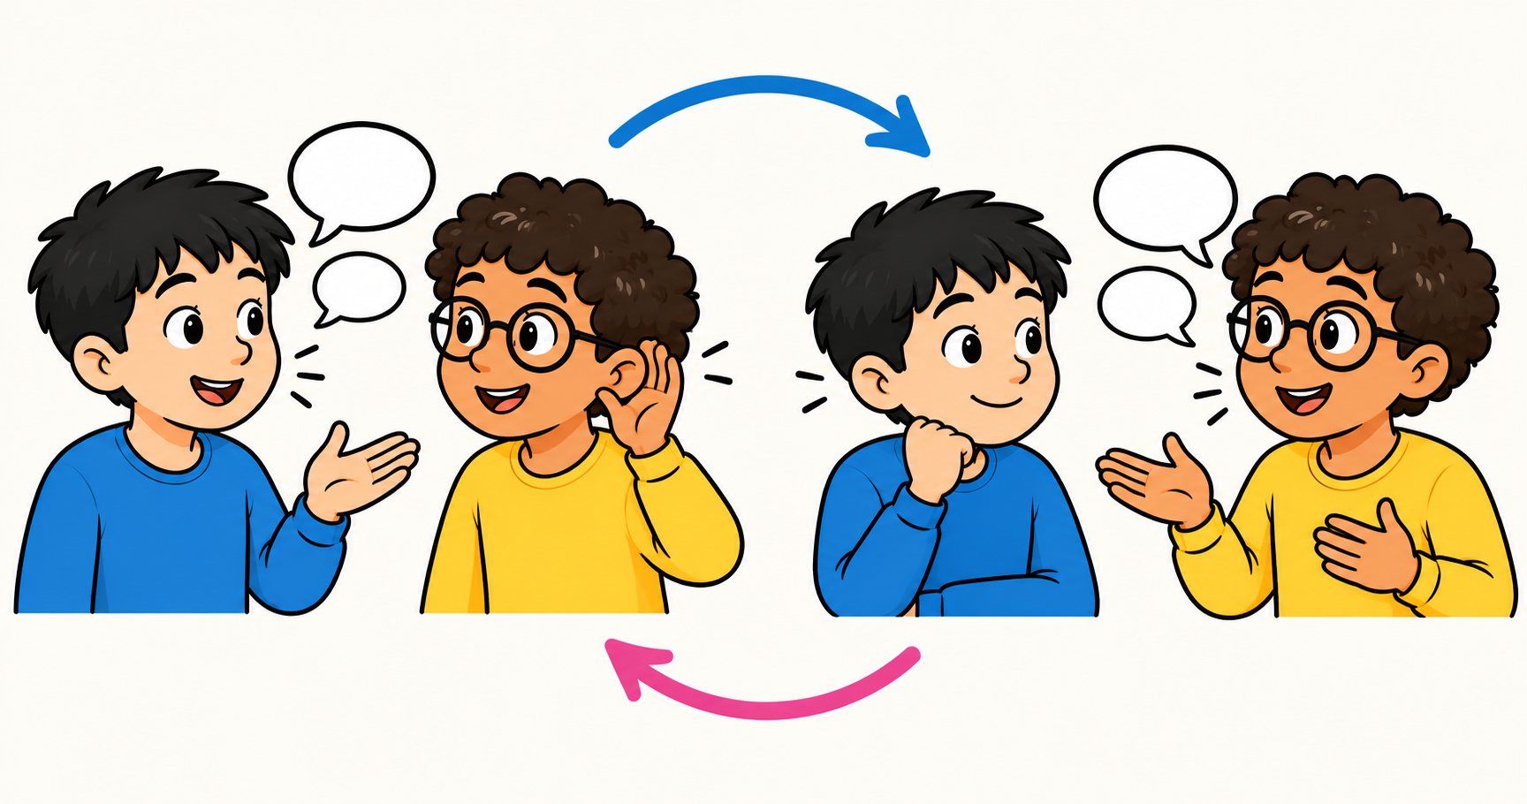
Next Person’s Turn to Speak

Slide 77
PRACTICE TASK
Today's B1 Discussion Prompt
Tell about the best meal you had recently—where you ate, what you ate, who you ate it with, etc.

Slide 78
Reflection
How was it?
Did you feel pushed?
Did it become more fluent with repetition?
What could you have done better?
What language would you like to learn?

Slide 79
Conclusion
What are the main points from today’s tallk that stood out to you?
What will you do to change your teaching?

Slide 80
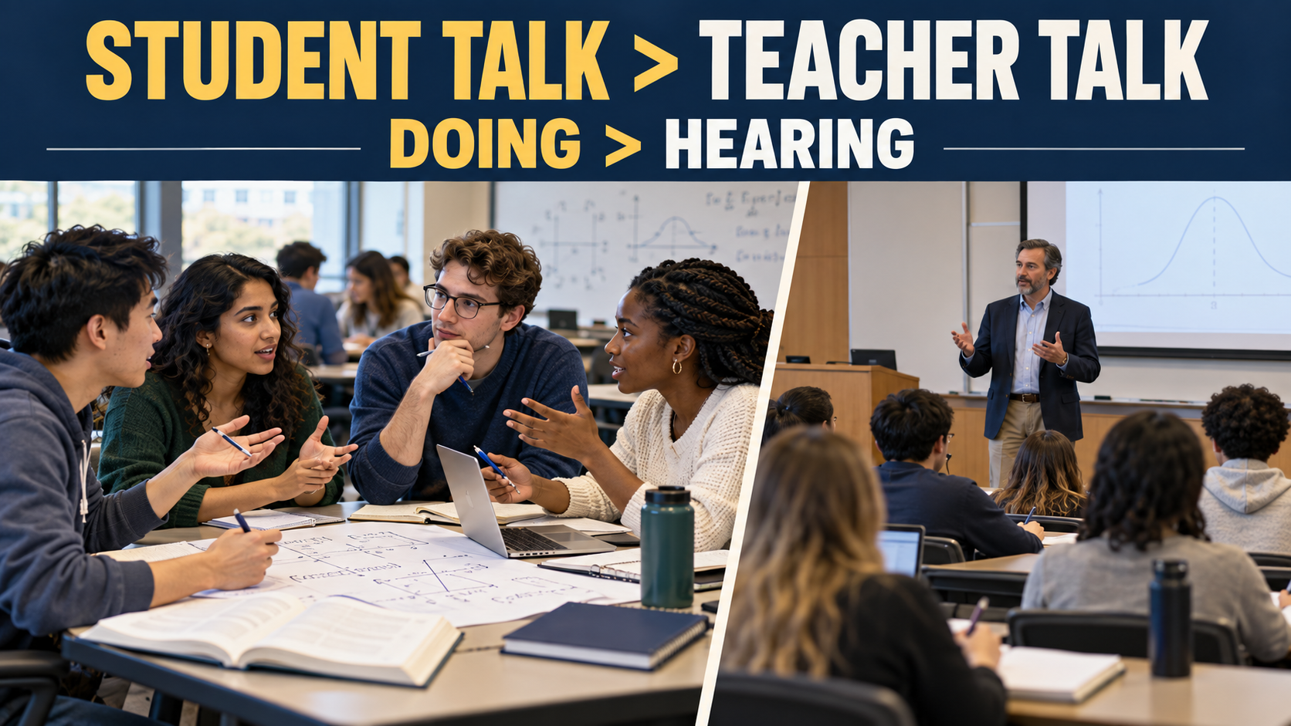
Notes:
Point teachers to the handout for self-review and the demo pack to run these with colleagues. • Thank the room; invite the one-move commitment again on the way out.

Slide 81
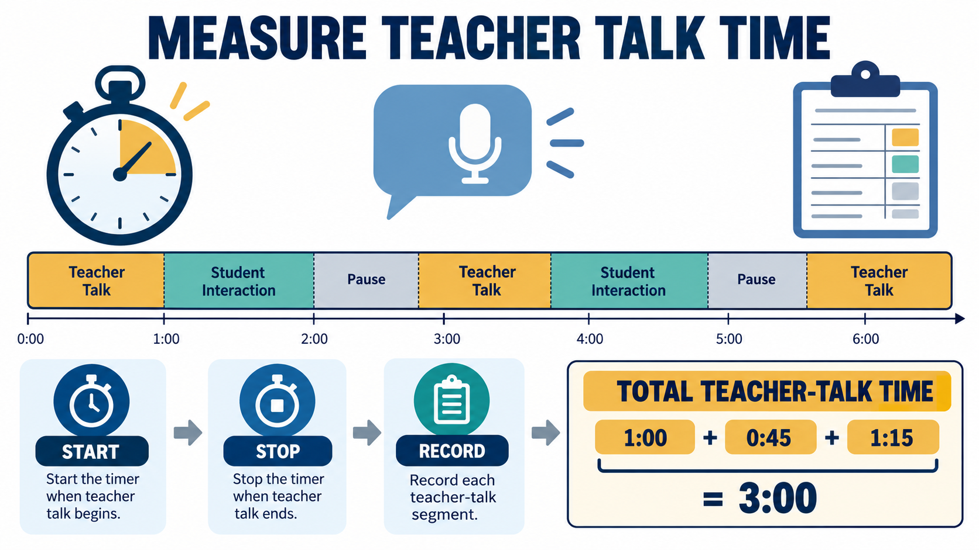
MAKE IT REAL
Measure it once. It will change how you teach. How many minutes do you talk?
Notes:
Give them a concrete self-audit they can do alone, no observer needed. A phone timer or a tally works. • This converts a principle into a habit by giving teachers feedback on themselves.

Slide 82
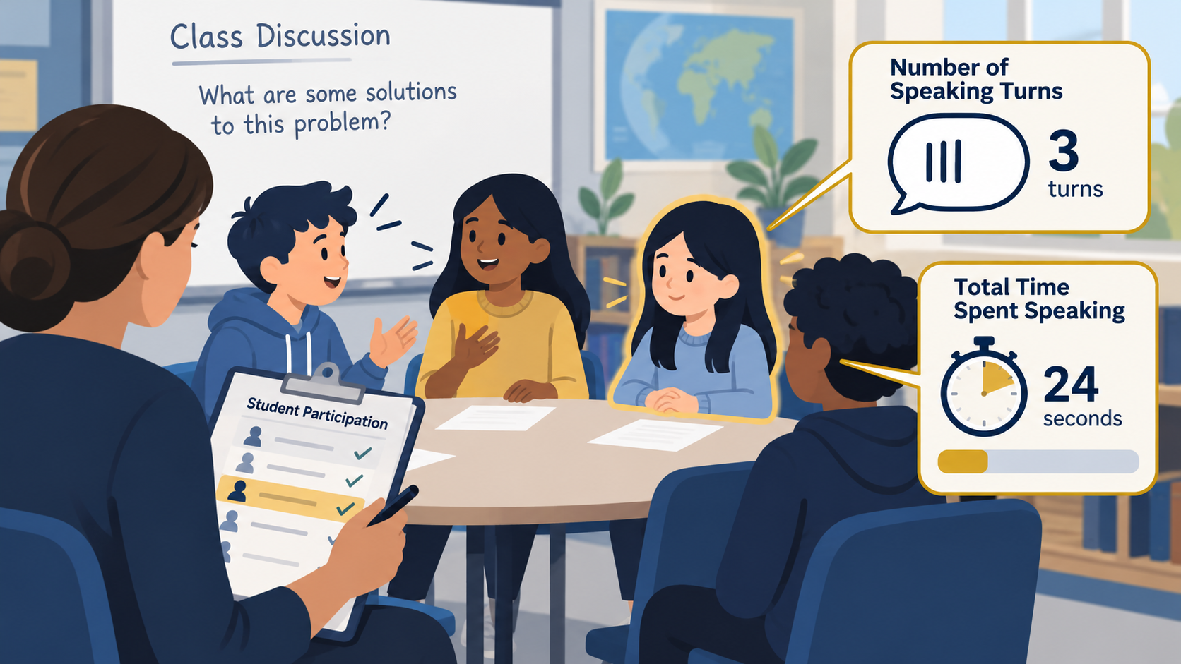
MAKE IT REAL
Think about this regularly:
How much time did your quietest student speak?
Notes:
Give them a concrete self-audit they can do alone, no observer needed. A phone timer or a tally works. • This converts a principle into a habit by giving teachers feedback on themselves.

Slide 83


Review Sheet for Reference (4-5 minutes)

Slide 84

ACTIVITIES:
Multiply student output. Cut your own teacher talk.
Use pairs, not hands-up — everyone answers every question.
4/3/2 for any “tell me about…” task.
“Say it again, better” as a regular habit—push them.
Think–pair–share so everyone speaks before anyone shares with the class.
Information Gap Activities
  Each person has some knowledge or ideas or thoughts the other does not have/know—the questioner is asking the listener to fill these gaps.
Notes:
The throughline of all of these: shift seconds of talk from you to them. Your job becomes designing and pushing, not performing.

Slide 85

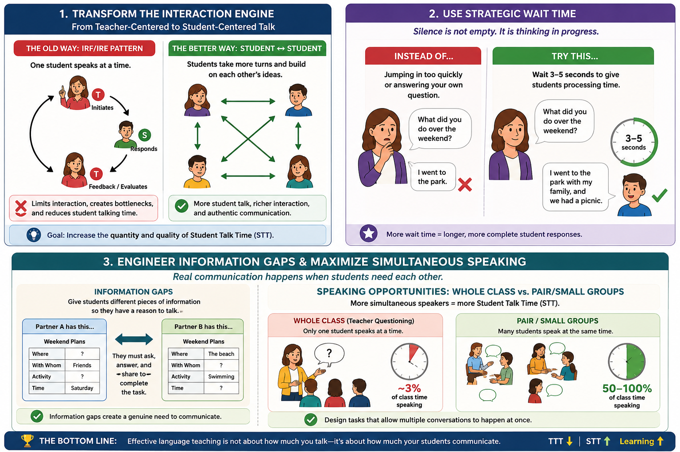
Sample Materials
Increase Student Talk Time

Slide 86

Increasing Volume and Pushed Output
AI Prompt Examples (See Ben’s Handout)
-Job Description, Level + Prepare, Practice, Notice Gaps, Practice Again
  Similar to this:
  Act as an expert in communicative language teaching, second-language acquisition, and instructional-materials design.
  Create a complete, one-hour stand-alone classroom activity for adult or university-level learners of English as a second language at approximately B1 level. The topic is “what I do during holidays”. Learners must prepare with some guidance, produce meaningful language, notice a gap—something they can improve or do better, receive a manageable push (be pushed to do just a little more a little better), and produce an improved second version.
Facilitator demo pack & interactive handout accompany this deck.
Notes:
Point teachers to the handout for self-review and the demo pack to run these with colleagues. • Thank the room; invite the one-move commitment again on the way out.

Slide 87

Notes:
Point teachers to the handout for self-review and the demo pack to run these with colleagues. • Thank the room; invite the one-move commitment again on the way out.

Slide 88

Contact Information: ddewey@byu.edu

