Slide 1
Device Drivers
Jonathan Misurda
jmisurda@cs.pitt.edu

Slide 2
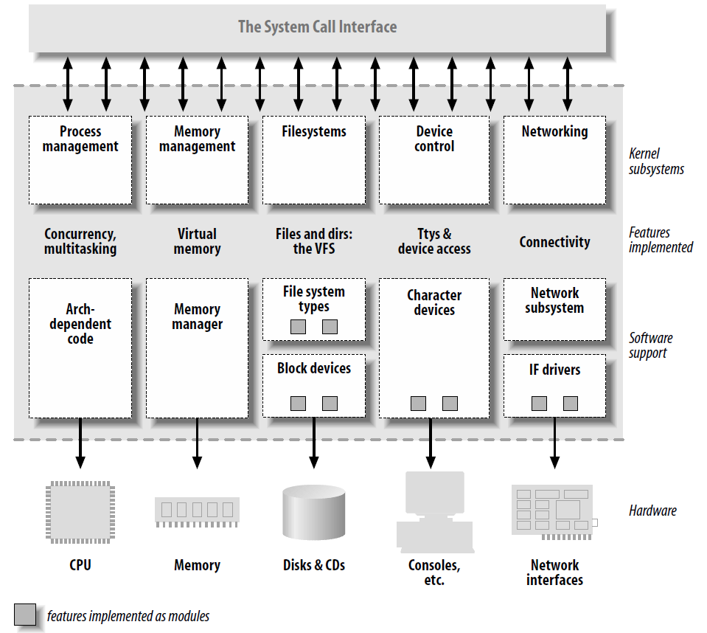
Abstraction via the OS

Slide 3
Software Layers
User-level I/O software & libraries
User
Device-independent OS software
Operating
system
(kernel)
Device drivers
Interrupt handlers
Hardware

Slide 4

Device Drivers
User
space
User
program
Kernel
space
Rest of the OS
Keyboard
driver
Disk
driver
Keyboard
controller
Disk
controller

Slide 5
Types of Devices
Block Devices
  A device that stores data in fixed-sized blocks, each uniquely addressed, and can be randomly accessed
  E.g., Disks, Flash Drives
Character Devices
  Device that delivers or accepts a stream of characters
  E.g., Keyboard, mouse, terminal

Slide 6
Mechanism vs. Policy
Mechanism – What capabilities to have (Algorithm)
Policy – How to use a mechanism (Parameters)
Drivers should be flexible by only providing mechanisms not policies

Slide 7
Device Drivers in Linux
Can be compiled into the kernel
Can be loaded dynamically as Modules

Slide 8
/dev
Character and block devices can be exposed via a filesystem
/dev/ typically contains “files” that represent the different devices on a system
/dev/console – the console
/dev/fd/ - a process’s open file descriptors

Slide 9
/proc
Virtual filesystem with information about the system and running programs
/proc/cpuinfo – text “file” containing CPU information

Slide 10
Sysfs
Exports information about devices and drivers to userspace,
Can configure aspects of device
/sys/

Slide 11
Hello World Module
#include <linux/init.h>
#include <linux/module.h>
MODULE_LICENSE("Dual BSD/GPL");
static int hello_init(void)
{
printk(KERN_ALERT "Hello, world\n");
return 0;
}
static void hello_exit(void)
{
printk(KERN_ALERT "Goodbye, cruel world\n");
}
module_init(hello_init);
module_exit(hello_exit);

Slide 12
Build and Run
% make
make[1]: Entering directory `/usr/src/linux-2.6.10'
CC [M] /home/ldd3/src/misc-modules/hello.o
Building modules, stage 2.
MODPOST
CC /home/ldd3/src/misc-modules/hello.mod.o
LD [M] /home/ldd3/src/misc-modules/hello.ko
make[1]: Leaving directory `/usr/src/linux-2.6.10'
% su
root# insmod ./hello.ko
Hello, world
root# rmmod hello
Goodbye cruel world
root#

Slide 13
Module Helper Programs
insmod – loads a module
rmmod – unloads a module
lsmod – lists what modules are loaded
modprobe – loads a module checking dependencies

Slide 14
Why printk?
The kernel does not have access to libraries
Can’t use printf or many other standard functions (FILE stuff, strtok, etc.)
Modules are linked against the kernel only
Kernel provides useful set of common functions like strcpy, strcat, etc.

Slide 15
MODULE_LICENSE
Informs the kernel what license the module source code is under
Affects which symbols (functions, variables, etc.) it may access in the kernel
A GPL-licensed module can access everything
Certain (or not specifying one) module license will “taint” the kernel

Slide 16
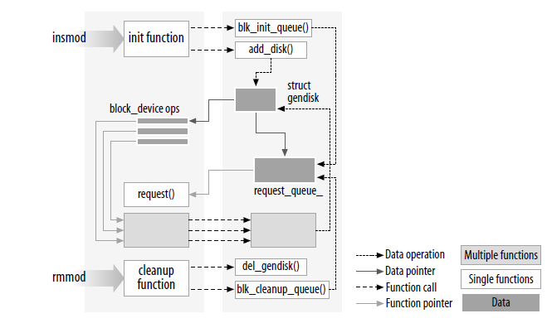
Loading a Module

Slide 17
Things you can’t do in the kernel
Stack allocate big arrays
  The stack is small, maybe only a single page (4KB)
  Use kmalloc to allocate heap space
Floating point arithmetic
  Context switch into the kernel does not save floating point registers

Slide 18
Error Handling
int __init my_init_function(void)
{
int err;
/* registration takes a pointer and a name */
err = register_this(ptr1, “driver”);
if (err) goto fail_this;
err = register_that(ptr2, “driver”);
if (err) goto fail_that;
err = register_those(ptr3, “driver”);
if (err) goto fail_those;
return 0; /* success */
fail_those: unregister_that(ptr2, “driver”);
fail_that: unregister_this(ptr1, “driver”);
fail_this: return err; /* propagate the error */
}

Slide 19
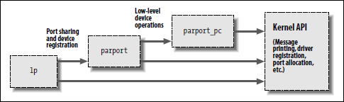
Driver Stacking

Slide 20
Race Conditions
The kernel will make calls into your module while your initialization function is still running

Slide 21
Module Parameters
insmod hellop howmany=10 whom=“Mom”
static char *whom = "world";
static int howmany = 1;
module_param(howmany, int, S_IRUGO);
module_param(whom, charp, S_IRUGO);

Slide 22
Parameter Types
bool, invbool (int)
charp
int, long, short
uint, ulong, ushort
Array parameters, where the values are supplied as a comma-separated list:
  module_param_array(name,type,num,perm);

Slide 23
Permissions
Module parameters show up as files in the sysfs entry
  If perm is set to 0, there is no sysfs entry at all
S_IRUGO – Read Only
S_IRUGO|S_IWUSR – Writeable by root

Slide 24
Makefile
obj-m := hello_dev.o
KDIR := /u/SysLab/shared/linux-2.6.23.1
PWD := $(shell pwd)
default:
$(MAKE) -C $(KDIR) M=$(PWD) modules

Slide 25
User Space Drivers
FUSE – Filesystem in User Space
Newest Kernels support other user space drivers
Advantages?

