Slide 1
WATER ALLOCATION TOOL SESSION 1 (repeat)
Introduction / Background
Water Allocation Tool / DWRAT Framework
Q & A / Discussion

Slide 2
UPCOMING PRESENTATIONS & TRAINING SESSIONS
1 – background, context, introduction, discussion
2 – DWRAT equations, input data, general workflow
3.A – presentation of output & related data
3.B – brainstorming metrics, analyses, discussion
4.A – presentation of python code, downloading & running
script from command line
4.B – scenario development, input files, data sources
5.A – use of main and ancillary python scripts, data
processing
5.B – programming continued, building the project folder

Slide 3
WATER ALLOCATION TOOL
A need for a formal procedure and tools to evaluate water availability that are:
Quantitative
Transparent
Open source
Inexpensive to implement
Easy to learn

Slide 4
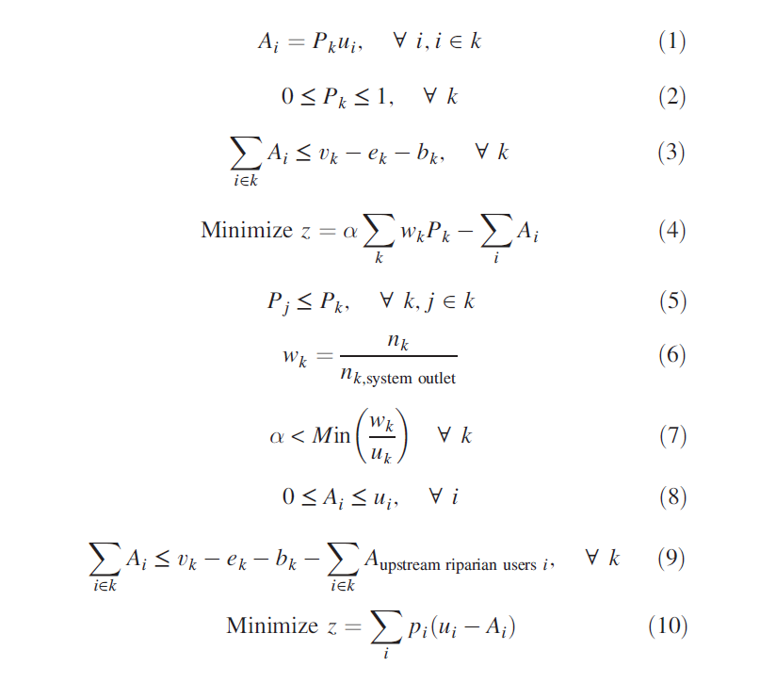
WATER ALLOCATION TOOL EQUATIONS

Slide 5
WATER ALLOCATION
The process of distributing water supplies to various uses when there is a shortfall.
If there is no shortage, all uses could receive an allocation of the full amount needed.

Slide 6
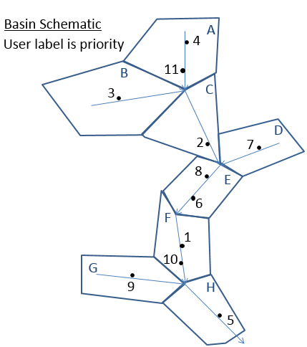
Appropriative model results
Goal:
Minimize penalties
Some results:
User 1 gets full allocation
Users 3 and 4 run out of water
Users 10 and 11 receive no allocation
Users | 1 | 2 | 3 | 4 | 5 | 6 | 7 | 8 | 9 | 10 | 11
Demand: | 7 | 4 | 8 | 8 | 8 | 4 | 3 | 9 | 9 | 7 | 10
Allocation: | 7.0 | 4.0 | 5.6 | 5.6 | 8.0 | 4.0 | 3.0 | 4.4 | 3.2 | 0.0 | 0.0
Shortage: | 0.0 | 0.0 | 2.4 | 2.4 | 0.0 | 0.0 | 0.0 | 4.6 | 5.8 | 7.0 | 10.0
Notes:
User 1 receives full allocation, runs out of right before runs out of water
Users 3 and 4 have high priority, but there just isn’t enough water available so they experience shortage. Run out of water before they run out of right

Slide 7
REASONS TO ALLOCATE WATER
To manage streams during periods of water shortage (i.e. curtail) in real time
To evaluate instream flow management scenarios and regulatory approaches

Slide 8
REASONS TO ALLOCATE WATER
Determining instream flow at a point in time and space requires knowing both:
flow
diversions
(or a stream gage)
Hydrology model flows are generally unimpaired

Slide 9
HOW TO ALLOCATE WATER ?
A legal system of water rights and environmental protections
Other ways:
First come first served
Auctions
Lottery
By use value
Through corruption ?

Slide 10
WHY ALLOCATE WATER ?
State Water Board Mission Statement
To preserve, enhance, and restore the quality of California's water resources and drinking water for the protection of the environment, public health, and all beneficial uses, and to ensure proper water resource allocation and efficient use, for the benefit of present and future generations.
California Constitution Article X Section 2
general welfare requires that the water resources of the State be put to beneficial use to the fullest extent of which they are capable…
Water Rights Mission Statement
Our Mission is to establish and maintain a stable system of water rights in California to best develop, conserve, and utilize in the public interest the water resources of the State while protecting vested rights, water quality and the environment

Slide 11
HOW DOES CALIFORNIA ALLOCATE WATER ?
Maximize beneficial use of water, subject to environmental protection, in accordance with water rights and California state law

Slide 12
OPTIMIZATION
determining the action that best achieves a desired goal or objective.
This means finding the action that optimizes (that is, maximizes or minimizes) the value of an objective function.

Slide 13
OPTIMIZATION PROBLEMS
THREE ELEMENTS IN COMMON
Objective function
Decision variables
Constraints

Slide 14
OPTIMIZATION PROBLEMS OBJECTIVE FUNCTIONS
objective functions:
A quantification of the management goal in terms of the decision variables
(in linear programming) the function that it is desired to maximize or minimize.

Slide 15
OPTIMIZATION PROBLEMS DECISION VARIABLES
decision variables:
Values or allocations that need to be set to find the optimum of the objective function

Slide 16
OPTIMIZATION PROBLEMS CONSTRAINTS
Constraints:
A set of equations or requirements that restrict the values of the decision variables

Slide 17
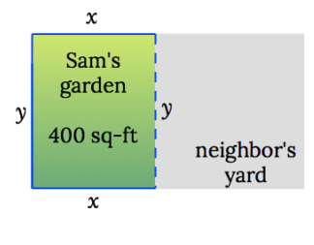
EXAMPLE OPTIMIZATION PROBLEM
What is the minimum cost to enclose a 400 sq-ft garden if Sam’s neighbor is paying half of the shared side?
https://www.matheno.com/calculus-1/optimization/garden-fence/

Slide 18
DECISION VARIABLES
x (width)
y (length)

Slide 19
CONSTRAINTS
x * y = 400 square feet
Solve or y in terms of x:
y = 400 / x

Slide 20
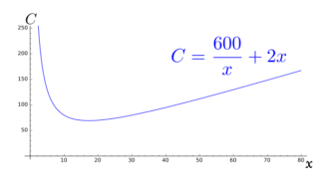
OBJECTIVE FUNCTION
Minimize C, (cost) as a function of x

Slide 21
FINDING OPTIMUM
Solving for (x, y) that minimizes cost requires lots of calculus
And real problems have 100s -1000s of decision variables
We need a Solver program

Slide 22
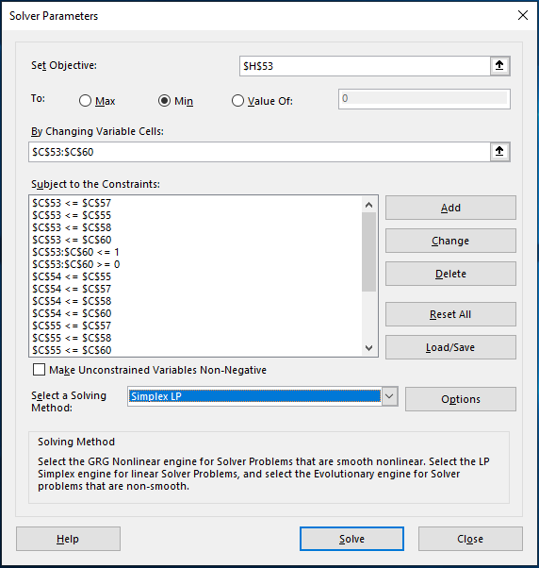
MS EXCEL SOLVER add-in

Slide 23
PuLP 2.0
Open source Python package for Linear Program modeling
Integrates with many available solvers
Used by UC Davis
Able to handle 1000s of decision variables vs. MS Excel maximum of 200

Slide 24
WATER ALLOCATION TOOL
A need for a formal procedure and tools to evaluate water availability that are:
Quantitative
Transparent
Open source
Inexpensive to implement
Easy to learn

Slide 25
DWRAT FRAMEWORK
Integrated set of mathematical equations that describe
water availability
instream flow requirements
and California water rights
These equations can be solved for an optimal water allocation among diverters given
basin flows
water demand
priority

Slide 26
TEN EQUATIONS

Slide 27
ASSUMPTIONS
Every user has access to all basin flow
All water use is 100% consumptive – no return flows
No losses to groundwater or evaporation
Flow is available to the whole network at each time step

Slide 28
DATA INPUTS
SUBBASINS:
inflow in units volume / time
downstream subbasin
USERS:
demand in units volume / time
location
priority
Optionally: e-flows, buffer, health & safety

Slide 29
VARIABLE DEFINITIONS
i : user subscript
k : basin subscript
P_{k} : basin proportion
A_{i} : user allocation
u_{i} : user demand
v_{k} : basin inflow
e_{k} : environmental flow
w_{k} : basin downstream cost
p_{i} : appropriative user priority

Slide 30
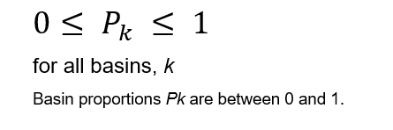
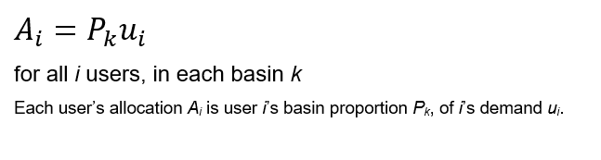
RIPARIAN DECISION VARIABLES Equations (1) & (2)
Basin proportions of demand allocated to riparian users:
Actual allocation is determined by proportions

Slide 31
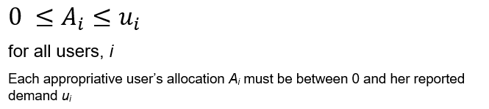
APPROPRIATIVE DECISION VARIABLES Equation (8)
Actual allocation for each appropriative user

Slide 32
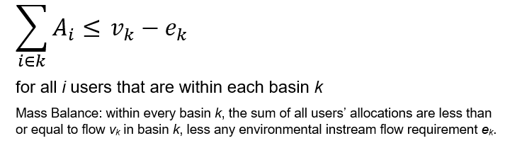
MASS BALANCE CONSTRAINT Equation (3)
RIPARIAN

Slide 33
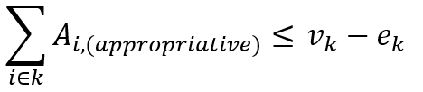
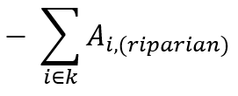
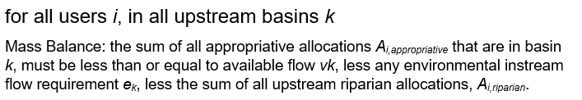
MASS BALANCE CONSTRAINT Equation (9)
APPROPRIATIVE

Slide 34
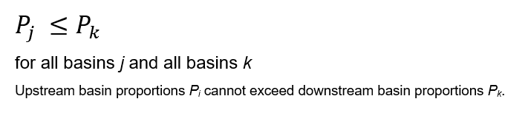
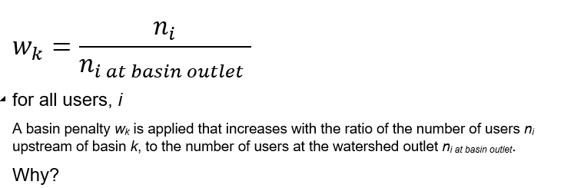
RIPARIAN LEGAL CONSTRAINTS Equations (5) & (6)
Shared shortage:
However:

Slide 35

APPROPRIATIVE LEGAL CONSTRAINTS
Seniority system shortage is minimized according to seniority:
Shortage is scaled in the objective function by the inverse of the priority aka (shortage penalty)

Slide 36
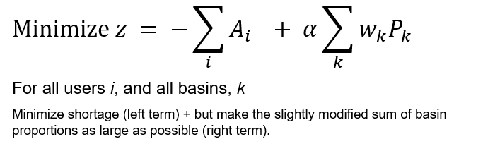
RIPARIAN OBJECTIVE FUNCTION Equations (4) & (7)
Maximize riparian allocations:

Slide 37
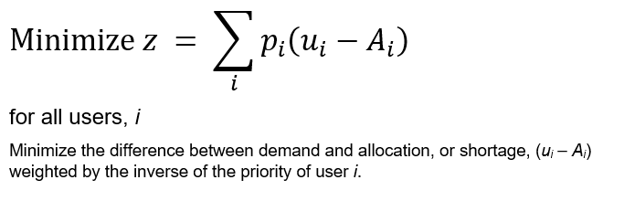
APPROPRIATIVE OBJECTIVE FUNCTION Equation (10)
Maximize appropriative allocations by seniority:

Slide 38
OUTPUT
APPROPRIATIVE USERS
flow allocation in units volume / time
RIPARIAN USERS
basin proportion of demand

Slide 39
NOTES
Resulting allocations are a best estimate
Only as accurate as the input data
Will require further testing, and adaptation to specific watersheds

Slide 40
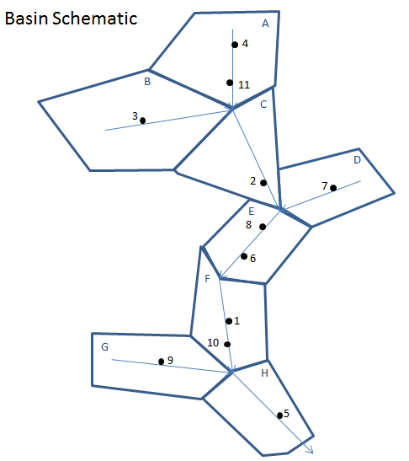
EXAMPLE MODEL
8 Basin 11 user toy model
Two scenarios:
All users riparian, equal priority
All users appropriative, priority by seniority
Local inflow of 7 for each watershed, 20% reserved for environmental flow
User: | 1 | 2 | 3 | 4 | 5 | 6 | 7 | 8 | 9 | 10 | 11
Demand: | 7 | 4 | 8 | 8 | 8 | 4 | 3 | 9 | 9 | 7 | 10

Slide 41
QUESTIONS ?

Slide 42
EXAMPLE MODEL
8 Basin 11 user toy model
Two scenarios:
All users riparian, equal priority
All users appropriative, priority by seniority
Local inflow of 7 for each watershed, 20% reserved for environmental flow
User: | 1 | 2 | 3 | 4 | 5 | 6 | 7 | 8 | 9 | 10 | 11
Demand: | 7 | 4 | 8 | 8 | 8 | 4 | 3 | 9 | 9 | 7 | 10

Slide 43
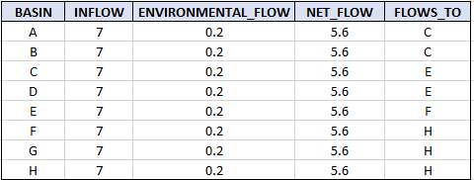
BASIN DATASETS

Slide 44
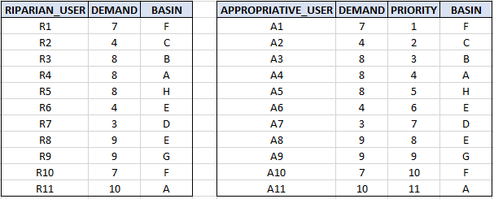
USER DATASETS

Slide 45
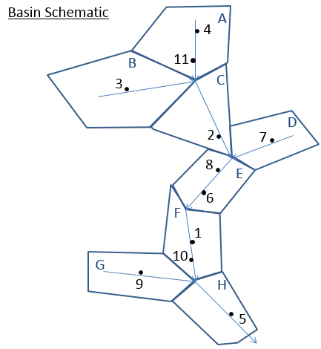
CONNECTIVITY MATRIX
A value of 1 indicates user (column) is upstream of basin outlet (row)
Used for implementation of mass balance constraints
Generated with GIS in larger river basins
 |  | Users
 |  | 1 | 2 | 3 | 4 | 5 | 6 | 7 | 8 | 9 | 10 | 11
Basins | A |  |  |  | 1 |  |  |  |  |  |  | 1
 | B |  |  | 1
 | C |  | 1 | 1 | 1 |  |  |  |  |  |  | 1
 | D |  |  |  |  |  |  | 1
 | E |  | 1 | 1 | 1 |  | 1 | 1 | 1 |  |  | 1
 | F | 1 | 1 | 1 | 1 |  | 1 | 1 | 1 |  | 1 | 1
 | G |  |  |  |  |  |  |  |  | 1
 | H | 1 | 1 | 1 | 1 | 1 | 1 | 1 | 1 | 1 | 1 | 1

Slide 46
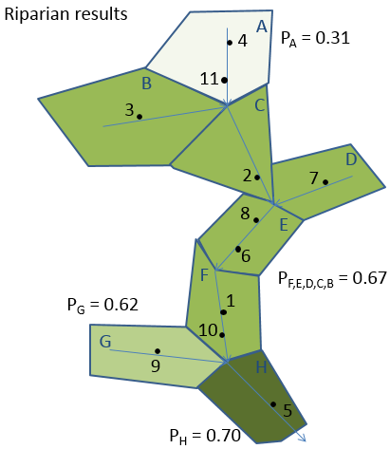
RIPARIAN MODEL RESULTS
Goal: Maximize total allocations with equitable distribution of shortage
Sensitivity analysis:
Upstream demand exceeds availability at points with red circles
User: | 1 | 2 | 3 | 4 | 5 | 6 | 7 | 8 | 9 | 10 | 11
Demand: | 7.0 | 4.0 | 8.0 | 8.0 | 8.0 | 4.0 | 3.0 | 9.0 | 9.0 | 7.0 | 10.0
Allocation: | 4.7 | 2.7 | 5.3 | 2.5 | 5.6 | 2.7 | 2.0 | 6.0 | 5.6 | 4.7 | 3.1
P: | 0.67 | 0.67 | 0.67 | 0.31 | 0.70 | 0.67 | 0.67 | 0.67 | 0.62 | 0.67 | 0.31
Shortage: | 2.34 | 1.34 | 2.67 | 5.51 | 2.41 | 1.34 | 1.00 | 3.01 | 3.41 | 2.34 | 6.89

Slide 47

RIPARIAN MODEL RESULTS
Curtailments in A
- Demand exceeds availability (FLOW LIMITED)
$$P_{A}=\frac{v_{k}^{A}−e_{k}^{A} }{\sum{u_{i, i∈A}}}= \frac{Availability in A}{Demand in A}= \frac{7 −1.4}{8+10}=0.31$$
${Allocation}_{4}= P_{A}∗u_{4}=8.0 ∗0.31=2.5$
User: | 1 | 2 | 3 | 4 | 5 | 6 | 7 | 8 | 9 | 10 | 11
Demand: | 7.0 | 4.0 | 8.0 | 8.0 | 8.0 | 4.0 | 3.0 | 9.0 | 9.0 | 7.0 | 10.0
Allocation: | 4.7 | 2.7 | 5.3 | 2.5 | 5.6 | 2.7 | 2.0 | 6.0 | 5.6 | 4.7 | 3.1
P: | 0.67 | 0.67 | 0.67 | 0.31 | 0.70 | 0.67 | 0.67 | 0.67 | 0.62 | 0.67 | 0.31
Shortage: | 2.34 | 1.34 | 2.67 | 5.51 | 2.41 | 1.34 | 1.00 | 3.01 | 3.41 | 2.34 | 6.89

Slide 48
RIPARIAN MODEL RESULTS
Curtailments in B
Availability exceeds demand
(DOWNSTREAM DEMAND LIMITED)
Downstream users in F have excessive demand
B is curtailed so downstream users experience less shortage
User: | 1 | 2 | 3 | 4 | 5 | 6 | 7 | 8 | 9 | 10 | 11
Demand: | 7.0 | 4.0 | 8.0 | 8.0 | 8.0 | 4.0 | 3.0 | 9.0 | 9.0 | 7.0 | 10.0
Allocation: | 4.7 | 2.7 | 5.3 | 2.5 | 5.6 | 2.7 | 2.0 | 6.0 | 5.6 | 4.7 | 3.1
P: | 0.67 | 0.67 | 0.67 | 0.31 | 0.70 | 0.67 | 0.67 | 0.67 | 0.62 | 0.67 | 0.31
Shortage: | 2.34 | 1.34 | 2.67 | 5.51 | 2.41 | 1.34 | 1.00 | 3.01 | 3.41 | 2.34 | 6.89

Slide 49
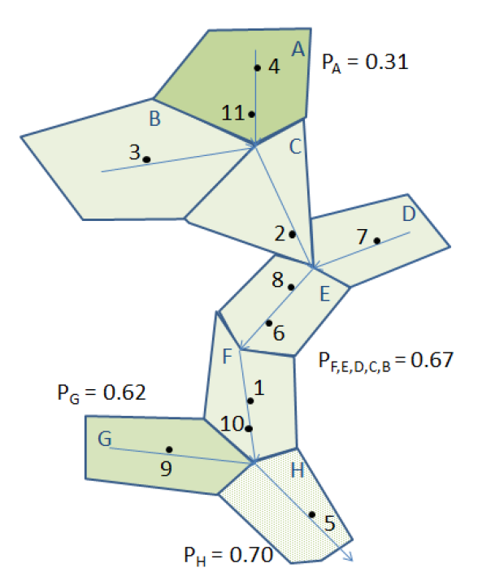
RIPARIAN ALLOCATIONS
From Water rights curtailments for drought in California: Method and Eel River Application
Benjamin Lord’s Master Thesis 2015

Slide 50
Appropriative model results
Goal:
Minimize penalties
Some results:
User 1 gets full allocation
Users 3 and 4 run out of water
Users 10 and 11 receive no allocation
Users | 1 | 2 | 3 | 4 | 5 | 6 | 7 | 8 | 9 | 10 | 11
Demand: | 7 | 4 | 8 | 8 | 8 | 4 | 3 | 9 | 9 | 7 | 10
Allocation: | 7.0 | 4.0 | 5.6 | 5.6 | 8.0 | 4.0 | 3.0 | 4.4 | 3.2 | 0.0 | 0.0
Shortage: | 0.0 | 0.0 | 2.4 | 2.4 | 0.0 | 0.0 | 0.0 | 4.6 | 5.8 | 7.0 | 10.0
Notes:
User 1 receives full allocation, runs out of right before runs out of water
Users 3 and 4 have high priority, but there just isn’t enough water available so they experience shortage. Run out of water before they run out of right

Slide 51
UPCOMING PRESENTATIONS & TRAINING SESSIONS
1 – background, context, introduction, discussion (REPEAT)
2 – DWRAT equations, input data, general workflow
3.A – presentation of output & related data
3.B – brainstorming metrics, analyses, discussion
4.A – presentation of python code, downloading & running
script from command line
4.B – scenario development, input files, data sources
5.A – use of main and ancillary python scripts, data
processing
5.B – programming continued, building the project folder

Slide 52
SESSION TWO
2 – DWRAT equations in depth, input data, data processing, general workflow, review, discussion.

