Slide 1
WATER ALLOCATION TOOL SESSION 2
Review Session 1
Connectivity matrices
Linear programming (LP)
Linear algebra
Variables
DWRAT equations & calculations
Q & A / Discussion

Slide 2
TRAINING SESSION SERIES
1 – background, context, introduction, discussion
2 – DWRAT equations, input data, general workflow
3.A – presentation of input, output & related data
3.B – brainstorming metrics, analyses, discussion
4.A – presentation of python code, downloading & running
script from command line
4.B – scenario development, input files, data sources
5.A – use of main and ancillary python scripts, data
processing
5.B – programming continued, building the project folder

Slide 3
DWRAT FRAMEWORK
Integrated set of mathematical equations that describe
water availability
instream flow requirements
and California water rights
These equations can be solved for an optimal water allocation among diverters given
basin flows
water demand
priority

Slide 4
WATER ALLOCATION
The process of distributing water supplies to various uses when there is a shortfall.
If there is no shortage, all uses could receive an allocation of the full amount needed.

Slide 5
REASONS TO ALLOCATE WATER
To manage streams during periods of water shortage (i.e. curtail) in real time
To evaluate instream flow management scenarios and regulatory approaches

Slide 6
OPTIMIZATION
determining the action that best achieves a desired goal or objective.
This means finding the action that optimizes (that is, maximizes or minimizes) the value of an objective function.

Slide 7
OPTIMIZATION PROBLEMS OBJECTIVE FUNCTIONS
objective functions:
A quantification of the management goal in terms of the decision variables
(in linear programming) the function that it is desired to maximize or minimize.

Slide 8
OPTIMIZATION PROBLEMS - DECISION VARIABLES
decision variables:
Values or allocations that need to be set to find the optimum of the objective function

Slide 9
OPTIMIZATION PROBLEMS - CONSTRAINTS
Constraints:
A set of equations or requirements that restrict the values of the decision variables

Slide 10
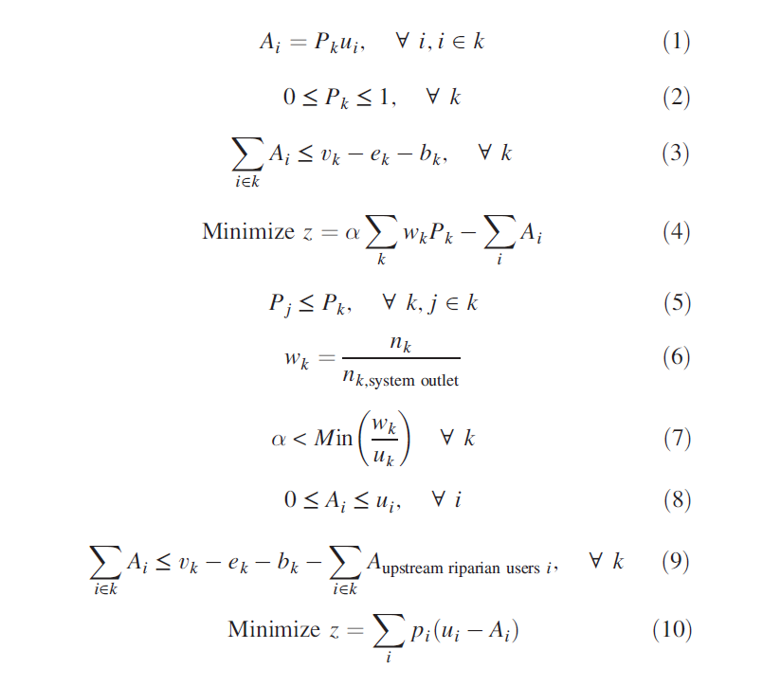
WATER ALLOCATION TOOL EQUATIONS

Slide 11
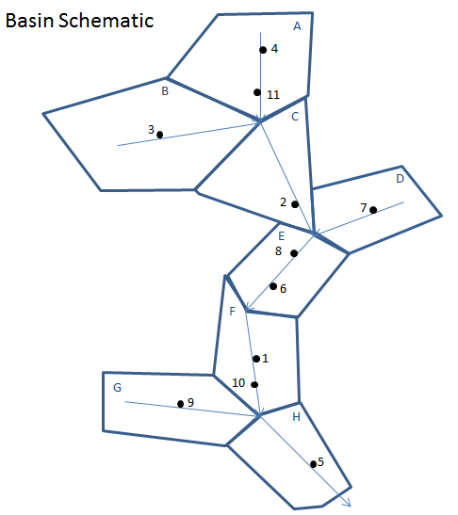
EXAMPLE MODEL
8 Basin 11 user toy model
Two scenarios:
All users riparian, equal priority
All users appropriative, priority by seniority
Local inflow of 7 for each watershed, 20% reserved for environmental flow = 5.6
User: | 1 | 2 | 3 | 4 | 5 | 6 | 7 | 8 | 9 | 10 | 11
Demand: | 7 | 4 | 8 | 8 | 8 | 4 | 3 | 9 | 9 | 7 | 10

Slide 12

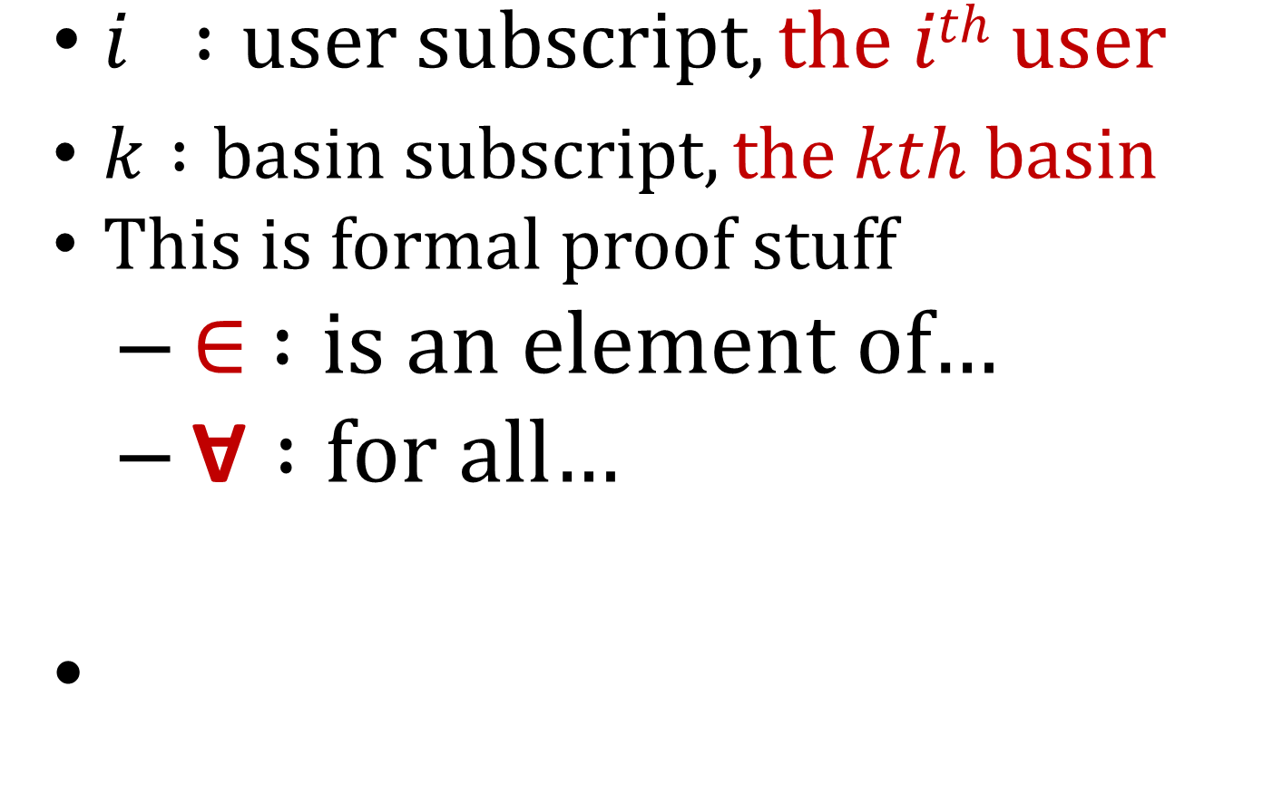
SOME NOTATION
$i :user subscript, the ith user$
$k :basin subscript, the kth basin$
This is formal proof stuff
$∈ :is an element of$…
$\text{Ɐ} :for all$…

Slide 13
MOTIVATION

Slide 14
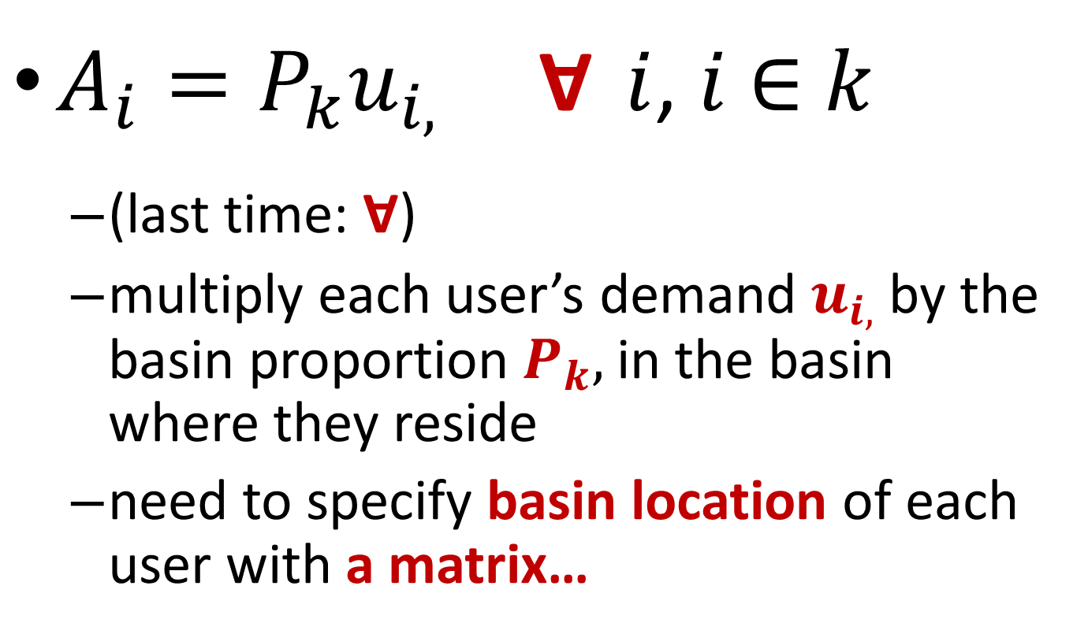
EQUATION ONE
$A_{i}=P_{k}u_{i,} \text{Ɐ}$ $i$, $i$ $∈$ $k$
(last time: $\text{Ɐ}$)
multiply each user’s demand $u_{i,}$by the basin proportion $P_{k},$in the basin where they reside
need to specify basin location of each user with a matrix…

Slide 15
WHAT IS A MATRIX ?
A rectangular array of numerical quantities arranged in a systematic fashion into rows and columns
Matrices describe aspects of phenomena which are inter-related in some manner
E.g. user & basin location
Vectors are matrices having a single column or row

Slide 16
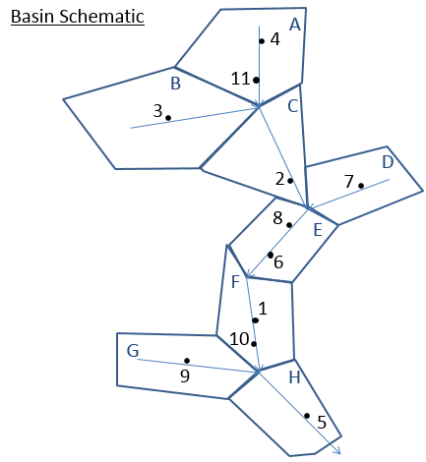
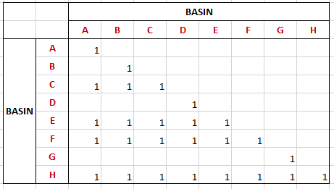
BASIN CONNECTIVITY MATRIX
Every basin is upstream of itself
Zeros are removed for legibility
Read from left to right, a (1) in a column indicates that the basin is upstream of that row basin.
A, B, and C are upstream of C

Slide 17
LINEAR PROGRAM

Slide 18
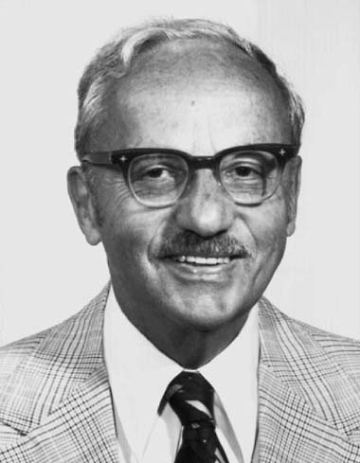
GEORGE B. DANTZIG (1914 – 2005)
The “real” Will Hunting
Inventor of linear programming (LP) and Simplex Method
Revolutionized the way government and private enterprise planned, scheduled and optimized operations
Simplex method
algo for solving LP problems (1947)
one of the earliest,
most important, and
widely used algorithms of 20th century

Slide 19
LINEAR PROGRAMMING
A technique for optimization of a linear objective function, subject to linear equality and inequality constraints.

Slide 20
LINEAR ALBEGRA
If linear algebra grew out of the solution of systems of linear equations, then linear programming grew out of attempts to solve systems of linear inequalities, allowing one to optimize linear functions subject to constraints expressed as inequalities

Slide 21
LINEAR ALBEGRA
Is using arithmetic on columns of numbers called vectors, and arrays of numbers called matrices, to create new columns and arrays of numbers

Slide 22
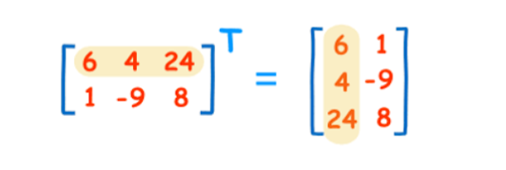
MATRIX TRANSPOSITON

Slide 23
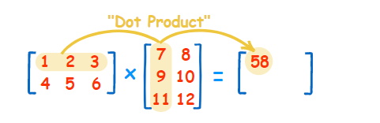
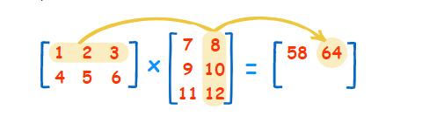
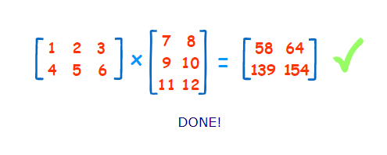
DOT PRODUCT

Slide 24
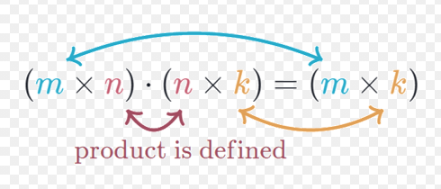
MATRIX MULTIPLICATION

Slide 25
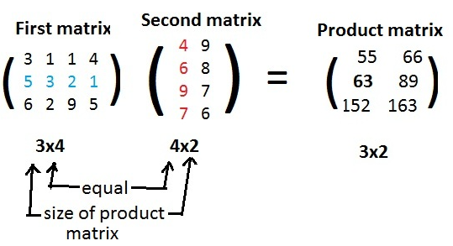
MATRIX MULTIPLICATION

Slide 26
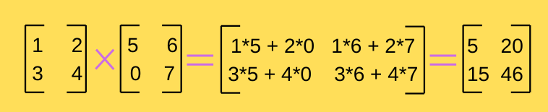
MATRIX MULTIPLICATION

Slide 27
MATRIX MULTIPLICATION

Slide 28
BASIN CONNECTIVITY MATRIX
Every basin is upstream of itself
Zeros are removed for legibility
Read from left to right, a (1) in a column indicates that the basin is upstream of that row basin.
A, B, and C are upstream of C

Slide 29
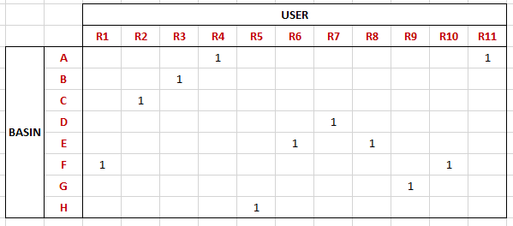
USER LOCATION MATRIX
Zeros have been removed…
All users have a 1 indicating their basin location

Slide 30
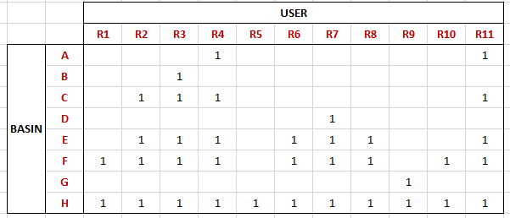
USER CONNECTIVITY MATRIX
Read from left to right, a 1 in a column indicates that the user is upstream of the row basin.
Users 2, 3, 4, and 11 are upstream of basin C

Slide 31
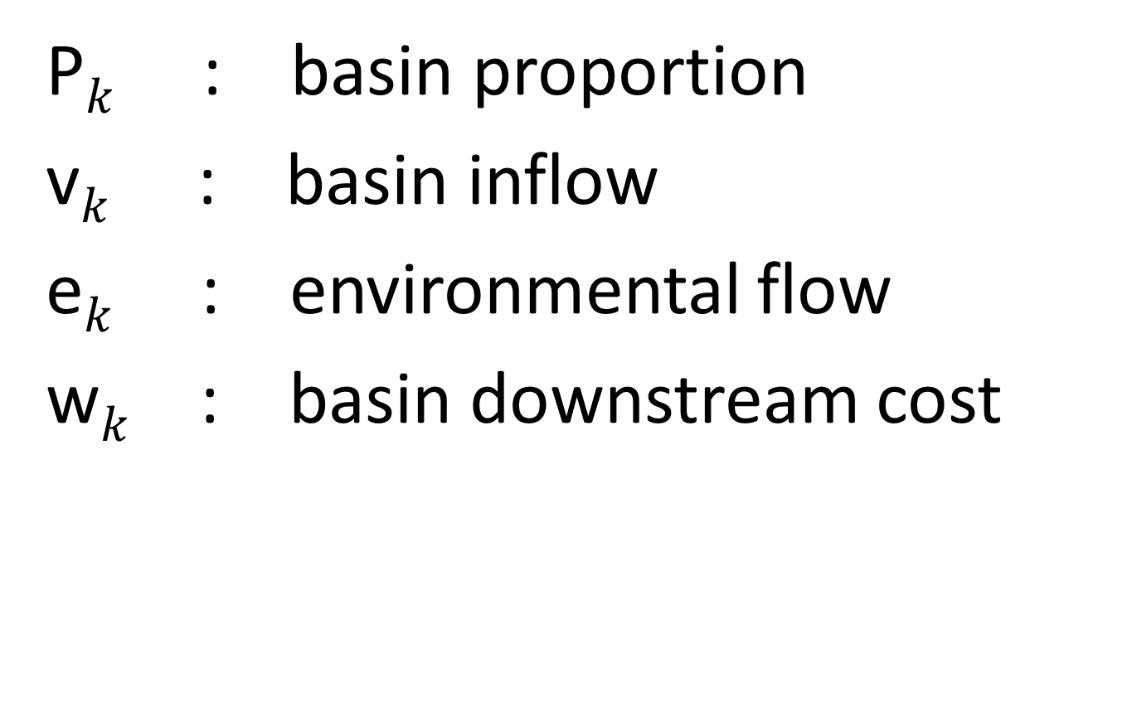
BASIN VARIABLE DEFINITIONS
P$k$ : basin proportion
v$k$ : basin inflow
e$k$ : environmental flow
w$k$ : basin downstream cost

Slide 32

USER VARIABLE DEFINITIONS
A$i$ : user allocation
u$i$ : user demand
p$i$ : appropriative user priority

Slide 33
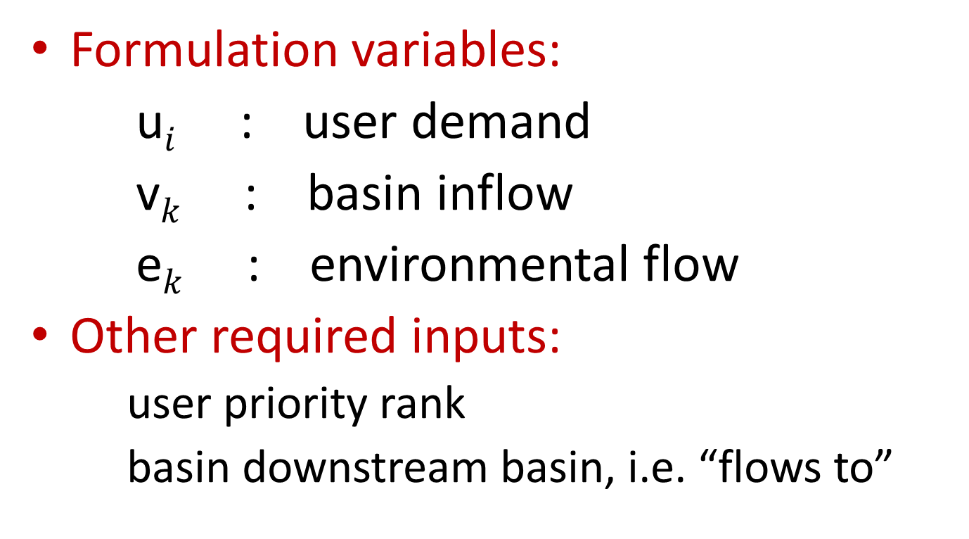
INPUT VARIABLES
Formulation variables:
u$i$ : user demand
v$k$ : basin inflow
e$k$ : environmental flow
Other required inputs:
user priority rank
basin downstream basin, i.e. “flows to”

Slide 34

OUTPUT VARIABLES
P$k$ : basin proportion
A$i$ : user allocation (appropriative)

Slide 35
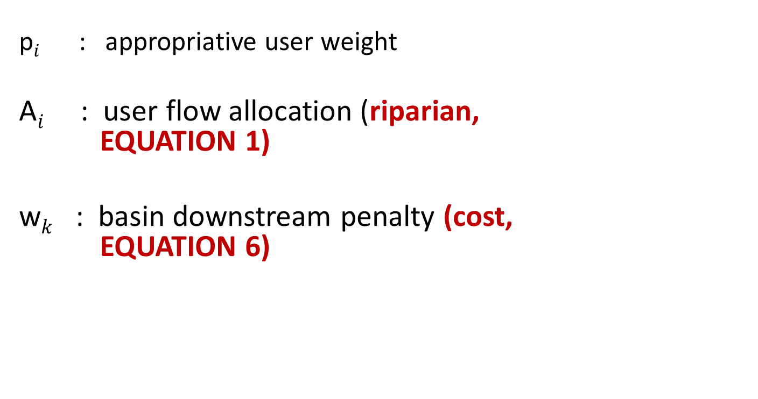
DERIVED VARIABLES
p$i$ : appropriative user weight
A$i$ : user flow allocation (riparian, EQUATION 1)
w$k$ : basin downstream penalty (cost, EQUATION 6)

Slide 36
PRELIMINARY CALCULATIONS
AVAILABLE FLOW
UPSTREAM DEMAND

Slide 37
BASIN CONNECTIVITY MATRIX
Every basin is upstream of itself
Zeros are removed for legibility
Read from left to right, a (1) in a column indicates that the basin is upstream of that row basin.
A, B, and C are upstream of C

Slide 38
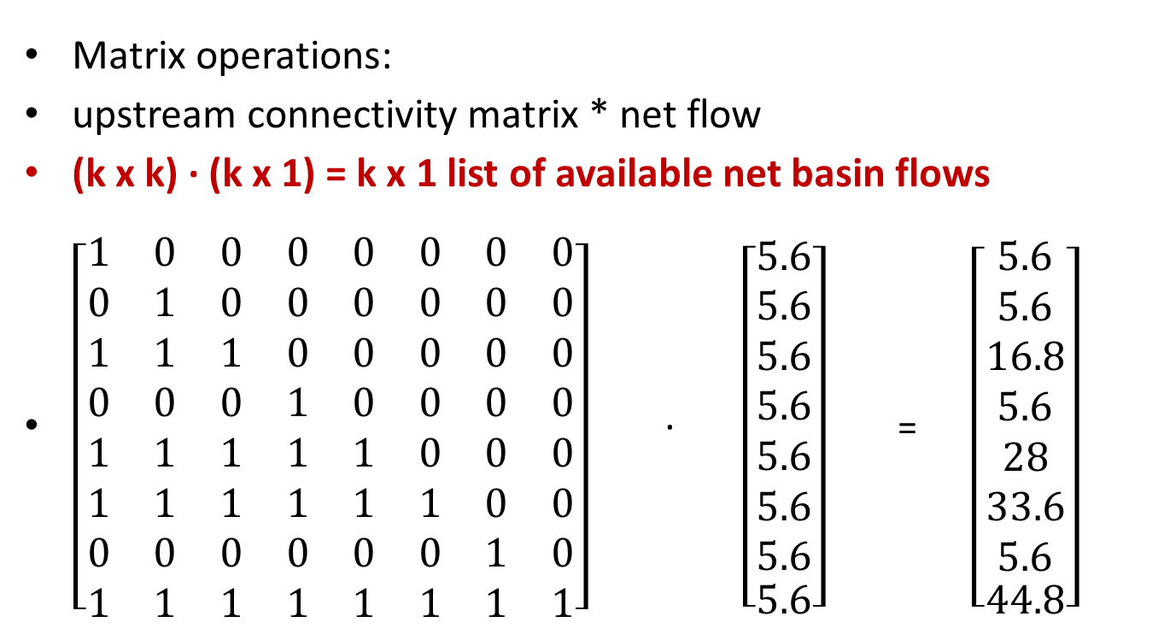
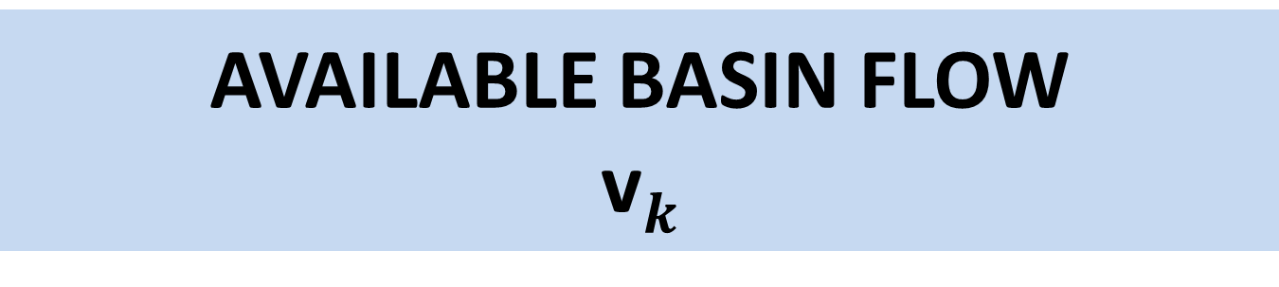
AVAILABLE BASIN FLOW v$k$
Matrix operations:
upstream connectivity matrix * net flow
(k x k) ∙ (k x 1) = k x 1 list of available net basin flows
$\left[\begin{matrix}1 & 0 & 0 & 0 & 0 & 0 & 0 & 0 \\ 0 & 1 & 0 & 0 & 0 & 0 & 0 & 0 \\ 1 & 1 & 1 & 0 & 0 & 0 & 0 & 0 \\ 0 & 0 & 0 & 1 & 0 & 0 & 0 & 0 \\ 1 & 1 & 1 & 1 & 1 & 0 & 0 & 0 \\ 1 & 1 & 1 & 1 & 1 & 1 & 0 & 0 \\ 0 & 0 & 0 & 0 & 0 & 0 & 1 & 0 \\ 1 & 1 & 1 & 1 & 1 & 1 & 1 & 1\end{matrix}\right]$ ∙$\left[\begin{matrix}\begin{matrix}5.6 \\ 5.6 \\ 5.6 \\ 5.6 \\ 5.6 \\ 5.6 \\ 5.6\end{matrix} \\ 5.6\end{matrix}\right]$ = $\left[\begin{matrix}\begin{matrix}5.6 \\ 5.6 \\ 16.8 \\ 5.6 \\ 28 \\ 33.6 \\ 5.6\end{matrix} \\ 44.8\end{matrix}\right]$

Slide 39
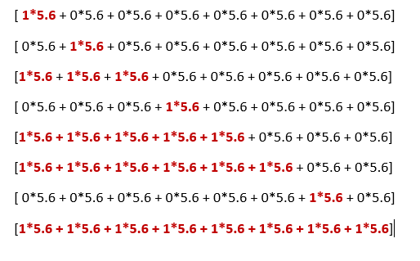
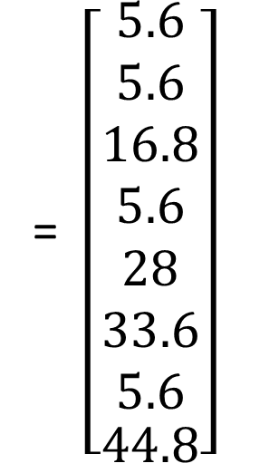

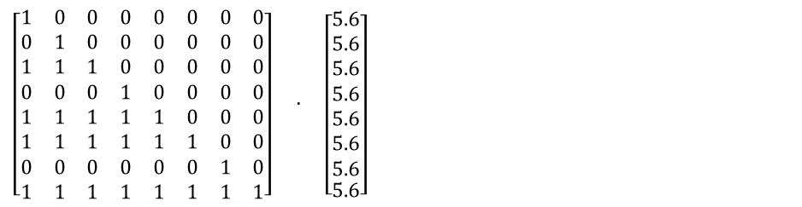
AVAILABLE BASIN FLOW v$k$
=
$\left[\begin{matrix}1 & 0 & 0 & 0 & 0 & 0 & 0 & 0 \\ 0 & 1 & 0 & 0 & 0 & 0 & 0 & 0 \\ 1 & 1 & 1 & 0 & 0 & 0 & 0 & 0 \\ 0 & 0 & 0 & 1 & 0 & 0 & 0 & 0 \\ 1 & 1 & 1 & 1 & 1 & 0 & 0 & 0 \\ 1 & 1 & 1 & 1 & 1 & 1 & 0 & 0 \\ 0 & 0 & 0 & 0 & 0 & 0 & 1 & 0 \\ 1 & 1 & 1 & 1 & 1 & 1 & 1 & 1\end{matrix}\right]$ ∙$\left[\begin{matrix}\begin{matrix}5.6 \\ 5.6 \\ 5.6 \\ 5.6 \\ 5.6 \\ 5.6 \\ 5.6\end{matrix} \\ 5.6\end{matrix}\right]$
= $\left[\begin{matrix}\begin{matrix}5.6 \\ 5.6 \\ 16.8 \\ 5.6 \\ 28 \\ 33.6 \\ 5.6\end{matrix} \\ 44.8\end{matrix}\right]$

Slide 40
USER CONNECTIVITY MATRIX
Read from left to right, a 1 in a column indicates that the user is upstream of the row basin.
Users 2, 3, 4, and 11 are upstream of basin C

Slide 41

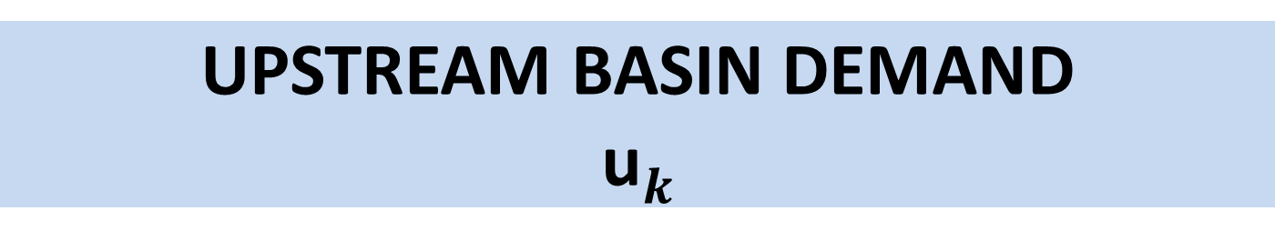

UPSTREAM BASIN DEMAND u$k$
Basin Demand is the sum of user demand upstream of each basin. k x i user connectivity matrix * i x 1 list of user demand = k x 1 basin demand
$\left[\begin{matrix}7 \\ 4 \\ 8 \\ 8 \\ 8 \\ 4 \\ 3 \\ 9 \\ 9 \\ 7 \\ 10\end{matrix}\right]$ = $\left[\begin{matrix}18 \\ 8 \\ 30 \\ 3 \\ 46 \\ 60 \\ 9 \\ 77\end{matrix}\right]$
$$\left[\begin{matrix}0 & 0 & 0 & 1 & 0 & 0 & 0 & 0 & 0 & 0 & 1 \\ 0 & 0 & 1 & 0 & 0 & 0 & 0 & 0 & 0 & 0 & 0 \\ 0 & 1 & 1 & 1 & 0 & 0 & 0 & 0 & 0 & 0 & 1 \\ 0 & 0 & 0 & 0 & 0 & 0 & 1 & 0 & 0 & 0 & 0 \\ 0 & 1 & 1 & 1 & 0 & 1 & 1 & 1 & 0 & 0 & 1 \\ 1 & 1 & 1 & 1 & 0 & 1 & 1 & 1 & 0 & 1 & 1 \\ 0 & 0 & 0 & 0 & 0 & 0 & 0 & 0 & 1 & 0 & 0 \\ 1 & 1 & 1 & 1 & 1 & 1 & 1 & 1 & 1 & 1 & 1\end{matrix}\right]$$
∙

Slide 42
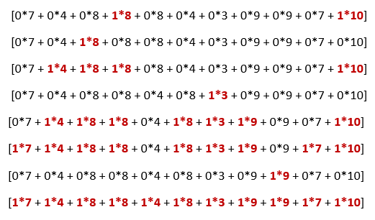
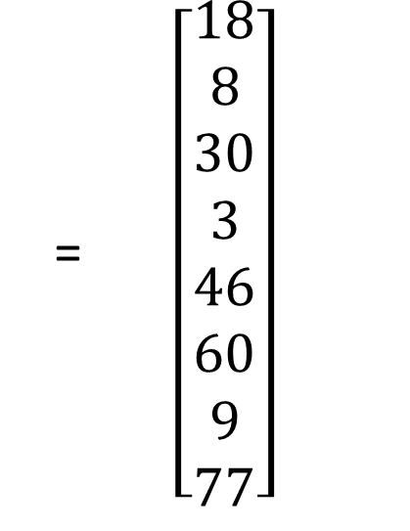



UPSTREAM BASIN DEMAND u$k$
$\left[\begin{matrix}7 \\ 4 \\ 8 \\ 8 \\ 8 \\ 4 \\ 3 \\ 9 \\ 9 \\ 7 \\ 10\end{matrix}\right]$ = $\left[\begin{matrix}18 \\ 8 \\ 30 \\ 3 \\ 46 \\ 60 \\ 9 \\ 77\end{matrix}\right]$
$$\left[\begin{matrix}0 & 0 & 0 & 1 & 0 & 0 & 0 & 0 & 0 & 0 & 1 \\ 0 & 0 & 1 & 0 & 0 & 0 & 0 & 0 & 0 & 0 & 0 \\ 0 & 1 & 1 & 1 & 0 & 0 & 0 & 0 & 0 & 0 & 1 \\ 0 & 0 & 0 & 0 & 0 & 0 & 1 & 0 & 0 & 0 & 0 \\ 0 & 1 & 1 & 1 & 0 & 1 & 1 & 1 & 0 & 0 & 1 \\ 1 & 1 & 1 & 1 & 0 & 1 & 1 & 1 & 0 & 1 & 1 \\ 0 & 0 & 0 & 0 & 0 & 0 & 0 & 0 & 1 & 0 & 0 \\ 1 & 1 & 1 & 1 & 1 & 1 & 1 & 1 & 1 & 1 & 1\end{matrix}\right]$$
∙
= $\left[\begin{matrix}18 \\ 8 \\ 30 \\ 3 \\ 46 \\ 60 \\ 9 \\ 77\end{matrix}\right]$

Slide 43



TOTAL BASIN DEMAND – NOT UPSTREAM BASIN DEMAND
[[0, 0, 0, 1, 0, 0, 0, 0, 0, 0, 1]
[0, 0, 1, 0, 0, 0, 0, 0, 0, 0, 0]
[0, 1, 0, 0, 0, 0, 0, 0, 0, 0, 0]
[0, 0, 0, 0, 0, 0, 1, 0, 0, 0, 0]
[0, 0, 0, 0, 0, 1, 0, 1, 0, 0, 0]
[1, 0, 0, 0, 0, 0, 0, 0, 0, 1, 0]
[0, 0, 0, 0, 0, 0, 0, 0, 1, 0, 0]
[0, 0, 0, 0, 1, 0, 0, 0, 0, 0, 0]]
∙
∙

Slide 44
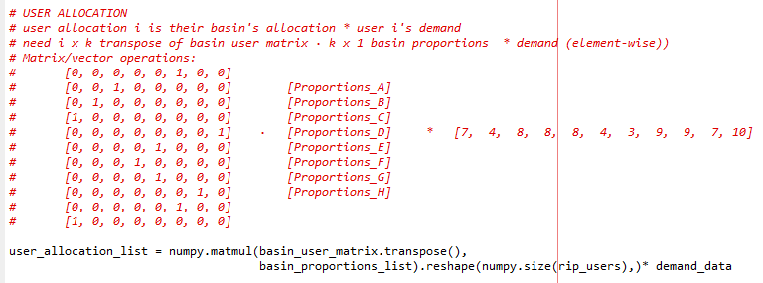
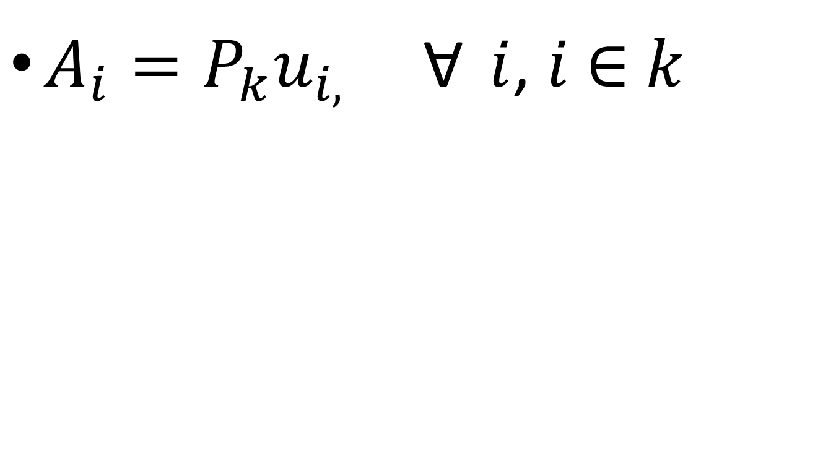
EQUATION ONE
$A_{i}=P_{k}u_{i,} \text{Ɐ}$ $i$, $i$ $∈$ $k$

Slide 45
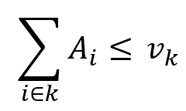
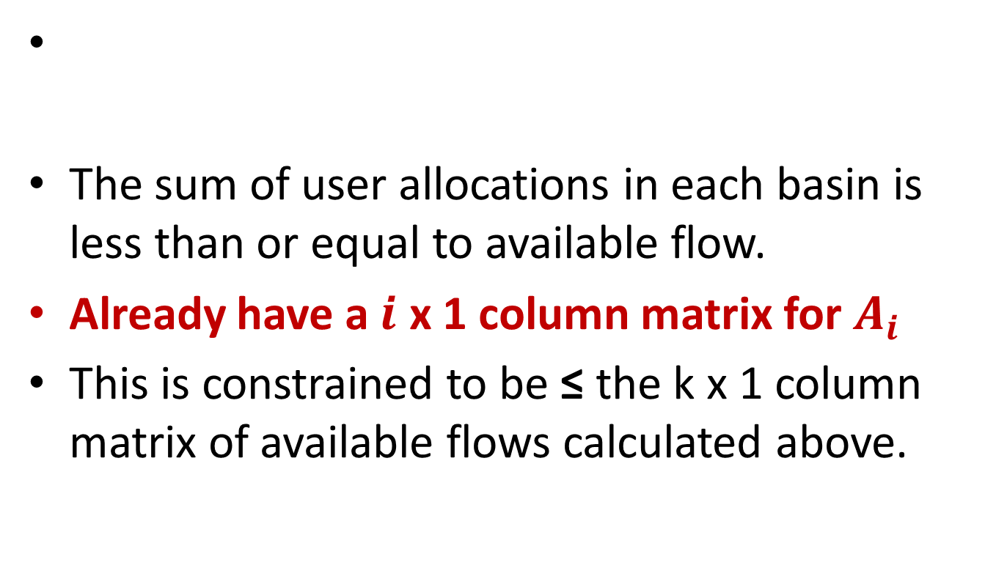
EQUATION THREE
The sum of user allocations in each basin is less than or equal to available flow.
Already have a $i$ x 1 column matrix for $A_{i}$
This is constrained to be ≤ the k x 1 column matrix of available flows calculated above.

Slide 46
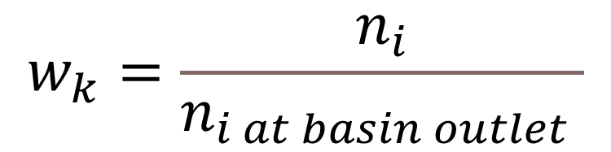
EQUATION SIX
$$w_{k}=\frac{n_{i}}{n_{i at basin outlet} }$$
The downstream penalty is simply the ratio between the number of users upstream of basin k, and the total number of users in the system.

Slide 47
USERS UPSTREAM OF basin k
(The user connectivity matrix)

Slide 48

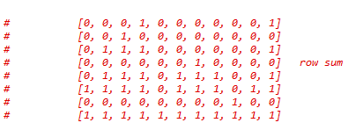

EQUATION SIX
downstream_penalty_list = np.divide(np.sum(riparian_user_connectivity_matrix, 1),
np.count_nonzero(rip_users))

Slide 49
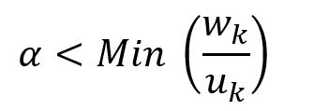

EQUATION SEVEN
We already have both these quantities.

Slide 50

EQUATION TWO
0 ≤${ P}_{k} \text{≤} 1$
No calculations Required. Just a constraint.

Slide 51
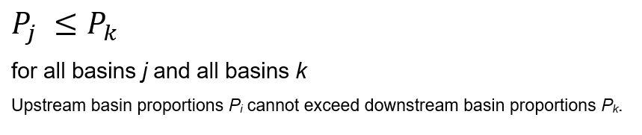
EQUATION FIVE
There are different ways of specifying this constraint.

Slide 52
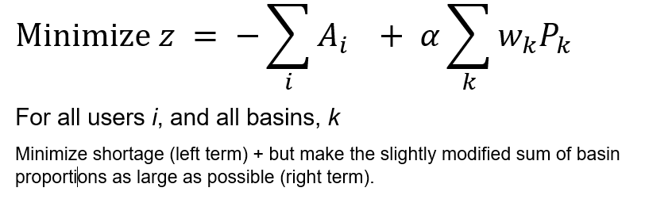
EQUATION FOUR
We already have these quantities

Slide 53
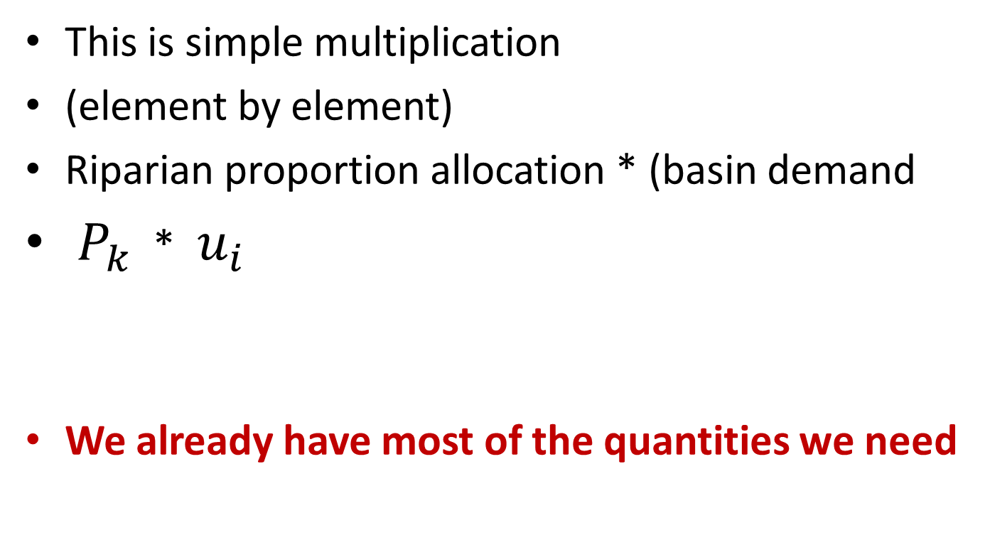
BASIN ALLOCATION
This is simple multiplication
(element by element)
Riparian proportion allocation * (basin demand
${ P}_{k}$ * ${ u}_{i }$
We already have most of the quantities we need

Slide 54
APPROPRIATIVE MODULE
We already have most of the quantities we need

Slide 55
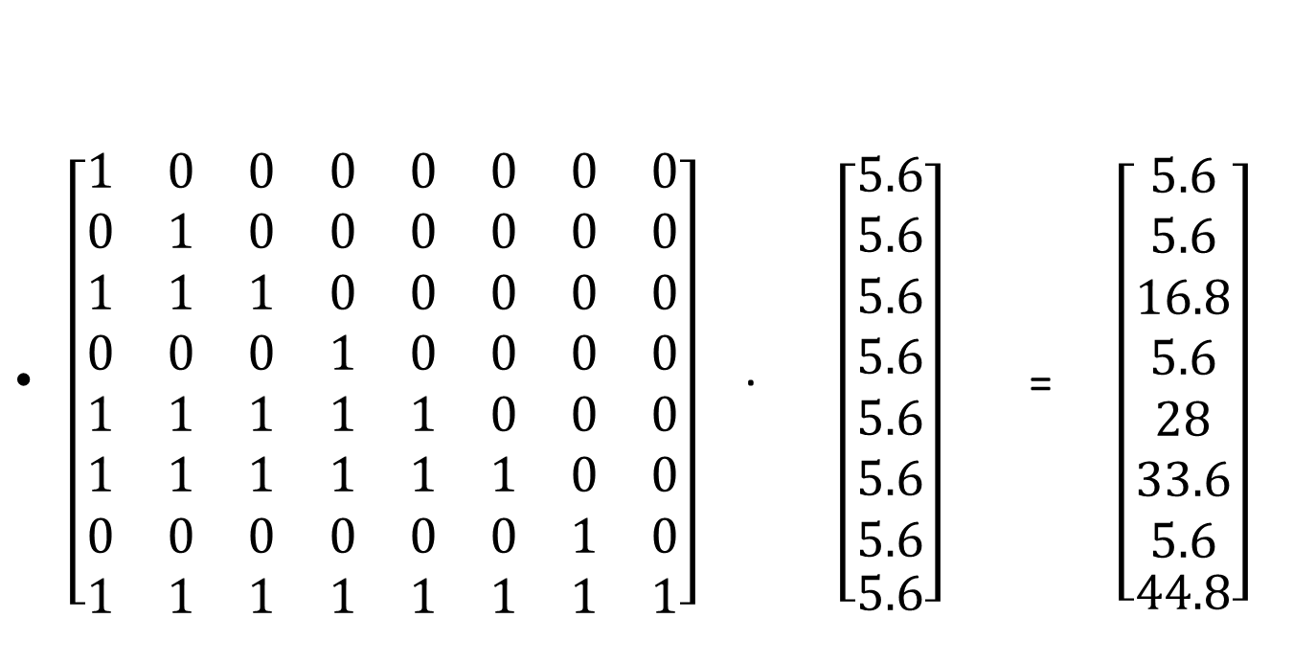
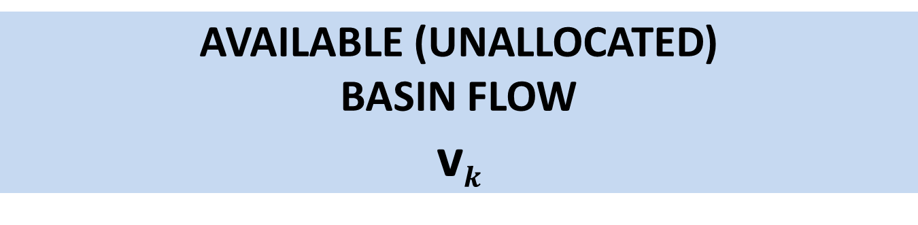
AVAILABLE (UNALLOCATED) BASIN FLOW v$k$
$\left[\begin{matrix}1 & 0 & 0 & 0 & 0 & 0 & 0 & 0 \\ 0 & 1 & 0 & 0 & 0 & 0 & 0 & 0 \\ 1 & 1 & 1 & 0 & 0 & 0 & 0 & 0 \\ 0 & 0 & 0 & 1 & 0 & 0 & 0 & 0 \\ 1 & 1 & 1 & 1 & 1 & 0 & 0 & 0 \\ 1 & 1 & 1 & 1 & 1 & 1 & 0 & 0 \\ 0 & 0 & 0 & 0 & 0 & 0 & 1 & 0 \\ 1 & 1 & 1 & 1 & 1 & 1 & 1 & 1\end{matrix}\right]$ ∙$\left[\begin{matrix}\begin{matrix}5.6 \\ 5.6 \\ 5.6 \\ 5.6 \\ 5.6 \\ 5.6 \\ 5.6\end{matrix} \\ 5.6\end{matrix}\right]$ = $\left[\begin{matrix}\begin{matrix}5.6 \\ 5.6 \\ 16.8 \\ 5.6 \\ 28 \\ 33.6 \\ 5.6\end{matrix} \\ 44.8\end{matrix}\right]$

Slide 56

EQUATION EIGHT
0 ≤${ A}_{i} \text{≤}{ u}_{i}$
No calculations Required. Just a constraint.

Slide 57
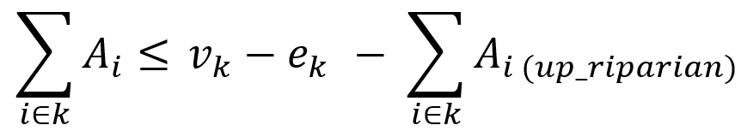
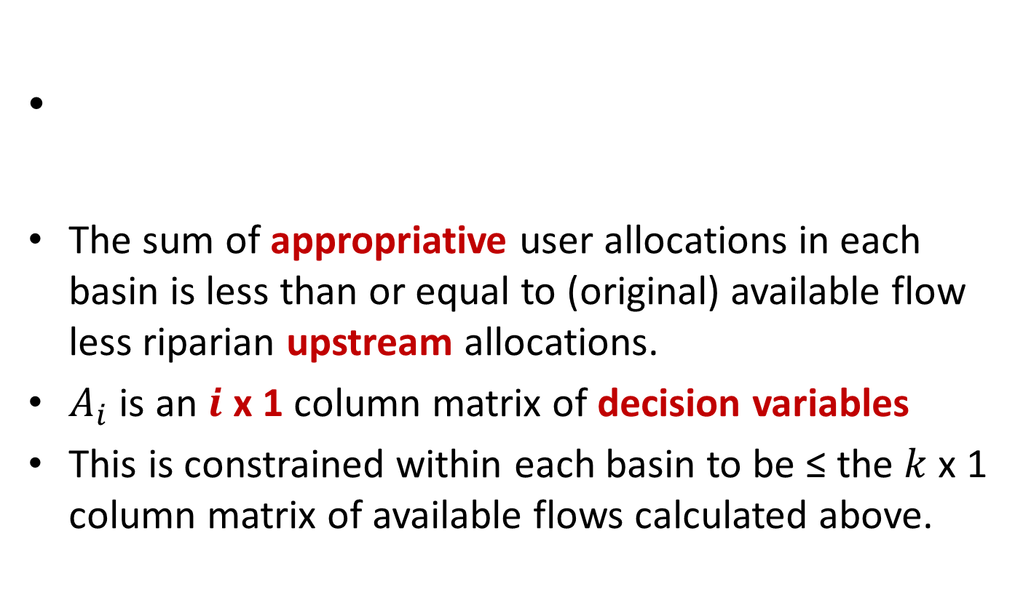
EQUATION NINE
The sum of appropriative user allocations in each basin is less than or equal to (original) available flow less riparian upstream allocations.
$A_{i}$ is an $i$ x 1 column matrix of decision variables
This is constrained within each basin to be ≤ the $k$ x 1 column matrix of available flows calculated above.

Slide 58
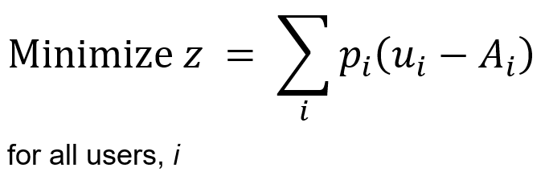
EQUATION TEN
This is just element-wise arithmetic

Slide 59
DEMONSTRATION

Slide 60
QUESTIONS ?

Slide 61
UPCOMING PRESENTATIONS & TRAINING SESSIONS
3.A – presentation of input, output & related data
3.B – brainstorming metrics, analyses, discussion
4.A – presentation of python code, downloading & running
script from command line
4.B – scenario development, input files, data sources
5.A – use of main and ancillary python scripts, data
processing
5.B – programming continued, building the project folder

Slide 62
SESSION THREE A/B
3.A – presentation of input, output & related data, discussion
3.B – brainstorming metrics, analyses, discussion

