Slide 1
WATER ALLOCATION TOOL
AKA DWRAT, pyWRAT, etc.

Slide 2
OUTLINE
Intro / Background to DWRAT, pyWRAT, etc.
Optimization Problems
Allocation Tool Overview
Formulations
Example Basin
Discussion / Q & A
New name?
Calculations / Programming
Vectorization
Numerical Python

Slide 3
MOTIVATION
A need for a formal procedure and tools to evaluate water availability that are:
Quantitative
Transparent
Open source
Easy to learn
Inexpensive to implement

Slide 4
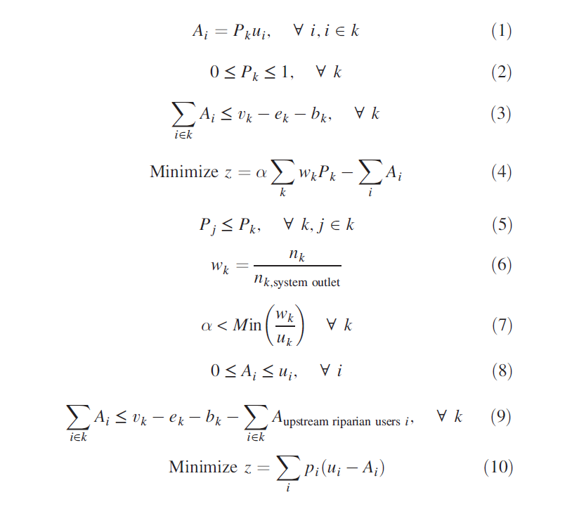

Slide 5
OPTIMIZATION PROBLEMS
Resource Allocation
Facility location decisions
Supply chain management
Blending problems

Slide 6
OPTIMIZATION PROBLEMS
HAVE THREE KEY COMPONENTS:
An objective function we want to optimize
A set of decision variables or allocations that need to be set to find the optimum of the objective function
A set of constraints that restrict the values of the variables

Slide 7
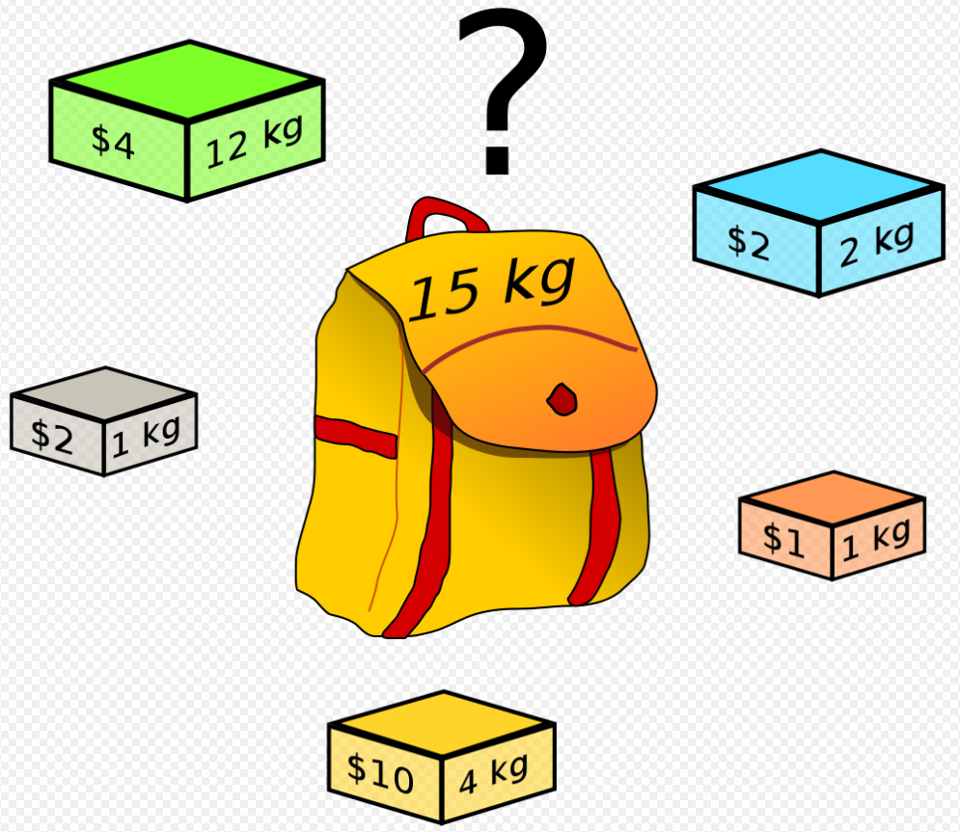
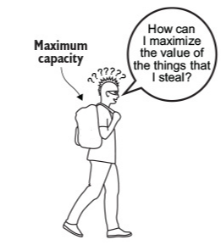
KNAPSACK PROBLEM

Slide 8
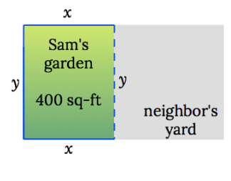
EXAMPLE OPTIMIZATION PROBLEM
What is the minimum cost to enclose a 400 sq-ft garden if Sam’s neighbor is paying half of the shared side?
https://www.matheno.com/calculus-1/optimization/garden-fence/

Slide 9
DECISION VARIABLES
Dimensions of garden:
x (width)
y (length)

Slide 10
CONSTRAINT
A (area) = 400 square feet
A = x*y = 400
Solve or y in terms of x:
y = 400 / x

Slide 11
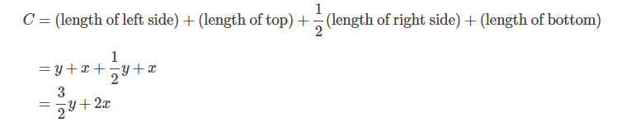
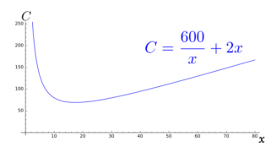
OBJECTIVE FUNCTION
Minimize C, (cost)
As a function
of x:

Slide 12
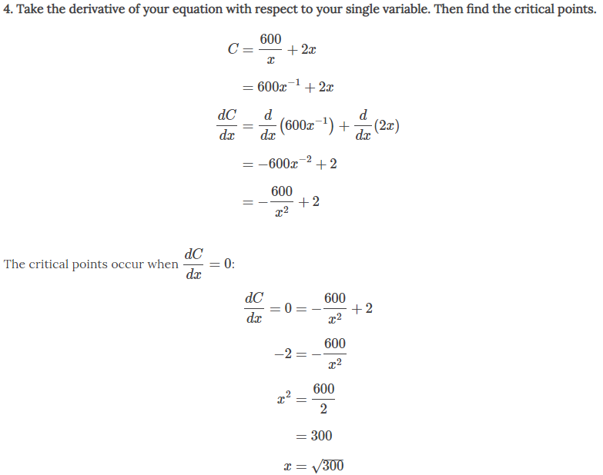
SOLVE

Slide 13
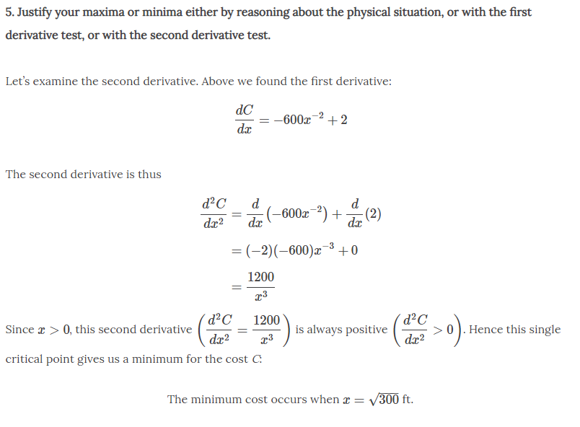
SOLVE (continued)

Slide 14
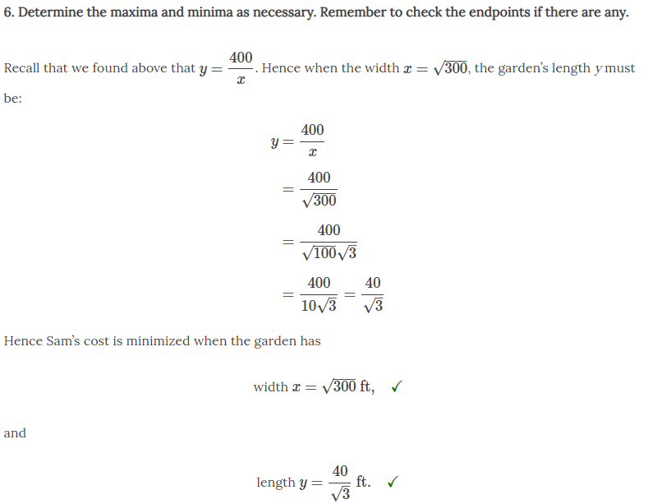
SOLVE (continued)

Slide 15
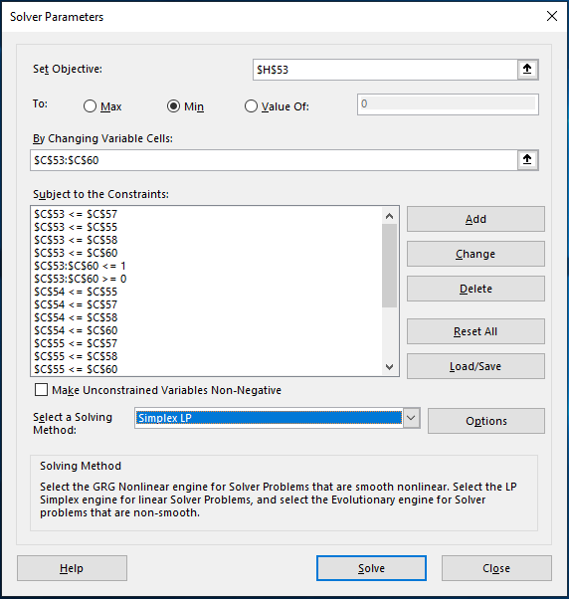
MS EXCEL SOLVER add-in

Slide 16
PuLP 2.0
Open source Python package for Linear Program modeling
Integrates with many available solvers
Used by UC Davis in both DWRAT and pyWRAT
Able to handle 1000s of decision variables vs. MS Excel maximum of 200
(Every watershed has one decision variable per sub-basin, and one per appropriative user)

Slide 18
WATER ALLOCATION TOOL
DWRAT
Implemented as Linear Program in Excel with OpenSolver (free) solution engine
pyWRAT
Implemented in Python using PuLP solver and Pandas data analysis packages
pyWRAT 2.0 (?)
Vectorized, implemented in Python using PuLP solver and Numerical Python (numpy) packages

Slide 19
ASSUMPTIONS
Every user has access to all basin flow, i.e. every user can divert from the outlet
All water use is 100% consumptive – no return flows
No losses to groundwater or evaporation
Flow is available to the whole network at each time step

Slide 20
VARIABLE DEFINITIONS
i : user subscript
k : basin subscript
P_{k} : basin proportion
A_{i} : user allocation
u_{i} : user demand
v_{k} : basin inflow
e_{k} : environmental flow
w_{k} : basin downstream cost
p_{i} : appropriative user priority

Slide 21
OPTIMIZATION PROBLEMS
HAVE THREE KEY COMPONENTS:
An objective function we want to optimize
A set of decision variables or allocations that need to be set to find the optimum of the objective function
A set of constraints that restrict the values of the variables

Slide 22
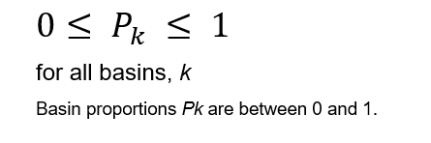
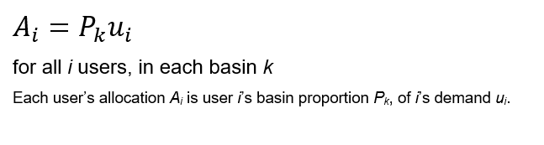
RIPARIAN DECISION VARIABLES
Basin proportions of demand allocated to riparian users:
Actual allocation is determined by proportions

Slide 23
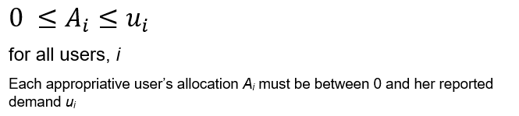
APPROPRIATIVE DECISION VARIABLES
Actual allocation for each appropriative user

Slide 24
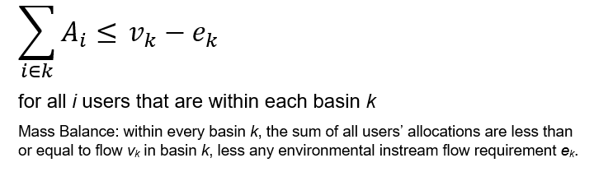
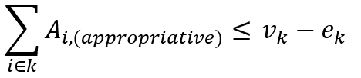
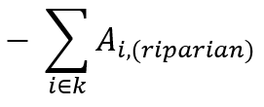
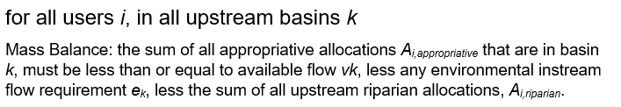
MASS BALANCE CONSTRAINTS
RIPARIAN
APPROPRIATIVE

Slide 25
WATER RIGHTS RULES (CONSTRAINTS)
Riparian Rights
Have highest priority
Share shortages proportionally
Appropriative Rights
First in time, first in right

Slide 26
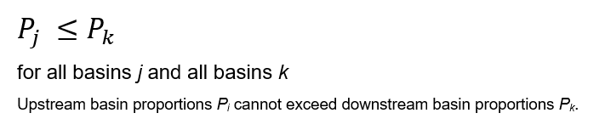
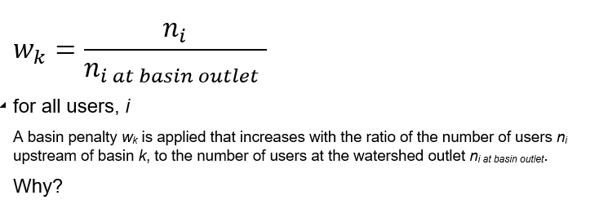
RIPARIAN LEGAL CONSTRAINTS
Shared shortage:
However:

Slide 27

APPROPRIATIVE LEGAL CONSTRAINTS
Seniority system shortage is minimized according to seniority:
Shortage is scaled in the objective function by the inverse of the priority aka (shortage penalty)

Slide 28
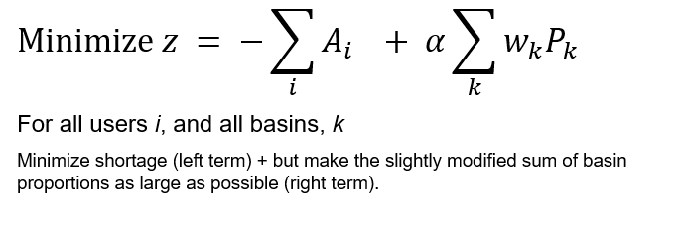
RIPARIAN OBJECTIVE FUNCTION
Maximize riparian allocations:

Slide 29
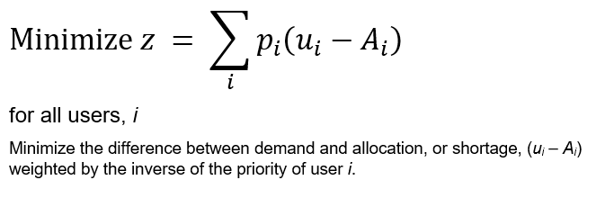
APPROPRIATIVE OBJECTIVE FUNCTION
Maximize appropriative allocations by seniority:

Slide 31
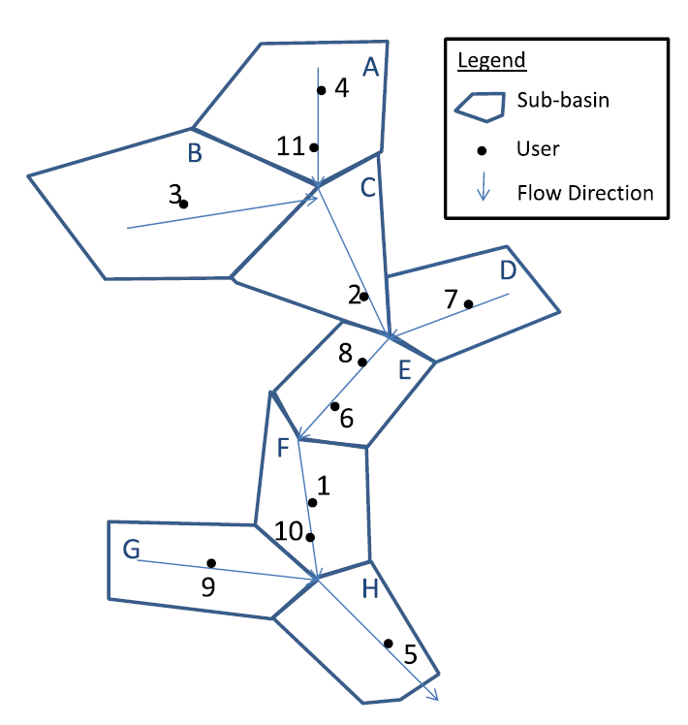
EXAMPLE
From Drought Water Right Curtailment Analysis for California’s Eel River.
Lord et al. - Journal of Water Resources Planning and Management - 2018

Slide 32
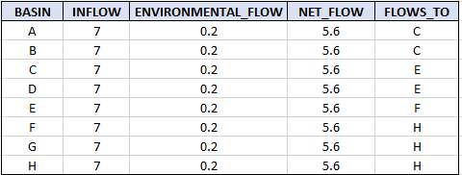
BASIN DATASETS

Slide 33
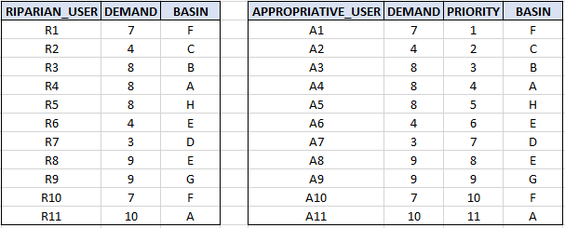
USER DATASETS

Slide 34
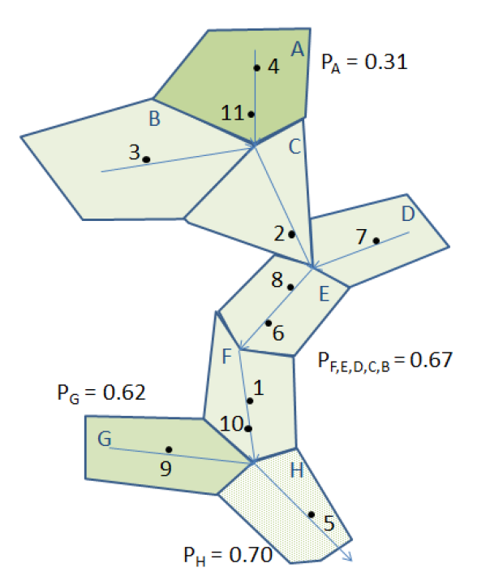
RIPARIAN ALLOCATIONS
From Water rights curtailments for drought in California: Method and Eel River Application
Benjamin Lord’s Master Thesis 2015

Slide 35
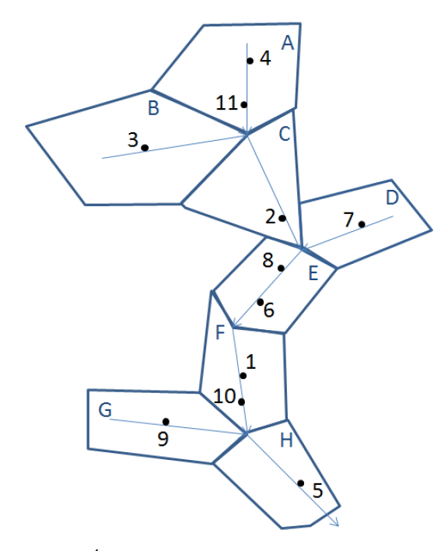
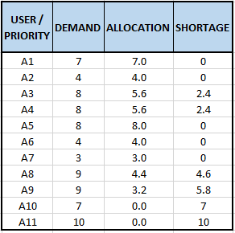
APPRIOPRIATIVE USER ALLOCATIONS

Slide 36
QUESTIONS ?

Slide 37
CALCULATIONS, PROGRAMMING APPROACHES, NUMERICAL PYTHON, ETC.

Slide 38
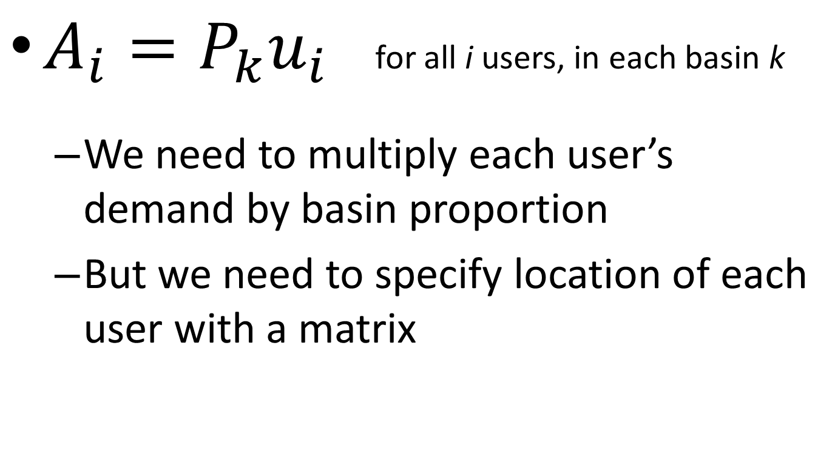
EXAMPLE CALCULATION
$A_{i}=P_{k}u_{i}$ for all i users, in each basin k
We need to multiply each user’s demand by basin proportion
But we need to specify location of each user with a matrix

Slide 39
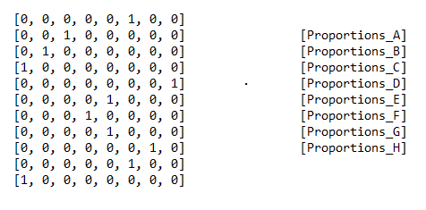

MATRIX OPERATIONS

Slide 40
VECTORIZATION
The process of converting routines that sequentially loop over elements to matrix operations
Vectorized operations are several orders of magnitudes faster,
And easier to understand from a mathematical perspective

Slide 41
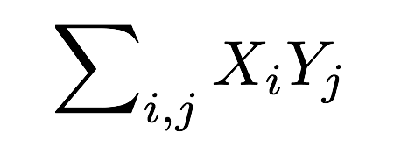
NESTED FOR LOOPS
MATRIX OPERATION
For all i,
For all j,
sum (X_{i} * Y_{j})
X ∙ Y
Or might need the
transpose:
X^{T} ∙ Y

Slide 42
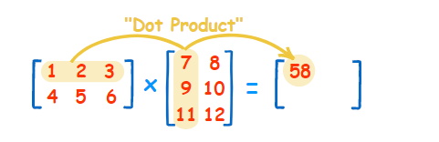
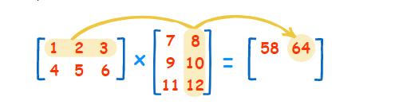
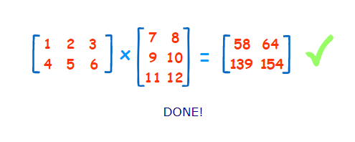
MATRIX MULTIPLICATION

Slide 43
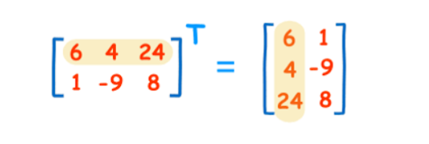
MATRIX TRANSPOSITON

Slide 44


UPSTREAM CALCULATION
Basin Demand is the sum of user demand upstream of each basin k x i user connectivity matrix * i x 1 list of user demand = k x 1 basin demand
$\left[\begin{matrix}7 \\ 4 \\ 8 \\ 8 \\ 8 \\ 4 \\ 3 \\ 9 \\ 9 \\ 7 \\ 10\end{matrix}\right]$ = $\left[\begin{matrix}18 \\ 8 \\ 30 \\ 3 \\ 46 \\ 60 \\ 9 \\ 77\end{matrix}\right]$
$$\left[\begin{matrix} & & & 1 & & & & & & & 1 \\ & & 1 & & & & & & & & \\ & 1 & 1 & 1 & & & & & & & 1 \\ & & & & & & 1 & & & & \\ & 1 & 1 & 1 & & 1 & 1 & 1 & & & 1 \\ 1 & 1 & 1 & 1 & & 1 & 1 & 1 & & 1 & 1 \\ & & & & & & & & 1 & & \\ 1 & 1 & 1 & 1 & 1 & 1 & 1 & 1 & 1 & 1 & 1\end{matrix}\right]$$
∙

Slide 45
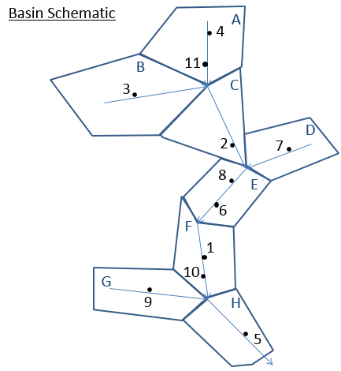
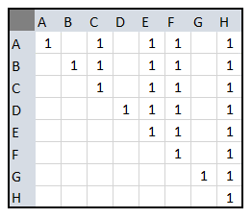
CONNECTIVITY MATRIX - BASINS
A value of 1 indicates row subbasin flows to corresponding column subbasin

Slide 46
CONNECTIVITY MATRIX - USERS
A value of 1 indicates user (column) is upstream of basin outlet (row)
Used for implementation of mass balance constraints
Generated with GIS in larger river basins
 |  | Users
 |  | 1 | 2 | 3 | 4 | 5 | 6 | 7 | 8 | 9 | 10 | 11
Basins | A |  |  |  | 1 |  |  |  |  |  |  | 1
 | B |  |  | 1
 | C |  | 1 | 1 | 1 |  |  |  |  |  |  | 1
 | D |  |  |  |  |  |  | 1
 | E |  | 1 | 1 | 1 |  | 1 | 1 | 1 |  |  | 1
 | F | 1 | 1 | 1 | 1 |  | 1 | 1 | 1 |  | 1 | 1
 | G |  |  |  |  |  |  |  |  | 1
 | H | 1 | 1 | 1 | 1 | 1 | 1 | 1 | 1 | 1 | 1 | 1

Slide 47
NUMERICAL PYTHON (NUMPY)
provides fast and efficient operations on arrays of homogeneous data.
NumPy extends python into a high-level language for manipulating numerical data, similar to MATLAB.
Most operations are one line of code, and very readable mathematically
Example: user allocation
user_allocation_list = (numpy.matmul (basin_proportions_list.transpose(), basin_user_matrix) * demand_data)

Slide 48
QUESTIONS ?

Slide 49
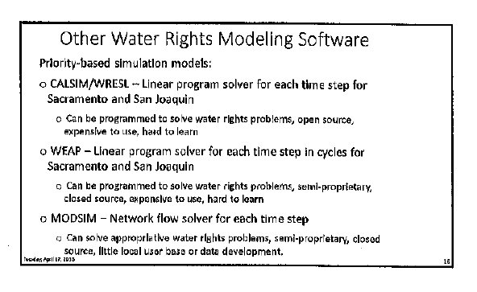
ALTERNATIVE ALLOCATION APPROACHES

