Slide 1
Airvita
Assembly guide

Slide 2
Airvita
Ptr4
FR3

Slide 3
Airvita assembly
Input stage
8mm
SV1
PR
6mm
8mm
6mm
6mm
SV2 High flow
6mm
6mm
12V Battery
+
-
6mm
SV2-bis SV4 Low flow
SV3
6mm
6mm
FR1
FR2

Slide 4

Airvita assembly
Output stage
8mm
SV1
PR
6mm
8mm
6mm
6mm
SV2 High flow
6mm
FR3
6mm
12V Battery
+
-
6mm
SV2-bis SV4 Low flow
SV3
6mm
6mm
NR1
FR1
FR2

Slide 5
Airvita assembly
Sensing part
8mm
SV1
PR
6mm
8mm
6mm
6mm
SV2 High flow
6mm
FR3
6mm
12V Battery
+
-
6mm
SV2-bis SV4 Low flow
SV3
6mm
6mm
NR1
FR1
FR2

Slide 6
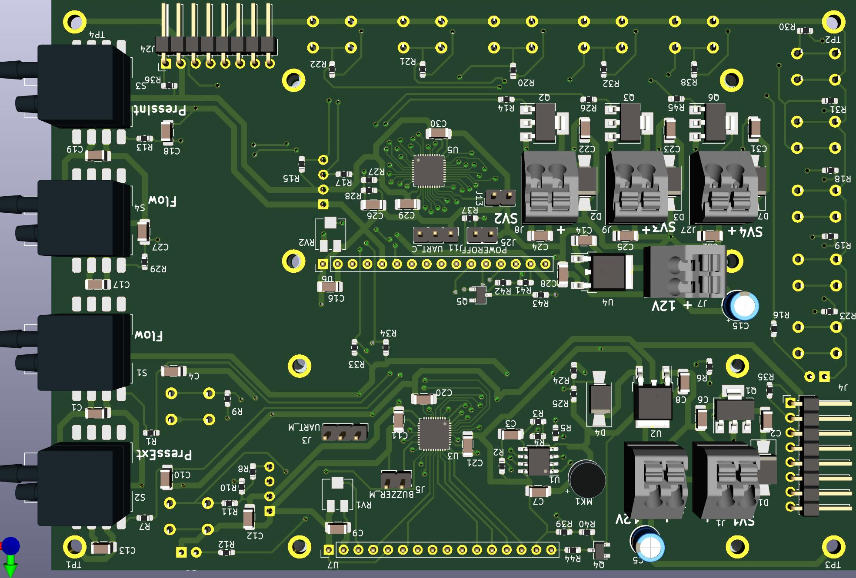
Airvita assembly
Sensing part

Slide 7
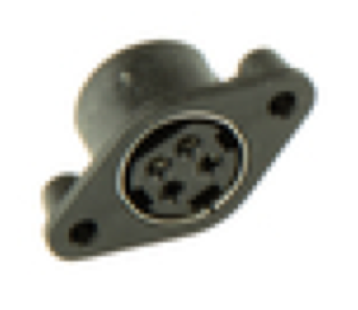
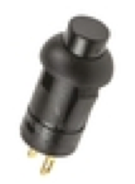
Airvita assembly
Cabling - Power supply
12V Battery
+
-

