Slide 1
Highest ranked countries in overall happiness.
By:
Deependra Dhakal

Slide 2
Research Question
What are the different factors that leads to the happiness of a country?
How does economy of a country determine its happiness?
Are the countries in certain region are correlated to average scores of the countries in the region?
What are the similarities and differences between the countries with highest and lowest scores?

Slide 3
Variables.
The ranking is based on the overall score. The variables that might affect the scores are:
Country
Economy_GDP
Family
Life_Expectancy
Freedom
Trust_corruption
Generosity

Slide 4
What do these variables mean?
Country represents the name of the country
Economy_GDP represents the economic well being of the country.
Family represents having someone in the time of need
Life_Expectancy represents the healthy life expectancy
Freedom. Freedom of choices.
Trust_corruption. Perceptions of government trust and corruption.
Generosity.

Slide 5
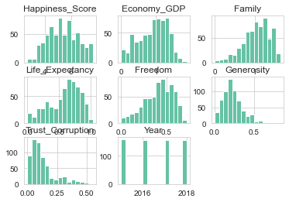
Histograms.

Slide 6
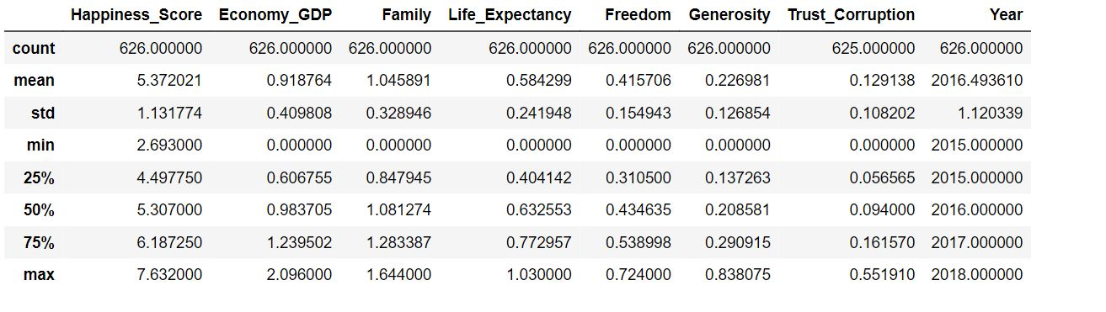
Descriptive Characteristics

Slide 7
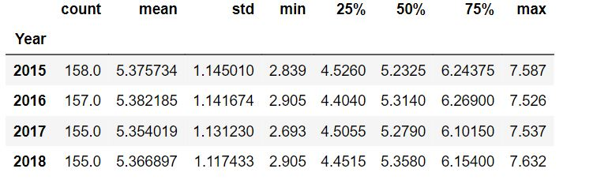
Yearly Summary of Happiness score

Slide 8
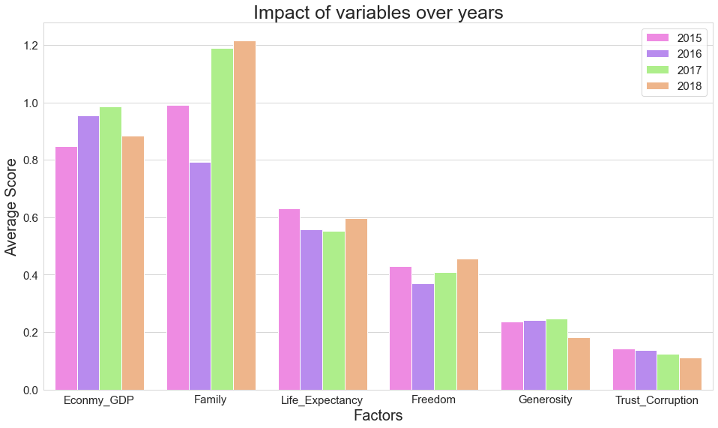
Influence of factors over years

Slide 9
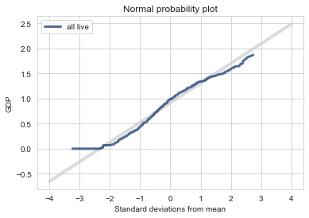
Distribution of Economy_GDP

Slide 10
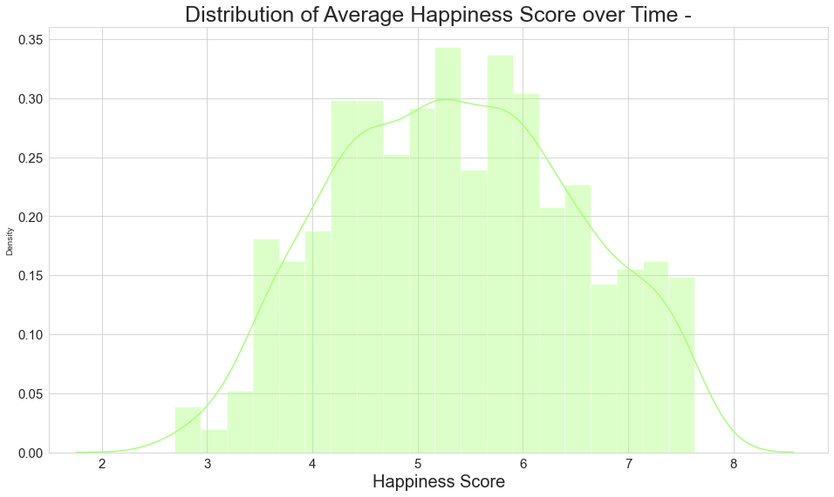
Distribution of happiness score over years

Slide 11
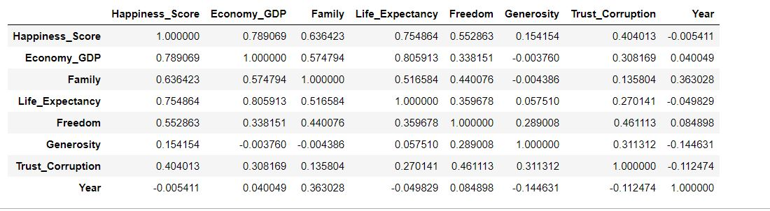
Correlation

Slide 12
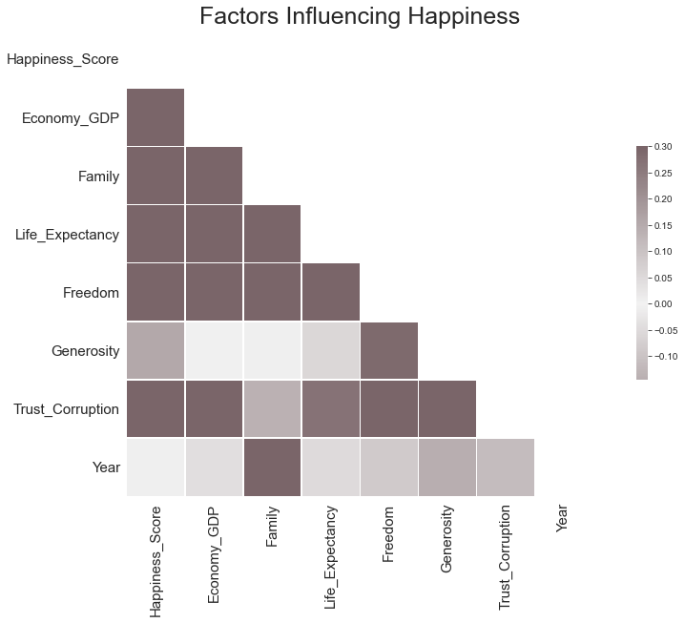
Correlation

Slide 13
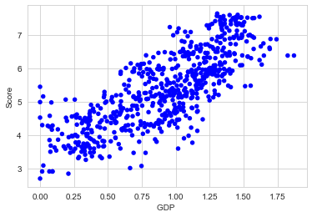
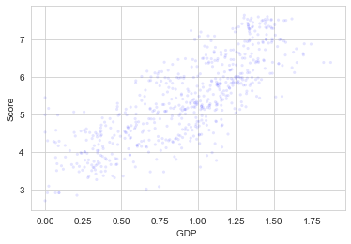
Scatter plot

Slide 14
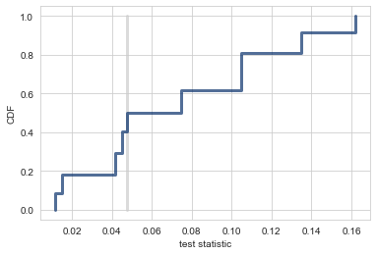
Hypothesis Testing

Slide 15
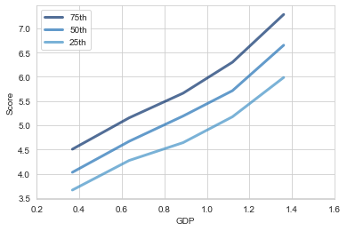
Percentile

Slide 16
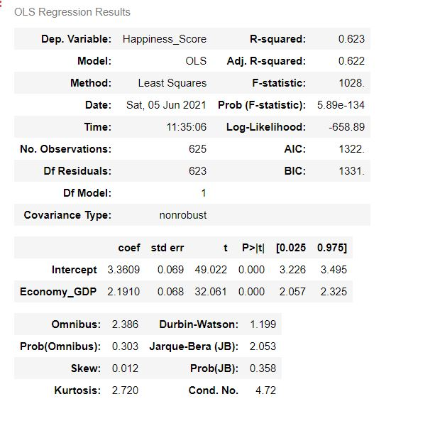
Simple Regression

Slide 17
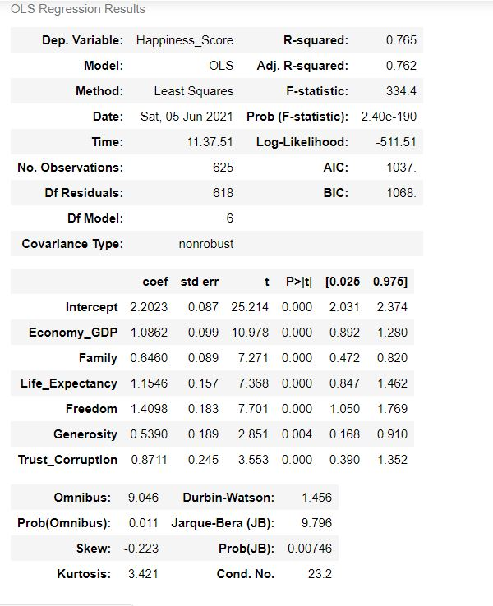
Multiple Regression

Slide 18
Conclusion.
Economic (GDP) tends to be the strongest of all factors in determining happiness and followed by health (life expectancy).
Countries in the similar region often have similar living conditions which affects the overall score accordingly.

