Slide 1
Executive Summary.
Airline Safety Analysis.
By: Deependra Dhakal.

Slide 2
Problem Statement.
Media has taken recent unfortunate events and created fear in the public minds.
The news and media outlets have been bombarding the public with reports and figures about the trends of airline safety and that things are not looking good.
Air travels has been recently promoted as the most dangerous form of transportation.

Slide 3
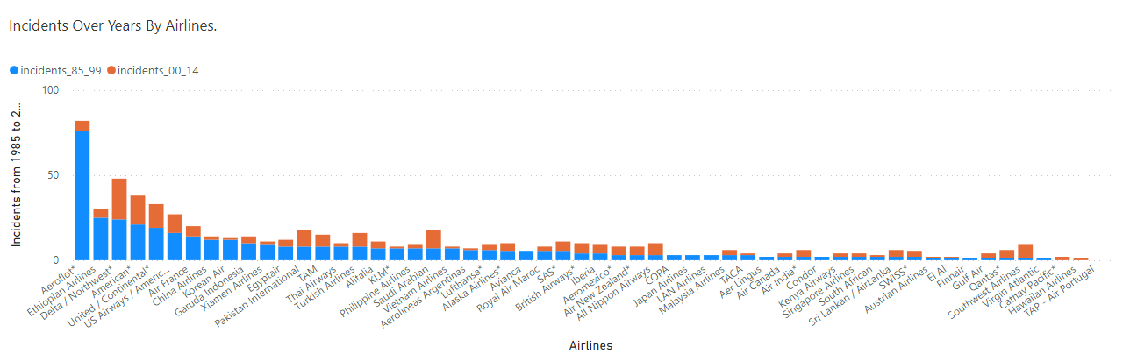
Analysis.
The number of incidents have reduced after the turn of the century. Even compared with incidents from 1985, Aeroflot seems to have the highest until the 2014 and the number of incidents are 82 out of which 6 of them happen to be reported from 2000 to 2014 which is a serious decrease in incidents compared to 76 1985 to 1999. With the advancement of technology, the incident seems to be decreased substantially.

Slide 4
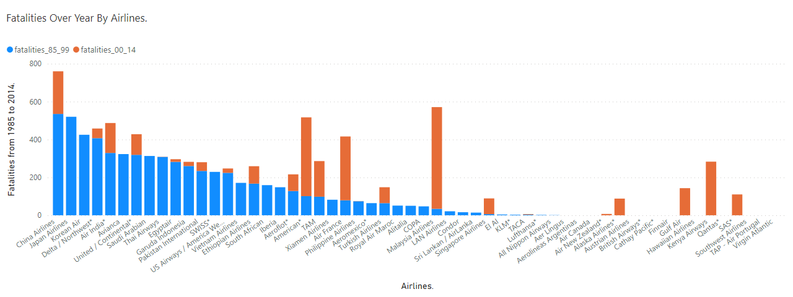
Airlines Fatalities.
Open in Power BI Dashborad_DDhakal_Final Data as of 1/26/22, 7:46 AM
Air Fatalities have reduced significantly over years.
Majority of the airlines didn’t record any fatalities.

Slide 5
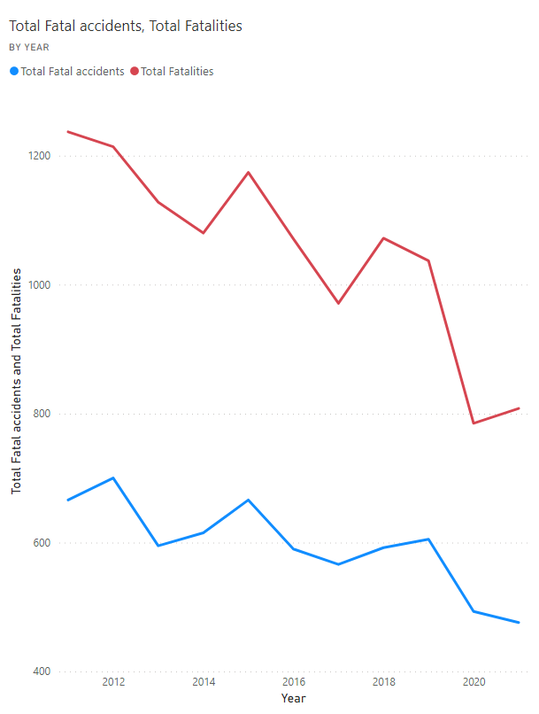
The Line chart indicates there is decrease in incidents and fatalities.
We are looking at 476 incidents and 808 fatalities in 2021 compared to 666 incidents and 1237 fatalities in 2011.

Slide 6
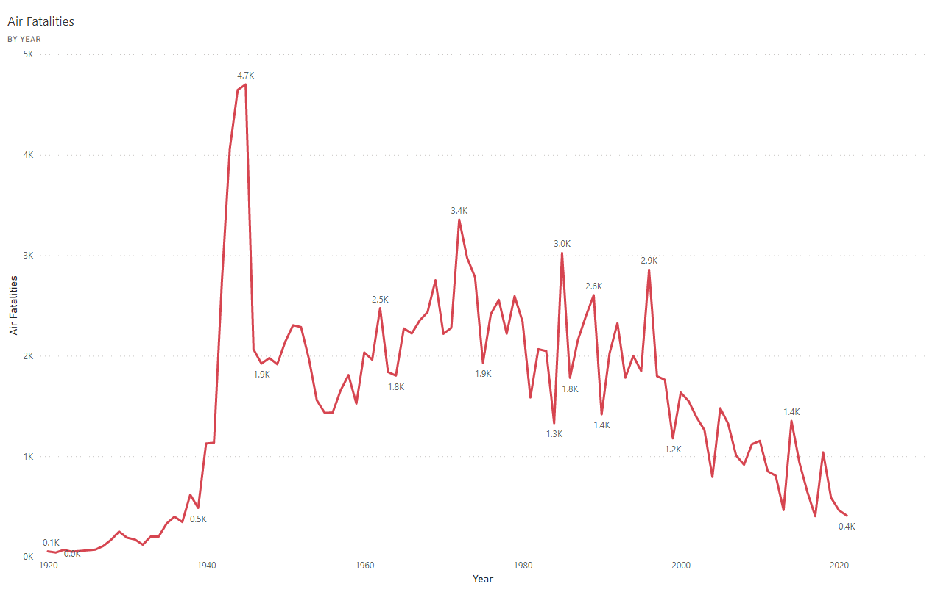
Total Worldwide Air Fatalities over years.
The highest number of air fatalities was of 4700 in the year 1945.
With the technological advancement the number has been reduced significantly .

Slide 7
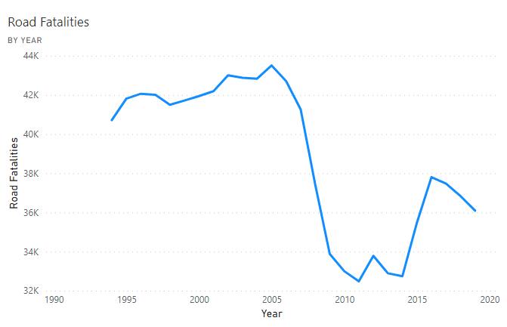
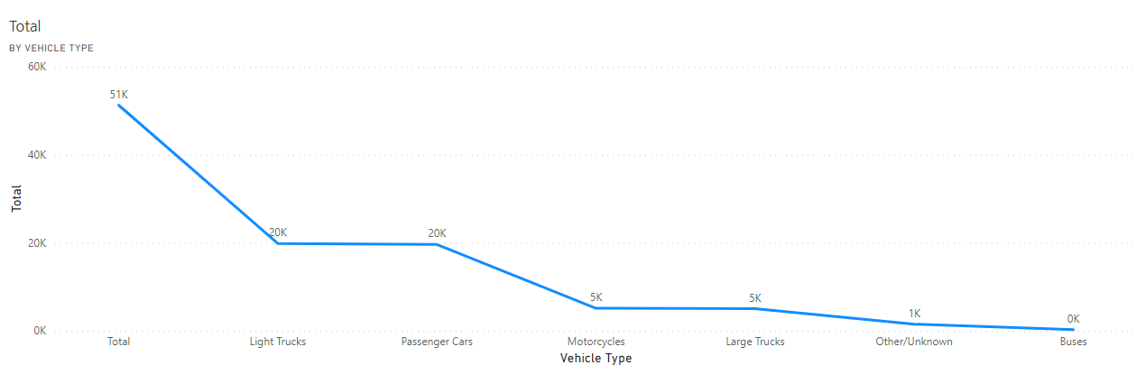
Road Fatalities.
Road fatalities peaked in the year 2005 with 43,510 fatalities.
The Lowest recorded fatalities was in 2011 with 32,479 fatalities.
Light Trucks and Passenger cars are the major cause of fatalities.

Slide 8
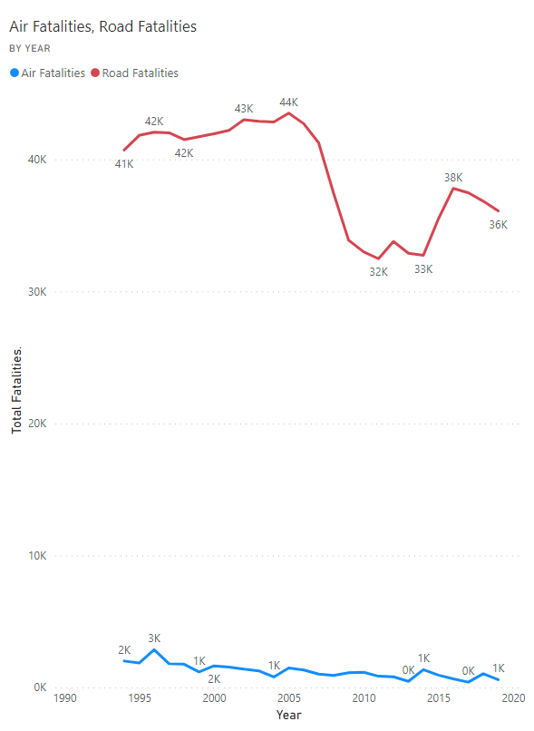
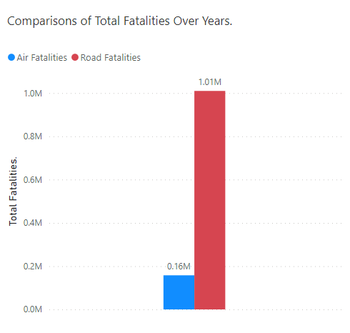
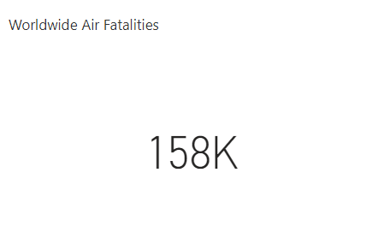

Comparing Airline Fatalities with Road.
Air travel is safer.
Airlines only has 158,000 fatalities worldwide over years to 1 million fatalities only in US in the same time frame.

Slide 9
Summary.
Airline incidents are so rare that if anything unusual happens, media seem to hype it all for their ratings.
Road accidents are so common, media does not seem to give much importance unless it’s a bi incident.
Airline has seen 158K fatalities to 1 million of road fatalities only in USA.
Air travel is safer than the road.

