Slide 1
An attempt at making the perfect bracket goes horribly wrong
By: David Pennington

Slide 2
SO MANY STATS
GM, GP, GS, PTS, FGM, FGA, FG%, FTM, FTA, FT% 3FGM, 3FGA, 3FG%, REB, OREB, DREB AST, STL, BLK, TO, EFF, PF, MIN…
PER:Player Efficiency Rating
PIR: Performance Index Rating
Injury History, GPA, HEIGHT, WEIGHT…

Slide 3
What should I do if I don’t know how to use basketball statistics, but I do know computer stuff?

Slide 4
Meta-Bracketology
Thousands of ‘Analysts’ on the internet hosting their brackets.
“They know Basketball, Right?”
Rank teams using a large population of analyst guesses and then run a bracket simulation.
The Code is on github
dpenning/meta-bracketology
Sources Brackets from CBS-Sports, ESPN, Sports-Illustrated, and USAToday

Slide 5
Team Ranking Calculation

Slide 6
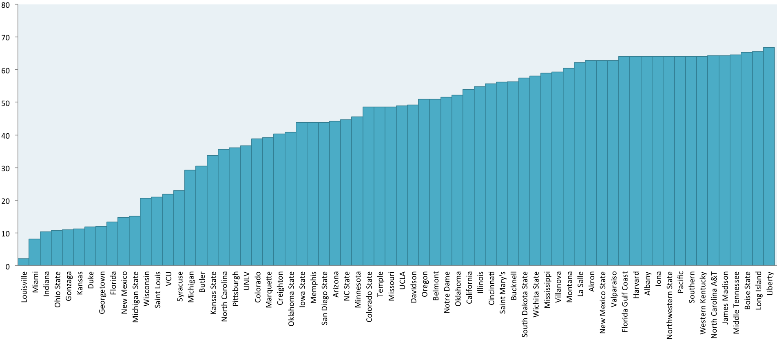
Rank of a team based on analyst guesses sorted by lowest ranking first

Slide 7
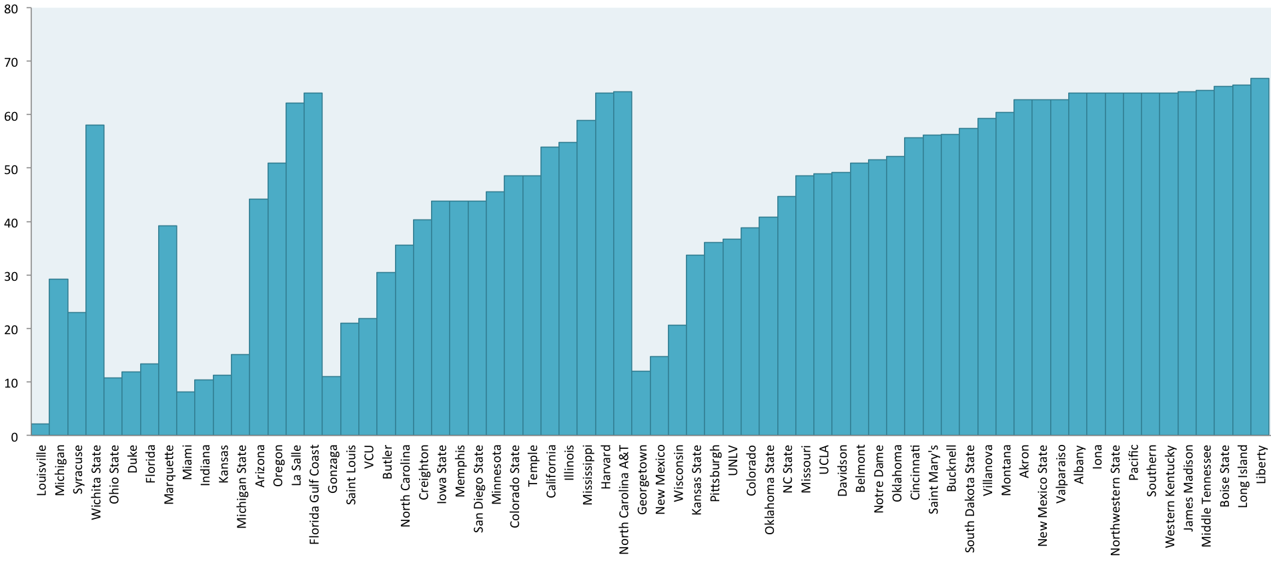
Rank of a team based on analyst guesses sorted actual finished position.

Slide 8
Louisville had the lowest ranking (2.1)
Liberty had the highest ranking(66.8)
The Runners up in the tournament (Michigan) had a rank of 29.2
Listing all groups based on max rating
Winning : 2.1 (Louisville)
Championship : 29.2 (Michigan)
Final 4 : Elite 8 : 58.1 (Wichita State)
Sweet 16: 64 (FGCU)

Slide 9
Their Actual Results

Slide 10
Upsets
The hardest part of making a bracket is picking the right upsets.
Statistics can help you with this.
Analysts can’t
Of the 10 in the first round, they picked 1
Of the 20 in the tournament, they picked 1

Slide 11
Correct Picks
As a whole they averaged 6/8 correct picks in the first round.
This was actually pretty standard based on brackets from ESPN.
For every conference, they picked the 1 and 2 seed to be in the elite 8 (3/8)…
They picked 1 of the 4 final four teams
and that was Louisville
They (almost) unanimously picked Louisville as the winner.

Slide 12
Conclusion
Never Trust Sports Analysts (unless they are actually statisticians)

