Slide 1

Capstone project Credit Card Fraud Detection
A presentation by Daniel Pérez Hernández

Slide 2
01 – Content

Slide 3
01
04
Content
Analysing the data
02
05
Why fraud detection?
Model predictions
03
06
ML Flow Overview
Conclusions

Slide 4
2 – Why Fraud Detection?

Slide 5


300 BC, Greece: A shipping merchant kept the “lost” cargo and the claiming from it.
1821: Gregor MacGregor sold non-existing land to investors from Europe.
Recent days: ATM/application/internet banking fraud, amongst others.
Origins
Shift towards new technologies.
Most recent pandemics
Lack of risk exposure awareness
From PwC’s Global Economic Crime and Fraud Survey 2022
Recent Causes
The Association of Certified Fraud Examiners estimates that US organizations lose about 7% of their revenues to fraud. Nisbet, et.al (2018)
Consequences
Artificial Intelligence is vital for financial risk control in cloud environment.
(Wang, et.al; 2021).
Solution

Slide 6
3 – ML Flow Overview

Slide 7
Dataset: banking transactions
Variables
Highly unbalanced
Normalization and Oversampling
Features: numerical
Label: categorical
A category excedes the other
Input
Fraud Detection Model
Type: Classification
Logistic Regression
Random Forest Classifier
Transaction is a fraud
Output
Transaction is not a fraud

Slide 8
4 – Analyzing the data

Slide 9
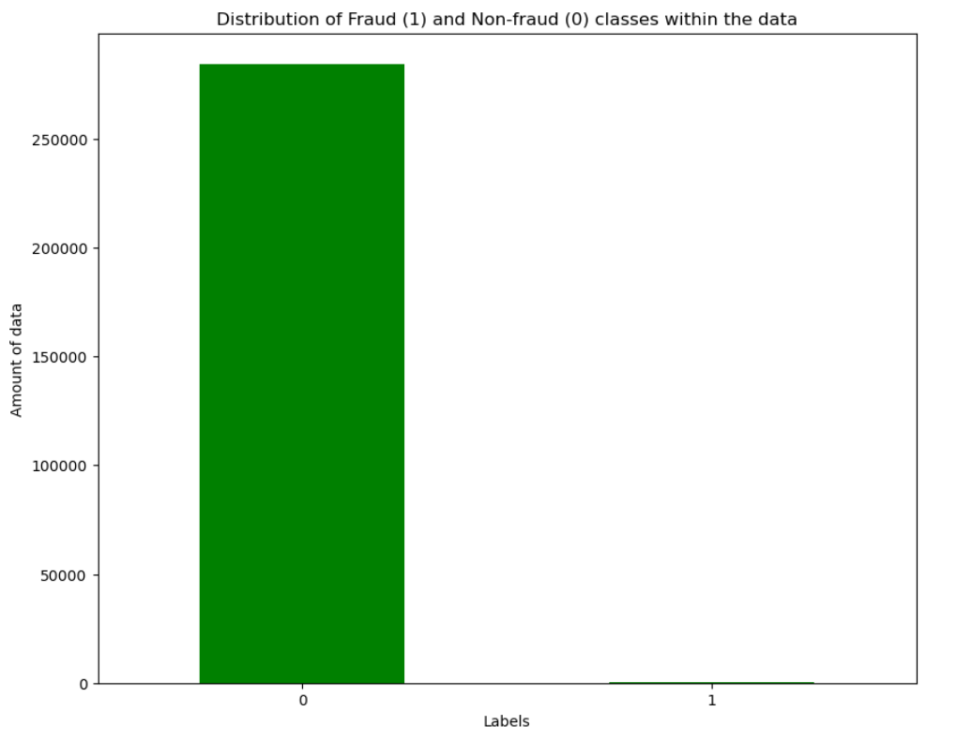
Original data
99.83% of the total transactions are labeled as Non-Fraud (284,315)
The rest (0.17%) is labeled as Fraud (495)
Total transactions: 284,807

Slide 10
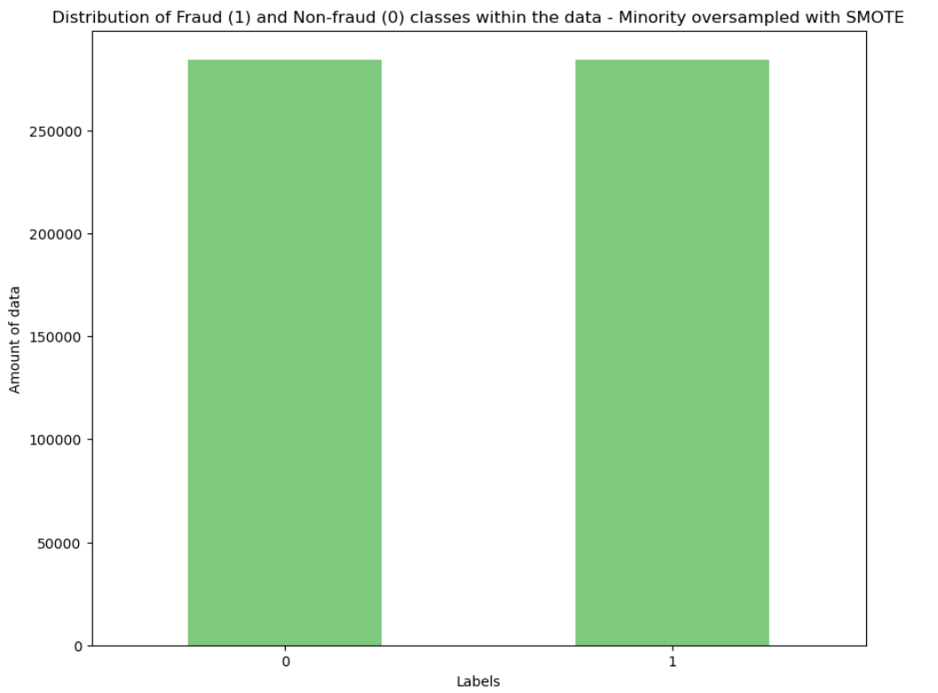
Oversampled data
50% of the total transactions are labeled as Non-Fraud (284,315)
The other 50% is labeled as Fraud (284,315)
The new data has doubled the size of the original

Slide 11
5 – Model predictions

Slide 12
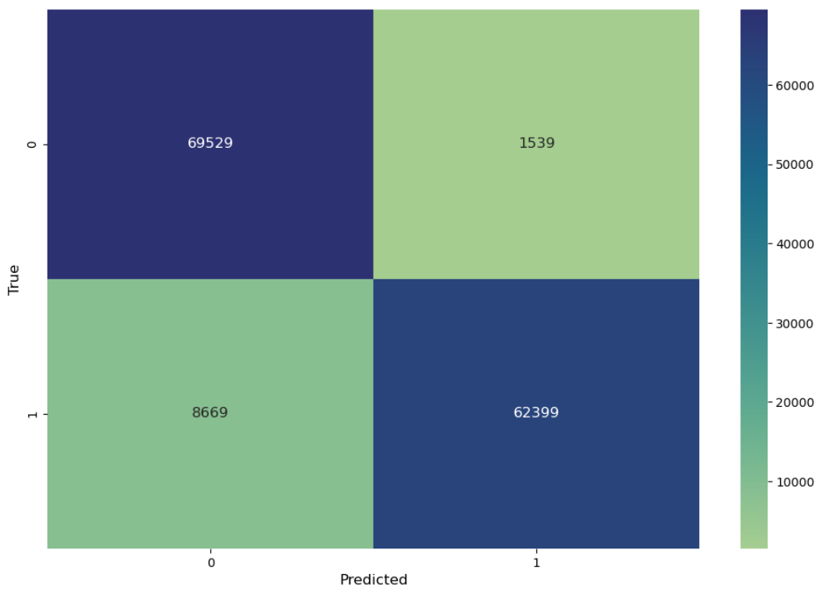
Correctly predicts Fraud transactions by 98.23% from both classes
Of all the Fraud predicted transactions, 97.59% were truly Fraud
Logistic
Regression
Of all the true Fraud predicted transactions, 87.80% were correctly predicted
F1-Score of 92.43%

Slide 13
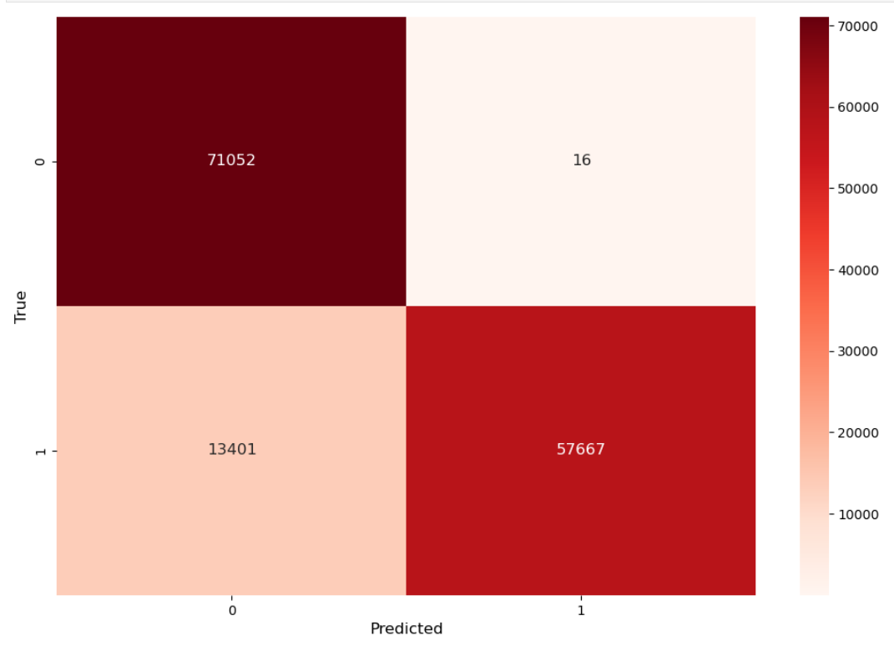
Correctly predicts Fraud transactions by 97.87% from both classes
Of all the Fraud predicted transactions, 99.97% were truly Fraud
Random Forest Classifier
Of all the true Fraud predicted transactions, 81.14% were correctly predicted
F1-Score of 89.58%

Slide 14
6 – Conclusions

Slide 15

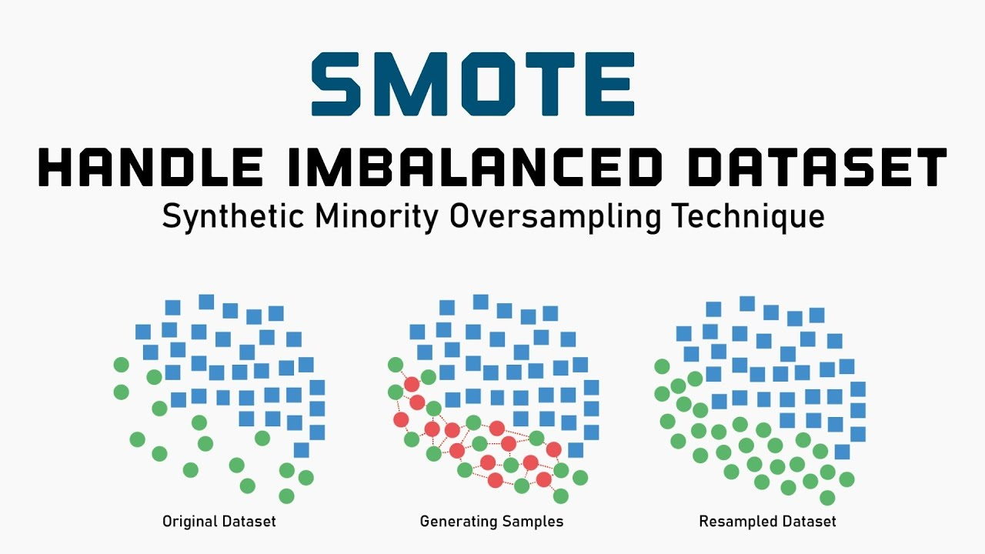
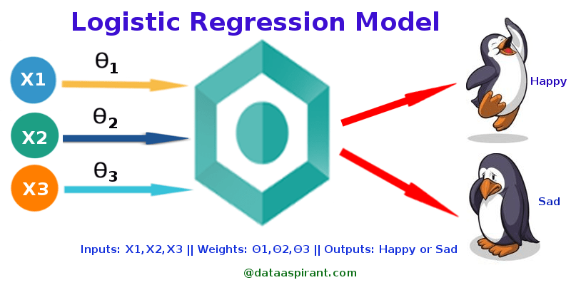
Machine learning algorithms can aid in detecting fraudulent activity in financial transactions at a low price and high efficiency.
For that, historical transactions data must be used for training the model.
Imbalanced datasets can be treated through statistical techniques for a better analysis and prediction.
However, there are some disadvantages that are worth exploring (e.g. it oversamples uniformly)
For this capstone project, the most efficient algoritm was the Logistic Regression Algorithm, although alternatives as Random Forest Classifier can be an alternative path if needed.

