Slide 1
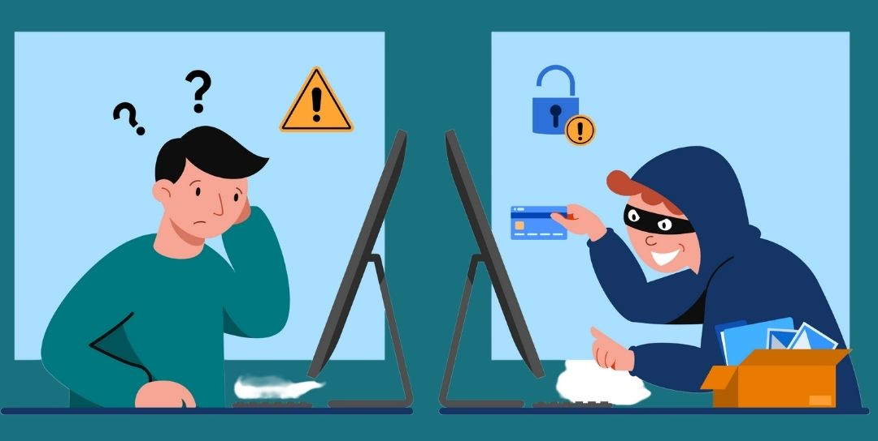
Capstone project Credit Card Fraud Detection
A presentation by Daniel Pérez Hernández

Slide 2
01 - Content
01
04
Content
Analysing the data
02
05
Why fraud detection?
Model predictions
03
06
Overview
Conclusions

Slide 3
02 – Why Fraud Detection?
300 BC, Greece: A shipping merchant kept the “lost” cargo and the claiming from it.
1821: Gregor MacGregor sold non-existing land to investors from Europe.
Recent days: ATM/application/internet banking fraud, amongst others.
Origins
Shift towards new technologies.
Most recent pandemics
Lack of risk exposure awareness
From PwC’s Global Economic Crime and Fraud Survey 2022
Recent Causes
The Association of Certified Fraud Examiners estimates that US organizations lose about 7% of their revenues to fraud. Nisbet, et.al (2018)
Consequences
Artificial Intelligence is vital for financial risk control in cloud environment.
(Wang, et.al; 2021).
Solution

Slide 4
03 – Overview
Text
Text
Text
Fraud Detection Model
Text
Text
Text
Text
Text

