Slide 1
Making Sense of Census Data
Don Perkus
12/14/16

Slide 2
Intro
Clustering model of our web site users
Needed demographic data
Very little demographic data available in-house.
US Census == “Problem Solved” ???
HUGE amount of data available
Various methods, APIs, permutations
It is not easy to figure out how to locate and obtain the "right" set of data.
Notes:
In this lightning talk I will briefly describe how I successfully found, acquired, and used the census data that I needed

Slide 3
Lots of data
over 130 different surveys and programs - thousands of data variables
Lots of different crosstabs
Example
Education high school degree, college / grad degree
By poverty Rate
By Earnings
By … etc …
And always by gender

Slide 4
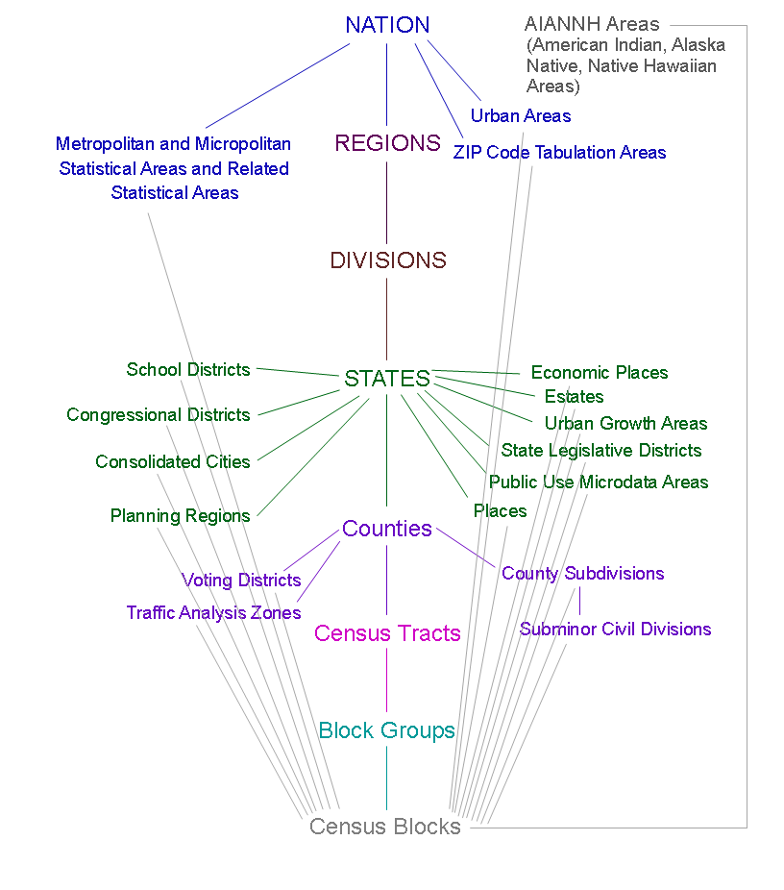
Census Geographic Hierarchy
From https://www.census.gov/geo/reference/webatlas/

Slide 5
American Fact Finder “Popular Tables” to the rescue!
SELECTED SOCIAL CHARACTERISTICS - DP02
Language and place of birth
SELECTED ECONOMIC CHARACTERISTICS - DP03
Employment and Income
SELECTED HOUSING CHARACTERISTICS - DP04
Renters and home owners
DEMOGRAPHIC AND HOUSING ESTIMATES - DP05
Ethnicity
EDUCATIONAL ATTAINMENTS – S1501
High school and college grads

Slide 6
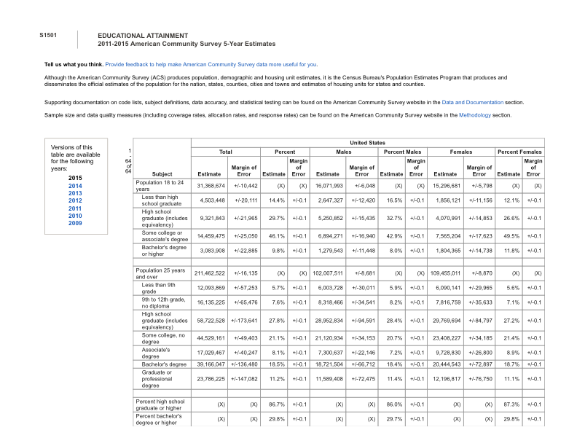
Educational Attainment – Table S1501

Slide 7
Census Geographic Hierarchy
From https://www.census.gov/geo/reference/webatlas/

Slide 8
Geocoding
Address => geographic identifier
Address to Zip Code is easy
Census Tract provides finer grain
But, Address to census tract is not so easy
Many free sources are volume limited
Our vendor could not provide “sub-tracts”
12345.01

Slide 9
Extract and Transform
S1501 Table for Zip codes
100Mb = 800 columns by 33,000 rows
S1501 Table for Census Tracts
225Mb = 800 columns by 70,000 rows
Only a few dozen are of interest
SMOP*
5 Tables
Extract useful columns
Handle missing data, clean up
* Simple Matter of Programming ☺

Slide 10
Resources available on my Github
https://github.com/dperkus/CensusMakingSense
Instructions for downloading tables
My list of selected data variables
Pseudocode
Thank you!

