Slide 1
Trello Executive Dashboard Hackathon Pitch
Excella Consulting
May 4, 2013

Slide 2

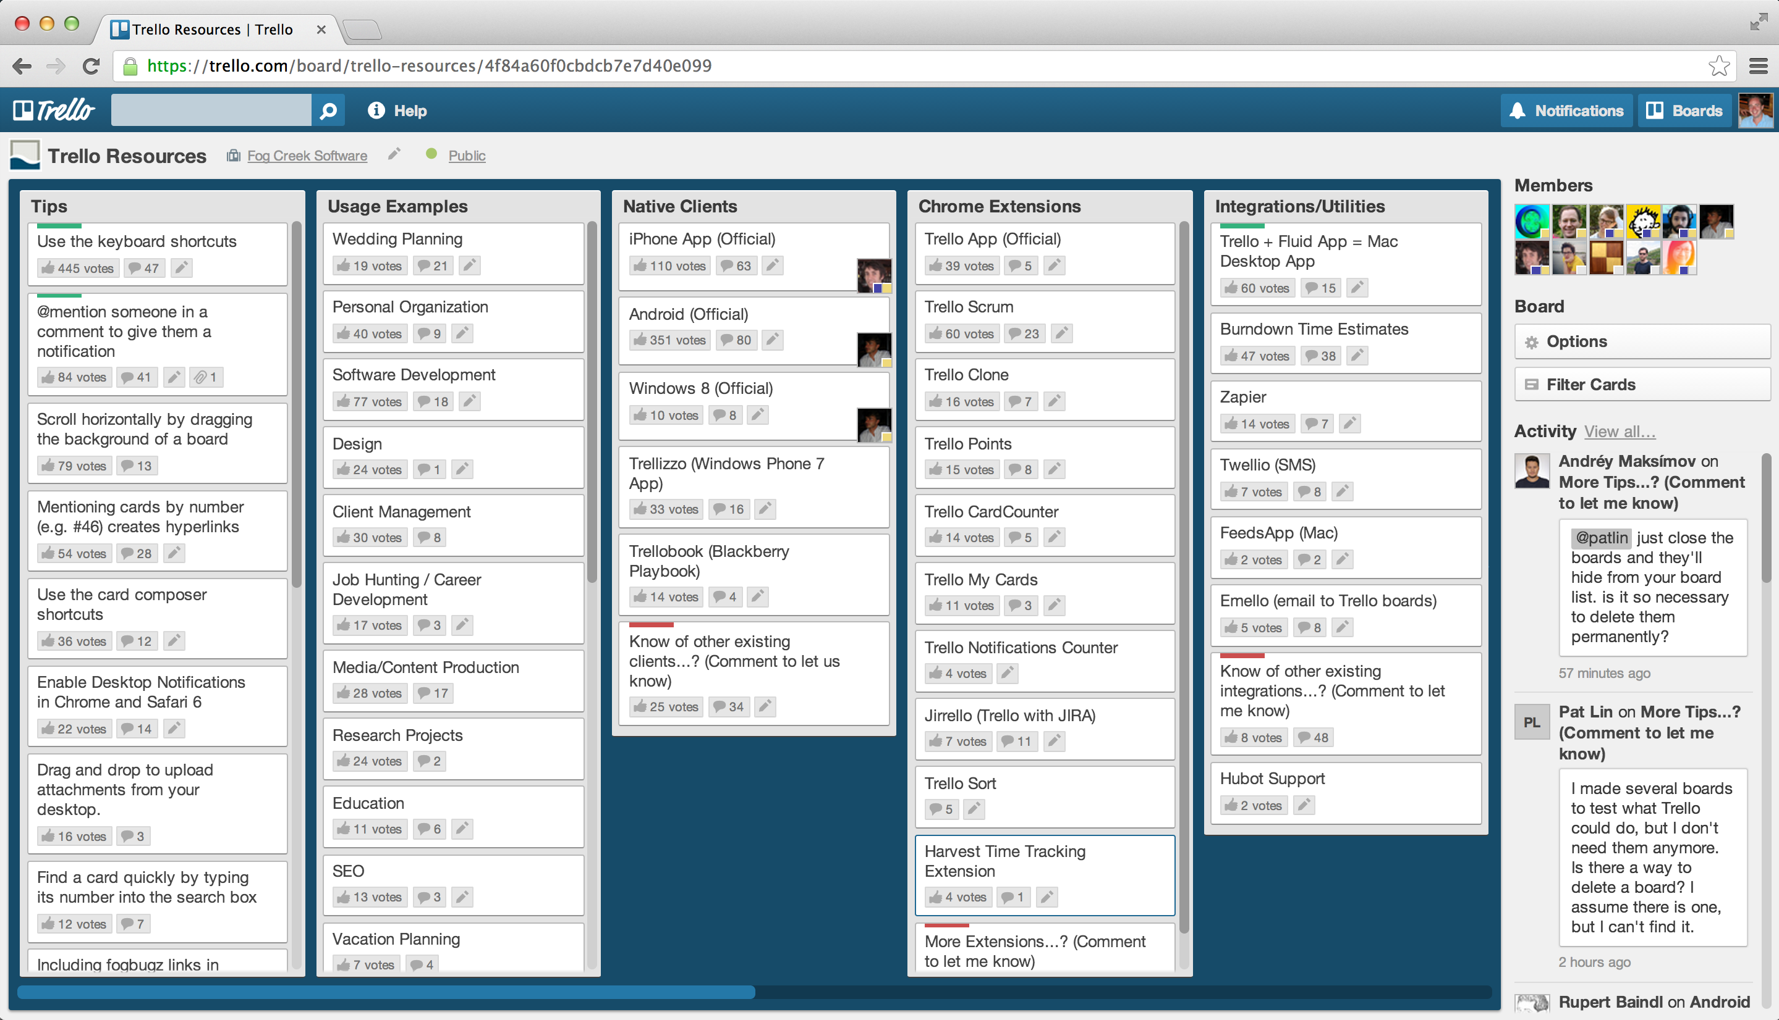
“Your entire project in a single glance.”
“Organize anything, together.”

Slide 3
“If you want to use Trello fine, but I still need that weekly report…”

Slide 4
Create a Dashboard that allows stakeholders to evaluate a Trello project’s status and key data in 120 seconds or less…
Vision

Slide 5

Trello Executive Dashboard
http://bit.ly/Zw3SGx

