Slide 1

Battleship
Learning the Scrum Project Management

Slide 2
Team management
Management
Daniel
Pfurner
GUI
Emanuel
Mair
Network
Aleksandar
Marinkovic
Database
Dominik
Salmhofer

Slide 3
File Structure
Client
Assets -> Icon, Ship Images
Gui -> Handler, Login, Matching, Game
Network
Ships
Starter
Server
Database
Network -> Interface, Models
Ships
Logic

Slide 4
Gui Page-Handling
Handler Window Class
Pages are Stored
Updated Page
Page Widgets with:
Initialization Function
Optional Timer Start
self.pages = { "login": LoginPage(), "matching": MatchingPage(), "game": GamePage() }
def set_page(self, page: str): if self.current_page: self.pages[self.current_page].parent = None self.pages[self.current_page] = self.defaults[self.current_page]() self.current_page = page self.setCentralWidget(self.pages[page]) self.pages[page].init()

Slide 5
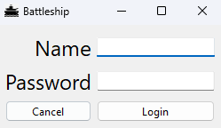
Login Page
Log in to your account
Registration is in background

Slide 6
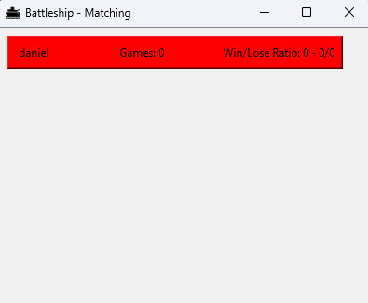
Matching Page
Available Matches are displayed
Stats of the players are displayed
Timer to update the players every second

Slide 7
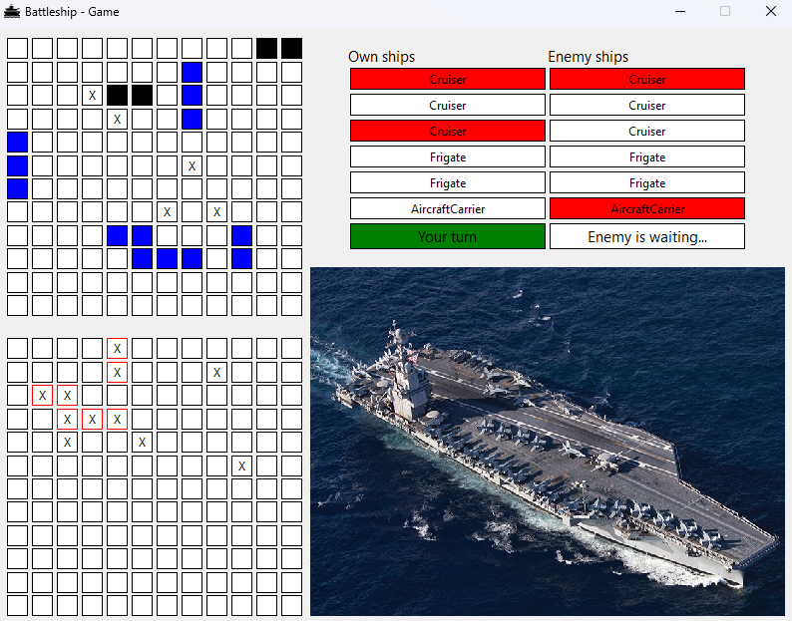
Game Page
Your ships are displayed
Positioning is available
The ships of the other player are not visible
Destroyed ships are displayed top-right corner
Timer to update the playing field every second

Slide 8
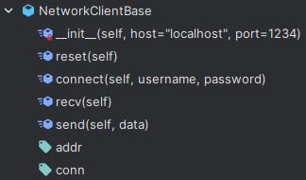
Client Setup
Data is transferred using pickle
Connection is handled in the NetworkClientBase

Slide 9
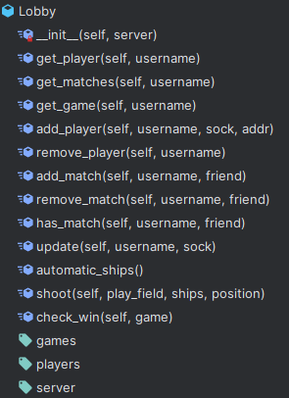
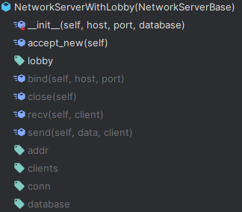
Server Setup
Data is transferred using pickle
Connections/Clients are handled in the NetworkServerWithLobby
Games are Handled in the Lobby
Handling Clients inside Threads

Slide 10
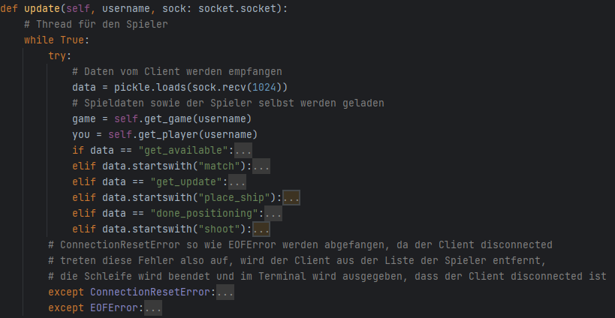
Server-Client Communication
Client requests updates from the server (every second -> using timers)
Requests are handled in a Thread

Slide 11
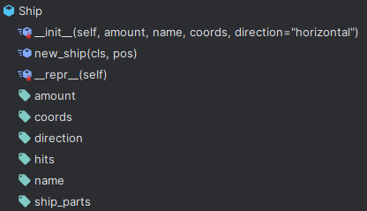
Ship-Models
There are 3 Types of ships:
Cruiser (2 Fields)
Frigate (3 Fields)
Aircraft Carrier (5 Fields)
On the Server-Side there is an additional Dummy that doesn’t stores the position of the ship

Slide 12
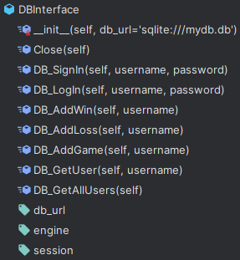
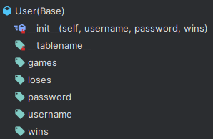
Database (Sqlite)
Database-Structure is built with sqlalchemy
Database Updates are made in the DBInterface

Slide 13
Additional Tools/Files
Validating a ship placement
Hashing Password
Player/Game Model
Starting File
Main Client File
Main Server File

Slide 14
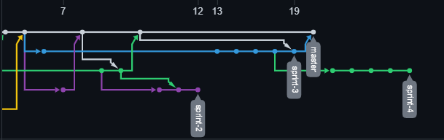
Network Graph

Slide 15
Management
Scrum-Planning in GitHub Projects
Version Control with GitHub

Slide 16

Conclusion
Working in a team is hard but possible
Finding a time to code together
Separating the Parts equally

