Slide 1


Introducing Classes and Objects
A class is a template that defines the form of an object. It specifies both the data and the code that will operate on that data.

Slide 2
Introduction
A class is a template that defines the form of an object. It specifies both the data and the code that will operate on that data.
C# uses a class specification to construct objects. Objects are instances of a class. Thus, a class is essentially a set of plans that specify how to build an object.
It is important to understand: A class is a logical abstraction. It is not until an object of that class has been created that a physical representation of that class exists in memory.

Slide 3
The General Form of a Class
When you define a class, you declare the data that it contains and the code that operates on it. While very simple classes might contain only code or only data, most real-world classes contain both.
data is contained in data members defined by the class, and code is contained in function members.
data members (also called fields) include instance variables and static variables. Function members include methods, constructors, destructors, indexers, events, operators, and properties.

Slide 4
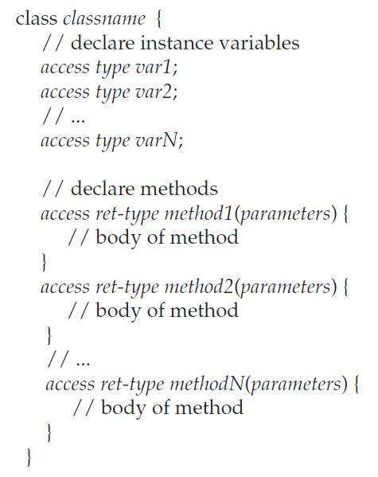
The General Form of a Class
A class is created by use of the keyword class. Here is the general form of a simple class definition that contains only instance variables and methods.
Notice that each variable and method declaration is preceded with access. Here, access is an access specifier, such as public, which specifies how the member can be accessed.

Slide 5
The General Form of a Class
The access specifier determines what type of access is allowed. The access specifier is optional, and if absent, then the member is private to the class. Members with private access can be used only by other members of their class.
To create a object, you will use a statement like the following:
Building house = new Building(); // create an object of type building
The dot operator links the name of an object with the name of a member. The general form of the dot operator is shown here:
object.member

Slide 6
How Objects Are Created
Building house = new Building();
This declaration performs three functions.
First, it declares a variable called house of the class type Building. This variable is not, itself, an object. Instead, it is simply a variable that can refer to an object.
Second, the declaration creates an actual, physical copy of the object. This is done by using the new operator.
Finally, it assigns to house a reference to that object. Thus, after the line executes, house refers to an object of type Building.
The new operator dynamically allocates (that is, allocates at runtime) memory for an object and returns a reference to it. This reference is then stored in a variable. Thus, in C#, all class objects must be dynamically allocated.

Slide 7
How Objects Are Created
As you might expect, it is possible to separate the declaration of house from the creation of the object to which it will refer, as shown here:
Building house; // declare reference to object
house = new Building(); // allocate a Building object
The key difference between value types and reference types is
int x;
x = 10;
x contains the value 10 because x is a variable of type int, which is a value type. However, in the case of
Building house = new Building();
house does not, itself, contain the object. Instead, it contains a reference to the object.

Slide 8
Reference Variables and Assignment
In an assignment operation, reference variables act differently than do variables of a value type, such as int.
When you assign one value type variable to another, the situation is straightforward. The variable on the left receives a copy of the value of the variable on the right.
When you assign one object reference variable to another, the situation is a bit more complicated because the assignment causes the reference variable on the left to refer to the same object to which the reference variable on the right refers.

Slide 9
Reference Variables and Assignment
For example, consider the following fragment:
Building house1 = new Building();
Building house2 = house1;
At first glance, it is easy to think that house1 and house2 refer to separate and distinct objects, but this is not the case.
Instead, house1 and house2 will both refer to the same object.

Slide 10
Reference Variables and Assignment
For example:
Building house1 = new Building();
Building house2 = house1;
Building house3 = new Building();
house2 = house3; //house2 and house3 refer to the same object.
After this sequence executes, house2 refers to the same object as house3. The object referred to by house1 is unchanged.

Slide 11
Thank You

