Slide 1


Arrays
An array is a collection of variables of the same type that are referred to by a common name.

Slide 2
Introduction
In C#, arrays can have one or more dimensions, although the one-dimensional array is the most common.
Arrays are used for a variety of purposes because they offer a convenient means of grouping together related variables.
Array have one special attribute: They are implemented as objects. By implementing arrays as objects, several important advantages are gained.

Slide 3
One-Dimensional Arrays
A one-dimensional array is a list of related variables. Such lists are common in programming.
Two steps are needed to obtain an array for use in your program.
First, you must declare a variable that can refer to an array.
Second, you must create an instance of the array by use of new.
Therefore, to declare a one dimensional array, you will typically use this general form:
type[ ] array-name = new type[size]; //int[] sample = new int[10];
The element type determines the data type of each element that comprises the array. Notice the square brackets that indicate a one-dimensional array is being declared. The number of elements that the array will hold is determined by size.

Slide 4
One-Dimensional Arrays
int[] sample;
sample = new int[10];
In this case, when sample is first created, it refers to no physical object. It is only after the second statement executes that sample refers to an array.
In C#, all arrays have 0 as the index of their first element. Because sample has 10 elements, it has index values of 0 through 9.
To index an array, specify the number of the element you want, surrounded by square brackets.

Slide 5
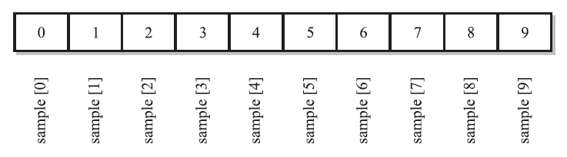
One-Dimensional Arrays
Conceptually, the sample array looks like this:

Slide 6
Initializing an Array
Arrays can be initialized when they are created. The general form for initializing a onedimensional array is shown here:
type[ ] array-name = { val1, val2, val3, ..., valN };
type[ ] array-name = new type[]{ val1, val2, val3, ..., valN };
type[ ] array-name = new type[10]{ val1, val2, val3, ..., valN };
Here, the initial values are specified by val1 through valN. They are assigned in sequence, left to right, in index order. C# automatically allocates an array large enough to hold the initializers that you specify. There is no need to use the new operator explicitly.

Slide 7
Boundaries Are Enforced
Array boundaries are strictly enforced in C#; it is a runtime error to overrun or underrun the ends of an array.
An IndexOutOfRangeException is generated and the program is terminated.

Slide 8
Multidimensional Arrays
A multidimensional array is an array that has two or more dimensions, and an individual element is accessed through the combination of two or more indices.
Two-Dimensional Arrays
The simplest form of the multidimensional array is the two-dimensional array.
In a two dimensional array, the location of any specific element is specified by two indices.
If you think of a two-dimensional array as a table of information, one index indicates the row, the other indicates the column.
To declare a two-dimensional integer array table of size 10, 20, you would write
int[,] table = new int[10, 20];
Notice that the two dimensions are separated from each other by a comma.

Slide 9
Arrays of Three or More Dimensions
C# allows arrays with more than two dimensions. Here is the general form of a multidimensional array declaration:
type[, ...,] name = new type[size1, size2, ..., sizeN];

Slide 10
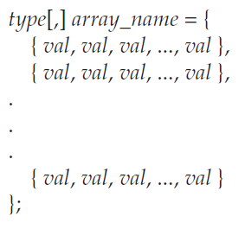
Initializing Multidimensional Arrays
A multidimensional array can be initialized by enclosing each dimension’s initializer list within its own set of curly braces.
For example, the general form of array initialization for a two-dimensional array is shown here:

Slide 11
Jagged Arrays
In the preceding examples, when you created a two-dimensional array, you were creating what is called a rectangular array. Thinking of two-dimensional arrays as tables, a rectangular array is a two-dimensional array in which the length of each row is the same for the entire array.
C# also allows you to create a special type of two-dimensional array called a jagged array.
A jagged array is an array of arrays in which the length of each array can differ. Thus, a jagged array can be used to create a table in which the lengths of the rows are not the same.

Slide 12
Jagged Arrays
Jagged arrays are declared by using sets of square brackets to indicate each dimension. For example, to declare a two-dimensional jagged array, you will use this general form:
type[ ] [ ] array-name = new type[size][ ];
Here, size indicates the number of rows in the array. The rows, themselves, have not been allocated. Instead, the rows are allocated individually. This allows for the length of each row to vary.

Slide 13
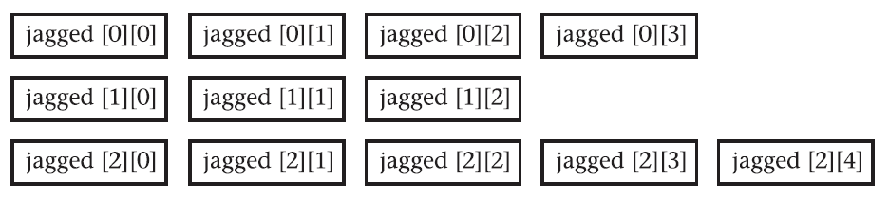
Jagged Arrays
int[][] jagged = new int[3][];
jagged[0] = new int[4];
jagged[1] = new int[3];
jagged[2] = new int[5];
After this sequence executes, jagged looks like this:

Slide 14
Jagged Arrays
One last point: Because jagged arrays are arrays of arrays, there is no restriction that requires that the arrays be one-dimensional. For example, the following creates an array of two-dimensional arrays:
int[][,] jagged = new int[3][,];

Slide 15
Thank You

